Slide 1
doctors_office
IT 125
Winter 2019
Keith Chirayus, Megan Laine, & Rita Yatina

Slide 2
Concept
A small medical office
What are the demographics of an office’s patient base?
Send a 1 year appointment reminder
Sports physicals
Vaccinations
Screenings
Status of insurance payments due
Common diagnoses
Tracking appointment information and diagnoses
Did you know?
There are 68,000 to 87,000 unique diagnosis codes

Slide 3
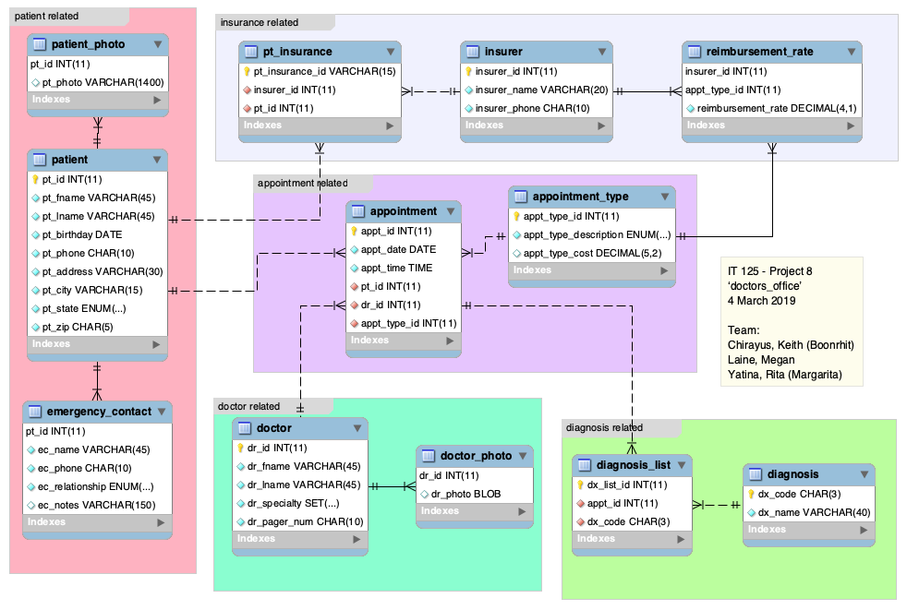

Slide 4
How did we divide work?
 | Keith | Megan | Rita
Phase 1 (stand-alone tables + data) | patient patient_photo emergency_contact + 3 queries | diagnosis insurer appointment_type + 3 queries | doctor doctor_photo + 3 queries
Phase 2 (linking tables + data) | reimbursement_rate pt_insurance + change 1 query to view | appointment + change 1 query to view | diagnosis_list + change 1 query to view

Slide 5
Patient
Spouse
Parent
Partner
Guardian
'patient''s partner OMERO lives in a different state’
'listed phone num is cell; work phone = 5108417895’
'2nd emergency contact: brother John 2145263542'

Slide 6
Doctor
Primary Care
Pediatrics
Urgent Care
Gynecologist
Allergist

Slide 7
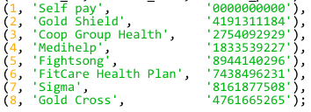
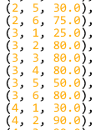
Insurance

Slide 8

Appointment

Slide 9
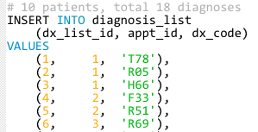
Diagnosis
Did you know?
You can include up to 12 diagnoses on a single insurance claim form
‘Z00’ Routine Health Maintenance
‘401’ Hypertension
‘T78’ Allergy
‘R05’ Cough
‘H66’ Acute otitis media
‘F33’ Depression
‘R51’ Headache
‘R69’ Illness unspecified

Slide 10
Example queries and views

Slide 11

Get a list of patients who are minors; show their phone # and mailing address.
CREATE OR REPLACE VIEW UnderagePatients AS SELECT CONCAT(pt_fname, ' ', pt_lname) AS Name, pt_birthday, pt_phone, pt_address, pt_city, pt_state, pt_zip FROM patient WHERE TIMESTAMPDIFF( YEAR, pt_birthday, CURDATE() ) < 18 ;
Keith

Slide 12
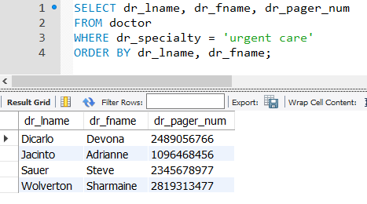
Get a list of the names and pager numbers for urgent care doctors:
Rita

Slide 13
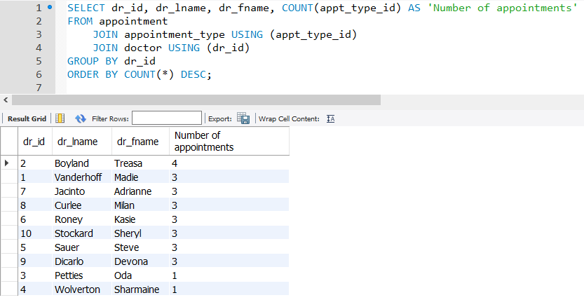
Which doctor has seen the most patients?
Rita

Slide 14

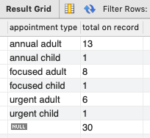
For each appointment type, how many of those appointments does the clinic have on record?
Megan

Slide 15
Lessons Learned
Practical experience creating database
Retrieve data, manipulate database objects
Image/file storage: BLOB vs VARCHAR (data path)
How to calculate how many years old/young
Domain knowledge important for DB design
Don’t use ENUM and SET data-type if business needs will change (ie doctor_specialty)

Slide 16
Thank you!
IT 125
Winter 2019
Keith Chirayus, Megan Laine, & Rita Yatina

