Slide 1

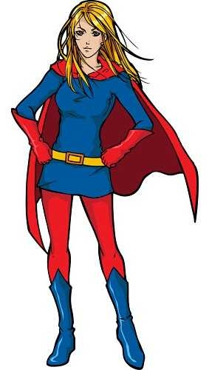
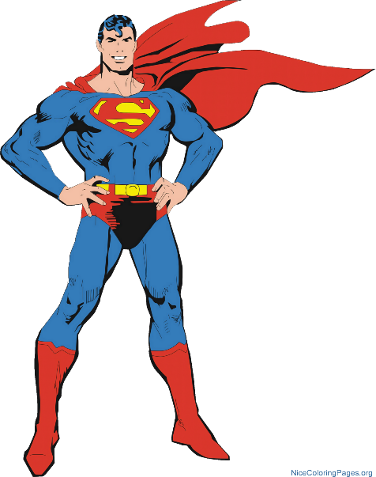
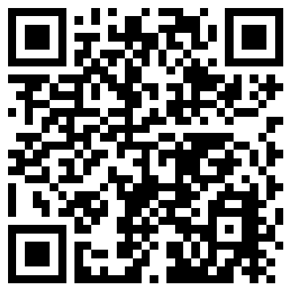
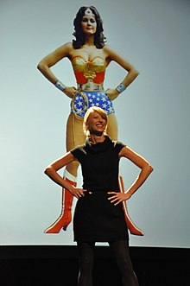
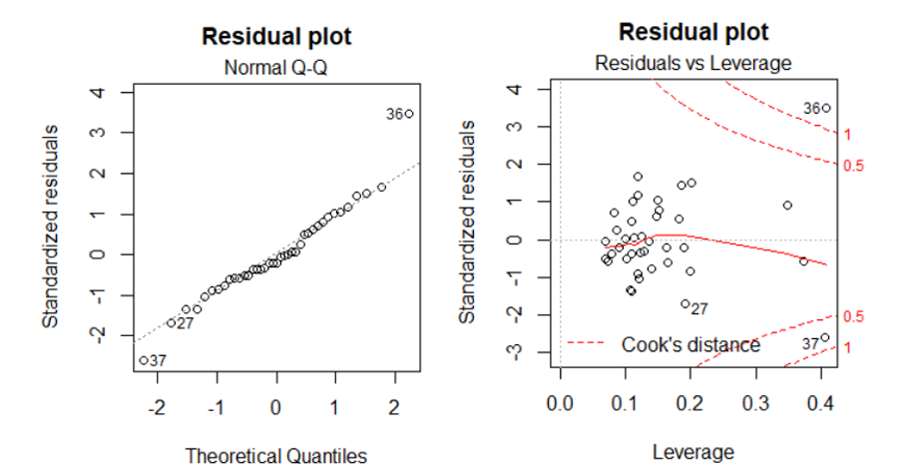
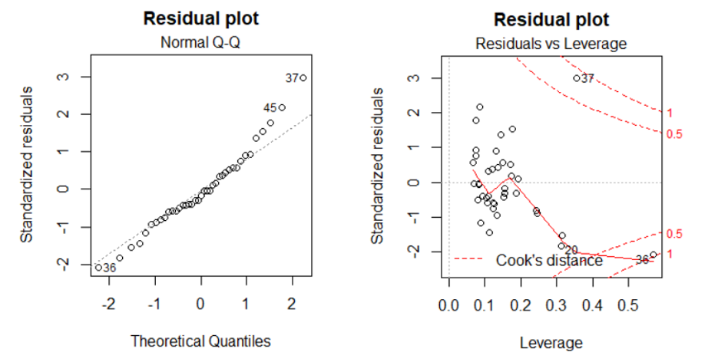
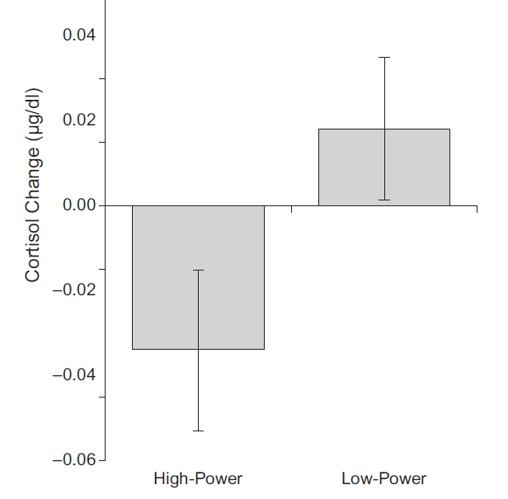
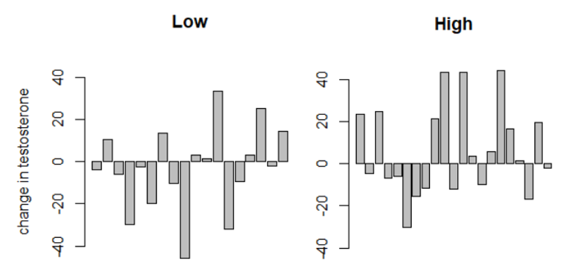
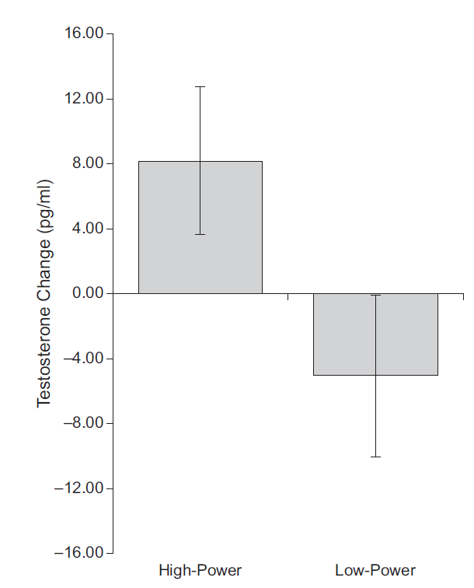
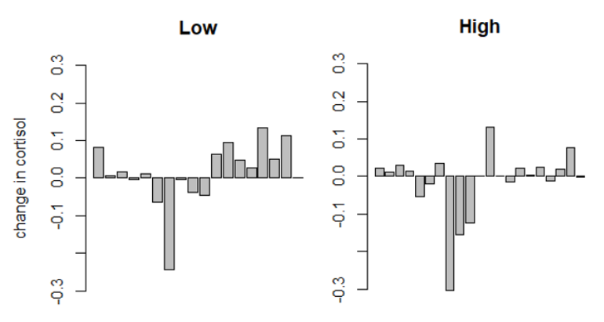
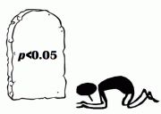
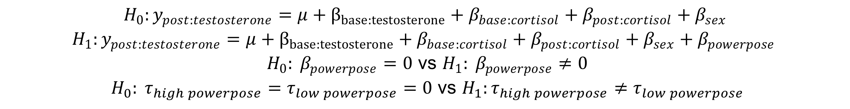


Amy Cuddy’s Power Pose: Statistical Integrity Explored
Megan Sorenson
Introduction
Power Pose Mania
Study Design
Methods
Table 1
Psychology Replication Crisis
42 Subjects
16 Male
26 Female
Randomly assigned high or low power pose
Hold pose for 2 minutes
Saliva measurements before and after pose
Testosterone
Cortisol
Participants thought
study was for EKG
Completely Randomized Design
With Covariates
Unbalanced
Separate Analyses for testosterone and cortisol
Research Question:
Is there a relationship between 2 minute power poses and changes in testosterone (cortisol) levels in saliva?
Quality Control
Removed 3 samples
Hormone levels > 3sd from mean
Source | Df | Sums of Squares | Mean Squares
Covariates
Baseline Testosterone | 1 | SS(Cov 1) | MS(Cov 1)
Baseline Cortisol | 1 | SS(Cov 2) | MS(Cov 2)
Post-pose Cortisol | 1 | SS(Cov 3) | MS(Cov 3)
Sex | 1 | SS(Cov 4) | MS(Cov 4)
Treatment
Pose | 1 | SS(Trt) | MS(Trt)
Residuals | 34 | SS(Residuals) | MS(Residuals)
$$F_{nested models }$$
$$= \frac{(RSS_{H_{0}}−RSS_{H_{1}})/(df_{H_{0}}−df_{H_{1}})}{RSS_{H_{1}}/df_{H_{1}}}$$
$$=\frac{(SS_{treatment})/(df_{treatment})}{RSS_{H_{1}}/df_{H_{1}}}$$
$$=\frac{EMS_{treatment}}{EMS_{residuals}}$$
$$=F_{ANCOVA}$$
Study claims holding a power pose for 2 minutes
Decreases cortisol levels
Increases testosterone
Increases feeling of power
Increases risk taking
Implications for life!
2012 TED talk
40 million views
2nd most watched talk
Replication crisis looked at reproducibility
Lack of Reproducibility
Study to Investigate Issue [1]
98 studies to attempt replication
39 replicated
24 moderately similar results
35 not replicated
‘Doesn’t support or dispute’ – Psychologist [4]
P-hacking?
Scan here for link to TED talk!
$$H_{0}:y_{post:testosterone}=μ+β_{base:testosterone}+β_{base:cortisol}+β_{post:cortisol}+β_{sex}$$
$$H_{1}:y_{post:testosterone}=μ+β_{base:testosterone}+β_{base:cortisol}+β_{post:cortisol}+β_{sex}+β_{powerpose }$$
$H_{0}: β_{powerpose}=0$ vs $H_{1}: β_{powerpose}≠0$
$H_{0}: τ_{high powerpose}=τ_{low powerpose}=0$ vs $H_{1}:τ_{high powerpose}≠τ_{low powerpose}$
Results
Testosterone Results
Diagnostic Plots
Approximately equal variance between groups
Constant variance across fitted values
QQplot shows normal distribution
2 leverage points
Removing leverage points results in p-value = 0.051
Table 2
Cortisol Results
Table 3
Power pose significantly associated
Other covariates not significantly associated
Source | Df | Mean Squares | F value | P-value
Covariates
Baseline Testosterone | 1 | 125.6 | 0.314 | 0.5787
Baseline Cortisol | 1 | 75.0 | 0.188 | 0.6675
Post-pose Cortisol | 1 | 613.3 | 1.536 | 0.2239
Sex | 1 | 1073.7 | 2.689 | 0.1105
Treatment
Pose | 1 | 1712.3 | 4.288 | 0.0463
Residuals | 33 | 399.3
Source | Df | Sums of Squares | Mean Squares | P-Value
Covariates
Baseline Cortisol | 1 | 0.13355 | 37.670 | 6.44e-07
Baseline Testosterone | 1 | 0.00217 | 0.611 | 0.4398
Post-pose Testosterone | 1 | 0.00560 | 1.580 | 0.2177
Sex | 1 | 0.00739 | 2.083 | 0.1584
Treatment
Pose | 1 | 0.02136 | 6.025 | 0.0195
Residuals | 33 | 0.00355
Cuddy Reported
Power pose significantly associated with change in testosterone
P-value < 0.05
Power pose significantly association with change in cortisol
P-value < 0.02
These values/figures in the results section were reproduced (by me) unless otherwise noted
Figure 1: Diagnostic plots for the analysis with change in testosterone
Figure 4: Diagnostic plots for the analysis with change in cortisol
Approximately equal variance between groups
Constant variance across fitted values
QQplot shows normal distribution
2 leverage points
Removing leverage points results in p-value = 0.0226
Power pose significantly associated
Other covariates not significantly associated
Figure 2: Testosterone changes with high and low power poses
Figure 3:Cortisol changes with high and low power poses as produced by Cuddy
Table 4
Low Pose
Mean: 0.0137
se: 0.0199
sd: 0.0843
High Power Pose
Mean:-0.138
se: 0.0195
sd: 0.0892
Low Pose
Mean: -3.001
se: 4.707
sd: 19.947
High Power Pose
Mean: 6.361
se: 4.671
sd: 21.405
Testosterone Model: Power Pose P-value | Covariates Included | Cortisol Model: Power Pose P-value
0.0463 | Original Model | 0.0195
0.1630 | Remove post-pose measurement of secondary hormone | 0.0624
0.1528 | Include age | 0.0815
0.1535 | Include sex and baseline hormone interaction | 0.0786
Figure 3: Testosterone changes with high and low power poses as produced by Cuddy
Figure 5: Cortisol changes with high and low power poses
Discussion
Testosterone
Able to reproduce F statistic and p-value
Cortisol
Able to reproduce p-value but not F statistic
Diagnostic plots
Overall look ok
Leverage points change association significance in testosterone
Cuddy’s analysis errors
Report F-statistic distribution wrong
Testosterone: $F_{1,39}$
Cortisol: $F_{1,38}$
Not clear on covariates used
Which samples use?
High/Low Power Stratified Means
Doesn’t report precise number
Cannot reproduce with data
Does not address variability within sample
Misleading/unreproducible graph
Covariate choices
High variability between models
Choice of covariates influences significance of power pose
Why did they choose this model?
P-hacking?
Conclusion
References
Study Design
Design is ok
Hormones measured after gambling?
Saliva hormone levels representative of blood?
Carney reported that some participants knew the goal of the study
Potential Placebo effect
Not convinced results are true
Too much variability in model choice
Errors in analysis
Hasn’t been reproduced
P curve analysis did not show significant results [6]
Carney says results are ‘undeniably false’ [5]
Cuddy states there isn’t enough information [2]
Even if the results are not true, if this gives people more confidence, does it matter?
Statistically? Yes; General Life? No
Problem lies in saying science backs up the idea
[1] Baker, M. (2015). First results from psychology’s largest reproducibility test. Nature.
[2] Biello, David. "Inside the debate about power posing: a Q&A with Amy Cuddy." TED, TED conferences, 22 Feb. 2017. [3] Carney, D. R., Cuddy, A. J. C., & Yap, A. J. (2010). Power Posing: Brief Nonverbal Displays Affect Neuroendocrine Levels and Risk Tolerance. Psychological Science, 21(10), 1363–1368.
[4] Maxwell, S. E., Lau, M. Y., Howard, G. S., & Scott, E. (2012). Is Psychology Suffering From a Replication Crisis? American Psychologist, 70(6), 487–498.
[5] Morris, David Z. "'Power poses' researcher Dana Carney now says effects are 'undeniably false'." Fortune, 16 Oct. 2016.
[6] Simmons, J. P., & Simonsohn, U. (2017). Power Posing: P-Curving the Evidence. Psychological Science, 28(5), 687–693.
Images: http://timothykurek.com/10-cartoon-images-of-superwoman/, https://en.wikipedia.org/wiki/Power_posing, http://clipartmag.com/superman-clipart, https://triangulations.wordpress.com/2016/02/22/p-hacking-hacking-self-doubt/

