Slide 1
Requirement Gathering for Web-Based Gaol Production Ordering Application in Tarutung
Group 05
11321020 – Mega Marbun
11321021 – Luana Banjarnahor
11321031 – Albert Aritonang
11321058 – Megaria Napitupulu

Slide 2
Outline
01
05
02
06
03
07
04
Abstract
Result & Discussion
Introduction
Conclusion
Literature Review
Reference
Methodology

Slide 3
Abstract
what is an abstract?
an abstract is a concise summary of a research paper or entire thesis. in the abstract there are 5 points including:
1. Reason for writing 2. problem 3. Methodology 4. Results
5. Implications

Slide 4
Introduction
-Significance
-The urgency why Requirement Gathering is necessary
-The GAP
-Present paper

Slide 5
Methodology
Data Collection
How was the data collected or generated?
Data Analysis
- In this data analysis we use statistical analysis
- Data collection was carried out by distributing questionnaires
- The questionnaire contains several questions
- The range of answers to these questions is limited to a value of 1-5

Slide 6
Literature Review
Article by Maiyana (2019)
“Sistem Informasi Booking Wedding Organizer Berbasis Website pada Max Entertaiment Kudus”
Article by Palupi dan Pakereng(2022)
“Penyewaan Online Wedding Organizer Berbasis Web”

Slide 7
Discussion
This research conducted interviews with clients to obtain data and needs in building applications.
Distributed questionnaires to 63 people in Tarutung to get public responses which will be processed using Likert scalar calculations.

Slide 8
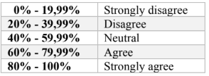


RESULT
Likert Scale Score
Formula Likert Scale

Slide 9
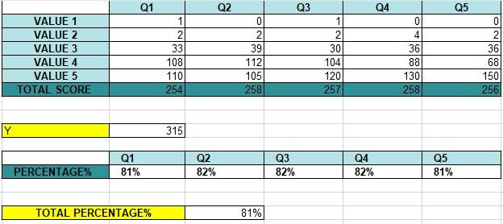
RESULT
Analysis of the Likert Scale

Slide 10
Conclusion
Purpose of conducting research
The GAP
Findings or Research result
Recommendation

Slide 11
References
Casadei, D., Serra, G., & Tani, K. (2019). Implementation of a Direct Control Algorithm for Induction Motors Based on Discrete Space Vector Modulation. IEEE Transactions on Power Electronics, 15(4), 769-777.
Ward, J., & Peppard, J. (2020). Strategic planning for Information Systems 4th ed. New York: John Willey & Sons.
Game, A. (2019). Creative Ways of Being. In J. R. Morss, N. Stephenson & J. F. H. V. Rappard (Eds.), Theoretical issues in psychology: Proceedings of the International Society for Theoretical Psychology 1999 Conference (pp. 3-12). Sydney: Springer.
[4] Sutabri, Tata. (2020). Analisis Sistem Informasi, Penerbit Andi, Yogyakarta
[5] Alamsyah, M. N., Mulyono, H., & Sari, D. P. (2021). Sistem Informasi Wedding Decoration Berbasis Web Mobile Pada Melati Wedding Organizer Kota Lubuklinggau. 1(3), 125–127.
[6] Aman, M., & Suroso. (2021). Pengembangan Sistem Informasi Wedding Organizer Menggunakan Pendekatan Sistem Berorientasi Objek Pada CV Pesta. Jurnal Janitra Informatika Dan Sistem Informasi, 1(1), 47–60.
[7] Ankur B. (2019). Methods for Decision-Making in Survey Questionnaires Based on Likert Scale. Journal of Asian Scientific Research, 3(1), 35–38.
[8] Wahyuni, T., Indriyanti, I., Ermawati, E., Fatah, H., & Ichsan, N. (2021). Rancang Bangun Sistem Penyewaan Baju Dan Dekorasi Berbasis Web Pada Nita Wedding Organizer. Jurnal Interkom: Jurnal Publikasi Ilmiah Bidang Teknologi Informasi Dan Komunikasi, 16(1), 1–9.
[9] Andini, R. P. (2021). Sistem Informasi Manajemen Nazwa Wedding Organizer Berbasis Web. Jurnal Perangkat Lunak, 3(3), 124–135.
[10] Joshi, A., Kale, S., Chandel, S., & Pal, D. (201). Likert Scale: Explored and Explained. British Journal of Applied Science & Technology, 7(4), 396–403. https://doi.org/10.9734/bjast/2015/14975

Slide 12
THANK YOU

