Slide 1


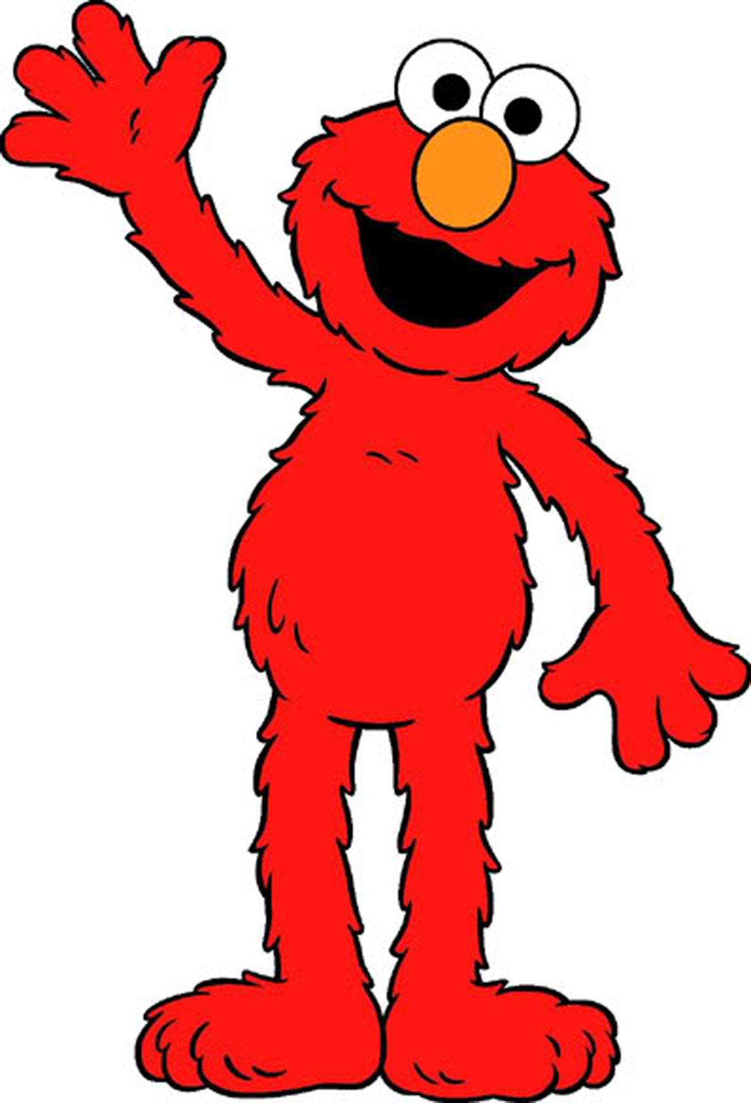
?

Slide 2


Slide 3


Slide 4
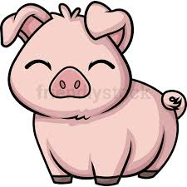

Slide 5


Slide 6
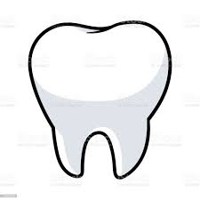

Slide 7


Slide 8


Slide 9
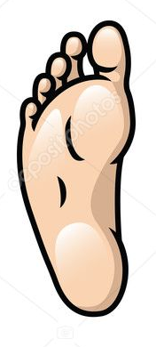

Slide 10


Slide 11


Slide 12
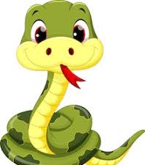

Slide 13


Slide 14


Slide 15
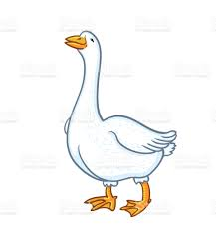

Slide 16
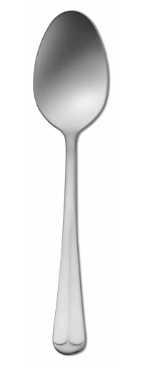

Slide 17
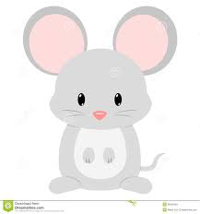

Slide 18

Notes:
Example Round
Frog and pigs

Slide 19
Notes:
Practice round 1
Man and turtles

Slide 20
Notes:
Practice round 2
Dogs and snakes

Slide 21
?

Slide 22
Notes:
Trial 1: RS + RP
Fork & Cats

Slide 23
Notes:
Trial 2: RS + IP
Pig & leaves

Slide 24
Notes:
Trial 3: RS + IS
Tooth and spoon

Slide 25
Notes:
Trial 4: RP+IP
Snakes and geese

Slide 26
Notes:
Trial 5: RP + IP
Frogs and teeth

Slide 27
Notes:
Trial 6: RS+RP
Snake and forks

Slide 28
Notes:
Trial 7: IS + IP
Man and mice

Slide 29
Notes:
Trial 8 – RP + IP
Dogs and snowmen

Slide 30
Notes:
Trial 9 : RS + IS
Turtle and goose

Slide 31
Notes:
Trial 10 : IS + RP
Woman and spoons

Slide 32
Notes:
Trial 11 : IS + IP
leaf and feet

Slide 33
Notes:
Trial 12: RS + IS
Cat and mouse

Slide 34
Notes:
Trial 13: IS + RP
Snowman and pigs

Slide 35
!

Slide 36
Notes:
Trial 14: RS + IP
Frog and women

Slide 37
Notes:
Trial 15: RP + IP
Turtles and men

Slide 38
Notes:
Trial 16: RS + IS
Dog and foot

Slide 39
Notes:
Test 1: RP + IP
Spoons and teeth

Slide 40
Notes:
Test 2: RS + IP
Frog and geese

Slide 41
Notes:
Test 3: RS + RP
Dog and pigs

Slide 42
Notes:
Test 4: RP + IP
Frogs and men

Slide 43
Notes:
Test 5: IS + IP
Goose and snowmen

Slide 44
Notes:
Test 6: RP + IP
Turtles and women

Slide 45
Notes:
Test 7: IS + IP
Man and leaves

Slide 46
Notes:
Test 8: IS + RP
leaf and snakes

Slide 47
Notes:
Test 9: RS + IP
Spoon and mice

Slide 48
Notes:
Test 10 : RP + IP
Cats and feet

