Slide 1


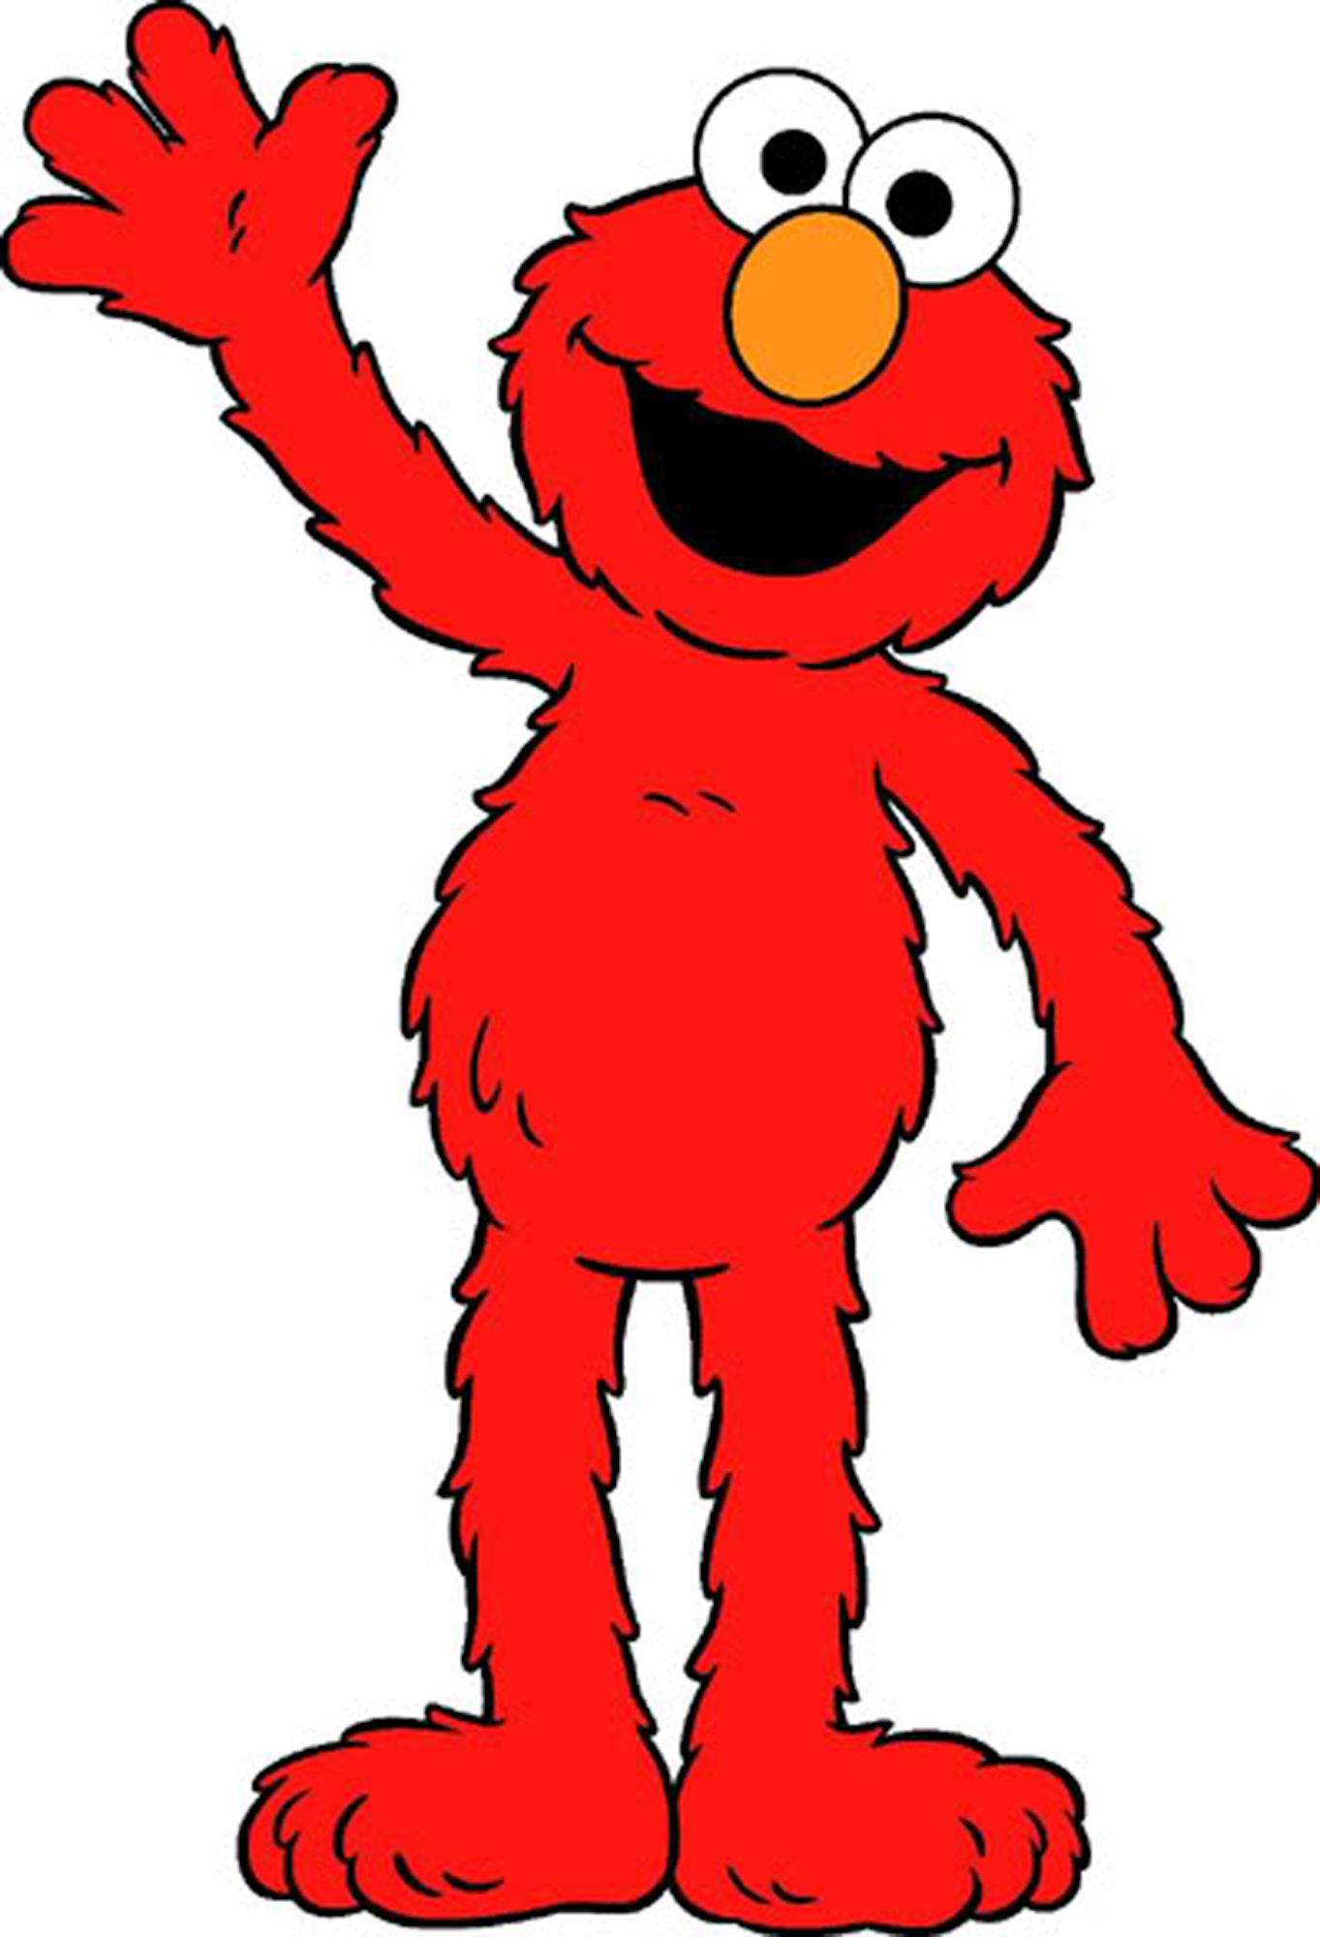
?

Slide 2


Slide 3


Slide 4
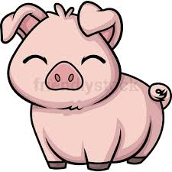

Slide 5


Slide 6
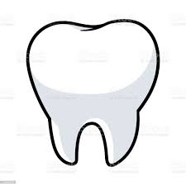

Slide 7


Slide 8


Slide 9
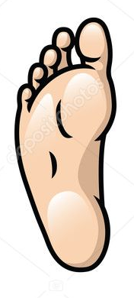

Slide 10


Slide 11
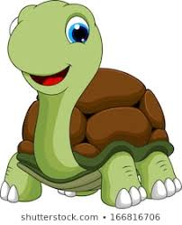

Slide 12
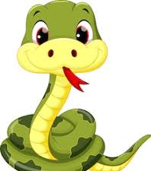

Slide 13


Slide 14


Slide 15
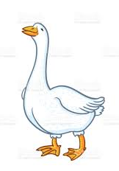

Slide 16
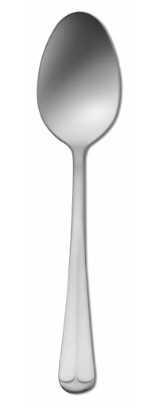

Slide 17
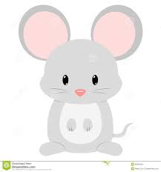

Slide 18

Notes:
Example Round
Frog and pigs

Slide 19
Notes:
Practice round 1
Man and turtles

Slide 20
Notes:
Practice round 2
Dogs and snakes

Slide 21
?

Slide 22
Notes:
Trial 1: IS + RP
Mouse + Snakes

Slide 23
Notes:
Trial 2: IS + IP
Leaf + Geese

Slide 24
Notes:
Trial 3: RS + IS
Pig + Man

Slide 25
Notes:
Trial 4: RS + RP
Dog + Pigs

Slide 26
Notes:
Trial 5: IS + IP
Goose + women

Slide 27
Notes:
Trial 6: RS + IS
Frog + Foot

Slide 28
Notes:
Trial 7: RP + IP
Frogs + Men

Slide 29
Notes:
Trial 8 : RS + RP
Spoon + Turtles

Slide 30
Notes:
Trial 9 : RS + IP
Snake + Snowmen

Slide 31
Notes:
Trial 10 : RP + IP
Spoons + Teeth

Slide 32
Notes:
Trial 11: RS + IS
Cat + Snowman

Slide 33
Notes:
Trial 12: RP + IP
Dogs + Feet

Slide 34
Notes:
Trial 13: RS + IS
Fork + Woman

Slide 35
!

Slide 36
Notes:
Trial 14: IS + RP
Tooth + Cats

Slide 37
Notes:
Trial 15: RS + IP
Turtle + Mice

Slide 38
Notes:
Trial 16: RP + IP
Forks + Leaves

Slide 39
Notes:
Test 1: IS +. IP
Man + Feet

Slide 40
Notes:
Test 2: RP + IP
Spoons + Women

Slide 41
Notes:
Test 3: RS + RP
Dog + Frogs

Slide 42
Notes:
Test 4: RS + IP
Snake + Men

Slide 43
Notes:
Test 5: RP + IP
Snakes + Leaves

Slide 44
Notes:
Test 6: IS + IP
Goose + Mice

Slide 45
Notes:
Test 7: RP + IP
Dogs + Snowmen

Slide 46
Notes:
Test 8: IS + RP
Mouse + Forks

Slide 47
Notes:
Test 9: RS + IP
Pig + Teeth

Slide 48
Notes:
Test 10: RP + IP
Turtles + Geese

