Slide 1
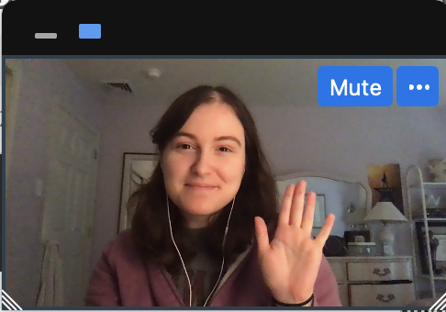

Notes:
Instruct parent to put me in full screen, select the “one box” option so they only see my face, and move my face into the box. You don't need to fit it perfectly, just put me in the box
****Test audio, how does this sound?

Slide 2
Notes:
Today, you’re going to help me finish a very important project.

Slide 3

Notes:
I’ve built this machine, and this machine is supposed to tell me***effect*** what was in my dreams last night. But it’s not finished yet! I need your help to make this dream machine work.
First, I need to make sure that my dream machine can show the pictures of my dreams. I'm going to turn the machine on, and I need you to tell me what you see in each dream cloud, okay?

Slide 4


Slide 5


Slide 6
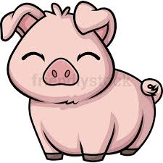

Slide 7


Slide 8
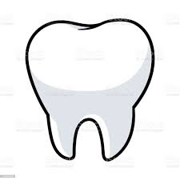

Slide 9


Slide 10


Slide 11
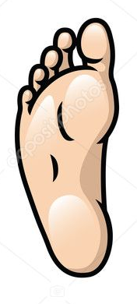

Slide 12


Slide 13


Slide 14


Slide 15


Slide 16
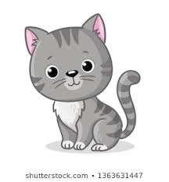

Slide 17


Slide 18
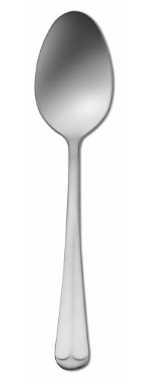

Slide 19
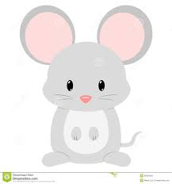

Slide 20
Notes:
Great! The dream machine does show me pictures of my dreams. But here’s another problem, the dream machine gets confused about which dream is right.

Slide 21
Notes:
When I ask the dream machine to read a dream, it shows me not just one, but three possible dreams that might be true. It’s not sure which one is the real dream. This is where you can help. I need you to follow the trail dream bubbles to the right dream cloud, and count what was in my dream. You need to tell me which dream is the correct one, so I can fix the dream machine. So if I follow the bubbles *effect* this dream is the correct one. It will also blink real fast.
So for this first dream, if we follow the bubbles, we see one frog, and two pigs. So I would say “one frog and two pigs”. Don’t say anything more than what’s in the dream so that I don’t confuse the dream machine. Ok?
When you hear this sound… that means the dream machine is ready and you can tell me what is in my dream.

Slide 22
Notes:
Let me try another one. Remember, I would follow the bubbles and say what’s in that cloud. Let me show you. ****
“one man and one turtle.” Okay? Now it’s your turn. Can you count what was in my dream? *response* “one man and one turtle”. Great!

Slide 25
?
Notes:
Awesome! You’re ready to help me fix my dream machine. Remember, when you hear the sound that means the dream machine is ready and you can tell me what is in my dream. And don't say anything more than what you're counting. Are you ready? Let’s go.

Slide 26
Notes:
Now it’s your turn! Tell me what is in my dream?

Slide 27
Notes:
Trial 2: RS + IP
Pig & leaves

Slide 28
Notes:
Trial 3: RS + IS
Tooth and spoon

Slide 29
Notes:
Trial 4: RP+IP
Snakes and geese

Slide 30
Notes:
Trial 5: RP + IP
Frogs and teeth

Slide 31
Notes:
Trial 6: RS+RP
Snake and forks

Slide 32
Notes:
Trial 7: IS + IP
Man and mice

Slide 33
Notes:
Trial 8 – RP + IP
Dogs and snowmen

Slide 34
Notes:
Trial 9 : RS + IS
Turtle and goose

Slide 35
Notes:
Trial 10 : IS + RP
Woman and spoons

Slide 36
Notes:
Trial 11 : IS + IP
leaf and feet

Slide 37
Notes:
Trial 12: RS + IS
Cat and mouse

Slide 38
Notes:
Trial 13: IS + RP
Snowman and pigs

Slide 39
Notes:
Trial 14: RS + IP
Frog and women

Slide 40
Notes:
Trial 15: RP + IP
Turtles and men

Slide 41
Notes:
Trial 16: RS + IS
Dog and foot

Slide 42

Notes:
Uh oh, my dream machine has stopped working! Hmmmm… oh I know! It looks like a piece fell out. Did you see where it went?
Ah, it was behind the cat! Let me put it back... Great! Now we can keep going! What was in my dream?

Slide 43
Notes:
Test 1: RP + IP
Spoons and teeth

Slide 44
Notes:
Test 2: RS + IP
Frog and geese

Slide 45
Notes:
Test 3: RS + RP
Dog and pigs

Slide 46
Notes:
Test 4: RP + IP
Frogs and men

Slide 47
Notes:
Test 5: IS + IP
Goose and snowmen

Slide 48
Notes:
Test 6: RP + IP
Turtles and women

Slide 49
Notes:
Test 7: IS + IP
Man and leaves

Slide 50
Notes:
Test 8: IS + RP
leaf and snakes

Slide 51
Notes:
Test 9: RS + IP
Spoon and mice

Slide 52
Notes:
Test 10 : RP + IP
Cats and feet

Slide 53
!
Notes:
Yay! The machine is fixed! Thank you so much for helping me. Before I turn it off, we need to say goodbye to everyone in my dreams okay? Like this…

Slide 54
Notes:
Bye bye forks! Okay now you go!

