Slide 1
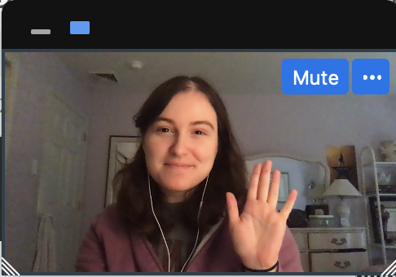

Notes:
Instruct parent to put me in full screen, select the “one box” option so they only see my face, and move my face into the box.
****Test audio, how does this sound?

Slide 2
Notes:
Today, you’re going to help me finish a very important project.

Slide 3

Notes:
I’ve built this machine, and this machine is supposed to tell me***effect*** what was in my dreams last night. But it’s not finished yet! I need your help to make this dream machine work.
First, I need to make sure that my dream machine can show the pictures of my dreams. I'm going to turn the machine on, and I need you to tell me what you see in each dream cloud, okay?

Slide 4


Slide 5


Slide 6
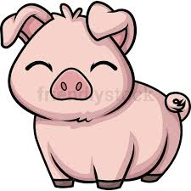

Slide 7


Slide 8
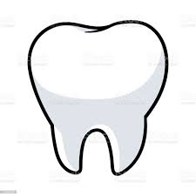

Slide 9


Slide 10


Slide 11
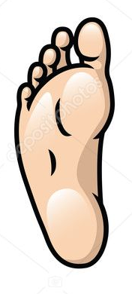

Slide 12


Slide 13
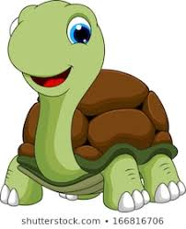

Slide 14
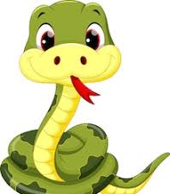

Slide 15


Slide 16
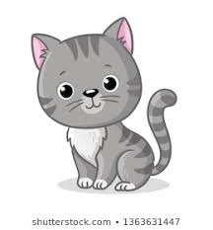

Slide 17


Slide 18
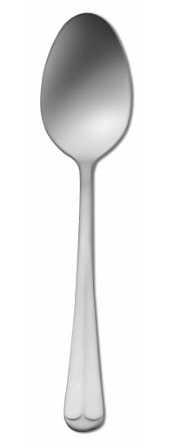

Slide 19
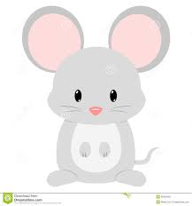

Slide 20
Notes:
Great! The dream machine does show me pictures of my dreams. But here’s another problem, the dream machine gets confused about which dream is right.

Slide 21
Notes:
When I ask the dream machine to read a dream, it shows me not just one, but three possible dreams that might be true. It’s not sure which one is the real dream. This is where you can help. I need you to follow the trail dream bubbles to the right dream cloud, and count what was in my dream. You need to tell me which dream is the correct one, so I can fix the dream machine. So if I follow the bubbles *effect* this dream is the correct one
When you hear this sound… that means the dream machine is ready and you can tell me what is in my dream.
So for this first dream, if we follow the bubbles, we see one frog, and two pigs. So I would say “one frog and two pigs”. Don’t say anything more than what’s in the dream so that I don’t confuse the dream machine. Ok?

Slide 22
Notes:
Let me try another one. Remember, I would follow the bubbles and say what’s in that cloud. Let me show you. ****
“one man and one turtle.” Okay? Now it’s your turn. Can you count what was in my dream? *response* “one man and one turtle”. Great!

Slide 24
?
Notes:
Awesome! You’re ready to help me fix my dream machine. Remember, when you hear the sound that means the dream machine is ready and you can tell me what is in my dream. Are you ready? Let’s go.

Slide 25
Notes:
Trial 1: IS + RP
Mouse + Snakes

Slide 26
Notes:
Trial 2: IS + IP
Leaf + Geese

Slide 27
Notes:
Trial 3: RS + IS
Pig + Man

Slide 28
Notes:
Trial 4: RS + RP
Dog + Pigs

Slide 29
Notes:
Trial 5: IS + IP
Goose + women

Slide 30
Notes:
Trial 6: RS + IS
Frog + Foot

Slide 31
Notes:
Trial 7: RP + IP
Frogs + Men

Slide 32
Notes:
Trial 8 : RS + RP
Spoon + Turtles

Slide 33
Notes:
Trial 9 : RS + IP
Snake + Snowmen

Slide 34
Notes:
Trial 10 : RP + IP
Spoons + Teeth

Slide 35
Notes:
Trial 11: RS + IS
Cat + Snowman

Slide 36
Notes:
Trial 12: RP + IP
Dogs + Feet

Slide 37
Notes:
Trial 13: RS + IS
Fork + Woman

Slide 38

Notes:
Uh oh, my dream machine has stopped working! Hmmmm… oh I know! It looks like a piece fell out. Did you see where it went?
Ah, it was behind the cat! Let me put it back... Great! Now we can keep going! What was in my dream?

Slide 39
Notes:
Trial 14: IS + RP
Tooth + Cats

Slide 40
Notes:
Trial 15: RS + IP
Turtle + Mice

Slide 41
Notes:
Trial 16: RP + IP
Forks + Leaves

Slide 42
Notes:
Test 1: IS +. IP
Man + Feet

Slide 43
Notes:
Test 2: RP + IP
Spoons + Women

Slide 44
Notes:
Test 3: RS + RP
Dog + Frogs

Slide 45
Notes:
Test 4: RS + IP
Snake + Men

Slide 46
Notes:
Test 5: RP + IP
Snakes + Leaves

Slide 47
Notes:
Test 6: IS + IP
Goose + Mice

Slide 48
Notes:
Test 7: RP + IP
Dogs + Snowmen

Slide 49
Notes:
Test 8: IS + RP
Mouse + Forks

Slide 50
Notes:
Test 9: RS + IP
Pig + Teeth

Slide 51
Notes:
Test 10: RP + IP
Turtles + Geese

Slide 52
!
Notes:
Yay! The machine is fixed! Thank you so much for helping me. Before I turn it off, we need to say goodbye to everyone in my dreams okay? Like this…

Slide 53
Notes:
Bye bye forks! Okay now you go!

