Slide 1
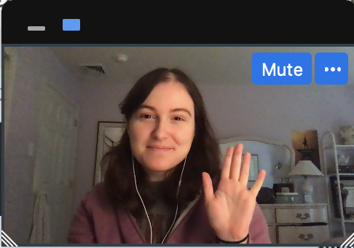

Notes:
Instruct parent to put me in full screen, select the “one box” option so they only see my face, and move my face into the box. You don't need to fit it perfectly, just put me in the box
****Test audio, how does this sound?

Slide 2
Notes:
Today, you’re going to help me finish a very important project.

Slide 3

Notes:
I’ve built this machine, and this machine is supposed to tell me***effect*** what was in my dreams last night. But it’s not finished yet! I need your help to make this dream machine work.
First, I need to make sure that my dream machine can show the pictures of my dreams. I'm going to turn the machine on, and I need you to tell me what you see in each dream cloud, okay? You can do this by saying hi to my dreams like this!

Slide 4

Notes:
Hi Frogs! Now you try!

Slide 5
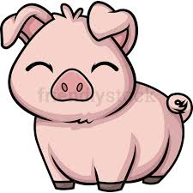

Slide 6


Slide 7
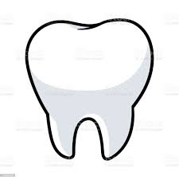

Slide 8


Slide 9


Slide 10
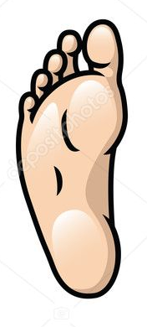

Slide 11


Slide 12


Slide 13
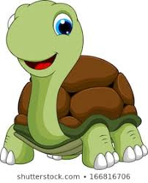

Slide 14
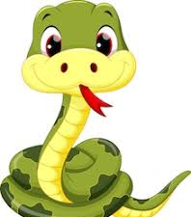

Slide 15


Slide 16
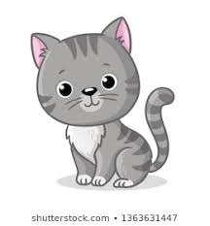

Slide 17


Slide 18
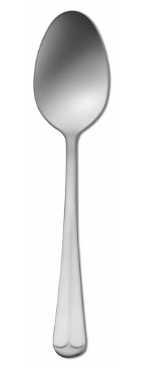

Slide 19
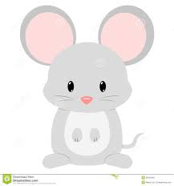

Slide 20
Notes:
Great! The dream machine does show the pictures of my dreams. But here’s another problem, the dream machine gets confused about which dream is right.

Slide 21
Notes:
When I ask the dream machine to read my dream, it shows me not just one, but two possible dreams that might be true. It’s not sure which one is right. This is where you can help. First, you’ll hear this beep *beep* and see the right dream blink. That means the dream machine is ready for you to count. I need you to *look* for the trail of dream bubbles to the right dream cloud and count what was in my dream. So, if we follow the bubbles, you would say one frog, and two pigs.

Slide 22
Notes:
Let me show you another one. Remember, you follow the bubbles and say what’s in that cloud. Let me show you. ****
“one man and one turtle.”
Now it’s your turn. Can you count what was in my dream? *response* “one man and one turtle”. Great!

Slide 23
Notes:
Now you give it a try.
Three dogs and two snakes

Slide 24
Notes:
Let’s practice one more time,
one mouse and three forks

Slide 25
?
Notes:
Awesome! You’re ready to help me fix my dream machine. Remember, when you hear the sound that means the dream machine is ready and you can tell me what is in my dream. And don't say anything more than what you're counting. Are you ready? Let’s go.

Slide 26
Notes:
one fork and two cats

Slide 27
Notes:
Trial 2: RS + IP
One pig and two leaves

Slide 28
Notes:
Trial 3: RS + IS
one tooth and one spoon

Slide 29
Notes:
Trial 4: RP+IP
two snakes and three geese

Slide 30
Notes:
Trial 5: RP + IP
two frogs and two teeth

Slide 31
Notes:
Trial 6: RS+RP
one snake and three forks

Slide 32
Notes:
Trial 7: IS + IP
one man and three mice

Slide 33
Notes:
Trial 8 – RP + IP
two dogs and two snowmen

Slide 34
Notes:
Trial 9 : RS + IS
one turtle and one goose

Slide 35
Notes:
Trial 10 : IS + RP
one woman and two spoons

Slide 36
Notes:
Trial 11 : IS + IP
one leaf and three feet

Slide 37
Notes:
Trial 12: RS + IS
one cat and one mouse

Slide 38
Notes:
Trial 13: IS + RP
one snowman and three pigs

Slide 39
Notes:
Trial 14: RS + IP
one frog and two women

Slide 40
Notes:
Trial 15: RP + IP
three turtles and two men

Slide 41
Notes:
Trial 16: RS + IS
one dog and one foot

Slide 42

Notes:
Uh oh, my dream machine has stopped working! Hmmmm… oh I know! It looks like a piece fell out. Did you see where it went?
Ah, it was behind the cat! Let me put it back... Great! Now we can keep going! What was in my dream?

Slide 43
Notes:
Test 1: RP + IP
two spoons and two teeth

Slide 44
Notes:
Test 2: RS + IP
one frog and three geese

Slide 45
Notes:
Test 3: RS + RP
one dog and two pigs

Slide 46
Notes:
Test 4: RP + IP
three frogs and two men

Slide 47
Notes:
Test 5: IS + IP
one goose and three snowmen

Slide 48
Notes:
Test 6: RP + IP
two turtles and three women

Slide 49
Notes:
Test 7: IS + IP
one man and two leaves

Slide 50
Notes:
Test 8: IS + RP
one leaf and three snakes

Slide 51
Notes:
Test 9: RS + IP
one spoon and two mice

Slide 52
Notes:
Test 10 : RP + IP
two cats and two feet

Slide 53
!
Notes:
Yay! The machine is fixed! Thank you so much for helping me. Before I turn it off, we need to say goodbye to everyone in my dreams okay? Like this…

Slide 54
Notes:
Bye bye forks! Okay now you go!

