Slide 1
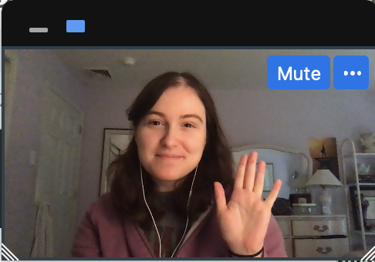

Notes:
Instruct parent to put me in full screen, select the “one box” option so they only see my face, and move my face into the box. You don't need to fit it perfectly, just put me in the box
****Test audio, how does this sound?

Slide 2
Notes:
Today, you’re going to help me finish a very important project.

Slide 3

Notes:
I’ve built this machine, and this machine is supposed to tell me***effect*** what was in my dreams last night. But it’s not finished yet! I need your help to make this dream machine work.
First, I need to make sure that my dream machine can show the pictures of my dreams. I'm going to turn the machine on, and I need you to tell me what you see in each dream cloud, okay? You can do this by saying hi to my dreams like this!

Slide 4
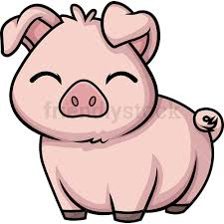
Notes:
Hi Pigs!

Slide 5


Slide 6
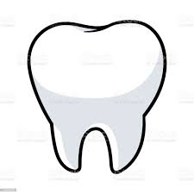

Slide 7


Slide 8
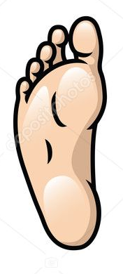

Slide 9


Slide 10


Slide 11

Notes:
Hi Frogs! Now you try!

Slide 12


Slide 13


Slide 14
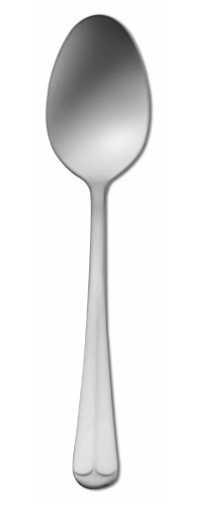

Slide 15


Slide 16
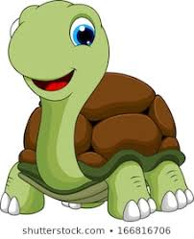

Slide 17
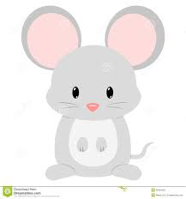

Slide 18
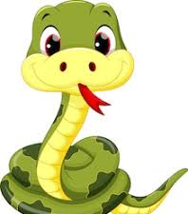

Slide 19
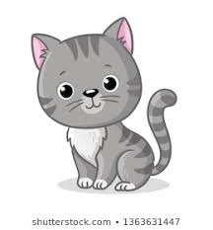

Slide 20
Notes:
Great! The dream machine does show me pictures of my dreams. But here’s another problem, the dream machine gets confused about which dream is right.

Slide 21
Notes:
When I ask the dream machine to read my dream, it shows me not just one, but two possible dreams that might be true. It’s not sure which one is right. This is where you can help. First, you’ll hear this beep *beep* and see the right dream blink. That means the dream machine is ready for you to count. I need you to *look* for the trail of dream bubbles to the right dream cloud and count what was in my dream. So, if we follow the bubbles, you would say one frog, and two pigs.

Slide 22
Notes:
Let me show you another one. Remember, you follow the bubbles and say what’s in that cloud. Let me show you. ****
“one man and one turtle.”
Now it’s your turn. Can you count what was in my dream? *response* “one man and one turtle”. Great!

Slide 23
Notes:
Now you give it a try.
Three dogs and two snakes

Slide 24
Notes:
Let’s practice one more time,
one mouse and three forks

Slide 25
?
Notes:
Awesome! You’re ready to help me fix my dream machine. Remember, when you hear the sound that means the dream machine is ready and you can tell me what is in my dream. Are you ready? Let’s go.

Slide 26
Notes:
Trial 1: IS + RP
One mouse and three snakes

Slide 27
Notes:
Trial 2: IS + IP
One leaf and two geese

Slide 28
Notes:
Trial 3: RS + IS
One pig and one man

Slide 29
Notes:
Trial 4: RS + RP
One dog and three pigs

Slide 30
Notes:
Trial 5: IS + IP
One goose and three women

Slide 31
Notes:
Trial 6: RS + IS
One frog and one foot

Slide 32
Notes:
Trial 7 : RS + RP
One spoon and three turtles

Slide 33
Notes:
Trial 8 : RS + IP
One snake and two snowmen

Slide 34
Notes:
Trial 9: RP + IP
Two frogs and two men

Slide 35
Notes:
Trial 10 : RP + IP
Three spoons and two teeth

Slide 36
Notes:
Trial 11: RS + IS
One cat and one snowman

Slide 37
Notes:
Trial 12: RP + IP
Two dogs and two feet

Slide 38
Notes:
Trial 13: RS + IS
One fork and one woman

Slide 39
Notes:
Trial 14: IS + RP
One tooth and two cats

Slide 40
Notes:
Trial 15: RS + IP
One turtle and two mice

Slide 41
Notes:
Trial 16: RP + IP
Two forks and three leaves

Slide 42

Notes:
Uh oh, my dream machine has stopped working! Hmmmm… oh I know! It looks like a piece fell out. Did you see where it went?
Ah, it was behind the cat! Let me put it back... Great! Now we can keep going! What was in my dream?

Slide 43
Notes:
Test 1: IS +. IP
Three men and two feet

Slide 44
Notes:
Test 2: RP + IP
One spoon and three women

Slide 45
Notes:
Test 3: RS + RP
One dog and two frogs

Slide 46
Notes:
Test 4: RS + IP
One cat and two men

Slide 47
Notes:
Test 5: RP + IP
Two snakes and two leaves

Slide 48
Notes:
Test 6: IS + IP
One goose and three mice

Slide 49
Notes:
Test 7: RP + IP
Two dogs and three snowmen

Slide 50
Notes:
Test 8: IS + RP
One mouse and two forks

Slide 51
Notes:
Test 9: RS + IP
One pig and three teeth

Slide 52
Notes:
Test 10: RP + IP
Two turtles and two geese

Slide 53
!
Notes:
Yay! The machine is fixed! Thank you so much for helping me. Before I turn it off, we need to say goodbye to everyone in my dreams okay? Like this…

Slide 56
Notes:
Bye bye forks! Okay now you go!

