Slide 1
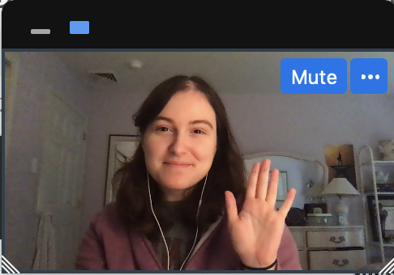

Notes:
Instruct parent to put me in full screen, select the “one box” option so they only see my face, and move my face into the box. You don't need to fit it perfectly, just put me in the box
****Test audio, how does this sound?

Slide 2
Notes:
Today, you’re going to help me finish a very important project.

Slide 3

Notes:
I’ve built this machine, and this machine is supposed to tell me***effect*** what was in my dreams last night. But it’s not finished yet! I need your help to make this dream machine work.
First, I need to make sure that my dream machine can show the pictures of my dreams. I'm going to turn the machine on, and I need you to tell me what you see in each dream cloud, okay? You can do this by saying hi to my dreams like this!

Slide 4

Notes:
Hi frogs! Okay now your turn!

Slide 5
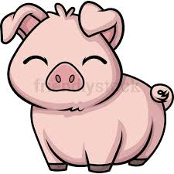

Slide 6


Slide 7
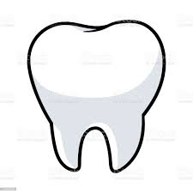

Slide 8


Slide 9


Slide 10
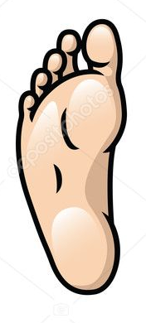

Slide 11


Slide 12


Slide 13
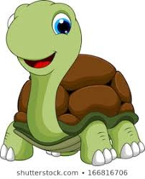

Slide 14
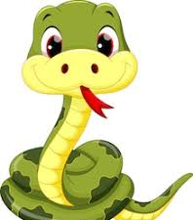

Slide 15


Slide 16
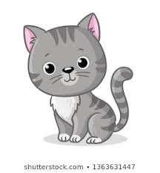

Slide 17


Slide 18
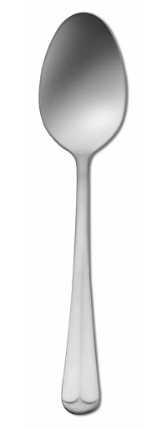

Slide 19
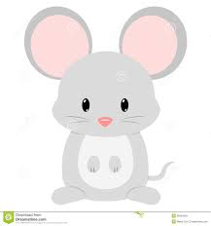

Slide 20
Notes:
Great! The dream machine does show the pictures of my dreams. But here’s another problem, the dream machine gets confused about which dream is right.

Slide 21
Notes:
When I ask the dream machine to read my dream, it shows me not just one, but two possible dreams that might be true. It’s not sure which one is right. This is where you can help. First, I’ll say what I remember about my dream. “I remember a frog and some pigs.” Then you’ll hear this beep *beep* and see the right dream blink. That means the dream machine is ready for you to count. I need you to *look* for the trail of dream bubbles to the right dream cloud and count what was in my dream. So, if we follow the bubbles, we see one frog, and two pigs.

Slide 22
Notes:
Let me show you another one. Remember, I’ll say what I remember, then you would follow the bubbles and count what’s in that cloud. Let me show you. ****
I remember a man and a turtle. You would say, “one man and one turtle.” Okay?
Now it’s your turn. Can you count what was in my dream? *response* “one man and one turtle”. Great!

Slide 23
Notes:
Now it's your turn to try. I say what I remember, you wait for the beep, then you count.
I remember some dogs and some snakes.

Slide 24
Notes:
Lets do one more practice round!
I remember a mouse and some forks.

Slide 25
?
Notes:
Awesome! You’re ready to help me fix my dream machine. Remember, when you hear the sound that means the dream machine is ready and you can tell me what is in my dream. And don't say anything more than what you're counting. Are you ready? Let’s go.

Slide 26
Notes:
I remember a fork and some cats

Slide 27
Notes:
I remember a pig and some leaves

Slide 28
Notes:
I remember a tooth and a spoon

Slide 29
Notes:
I remember some snakes and some geese

Slide 30
Notes:
I remember some frogs and some teeth

Slide 31
Notes:
I remember some snakes and some forks

Slide 32
Notes:
I remember a man and some mice

Slide 33
Notes:
I remember some dogs and some snowmen

Slide 34
Notes:
I remember a turtle and a goose

Slide 35
Notes:
I remember a woman and some spoons

Slide 36
Notes:
I remember a leaf and some feet

Slide 37
Notes:
I remember a cat and a mouse

Slide 38
Notes:
I remember a snowman and some pigs

Slide 39
Notes:
I remember a frog and some women

Slide 40
Notes:
I remember some turtles and some men

Slide 41
Notes:
I remember a dog and a foot

Slide 42

Notes:
Uh oh, my dream machine has stopped working! Hmmmm… oh I know! It looks like a piece fell out. Did you see where it went?
Ah, it was behind the cat! Let me put it back... Great! Now we can keep going! What was in my dream?

Slide 43
Notes:
I remember some spoons and some teeth

Slide 44
Notes:
I remember a frog and some geese

Slide 45
Notes:
I remember a dog and some pigs

Slide 46
Notes:
I remember some frogs and some men

Slide 47
Notes:
I remember a goose and some snowmen

Slide 48
Notes:
I remember some turtles and some women

Slide 49
Notes:
I remember a man and some leaves

Slide 50
Notes:
I remember a leaf and some snakes

Slide 51
Notes:
I remember a spoon and some mice

Slide 52
Notes:
I remember some cats and some feet

Slide 53
!
Notes:
Yay! The machine is fixed! Thank you so much for helping me. Before I turn it off, we need to say goodbye to everyone in my dreams okay? Like this…

Slide 54
Notes:
Bye bye forks! Okay now you go!

