Slide 1
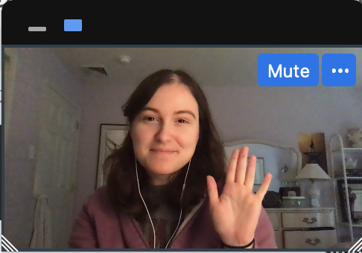

Notes:
Instruct parent to put me in full screen, select the “one box” option so they only see my face, and move my face into the box. You don't need to fit it perfectly, just put me in the box
****Test audio, how does this sound?

Slide 2
Notes:
Today, you’re going to help me finish a very important project.

Slide 3

Notes:
I’ve built this machine, and this machine is supposed to tell me***effect*** what was in my dreams last night. But it’s not finished yet! I need your help to make this dream machine work.
First, I need to make sure that my dream machine can show the pictures of my dreams. I'm going to turn the machine on, and I need you to tell me what you see in each dream cloud, okay? You can do this by saying hi to my dreams like this!

Slide 4
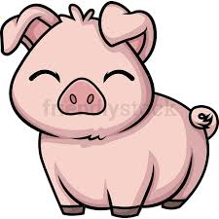
Notes:
Hi Pigs!

Slide 5


Slide 6


Slide 7


Slide 8
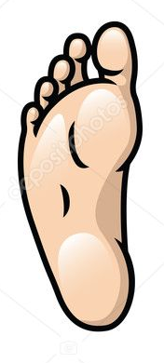

Slide 9


Slide 10


Slide 11

Notes:
Hi Frogs! Now you try!

Slide 12


Slide 13


Slide 14
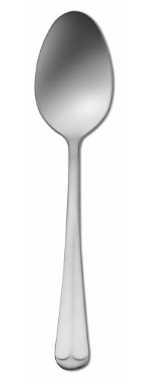

Slide 15


Slide 16
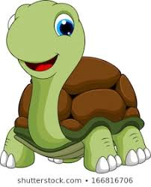

Slide 17
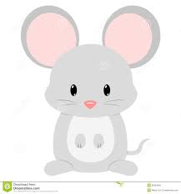

Slide 18
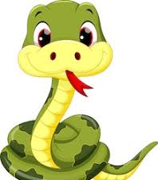

Slide 19
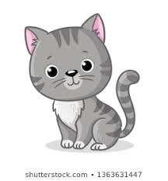

Slide 20
Notes:
Great! The dream machine does show me pictures of my dreams. But here’s another problem, the dream machine gets confused about which dream is right.

Slide 21
Notes:
When I ask the dream machine to read my dream, it shows me not just one, but two possible dreams that might be true. It’s not sure which one is right. This is where you can help. First, I’ll say what I remember about my dream. “I remember a frog and some pigs.” Then you’ll hear this beep *beep* and see the right dream blink. That means the dream machine is ready for you to count. I need you to *look* for the trail of dream bubbles to the right dream cloud and count what was in my dream. So, if we follow the bubbles, we see one frog, and two pigs.

Slide 22
Notes:
Let me show you another one. Remember, I’ll say what I remember, then you would follow the bubbles and count what’s in that cloud. Let me show you. ****
I remember a man and a turtle. You would say, “one man and one turtle.” Okay?
Now it’s your turn. Can you count what was in my dream? *response* “one man and one turtle”. Great!

Slide 23
Notes:
Now you give it a try.
I remember some dogs and some snakes.

Slide 24
Notes:
Let’s practice one more time,
I remember a mouse and some forks.

Slide 25
?
Notes:
Awesome! You’re ready to help me fix my dream machine. Remember, when you hear the sound that means the dream machine is ready and you can tell me what is in my dream. Are you ready? Let’s go.

Slide 26
Notes:
Trial 1: IS + RP
I remember a mouse and some snakes

Slide 27
Notes:
Trial 2: IS + IP
I remember a leaf and some geese

Slide 28
Notes:
Trial 3: RS + IS
I remember a pig and a man

Slide 29
Notes:
Trial 4: RS + RP
I remember a dog and some pigs

Slide 30
Notes:
Trial 5: IS + IP
I remember a goose and some women

Slide 31
Notes:
Trial 6: RS + IS
I remember a frog and a foot

Slide 32
Notes:
Trial 7 : RS + RP
I remember a spoon and some turtles

Slide 33
Notes:
Trial 8 : RS + IP
I remember a snake and some snowmen

Slide 34
Notes:
Trial 9: RP + IP
I remember some frogs and some men

Slide 35
Notes:
Trial 10 : RP + IP
I remember some spoons and some teeth

Slide 36
Notes:
Trial 11: RS + IS
I remember a cat and a snowman

Slide 37
Notes:
Trial 12: RP + IP
I remember some dogs and some feet

Slide 38
Notes:
Trial 13: RS + IS
I remember a fork and a woman

Slide 39
Notes:
Trial 14: IS + RP
I remember a tooth and some cats

Slide 40
Notes:
Trial 15: RS + IP
I remember a turtle and some mice

Slide 41
Notes:
Trial 16: RP + IP
I remember some forks and some leaves

Slide 42

Notes:
Uh oh, my dream machine has stopped working! Hmmmm… oh I know! It looks like a piece fell out. Did you see where it went?
Ah, it was behind the cat! Let me put it back... Great! Now we can keep going! What was in my dream?

Slide 43
Notes:
Test 1: IS +. IP
I remember some men and some feet

Slide 44
Notes:
Test 2: RP + IP
I remember a spoon and some women

Slide 45
Notes:
Test 3: RS + RP
I remember a dog and some frogs

Slide 46
Notes:
Test 4: RS + IP
I remember a cat and some men

Slide 47
Notes:
Test 5: RP + IP
I remember some snakes and some leaves

Slide 48
Notes:
Test 6: IS + IP
I remember a goose and some mice

Slide 49
Notes:
Test 7: RP + IP
I remember two dogs and two snowmen

Slide 50
Notes:
Test 8: IS + RP
I remember a mouse and some forks

Slide 51
Notes:
Test 9: RS + IP
I remember a pig and some teeth

Slide 52
Notes:
Test 10: RP + IP
I remember some turtles and some geese

Slide 53
!
Notes:
Yay! The machine is fixed! Thank you so much for helping me. Before I turn it off, we need to say goodbye to everyone in my dreams okay? Like this…

Slide 56
Notes:
Bye bye forks! Okay now you go!

