Slide 1
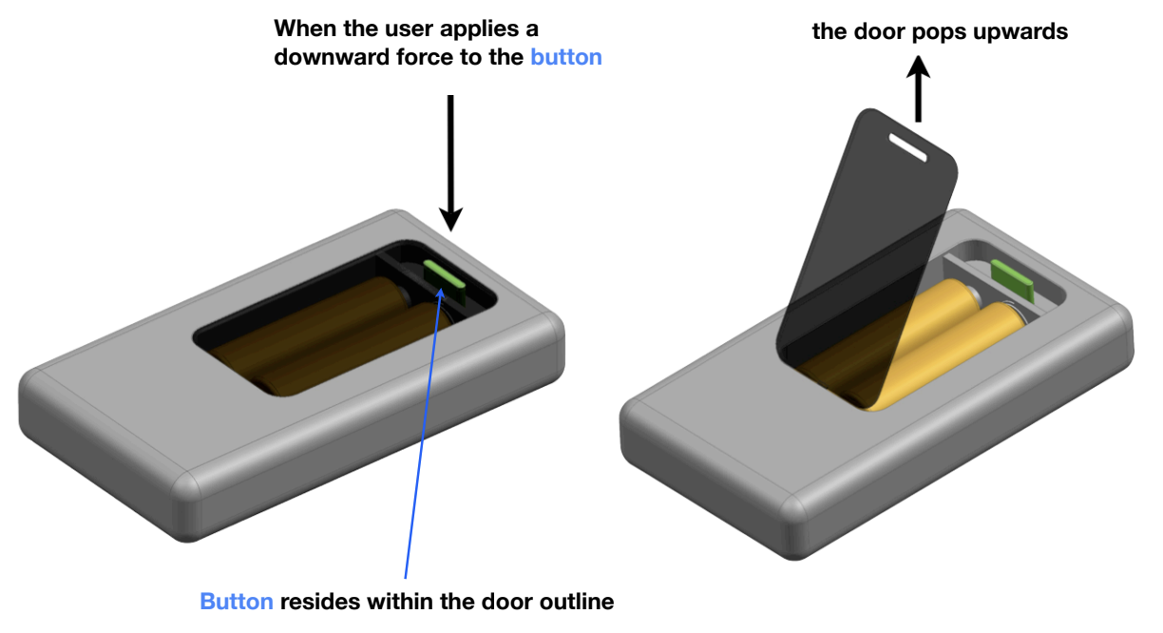
Battery Door Design Challenge
Megan Ying

Slide 2
Problem Statement and Assumptions
Problem Statement
Assumptions
5th generation iPod Classic
  Dimensions: 103.5 mm x 61.8 mm x 10.5 mm
  Weight: 140 g
Other internal electronics do not exist
Users will accept a thicker product
Mechanism is cycled less than 1000x
  Duracell AA batteries last ~100 hours in constant use
  iPod Classic lasts ~5 years
Product will be mass manufactured
Door will pop open when released
Users want to be able to replace batteries on the iPod

Slide 3
Requirements and Constraints
Functionality
User
Can sustain cycling over product lifespan
Withstands drop testing without failure
Withstands extreme temperature conditions without failure
Does not require excessive user force
Can be actuated using one hand
Is not prone to accidental actuation
Offers auditory or tactile feedback
Design
Minimizes number of components
Minimizes production time
Minimizes production costs
Minimizes weight addition
Minimizes thickness addition
Sleek and aesthetically pleasing

Slide 4
Assumptions and Requirements
Assumptions
Requirements
5th generation iPod Classic
  Dimensions: 103.5 x 61.8 x 10.5 mm
  Mass: 140 g
Other internal components are out-of-scope
Users will accept a thicker product
  AA battery diameter: 14 mm
Product is cycled < 1000 times over lifespan
  Duracell AA batteries last ~100 hours during constant use
  iPod Classic lasts ~5 years
Product will be mass manufactured ( >100,000 units per year)
Door will pop open when released due to spring-loaded hinge
Button requires minimal user effort to actuate, but resists accidental actuation
  Button press force of 2-5 N and travel distance of 1-3 mm
Door require minimal user effort to close, but resists accidental opening
  Closing force of < 8 N and opening force of > 20 N
Does not obstruct battery removal or handling
Prevents rattling or unwanted noise during use
Endures repeated use over product’s lifespan
Remains functional and secure during drops
Remains functional under extreme temperatures
Minimizes production costs and assembly time
Minimizes additional weight and space footprint
Maintains sleek and aesthetically pleasing appearance

Slide 5
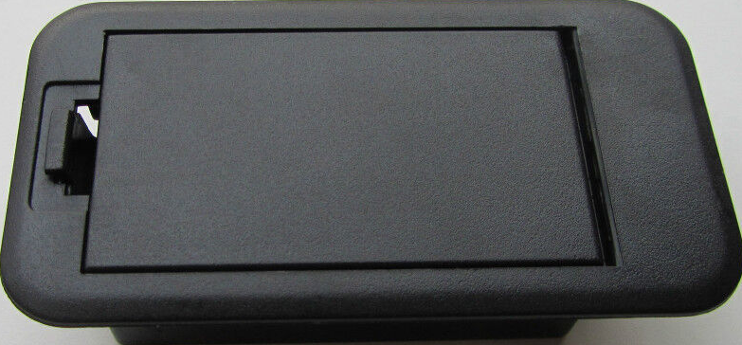
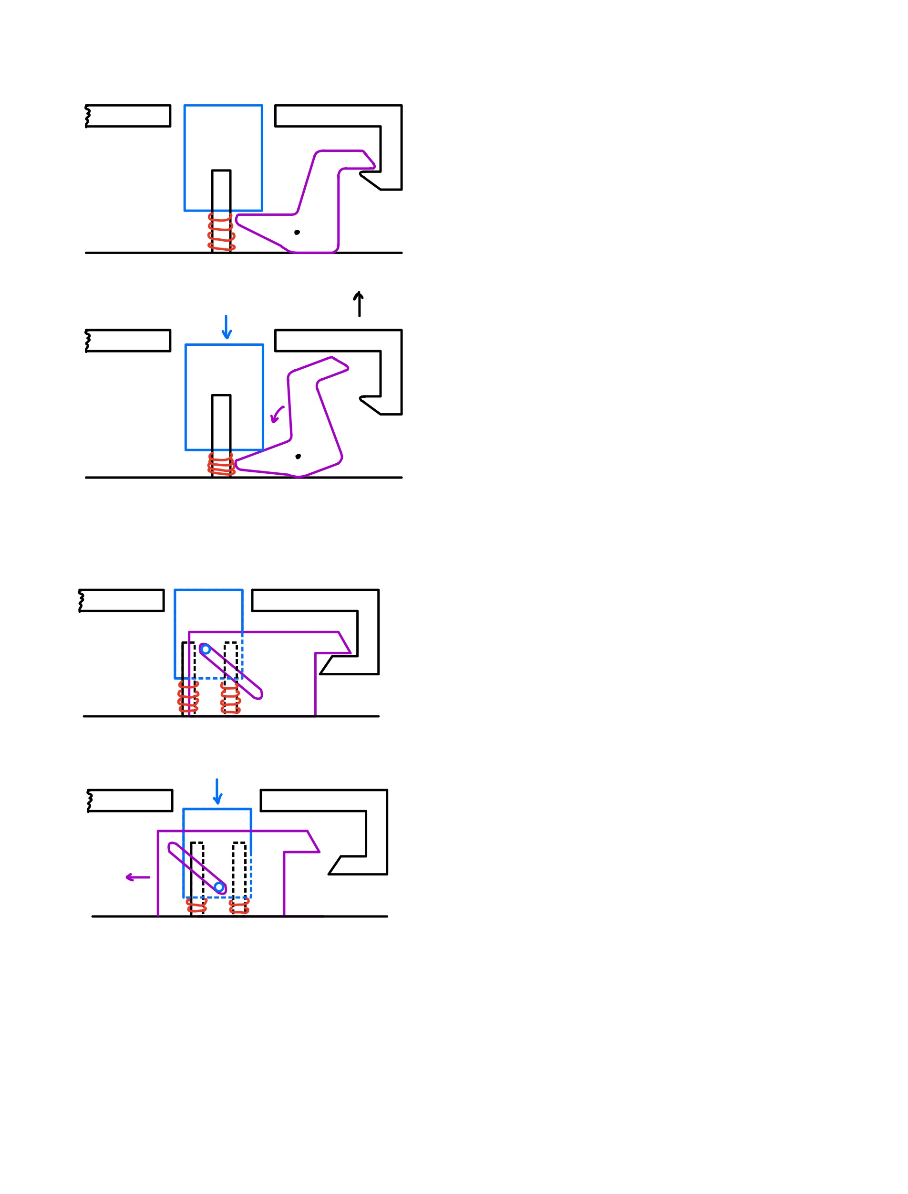
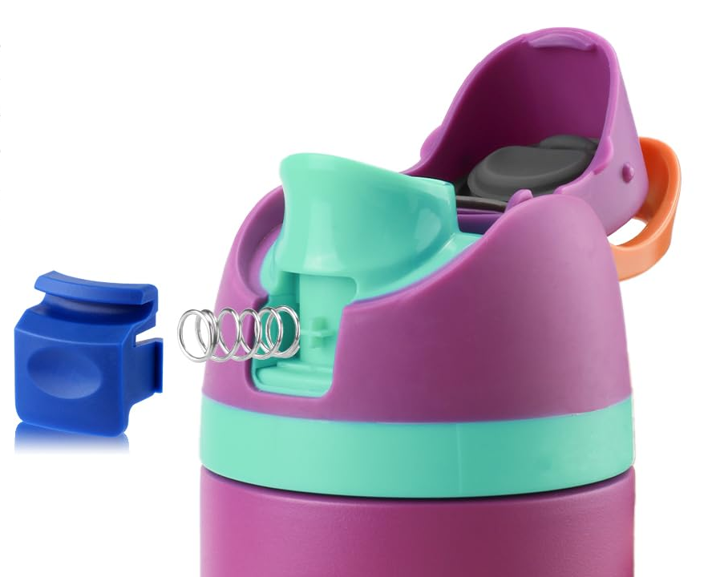
Moving Snap Fit Mechanism
Inspiration
Concept
1. Latch hooks onto door in locked position
2. Button is pressed and latch moves to release door
Battery covers and water bottles with snap fits

Slide 6
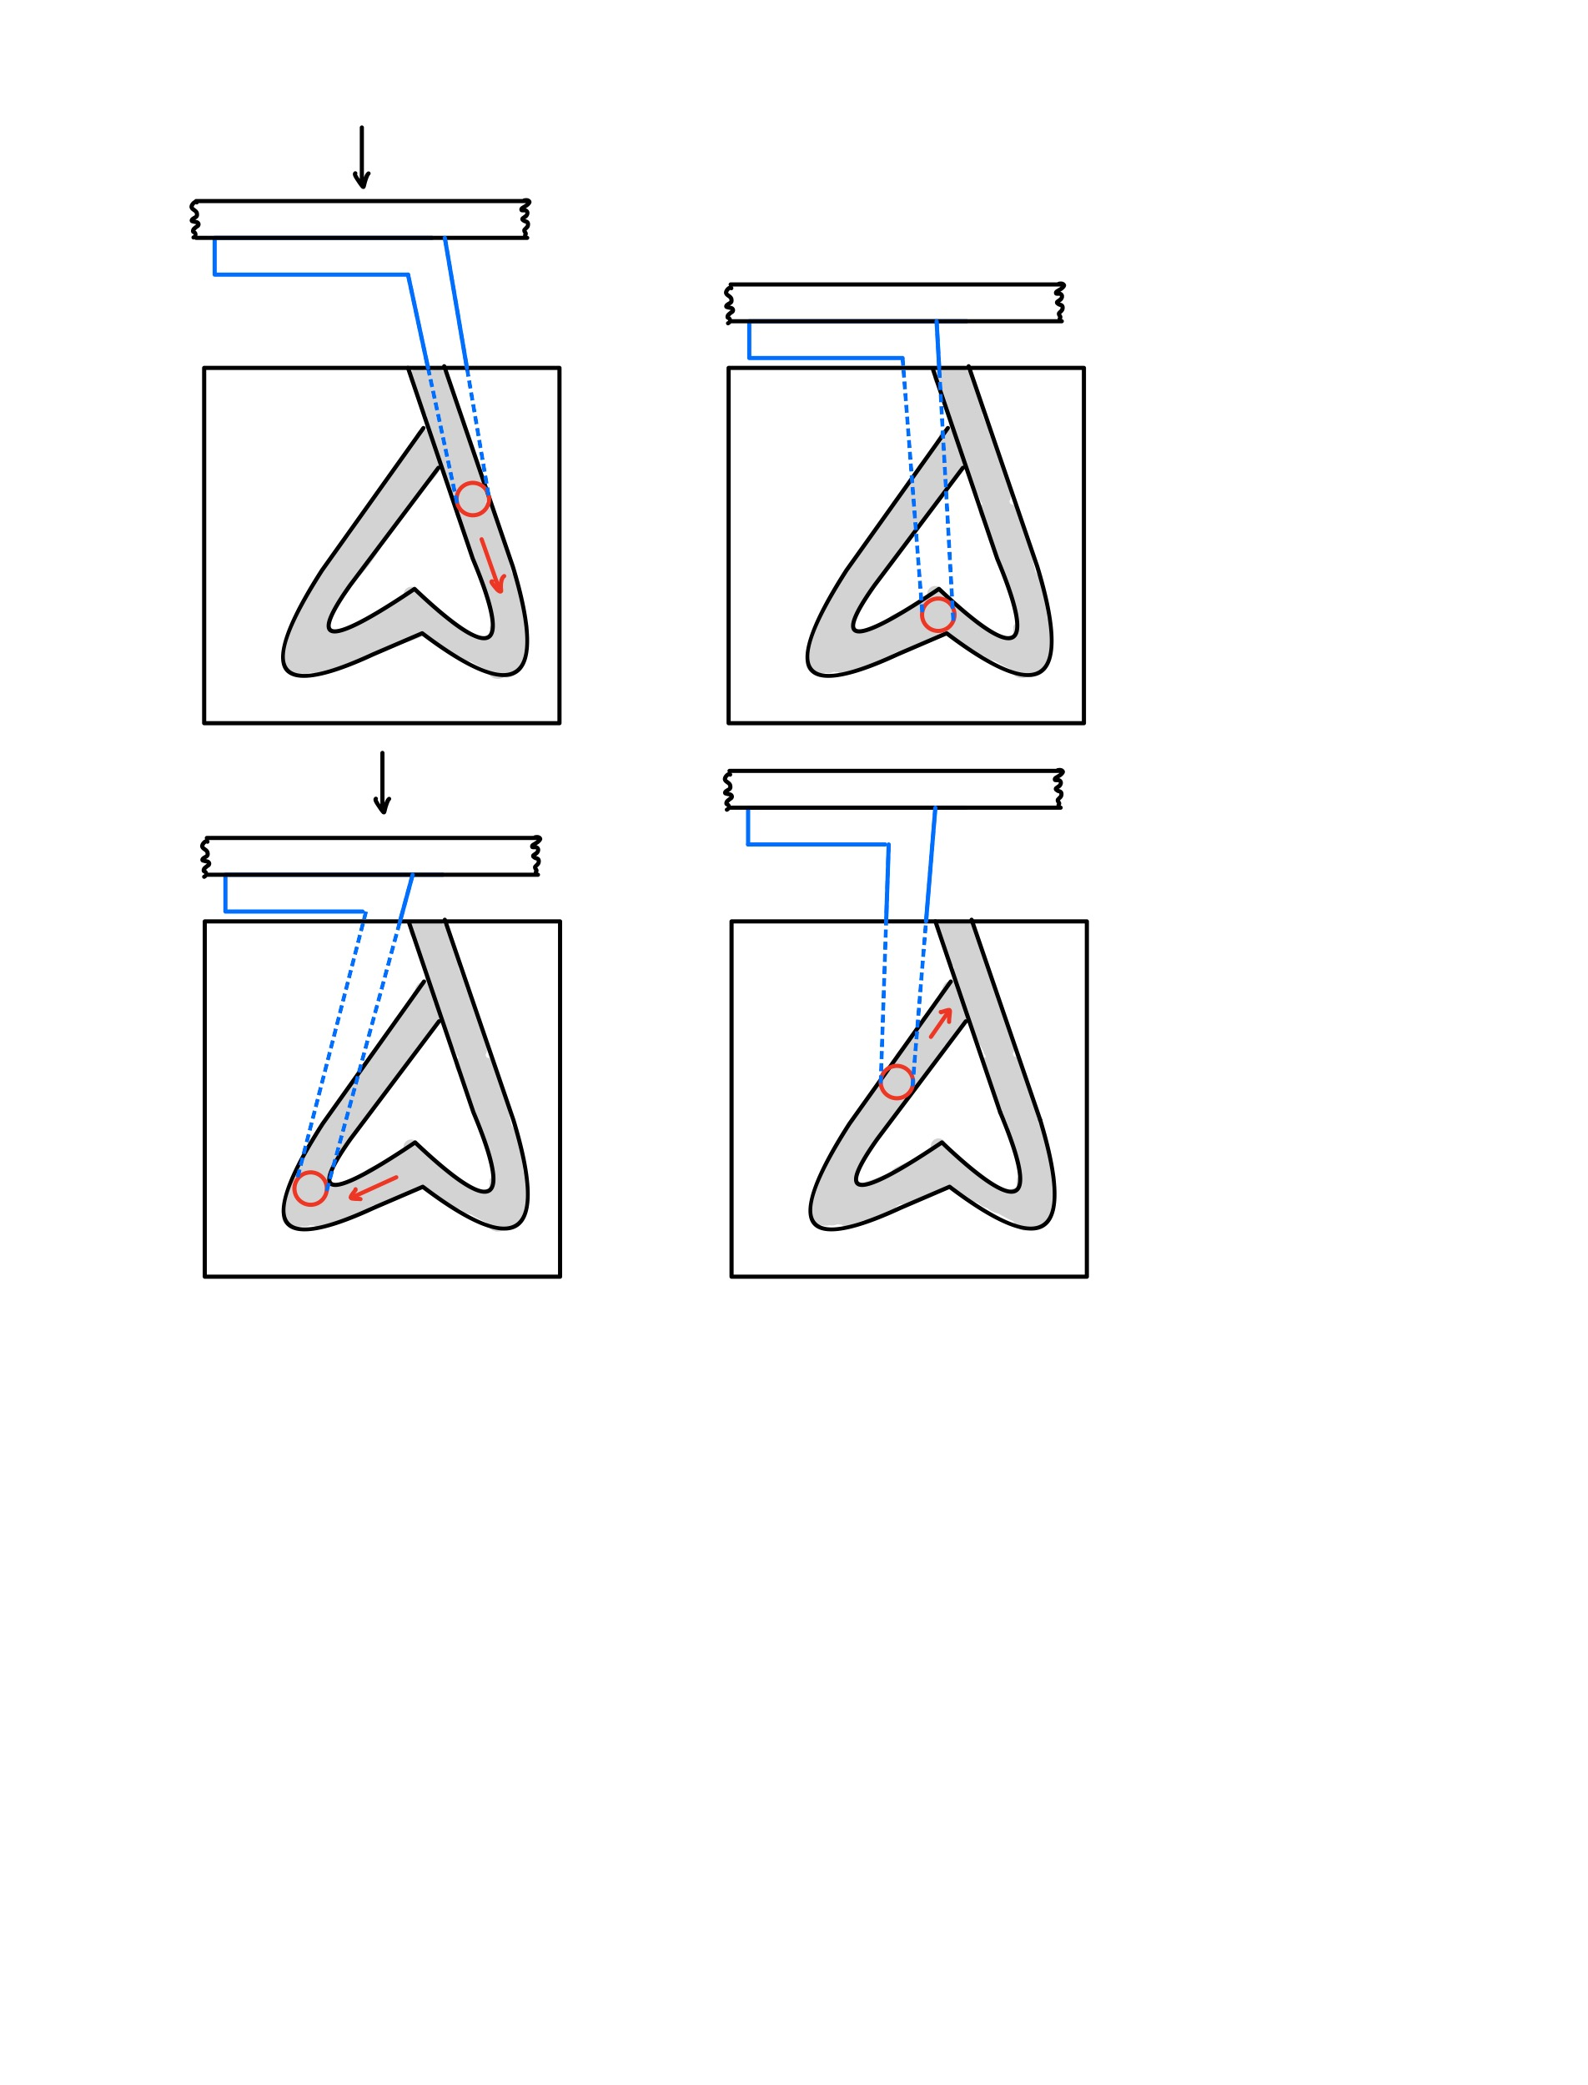
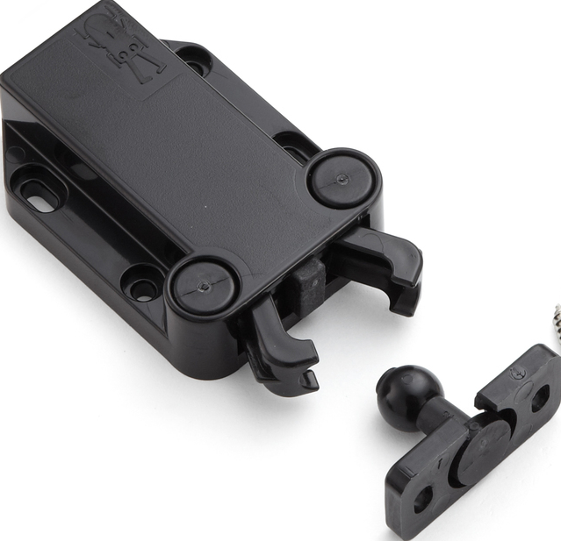
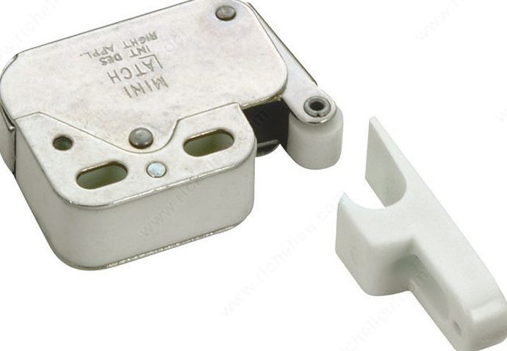
Push Release Mechanism
Inspiration
Concept
1. Button is pressed and hook travels down groove
2. Button is released and hook sits in locked position
Push to open cabinets with touch latches
3. Button is pressed and hook travels down groove
4. Button is pressed and hook travels to unlocked position

Slide 7
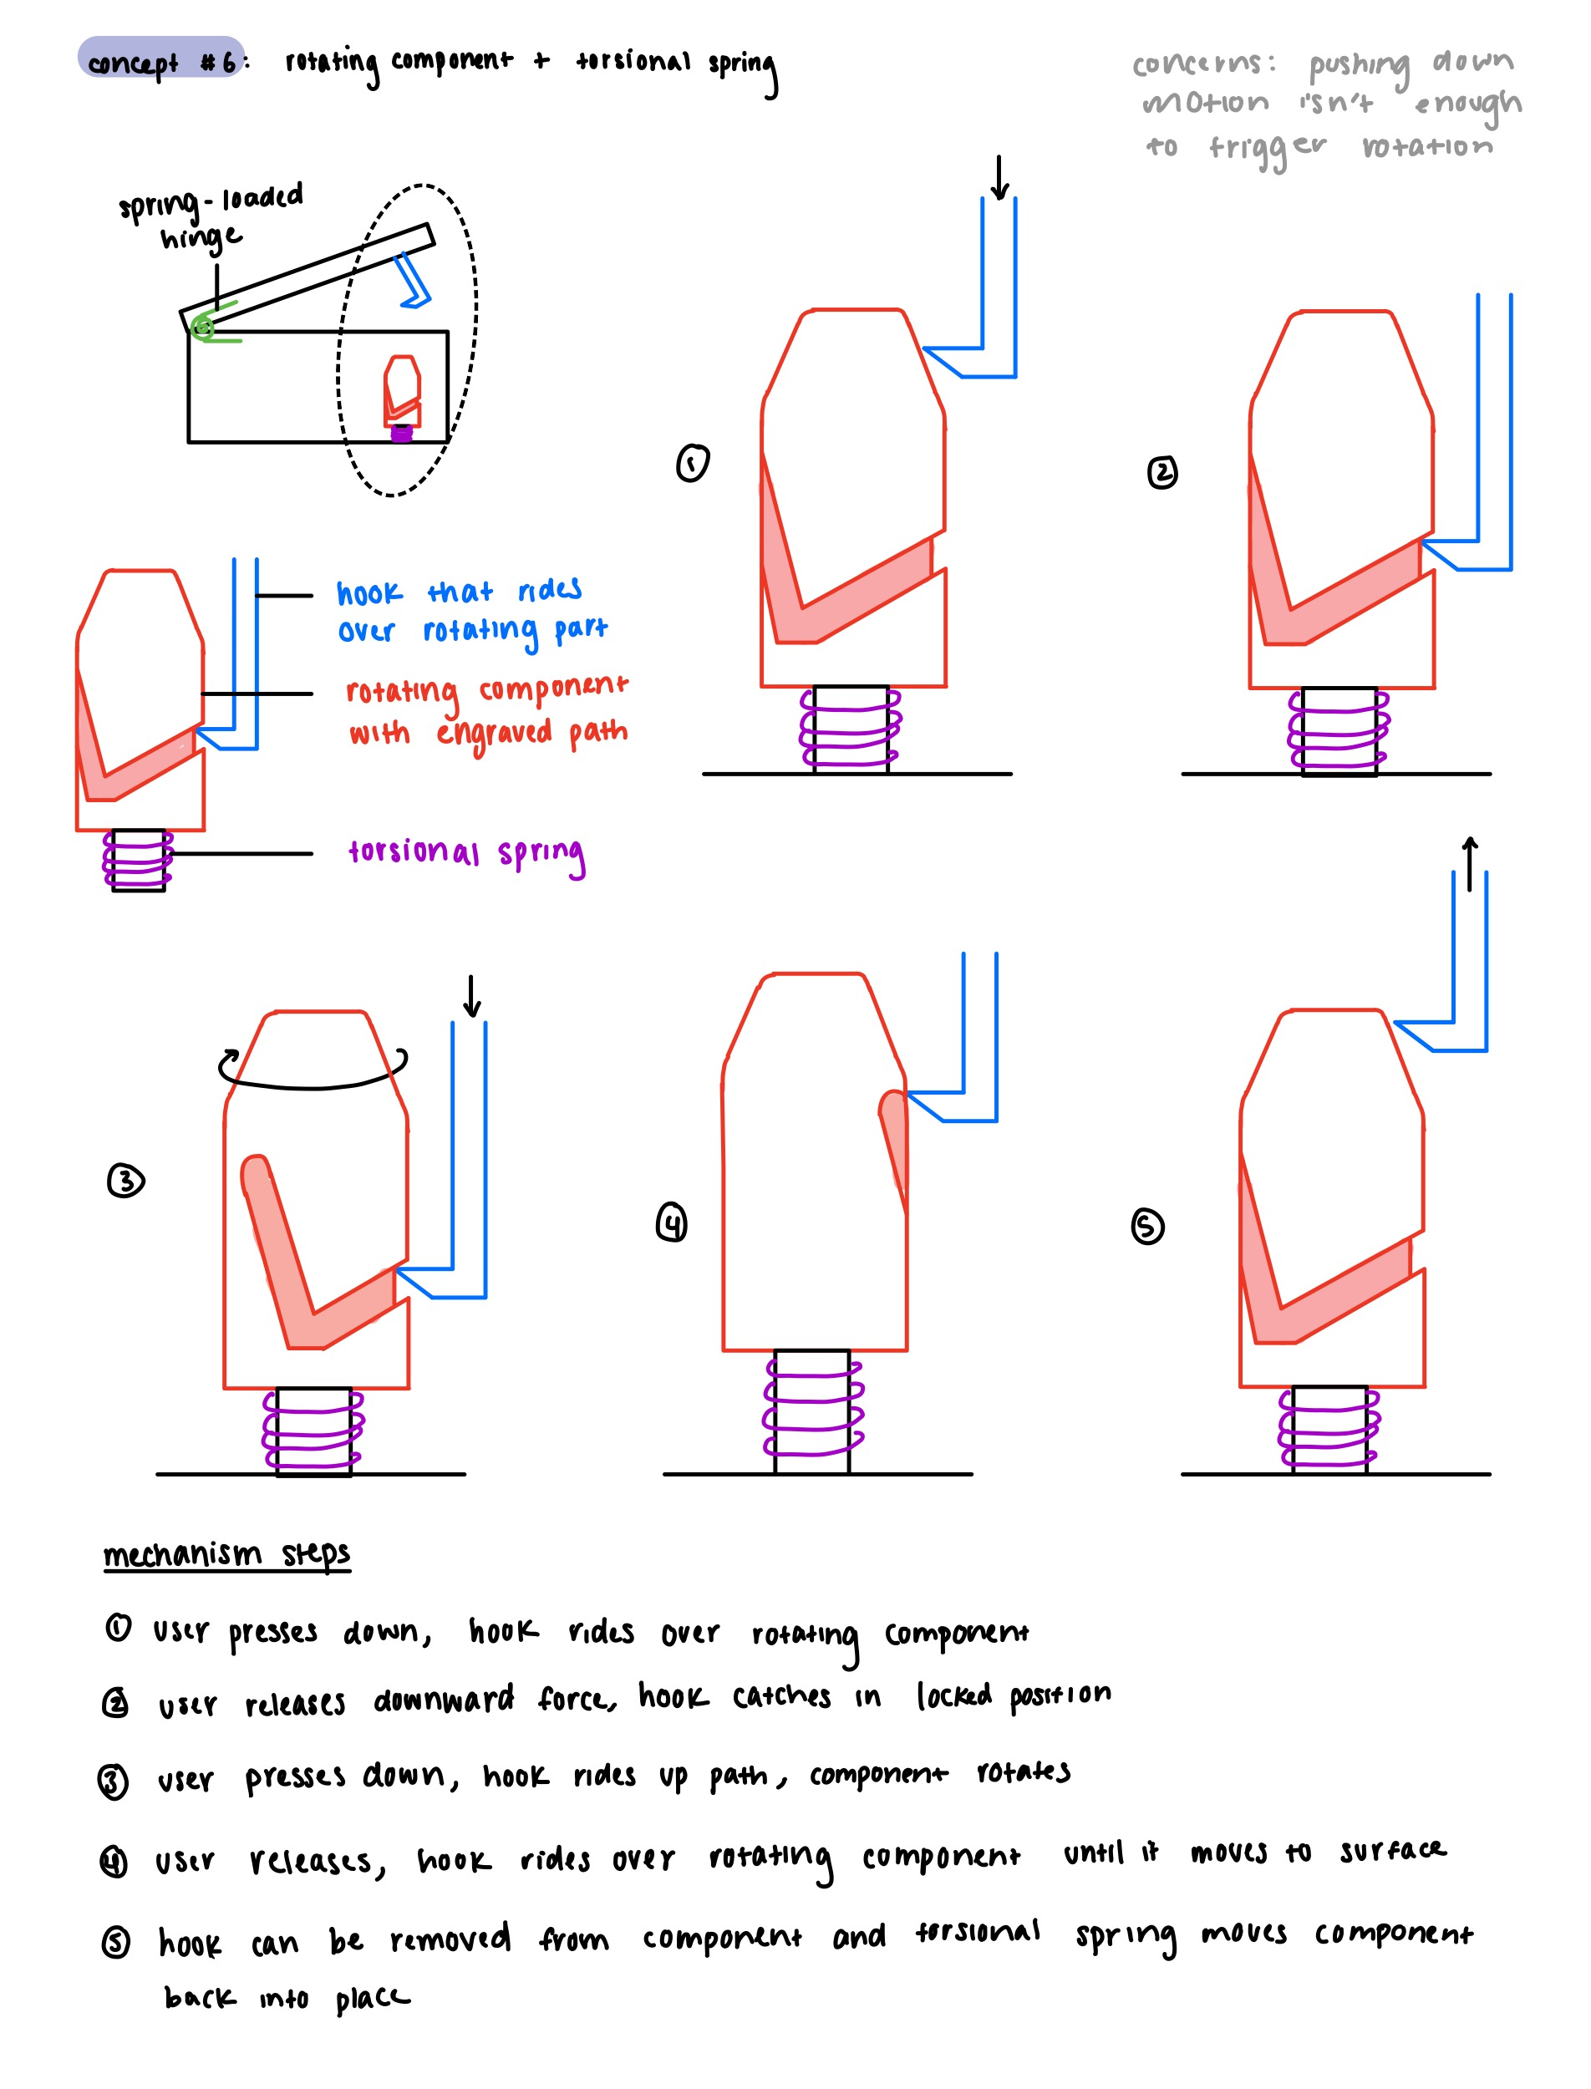

Rotating Body Mechanism
Inspiration
Concept
1. Hook sits in groove of rotating part when locked
2. Button is pressed and hook travels down path
Retractable pens with rotating cam body
3. Button is released and hook travels up path
4. Hook is removed and part rotates to initial position

Slide 8
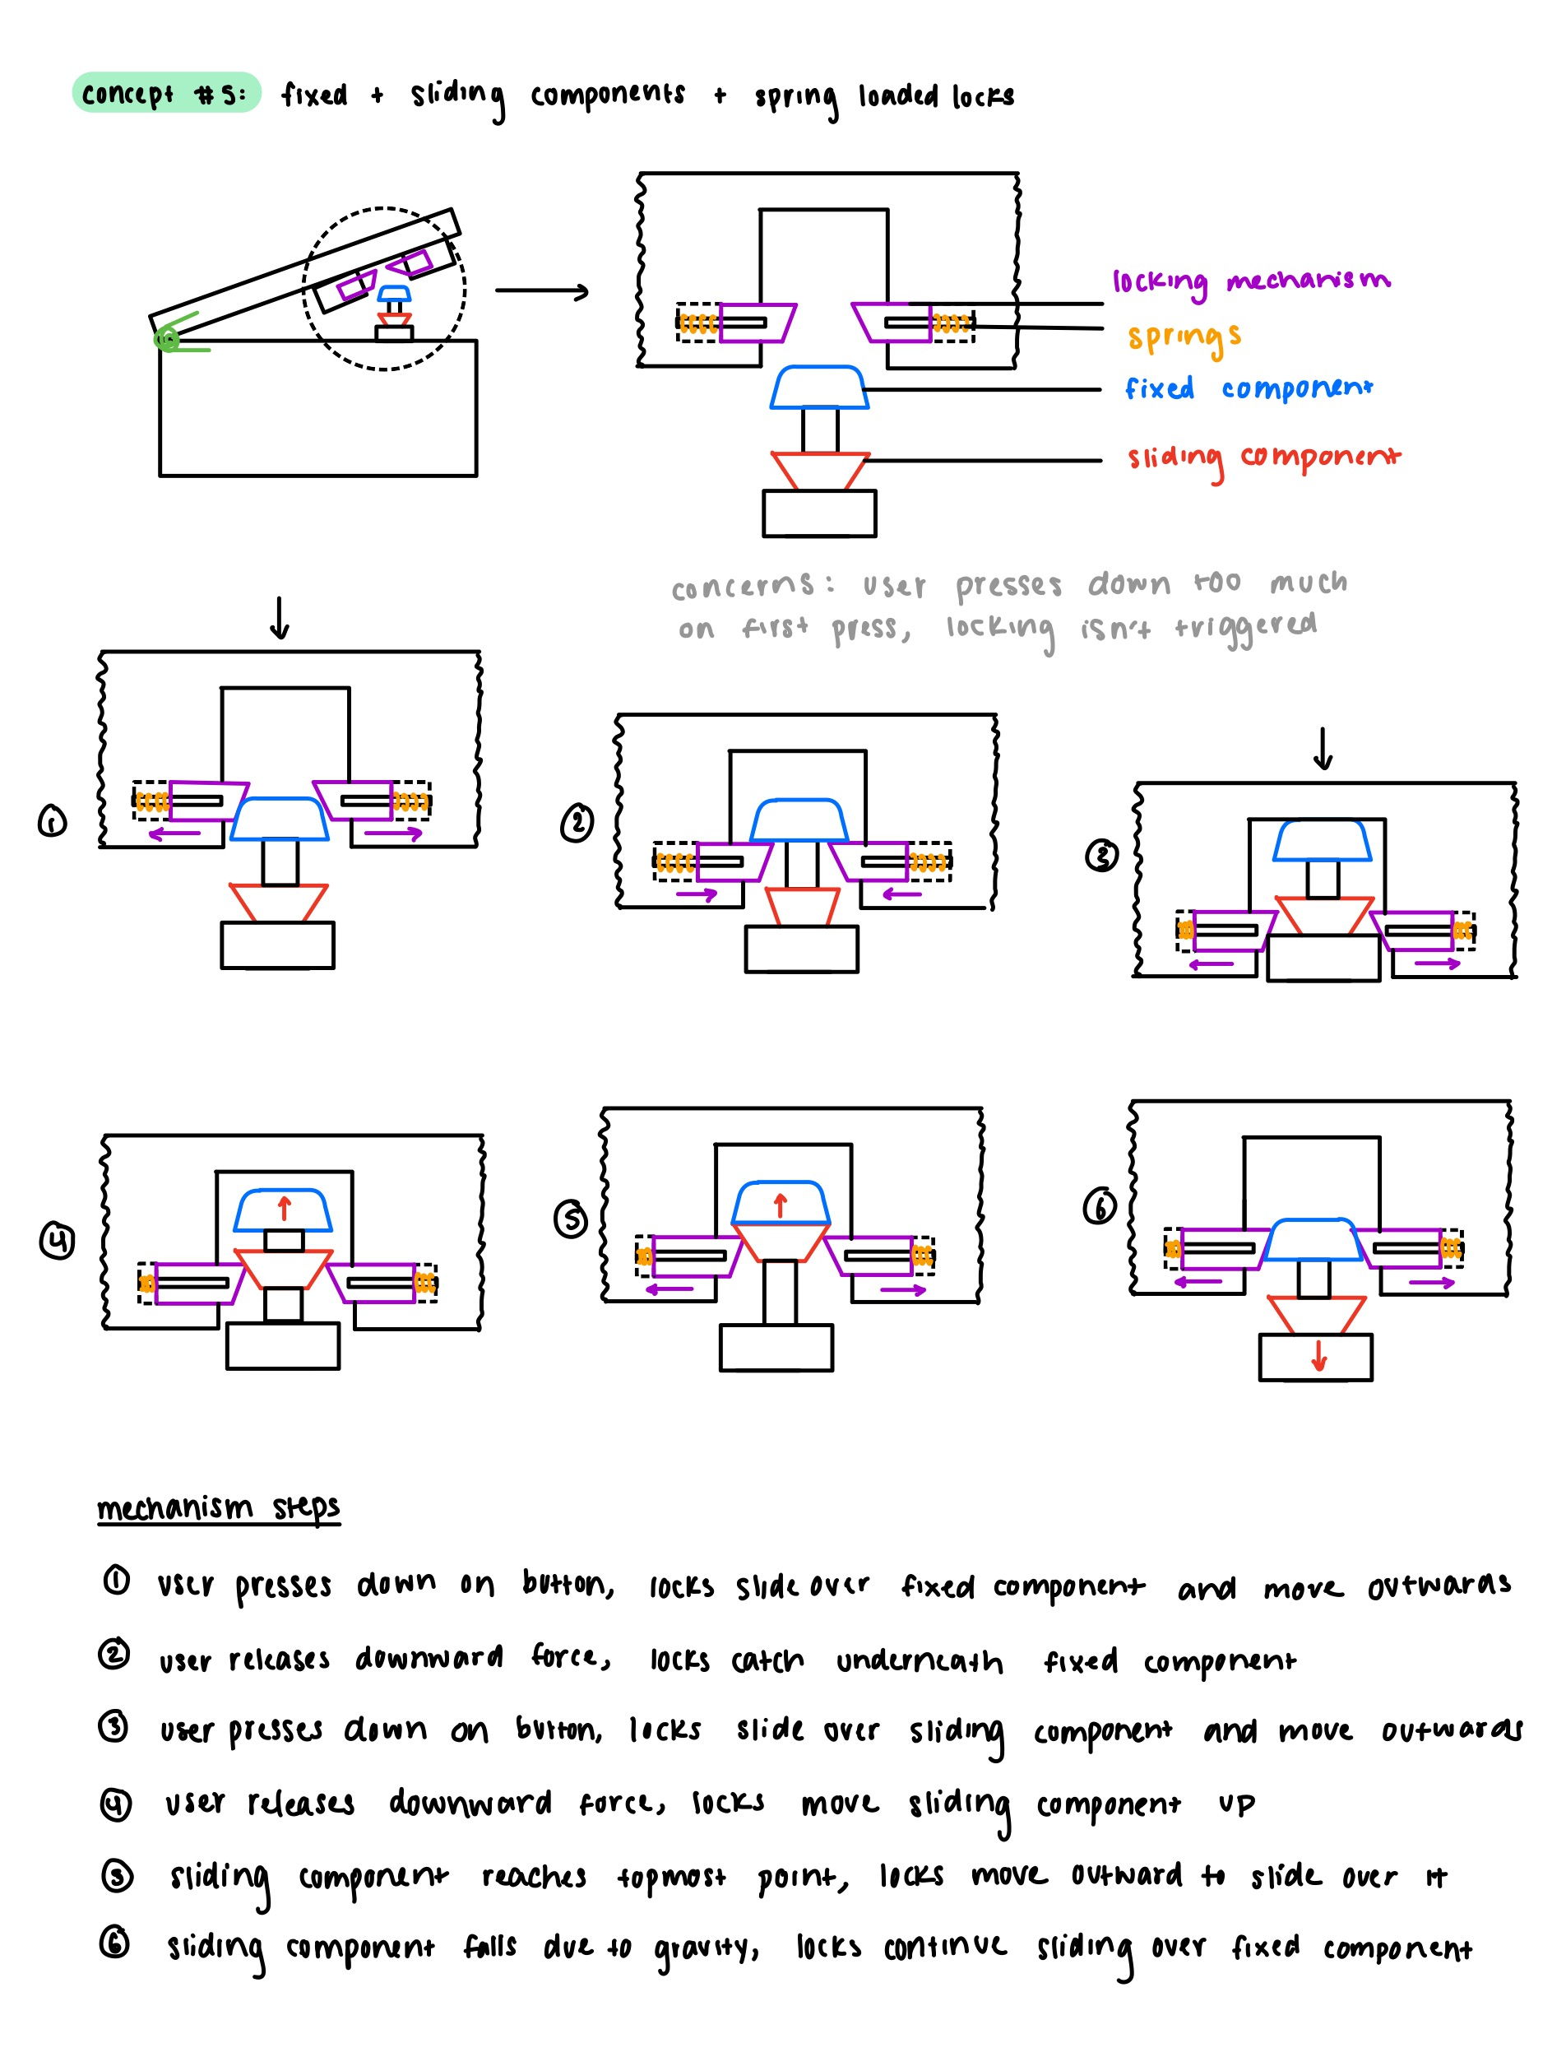
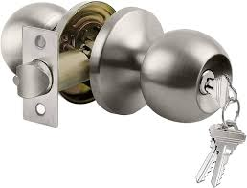
Sliding Latch Mechanism
Inspiration
Concept
1. Button is pressed and latches slide over fixed part
2. Button is released and latches lock in place
Knobs with strike plate and sliding latch
3. Button is pressed and latches slide over sliding part
4. Button is released and latches to unlocked position

Slide 9
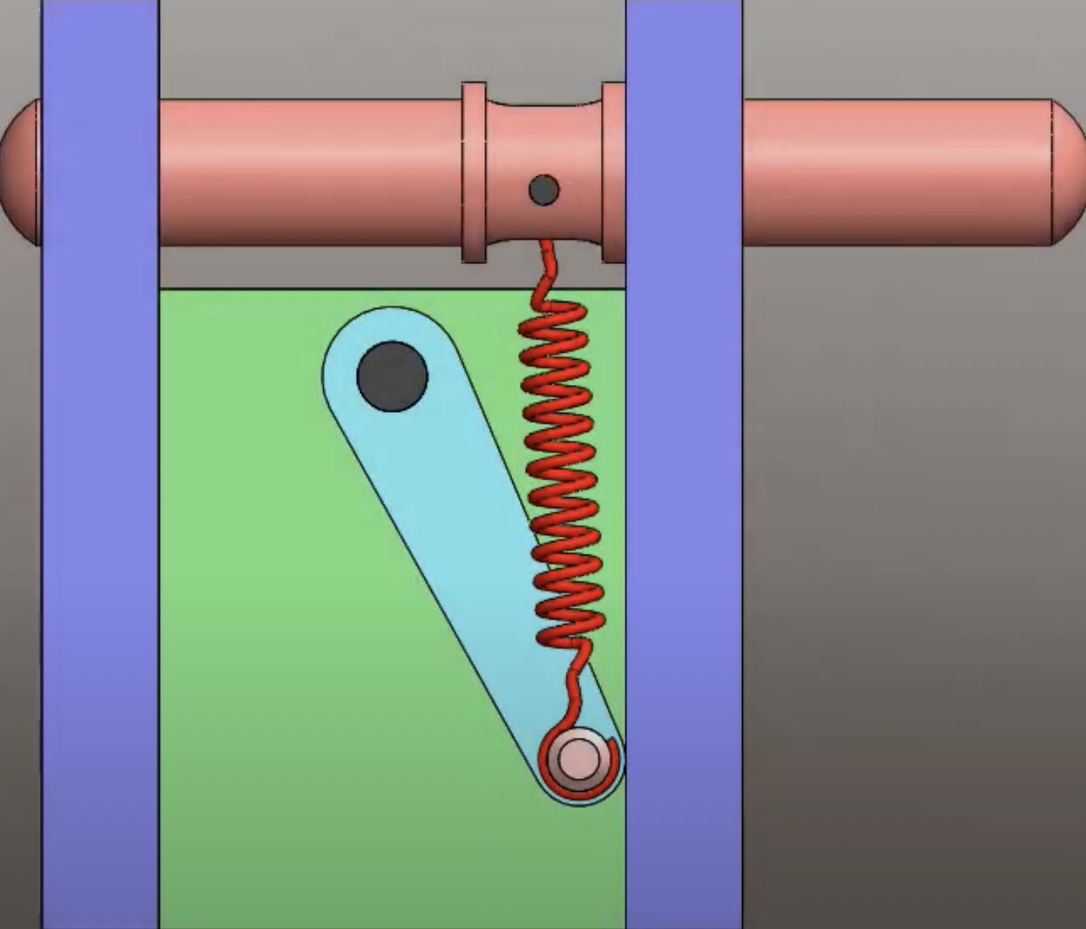
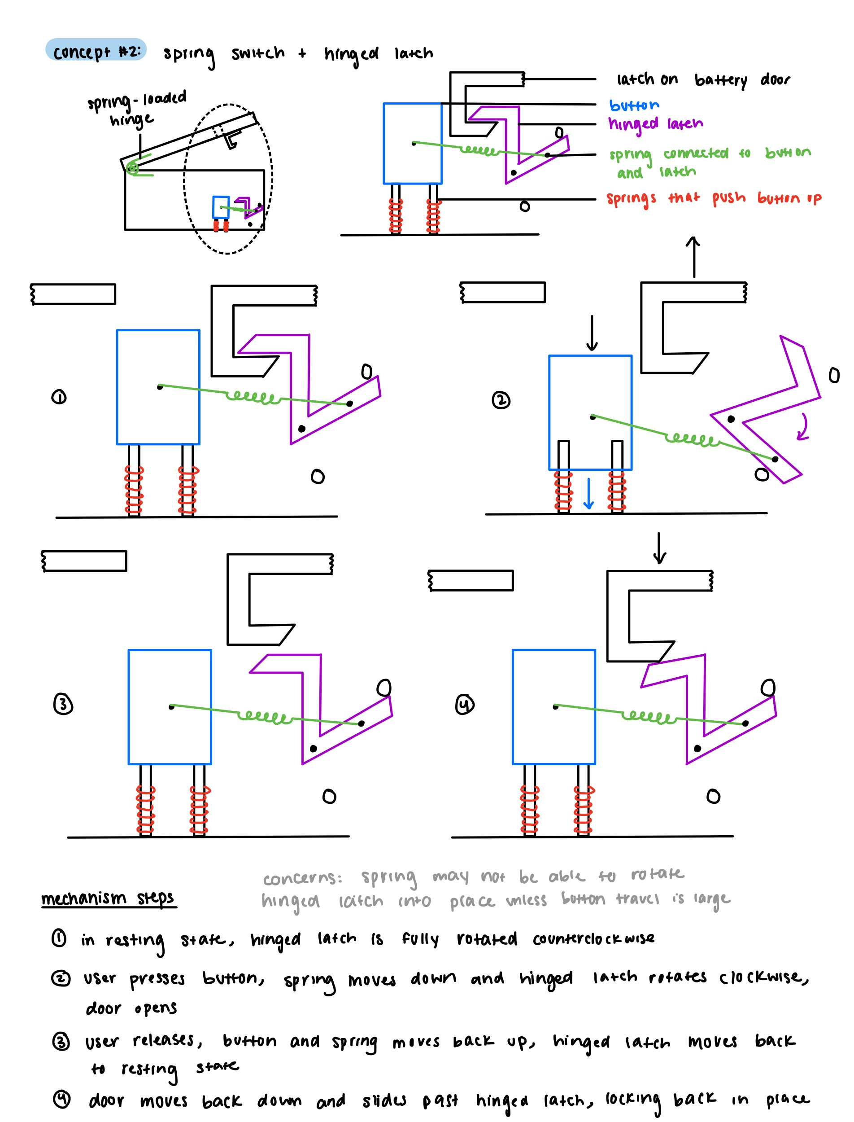
Mechanisms: Flippable Snap Fit
Inspiration
Concept
1. Hinged latch is sitting in locked position
2. Button is pressed and hinged latch flips to unlocked position
Switches with spring toggle mechanism

Slide 10
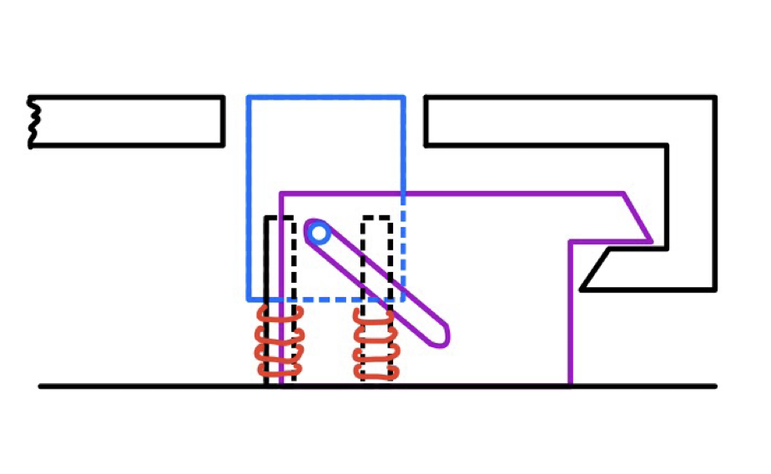
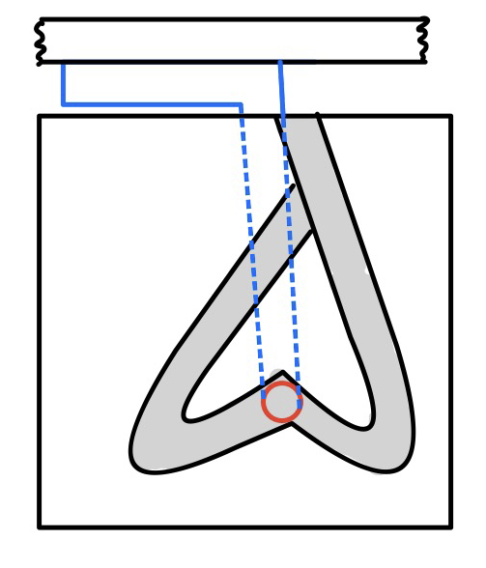
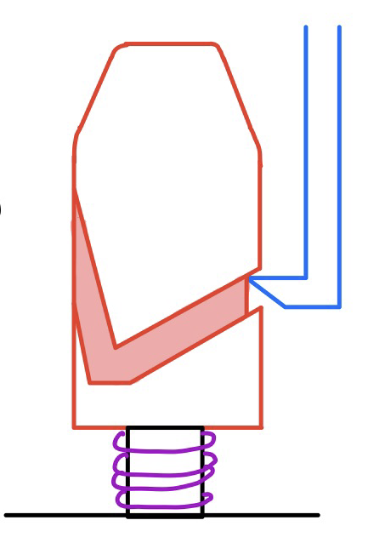
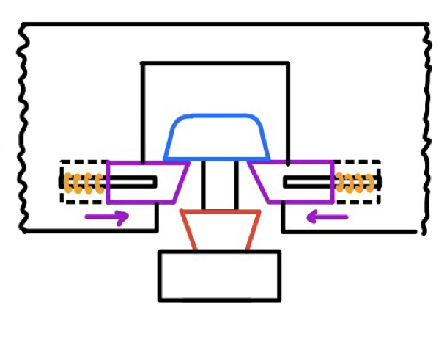
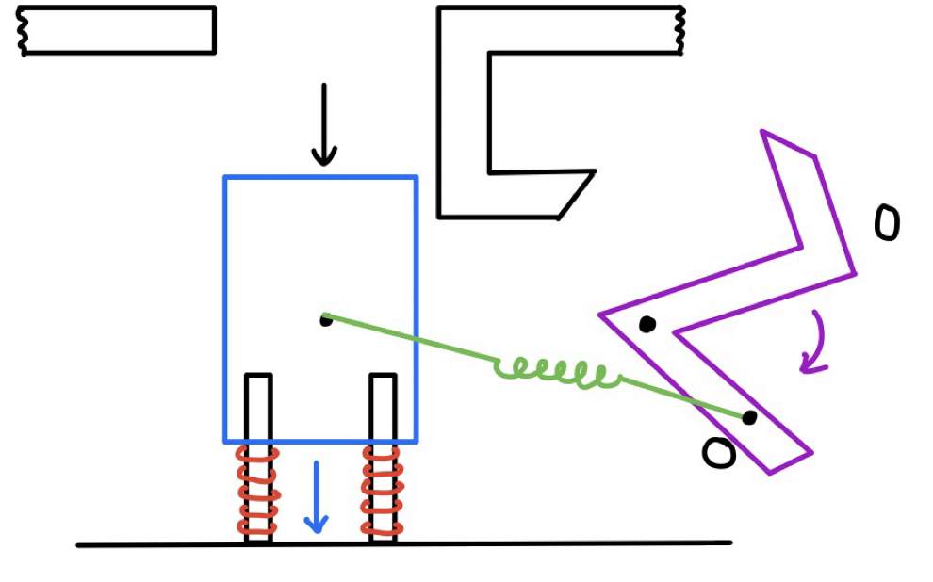
Comparing Mechanisms
Moving Snap Fit | Push Release | Rotating Body | Sliding Latch | Flippable Snap Fit
+ Less sensitive to tolerances + Not easily actuated + Simple components + Less components | + Button exists on door + Not easily actuated + Less components + Compact | + Button exists on door + Not easily actuated + Less components | + Button exists on door + Less sensitive to bending | + Less sensitive to tolerances + Simple components
- Sensitive to bending and wear - Button exists on housing | - Groove may jam - Sensitive to bending in multiple directions - Sensitive to tolerances - Complex components | - Groove may jam - Sensitive to tolerances - Downward hook force may not trigger rotation - Requires more space - Complex components | - Sensitive to tolerances - User may push down too far during locking - More components - Requires more space - Complex components | - Sensitive to bending and wear - May not actuate if button travel is small - Button exists on housing - More components

Slide 11
Comparing Mechanisms
Moving Snap Fit | Push Release | Rotating Body | Sliding Latch
+ Less sensitive to tolerances + Not easily actuated + Simple components + Less components | + Button exists on door + Not easily actuated + Less components + Compact | + Button exists on door + Not easily actuated + Less components | + Button exists on door + Less sensitive to bending
- Sensitive to bending and wear - Button exists on housing (user must put finger through door) | - Groove may jam - Sensitive to bending in multiple directions - Sensitive to tolerances - Complex components | - Groove may jam - Sensitive to tolerances - Downward hook force may not trigger rotation - Requires more space - Complex components | - Sensitive to tolerances - User may push down too far during locking - More components - Requires more space - Complex components

Slide 12
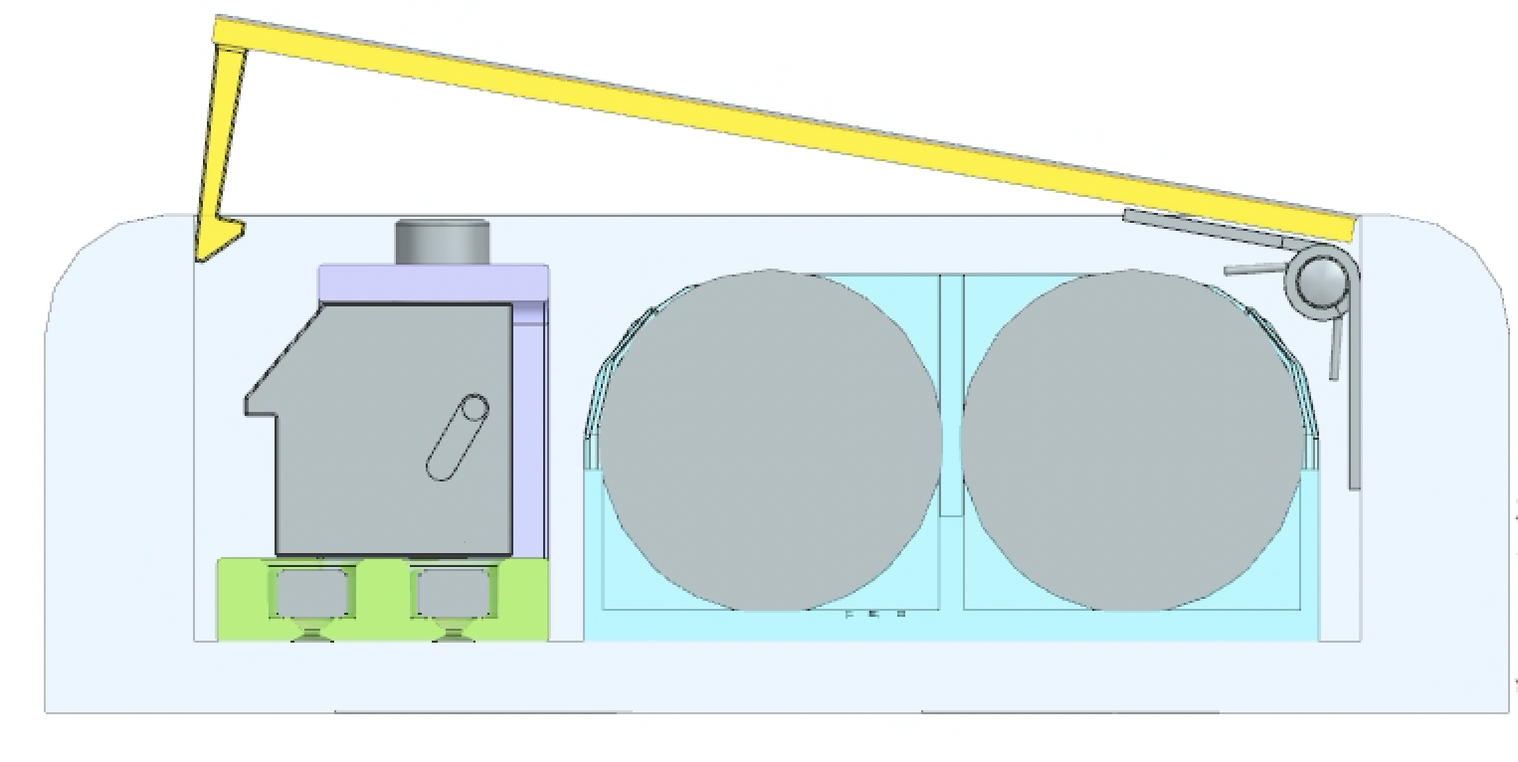
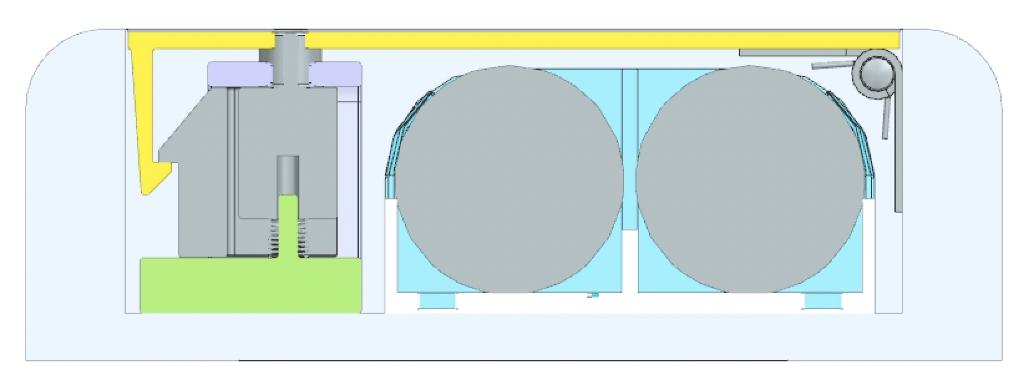
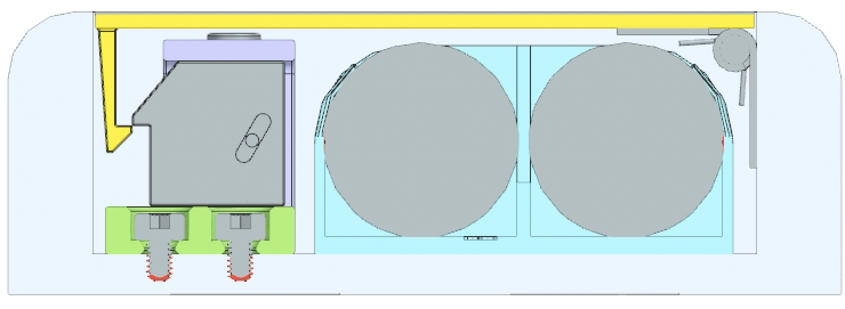
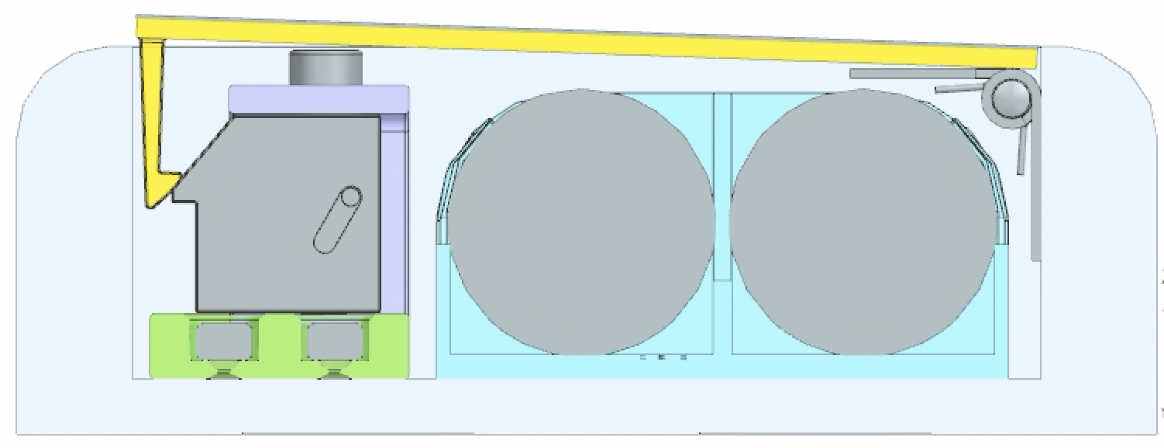
Sliding Snap Fit Design
1. User presses down on the button, which is constrained by the chassis and pushed upward by the springs.
3. Downward force applied by latch to door is removed and spring loaded hinges cause door to pop open.
2. Button moves down and pegs apply a force to the latch slot, causing the latch to slide away from the door.
4. After replacing batteries, user applies a downward force to the door, engaging the snap fit mechanism.

Slide 13
Sliding Snap Fit Bill of Materials
* Remaining components assumed out-of-scope
Component | Quantity | Material | Manufacturing | Mass (g) | Cost per Unit ($) | Total Cost ($)
Top Chassis | 1 | ABS | Injection Molding | 6.9 | $0.35 | $0.35
Button | 1 | Aluminum 6061-T6 | Die Casting | 3.6 | $0.10 | $0.10
Latch | 1 | ABS | Injection Molding | 4.6 | $0.25 | $0.25
Springs | 2 | (Purchased) | (Purchased) | (Purchased) | $0.10 | $0.20
Screws | 4 | (Purchased) | (Purchased) | (Purchased) | $0.10 | $0.40
Bottom Chassis | 1 | ABS | Injection Molding | 8.6 | $0.45 | $0.45
Spring Loaded Hinge | 2 | (Purchased) | (Purchased) | (Purchased) | $0.10 | $0.20
Door | 1 | ABS | Injection Molding | 24.4 | $1.20 | $1.20
Door Cover | 1 | Aluminum 6061-T6 | Stamping | 4.7 | $0.15 | $0.15
 |  |  |  |  | Total | $3.30

Slide 14
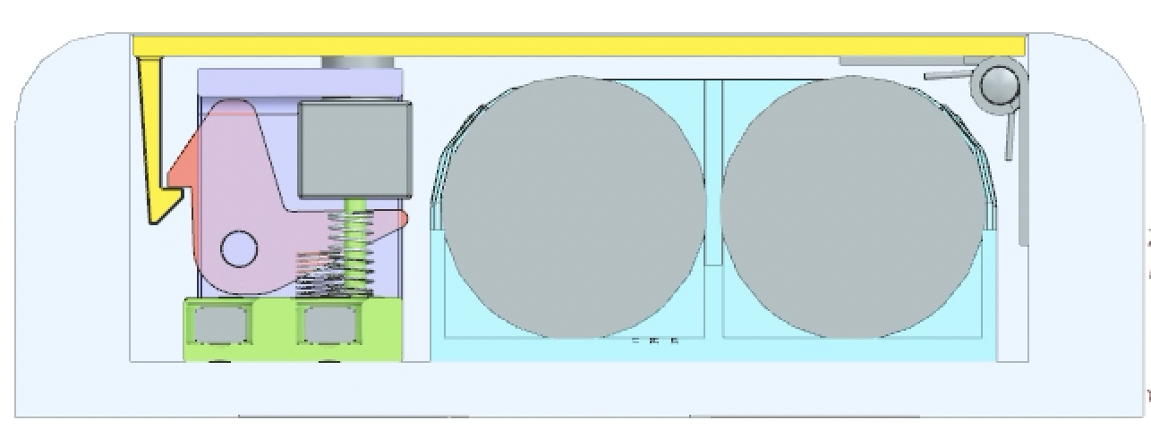
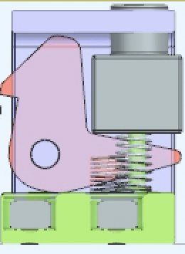
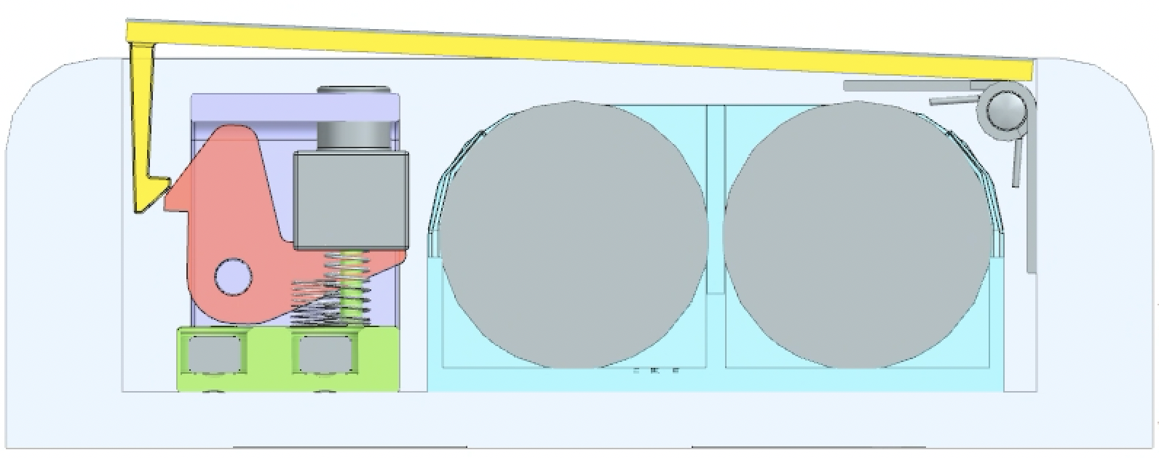
Rotating Snap Fit Design
1. User presses down on the button, which is constrained by the top chassis and pushed upward by the springs.
3. Downward force applied by latch to door is removed and spring loaded hinges cause door to pop open.
2. Button moves down and applies a force to the tail of the latch, causing it to rotate about the peg.
4. After replacing batteries, user applies a downward force to the door, engaging the snap fit mechanism.

Slide 15
Rotating Snap Fit Bill of Materials
* Remaining components assumed out-of-scope
Component | Quantity | Material | Manufacturing | Mass (g) | Cost per Unit ($) | Total Cost ($)
Top Chassis | 1 | ABS | Injection Molding | 8.5 | $0.45 | $0.45
Button | 1 | Aluminum 6061-T6 | Die Casting | 3.8 | $0.10 | $0.10
Latch | 1 | ABS | Injection Molding | 2.4 | $0.15 | $0.15
Springs | 2 | (Purchased) | (Purchased) | (Purchased) | $0.10 | $0.20
Screws | 4 | (Purchased) | (Purchased) | (Purchased) | $0.10 | $0.40
Bottom Chassis | 1 | ABS | Injection Molding | 7.3 | $0.35 | $0.35
Spring Loaded Hinge | 2 | (Purchased) | (Purchased) | (Purchased) | $0.10 | $0.20
Door | 1 | ABS | Injection Molding | $1.20 | $1.20 | $1.20
Door Cover | 1 | Aluminum 6061-T6 | Stamping | $0.15 | $0.15 | $0.15
 |  |  |  |  | Total | $3.20

Slide 16
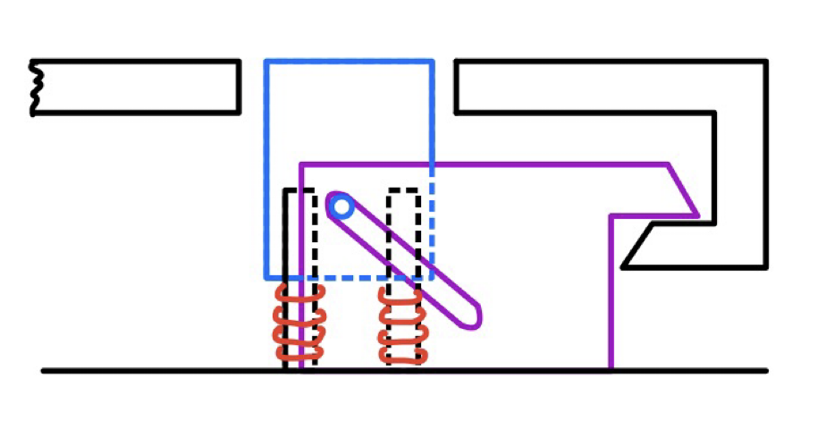
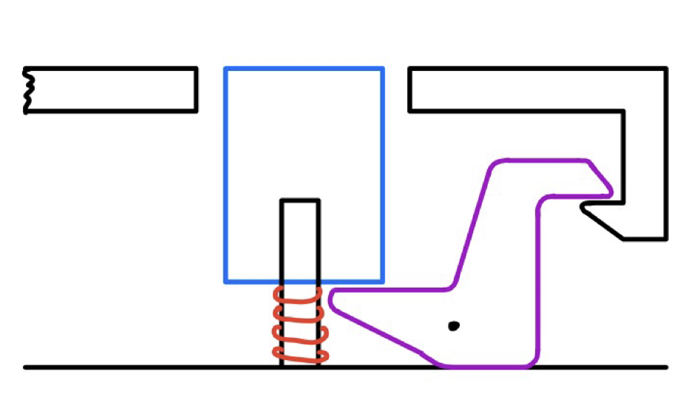
Decision Matrix
 |  | Design 1: Sliding Snap Fit |  | Design 2: Rotating Snap fit
Criterion | Weight | Rating | Weighted Score | Rating | Weighted Score
Effectiveness | 5 | 4 | 20 | 3 | 15
User Experience | 4 | 4 | 16 | 3 | 12
Manufacturability | 4 | 3 | 12 | 3 | 12
Ease of Assembly | 4 | 3 | 12 | 3 | 12
Compactness | 4 | 3 | 12 | 4 | 16
Cost | 3 | 3 | 9 | 4 | 12
Total Score |  |  | 81 |  | 79

Slide 17
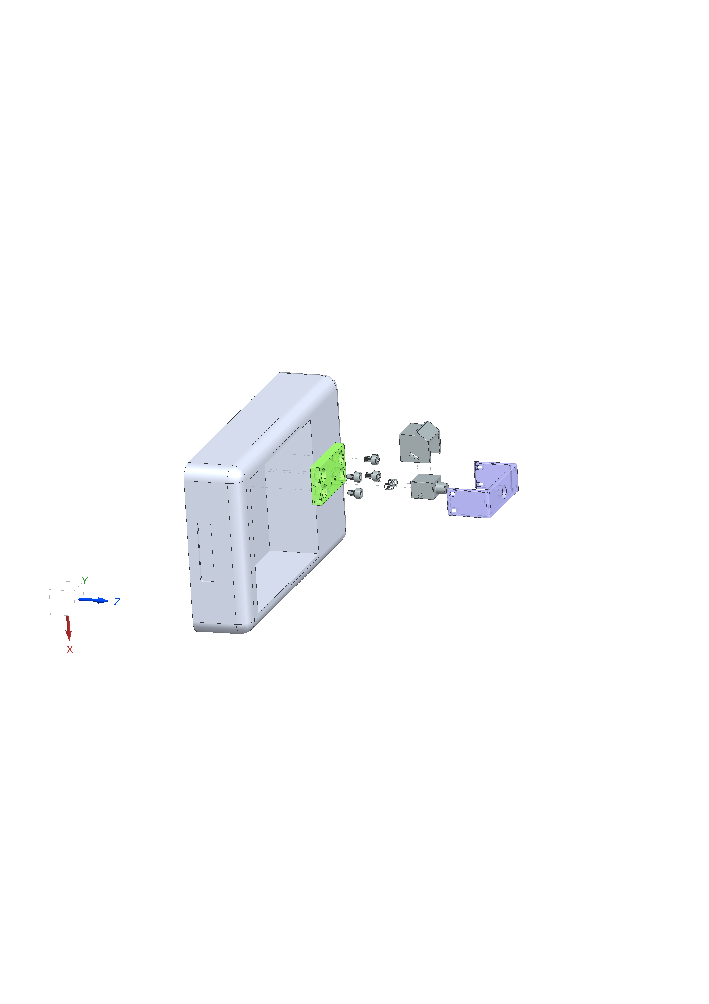
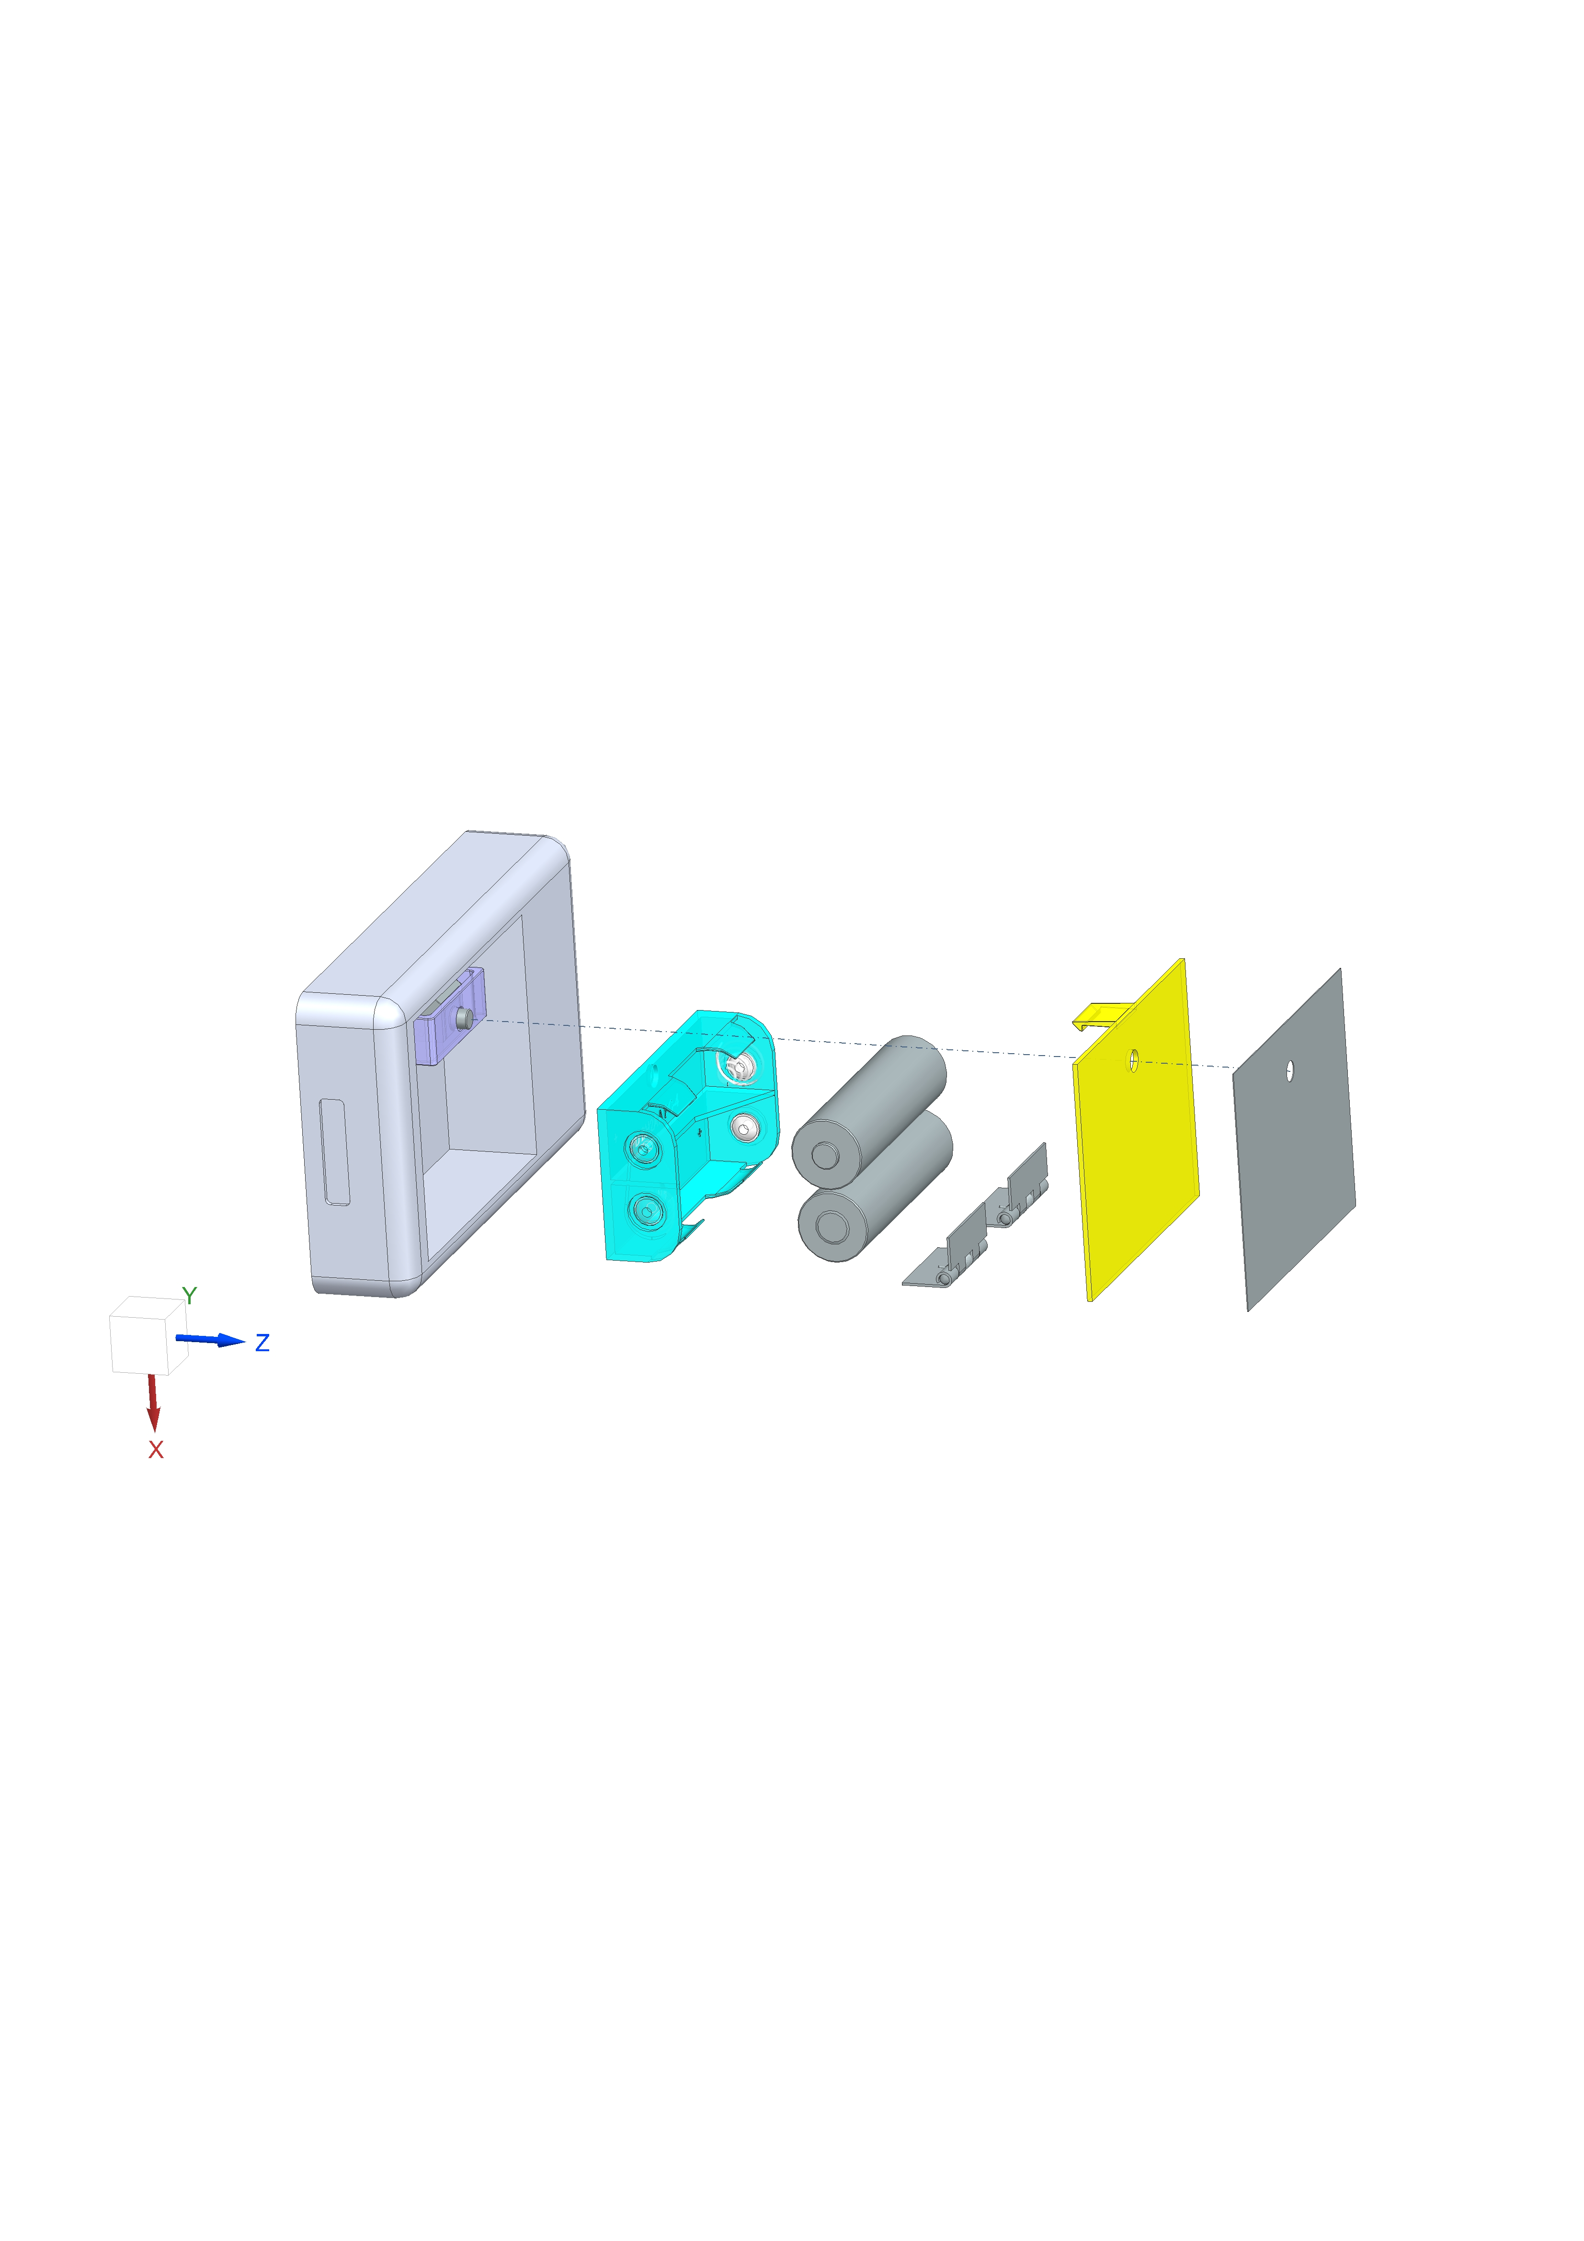
Sliding Snap Fit Components and Assembly
Procedure
Door Cover
Bottom chassis is fixed to housing via screws
Button is assembled into latch so that button pegs will slide along latch slots
Springs placed onto bottom chassis posts
Latch and button assembly positioned over bottom chassis posts
Top chassis secured to bottom chassis via snap fit features
Battery holder fixed to housing (assumed out-of-scope)
Door cover secured to door via adhesive
Hinges assembled to door and housing via adhesive or screws
Top Chassis
7
Door
Button
Latch
8
Spring
Loaded Hinge
Springs
Screws
AA Battery
Bottom Chassis
6
Battery Holder

Slide 18
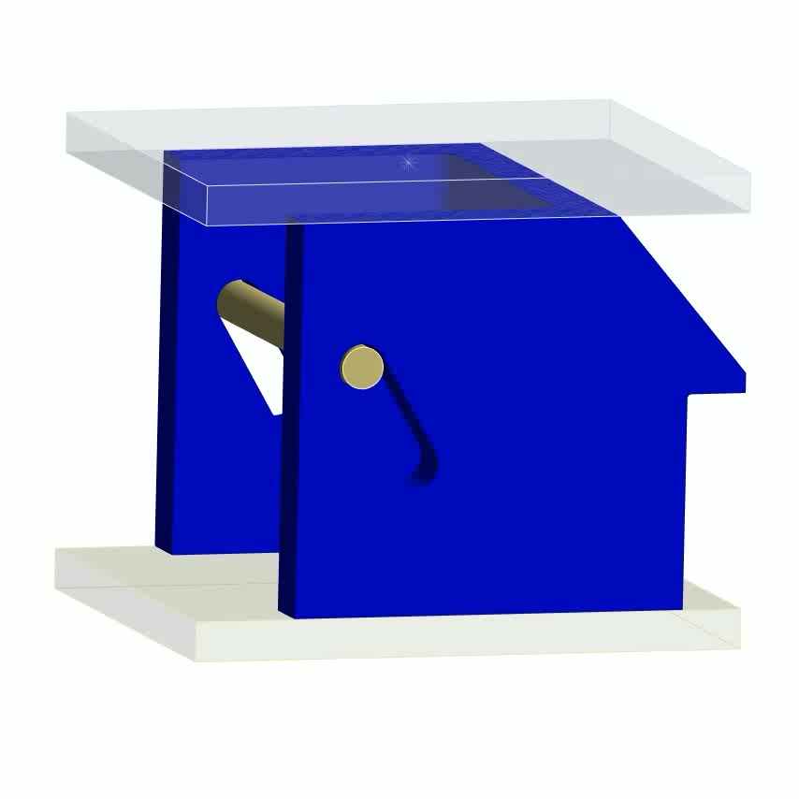
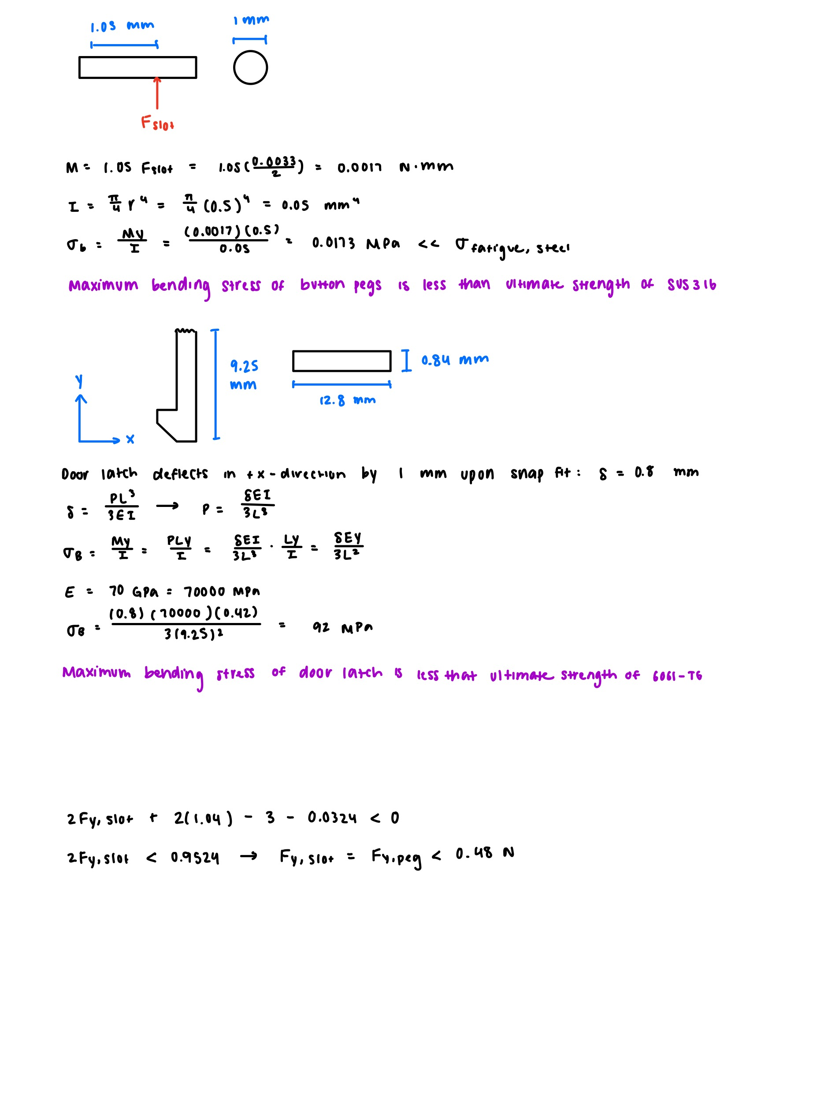
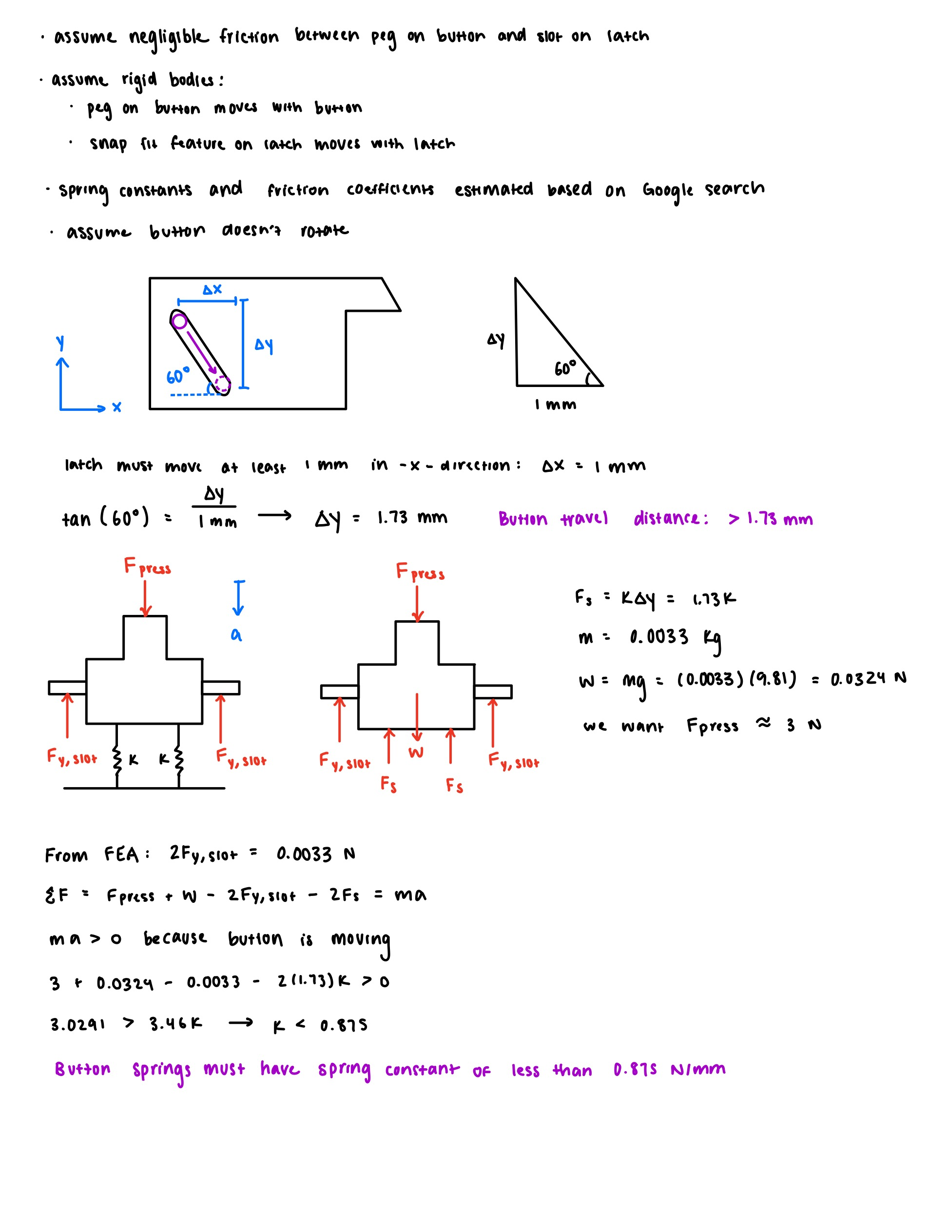
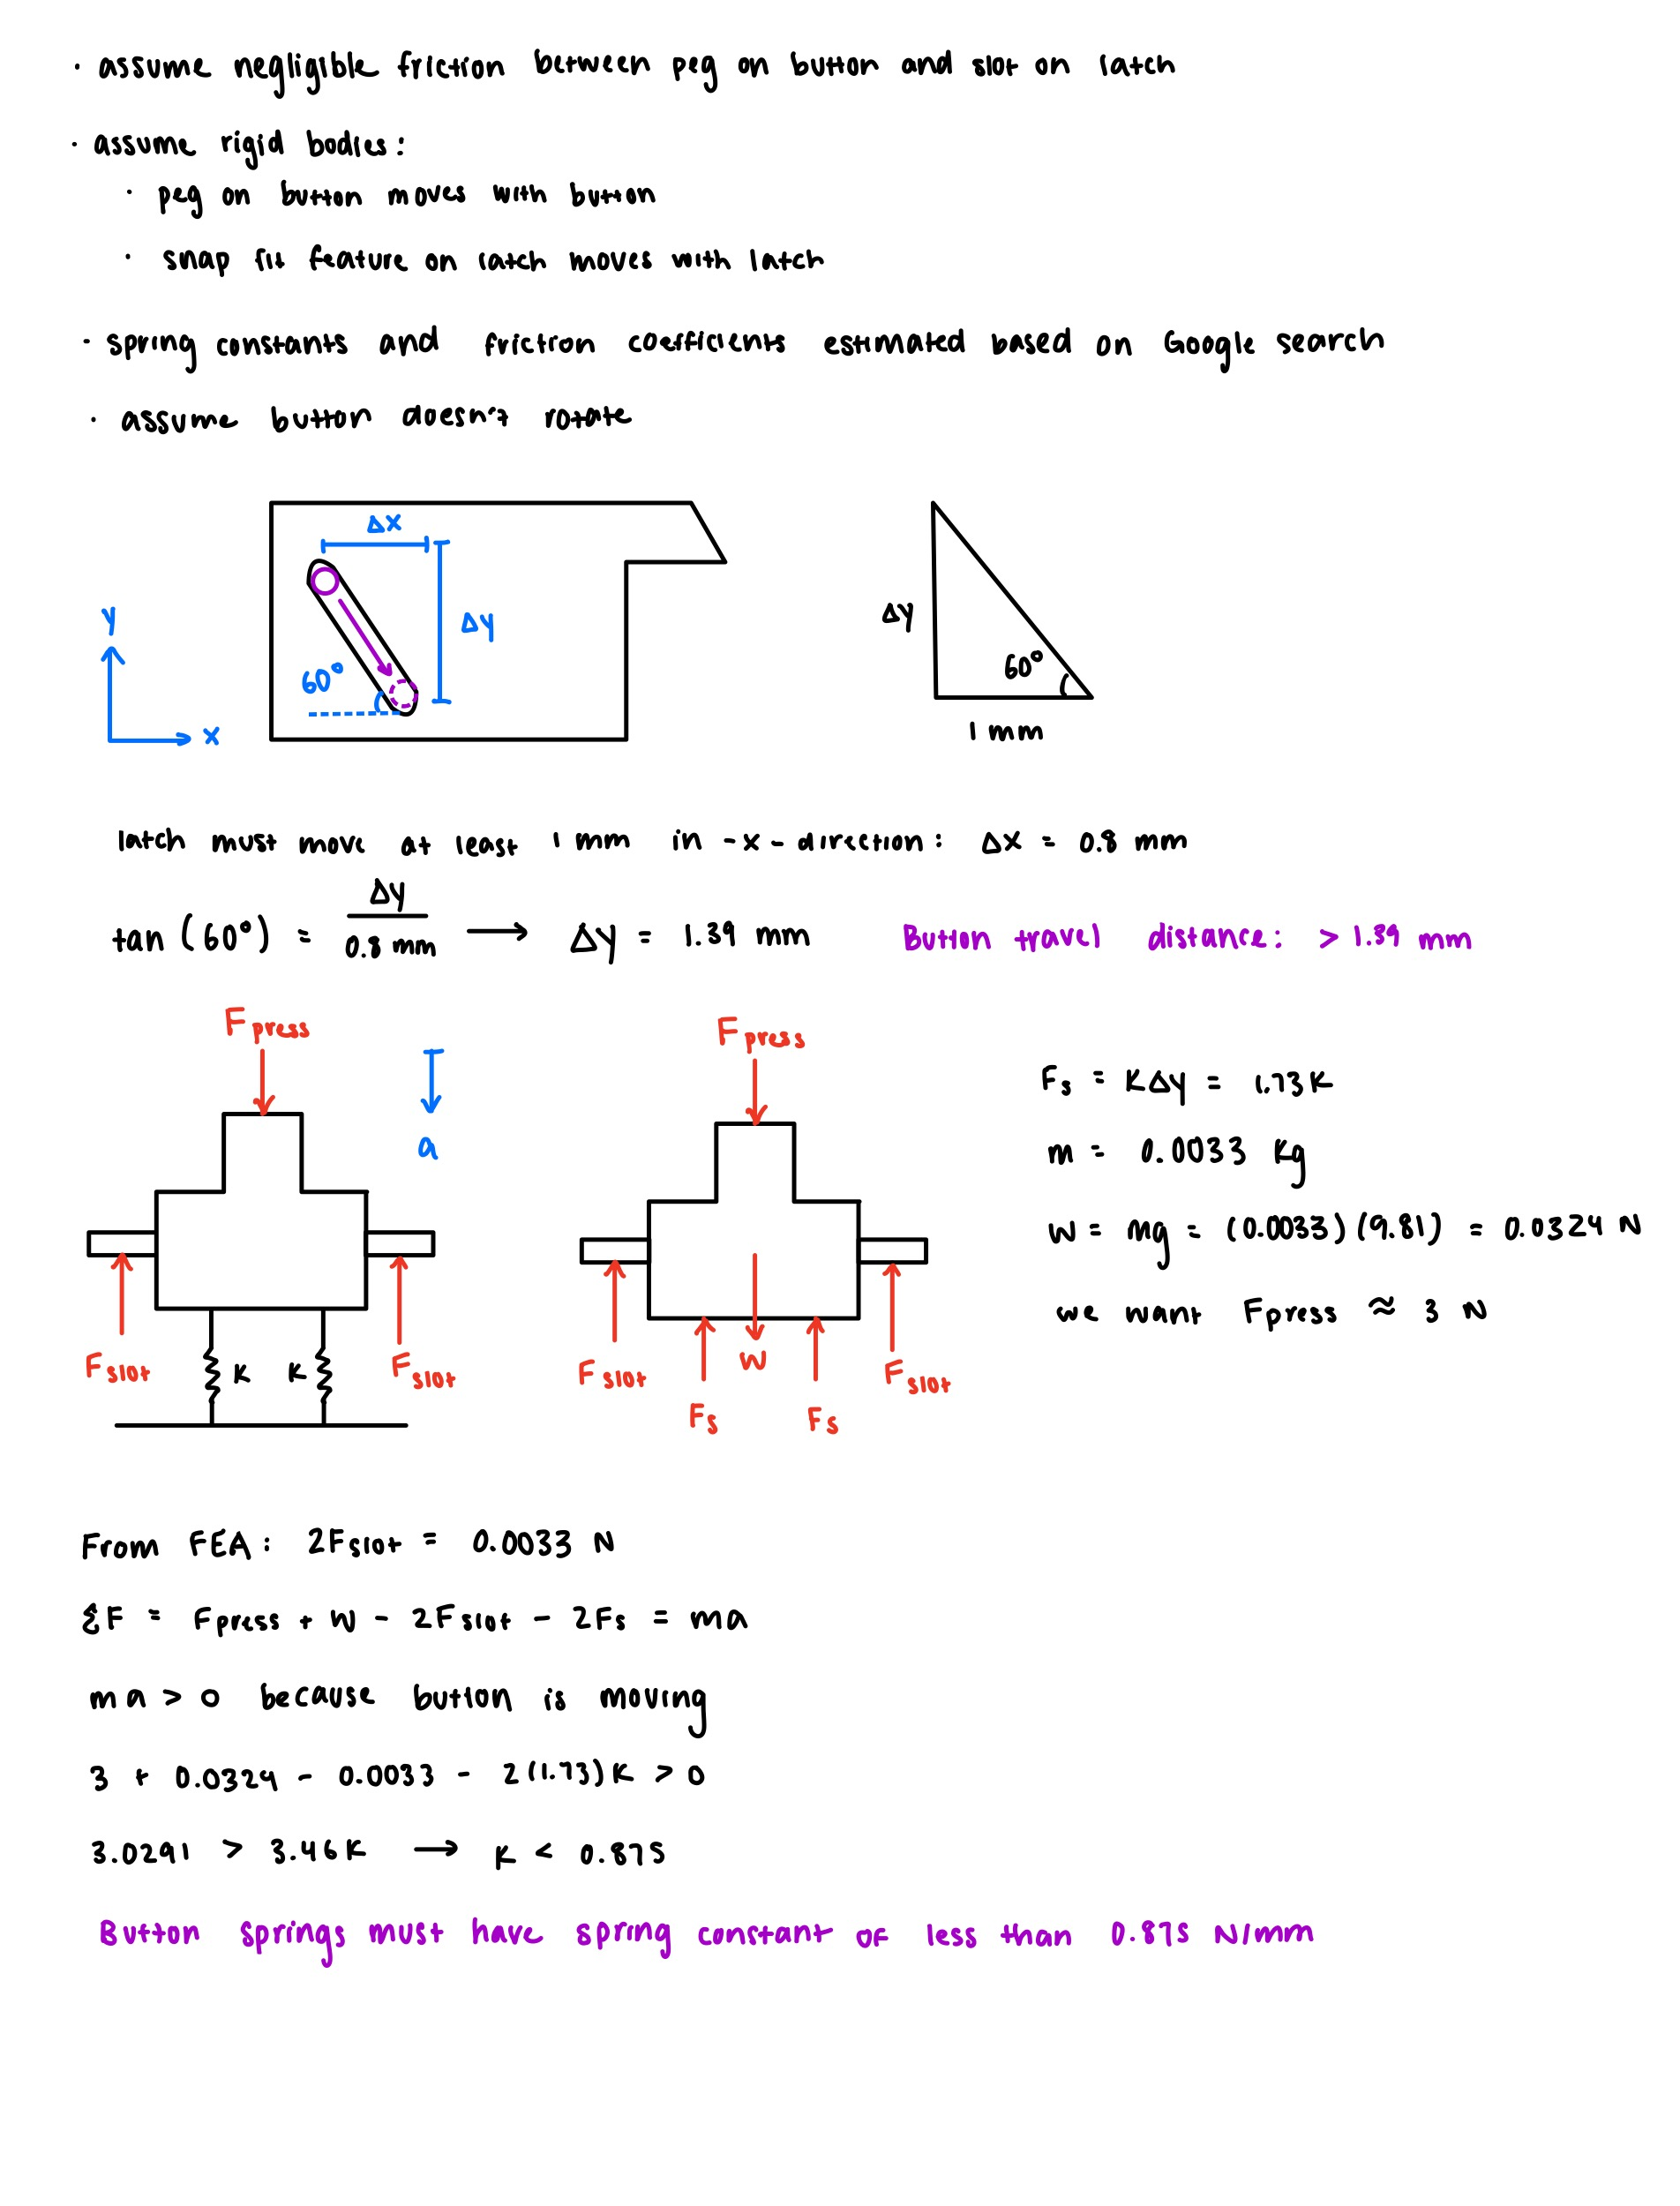
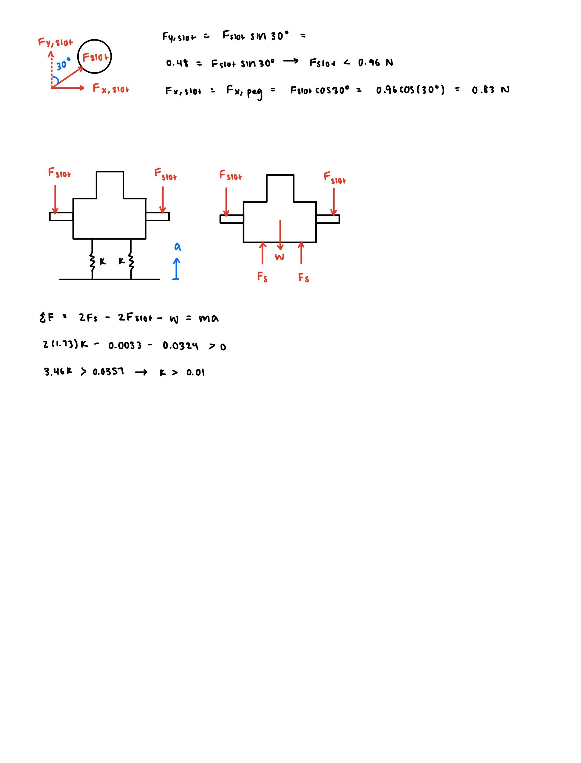
Initial Button and Latch Calculations
FEA
Hand Calculations
μ = 0.2
Max peg bending stress < fatigue strength
of SUS316 for 1000 cycles (300 MPa)
Button travel: 1.39 mm
Force for button to slide latch: 0.0033 N
Assumptions
Negligible friction between peg and slot
Negligible friction between latch and door
Rigid bodies: button peg moves with peg, snap fit moves with latch
Required spring constant: 0.01-0.875 N/mm

Slide 19
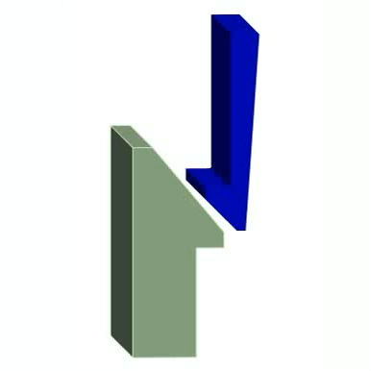
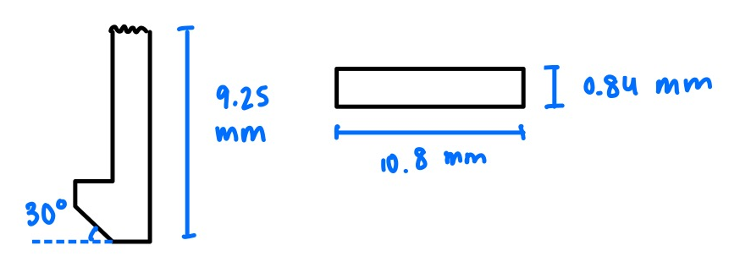

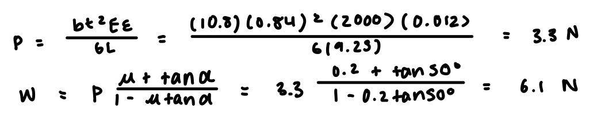
Door and Latch Calculations
FEA
Hand Calculations
μ = 0.2
Max deflection of door: 0.78 mm
Max equivalent stress: 49 MPa
Max force required: 28 N
Max door strain < allowable strain for ABS (7%)
Total deformation
Equivalent stress
Simulation assumes latch is a rigid body, latch does not move during door closing, and base of snap fit feature is fixed → use hand calculations
Max door stress < fatigue strength of ABS for 1000 cycles (35 MPa)
Assumptions
Snap fit has constant cross-section
Deflection magnification factor Q = 1
Latch does not move during door closing (assume worst case)
Required force to close door: 6.1 N

Slide 20
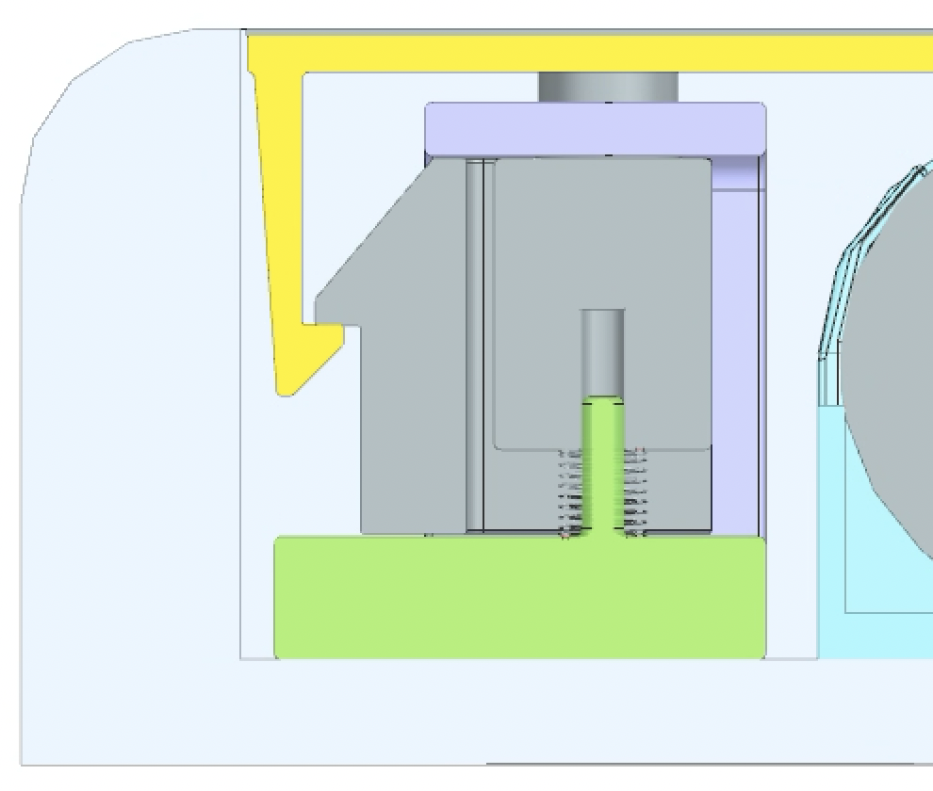
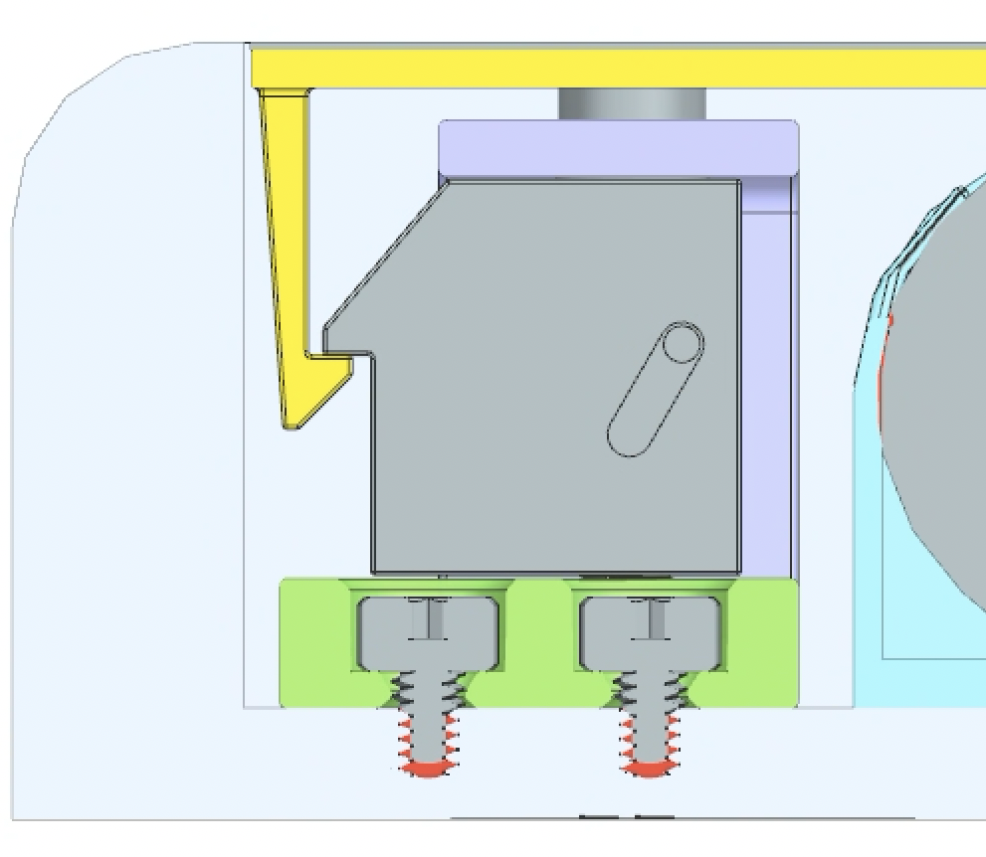
Initial Door and Latch Calculations
Hand Calculations
Tolerance Analysis
Max strain < allowable strain for ABS (7%)
+
4, 5
8
9
6, 7
1
2, 3
Max door stress < fatigue strength of ABS for 1000 cycles (35 MPa)
No. | Description | Nom. | + Tol. | - Tol.
1 - 2 | Latch tip to latch slot center | 9.70 | 0.05 | 0.05
2 - 3 | Latch slot center to button peg center | 0.00 | 0.10 | 0.00
3 - 4 | Button peg center to button hole | -1.50 | 0.05 | 0.05
4 - 5 | Button hole to chassis post | 0.00 | 0.10 | 0.10
5 - 6 | Chassis post to screw hole center | 0.64 | 0.05 | 0.05
4 - 5 | Chassis screw hole center to housing | 0.00 | 0.10 | 0.10
 | housing screw hole center
5 - 6 | Housing screw hole center to edge | -11.00 | 0.10 | 0.10
6 - 7 | Housing edge to door tip | 2.95 | 0.20 | 0.20
Nominal overlap: 0.79 mm
RSS Max overlap: 1.09 mm
RSS Min overlap: 0.51 mm
Required force to close door: 6.1 N

