Slide 1
A simple Presentation
Some informations

Slide 2
Second slide
First headline
Second headline

Slide 3
Third slide
Third headline
Fourth headline
5th headline

Slide 4
Nice drawing
Click
Drag
Click

Slide 5
Text
This text does not fit
On one line
So I split it up into many lines
If there are not enough lines
I just
Make the font smaller
And if I do not like the font, try something else
And if I do not like the font, try something else
And if I do not like the font, try something else

Slide 6
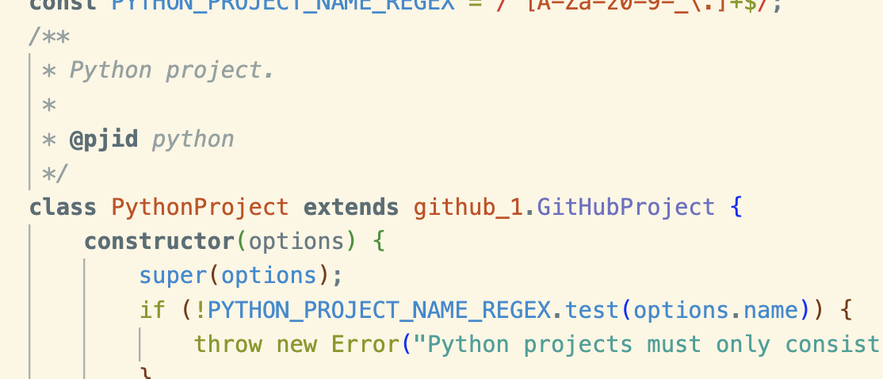
Only screenshots look good
/** * Python project. * * @pjid python */ class PythonProject extends github_1.GitHubProject { constructor(options) { super(options); if (!PYTHON_PROJECT_NAME_REGEX.test(options.name)) { throw new Error("Python projects must only consist of alphanumeric characters, hyphens, and underscores."); }

Slide 7

$${\left(x+a\right)}^{n}=\sum_{k=0}^{n}{\left({n \atop k}\right)x^{k}a^{n−k}}$$

