Slide 1
Academic Research Computing
MYTHS: “Someone will do it…”
“Just ask the post-docs for help.”
REALITY: “You’re here (in academia) to learn.”
Many scientists spend much of their research time developing, maintaining, & running software programs, often repeatedly
Few scientists ever have formal software training → development often takes longer
Are we Software Engineers? Developers? Programmers? Coders? Hackers?

Slide 2
Software Carpentry
Write software for people, not computers
Don’t repeat yourself
Automate repetitive tasks (reusable fns)
Use the computer to record history
Make incremental changes (save often)
Use version control (git)
Plan for mistakes (bugs)
First do it right, then make it cleaner & faster
Document design & purpose, not mechanics
Comments! Comments!
Conduct code reviews
Wilson et al. (2014) Best practices for scientific computing. PLoS Biology 12: e1001745

Slide 3
SWC Python Components
Interactive Jupyter notebook
Learn and test syntax, methods, functions
Explore your data in manageable chunks
Mark it up, save it, share it, reuse it
Command-line scripts
Organization
Commenting and Documentation
Execution

Slide 4
I have data. Where do I start?
What kind of data? Many sources?
What is the purpose of your work?
Improve productivity (automation)
Improve data/output quality (precision)
Improve usability (collaboration)
Improve scope (application)
Which programming language?
→ Develop a workflow

Slide 5
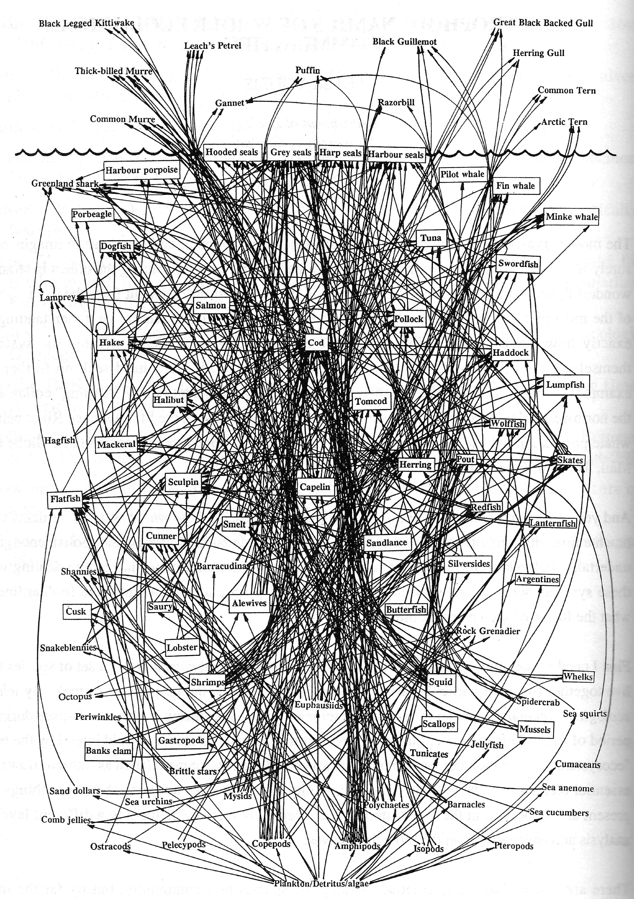
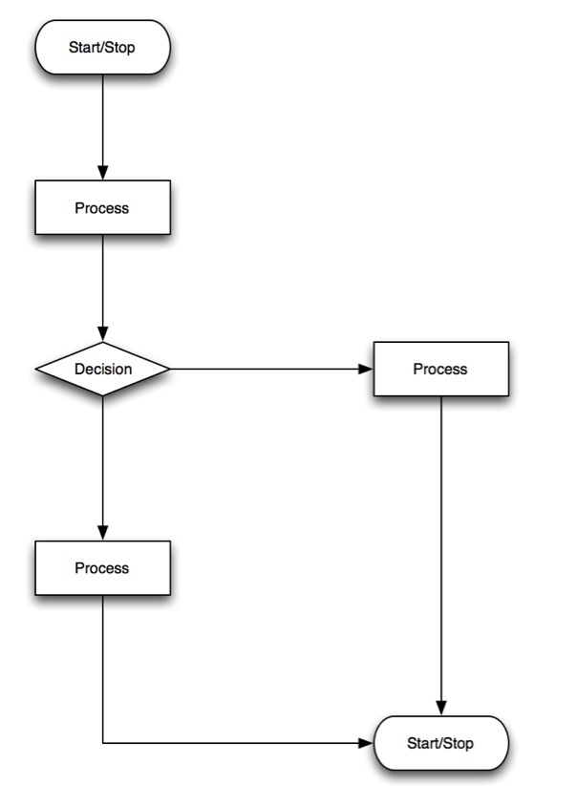
Thinking about information flow
(write once, use to ∞)
Notes:
A “simplified food web” for northwestern Atlantic Cod from Prof. David Lavigne, Natural Sciences and Engineering Research Council
Based on figure at http://www.fisherycrisis.com/coral7.html

Slide 6
Python — Our Progression
Variable types
Focus on Booleans
Conditional Statements
Lists
Counting / Indexing
Pointing & Copying
Arrays
Numpy
Indexing & Slices
Loops
Functions
Docstrings
Catching Errors
Exploratory Data Analysis
Plotting Graphs
matplotlib
Exporting & Cleaning Up
Command-line Use

Slide 7
Python — Getting Started
Open your web browser
Open your console (bash or git-bash)
cd to your working folder / directory
In console, type “python --version” → is it v3.5.x?
In console, type “jupyter notebook”
→ Spawns a new browser tab with jupyter page
At upper right of browser page click “New” → “Python 3”
When done with a notebook tab, don’t just X out of the browser tab!
Click “File” → “Close and Halt”
When done with the jupyter page → X out → console → <ctrl-C>

