Slide 1
Research Computing
MYTHS: “Someone will do it…”
“Just ask the post-docs for help.”
REALITY: “You’re here (in academia) to learn.”
Many scientists spend much of their time developing, maintaining, & running software for data collection, analysis, publication prep
Few scis have ever learned programming formally → development often takes longer
Are we Software Engineers? Developers? Programmers? Coders? Hackers?

Slide 2
Software Carpentry
Write software for people, not computers
Don’t repeat yourself
Automate repetitive tasks (reusable fns)
Use the computer to record history
Don’t repeat yourself
Make incremental changes (save often)
Use version control (git)
Plan for mistakes (bugs)
First do it right, then make it cleaner & faster
Don’t repeat yourself
Document design & purpose, not mechanics
Comments! Comments!
Conduct code reviews
Wilson et al. (2014) Best practices for scientific computing. PLoS Biology 12: e1001745

Slide 3
SWC Python Components
Interactive Jupyter notebook
Learn and test syntax, methods, functions
Explore your data in manageable chunks
Mark it up, save it, and share it
Command-line scripts
Organization
Commenting
Execution

Slide 4
I have data. Where do I start?
Ponder the nature of your data
Consider the purpose of your work
Improve productivity (automation)
Improve data/output quality (precision)
Improve usability (collaboration)
Improve scope (application)
Choose a programming language
Build a workflow

Slide 5
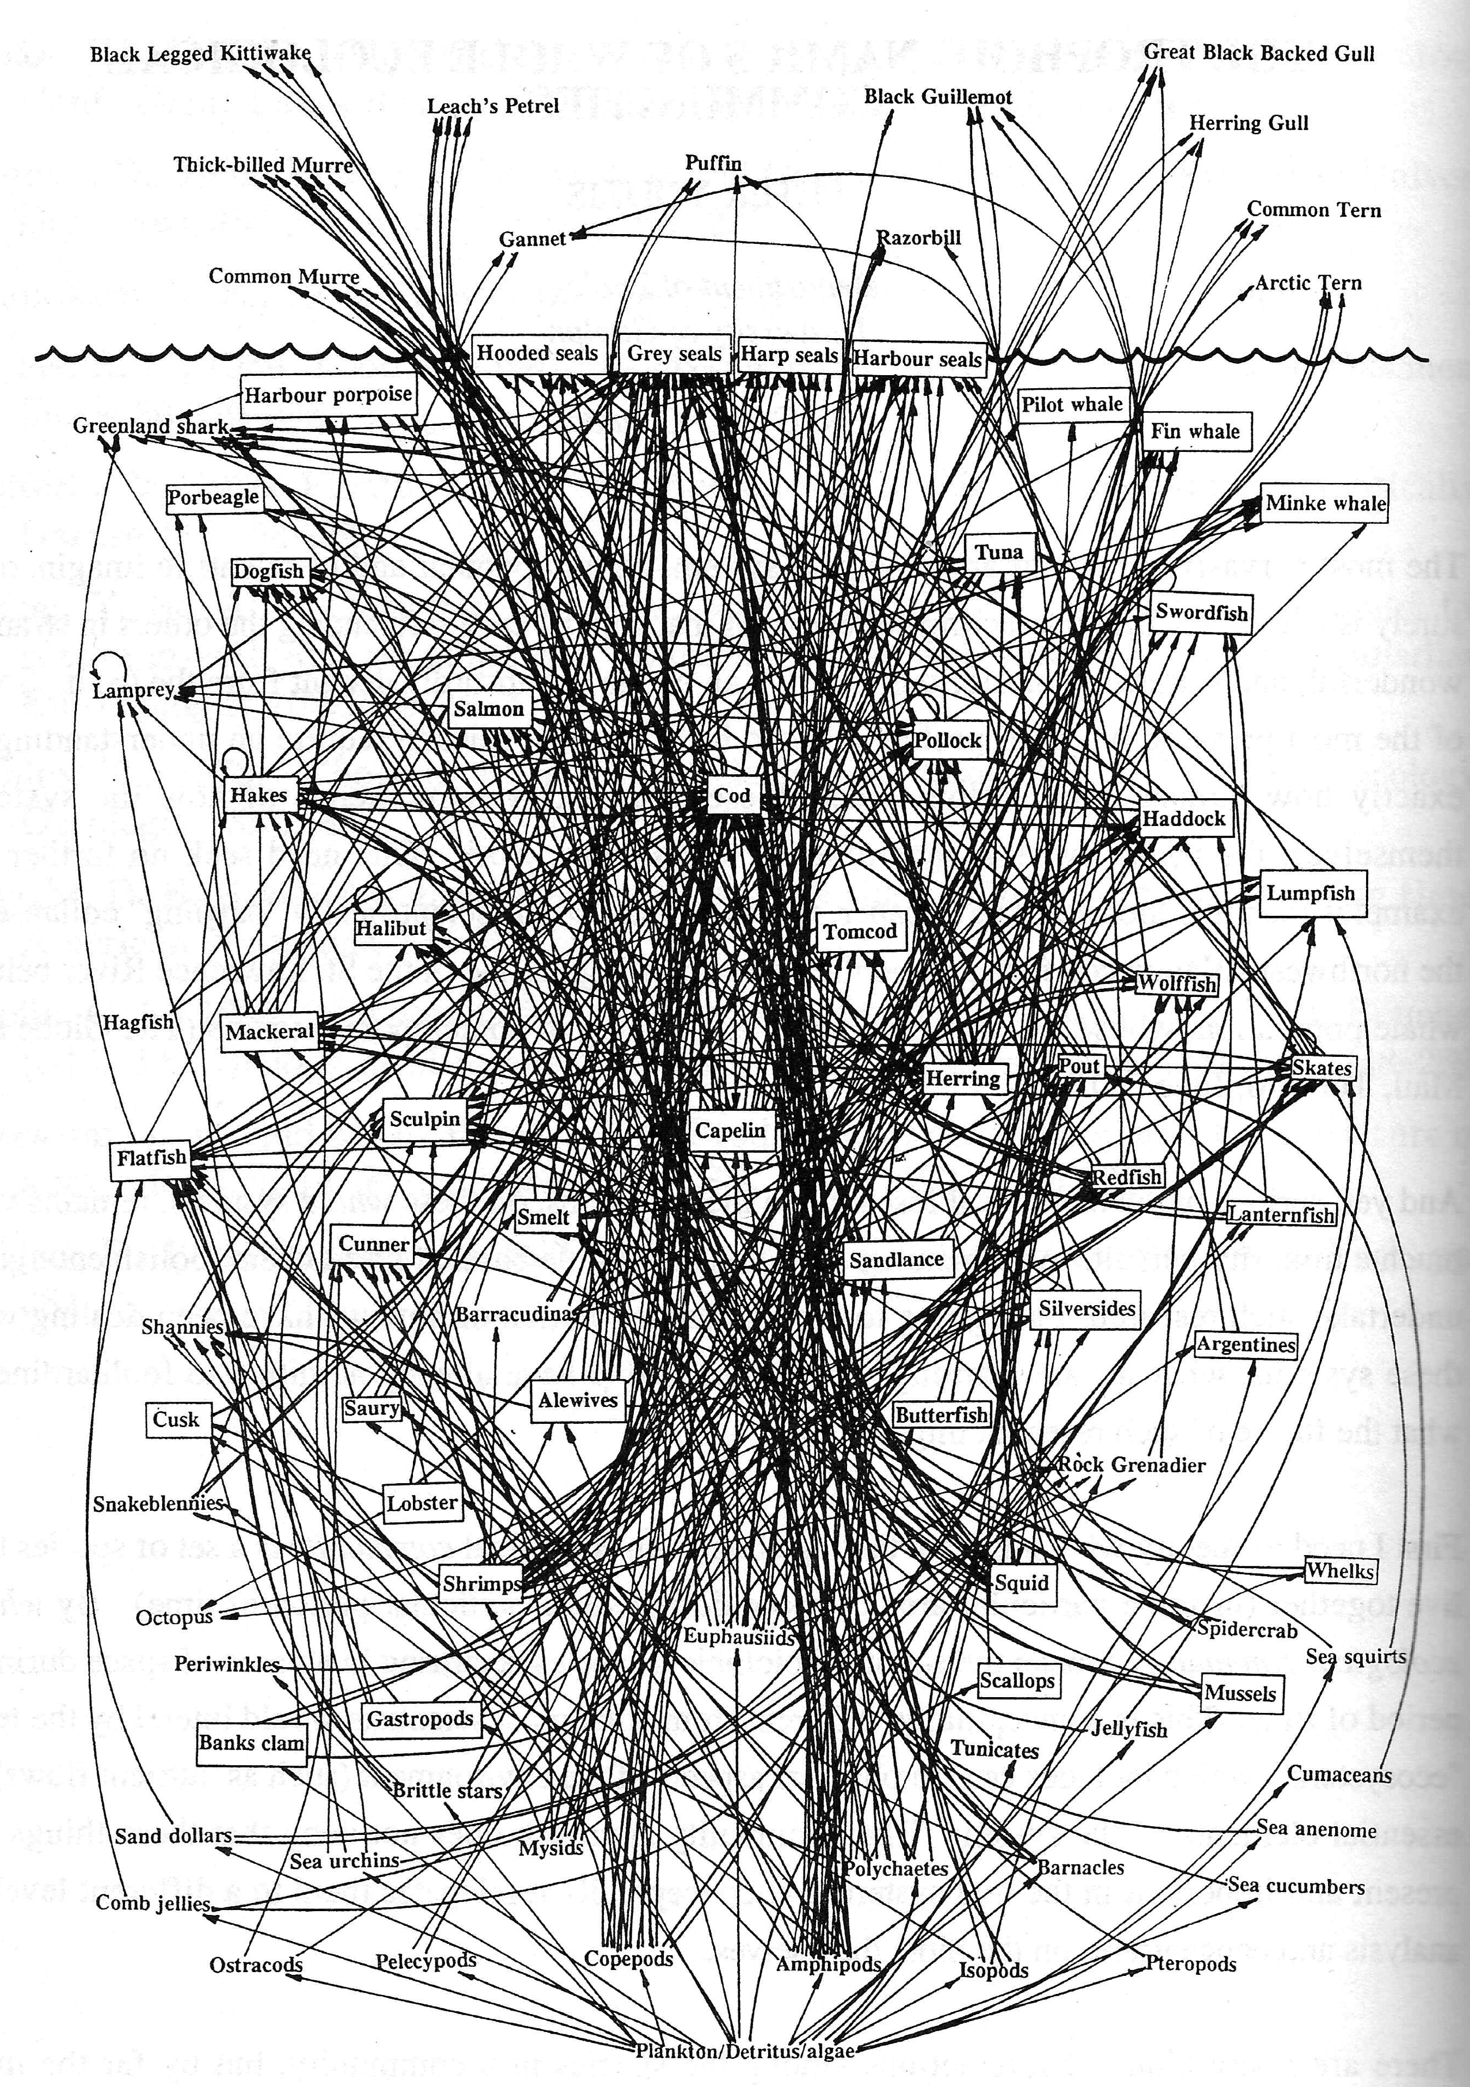
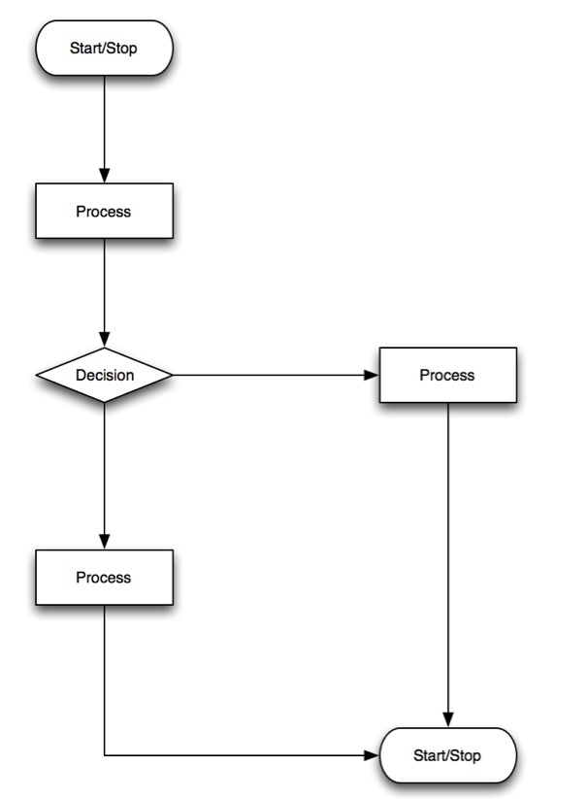
Thinking about information flow
(write once, use to ∞)
Notes:
A “simplified food web” for northwestern Atlantic Cod from Prof. David Lavigne, Natural Sciences and Engineering Research Council
Based on figure at http://www.fisherycrisis.com/coral7.html

Slide 6
Python — Our Progression
Variable names
Variable types
Boolean type
Conditional statements
Lists
Indexing
Pointing
Copying
Slices
Arrays
Numpy
Indexing and Slices
Copying
Loops
Functions
Catching Errors
Example Data Analysis
Command-line Use

Slide 7
Python — Getting Started
Open your console (bash or git-bash)
cd to your working directory
Open your web browser
In console, type “python --version” → is it v3.5 ?
In console, type “jupyter notebook”
→ Opens a new browser tab
At upper right click “New” → “Python 3”
When done, don’t just X out of the browser tab!
Click “File” → “Close and Halt”

