Slide 1

Bussines Analytics

Slide 2
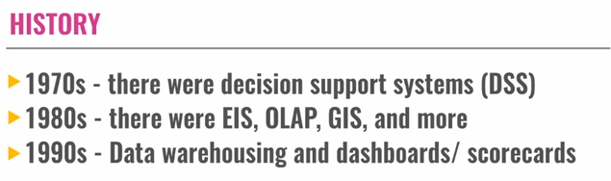
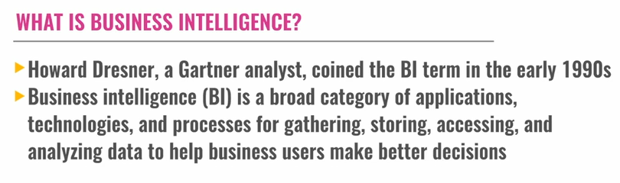
EVOLUTION OF ANALYTICS
Executive information systems
Online analytical processing

Slide 3
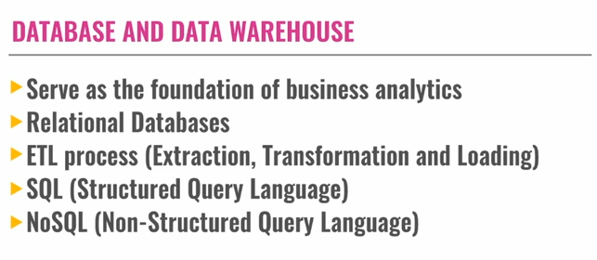
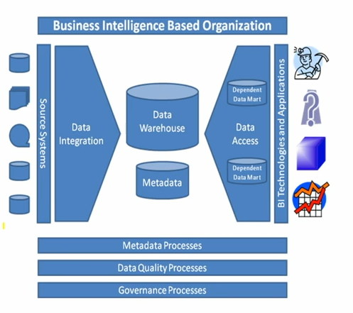
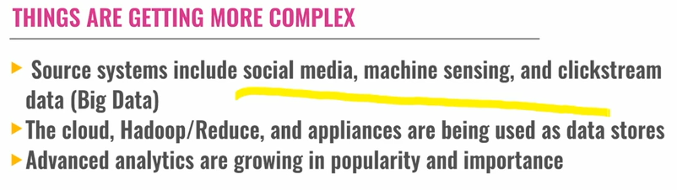
HADOOP

Slide 4
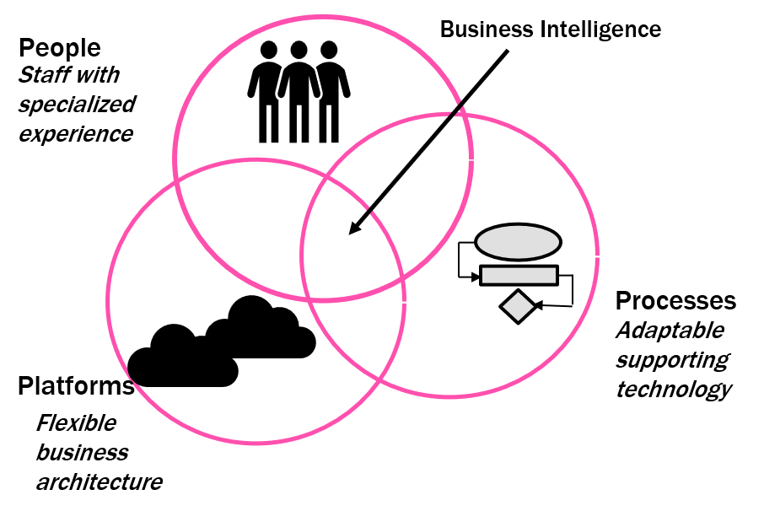
Define Database
A Database is an organized, machine-readable collection symbol, to be interpreted as a true account of some enterprise. A database is machine-updatable too, and so must also be a collection of variables. A database is typically available to a community of users, with possibly varying requirements.
Business Intelligence Defined
The Data Warehousing Institute, a provider of education and training in the data warehouse and BI industry defines Business Intelligence as:
“The processes, technologies, and tools needed to turn data into information, information into knowledge, and knowledge into plans that drive profitable business action. Business intelligence encompasses data warehousing, business analytic tools, and content\knowledge management.”

Slide 5
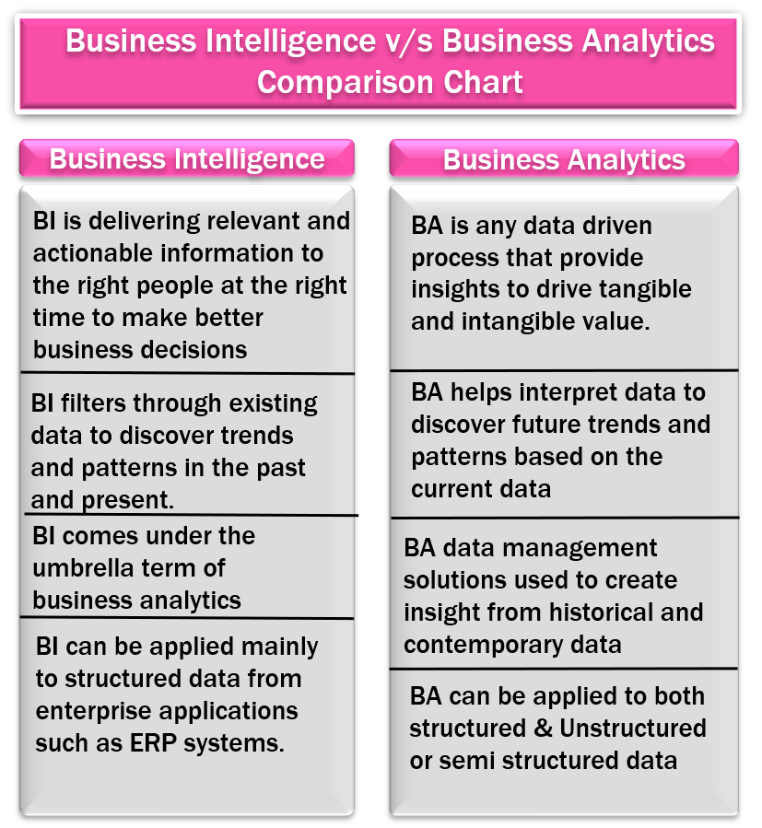
A BI program encompasses more than just a collection of software products and visualization tools. The value of BI comes from the processes for delivering actionable knowledge to the end-users, the processes for acting upon that knowledge, and the right people willing to take action. This means that without the processes and the right people, the tools are of little value.
The value of BI is the realization in the context of profitable business action. This means that if the knowledge that can be used for profitable action is ignored, the practice is of little value.

Slide 6
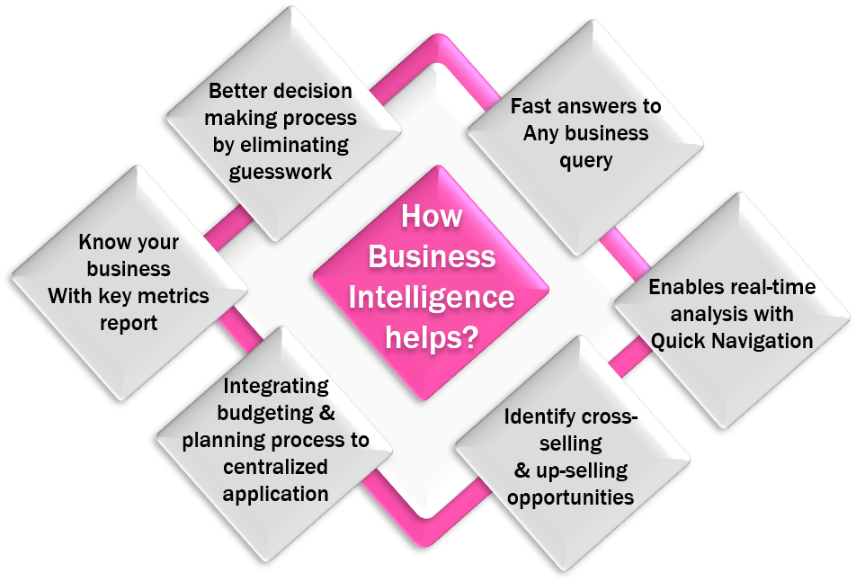
From the perspective of Information Systems (IS) Research, BI&A represents the latest evolution of technologies that have been developed to support managerial decision-making. This evolution began in the early 1960s, with the introduction of the first data processing systems. The idea of using the newly available data for supporting managerial decision-making led to the development of the first management information systems (MISs). In the following decades, these systems evolved through several stages, from personal decision support systems (PDSSs) to executive information systems (ELSs) and data warehouses (DWs) towards the current state-of-the-art technologies in BI&A. Each stage in this evolution increased data-processing capabilities, thus improving the available data basis or analytic capabilities and thereby providing more advanced capacities for data analysis.

Slide 7
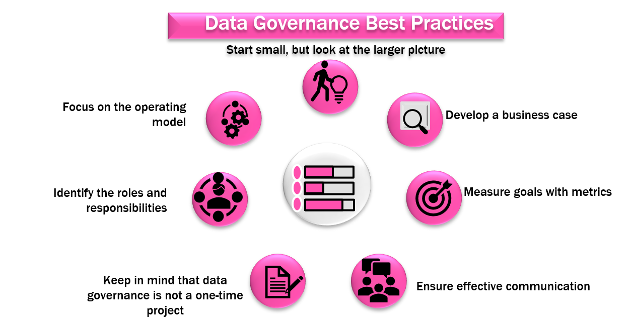
“Data Governance is the discipline of administering data and information assets across an organization through formal oversight of the people, processes, technologies, and lines of business that influence data and information outcomes to drive business performance.”

Slide 8
Data governance is largely about collaboration, for example, connecting data producers and data consumers, and managing common or shared data for the benefit of the enterprise. It is also about “decisions” determining who makes decisions about data. This is not to suggest that decisions are made centrally, but rather to determine what level and specifically who can best make different types of data decisions to expedite the decision process.
There are many types of metadata users due to the many types and sources of metadata. Users of Metadata can typically be divided into three categories:
Business Users: need to understand the business meaning of the data in the systems they use or own. Besides, they need to know the business rules and data access rules that apply to the data. Data stewards often perform the management of business metadata in terms of creation, maintenance, and usage on behalf of the business users and data owner.
Technology Users: Information technology (IT) professionals who are responsible for planning and building the transactional and analytic systems need to understand the end-to-end picture of the data to manage change. These users need the technical metadata for the technical information about the data environment, such as physical data structures, extract-transform-load (ETL) rules, reporting information, and impact analysis. Examples of technology users include data modelers, data integration architects, BI architects, designers, and developers.
Operational Users: Operational professionals are those who are responsible for the day-to-day operation of the data environment and are users of operational metadata. Operational metadata can assist them in identifying and resolving problems as well as managing change in the production environment by providing data information about the data integration processing and job processing impact analysis.

Slide 9
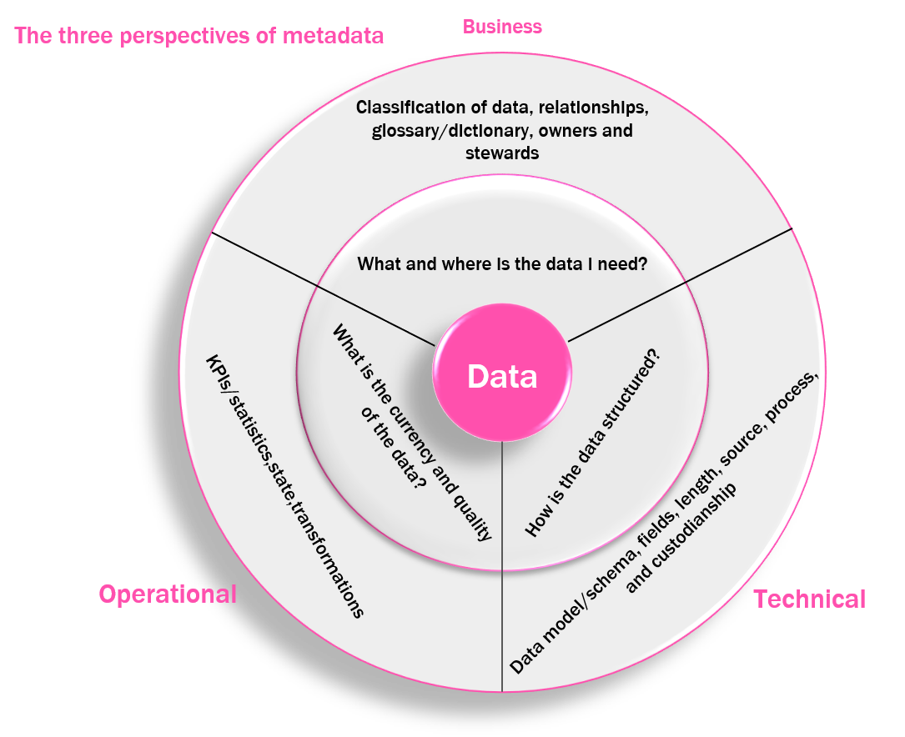

Slide 10
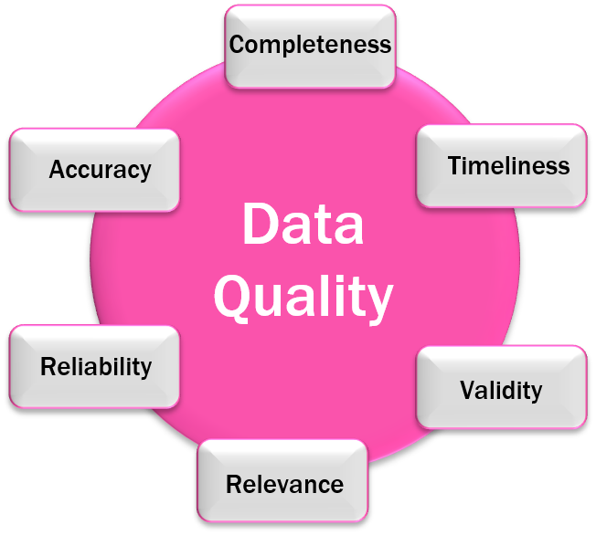
The formal definition of data quality is “the commonly understood business and technical definitions of data within defined ranges”. The confusing nature of data quality is that it is simply a part of the definition of the data; it is not a separate “component” of the data. Data quality is measured by how effectively the data supports the transactions and what it is used for. The level of data quality required to effectively support operations will vary by information system or business unit, depending on the information needed to conduct that business unit’s operations.

Slide 12
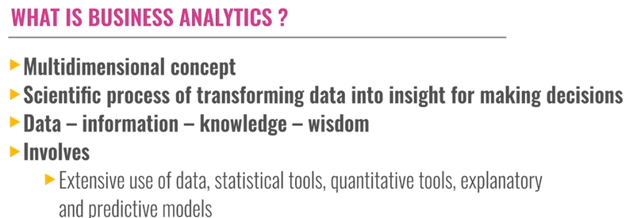
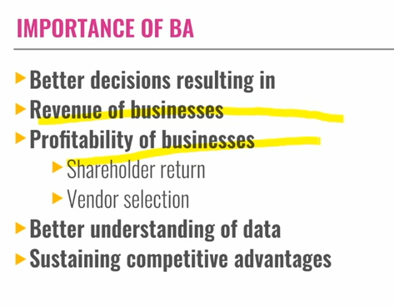
Introduction to Business Analytics

Slide 13
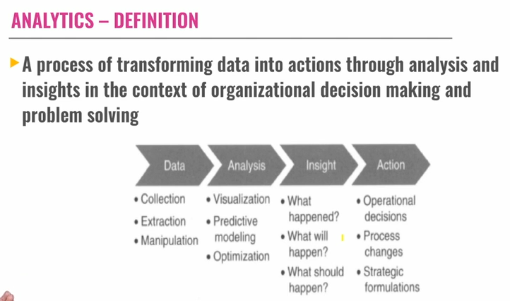

Slide 14
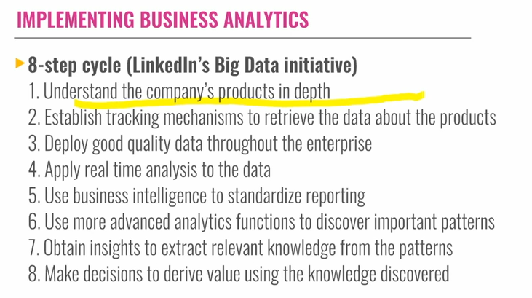

Slide 15
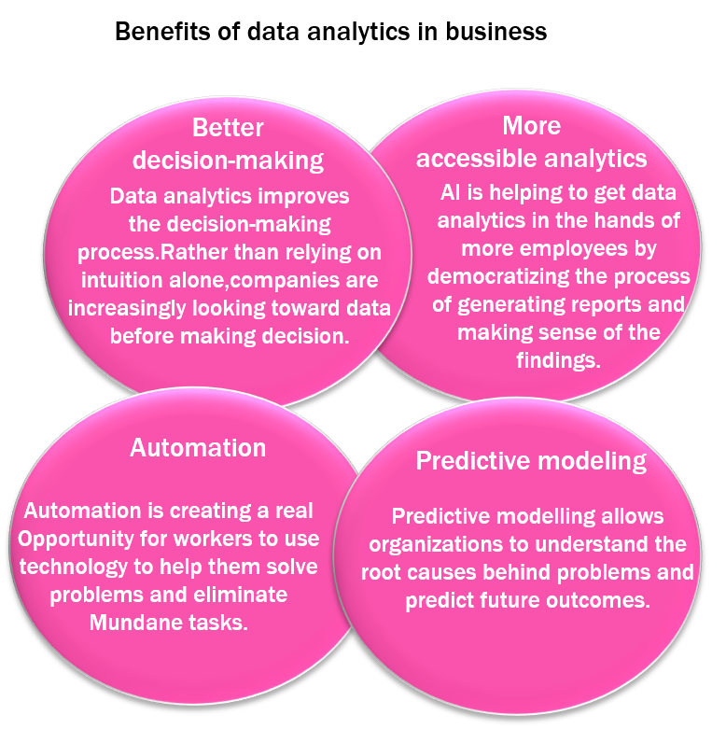
Business Analytics is the scientific process of transforming data into insight for making better decisions. Business analytics is used for data-driven or fact-based decision-making. Which is often seen as more objective than other alternatives for decision making.

Slide 16
Pero el análisis de negocios es lo más parecido a una bola de cristal para responder a preguntas importantes de negocios. Las respuestas se convierten en la base de información y conocimiento que hace que el análisis de negocios sea una herramienta valiosa para la toma de decisiones y ayuda a explicar por qué es importante aprenderlo y usarlo. La muestra de los tipos de preguntas que un análisis de negocios típico puede generar está relacionada no solo con cada paso en el proceso de análisis de negocios, sino también con el contexto del tiempo. Para comprender mejor el valor de la información que proporciona el análisis de negocios y entender por qué este tema es importante para mejorar el desempeño empresarial. Las empresas que hacen planes que generan resultados exitosos son ganadoras en el mercado. Las empresas que no planifican de manera efectiva tienden a ser perdedoras en el mercado. La planificación es una parte fundamental de la gestión de cualquier negocio. Si se hace bien, obtiene los resultados que desean los planificadores. La planificación de la organización empresarial generalmente se segmenta en tres tipos: descriptiva, predictiva y prescriptiva. El proceso de planificación generalmente sigue una secuencia desde la estrategia hasta la táctica y luego hasta la operativa.

Slide 17
Analytics – Definition
“Data Analytics is defined as a process of inspecting, cleansing, transforming, and modeling data to discover useful information, suggesting conclusions, and supporting decision making. Data analysis has multiple facets and approaches, encompassing diverse techniques under a variety of names, in different business, science, and social science domains.”
Tom Davenport’s book “Competing on Analytics” offers the following definition.
“By analytics, we mean the extensive use of data statistical and quantitative analysis, explanatory and predictive models, and fact-based management to drive decisions and actions. The analytics may be input for human decisions or may drive fully automated decisions.”
“Data Analytics is any activity that involves applying an analytical process to data to derive insight from the data.”

Slide 18
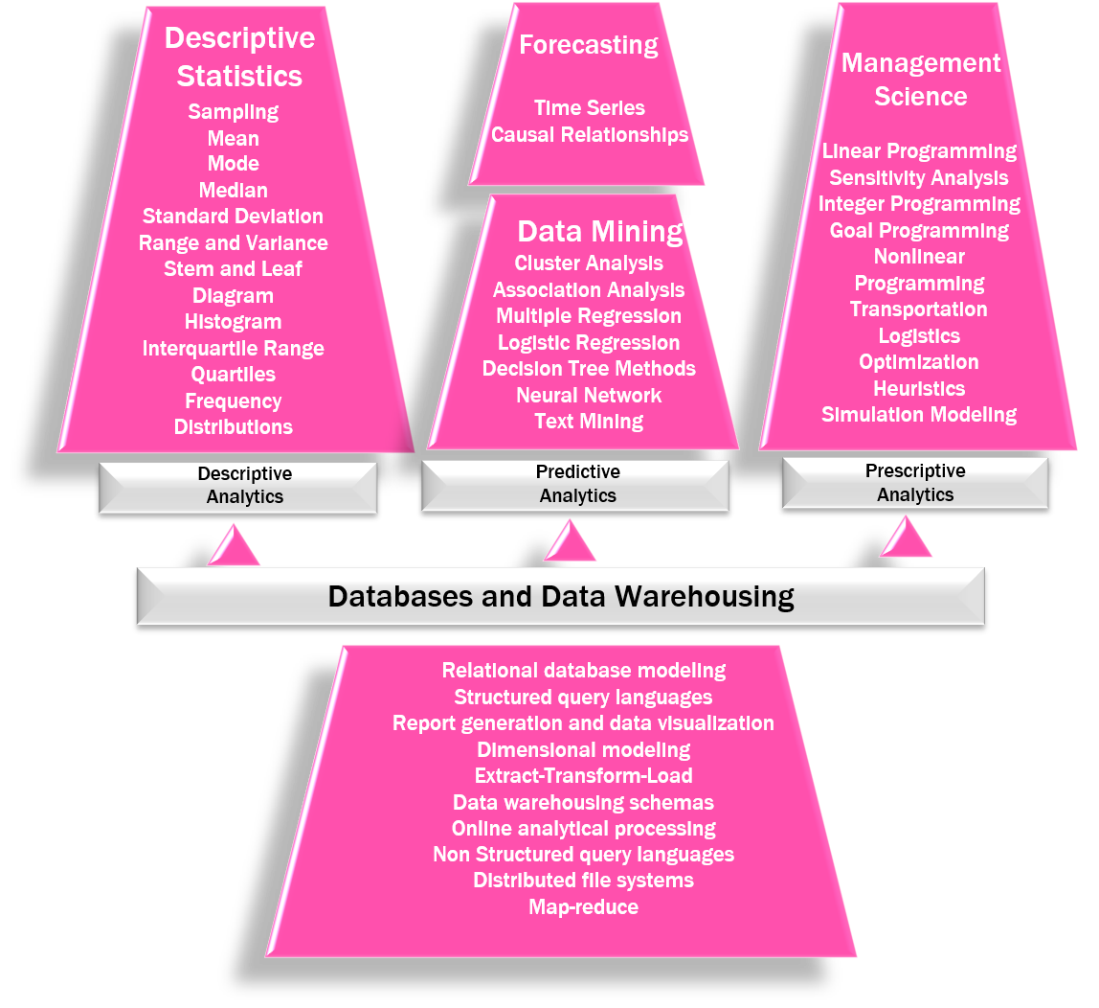

Slide 19
Implementing Business Analytics
As organizations are becoming more competitive by using business analysis, there is no doubt that practitioners, from both large and small companies, are eager to learn more about data analytics and how to implement it in their everyday decision-making. But how do managers implement business analytics in the workplace? Is there a methodology or a recommended set of steps that can be followed by practitioners? The examples of Target, LinkedIn, First Tennessee, and many other companies that have implemented data analytics can be used to derive practical steps for implementing analytics in organizational settings. Business Analytics initiatives in the Era of Big Data usually follow an Eight-Step Cycle:
Understand the company’s products in depth.
Establish tracking mechanisms to retrieve the data about the products.
Deploy good-quality data throughout the enterprise.
Apply real-time analysis to the data.
Use business intelligence to standardize reporting.
Use more advanced analytics functions to discover important patterns.
Obtain insights to extract relevant knowledge from the patterns.
Make decisions to derive value using the knowledge discovered.
These eight steps illustrate how organizations utilize all aspects of data analytics. LinkedIn, for example, uses information about its members, which is housed in operational databases. This information is then organized into a data warehouse and the analysts can use this information to explore the browsing history of LinkedIn members. Furthermore. LinkedIn uses descriptive statistics to generate reports and discover patterns. These patterns let the data analytical team at LinkedIn use predictive analytics to discover that speed is very important in receiving positive responses. Specifically, LinkedIn analysts were able to determine that “adaptation exponentially increases as the response time goes towards sub-seconds.” Finally, prescriptive analytics is used to generate appropriate actions. For example, LinkedIn could use optimization techniques to identify the best mix of companies or individuals, which maximizes the number of prospects or product sales.

Slide 20
Data analytics can help us to understand past trends and patterns, but it cannot predict the future with certainty. This is because there are always several factors that can affect the outcome of any event, and these factors are only sometimes known or predictable.
Metadata is data that describes other data. It can include information about the data's source, format, and meaning. Metadata is used by technology professionals to manage data, by operational professionals to understand data, and by business, units to make decisions based on data.
The few developments that contributed to the evolution of business analytics are personal decision support systems to executive information systems. The growth of business analytics has been driven by several developments, including the rise of personal computers, the development of data warehouses, the introduction of statistical and machine learning algorithms, and the increasing availability of data.
Data warehousing is the process of collecting and storing data from various sources within an organization in a centralized repository. The data is then organized and analyzed to help businesses make better decisions. Data warehouses were developed in the late 1990s, and they have evolved significantly over time. Today, data warehouses are used by businesses of all sizes to store and analyze vast amounts of data.
Business analytics is a process that involves the use of data to create predictive models using statistical and quantitative tools. Business analytics is a broad term that encompasses the use of data and analytics to improve decision-making. It can be used to collect data from a variety of sources, store it in a central repository, and then analyze it to identify trends, patterns, and insights.

