Slide 1
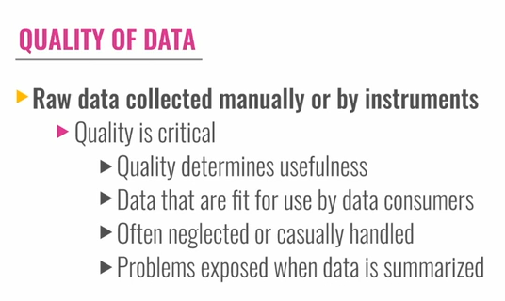
Quality of Data
Smart questions, Smart answers

Slide 2
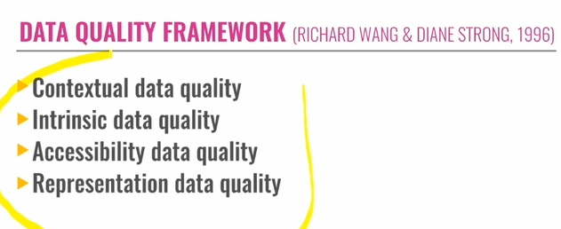
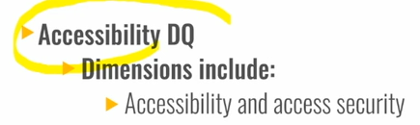
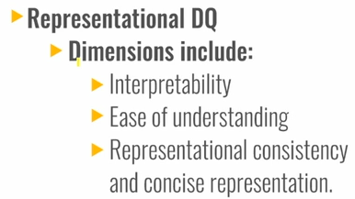
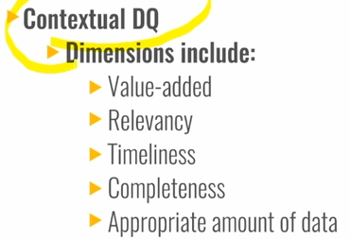
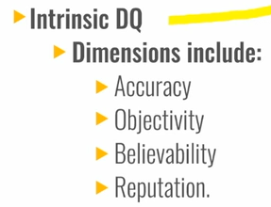

Slide 3
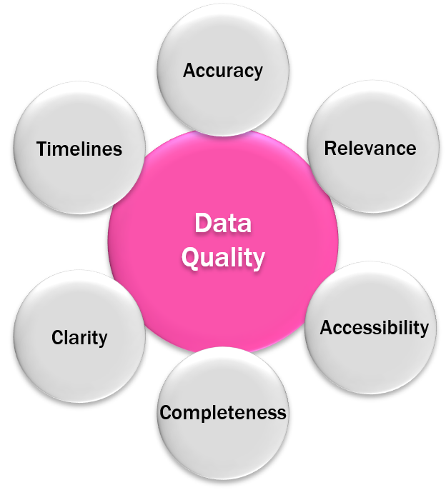
QUALITY OF DATA
Data Quality Framework
"Beyond Accuracy: What data quality means to data consumers,” Wang and Strong present results of a survey conducted to understand data quality dimensions from the point of view of people using data. Their starting assumption is that “data consumers have a much broader data quality conceptualization than IS professionals realize”. In summarizing previous work on data quality dimensions, they point out the limits of both an intuitive and the theoretical approach to data quality; both focus on development characteristics rather than use characteristics of data.

Slide 4
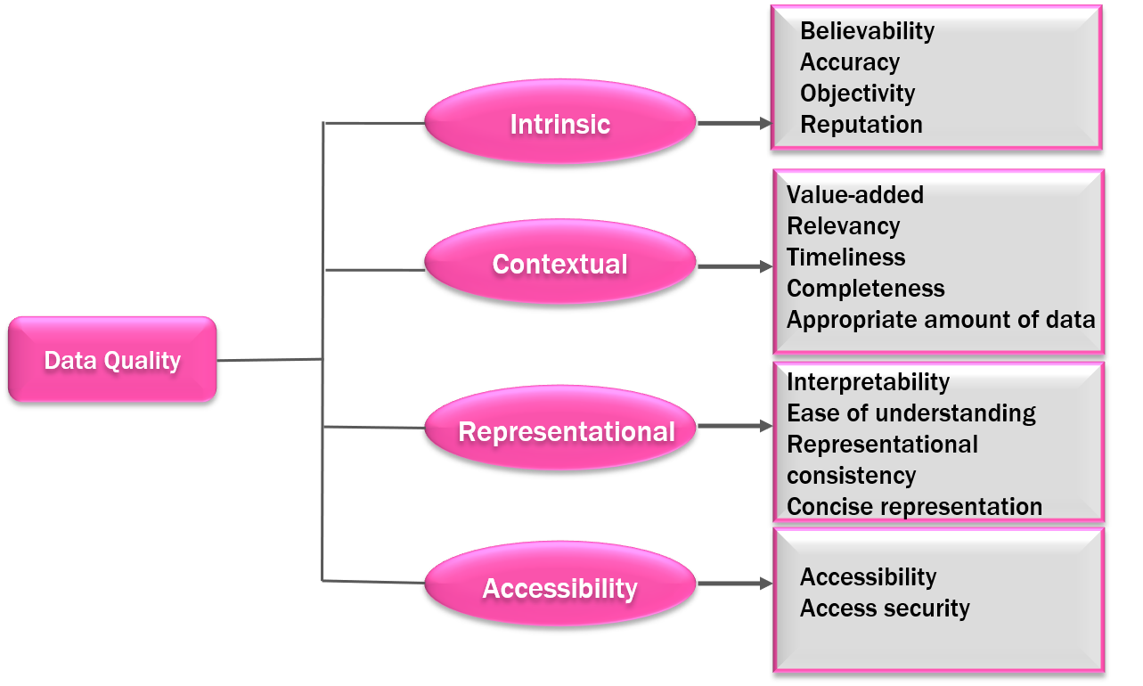
Wang and Strong define Data Quality as “data that are fit for use by data consumers,” and they define Data Quality Dimensions as “a set of data quality attributes that represent a single aspect or construct of data quality”. To establish their dimensions, they first collected a set of 118 attributes of data identified by consumers themselves. Next, they asked survey respondents to categorize the characteristics and to rate their importance about data use. Wang and Strong performed factor analysis on the results and re-surveyed to understand the association of dimensions with categories of data quality.

Slide 5
Intrinsic Data Quality : It denotes that data have quality in their own right; understood largely as the extent to which data values are in conformance with the actual or true values. Intrinsically good data is accurate, correct, and objective, and comes from a reputable source. Dimensions include accuracy, objectivity, believability, and reputation.
Contextual Data Quality : It points to the requirement that data quality must be considered within the context of the task at hand, understood largely as the extent to which data is applicable (pertinent) to the task of the data user. The focus of contextual Data Quality is the data consumer’s task, not the context of representation itself. For example, contextually appropriate data must be relevant to the consumer, in terms of timeliness and completeness. Dimensions include value-added, relevancy, timeliness, completeness, and the appropriate amount of data.
Representational Data Quality : Representational data quality refers to the format of the data (concise and consistent representation) and the degree to which one can derive meaning from them (interpretability and ease of understanding). The category is “based on the direct usability of data”. Wang and Strong (1996) describe representational consistency as data that are continuously presented in an identical format, the consistency as data that are continuously presented in an identical format, consistently represented and formatted, as well as compatible with data that were presented beforehand. Individual dimensions related to representational data quality are interpretability, ease of understanding, concise representation, and consistent representation.
Accessibility Data Quality : Accessibility data quality highlights the significance of the roles and permissions required to access systems. Related dimensions are accessibility and access security. Accessibility is the extent to which data is available or obtainable, as well as the ease with which it can be made available to the data consumer, while access security is about restricting and controlling access. If data cannot be accessed, a data consumer cannot assess other quality aspects of the data like accuracy, uniqueness, completeness, and so on. The system must also be protected to avoid misappropriation of data.

Slide 6
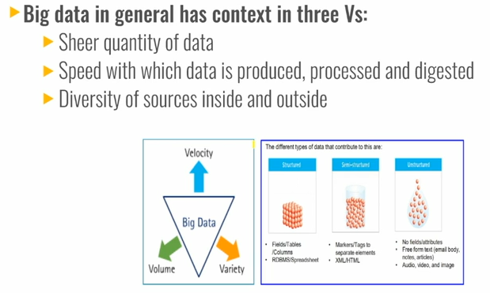
Big Data

Slide 7
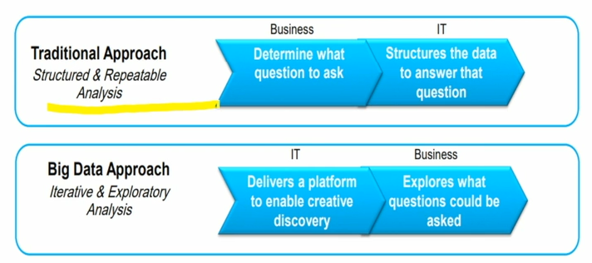
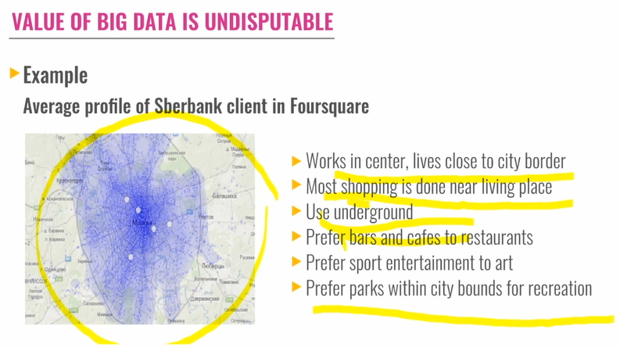

Slide 8
The first V is Volume. The more data volume that receives, the harder it becomes for the traditional infrastructure to handle it. Managing that huge flow of data with your current budget might not be economically feasible. Enterprises are awash with ever-growing data of all types, easily amassing terabytes (even petabytes) of information.
The second V is Velocity. When this large volume is handled with instruments such as radio frequency identification (RFID) sensors, cellular phones, and social media, the question is what can we do to improve the response time. Some of the data is highly perishable, and its usefulness is over in a short time. Sometimes two minutes is too late. For time-sensitive processes, such as catching fraud, big data must be processed immediately as it streams into your enterprise to maximize its value.
The third V is Variety. Big data is any type of data: structured and unstructured data, such as text, sensor data, audio, video, click streams, and log files. New insights are found when these data types are analyzed together. To put that in context, if one cup of coffee was a gigabyte, the Great Wall of China would be 1 zettabyte. So, all of the data in the world is equal to one and one half great walls of china. Now, of that 1.6 zettabytes, 80% of that data is unstructured, so there are many novel sources of data that traditional technologies cannot manage or analyze.

Slide 9
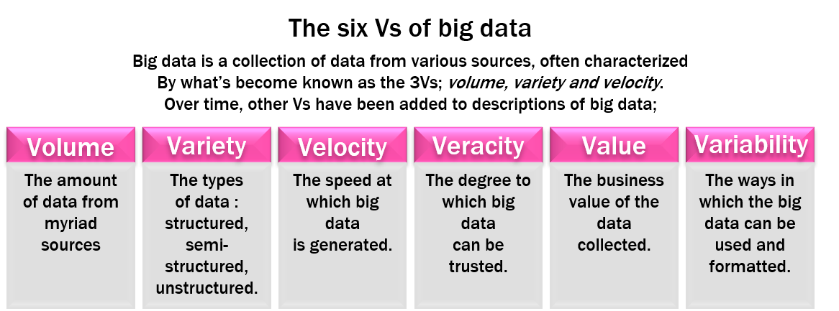
There is a notion that, by having this much data in the world and trying to manage and analyze that data, you must be able to trust the resulting information. Bad input equals bad output. In fact, in surveys that are conducted with the CIO, CFO, and CEO of companies, some of the information that was provided by these business leaders is surprising. One in three business leaders think they make frequent decisions with a lack of trust in the information, and one in two say that they do not have access to information that they need to do their jobs. So, 50% said they cannot do their job as well as they could; not because they are not getting the information that they need for the perfect analysis, but because even though we think that we gave them all of the information that they need, they do not think so. Also, 83% of the CIOs that were surveyed think and see analytics and business intelligence as part of their future roadmap. But how can you act upon information if you do not trust it? Establishing trust in big data presents a huge challenge because the variety and number of sources grow. Veracity becomes the fourth V around big data.

Slide 10
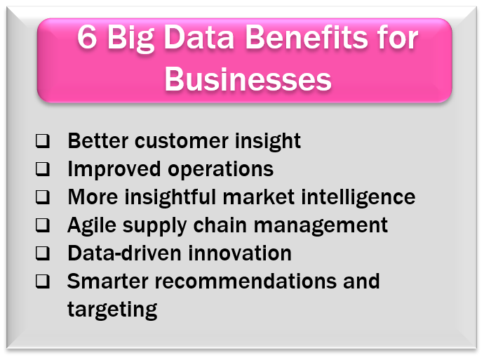
Why Is Big Data Important?
Determining root causes of failures, issues and defects in near-real time.
Generating coupons at the point of sale based on the customer’s buying habits.
Recalculating entire risk portfolios in minutes.
Detecting fraudulent behavior before it affects your organization.

Slide 11
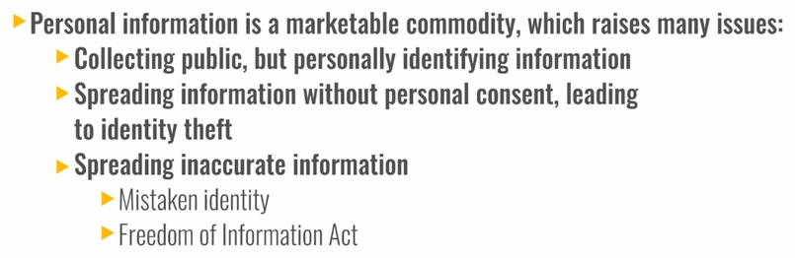
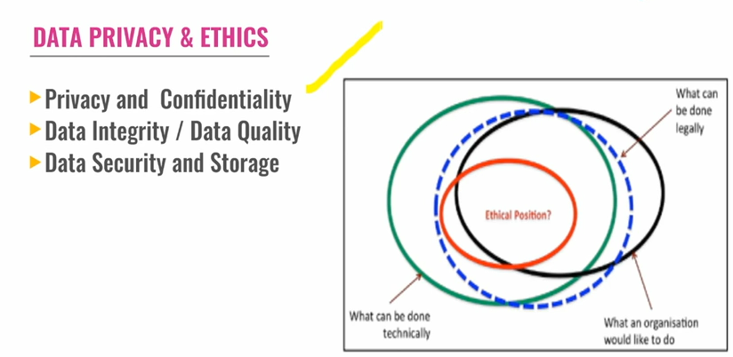
Data privacy and Ethics

Slide 12
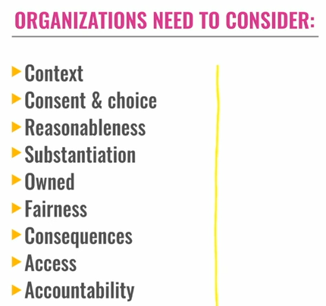
DATA PRIVACY AND ETHICS
Definition of Data Privacy
Data Privacy, also called Information Privacy, is the aspect of information technology (IT) that deals with the ability an organization or individual has to determine what data in a computer system can be shared with third parties.
Definition of Data Ethics
“A specialized area of Data Governance and Stewardship” where data can be “productionalized and, in large part, automated through the use of good tooling.” (Andrew Brust, Tech Crunch)
Not only moral guidance as to “what data should be collected and how it should be used,” but also “who gets to make those decisions in the first place.” (James Arvanitakis, et al., Phys.org)
A code of conduct or ethics for Data Scientists, similar to the purpose of the Hippocratic Oath in guiding medical professionals. (Natalie Evans Harris, BrightHive)

Slide 13
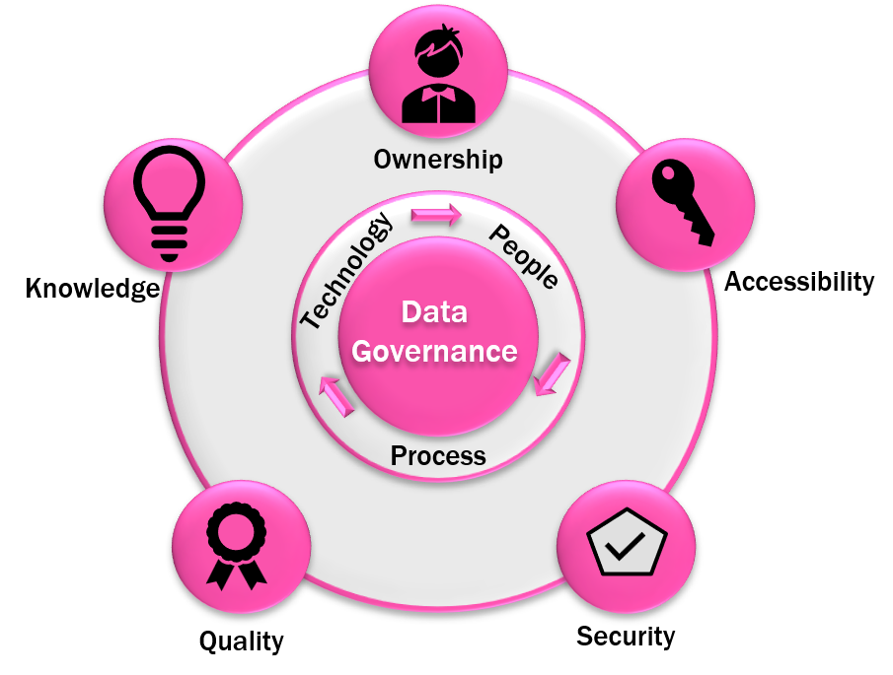
Data Governance: A process of management and oversight for information access according to established best practice standards to ensure:
Data Integrity
Security
Privacy and Confidentiality

Slide 14
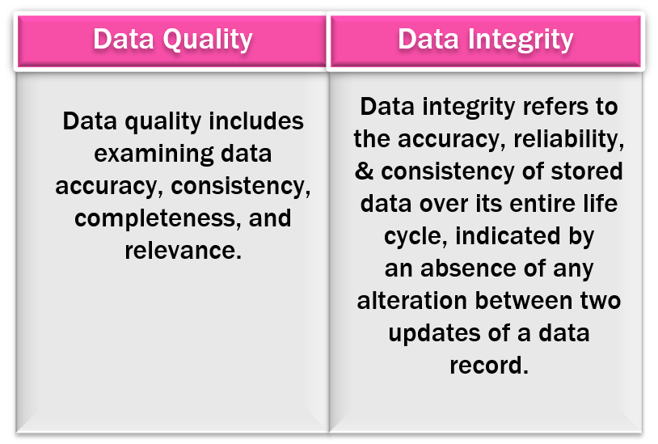
Data Integrity: The entire set of characteristics associated with data quality. These include data content, including, currency (whether data are up to date or current), relevance to the decision-making purpose, and accuracy (whether data are correct); scope (comprehensiveness); level of detail composition (issues involved in database structure and the definition of entities and attributes) consistency, including both semantic consistency (consistency in the definitions of data elements, such as “patient number”, across entity types, such as “patient” and “encounter”) and structural consistency (consistency in the business rules that define the relationships among data elements) and reaction to change, which concerns how data elements are updated, deleted or added to a database.
Data Security: Physical and electronic protection of integrity, availability, and confidentiality of computer-based information and the resources used to enter, store, process, and communicate it. The means to control access and protect information from accidental or intentional disclosure.
Data Quality: The data owner is also accountable for maintaining the quality of the information. This may include determining and setting user data quality expectations, instituting gauges and measurements of the levels of data quality, and providing reports on the conformance to data quality. This also includes defining data quality policies for all data that flows into the system and any data cleansing, standardization, or other preparation for user applications.

