Slide 1

Diploma in Data Analytics

Slide 2
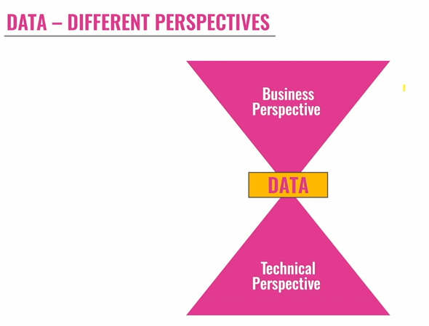
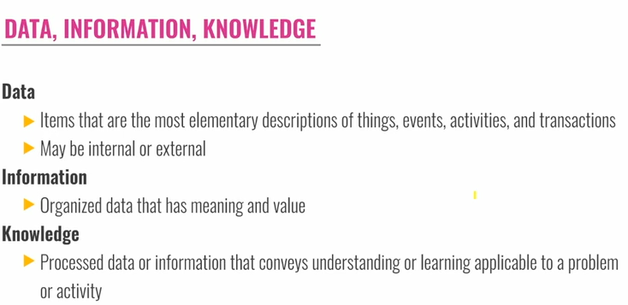
Concept

Slide 3
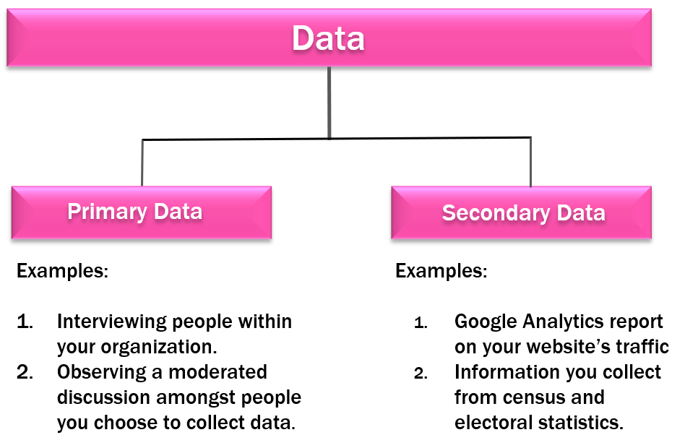
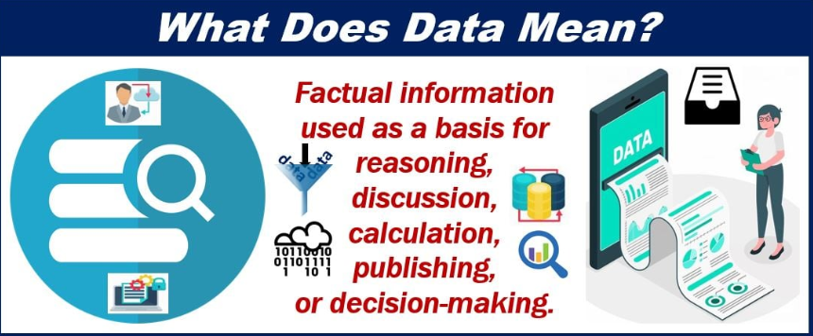
Primary data is what we usually mean by data: the content of documents or databases, or messages transferred over a network, or sensor readings.
Metadata refers to primary data by describing its format, version, status, and so forth. Metadata is data about data.
Operative Data is a subtype of metadata describing how data is to be used.
Derivative Data is derived from the three above-mentioned data types. It can be used to sort, organize, or search for patterns in the above-mentioned types of data.

Slide 4
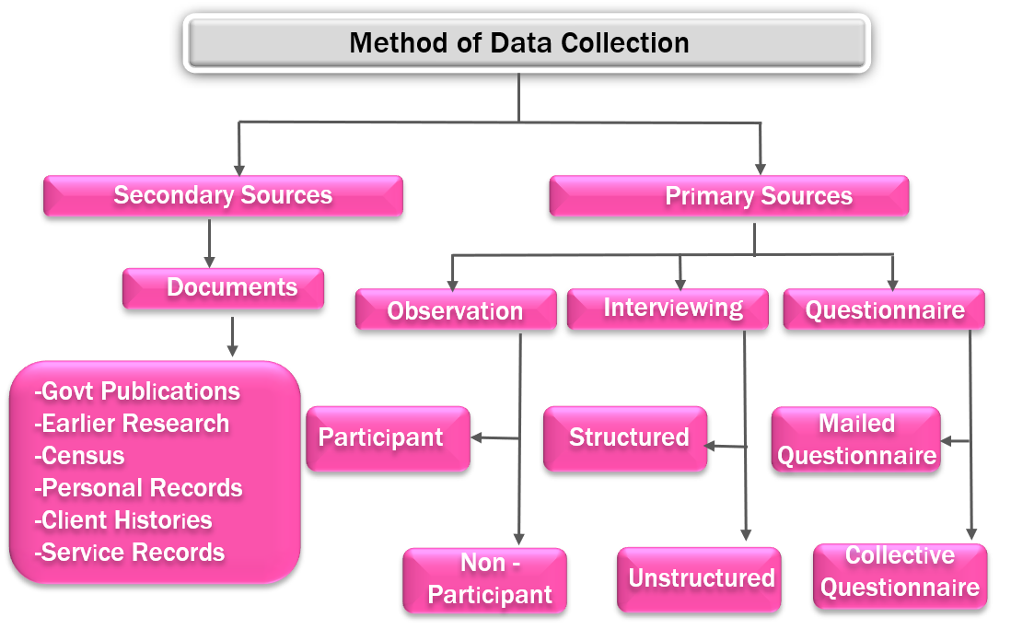

Slide 5
Definition of Information
Information is well-formed data with meaning. Data must follow syntactical rules. Information goes beyond that by adding meaning. There is a reference to the “well-formedness” of the combined data elements because meaning cannot be assigned to terms that violate syntax rules.
Different data can mean the same thing. Vice versa, the same data can mean different things - if it is interpreted differently. Because information consists of data and assigned meaning, different data can never be the same information (but can mean the same thing).
Knowledge
“Knowledge is the human expertise stored in a person’s mind, gained through experience and interaction with the person’s environment”.
This definition provides a link to interaction and experience, and it emphasizes: knowledge resides in the mind. When knowledge management refers to the organizational dimension of learning, knowledge must be spread. In the sense of this can only mean converting the knowledge of person A into information and finally into data. Data can be stored and information re-created by again assigning meaning and context.

Slide 6
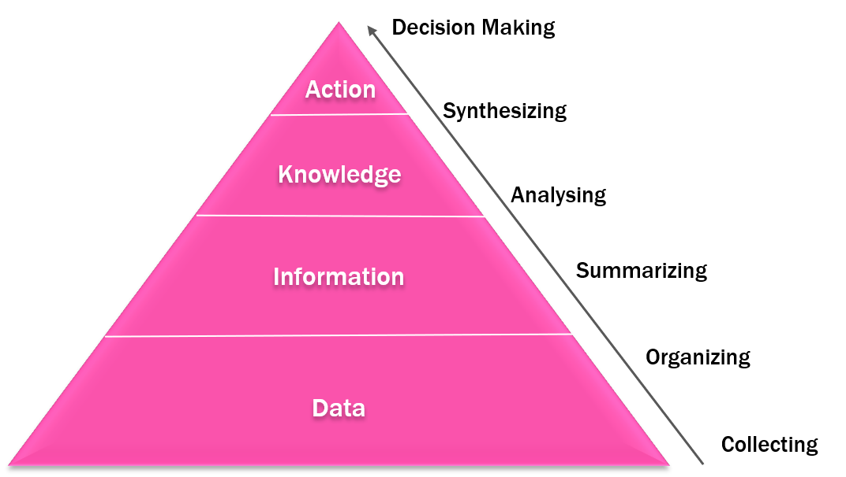

Slide 7
Information and knowledge are the outcomes of human action that engage signs, signals, and artifacts in social and physical settings.
Knowledge builds on an accumulation of experience.
Information depends on an aggregation of data. The transformation of data into information and then into knowledge requires a human cognitive effort that results in the perception of structure and the attribution of meaning and significance. Consider a document containing a table of numbers indicating product sales for the quarter. As they stand, these numbers are data. An executive reads these numbers, recognizes the name and nature of the product, and notices that the numbers are lower than the corresponding figures of the last three quarters, thus indicating a downward trend.
Data has become information. The individual considers possible explanations for the product decline and concludes that the product is no longer attractive to its customer. This new belief, derived from reasoning and reflection, is knowledge. Based on this knowledge, the individual may decide to take some action (such as adding new product features or identifying new markets). In this way, information is data given context and vested with meaning and significance.

Slide 8

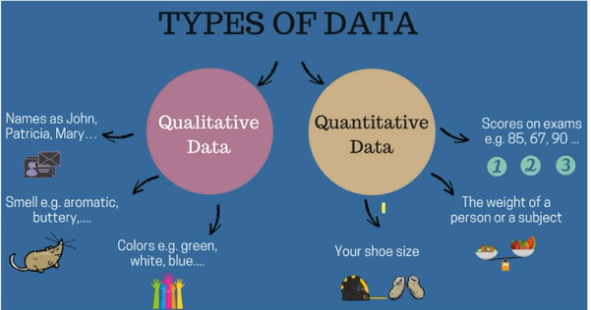
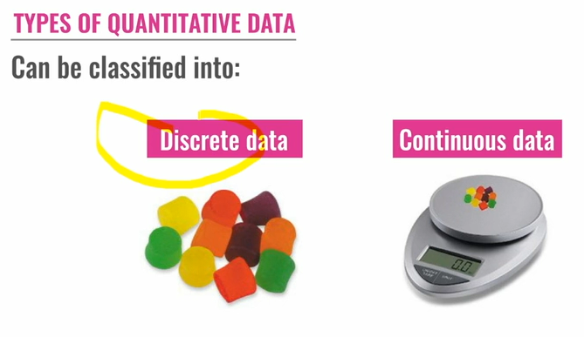
Types of data

Slide 9
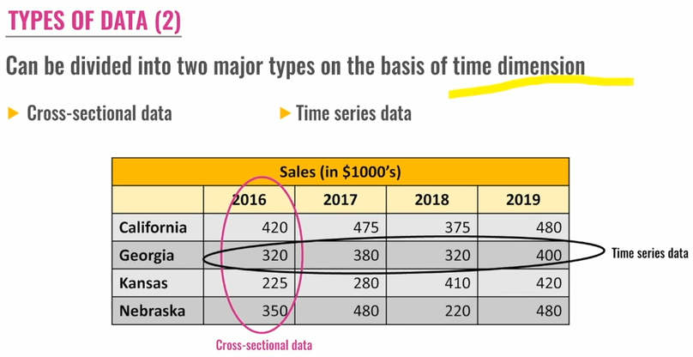

Slide 10
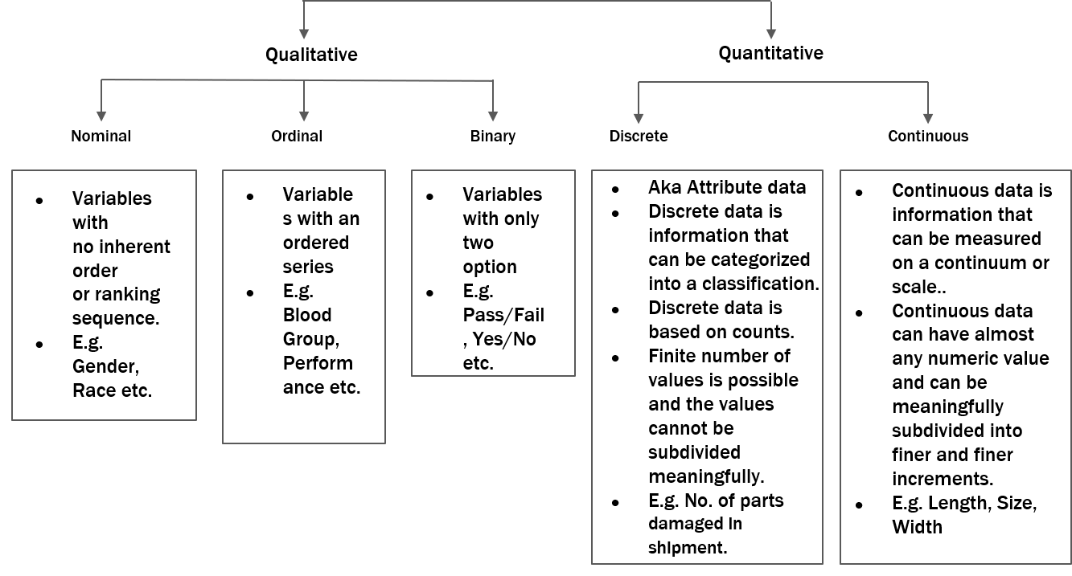
TYPES OF DATA
The word Data means a set of known facts. There are different types of data because there are different ways in which facts are gathered. Some data may exist because specific things have characteristics that have been categorized whereas other data may exist as a result of things being counted, or measured on some sort of scale.

Slide 11
The first important distinction to make is between Qualitative Data and Quantitative Data. Qualitative data consists of categories or types of a characteristic or attribute. These categories form the basis of the analysis of qualitative data. The socio-economic definitions, social class A, B, C1, and so on, would be qualitative data, whereas the numbers of houses or amount of income would be quantitative data. Quantitative Data is based on counting or measuring. The numerical scale used to produce the figures forms the basis of the analysis of Quantitative Data.
The second important distinction to make is between the two different types of quantitative data: Discrete and Continuous.
Discrete Data
Discrete data is quantitative data that can take only a limited number of values because it is produced by counting in distinct or “discrete” steps or measuring against a scale made up of distinct steps.
There are Three types of Discrete Data that You May have to Deal with,
Data that can only take certain values because other values simply cannot occur, for example, the number of t-shirts sold by a clothing retailer in a day. There could be 12 sold one day and 7 on another, but selling 9.3 t-shirts in a day is not possible because there is no such thing as 0.3 of a t-shirt.
Data that take only certain values because those are the ones that have been established by long-standing customers and practice, for example, public houses in the UK sell draught beer in whole and half-pints. You could try asking for three-quarters of a pint, but the bar staff would no doubt insist that you purchase the smaller or larger quantity.
Data that only takes certain values because the people who have provided the data or the analysis have decided, for convenience, to round values that don’t have to be discrete. For example This is what you are doing when you give your age to the last full year. Similarly, the temperatures given in weather reports are rounded to the nearest degree, and the distances on road signs are usually rounded to the nearest mile. Such data is discrete by convention rather than by definition. It is really continuous data.

Slide 12
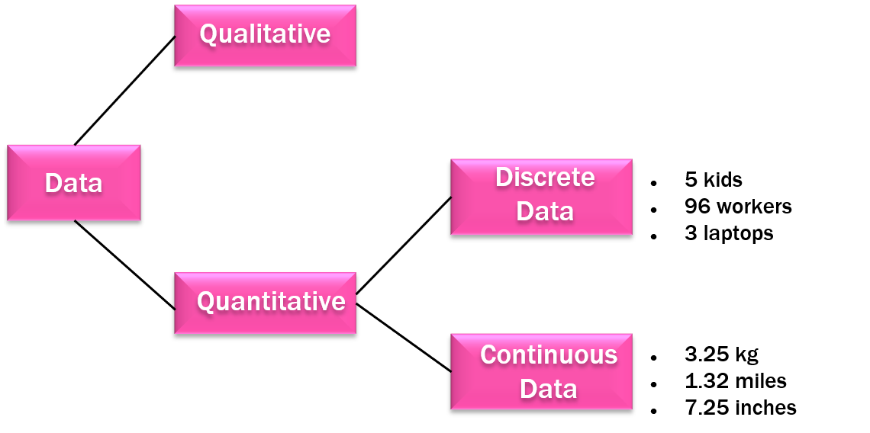
Continuous Data
The precision of Continuous Data is limited only by how precisely the quantities are measured. For instance, we measure both the length of bus journey and athletic performances using the scale of time. In the first case, a clock or a wristwatch is sufficiently accurate, but in the second case, we would use a stopwatch or an even more sophisticated timing device. Further on you will find the terms discrete variable and continuous variable. A discrete variable has discrete values whereas a continuous variable has continuous values.

Slide 13
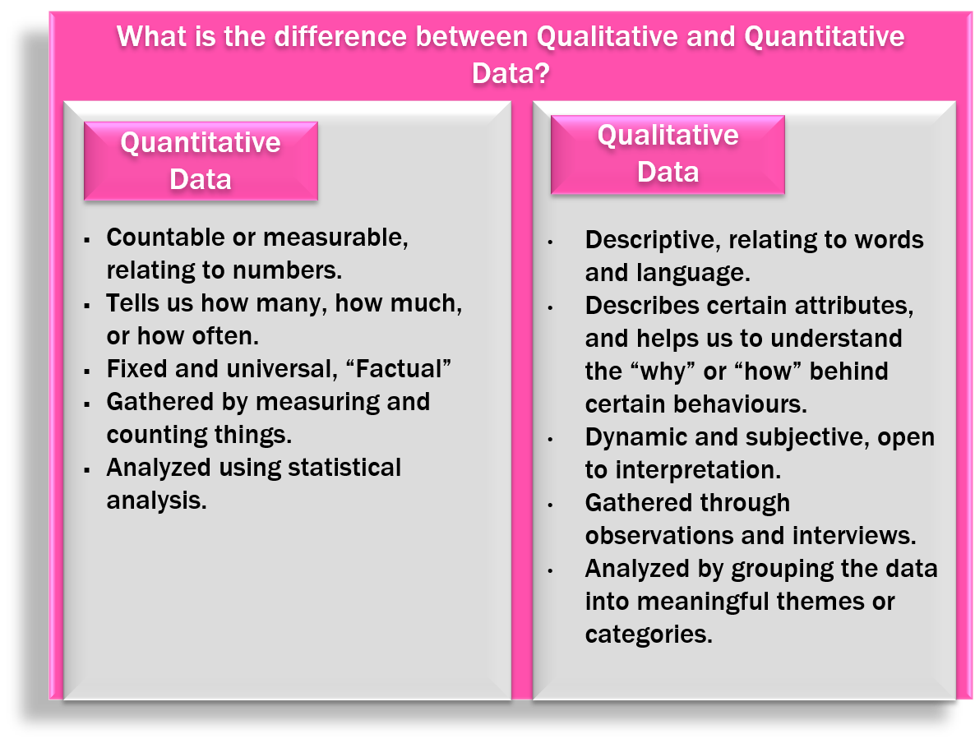

Slide 14
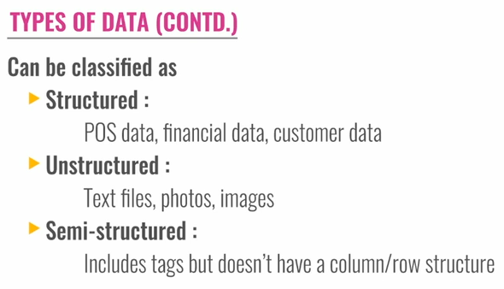
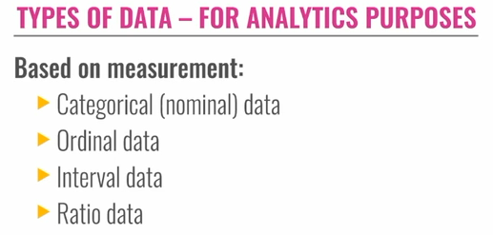
Types of Data

Slide 15
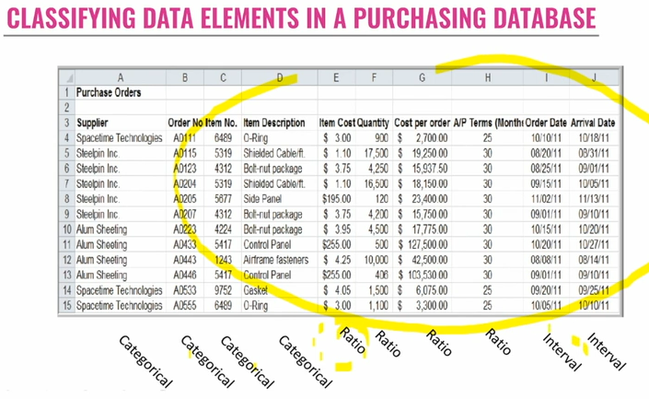

Slide 16
TYPES OF DATA (Continue)
Structure Data
term used when it is clear what data elements exist, where, and in what form. In its most simple form, structured data is a fixed record layout; however, there are variable record layouts, including XML that make it clear what data points exist, where, and in what form.
The most common form of structured data is file and database data. This includes the content of the many databases and files within an enterprise company where there is a formal file layout or database schema. This data is typically the result of business applications collecting books and records data for the enterprise.
Unstructured Data
term used when it is not clear what data elements exist, where they exist, and the form they may be in. Common examples include written or spoken language, although heuristics can often be applied to discern some sampling of structured data from them.
The most unstructured data does not even have data elements. These forms of unstructured data include signal feeds from sensors involving streaming video, sound, radar, radio waves, sonar, light sensors, and charged particle detectors.
Often some degree of structured data may be known or inferred with even these forms of unstructured data, such as its time, location, source, and direction.
Semi-Structured Data
term used when it is clear that there is some combination of structured and unstructured data, which often represents the largest amount of data in size across almost every enterprise.
The most common forms of semi-structured data include electronic documents, such as PDFs, diagrams, presentations, word processing documents, and spreadsheet documents, as distinct from spreadsheets that strictly represent flat files of structured data. Another common form of semi-structured data includes messages that originate from individuals, such as email, text messages, and tweets.

Slide 17
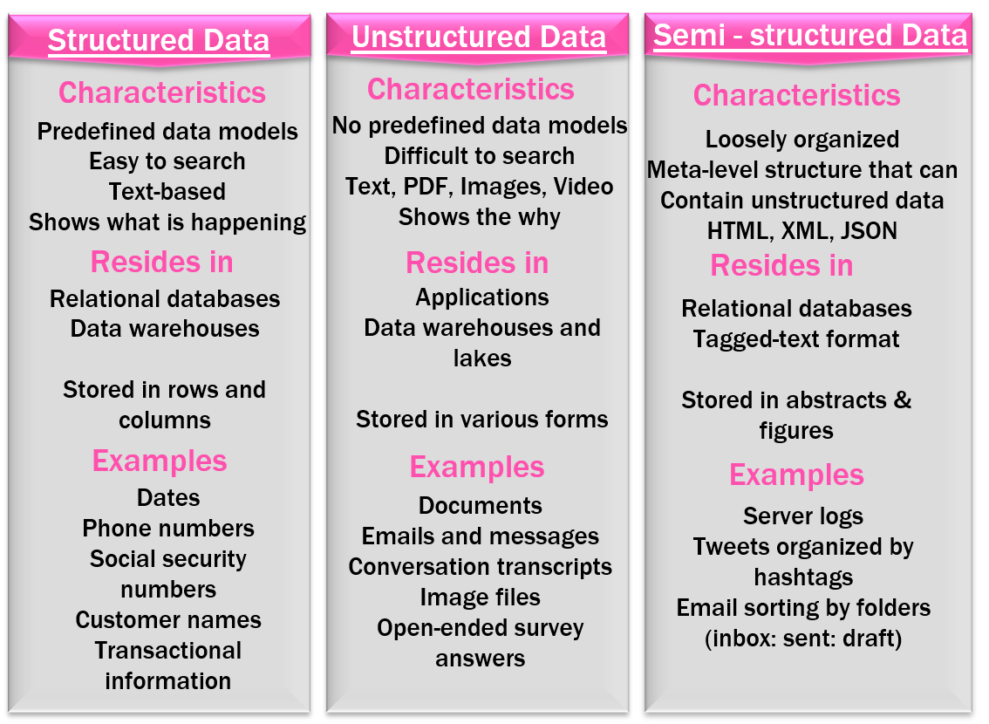

Slide 18
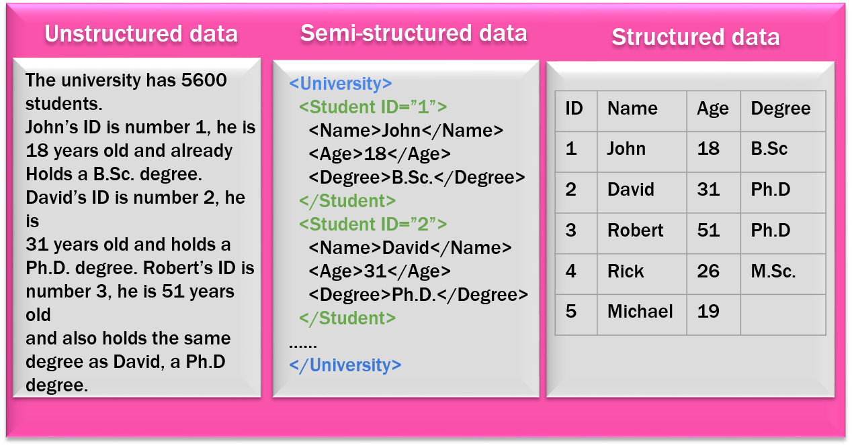

Slide 19
Interval (or Scale) Data are values recorded along a numeric scale, e.g. reading the length along a ruler, or noting an output reading on a PH meter. The differences (intervals) on the scale represent true measures, e.g. the difference between 40 degrees Celsius and 80 degrees Celsius is twice the temperature difference between 0 degrees Celsius and 20 degrees Celsius. Interval data can be discrete, where values are recorded to a limited precision or continuous, in which values can be recorded to any possible precision.
Ordinal Data is nominal data where the different categories show a sense of progression that can be represented by numerical values. For example, the assessment of quality defined by poor, satisfactory good, excellent, could also be defined by 1,2,3,4. However, the values are not interval data because of the difference between excellent 4. And satisfactory 2. Cannot be assumed to be twice the difference between the good 3. And satisfactory.
Categorical Data is data that has been put into specific categories. Nominal data is a natural example of categorical data, but ordinal data with a limited number of values can also be treated as categorical data. Interval data can be grouped into categories by binning (8.1.8), and the number (frequencies) of values in each category can be ‘counted’ using tabulation (8.1.7). The analysis of categorical data is developed with chi-squared analysis in section 3.7.
Ratio Data is interval data where the ‘0’ value equates to a true zero in a scientific context. For example, the Kelvin and Celsius temperature scales both have the same interval of one degree, but the Kelvin scale is not ratio data because it only defined o degree Celsius as the triple point of water. 100 degree K is twice the thermodynamic temperature of 50 degree Celsius K, but 100 degree Celsius (373 degrees K) is not twice the thermodynamic temperature of 50 degree Celsius (323 degrees K).

Slide 20
