Slide 1
Decision Making

Slide 2
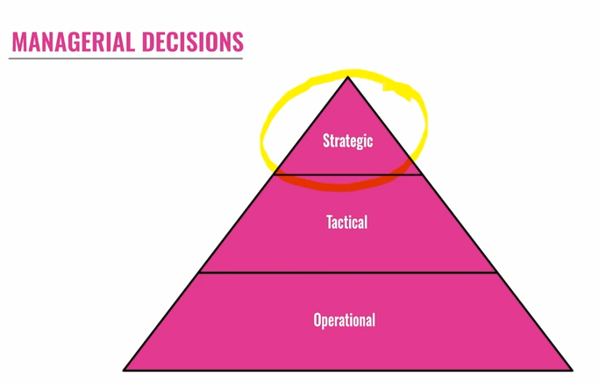
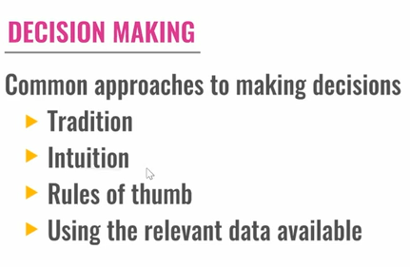

Slide 3
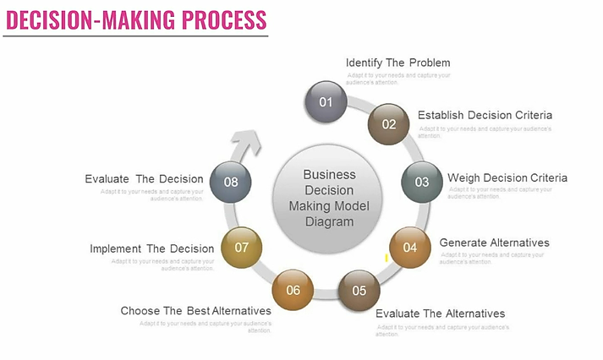

Slide 4
DECISION MAKING
Decision-Making is said to be a psychological construct. This means that although we can never “see” a decision, we can infer from observable behavior that a decision has been made. Therefore, we conclude that a psychological event that we call “decision making” has occurred. It is a construction that imputes commitment to action. That is, based on observable actions, we assume that people have committed to effecting the action.
“Decision making is defined as the selection of a future course of action from among various alternatives. A decision is a choice made from available alternatives. Decision making is the process of identifying problems and opportunities and then resolving them by choosing the right solutions for that particular situation.”
We may Summarize the Definition of Decision Making as follow:
Decision–making is the study of identifying and choosing alternatives based on the values and preferences of the decision-maker.
Decision–making is the process of sufficiently reducing uncertainty and doubts about alternatives to allow a reasonable choice to be made from among them.

Slide 5
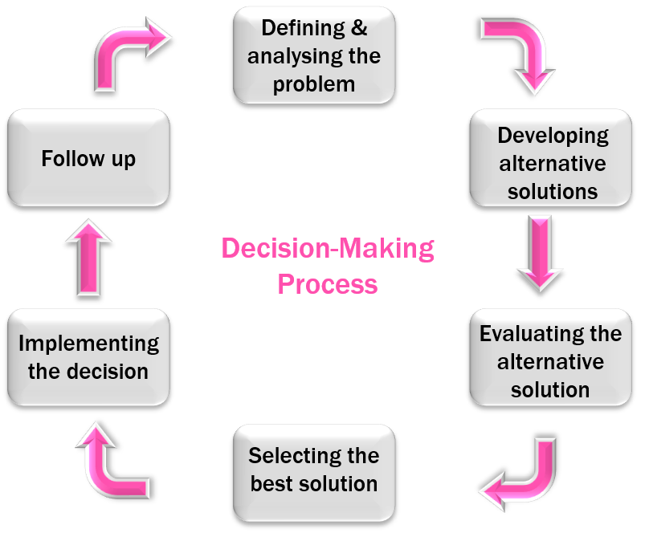

Slide 6
Define the Problem: Decision-making is needed only when there is a problem that needs immediate attention. Hence the first step in decision making is defining the problem. The problem must be correctly defined as a wrong definition leads to the wrong decision. That is why it is said that “A problem well defined is a problem half solved”. The problem may arise due to a gap between actual and desired results. It may also be due to a change in the environment which may result in an opportunity or a threat. Thus identification of problems calls for continuous monitoring of the environment and timely and correct identification of problems.
Analyze the Problem: Once the problem is identified it has to be thoroughly analyzed. Analysis of the problem in terms of its magnitude, its relation to other problems, the variables influencing the problem, and possible causes of the problem are very important and they will have a significant influence in the selection of a better solution. The problem has to be analyzed for the nature of the decision needed, the impact of a decision, and the limiting factors or constraints of the decision.
Develop Alternatives: Every problem has many solutions and one cannot say that there are no alternatives. Good decision-making is all about selecting the right alternative for the problem situation. Managers have to develop as many alternatives as possible so that they cannot miss the best course of action. The ability to develop as many alternatives as possible depends on the creativity and imagination of the manager. For complex decisions involving a group of people, a brainstorming session can generate many choices.
Evaluate each Alternative: Each alternative developed has to be evaluated and tested for its suitability. Alternatives have to be evaluated concerning the objectives to be achieved. Analysis of each alternative for cost-benefit analysis, feasibility, technical viability, availability of resources for its implementation, relative merits and demerits, etc. has to be made.
Select the best Alternative and Implement: The best alternative is one that can be implemented within the situational constraints and maximize results in terms of defined objectives of the organization. Thus situational constraints like budget resource availability, time available, etc. may influence the selection of the best alternative. Once an alternative is selected, it has to be implemented systematically, it has to be communicated to all those concerned and all the resources which are required for implementation are to be more available. Coordination of all the parties involved is very important for the successful implantation of the decision.
Follow-Up and Feedback: Implementation of decision requires continuous monitoring. Any changes in the environment may result in many hindrances to implementation or changes may even make a decision ineffective. Hence continuous follow-up and feedback can help the managers in taking timely unpleasant circumstances and ensures that decisions contribute to the achievement of objectives

Slide 7

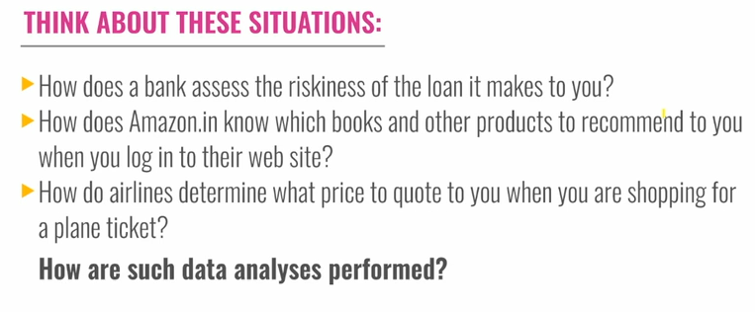

Slide 8
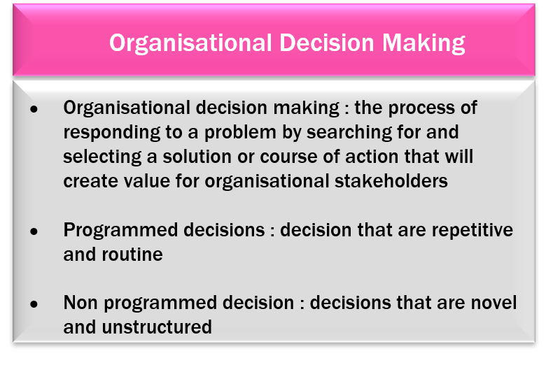
DATA TO INSIGHTS IN DECISION MAKING
The Process of Organizational Decision Making
The theme of the preceding section, rational decision, can be applied to the levels of both the individual or to the organization, or even to the State itself. To change the level of analysis from individual to collectivity does not change the form of the analysis, in principle.

Slide 9
Organizations could have a single set of well-ordered goals to which its members are equally dedicated and which (by instruction or by the manner of their recruitment) are ranked in an official order, and where the set of feasible means to achieve those goals is a shared body of knowledge in the organization. In short it is possible to think of the organization as an individual, albeit a more knowledgeable and more consistent one than the real thing. Lindblom’s “disjointed incrementalism” could then be viewed as the result of the decision-making process amongst a number of officials whose work is smoothly coordinated (by the visible hand of the organization’s leaders) and brought to bear on the agreed and publicly stated problems which the organization is expected to solve – be it efficient education, investment analysis or national defense.
Such a view has been held by theorists of organized decision-making. But the central thrust of modern analysis of decision making in organizations is away from this simple view towards a descriptive and analytic picture of organizations whose members as a body necessarily value goals in policy-making which are either indifferent to the organization’s purposes as defined by its masters, or even hostile to them.

Slide 10
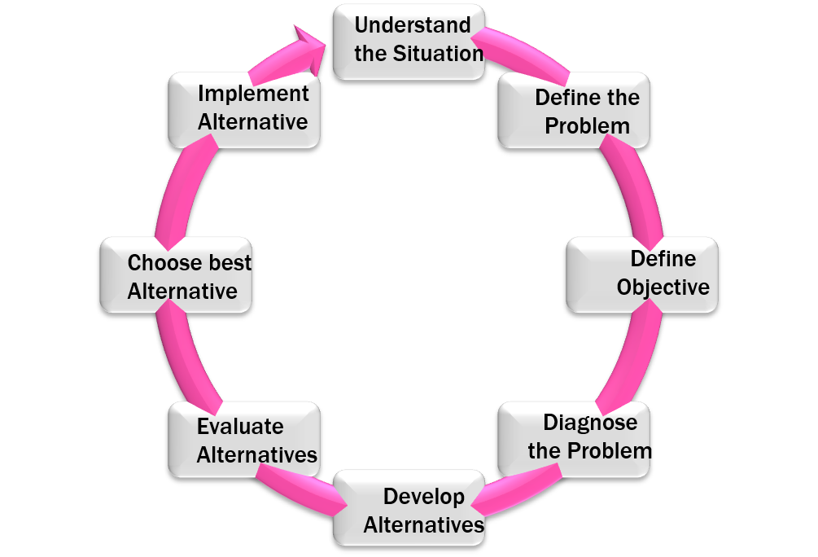


Slide 11
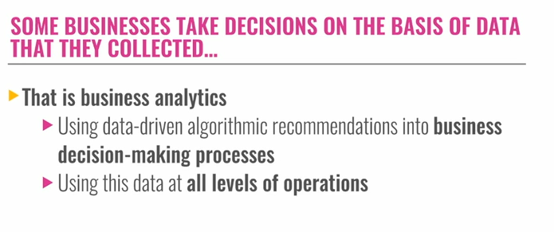
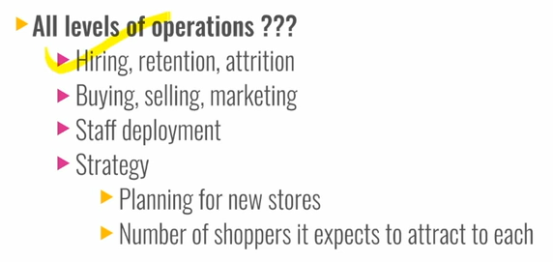

Slide 12
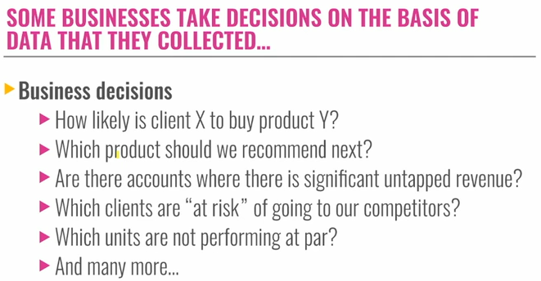
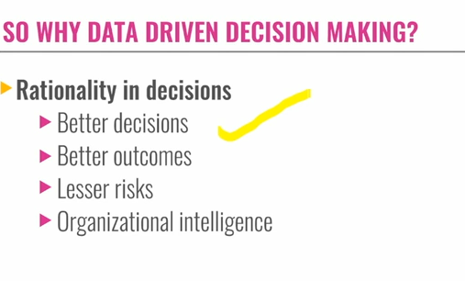

Slide 13
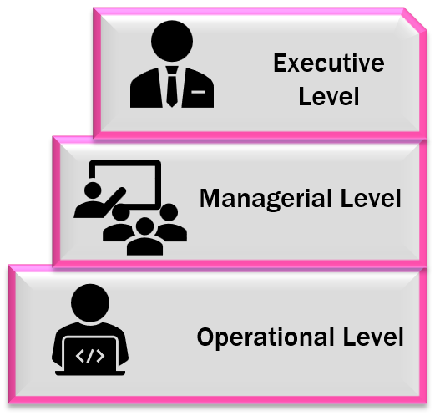
DECISION MAKING IN ORGANIZATION
Fewer top-performing companies (40%) than laggards base the majority of their business decisions on gut feel or experience (70%). In other words, more organizations that make data-driven decisions are at the top of their game than businesses whose decisions are driven by instinct.

Slide 14
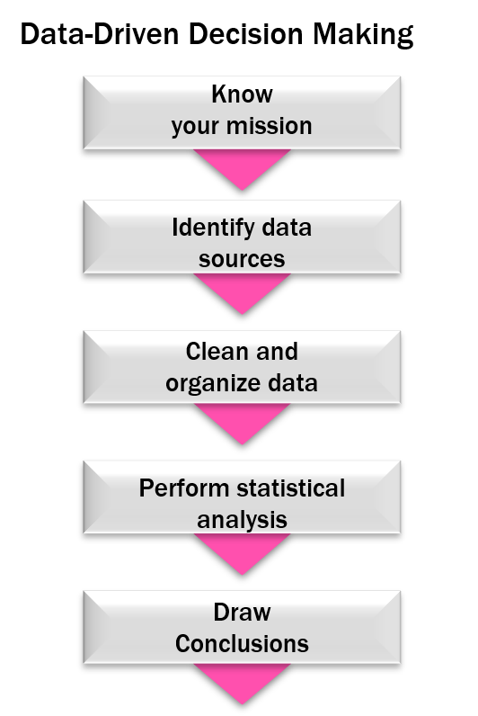
Here are just some of the things you stand to gain by becoming a Data-Driven Organization:
Remain competitive among forward-thinking companies that do use data to their advantage
Data-driven companies are more customer-focused and enjoy a deeper insight into the customer and their journey
Cost-effective – it can be costly to store large volumes of data, especially if you only use it for compliance purposes
Detect new or missed opportunities, helping your company grow and improve regularly
Become more agile and better able to respond to markets

Slide 15
Know your Mission
A well-rounded data analyst knows the business well and possesses sharp organizational acumen. Ask yourself what the problems are in your given industry and competitive market. Identify and understand them thoroughly. Establishing this foundational knowledge will equip you to make better inferences with your data later on.
Identify Data Sources
Put together the sources from which you’ll be extracting your data. You might be coordinating information from different databases, web-driven feedback forms, and even social media.
Clean and Organize Data
Surprisingly, 80 percent of a data analyst’s time is devoted to cleaning and organizing data, and only 20 percent is spent actually performing analysis. This so-called “80/20 rule” illustrates the importance of having clean, orderly information before you can attempt to interpret what it might mean for your organization.
Perform Statistical Analysis
Once you’ve thoroughly cleaned the data, you can begin to analyze the information using statistical models. At this stage, you will start to build models to test your data and answer the business questions you identified earlier in the process.
Here, you will also need to decide how to present the information in order to answer the question at hand. There are three different ways to demonstrate your findings:
Descriptive Information: Just the facts.
Inferential Information: The facts, plus an interpretation of what those facts indicate in the context of a particular project.
Predictive Information: An inference based upon facts and advice for further action based on your reasoning.
Draw Conclusions
The last step in data-driven decision making is coming to a conclusion. Ask yourself, “What new information did you learn from the collection of statistics?” Despite pressure to discover something entirely new, a great place to start is by asking yourself questions to which you already know—or think you know—the answer.

Slide 16
Incidentally, the majority of the steps listed above do not generate statistics. The majority of these steps to effectively utilize data instead encourage novice data analysts to become well-rounded in their role. This process helps professionals become capable of not only analyzing, but understanding data from a holistic perspective and providing insight based upon the data as well.
Joel Schwartz, a non-teaching affiliate of Northeastern adds, that it’s worth asking, ‘Who isn’t utilizing data-driven decision making in my industry?’ because the most successful companies almost always are. He continues:
Consider Netflix, for example. The company started as a mail-based DVD sharing business and, based on a data-driven decision, grew to internet streaming—becoming one of the most successful companies today. Without data, Netflix would not have had the basis to make such an immense and impactful decision. Moreover, without that decision, the company would not have flourished at the rate or in the direction it did.
Amazon is another poignant example. What started as an online bookstore has blossomed into a massive online hub for just about any product a person could want or need. What drove them to make such enormous decisions? Data. It’s no surprise that such major (and successful) rebranding moves were made based on data collection and the inferences made as a result.
Without the data-driven approach to decision making, Netflix would still be mailing you an outdated mode of movie content and Amazon would be a simple online bookstore. The bottom line is that this data-driven approach is putting all other methods out of business. The world is becoming data-driven, and to not make data-driven decisions would be foolish.

Slide 17
