Slide 1
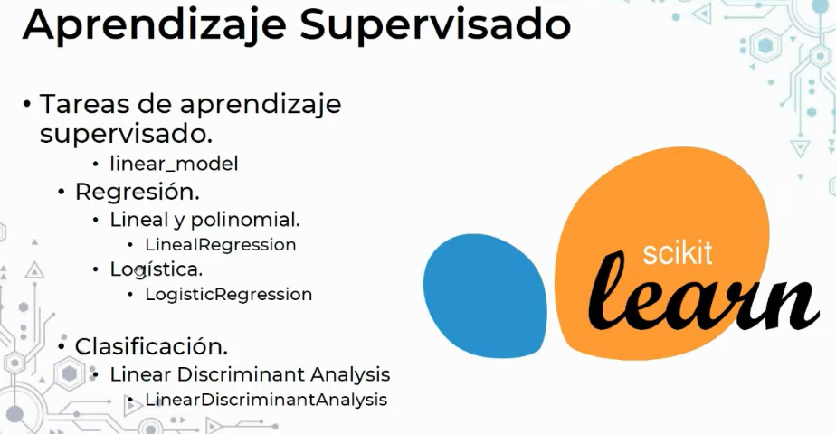

Slide 2
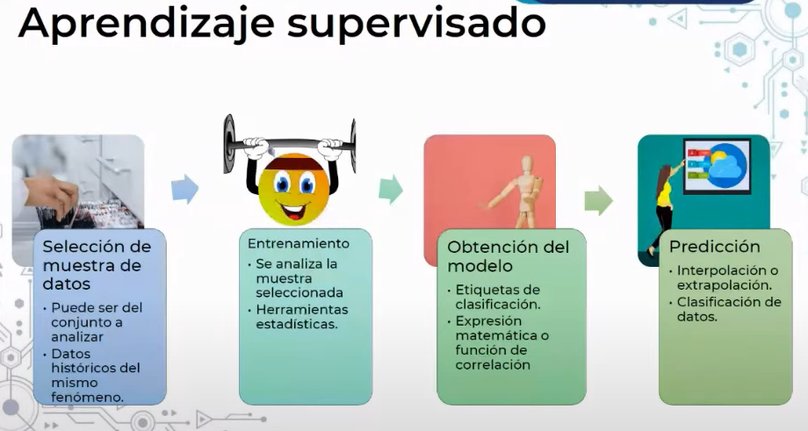

Slide 3
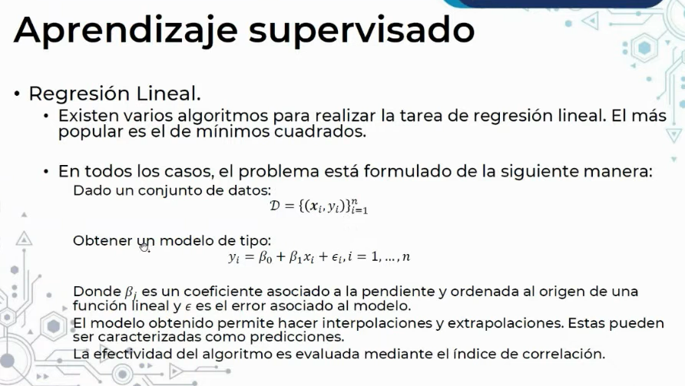

Slide 4
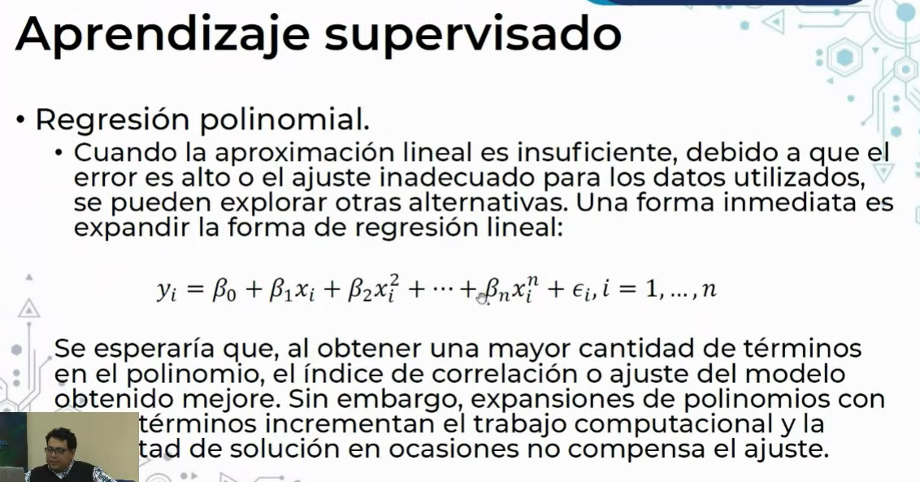

Slide 5
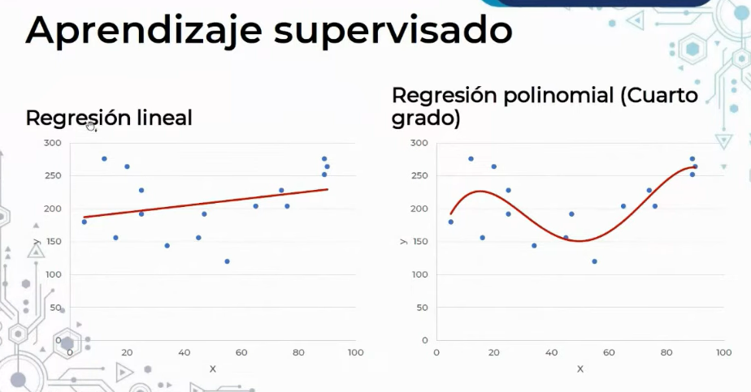

Slide 6
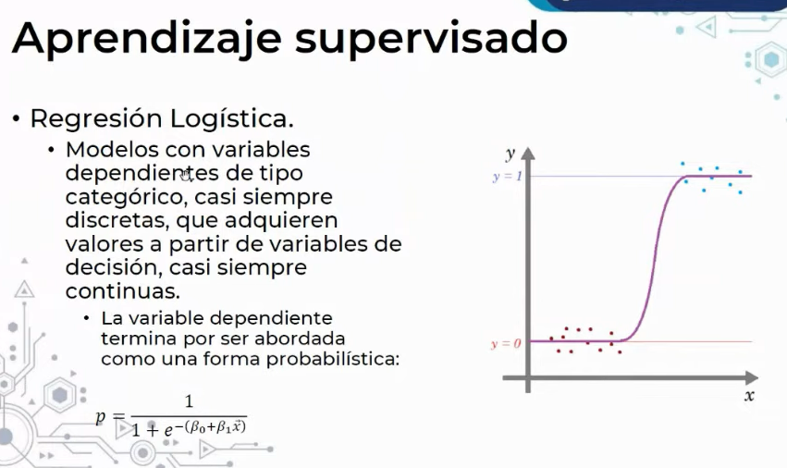

Slide 7
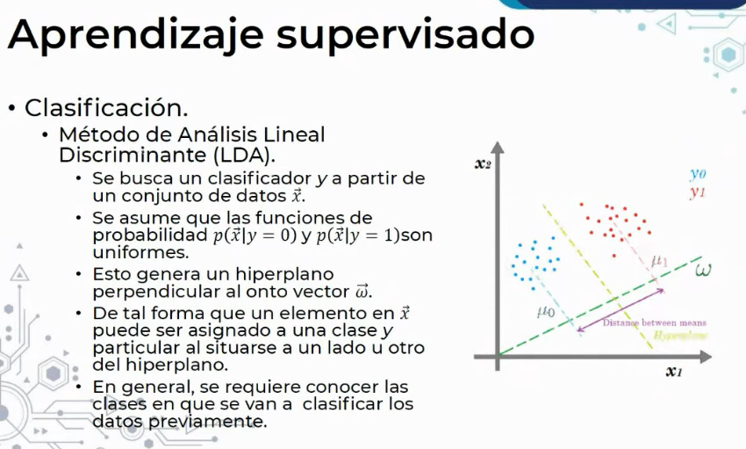

Slide 8
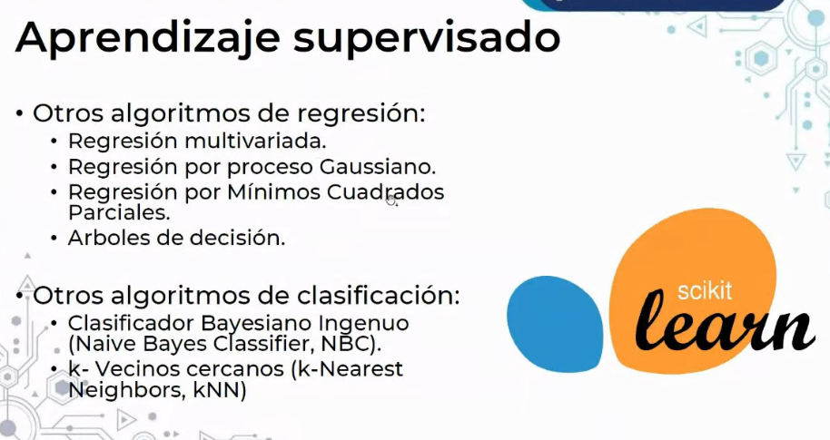

Slide 9
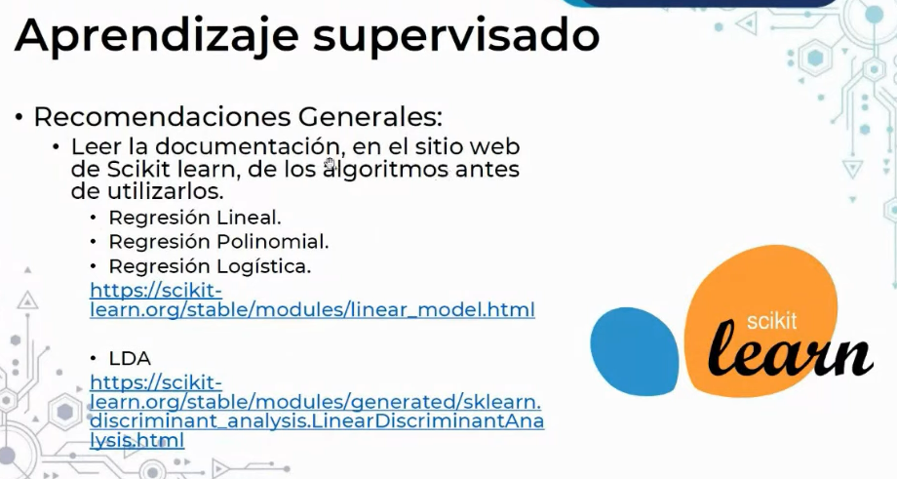

Slide 10
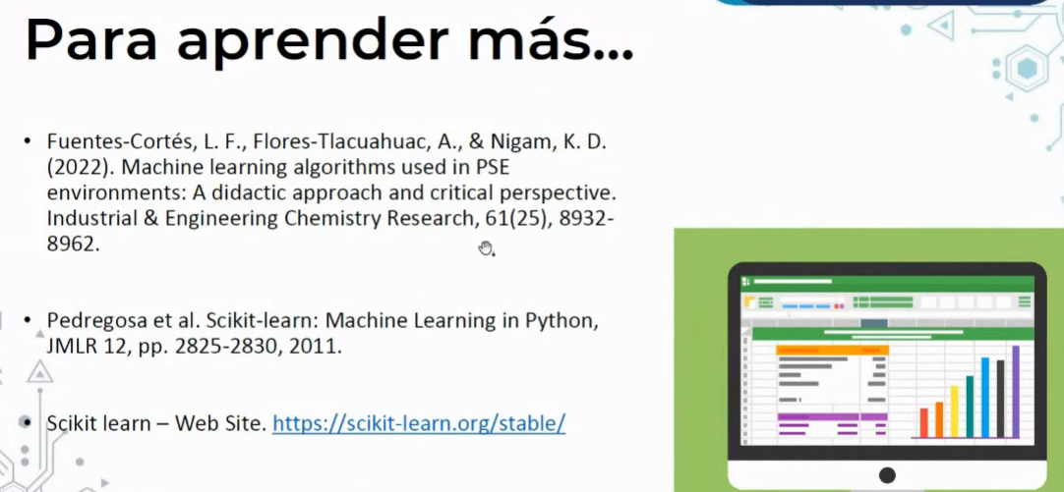

Slide 11
PolynomialFeatures
https://scikit-learn.org/stable/modules/generated/sklearn.preprocessing.PolynomialFeatures.html
LogisticRegression
https://scikit-learn.org/stable/modules/generated/sklearn.linear_model.LogisticRegression.html
LinearDiscriminantAnalysis
https://scikit-learn.org/stable/modules/generated/sklearn.discriminant_analysis.LinearDiscriminantAnalysis.html

Slide 13
KMeans
https://scikit-learn.org/stable/modules/generated/sklearn.cluster.KMeans.html
PCA
https://scikit-learn.org/stable/modules/generated/sklearn.decomposition.PCA.html

