Slide 1


Slide 2
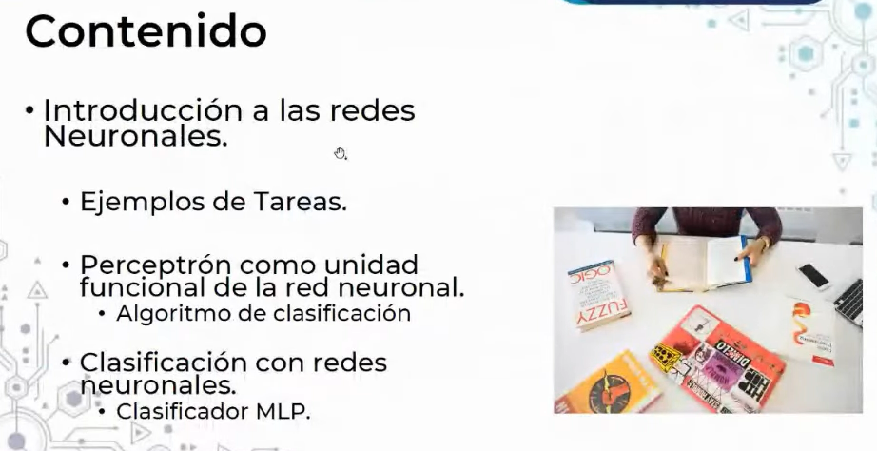

Slide 3
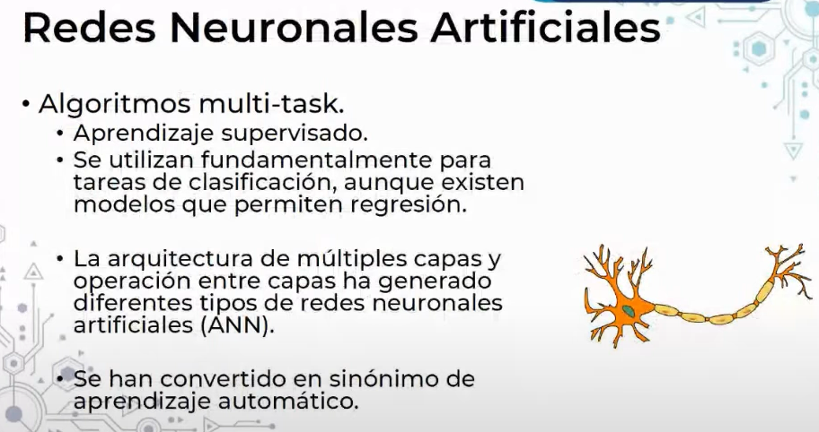

Slide 4
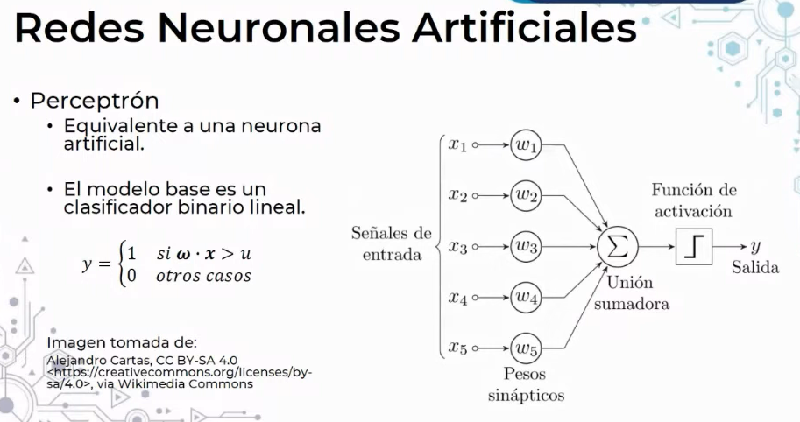

Slide 5
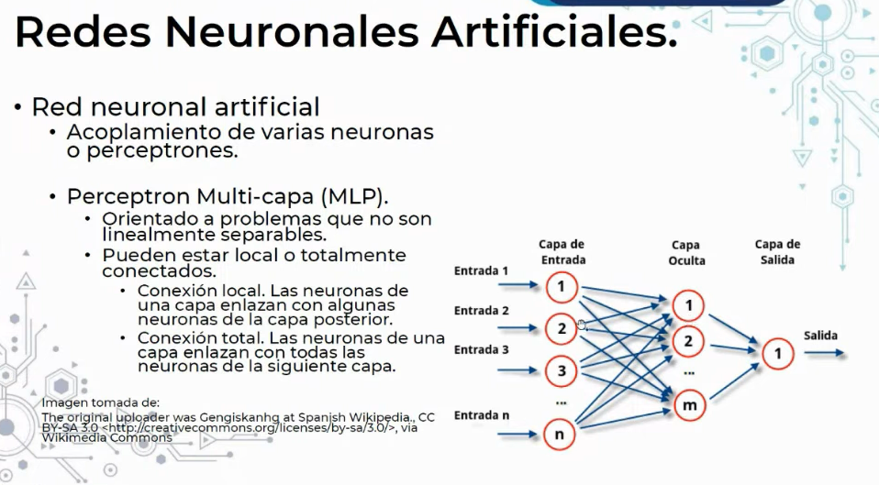

Slide 6
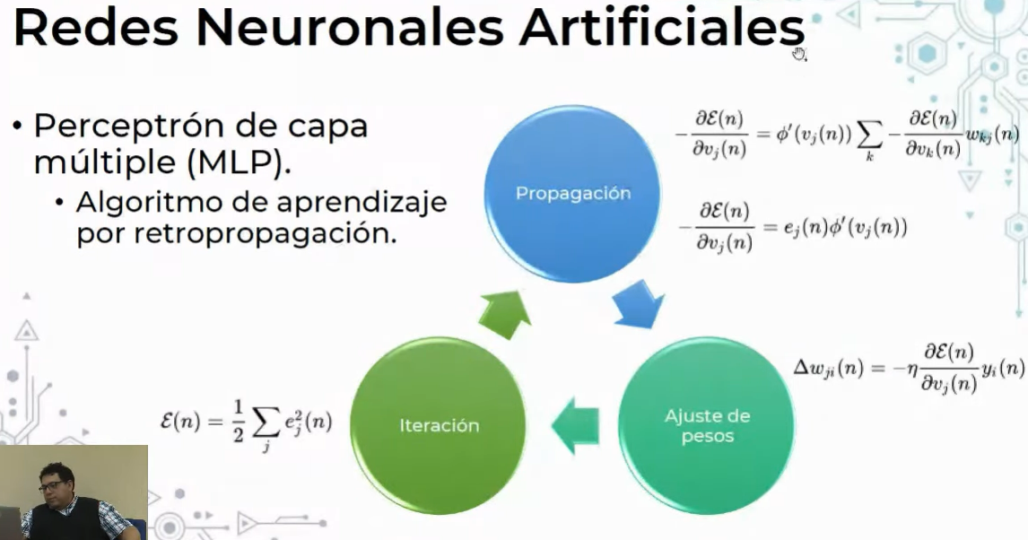

Slide 7
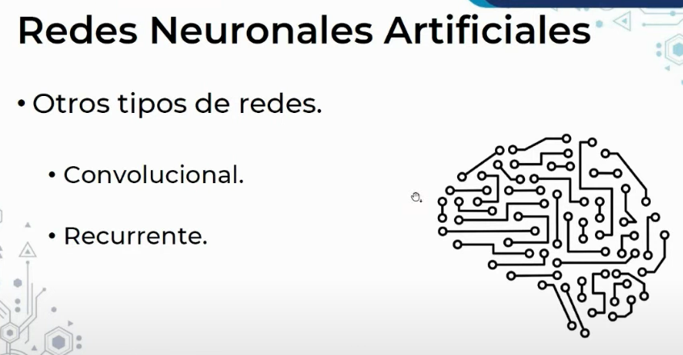

Slide 8
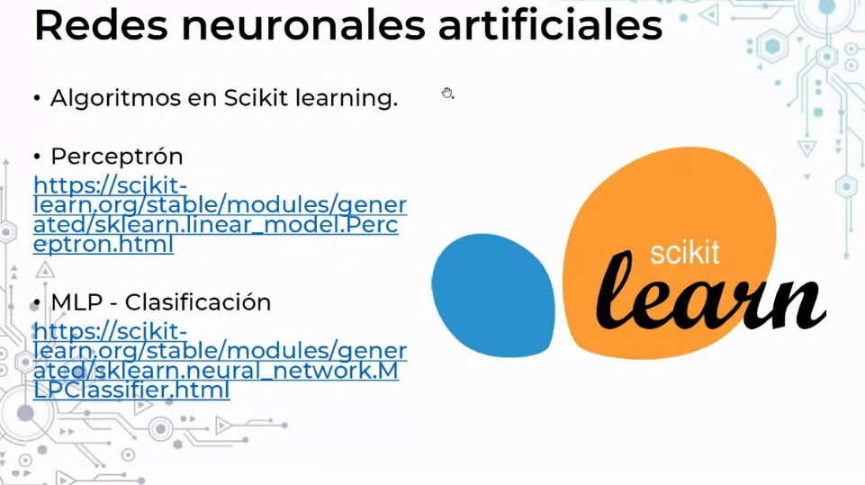

Slide 9
Neural network models (supervised)
https://scikit-learn.org/stable/modules/neural_networks_supervised.html
Perceptron
https://scikit-learn.org/stable/modules/generated/sklearn.linear_model.Perceptron.html

