Slide 1
Cascading Style Sheets (CSS)

Slide 2
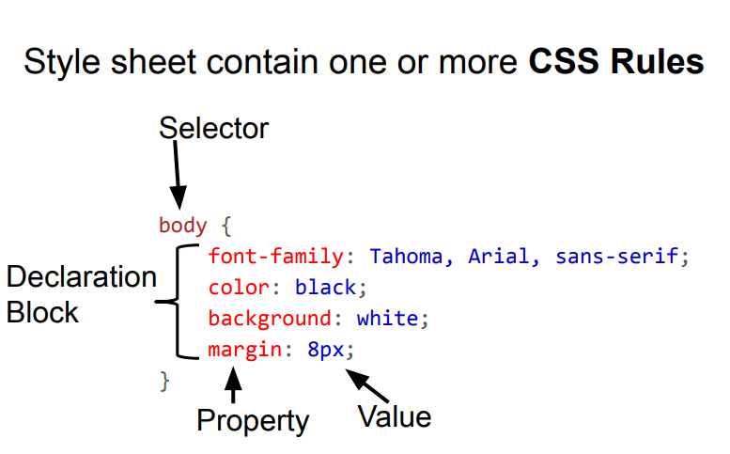

Slide 3
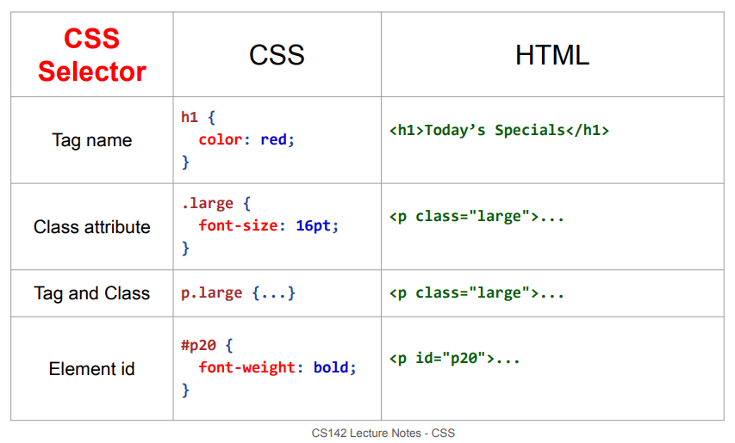

Slide 4
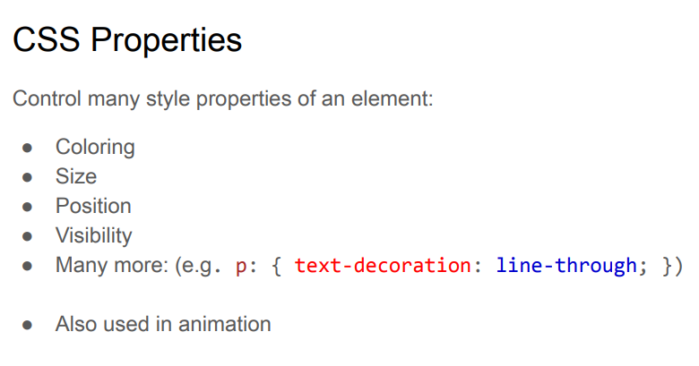

Slide 5
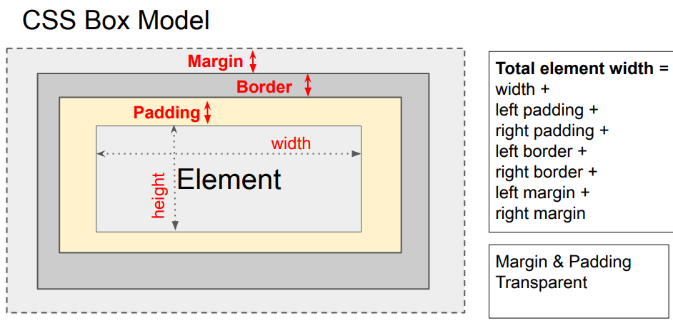

Slide 6
Especificación en
HTML
<style>
</style>
CSS
<link rel="stylesheet" href="">

Slide 7
background-color
color: red/rgb(200,150,220);
opacity: 0.3
text-align:
text-decoration-line: underline
overline/line trough
font-weight:
font-family: cursive
font-size:
direction: rtl;
unicode-bidi: bidi-override;
text-decoration-line: underline;
text-decoration-color: red;
text-decoration-style: dotted;
text-decoration-thickness: 5px;

Slide 8
height: 400px
background-image: url("rp20im.jpg");
background-repeat: repeat-x;
background-repeat: no-repeat;
background-position: center;
background-size: cover;

Slide 9
height: 400px
background-image: url("rp20im.jpg");
background-repeat: repeat-x;
background-repeat: no-repeat;
background-position: center;
background-size: cover;

