Slide 1

Improving the UX in Healthcare portal using Question Similarity
Final
DSC 595 Spring 2023
Raunak Mahtani and Mega Viswanathan

Slide 2
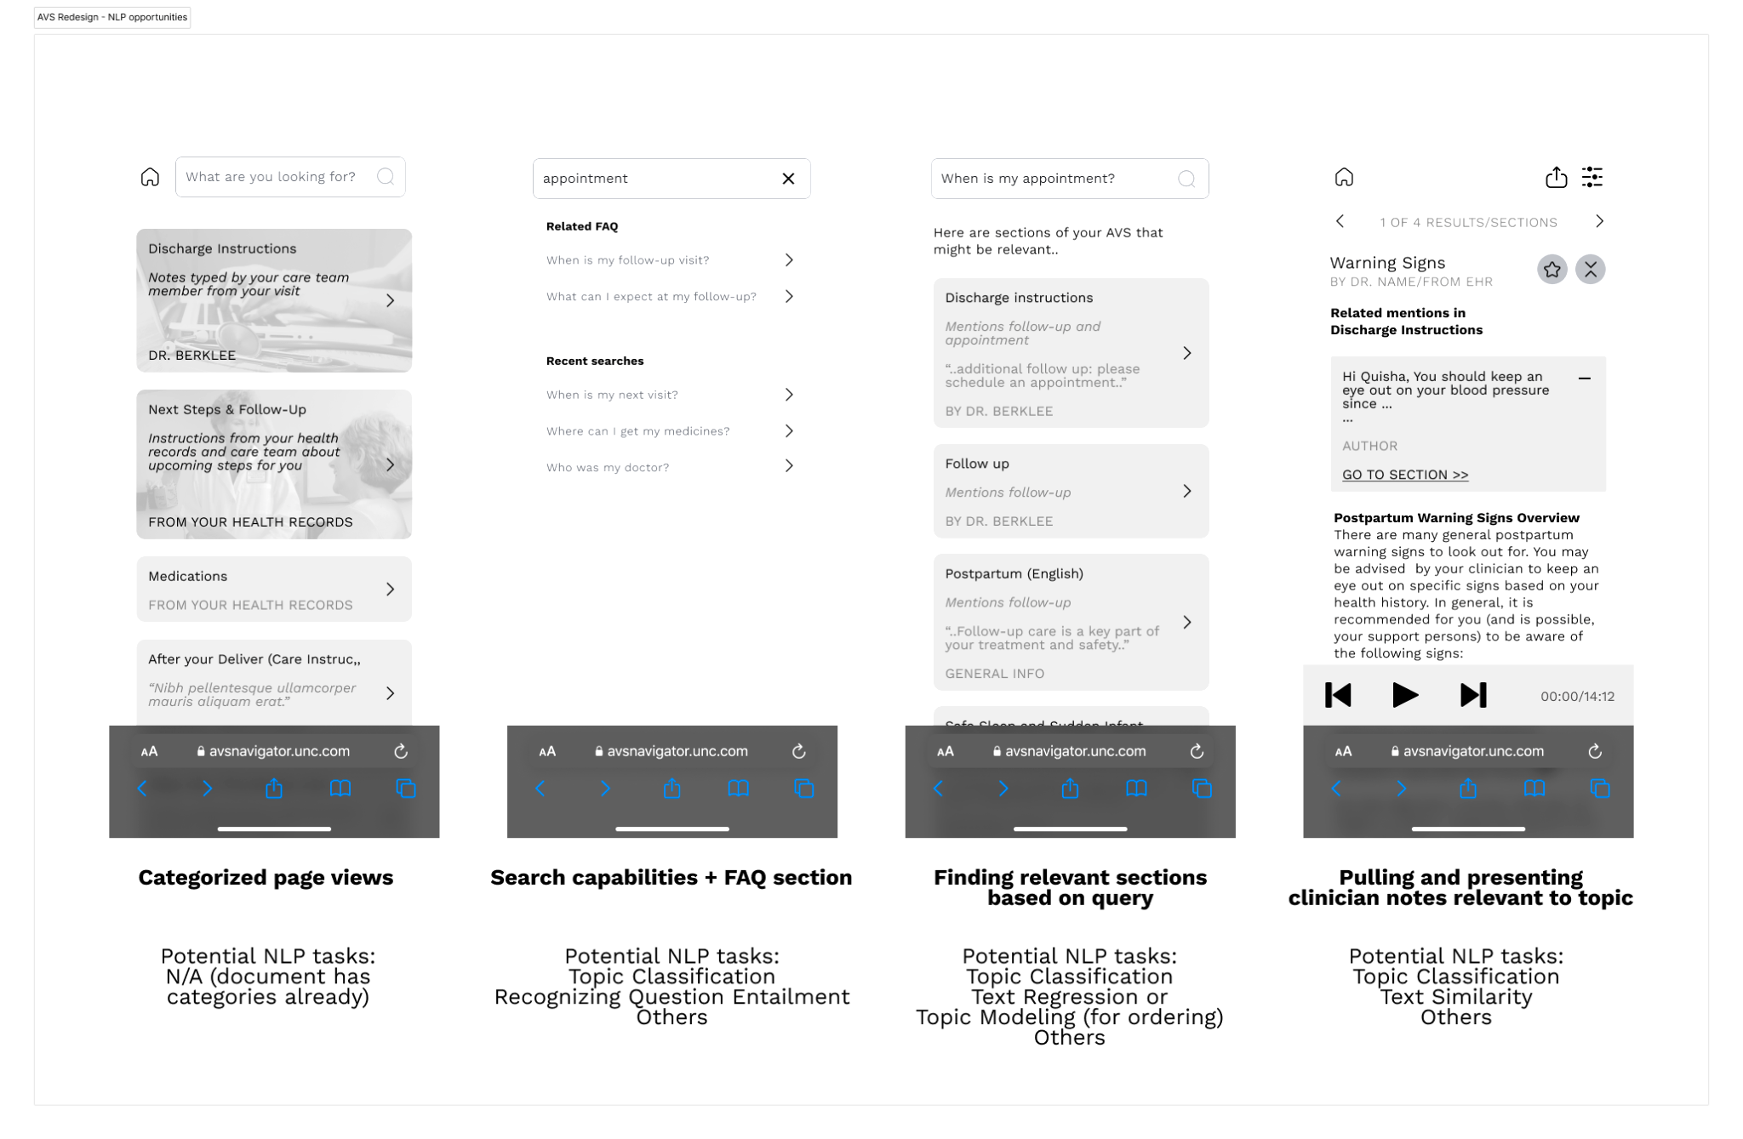
Project Goal: Enabling postpartum patients to find information in their often long After Visit Summaries (AVSs) easily.

Slide 3
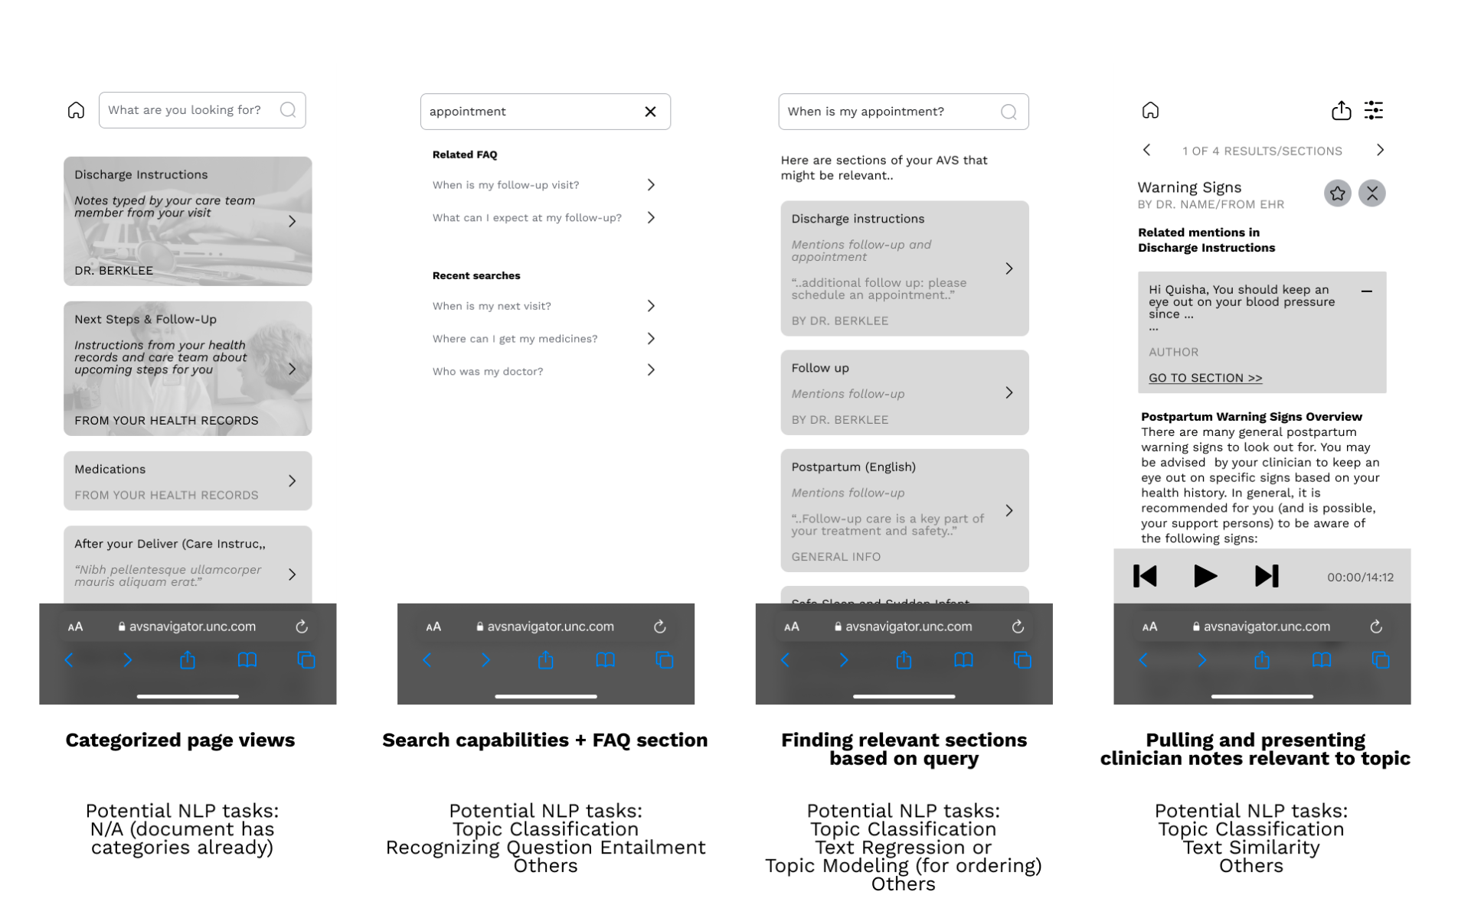
NLP can be helpful, to fetch questions similar to ones typed by users in a search bar

Slide 4
Model output desired
Prediction whether question pairs are similar or not (binary)
Useful for selecting which related questions to display
Similarity measure (continuous)
Useful for sorting/ordering related questions that are displayed

Slide 5
Requirements for NLP solution:
Important to provide useful suggestions of similar questions to patient while being appropriate to show some irrelevant results
Relatively high recall with low precision okay (false positives okay)
Efficiency (needs to load up quickly!)

Slide 6
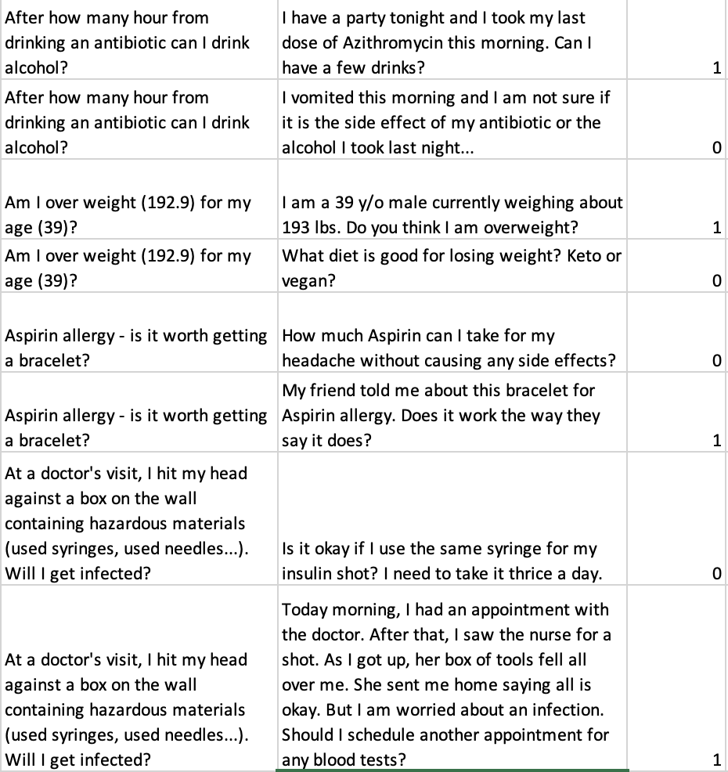
Selected Dataset: Medical Question Pairs (McCreery et al., 2020)
Q1
Q2
Equivalence

Slide 7
Characteristics and Biases
3048 question pairs
Equal split of similar and dissimilar question pairs
Domain transfer: general healthcare focus rather than postpartum-care specific
Trained model may not apply equally well in a postpartum context
Questions sourced from a public question board HealthTap
Ways of framing questions likely to be different from ways in which someone would search in an app
Oddities
Irrelevant sentences eg. ‘Extension from my last Q’
Slang and emoji usage eg. ‘Plz’, ‘:(‘
Numbers mentioned as digits and words

Slide 8
Analysis Methods
Linear SVC
Preprocessing - REGEX
Removing excess punctuation Removing emojis Keeping stop words for sentence context
vs.
BERT sentence encoder trained on Quora data (ran through sPacy)
Logistic Regression
vs.
Random Forest
80/20 train-test split through SkLearn

Slide 9
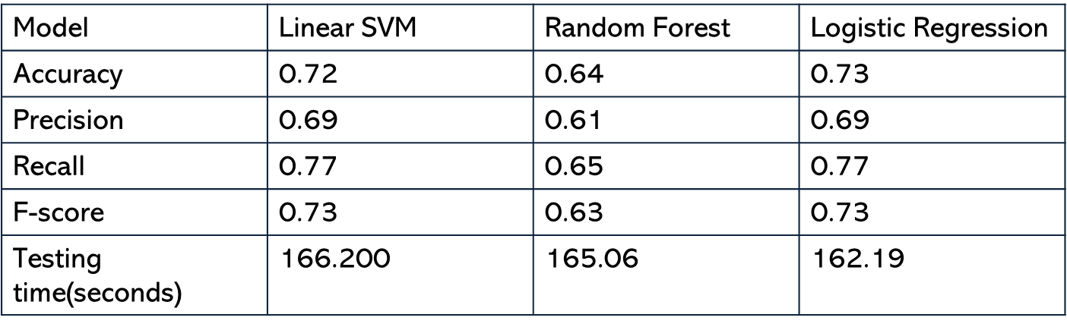
Model Comparison

Slide 10
Results
Our hypothesis
LinearSVC and logistic regression model works as a more accurate classifier with higher recall for this context than Random Forest.
All modelsneed more fine tuning!
Should other use our hypothesis?
NO! We compared simple models without fine tuning
More refinement needed for improvement

Slide 11
Room for improvement and future scope
Pre-processing
Removing irrelevant sentences
Fixing spelling errors*
Replacing synonyms
Finding common words across sentence pairs*
Feature extraction
Sentence length, number of common words, etc. could be useful features
Fine-tuning model parameters
*unsuccessfully attempted

Slide 12
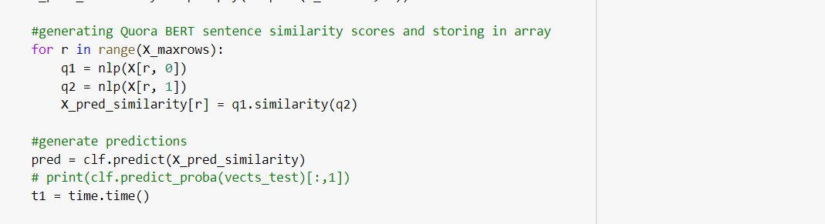
Analysis Method and Tuning
Quora BERT sentence similarity

Slide 13
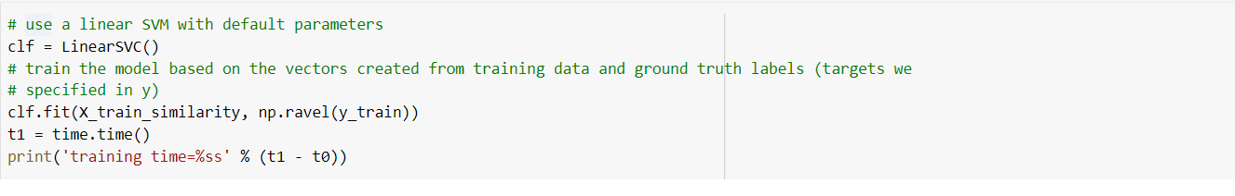
Disadvantage: Longer training time
the training time will still depend on the size of the dataset and the complexity of the model.
Unsupervised method of learning
Linear SVM Method

Slide 14


Slide 15
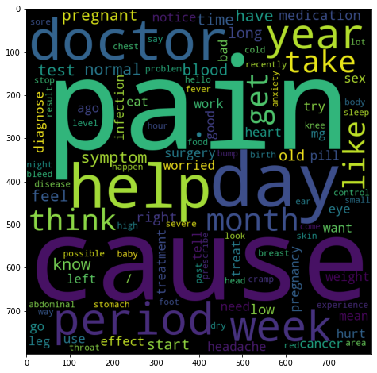
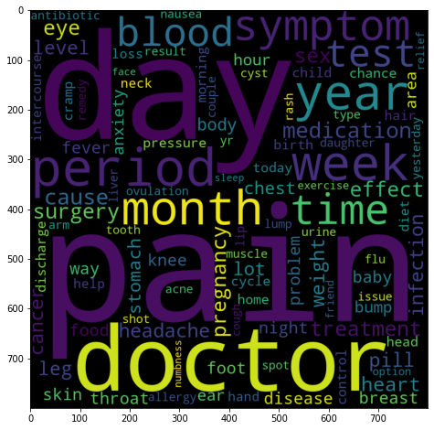
Data Cleaning
Post
lemmatiziation
Nouns only
REGEX for replacing punctuation, emojis and numbers
Removing (perhaps only a subset of) stop words
Lemmatization
Checking for spelling
Replacing synonyms

Slide 16
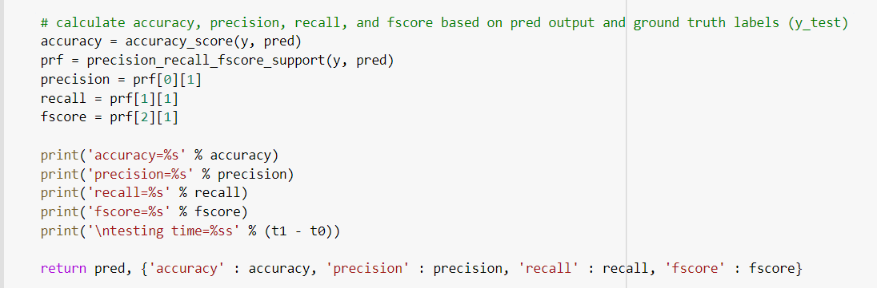
Performance Metric

Slide 17
Text representation possibilities
N-grams
Efficient but keeping some context
TF-IDF
Important to weigh unique words since many common words would be shared across questions
Contextual word embeddings
Maintaining context

