Slide 1
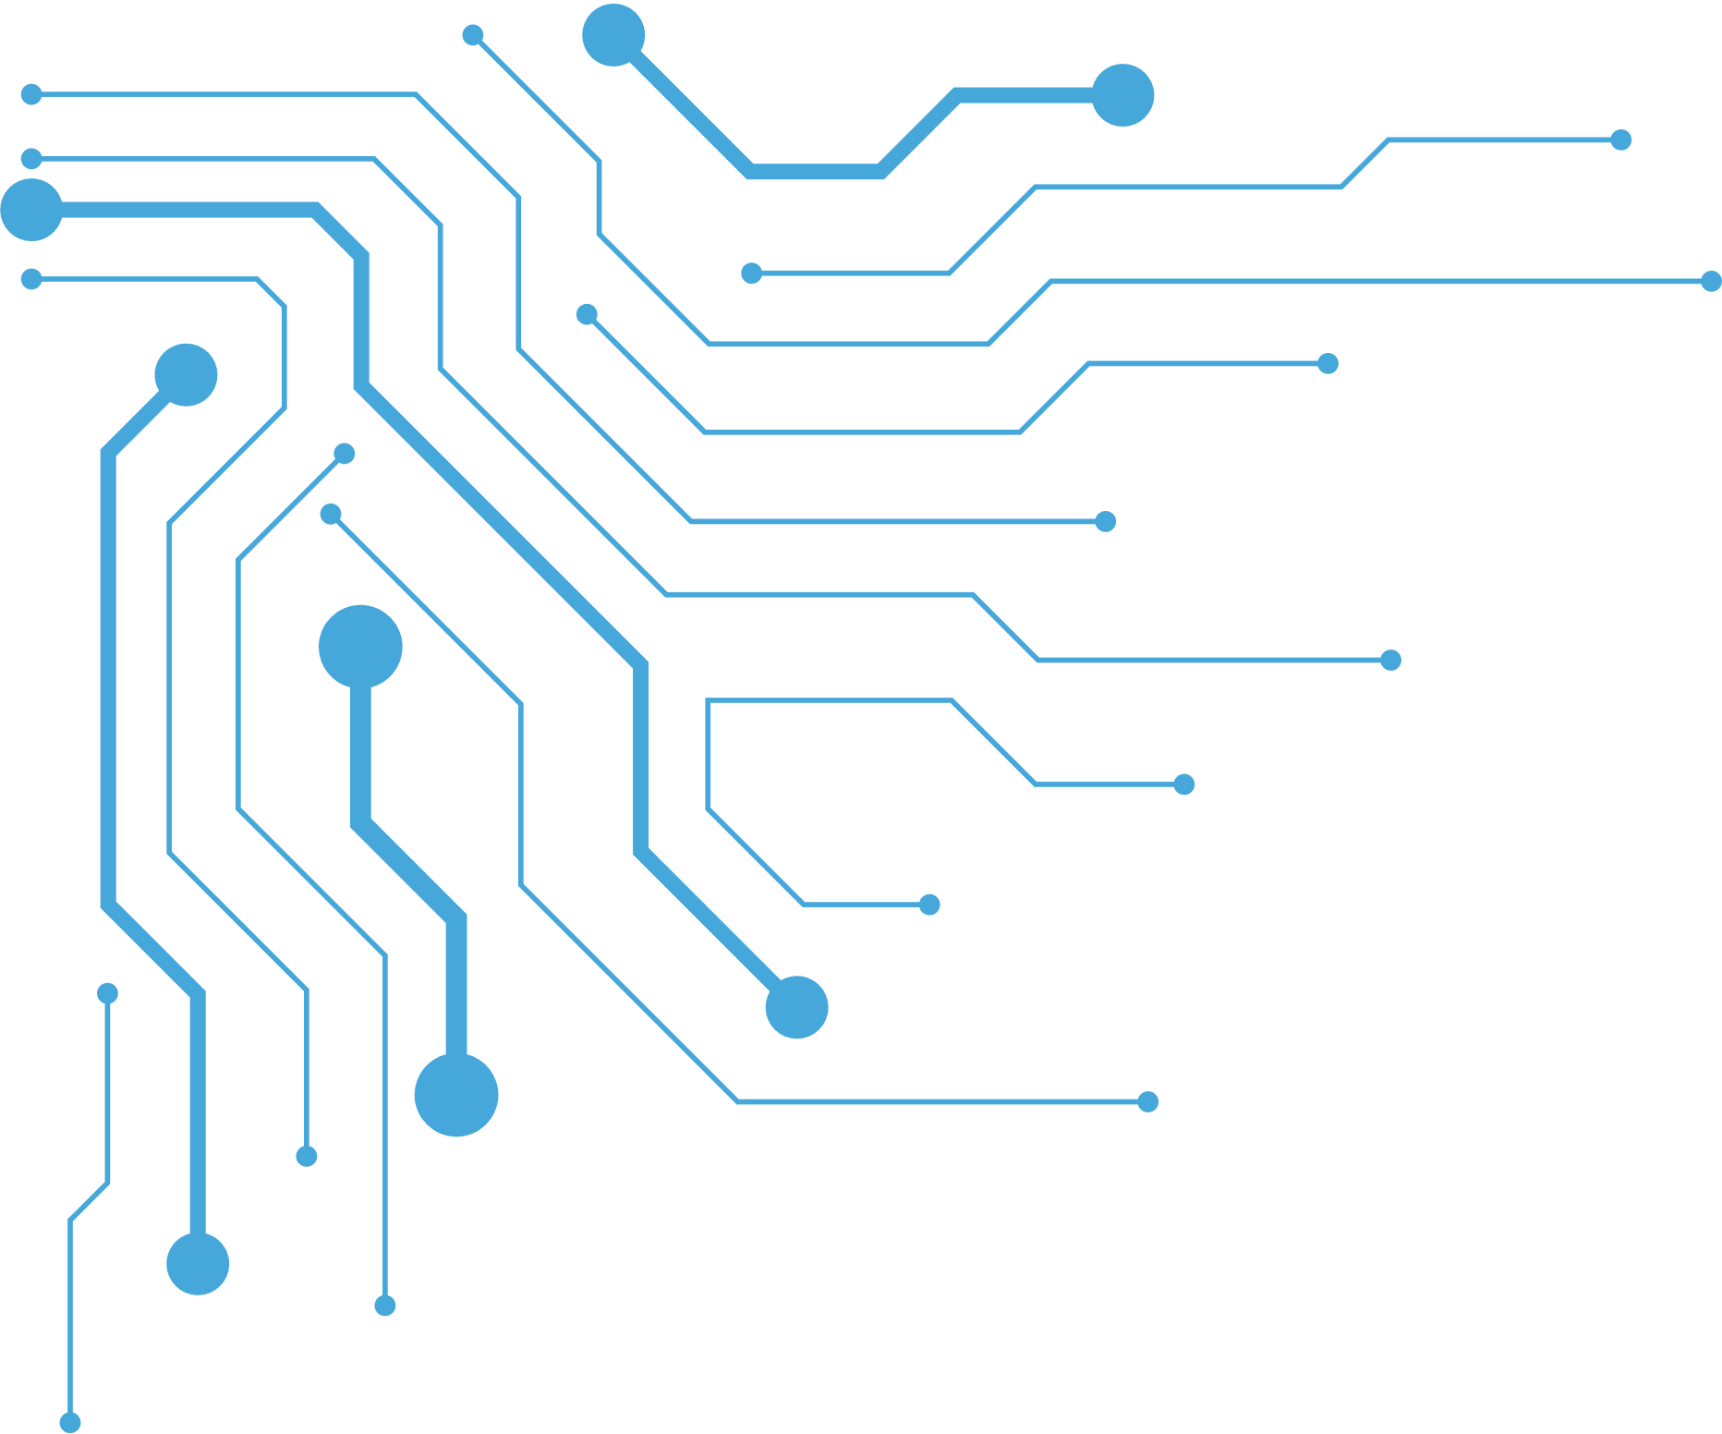

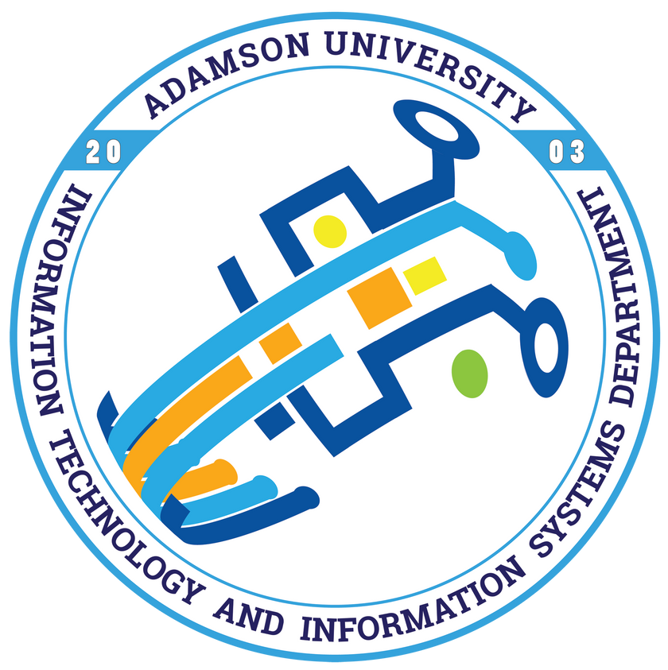
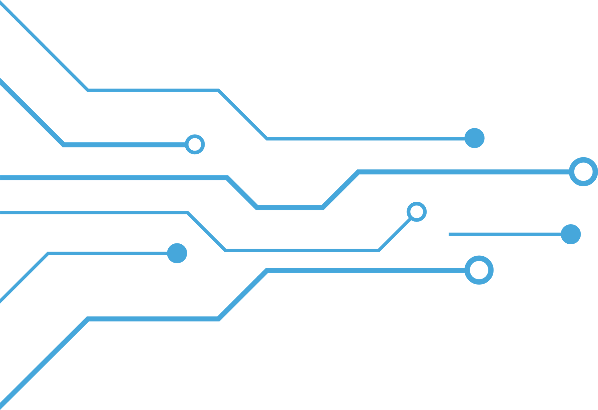
Module 1 – Introduction to Computing
College of Computing and Information Technology | Information Technology and Information Systems Department

Slide 2

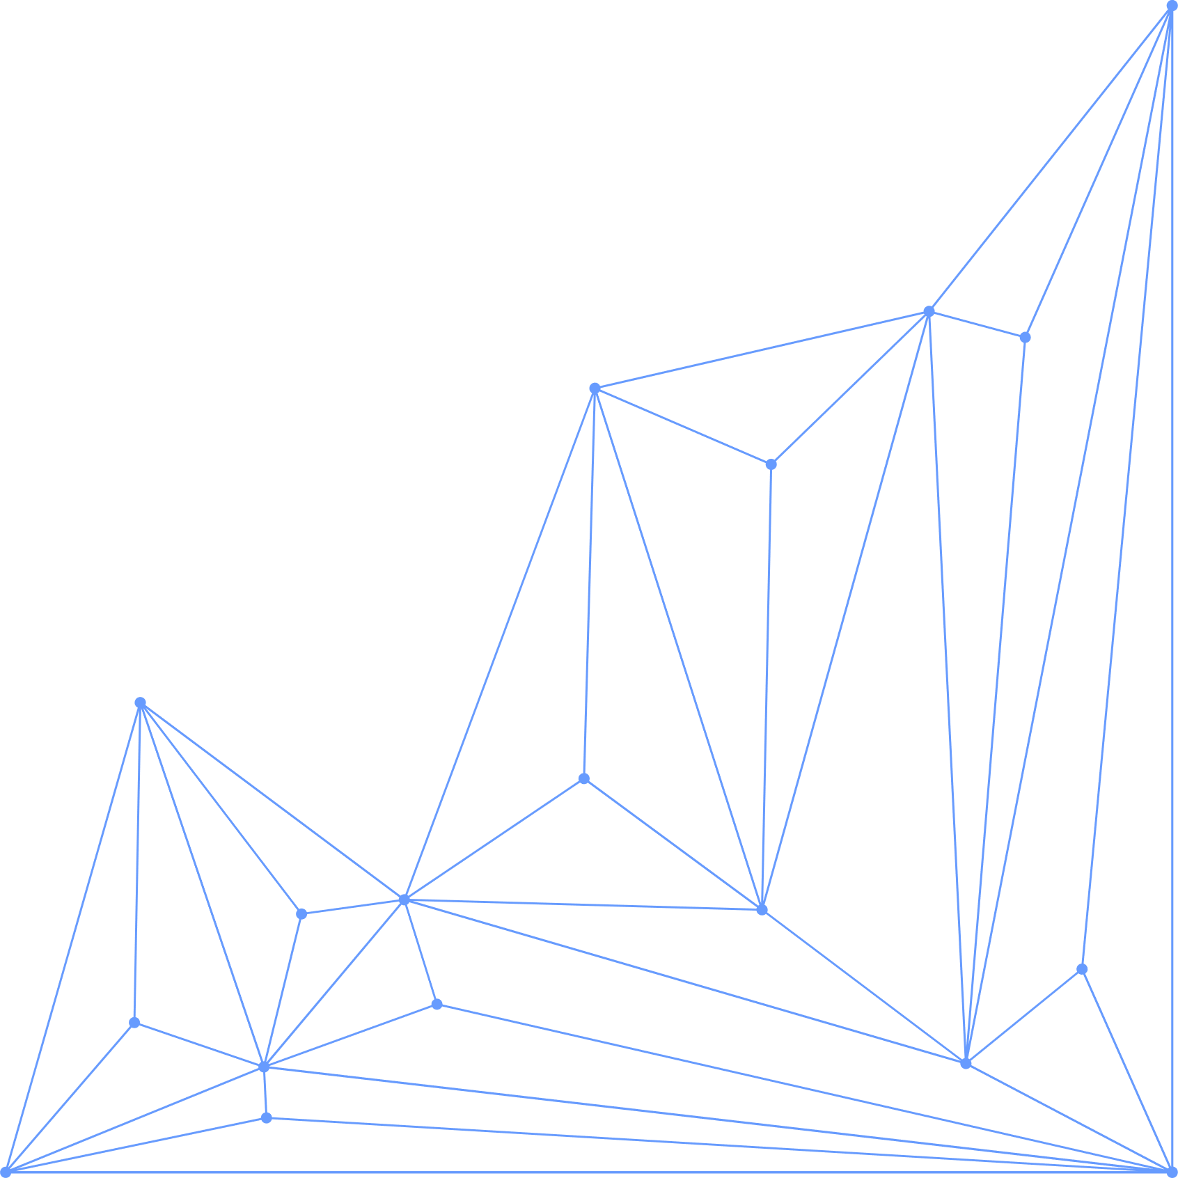
Analyzes and discuss the meaning, concepts of Computers and Information Technology
College of Computing and Information Technology | Information Technology and Information Systems Department
Notes:
Change image or you can remove it

Slide 3

By the end of this module, students should be able to:
Define computing and explain its importance in daily life.
Trace the historical evolution and generations of computers.
Identify and classify the major components of a computer system.
Discuss the significance of IT in society and its impact on different sector
College of Computing and Information Technology | Information Technology and Information Systems Department
Notes:
Change image or you can remove it

Slide 4
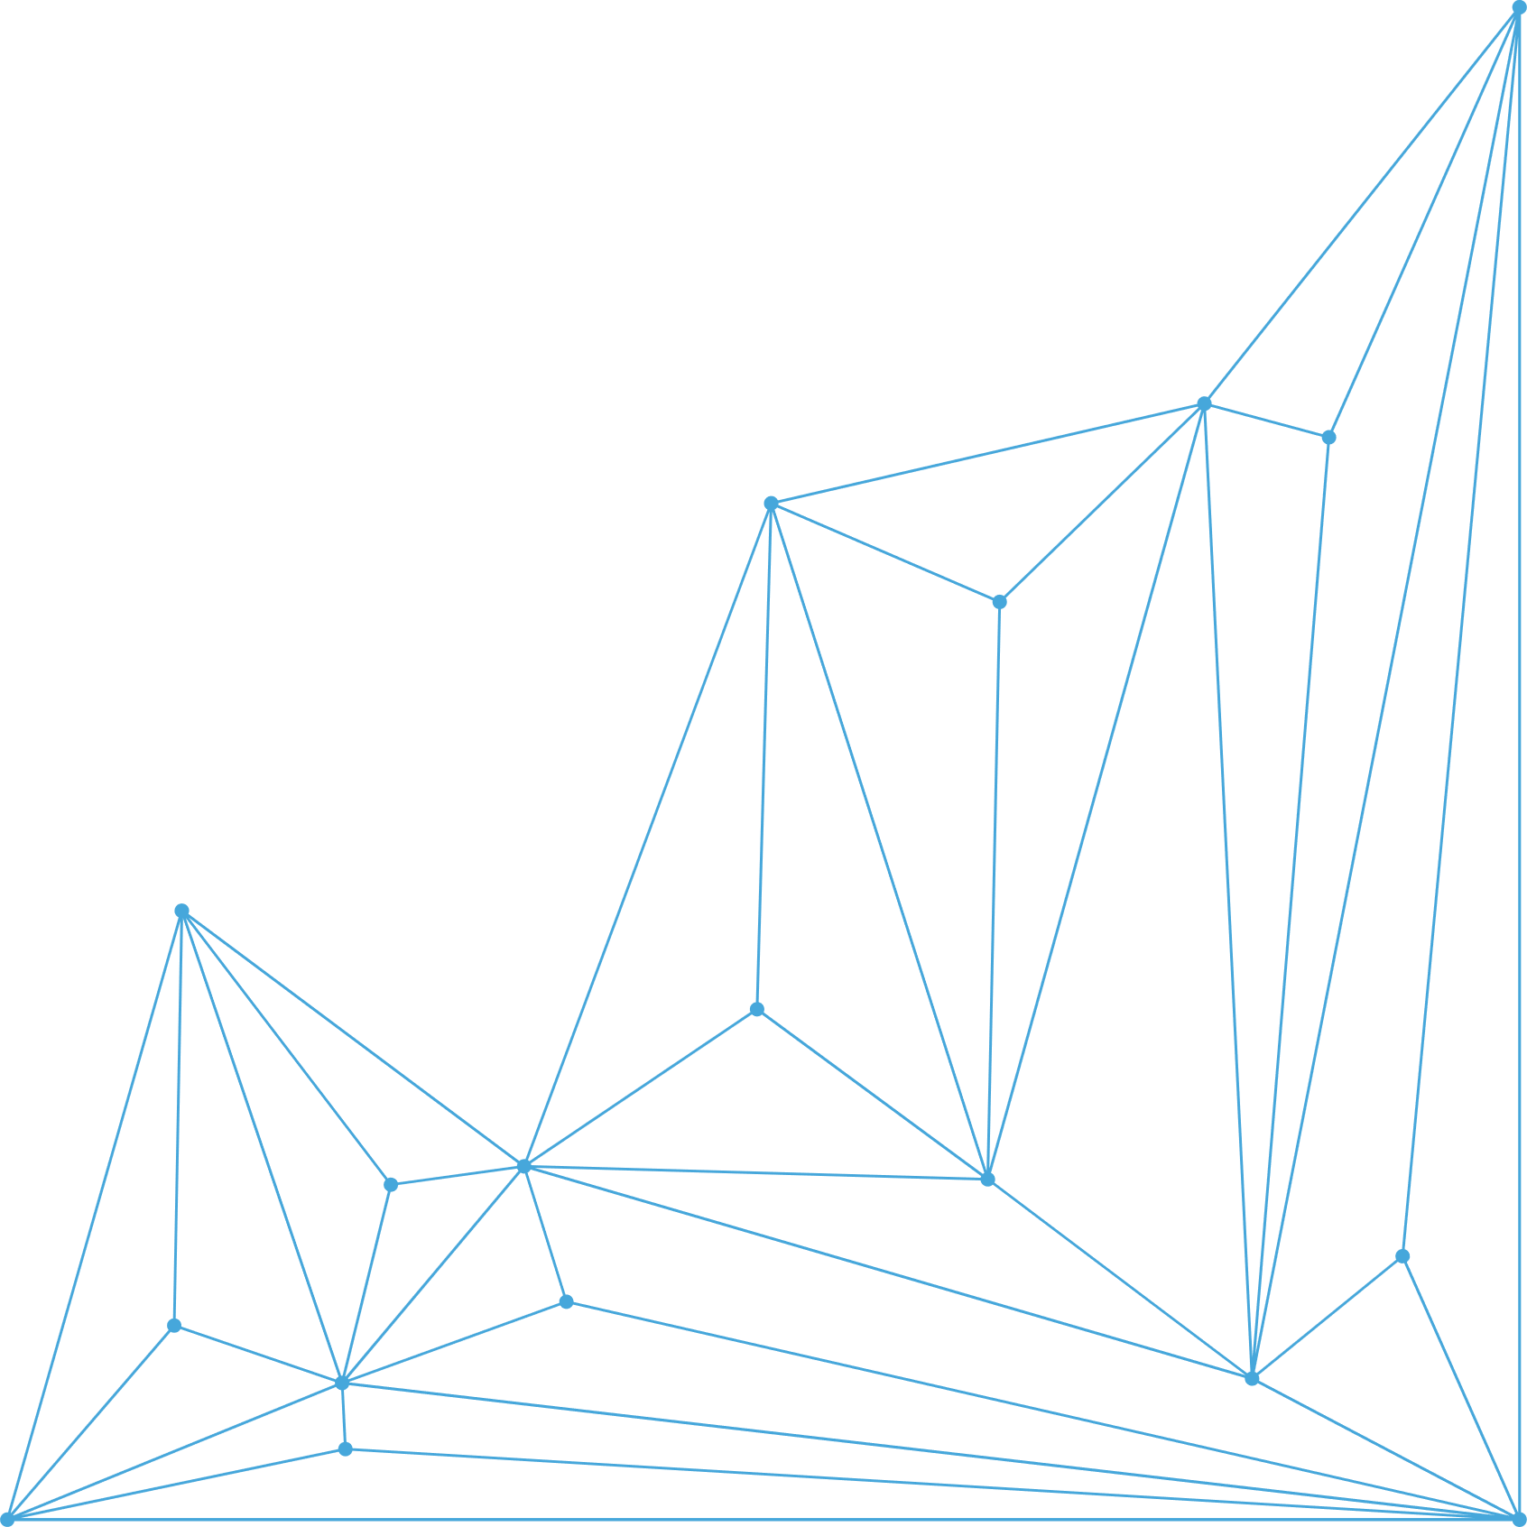

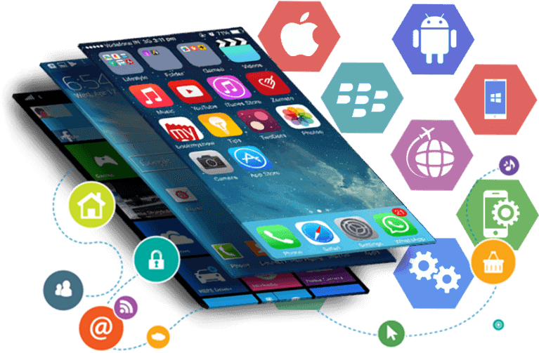
Topics
Introduction to Computing
  Definition and importance
  Evolution of computing
  Generations of computers (1st to 5th generation, and beyond)
Components of a Computer System
  Hardware (input, output, storage, processing devices)
  Software (system and application software)
  Peopleware (users, IT professionals)
Role of IT in Society
  Business (e-commerce, digital banking, automation)
  Education (e-learning, LMS platforms, virtual labs)
  Communication (social media, video conferencing, IoT)
College of Computing and Information Technology | Information Technology and Information Systems Department

Slide 5
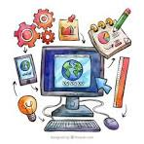
Computing is the process of using computers, digital devices, and intelligent systems (AI, cloud, IoT, quantum) to process data, solve problems, and create value. It includes hardware, software, networks, and human interaction.
College of Computing and Information Technology | Information Technology and Information Systems Department

Slide 6
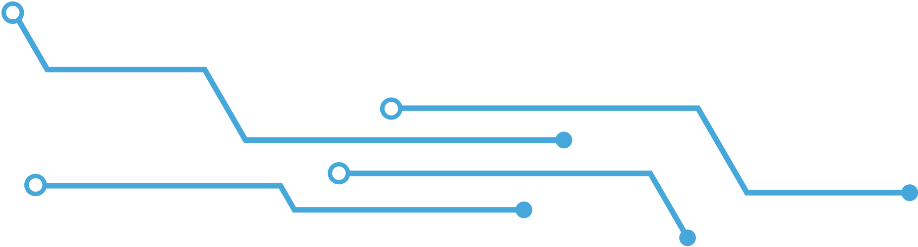

Importance in 2025:
Business: Companies rely on cloud computing and AI-driven analytics to make faster decisions (e.g., Amazon using AI for logistics and customer recommendations).
Education: Students access virtual classrooms, AI tutors, and digital labs (e.g., Coursera & AI learning assistants).
Healthcare: AI systems assist doctors in diagnosing diseases (e.g., IBM Watson Health, AI-assisted cancer detection).
Daily Life: Smart assistants (Siri, Alexa, Google Assistant) and IoT devices control homes, cars, and workplaces.
College of Computing and Information Technology | Information Technology and Information Systems Department
Notes:
Real-world example (2025): Generative AI (like ChatGPT-5) is used by businesses and schools worldwide for automation, customer service, and education support.

Slide 7
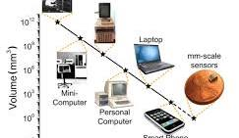
Evolution of Computing
College of Computing and Information Technology | Information Technology and Information Systems Department

Slide 8
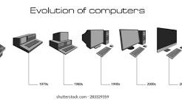
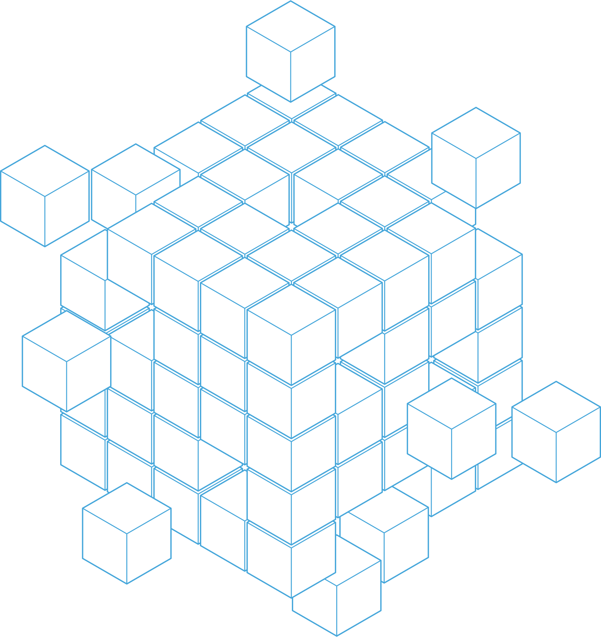
Computing has transformed from manual calculation to intelligent systems:
Mechanical Era: (1600s–1800s) Devices like the Abacus and Charles Babbage’s Analytical Engine.
Electromechanical Era: (1900s) First punched card machines and tabulators.
Electronic Era: (1940s onwards) Computers using electricity, transistors, and microprocessors.
Modern Era (2000s–2025): Cloud, AI, mobile, and quantum computing shape society.
College of Computing and Information Technology | Information Technology and Information Systems Department
Notes:
Example: In 1950, computers filled entire rooms; in 2025, a smartphone is more powerful than NASA’s computers used in the Apollo missions.
Discussion: Evolution of Computing
Computing has undergone significant transformation — from manual calculation tools to today’s intelligent and connected systems. Each era reflects how technology addressed society’s growing needs for speed, accuracy, and automation.
1. Mechanical Era (1600s–1800s)
This era marks the use of mechanical devices to assist humans in performing arithmetic and logical operations.
Key Devices & Examples:
Abacus (c. 1600 BC, still used today): A frame with beads for arithmetic operations (addition, subtraction, multiplication, division).
Pascaline (1642): A mechanical calculator invented by Blaise Pascal for addition and subtraction.
Leibniz’s Step Reckoner (1673): Could perform multiplication and division.
Charles Babbage’s Analytical Engine (1837): The first design of a programmable computer, with concepts of memory and CPU.
Sample Activity (Classroom):
Ask students to simulate addition using an abacus app or physical abacus to appreciate early computing.
2. Electromechanical Era (1900s)
Machines started combining mechanical parts with electrical power to improve speed and reliability.
Key Developments & Examples:
Herman Hollerith’s Punched Card Machine (1890): Used in the U.S. census for data tabulation. This innovation laid the foundation for IBM.
Telephone Switches (early 1900s): Used electromechanical relays for automated communication systems.
Zuse Z3 (1941): Considered the first programmable electromechanical computer.
Real-world Application:
Punched cards were used for payroll systems, train ticketing, and census processing.
3. Electronic Era (1940s – onwards)
Computers transitioned from mechanical switches to electronic components such as vacuum tubes, transistors, and microprocessors.
Key Stages:
First Generation (1940s–1956): Vacuum tube computers (ENIAC, UNIVAC). Bulky, expensive, high power consumption.
Second Generation (1956–1963): Transistor-based computers (IBM 7090). Faster, smaller, more reliable.
Third Generation (1964–1971): Integrated Circuits (ICs) allowed multiple transistors in a single chip. Examples: IBM 360, DEC PDP-8.
Fourth Generation (1971–1980s): Microprocessors (Intel 4004, Apple II, IBM PC). Birth of personal computing.
Sample Code (Fourth Gen Illustration – 1970s microprocessor → modern):
// Example: Hello World in C (developed in the 1970s for UNIX systems) #include <stdio.h> int main() { printf("Hello, World!"); return 0; }
This shows how early languages like C became the foundation of modern computing.
4. Modern Era (2000s – 2025)
Computing has moved into an age of intelligent, mobile, and cloud-based systems, deeply integrated into society.
Key Trends & Examples:
Cloud Computing: Services like AWS, Azure, and Google Cloud allow businesses to scale globally.
Artificial Intelligence (AI): AI assistants (Siri, Alexa, ChatGPT-5) used in business, education, and healthcare.
Mobile Computing: Smartphones and tablets enable global communication and instant access to information.
Quantum Computing: IBM, Google, and Microsoft are developing quantum processors for solving complex problems like drug discovery and climate modeling.
Real-World Example (2025):
AI in Daily Life: ChatGPT-5 as a personal assistant for writing, coding, and research.
Cloud in Business: Netflix streaming runs on Amazon Web Services.
Quantum Breakthroughs: Google’s Quantum AI performs calculations impossible for classical computers.
Sample Student Activity:
Research and present: How does cloud computing (Google Drive, OneDrive, iCloud) impact your daily study habits compared to earlier computing methods (like floppy disks or CDs)?

Slide 9
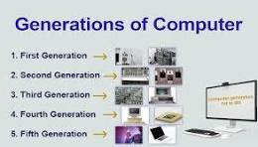
College of Computing and Information Technology | Information Technology and Information Systems Department
Notes:
Generations of Computers
First Generation (1940–1956) – Vacuum Tubes
Large, expensive, generated heat.
Example: ENIAC, UNIVAC.
Real-world impact: Used in military and scientific research.
Second Generation (1956–1963) – Transistors
Smaller, faster, cheaper than vacuum tubes.
Example: IBM 1401.
Impact: Businesses started adopting computers for payroll and accounting.
Third Generation (1964–1971) – Integrated Circuits (ICs)
Thousands of transistors in one chip.
Example: IBM 360 series.
Impact: Rise of personal and business computing.
Fourth Generation (1971–1980s) – Microprocessors
Complete CPU on a single chip.
Example: Intel 4004, Apple II, IBM PC.
Impact: Start of personal computers (PC era).
Fifth Generation (1980s–Present) – Artificial Intelligence
Use of parallel processing, AI, robotics.
Examples: Smartphones, AI assistants, self-driving cars.
Impact: AI-driven applications transform industries.
Beyond Fifth Generation (2020s–Future) – Quantum & Bio-computing
Quantum Computing: Uses quantum bits (qubits) for exponential processing power (e.g., Google’s Quantum AI, IBM Quantum).
AI Everywhere: Generative AI, autonomous robots, digital twins.
Neuromorphic Computing: Chips mimicking the human brain.
Real-world example (2025): OpenAI’s GPT-5 and Google’s Gemini 2.0 are redefining knowledge work, while IBM’s Quantum computers are solving problems in drug discovery and climate prediction.

Slide 10
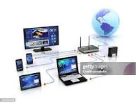
Components of a Computer System
Hardware (input, output, storage, processing devices)
Software (system and application software)
Peopleware (users, IT professionals)
College of Computing and Information Technology | Information Technology and Information Systems Department

Slide 11
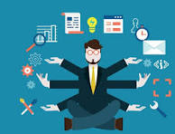
Role of IT in Society
Business (e-commerce, digital banking, automation)
Education (e-learning, LMS platforms, virtual labs)
Communication (social media, video conferencing, IoT)
College of Computing and Information Technology | Information Technology and Information Systems Department

Slide 12
Role of IT in Society
Information Technology (IT) plays a critical role in shaping modern life by improving efficiency, accessibility, and connectivity. Its impact can be seen in business, education, and communication, where it has transformed traditional practices into digital and automated processes.
College of Computing and Information Technology | Information Technology and Information Systems Department

Slide 13

Business
IT enables businesses to operate faster, reach wider markets, and reduce costs through automation and digital services. Processes such as sales, customer support, and financial transactions are now handled digitally.
Real-World Examples:
E-commerce: Platforms like Shopee, Lazada, Amazon allow customers to shop online 24/7.
Digital Banking: Mobile apps like GCash, PayMaya, PayPal let users transfer money, pay bills, and manage accounts securely.
Automation: Factories use robots and AI-powered systems to streamline production and reduce human error (e.g., Toyota’s automated assembly lines).
College of Computing and Information Technology | Information Technology and Information Systems Department

Slide 14

Education
IT has revolutionized education by providing online learning resources, interactive platforms, and global access to knowledge. It supports both formal education and lifelong learning.
Real-World Examples:
E-learning Platforms: Coursera, Udemy, and Khan Academy provide online courses worldwide.
LMS Platforms: Moodle, Blackboard, and Canvas allow teachers to upload lessons, assignments, and quizzes.
Virtual Labs: Engineering and science students use simulations like Labster to experiment digitally without physical lab equipment.
College of Computing and Information Technology | Information Technology and Information Systems Department

Slide 15
Communication
IT allows people to connect instantly across the globe, breaking barriers of distance and time. It supports personal, professional, and industrial communication.
Real-World Examples:
Social Media: Facebook, Instagram, TikTok connect people, promote businesses, and share information.
Video Conferencing: Zoom, Microsoft Teams, and Google Meet make remote work and online classes possible.
Internet of Things (IoT): Devices like smart homes (Google Nest, Alexa) and connected cars communicate with each other for automation and convenience.
College of Computing and Information Technology | Information Technology and Information Systems Department

Slide 16

Computing has evolved from mechanical devices to advanced intelligent systems.
A computer system is composed of hardware, software, and peopleware, all of which are equally important.
IT plays a transformative role in society by improving productivity, connectivity, and learning.
Understanding the history of computers helps us appreciate current trends and prepare for future innovations.
College of Computing and Information Technology | Information Technology and Information Systems Department

Slide 17


College of Computing and Information Technology | Information Technology and Information Systems Department

Slide 18
Topics (Pick 1 per pair):
Evolution of Computing
  Task: Create a short timeline (at least 4 eras) showing how computing evolved from mechanical devices to intelligent systems.
  Output: A simple chart or diagram.
  Example: Abacus → Punch Cards → Microprocessors → Cloud/AI.
Computer System Components
  Task: Explain with examples how hardware, software, and peopleware interact in one real-world application.
  Output: A short paragraph + illustration.
  Example: Online classes → Laptop (hardware), Zoom (software), Teacher/Student (peopleware).
Role of IT in Society
  Task: Choose one area (Business, Education, or Communication). Describe how IT improves productivity and give 2 real-world examples.
  Output: Short explanation with concrete examples.
  Example: E-learning platforms like Google Classroom and Coursera.
History of Computers and Future Trends
  Task: Discuss why it is important to study the history of computers. Then predict one future innovation in computing.
  Output: Short essay (5–7 sentences).
  Example: “From the ENIAC to Quantum Computing, studying history shows us progress. In the future, AI may become fully self-learning.”
👩‍💻 Pair Activity: Exploring the World of Computing
Instructions:
Work in pairs (2 students).
Choose one topic below (assigned or by choice).
Discuss and write your answers on a short bond paper / digital doc.
Present briefly (2–3 minutes per pair).
College of Computing and Information Technology | Information Technology and Information Systems Department

Slide 19

Performance Indicators:
Shows understanding of computing evolution.
Identifies key components of a computer system.
Explains IT’s role in society with examples.
Relates past innovations to future trends.
College of Computing and Information Technology | Information Technology and Information Systems Department

Slide 20
Rubric for Pair Activity (Total: 20 pts)
Criteria | Excellent (5) | Good (4) | Fair (3) | Poor (1–2)
Content | Accurate & complete | Mostly correct | Some errors | Inaccurate/off-topic
Clarity | Clear & organized | Minor confusion | Somewhat unclear | Disorganized
Creativity | Engaging, uses examples | Some creativity | Minimal effort | No creativity
Teamwork | Equal effort | Uneven effort | One dominates | No teamwork
College of Computing and Information Technology | Information Technology and Information Systems Department

Slide 21
Book References (Latest Editions 2024–2025)
Brookshear, J. Glenn & Brylow, Dennis. Computer Science: An Overview (14th Edition, 2024). Pearson.
Morley, Deborah & Parker, Charles. Understanding Computers: Today and Tomorrow (18th Edition, 2025). Cengage Learning.
Shelly, Gary B. & Vermaat, Misty. Discovering Computers 2025: Digital Technology in a Changing World. Cengage Learning.
College of Computing and Information Technology | Information Technology and Information Systems Department

Slide 22


College of Computing and Information Technology | Information Technology and Information Systems Department

