Slide 1
MSc PROJECT · ROS 2 JAZZY · TWO KINOVA GEN3 7-DOF
Multimodal Teleoperation of a Wearable Dual-Arm Supernumerary Robotic System
Master interface design, safety architecture, and a workspace characterisation
Gaus Sayyad
The arms are worn by one person and driven by a different person. Both are participants.
Every figure in this deck is regenerated from a committed recording by scripts/make_presentation.py

Slide 2
CONTENTS
What this deck covers
1 · The problem
A third and fourth arm worn by someone who is not driving them
2 · The system as built
Master arm, five operating modes, and the safety architecture
3 · Perception and autonomy
Measure the environment, then plan against the measurement
4 · Results
Grasping, motion generation, VR, and the simulation-to-hardware gap
5 · Workspace characterisation
Why the arms barely move, sized rather than asserted
6 · Method, limits and next steps
What is verified, what is demonstration, and what is blocked
The deck is ordered as the thesis is: what was built, what was measured, and what the measurement does not support.
source: thesis_v2/main.tex — chapters 1-14
Wearable dual-arm supernumerary robot · shared autonomy
1

Slide 3
PART 1
The problem
A supernumerary limb is not a prosthesis and not an industrial arm. Two people share one body's worth of space, and only one of them is in control.
2

Slide 4
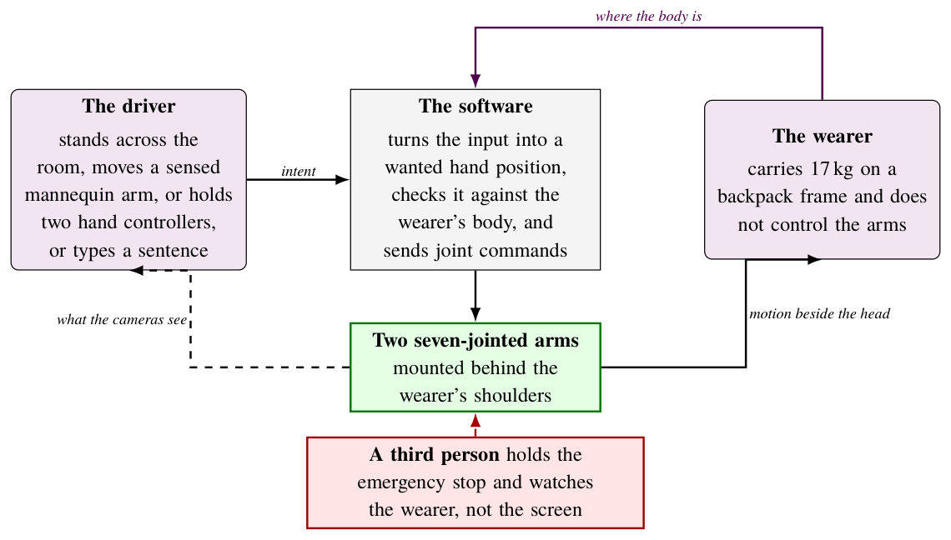
FRAMING
Two people, one body, one set of arms
The driver is across the room. The wearer carries 17 kg on a backpack frame and does not control the arms. A third person holds the emergency stop and watches the wearer, not the screen. This split is what makes the safety case different from ordinary teleoperation.
source: thesis_v2/figures/tikz/overview.tex
Wearable dual-arm supernumerary robot · shared autonomy
3

Slide 5
OBJECTIVES
What the project set out to build
A master interface a person can actually drive
An instrumented mannequin arm over a Teensy 4.1, plus a VR route and a typed or spoken sentence — four ways into the same arms.
A safety case that survives the arms being worn
The wearer is in the collision model, the clearance floor is measured geometrically, and every refusal names what blocked it.
A workspace characterisation, sized rather than asserted
What limits the reach, by how much, and what each design choice costs in millimetres.
Autonomy that can be checked
From a typed sentence to four cubes placed by colour, with the camera's detections shown before anything moves.
An instrument discipline
Every analysis script carries a known-answer test, because the measuring tool has been the fault seventeen times.
The five objectives, and the order the rest of this deck follows.
source: docs/WORK_BRIEF.md, docs/TASK_SPEC.md
Wearable dual-arm supernumerary robot · shared autonomy
4

Slide 6
PART 2
The system as built
Hardware, the master arm, the software architecture, the five operating modes, and the safety chain that gates all of them.
5

Slide 7
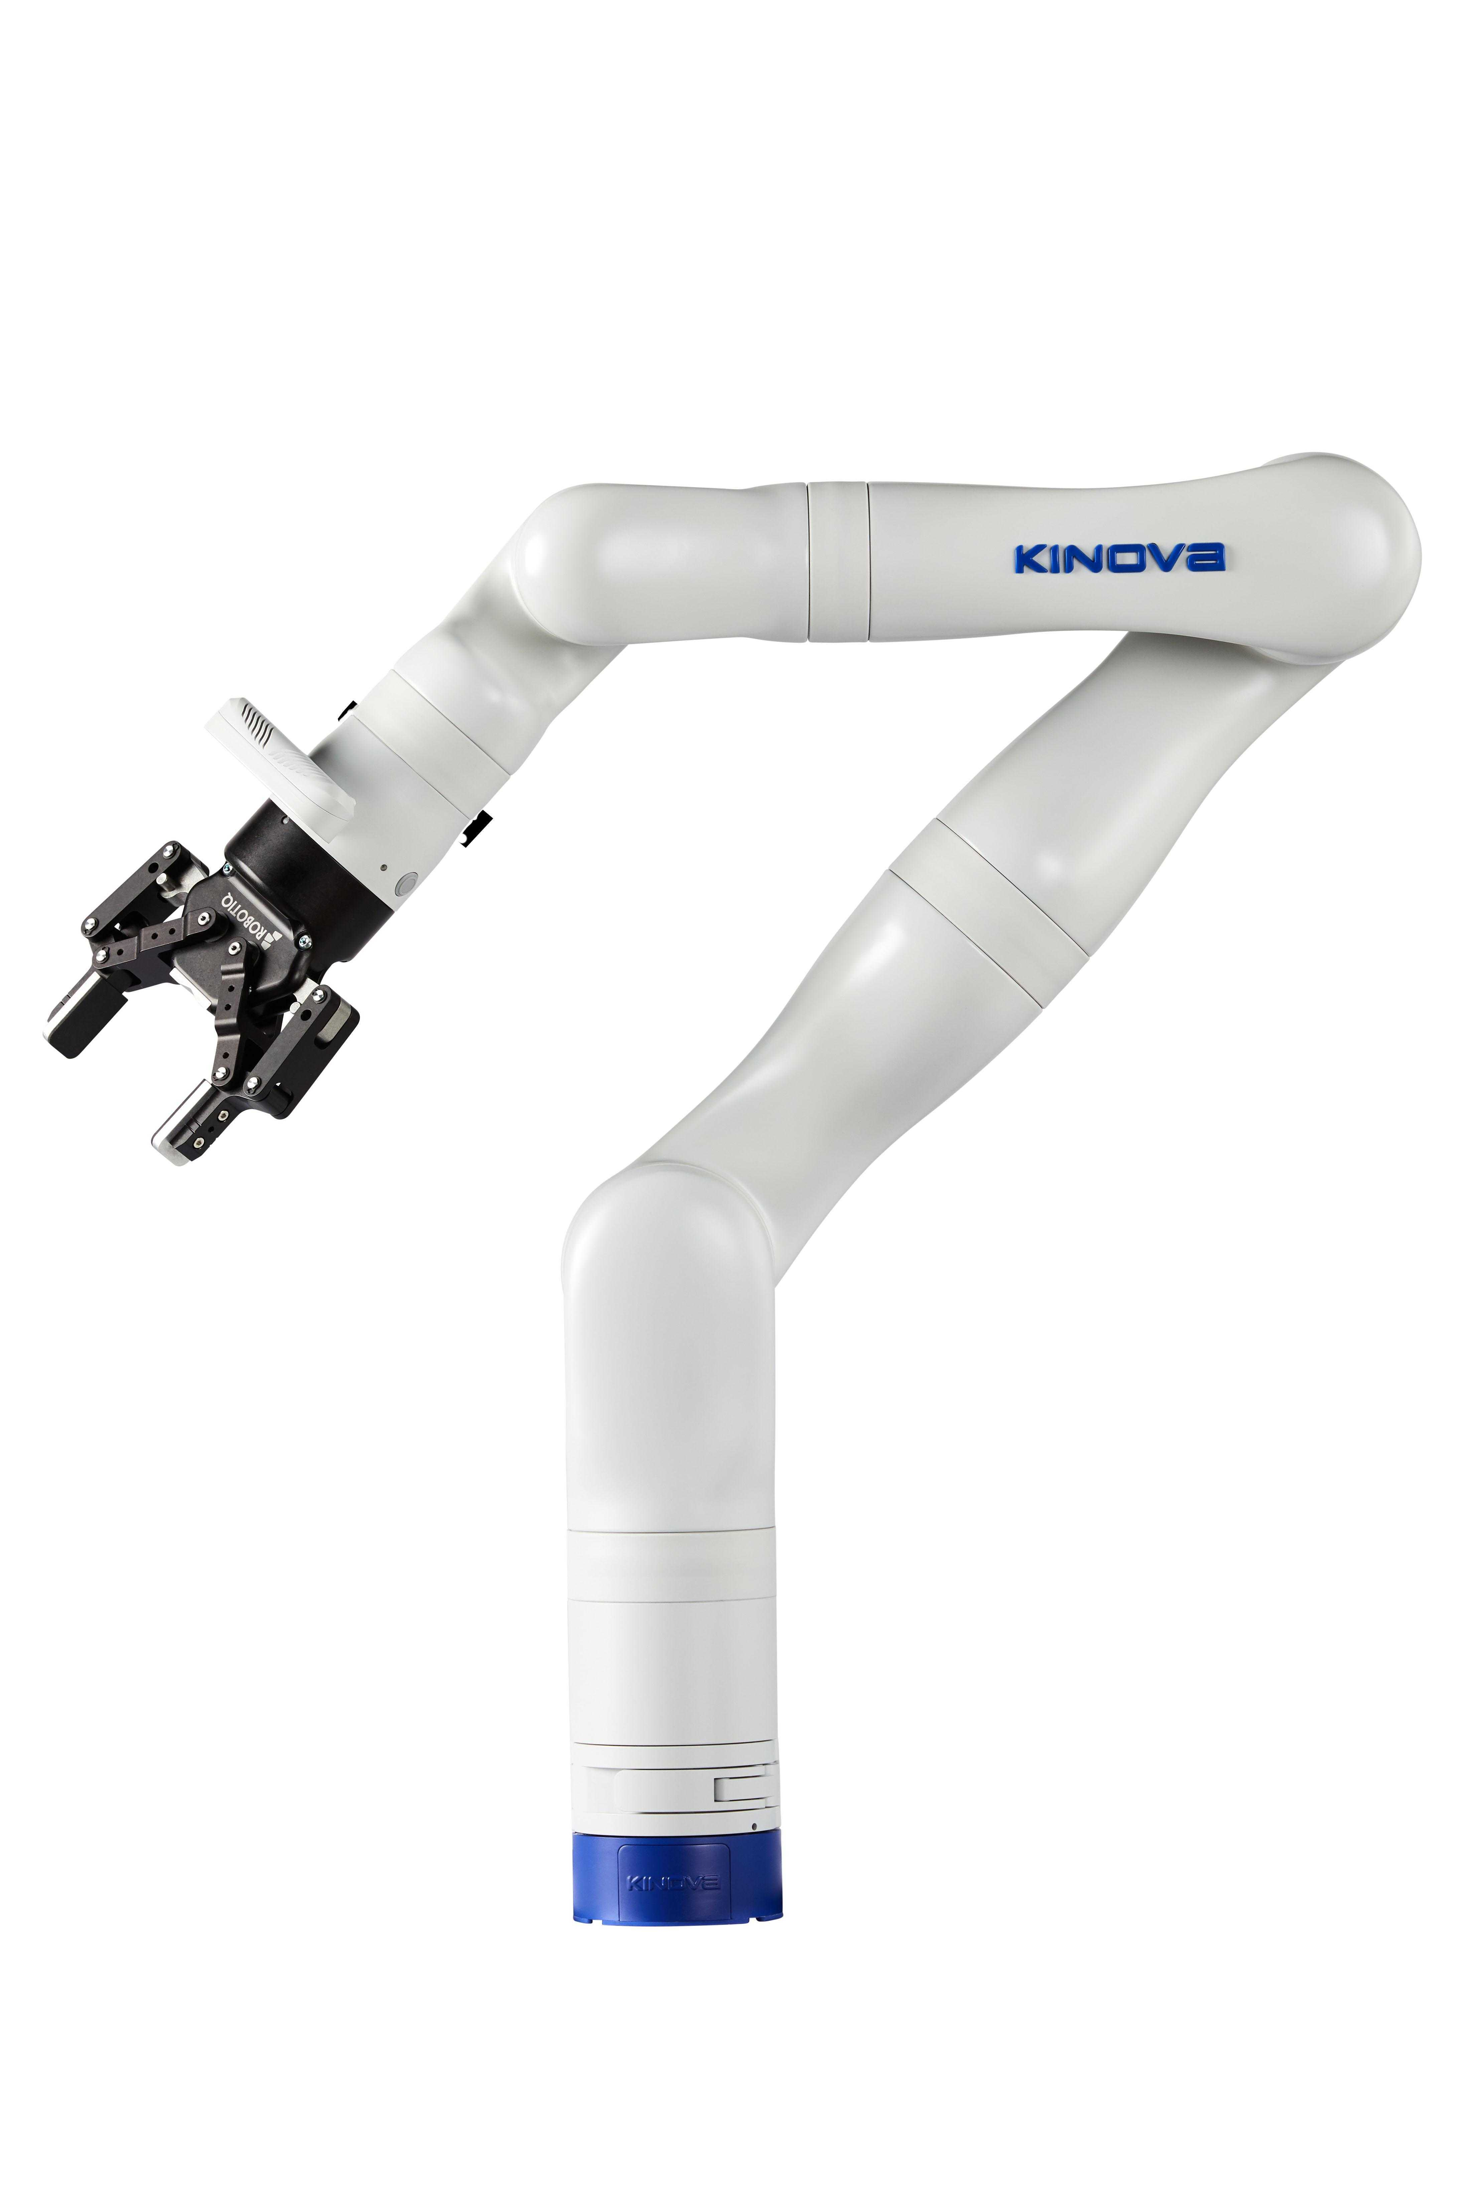
AS BUILT
The hardware
Two Kinova Gen3, 7-DOF, Robotiq 2F-85
Mounted behind the wearer's shoulders on a backpack frame, 150 mm outboard and 15° of yaw from the shoulder line.
Master: an instrumented mannequin arm
14 channels over a Teensy 4.1 — roll and bend alternating along the chain.
ROS 2 Jazzy, 16 packages
Teleoperation imports nothing in-repo, so it stays the baseline condition of every comparison.
Host is WSL2
Which forces the high-level Kortex API: every cyclic write is a network round trip.
The arm shown is the vendor's product image. NO PHOTOGRAPH OF THE ASSEMBLED LAB RIG IS COMMITTED TO THIS REPOSITORY — every visual in this deck is a render, a screenshot or a diagram, and is labelled as such.
source: src/ros2_kortex/doc/resources/ — vendor image, not a lab photograph
Wearable dual-arm supernumerary robot · shared autonomy
6

Slide 8
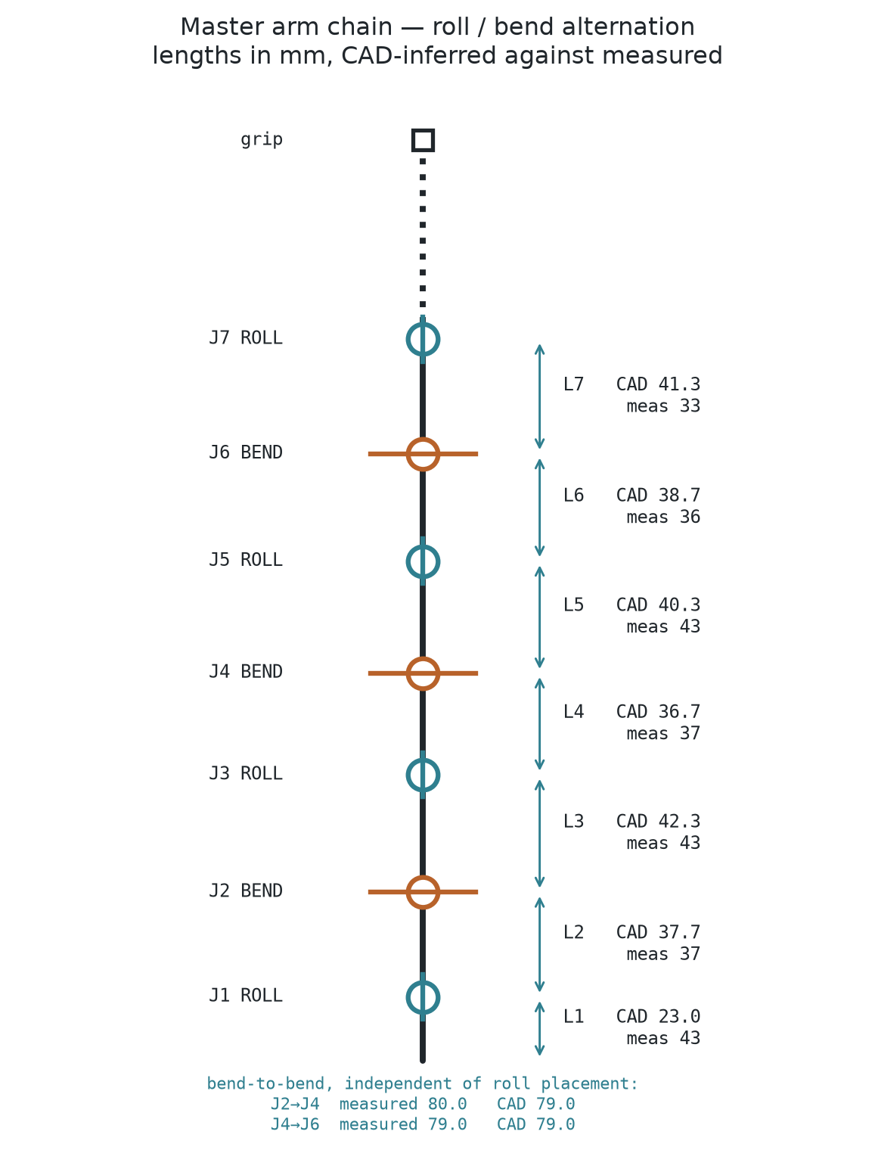
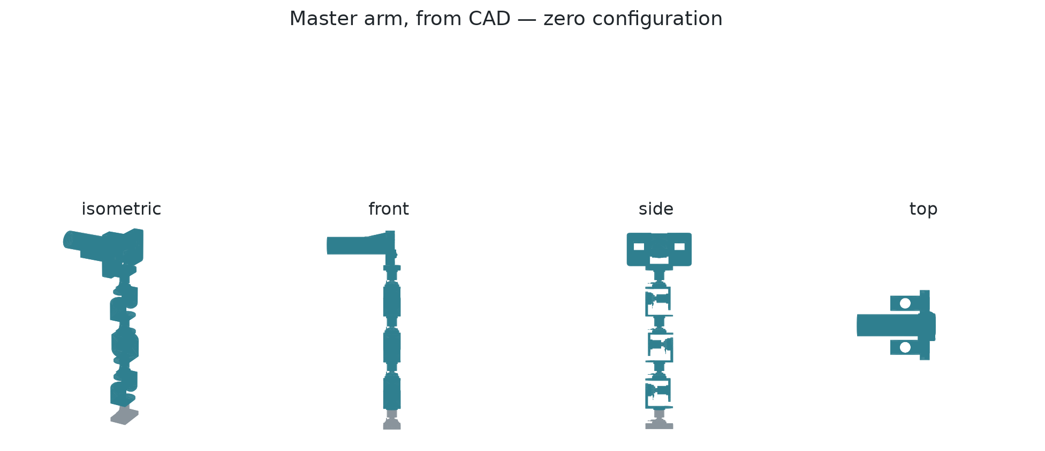
MASTER INTERFACE
The master arm, from CAD to kinematic chain
CAD, zero configuration
Chain: CAD against measured, mm
Roll and bend alternate along the chain. Link lengths are CAD-inferred and then checked against the measured arm — the two disagree by a few millimetres per link, and the measured value is the one the software uses.
source: thesis_v2/figures/master_arm_cad_views.png, master_arm_chain.png
Wearable dual-arm supernumerary robot · shared autonomy
7

Slide 9
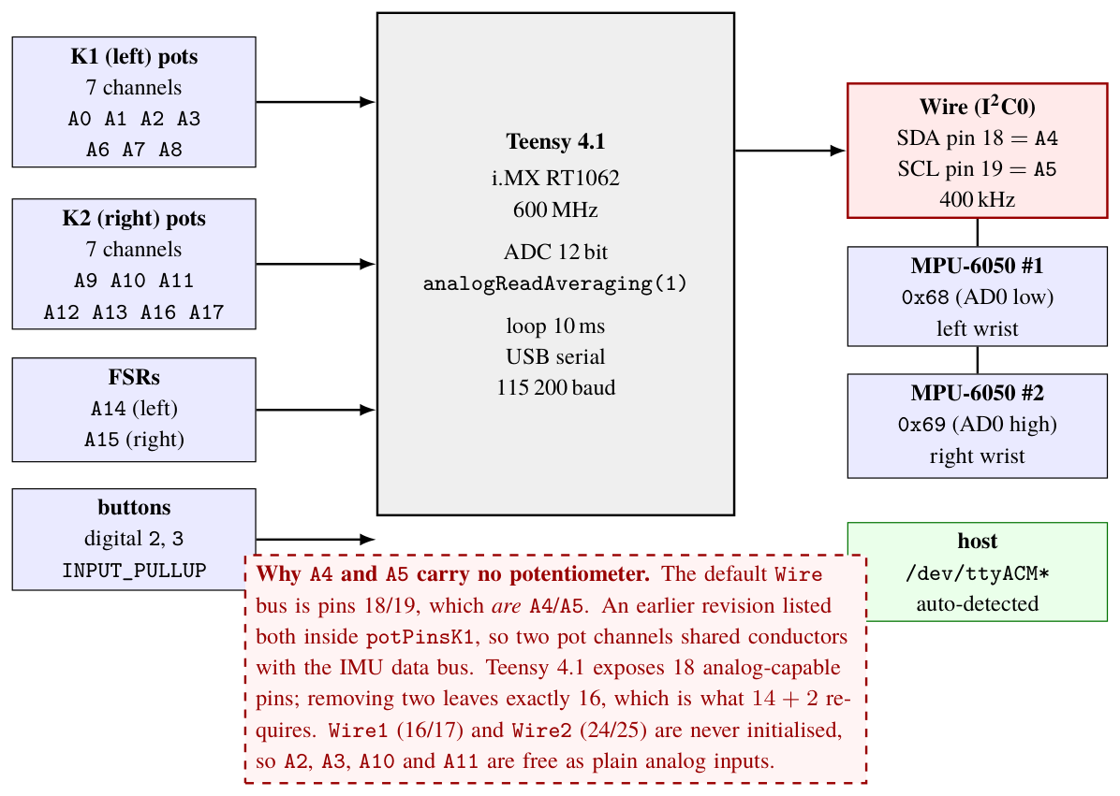
MASTER INTERFACE
Electronics and pin assignment
Fourteen channels over one Teensy 4.1. The call-out records why two analog-capable pins could not be used — a wiring constraint that later shows up in the channel health results.
source: thesis_v2/figures/diagrams/electronics.tex
Wearable dual-arm supernumerary robot · shared autonomy
8

Slide 10
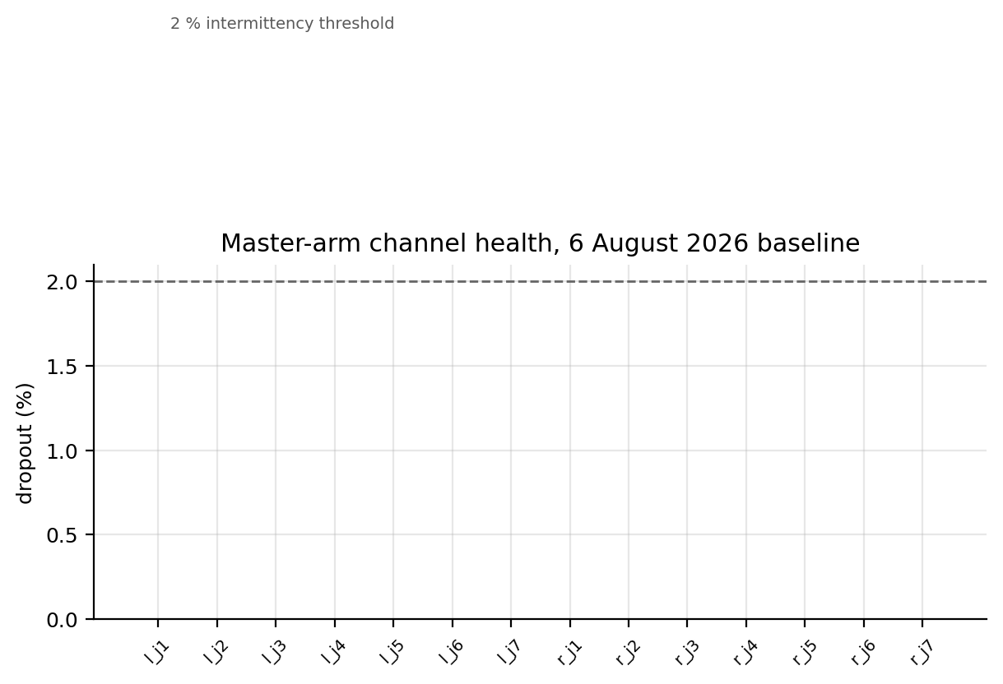
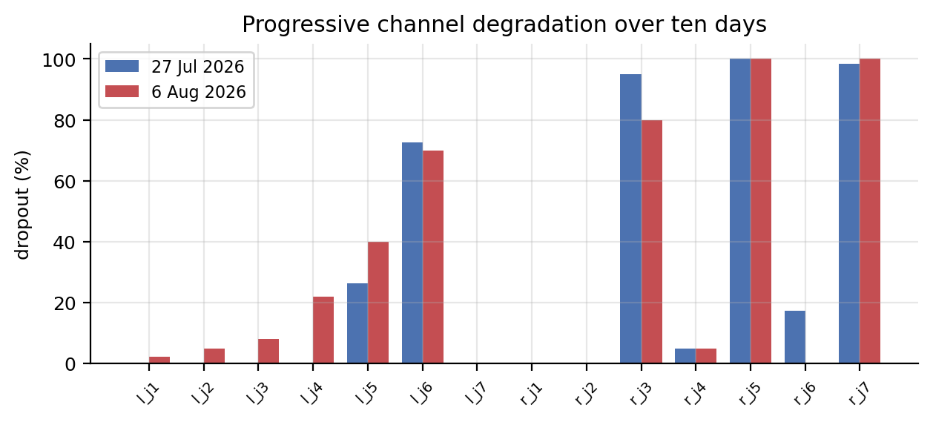
MEASURED
Master channel health — the honest picture
Seven of fourteen channels are incoherent — a soldering problem, with l_j2 and l_j4 named by regression. The system degrades rather than stopping: which channels are FROZEN is decided from the newest baseline, and a stale baseline freezes channels that now work.
source: recordings/baselines/channels_20260806.json (2026-08-06)
Wearable dual-arm supernumerary robot · shared autonomy
9

Slide 11
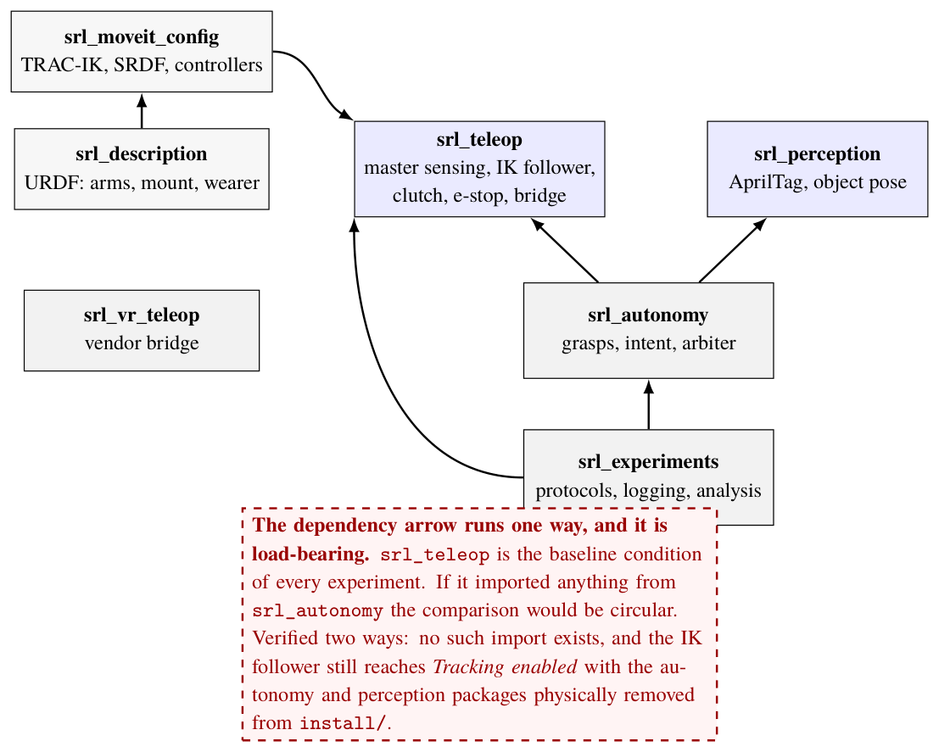
ARCHITECTURE
Software architecture
Six srl_* packages. The dependency arrow runs one way: srl_teleop imports nothing in-repo, so the baseline condition of every experiment cannot be contaminated by the autonomy layer it is compared against.
source: thesis_v2/figures/diagrams/architecture.tex
Wearable dual-arm supernumerary robot · shared autonomy
10

Slide 12
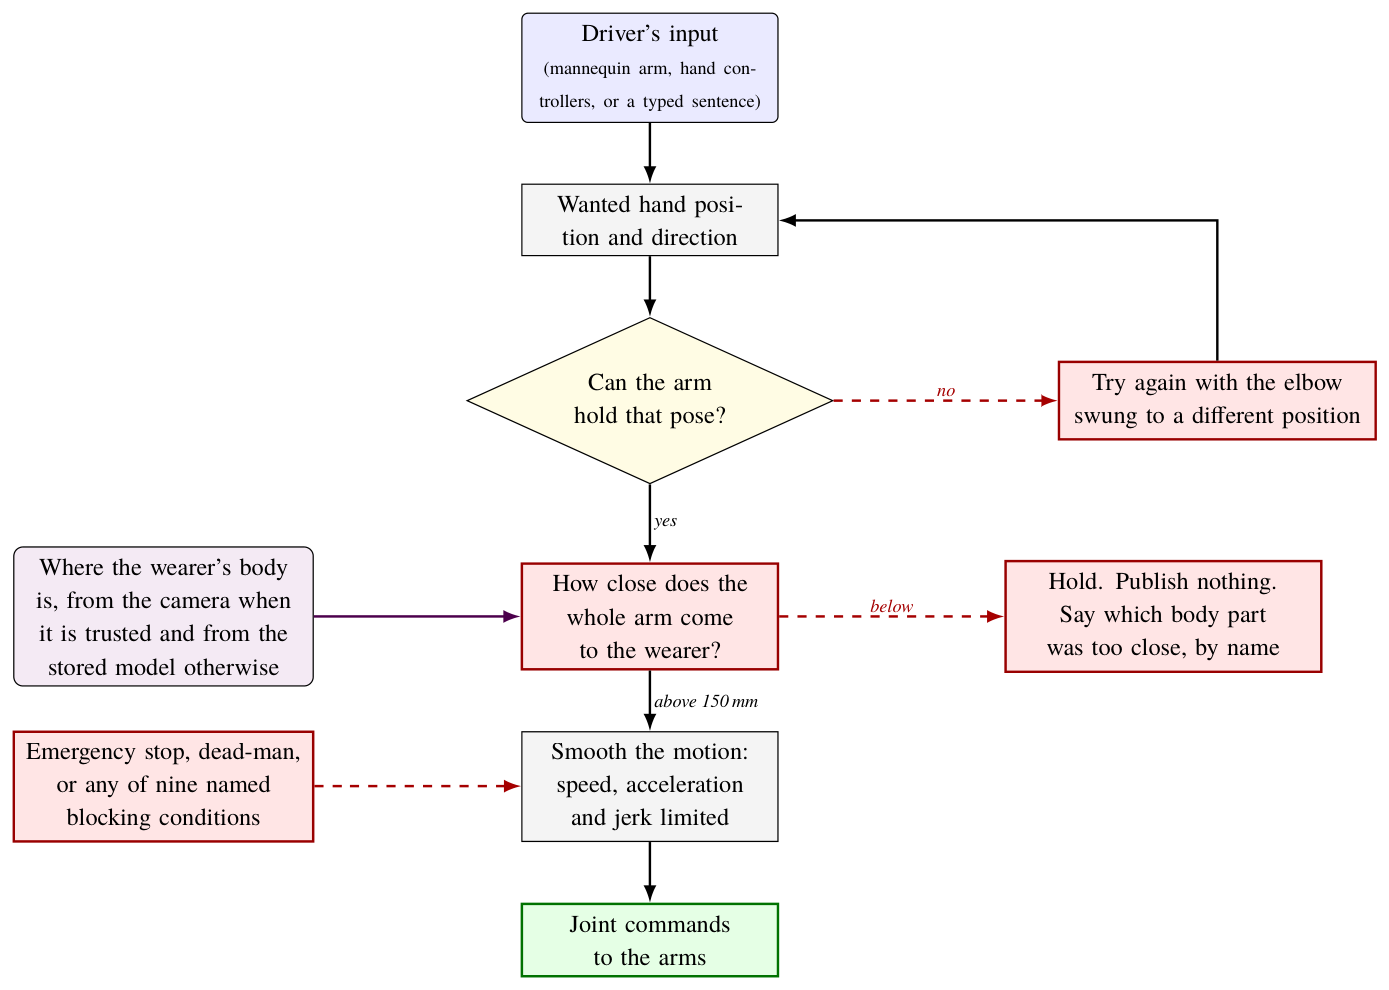
ARCHITECTURE
The data path, end to end
From a sensed master joint to a commanded arm joint, with every rate and every gate on the way.
source: thesis_v2/figures/tikz/datapath.tex
Wearable dual-arm supernumerary robot · shared autonomy
11

Slide 13
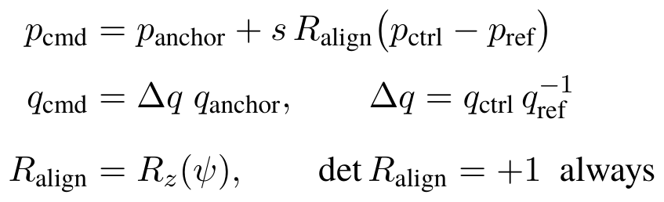
THE MATHEMATICS
The control law: two input paths, one arm command
MODE 01 — the mannequin gives position; gravity gives roll and pitch but never yaw, and on this rig j7 is railed and j5/j6 are dead, so orientation is pinned to the anchor constant.
MODE 02 — the Quest gives full 6-DOF, so orientation is commanded too. Both are RELATIVE: the anchor pair is latched at each clutch engage, so only motion SINCE engage matters and the re-engage jump is zero by construction.
and this is the whole workspace story in one line: a fixed 6-DOF pose on a 7-DOF arm leaves a null space of dimension one, and that one is the joint that moves the elbow out of the wearer.
R_align is a YAW and can never be a reflection. Facing someone and copying them is a reflection, det = −1, which would mirror every ORIENTATION while the positions still looked right — the hardest class of bug to see. That is why the parameter is an angle and not a set of per-axis sign flips. It is calibrated from a recorded motion, not guessed.
source: srl_teleop/master_pose_node.py:1502; srl_vr_teleop/vr_pose_mapper.py:16-17
Wearable dual-arm supernumerary robot · shared autonomy
12

Slide 14
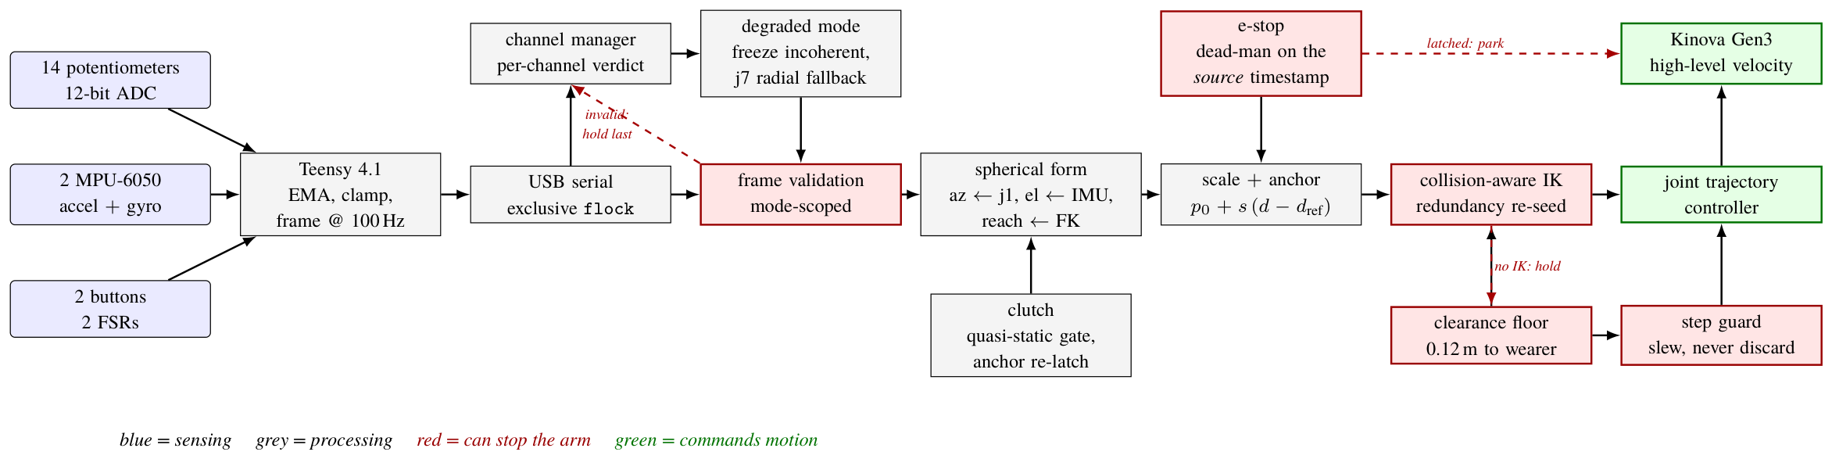
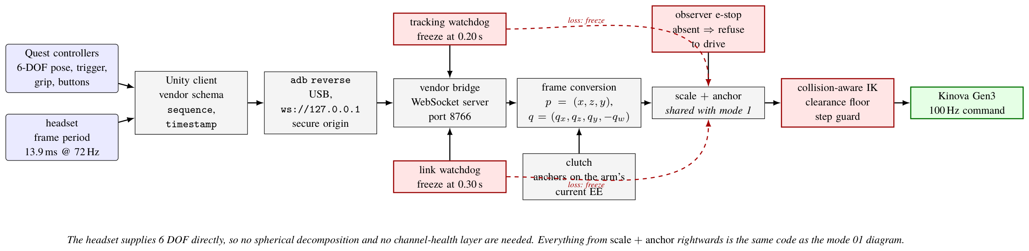
OPERATING MODES
Driving the arms by hand: the mannequin, and VR
MODE 01 — instrumented mannequin arm over a Teensy 4.1
MODE 02 — two hand controllers as 6-DOF motion capture
Blue is sensing, grey is processing, red can stop the arm, green commands motion — the same colour law in every mode diagram.
source: thesis_v2/figures/diagrams/mode1_mannequin.tex, mode2_vr.tex
Wearable dual-arm supernumerary robot · shared autonomy
13

Slide 15
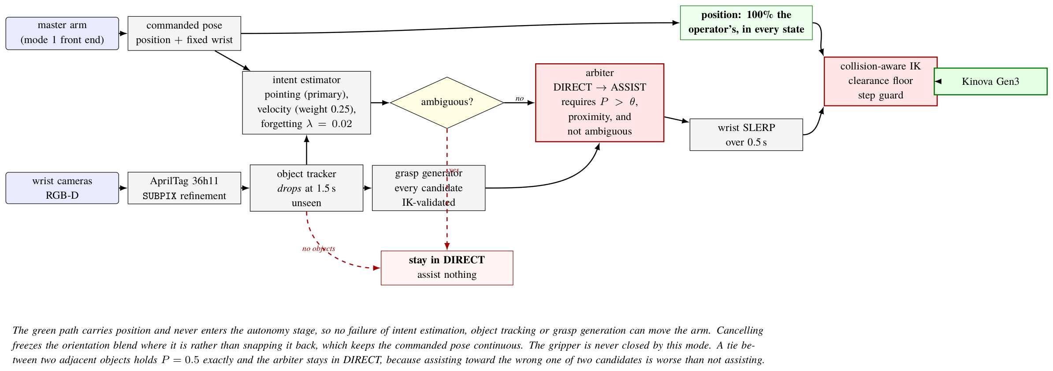
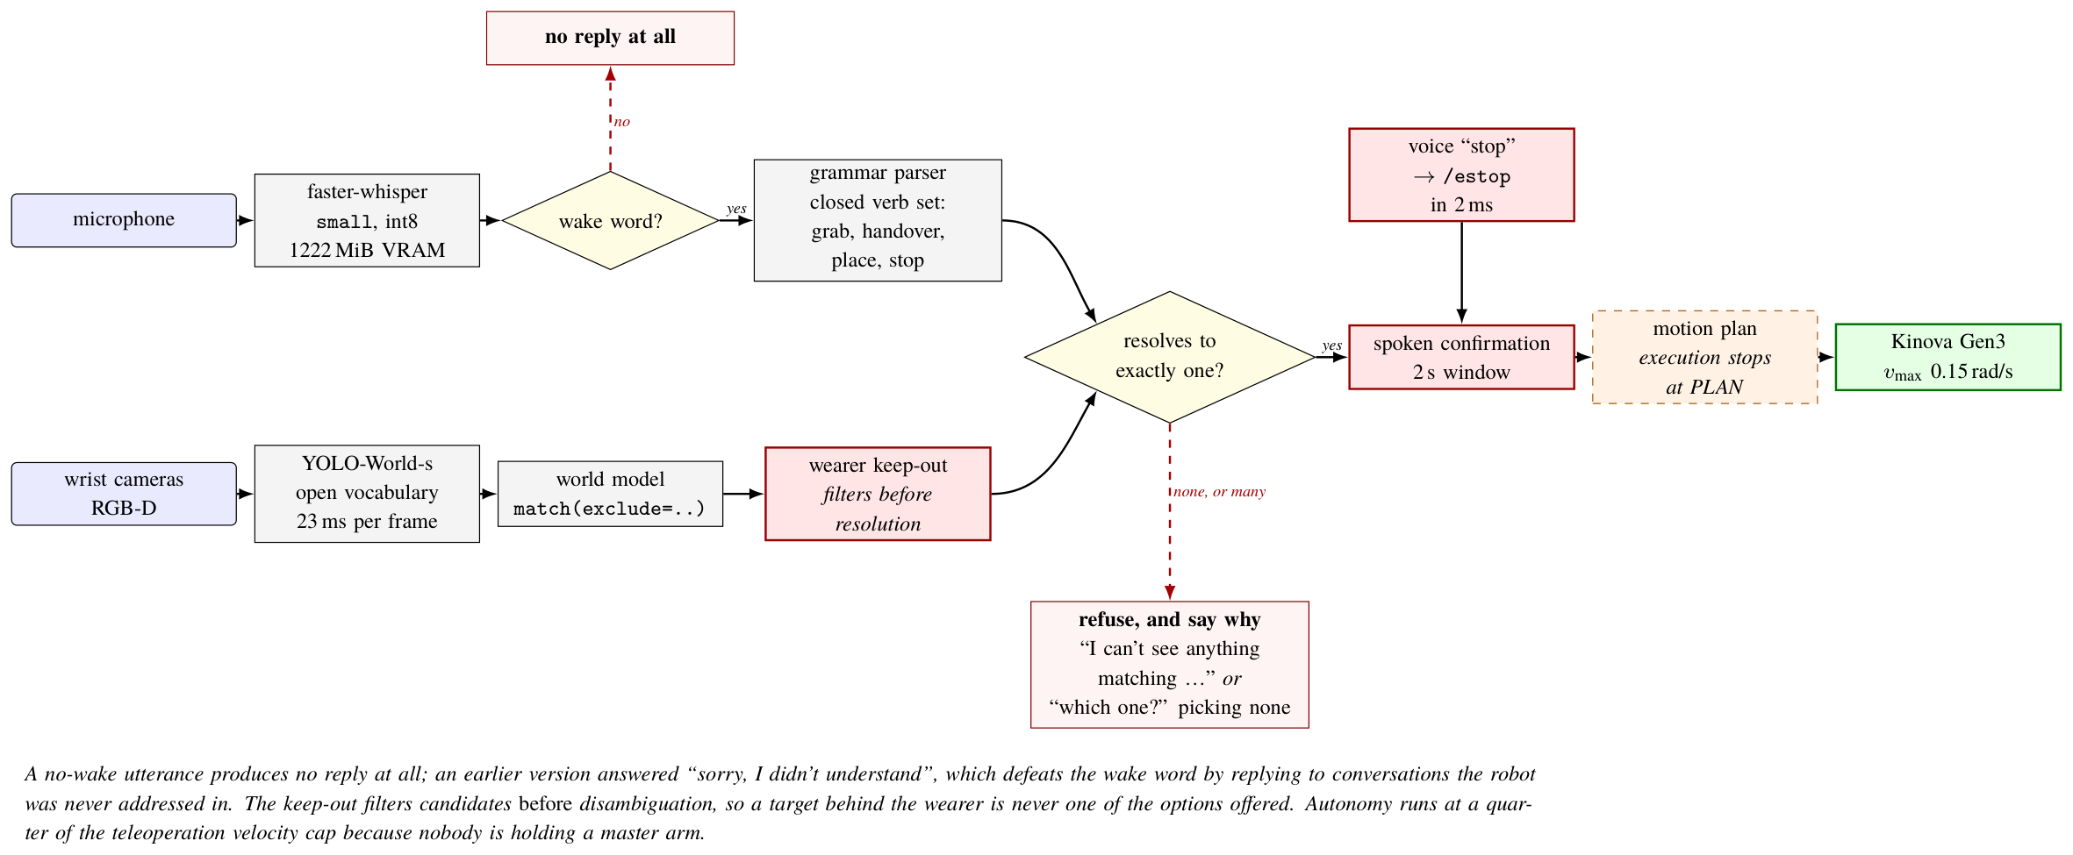
OPERATING MODES
Sharing control, and giving up control entirely
MODES 03 / 04 — shared autonomy over either input path
MODE 06 — full autonomy from a typed or spoken sentence
The task layer commands the SAME waypoints under every mode — run_abc builds them with no mode argument — so any difference in what the robot does is a property of the mode, not of the task.
source: thesis_v2/figures/diagrams/mode3_shared.tex, mode4_voice.tex
Wearable dual-arm supernumerary robot · shared autonomy
14

Slide 16
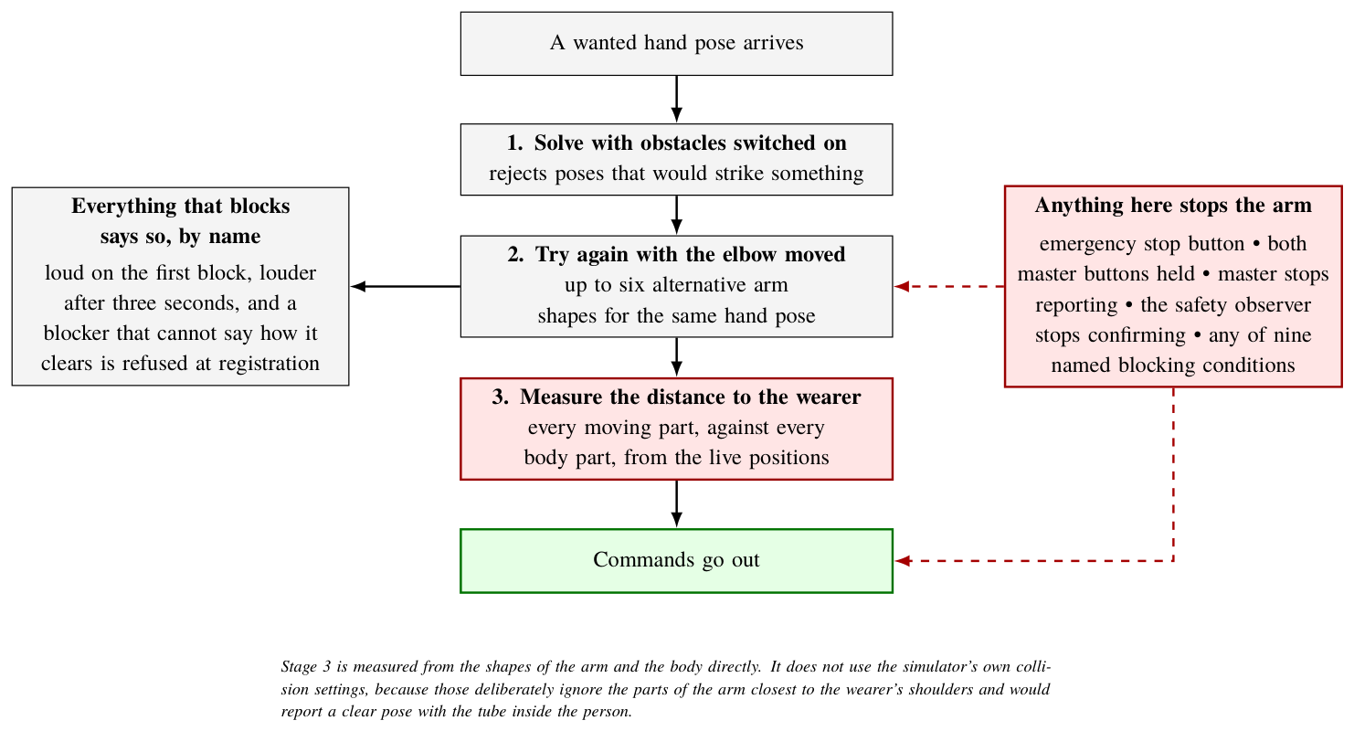
SAFETY
The safety chain
Three stages before any command leaves. Stage 3 measures the distance to the wearer from the shapes directly — it does not use the simulator's collision settings, because the SRDF deliberately excludes the 44 proximal pairs a shoulder mount actually threatens, and would report a clear pose with the tube inside the person.
source: thesis_v2/figures/tikz/safety.tex
Wearable dual-arm supernumerary robot · shared autonomy
15

Slide 17
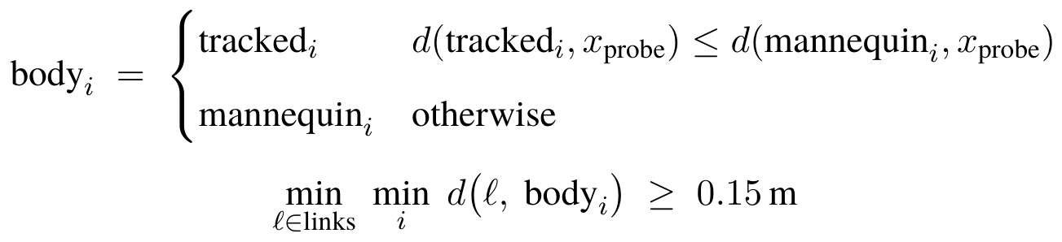
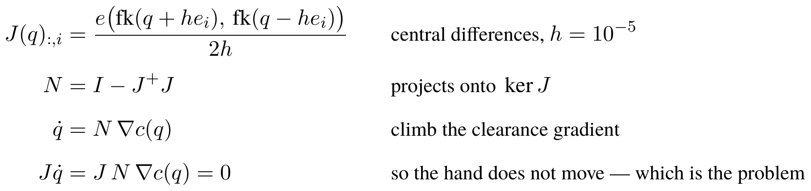
THE MATHEMATICS
The safety case, as two expressions
The camera may only make the wearer BIGGER. Per part, keep whichever primitive is CLOSER to where the robot works — there is no mode switch, so there is no mode to be in the wrong one of. A part the camera says is further away is kept at the assumed position, because a monocular depth error looks exactly the same from one camera.
And the predictive avoider, whose own algebra explains why it is worth so little: the null space holds the hand fixed by definition, and it is the hand that is inside the person.
The distance is measured geometrically against the primitives. It is NOT the planner's collision check: the SRDF deliberately excludes the 44 proximal pairs a shoulder mount actually threatens, so a pose it calls valid can have the tube inside the person.
source: srl_perception/wearer_tracking.py:273 (fuse); srl_teleop/predictive_avoidance.py:226-268
Wearable dual-arm supernumerary robot · shared autonomy
16

Slide 18
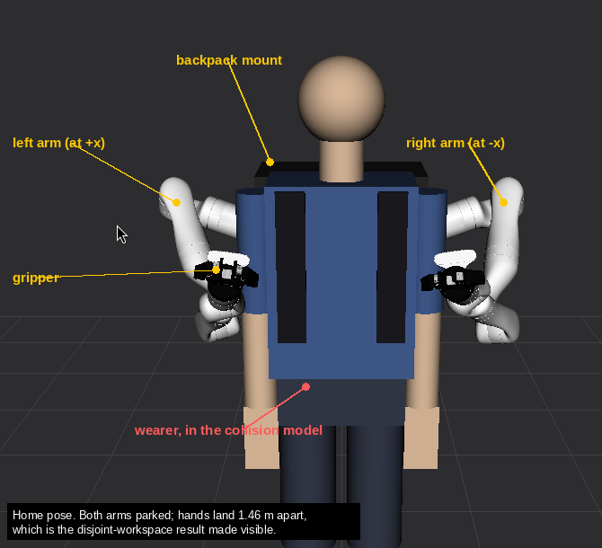
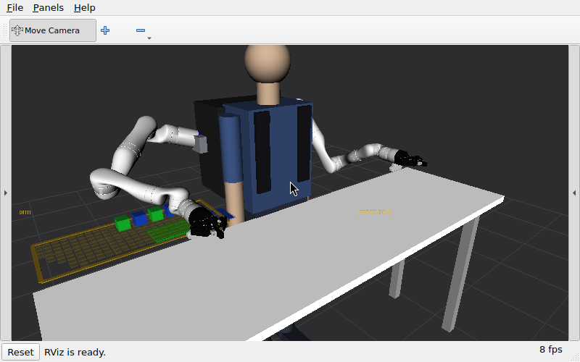
SAFETY
The wearer is in the collision model
RViz, home pose, both arms parked. The wearer's torso, head, hips and arms are all in the model, and the wearer's posture is a variable with one source — a posture that reaches the planner but not the clearance guard measures the old body under a new name.
source: thesis_v2/figures/rviz/home_pose_labelled.png; docs/img/presentation_pose_iso.png (2026-08-15)
Wearable dual-arm supernumerary robot · shared autonomy
17

Slide 19
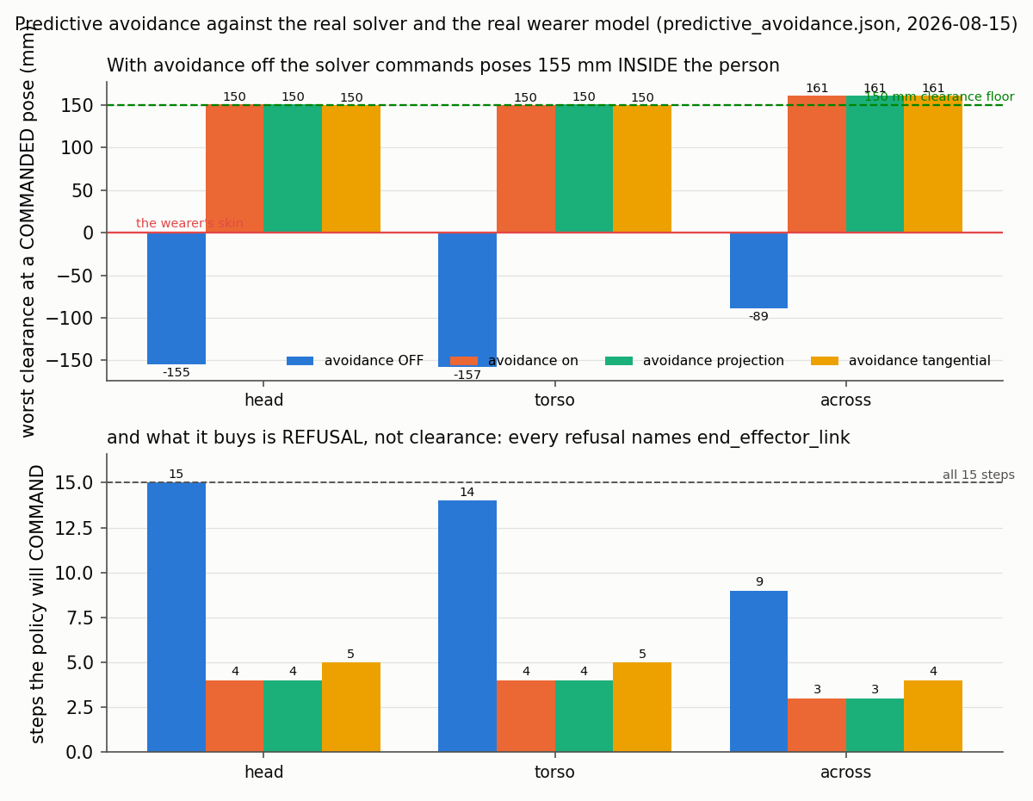
SAFETY · MEASURED
Predictive avoidance: what it actually buys
With avoidance OFF the solver cheerfully commands poses 155 mm INSIDE the wearer. With it on, every pose it will command clears the 150 mm floor and the rest are refused by name. So what the null space buys is REFUSAL, not clearance — the clearance gain itself is single-figure millimetres, because the null space holds the hand fixed by definition and it is the hand that is inside the person.
source: recordings/baselines/predictive_avoidance.json (2026-08-15)
Wearable dual-arm supernumerary robot · shared autonomy
18

Slide 20
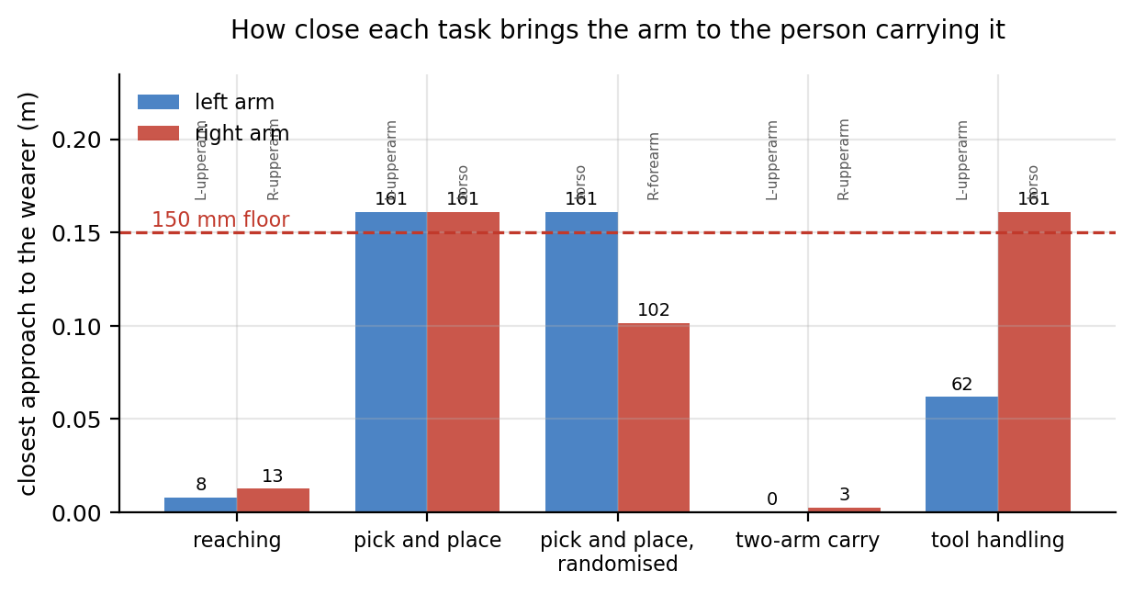
SAFETY · MEASURED
Clearance to the wearer, per task
The floor is 150 mm
and the mount alone sits 161 mm from the torso — so there are 11 mm of headroom before the arm does anything at all.
Only T1 stage 1 is clean
T0 breaches by ~142/137 mm, T2 by 150/147, T3's left arm by 88.
Predictive avoidance is worth 0.0–5.6 mm
All 28 refusals name end_effector_link: the hand is inside the person, and the null space holds the hand fixed by definition.
A breach is reported, not silenced. An SRDF exclusion silences an alarm; it does not move the metal.
source: recordings/baselines/home_change_applied.json, predictive_avoidance.json
Wearable dual-arm supernumerary robot · shared autonomy
19

Slide 21
PART 3
Perception and autonomy
Measure the environment, then plan against the measurement — rather than against a scene someone typed in.
20

Slide 22
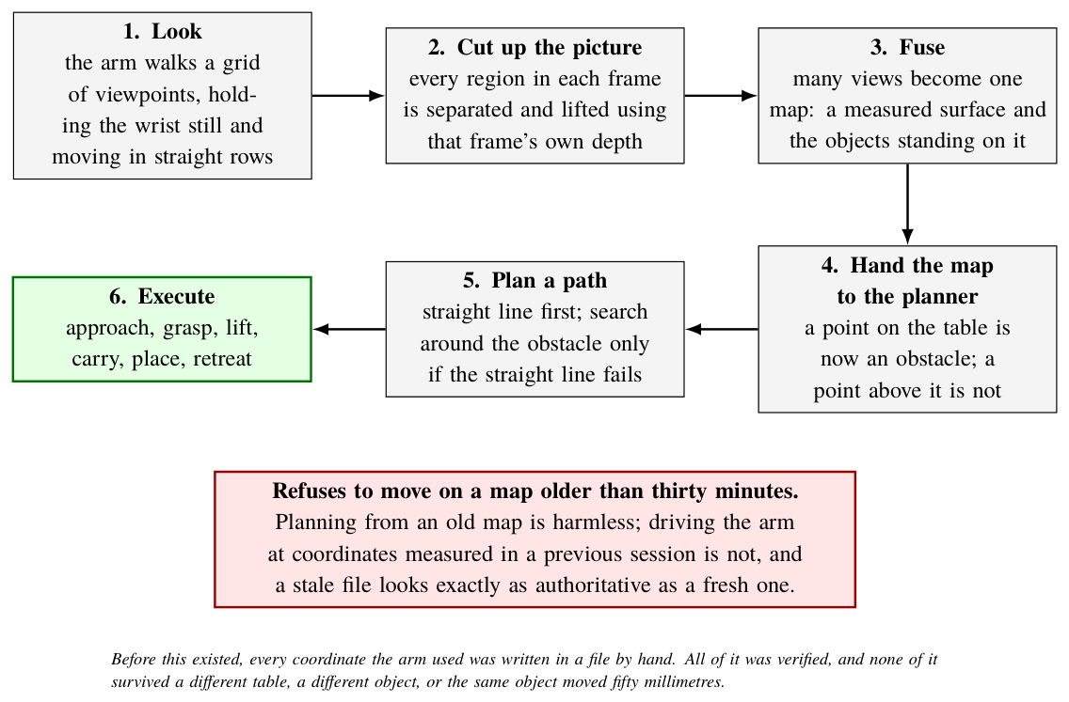
PERCEPTION
The perception pipeline
Four cameras — both wrist RGB-D, a RealSense and a USB scene camera — reduced to a plane and a set of objects per camera per cycle, with per-camera health and named refusals.
source: thesis_v2/figures/tikz/perception.tex
Wearable dual-arm supernumerary robot · shared autonomy
21

Slide 23
SAFETY CASE
The camera may only make the wearer BIGGER
fuse() keeps whichever body is CLOSER to the robot, per part, with no mode switch.
A tracked torso can sit beside a mannequin upper arm in one scene. A body injected 0.10 / 0.30 / 1.00 / 5.00 m FURTHER away changes nothing at all — which is the property that makes the camera safe to add.
fault injected through the live node
what must happen
result
the frame is dark
refuse, naming darkness
PASS
the frame is blank
refuse, naming a blank frame
PASS
two people in frame
refuse, naming the second person
PASS
nobody in frame
refuse, naming the empty frame
PASS
the arms are occluded
fall back per part, naming the occlusion
PASS
the body is pushed further away
ignore it — keep the mannequin
PASS
control: one person, clear frame
track, and say it is tracking
PASS
7 of 7 — and the requirement that a refusal NAME its own fault caught a false pass where the two-person gate had never run. The injected frames are stock test images, not lab photographs.
source: scripts/verify_wearer_fallbacks.py, src/srl_perception/test/test_wearer_tracking.py
Wearable dual-arm supernumerary robot · shared autonomy
22

Slide 24
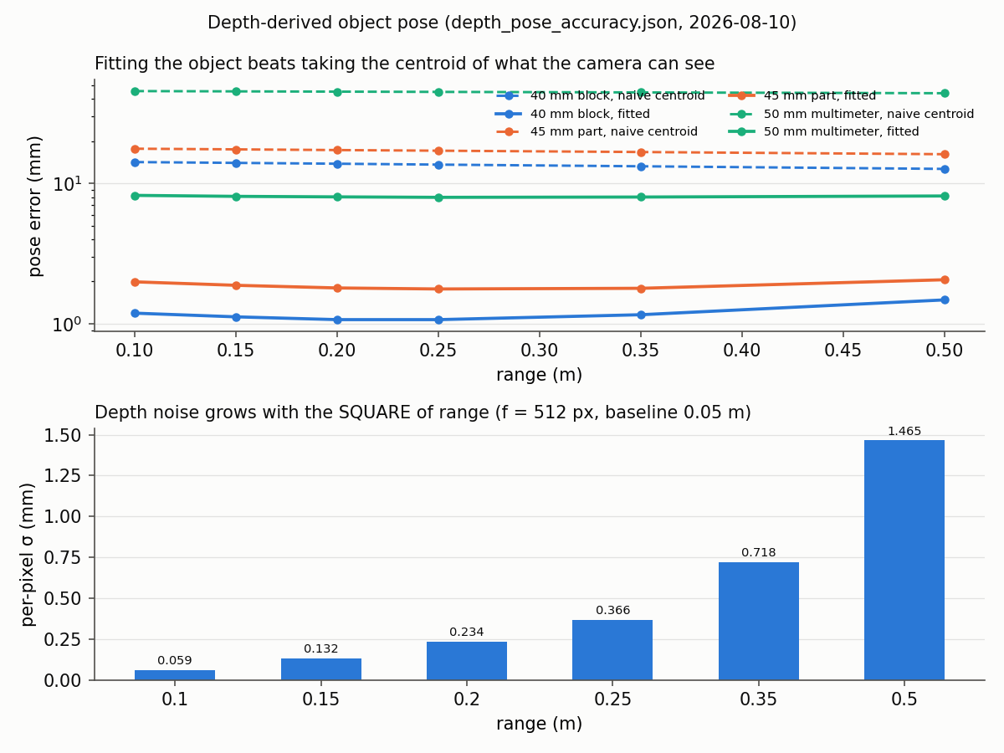
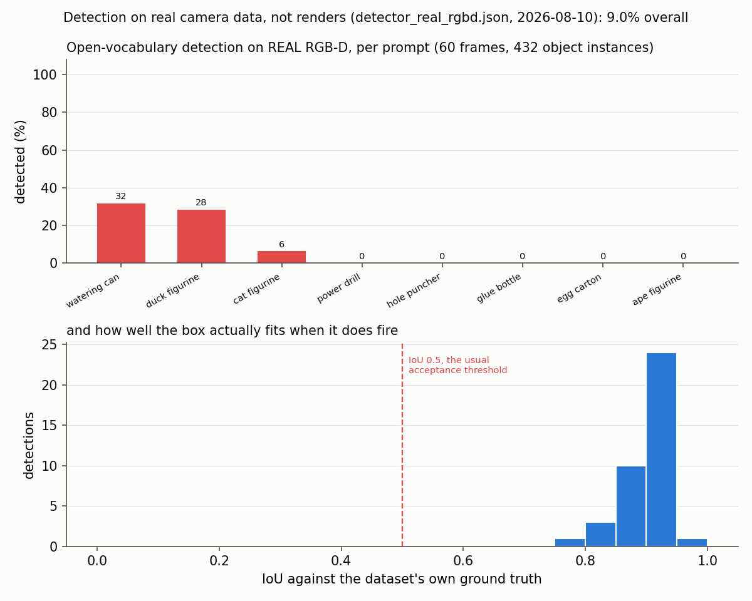
PERCEPTION
Depth accuracy, and detection on real camera data
pose error against range
prompted detection on real RGB-D
Fitting the object beats taking the centroid of what the camera can see, by an order of magnitude — that is the 2.0 mm term in the control budget. On the right is the only detection number in this project measured on REAL RGB-D: 9% overall on the dataset's cluttered figurines. The boxes it does return fit well, so the failure is RECALL, not localisation — and it is why the 100% colour-vision score is labelled RENDERED.
source: recordings/baselines/depth_pose_accuracy.json, detector_real_rgbd.json
Wearable dual-arm supernumerary robot · shared autonomy
23

Slide 25
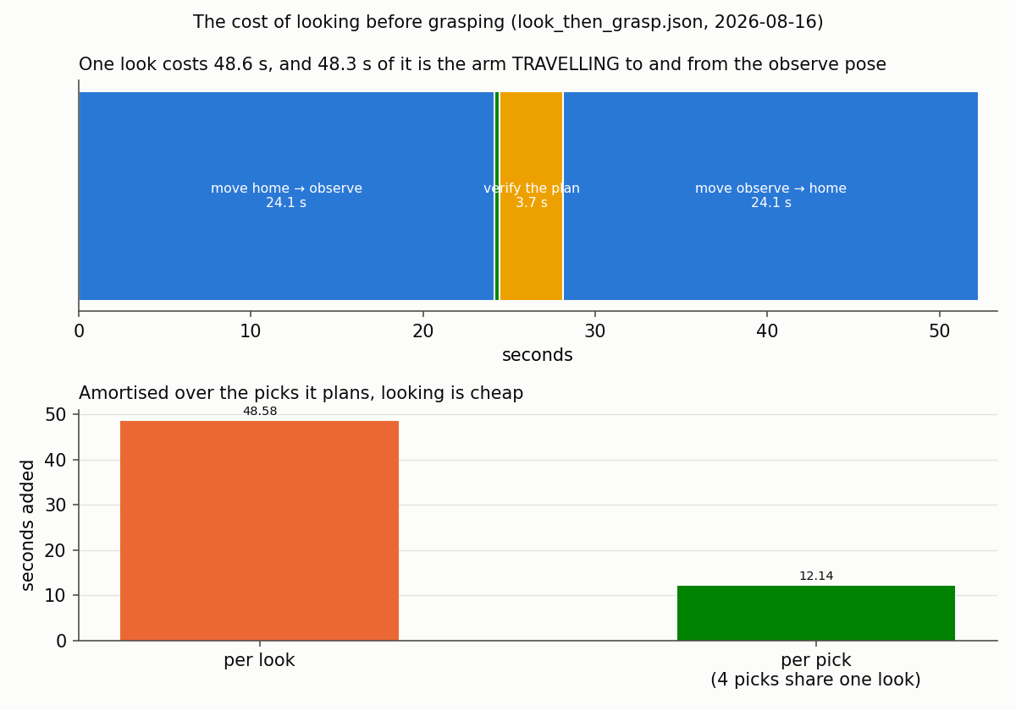
PERCEPTION
What it costs to look before grasping
One look costs 48.6 s — and 48.3 s of that is the arm TRAVELLING to and from the observe pose. Detection and classification take 0.31 s. The whole optimisation available here is a shorter journey, not a faster detector, and amortised over the four picks one look plans it adds 12.1 s per pick.
source: recordings/baselines/look_then_grasp.json (2026-08-16)
Wearable dual-arm supernumerary robot · shared autonomy
24

Slide 26
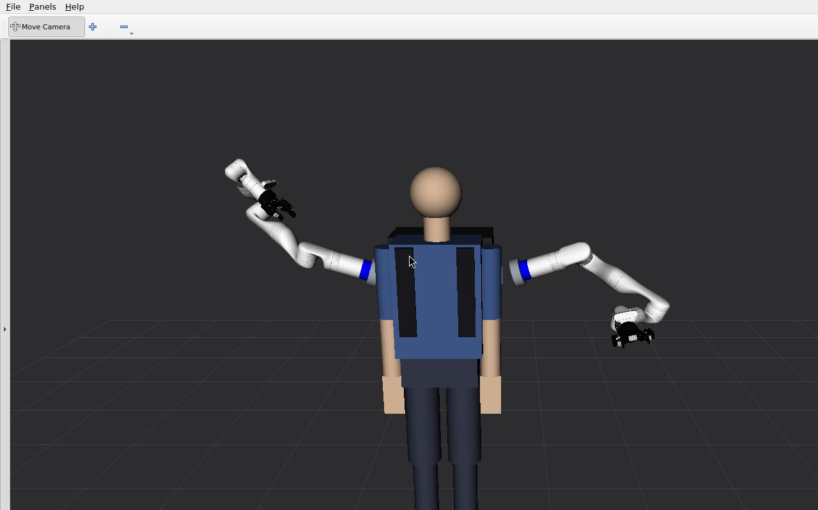
ENVIRONMENT MAPPING
The robot maps the workspace, then plans against the map
6 / 6
+0.2 mm
objects recovered
surface height error
every one exact in x,y to a millimetre; every dimension within 3 mm
against the renderer's own geometry
Objects are cut from the picture
segment_lift, not clustered from the point pile.
One wrist attitude per pass, pure translation
printer-probe style: 2 layers × 3 yaws × 2 arms.
74 of 74 reachable cells, 0 stillness refusals
and the sweep records what it can reach, then replans from it.
The earlier '−5.2 mm' surface error was surface_z reporting the plane's intercept AT THE ORIGIN, which is inside the wearer — an instrument fault, not a measurement.
source: recordings/session/20260824_190937/ ; docs/system/25_calibrate_then_plan.md
Wearable dual-arm supernumerary robot · shared autonomy
25

Slide 27
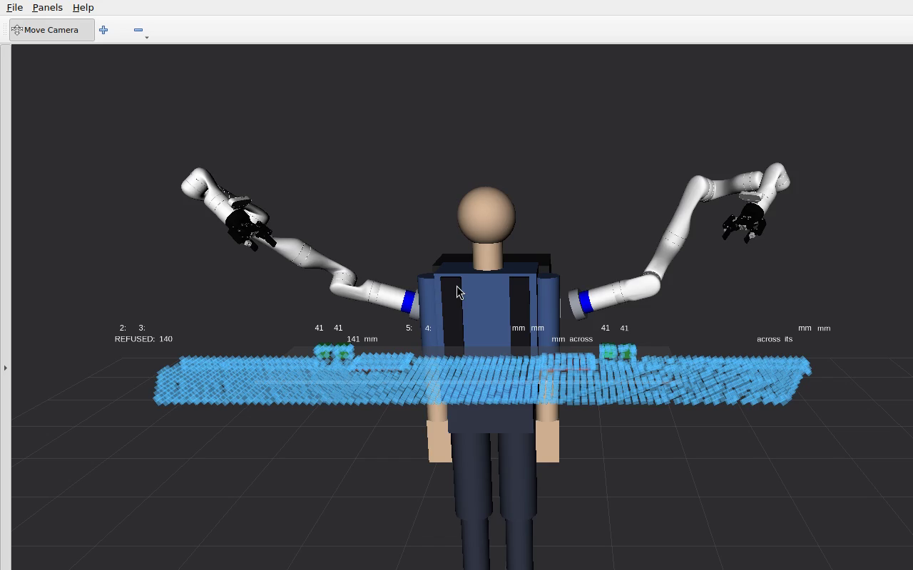
ENVIRONMENT MAPPING
From the map to a pick
Table found at z = 1.2485 m, tilt 0.54°
bounds found by a coarse probe before the sweep, not typed in.
6 objects; 4 graspable at 41 mm, 2 refused at 140 mm
'too wide' is a named refusal — the gripper opens 85 mm.
Approached from ABOVE
pregrasp z 1.490 → grasp z 1.381 onto an object at z 1.282.
765 s end to end, 55 narration sentences
full scan, reference, pick and quick check, all exit 0.
DEMONSTRATION, not evidence: the arm is simulated and the depth is rendered. What is real is the sweep order, the deprojection, the segmentation, the fusion, the plane fit, the IK, the approach-angle search and every refusal.
source: recordings/session/20260824_190937/summary.txt (2026-08-24)
Wearable dual-arm supernumerary robot · shared autonomy
26

Slide 28
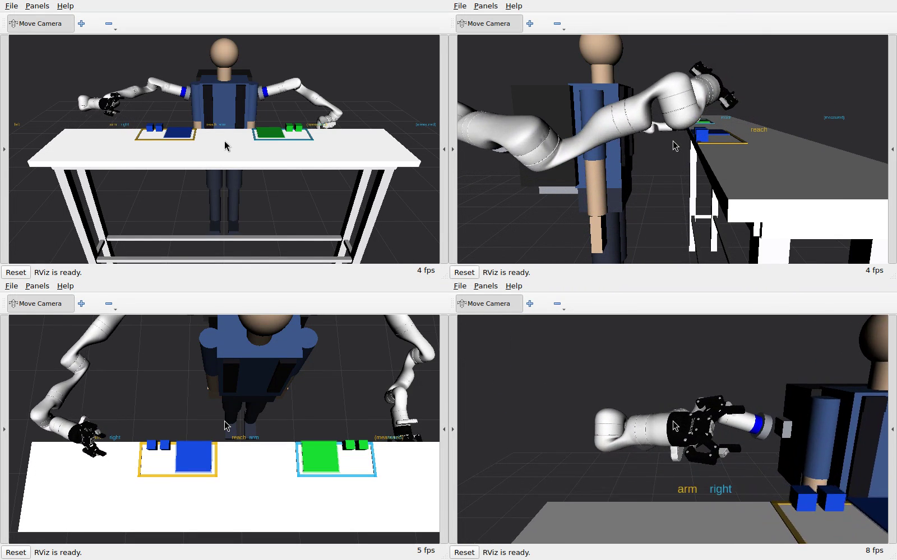
MODE 06
Full autonomy: four cubes placed by colour, from a typed sentence
4 grasps, 4 releases
every cube on the pad of its own colour, started at home 0.0000 rad.
Both arms, pads at ±0.290 m
straddling the centreline — and neither arm can cross it, so a cube is only ever delivered to the pad on its own side.
Each clip runs card → look → task
the observe move is in the footage, and the card carries the sentence verbatim.
Four synchronised RViz views of one run. The wearer, the table, the two coloured pads and the four cubes are all in the scene the planner is checked against.
source: recordings/verification/06_full_autonomy/T1/S1_both_arms_centre/rviz_quad.mp4 (2026-08-23)
Wearable dual-arm supernumerary robot · shared autonomy
27

Slide 29
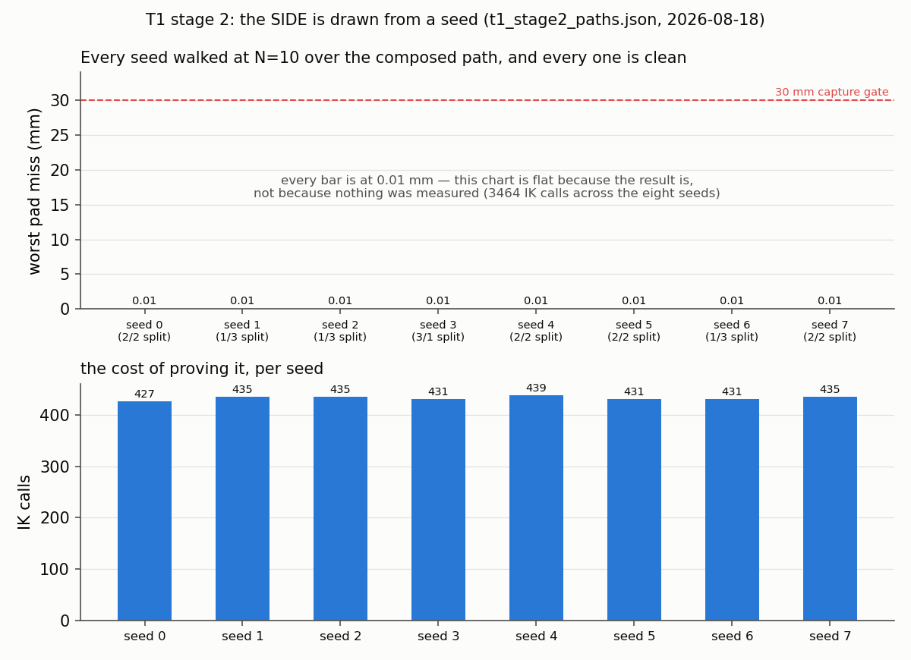
MODE 06
Stage 2 is eight layouts, not one
Every stage-2 seed walked at N=10 over the composed path. Splits of 1/3, 2/2 and 3/1 all occur and both arms always work. The chart is flat because the result is — worst pad miss 0.01 mm across all eight — not because nothing was measured: it cost 3 464 IK calls. Seed 0 draws 2/2 and is indistinguishable from stage 1, which is why the recorded clip uses seed 3: a task that only ever demonstrates its easy case has demonstrated nothing.
source: recordings/baselines/t1_stage2_paths.json (2026-08-18)
Wearable dual-arm supernumerary robot · shared autonomy
28

Slide 30
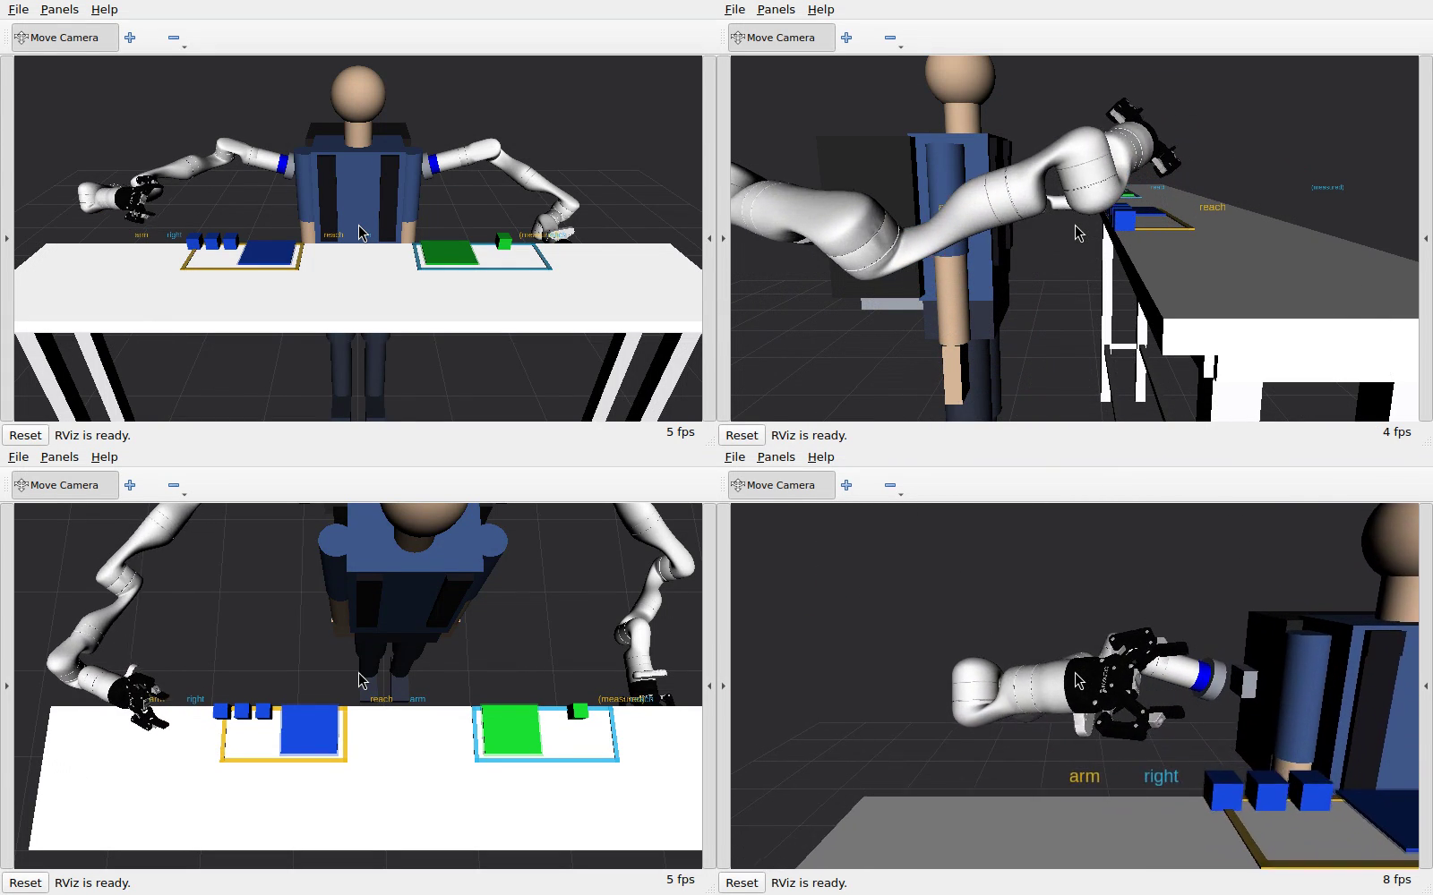
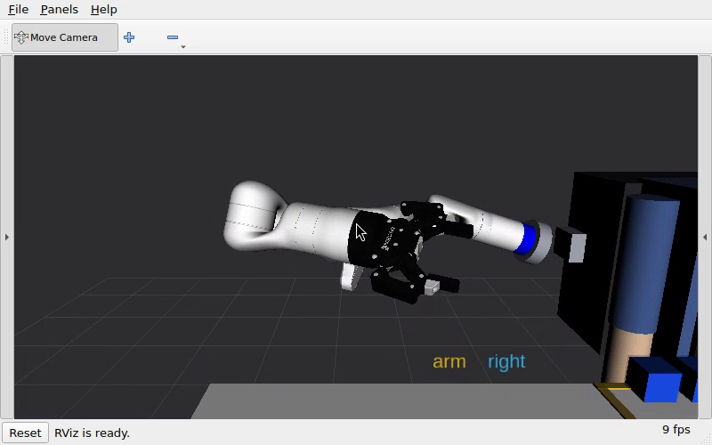
MODE 06
A seeded layout, and the view where a grasp is judged
T1 stage 2 — seeded layout
T1 — the pads on the cube
Stage 2 is stage 1's geometry with the side drawn at random — eight seeds walked, all clean. The gripper view exists because a grasp asserted from a joint angle is not a grasp: it has to be seen closing on the object.
source: recordings/verification/06_full_autonomy/T1S2/... and .../T1/S1_both_arms_centre/rviz_gripper.mp4
Wearable dual-arm supernumerary robot · shared autonomy
29

Slide 31
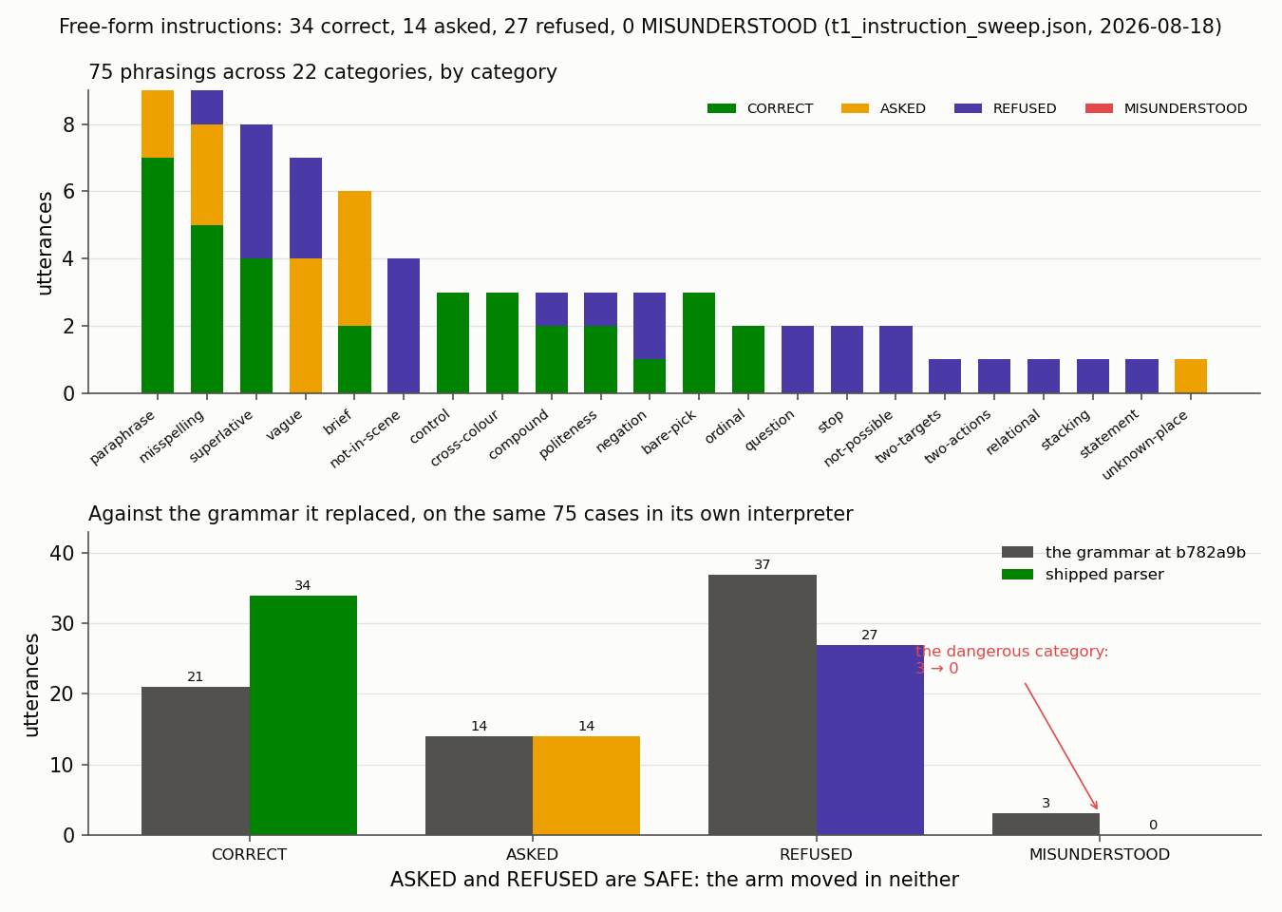
LANGUAGE
The full instruction sweep, against the grammar it replaced
75 phrasings across 22 categories: 34 correct, 14 asked, 27 refused, 0 MISUNDERSTOOD — against 21 / 14 / 37 / 3 for the grammar it replaced, run on the same cases in its own interpreter. An utterance that moves the arm to the wrong place is the only unsafe outcome, and there are none. ASKED and REFUSED are both safe: the arm moved in neither.
source: recordings/baselines/t1_instruction_sweep.json (2026-08-18)
Wearable dual-arm supernumerary robot · shared autonomy
30

Slide 32
THE MATHEMATICS
How voice is scored — and what the score is not
Word error rate over the 40 spoken cases, and the wake gate as an edit distance on the transcribed prefix. The threshold sweep says the shipped value of 4 is looser than the data supports; 1 is what the measurement recommends.
A 25.2% word error rate with ZERO exact transcripts still yields a parser that misunderstands nothing, because the grounding step re-resolves against what the camera can actually see and asks when it cannot. That is the argument for scoring the PARSER separately from the transcription — and it is why no claim here is a transcription claim.
source: recordings/baselines/voice_instruction.json, wake_word.json
Wearable dual-arm supernumerary robot · shared autonomy
31

Slide 33
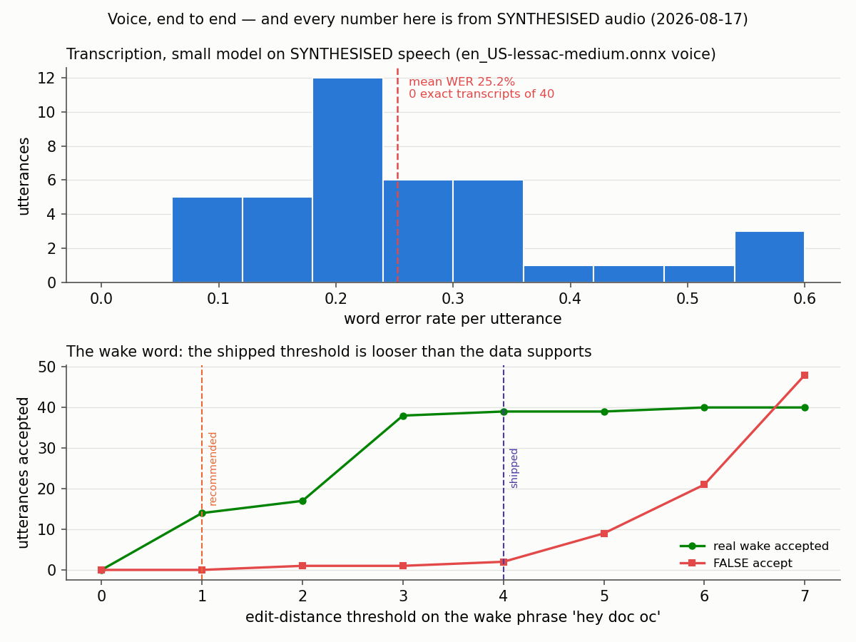
LANGUAGE
Voice, end to end — and why it is a parser score
Word error rate per utterance, and the wake-word threshold sweep showing the shipped threshold is looser than the data supports. The parser still returns 14 correct / 5 asked / 21 refused / 0 misunderstood THROUGH this transcription. Every number here came from SYNTHESISED audio: /dev/snd on this host has only 'timer', so no microphone can be opened, and accuracy against a real speaker is unmeasured.
source: recordings/baselines/voice_instruction.json, wake_word.json
Wearable dual-arm supernumerary robot · shared autonomy
32

Slide 34
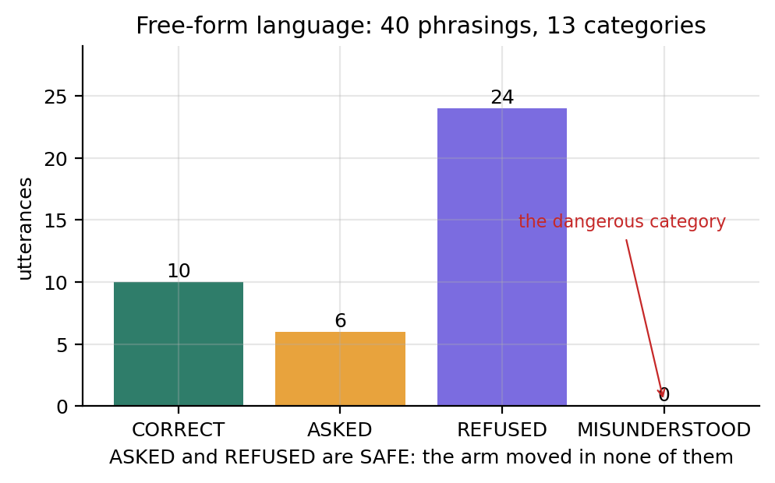
LANGUAGE
Understanding a free-form sentence
Zero MISUNDERSTOOD is the whole result
ASKED and REFUSED are both SAFE — the arm moved in neither. The bar is drawn at zero rather than omitted, so it reads as a measured zero and not an absence.
A wider parser sweep, 75 phrasings
34 correct / 14 asked / 27 refused / 0 misunderstood, against 21 / 14 / 37 / 3 for the grammar it replaced, run on the same cases in its own interpreter.
Ambiguity asks, and the ask is answerable
10 of the 14 asks carry a scored reply; all 10 resolve correctly, and a reply is never counted as CORRECT.
Voice is a PARSER score, never a transcription score. /dev/snd on this host has only 'timer', so no microphone can be opened and every voice figure came from synthesised audio.
source: recordings/baselines/language_vision_sweep.json (40 phrasings); scripts/sweep_t1_instructions.py (75)
Wearable dual-arm supernumerary robot · shared autonomy
33

Slide 35
PART 4
Results
Grasping and placement, motion generation, the VR path, and the one measurement taken on real hardware.
34

Slide 36
RESULTS
Headline results
100%
0.000 mm
56.3 mm
12.91 mm
grasp success
grasp positioning error
T1 placement error
control budget, RSS
17 cells × 8 angles, all five modes (2026-08-23 clip set)
against a 30 mm capture gate
down from 319.7 mm before the re-record
worst case 19.99 mm — inside the 30 mm gate for the first time
mode
task
n
grasped
positioning
placement
01 master
T3
2
2 / 2
0.00 mm
—
02 VR
T3
2
2 / 2
0.00 mm
—
03 shared
T3
2
2 / 2
0.00 mm
—
04 VR + shared
T3
2
2 / 2
0.00 mm
—
06 autonomy
T1
4
4 / 4
0.00 mm
55.5 – 56.9 mm
06 autonomy
T1S2
4
4 / 4
0.00 mm
—
T1 and T1S2 run under mode 06 only; T0 and the dance routines grasp nothing by design. Reading a by-design absence as a gap has been an instrument fault here three times.
source: recordings/verification/accuracy_table.json (2026-08-24)
Wearable dual-arm supernumerary robot · shared autonomy
35

Slide 37
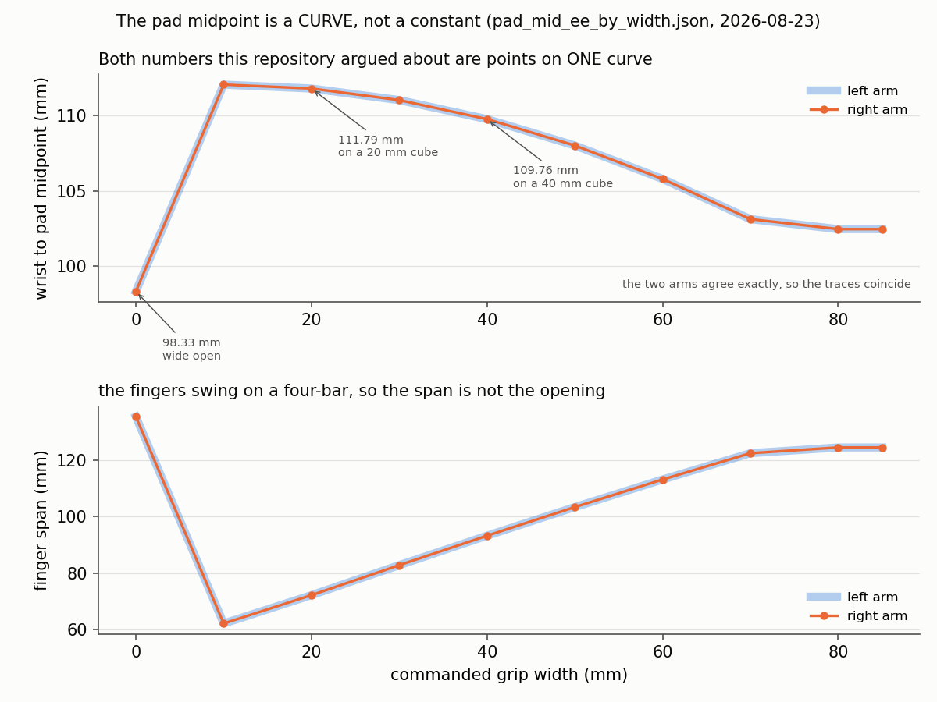
RESULTS · GRASPING
The pad midpoint is a curve, not a constant
The Robotiq's fingers swing on a four-bar, so wrist-to-pad changes with the opening: 98.33 mm wide open, 110.98 mm on a 40 mm cube. BOTH numbers this project argued about are points on this curve — the '13.47 mm too long' and T1's '11.43 mm short' were comparing two different gripper states, which is why the evidence flipped depending on what opening the simulator had been left at.
source: recordings/baselines/pad_mid_ee_by_width.json (2026-08-23)
Wearable dual-arm supernumerary robot · shared autonomy
36

Slide 38
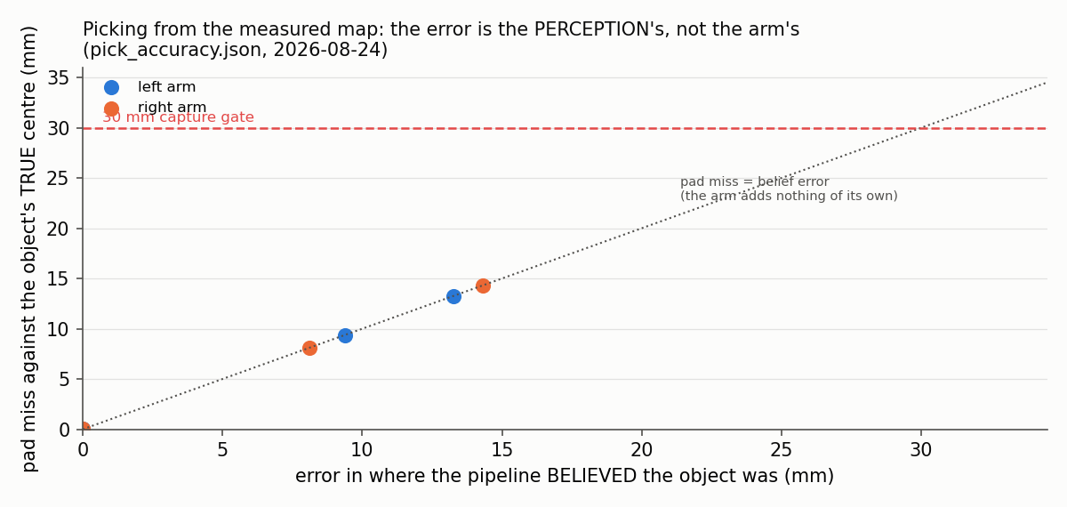
RESULTS · GRASPING
Picking from the measured map: whose error is it?
Pad miss against belief error for every pick planned from the measured world map. The points sit on the diagonal: wherever the pipeline believes the object is, the arm puts the pads there. That localises the remaining error in PERCEPTION rather than in the kinematics — and is why the unmeasured camera extrinsic is the most expensive thing outstanding.
source: recordings/baselines/pick_accuracy.json (2026-08-24)
Wearable dual-arm supernumerary robot · shared autonomy
37

Slide 39
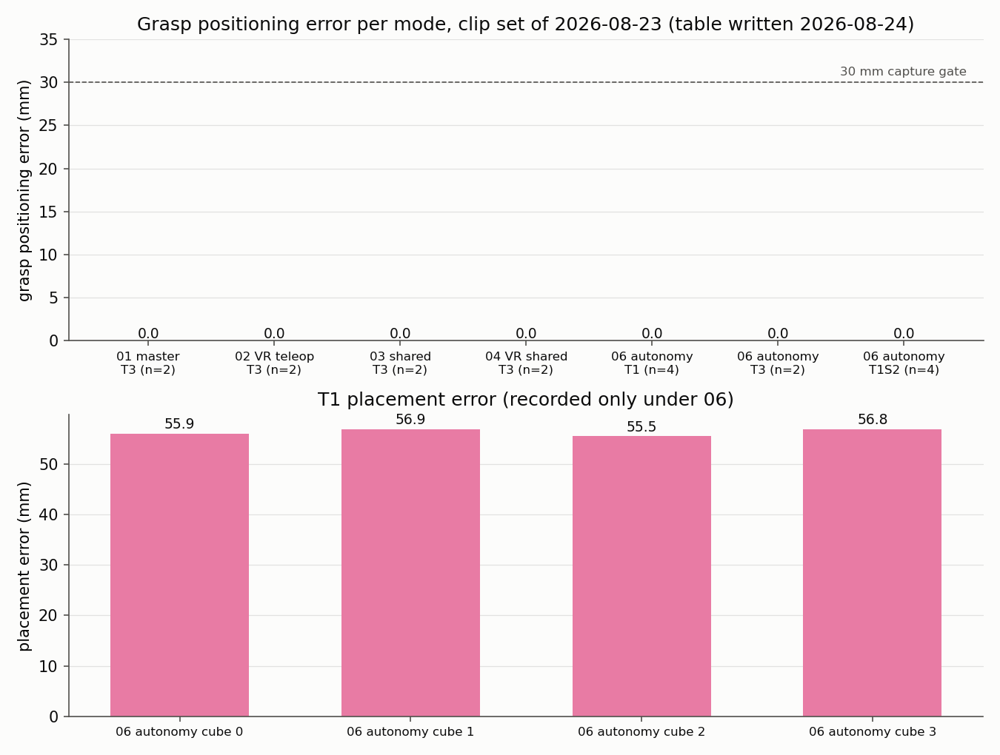
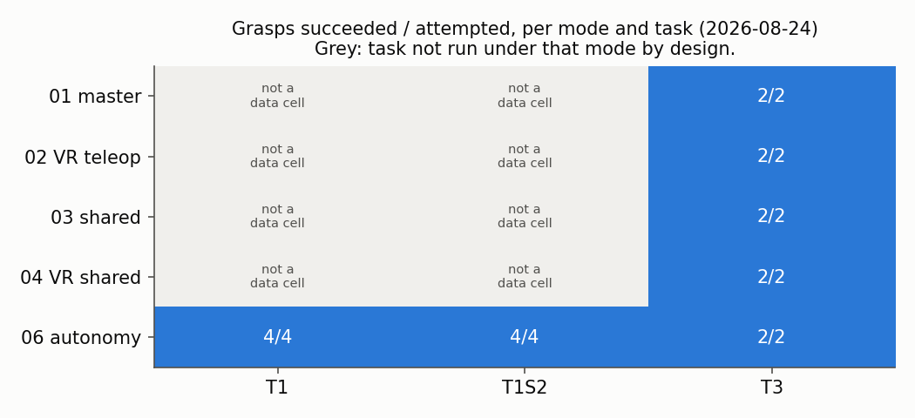
RESULTS
Grasp success and positioning error, per mode
grasp success, mode × task
positioning and placement error
Accuracy is TIED across all five modes on this clip set. That is the honest answer to 'is VR the most accurate mode': it is not distinguishable here, and this set PREDATES the 2026-08-26 VR smoothing.
source: recordings/verification/accuracy_table.json → recordings/analysis/ (2026-08-24)
Wearable dual-arm supernumerary robot · shared autonomy
38

Slide 40
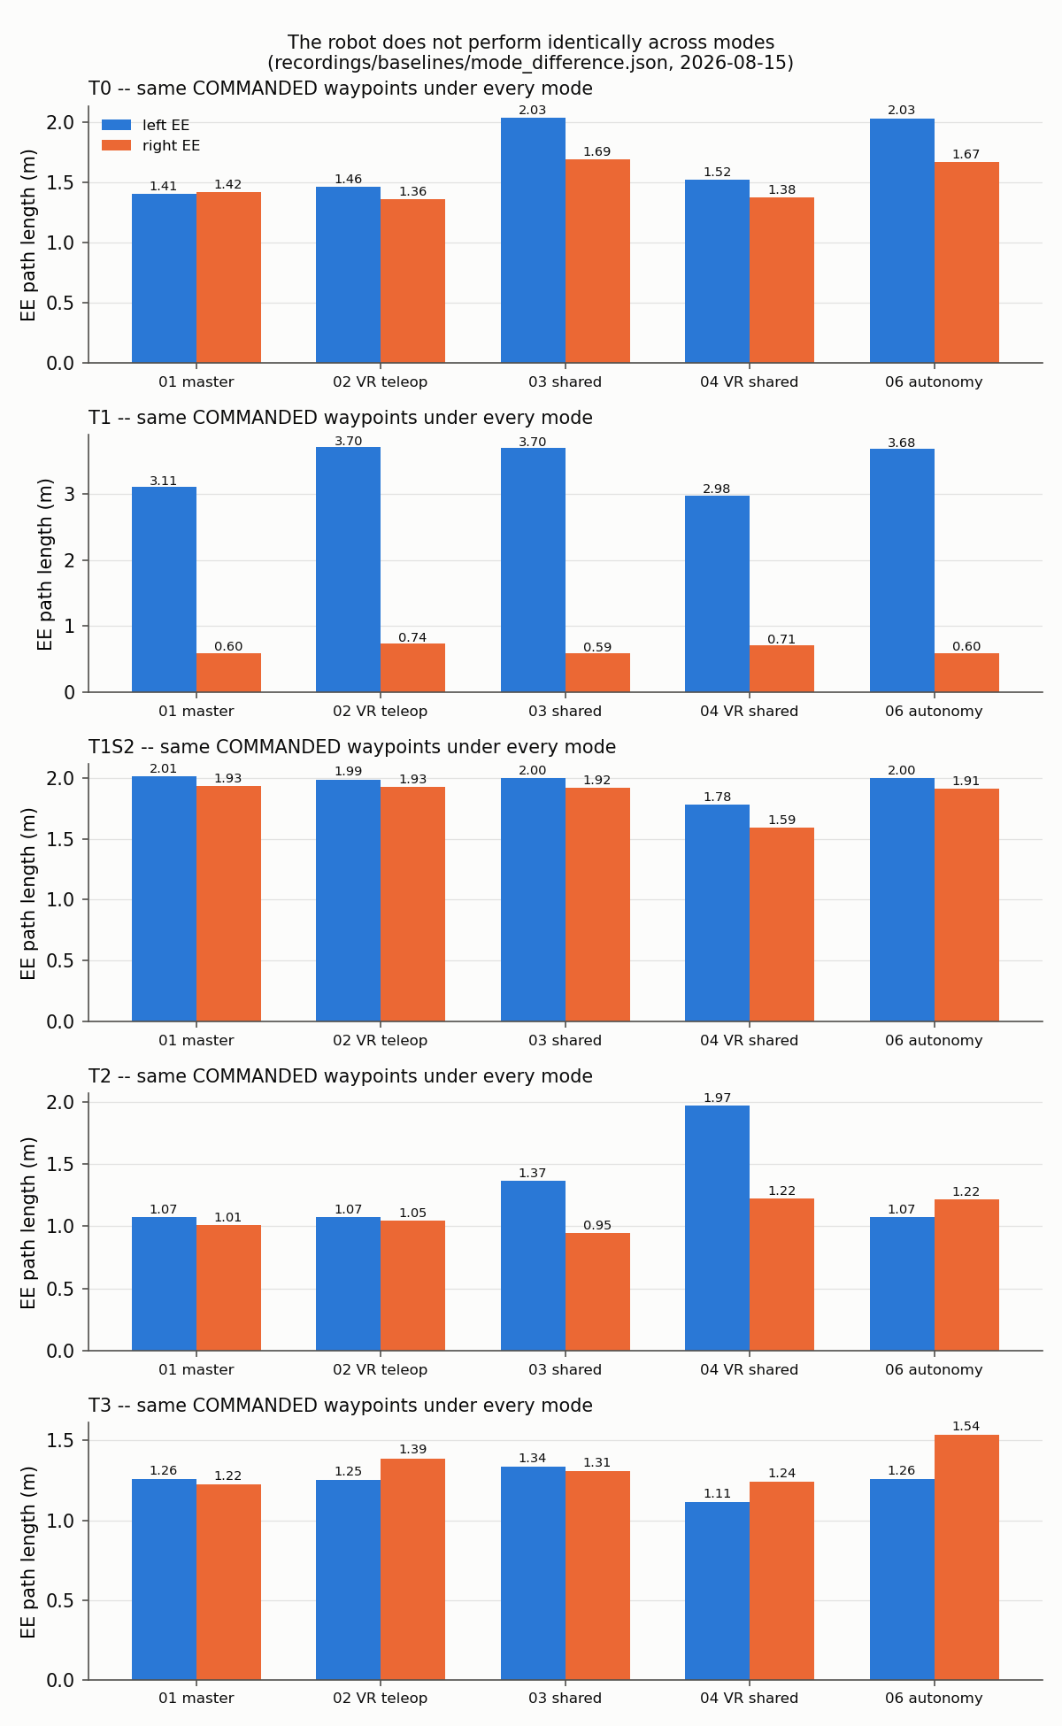
RESULTS
The same waypoints, different travel
The task layer commands identical waypoints under every mode — run_abc builds them with no mode argument. The robot does not perform identically: T0's left path is 1.407 m under mode 01 against 2.034 m under mode 03, measured with no operator present.
source: recordings/baselines/mode_difference.json (2026-08-15)
Wearable dual-arm supernumerary robot · shared autonomy
39

Slide 41
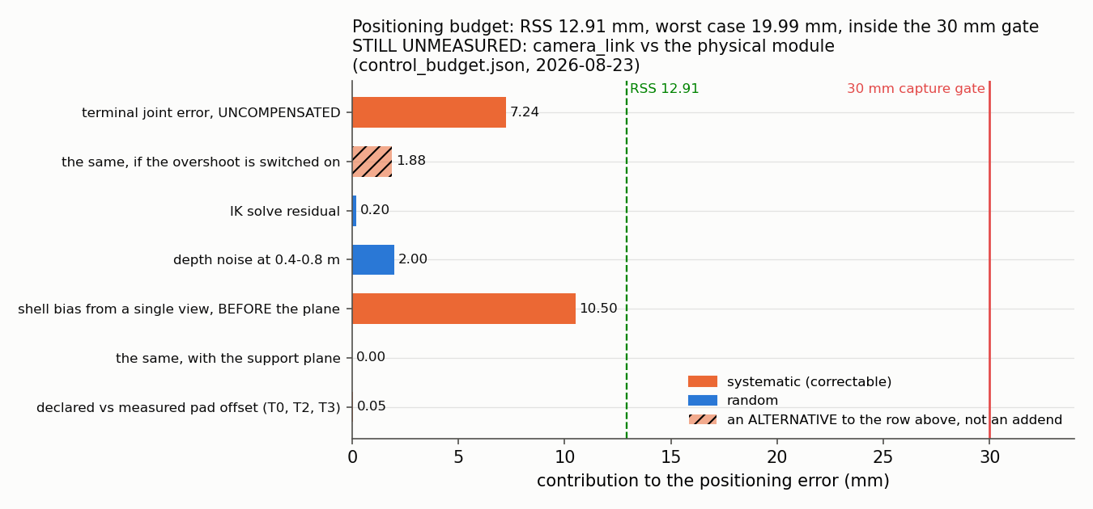
RESULTS · BUDGET
The positioning budget, term by term
Systematic terms separated from random ones, because only the systematic ones can be calibrated away, and the two alternatives hatched so the column cannot be summed by mistake. RSS 12.91 mm against a 30 mm capture gate. The largest term left is not on the chart at all: the camera frame against the physical module has never been measured.
source: recordings/baselines/control_budget.json (2026-08-23)
Wearable dual-arm supernumerary robot · shared autonomy
40

Slide 42
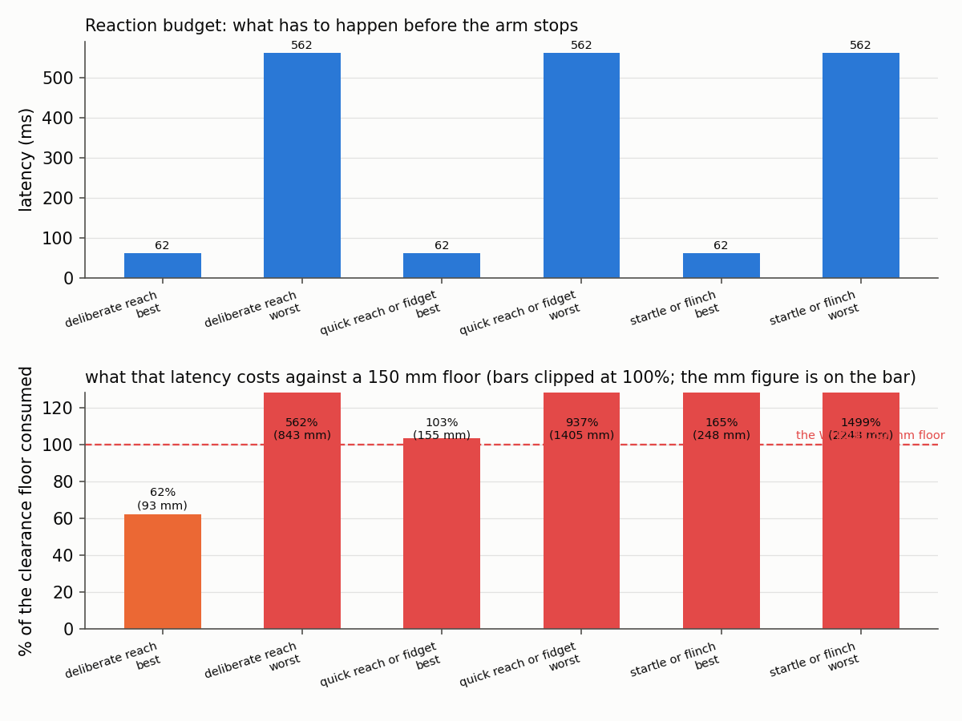
RESULTS · SAFETY
The reaction budget: how far the arm gets before anyone can stop it
Latency, and what that latency costs against the 150 mm clearance floor. A deliberate reach at its worst consumes 562% of the floor; a startle or flinch, 1499%. This is the argument for the floor being 150 mm and for the observer e-stop being a person watching the wearer rather than the screen — no software gate closes this gap.
source: recordings/baselines/control_budget.json (2026-08-23)
Wearable dual-arm supernumerary robot · shared autonomy
41

Slide 43
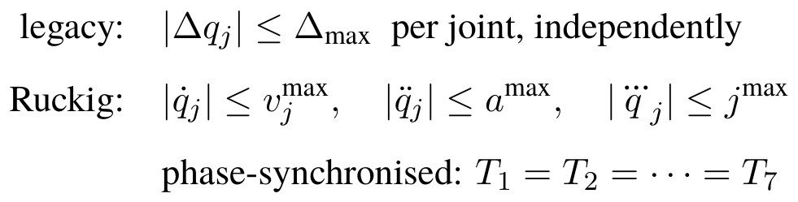
THE MATHEMATICS
What the motion generator is actually constrained by
The legacy generator clamped each joint independently, so seven joints arrived at seven different times and the hand left the line the IK implies by 51.3 mm. Ruckig is jerk-limited and phase-synchronised: every joint is given the same duration, so they arrive together.
The velocity limits are the robot's own, read from joint_limits.yaml — which the legacy generator never opened, commanding 17.5 rad/s against a 1.3963 limit. Acceleration and jerk are ASSUMED and labelled as such, because that file declares has_acceleration_limits: false for all fourteen joints.
source: srl_teleop motion generator; config/joint_limits.yaml
Wearable dual-arm supernumerary robot · shared autonomy
42

Slide 44
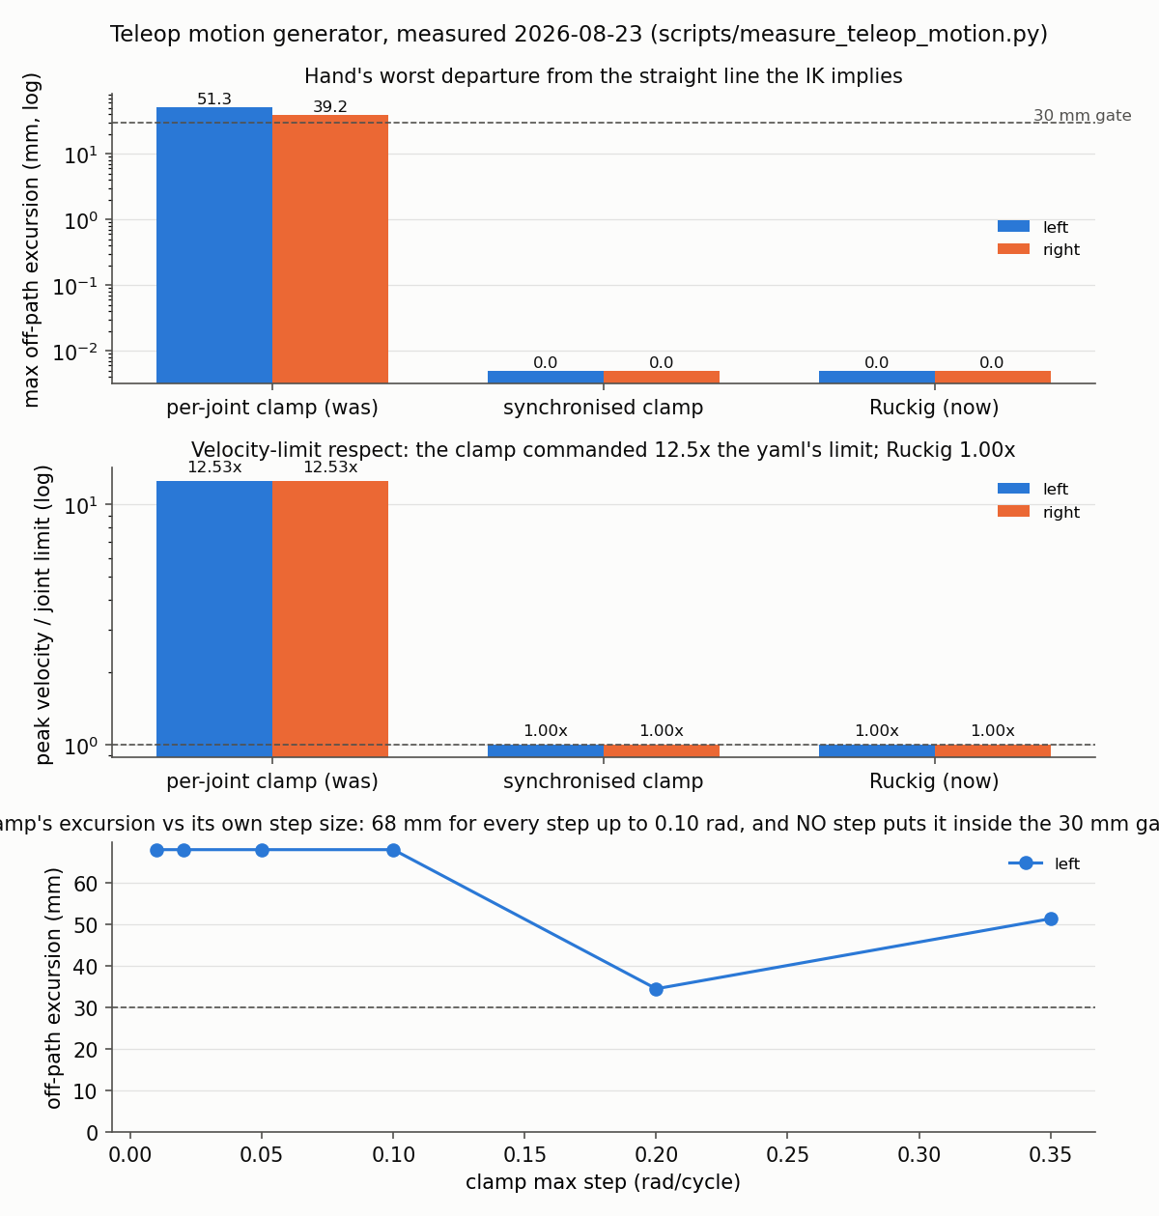
RESULTS · MOTION
Motion generation: a per-joint clamp replaced by Ruckig
51.3 → 0.0
off-path excursion, mm
left arm; right 39.2 → 0.0, against a 30 mm gate
It never read joint_limits.yaml
17.5 rad/s commanded against a 1.3963 limit — 12.53×. Now 1.00×.
Not a tuning problem
swept against its own step size, the clamp's excursion SETTLES at 68 mm. It cannot be tuned into compliance.
Acceleration and jerk are ASSUMED and labelled
the yaml declares has_acceleration_limits: false for all fourteen joints. Velocity limits are the robot's.
motion_generator:=legacy reproduces any recording made before 2026-08-23.
source: recordings/baselines/teleop_motion.json (2026-08-23)
Wearable dual-arm supernumerary robot · shared autonomy
43

Slide 45
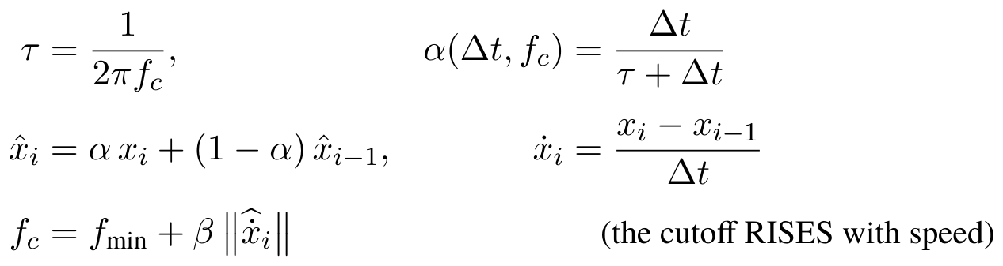
THE MATHEMATICS
Why a fixed EMA is the wrong shape, and what replaced it
The 1-Euro filter (Casiez, Roussel & Vogel, CHI 2012): a one-pole low pass whose cutoff rises with the estimated speed. Still, the cutoff is low and tremor is filtered hard; moving, the cutoff opens and the lag collapses.
Tremor is high frequency at low amplitude and motion is low frequency at high amplitude, so one constant cannot serve both. Every alpha is computed from the MEASURED dt, so the response belongs to the filter and not to the machine's load — the EMA applied a fixed alpha per timer tick at 100 Hz against a 72 Hz headset. Orientation SLERPs with sign canonicalisation: averaging quaternion components chases a 360° excursion across a sign flip that never physically happened.
source: srl_teleop/smoothing.py — one implementation, both input paths
Wearable dual-arm supernumerary robot · shared autonomy
44

Slide 46
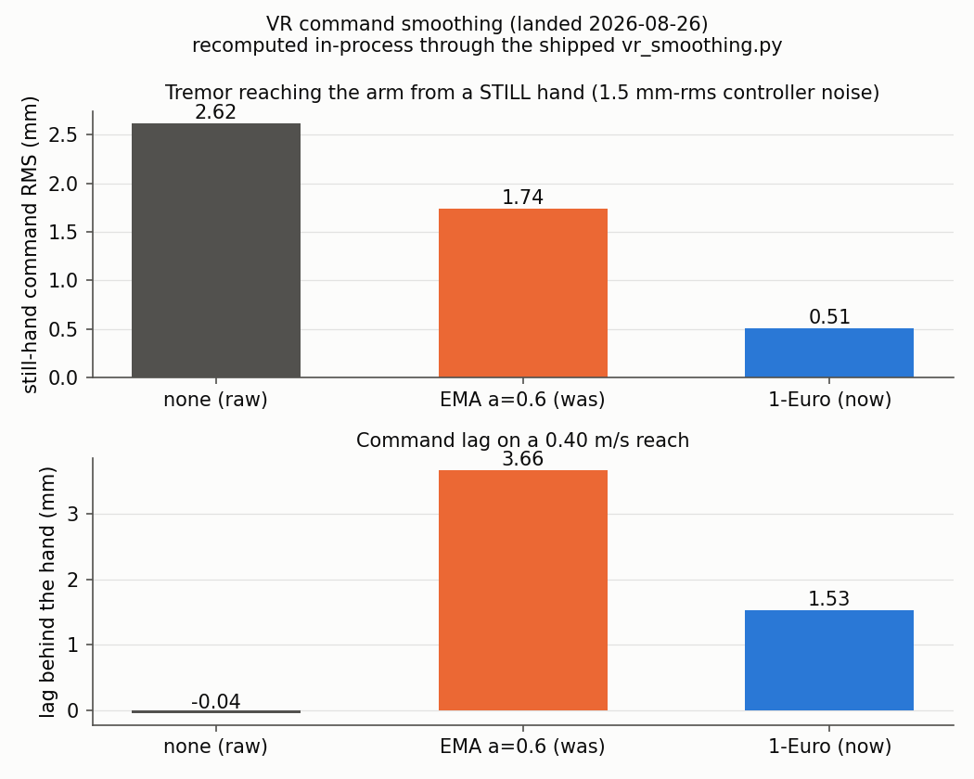
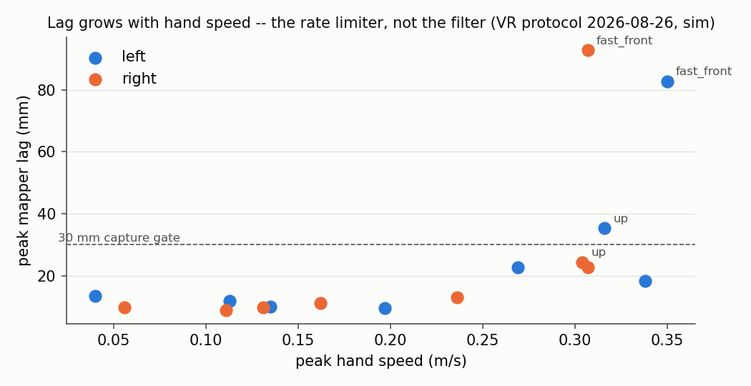
RESULTS · VR
The VR path: smoothing, and where it stops working
stillness residual and reach lag
peak lag against peak hand speed
1-Euro against the EMA it replaced: 3.4× better stillness and 2.4× less lag. Under 0.27 m/s every protocol segment stays inside the 30 mm gate; the deliberate fast reach at 0.31–0.35 m/s does not. The smoothing figure is the filter maths recomputed through the shipped code — NOT a through-the-node or real-arm measurement.
source: srl_vr_teleop/vr_smoothing.py; recordings/vr_teleop/protocol_20260826_124739.json
Wearable dual-arm supernumerary robot · shared autonomy
45

Slide 47
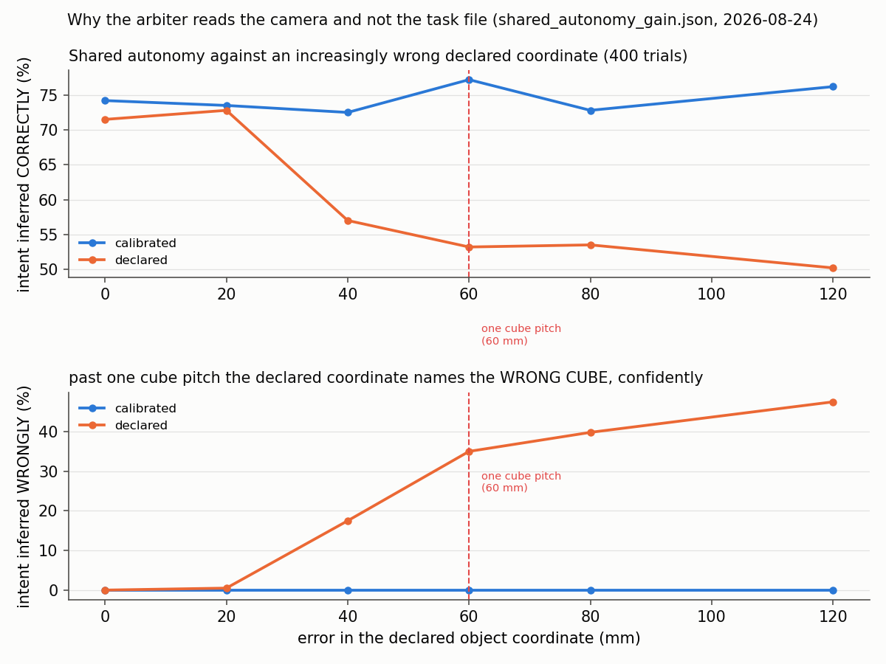
RESULTS · AUTONOMY
What shared autonomy is actually for
Intent inference against a declared object coordinate that is wrong by 0 to 120 mm, 400 trials. Calibrated perception holds flat; the declared coordinate collapses past one cube pitch and — the part that matters — becomes CONFIDENTLY wrong rather than ambiguous. The ambiguous fraction falls as the wrong fraction rises, which is the worst failure shape a shared-control arbiter can have.
source: recordings/baselines/shared_autonomy_gain.json (2026-08-24)
Wearable dual-arm supernumerary robot · shared autonomy
46

Slide 48
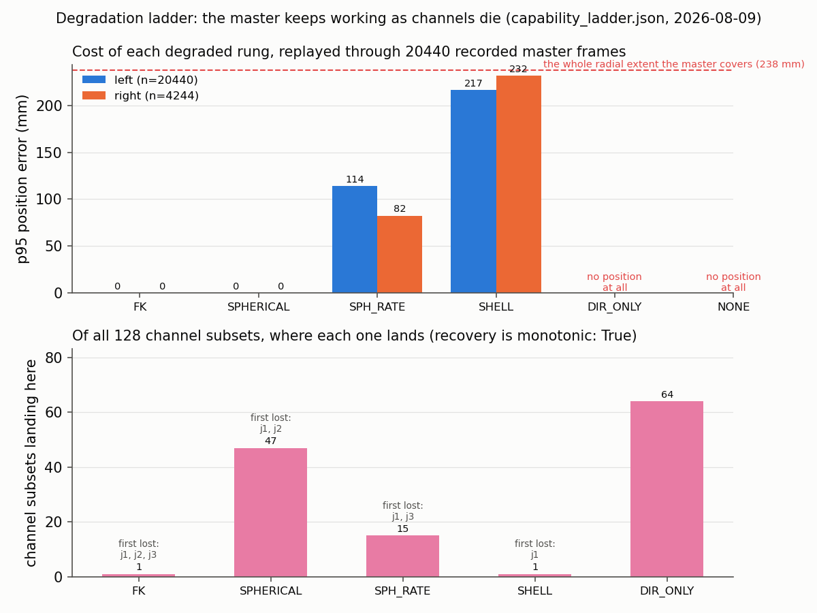
RESULTS · ROBUSTNESS
Degrading rather than stopping, one rung at a time
What each rung of the degradation ladder costs in end-effector position, replayed through 20 440 REAL recorded master frames, and where each of the 128 channel subsets lands. DIR_ONLY and NONE produce no position at all — drawn as 'no position', never as a bar of height zero, which would read as perfect. Recovery is monotonic: a channel coming back never leaves the system on a lower rung.
source: recordings/baselines/capability_ladder.json, capability_degradation.json
Wearable dual-arm supernumerary robot · shared autonomy
47

Slide 49
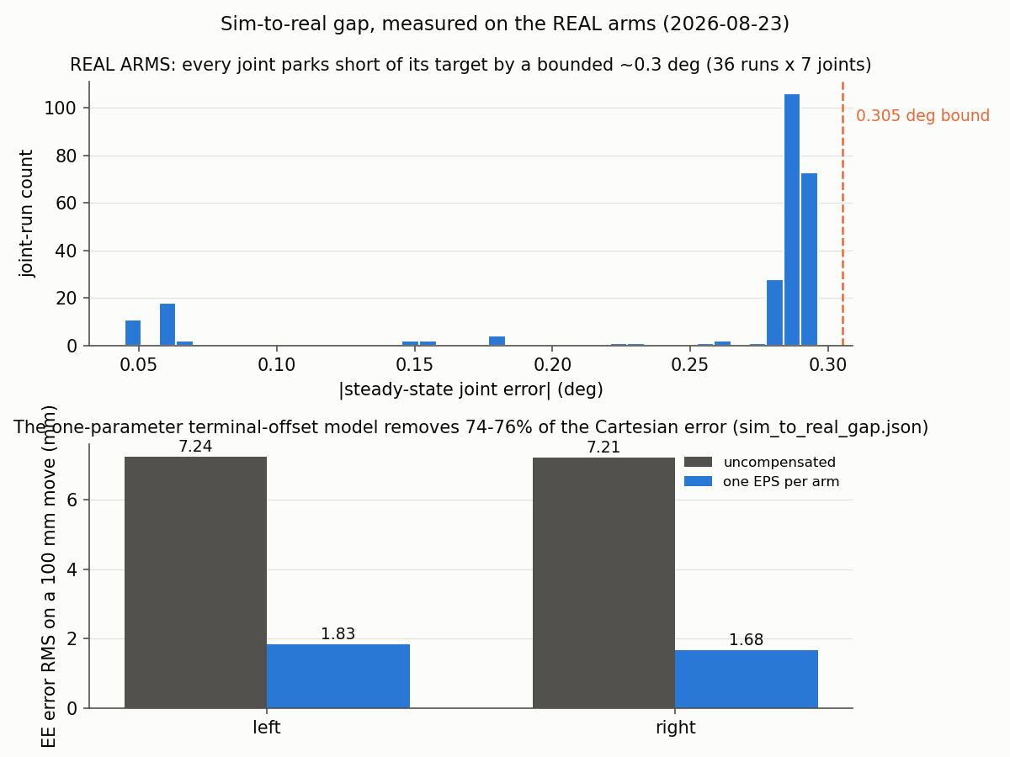
RESULTS · REAL HARDWARE
The simulation-to-hardware gap — measured on the real arms
0.305°
every joint parks short
on the side it came from; 211 of 252 errors in a 0.007° band
7.2 mm RMS at the end effector
on a 100 mm move, both arms.
A bound, not a spread
pushing the joint errors through the Jacobian reproduces the Cartesian error to 90%, r = 0.923 — a constant terminal offset.
ONE parameter per arm removes 74% / 76%
held out on an axis it was never fitted on, where a Cartesian 3×3 scores 93 mm.
36 real runs on the physical arms — the only hardware measurement in this deck. The COMPENSATION is modelled and has NOT been tried on hardware. The data already existed in arm_directional_calibration.json and nothing read it.
source: recordings/baselines/arm_directional_calibration.json, sim_to_real_gap.json (2026-08-23)
Wearable dual-arm supernumerary robot · shared autonomy
48

Slide 50
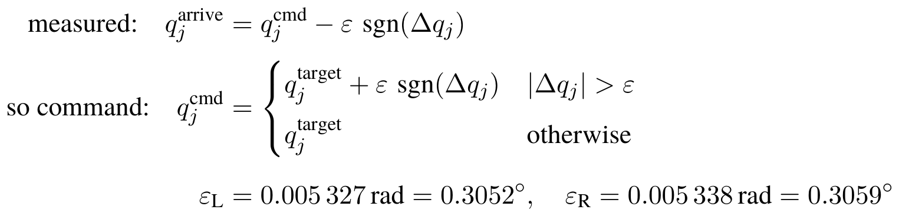

THE MATHEMATICS
The measurement models behind the numbers
The simulation-to-hardware gap: every joint parks ε short of its target, on the side it came from. The compensation is to overshoot by ε in the direction of travel — no matrix, no direction basis, no step length, which is exactly why it survives the axis hold-out that kills a Cartesian 3×3.
Summed two ways on purpose: RSS is what you would quote if the terms were independent and zero-mean; WORST CASE is what you must design to when several are systematic and point the same way — and the biggest one here is.
Stereo depth noise grows with the SQUARE of range, which is why 2.0 mm at grasp range and the 0.082 m quoted elsewhere are the same sensor at different distances.
source: srl_teleop/sim_to_real_gap.py; scripts/measure_control_budget.py; scripts/measure_depth_pose_accuracy.py
Wearable dual-arm supernumerary robot · shared autonomy
49

Slide 51
RESULTS · INSTRUMENT
And the 'speed sweep' was not one
The claim
I reported the parking error as speed-independent across a 5× range.
What the data says
vmax_rad_s was read once at bridge start-up and never applied. 7 of 36 runs moved FASTER than the limit they were commanded with, and kortex_highlevel_bridge records this in its own source.
So
the three speeds are three REPLICATES of one condition. How the error varies with speed has NEVER been measured, and the file now says so in its own verdict field.
A control was added
which asserts the sweep still looks inert — so a genuine sweep makes the test fail and the stale sentences get rewritten.
This slide is a result. A measurement that contradicts an earlier one is an instrument check, not a finding, until the two are reconciled.
source: recordings/baselines/sim_to_real_gap.json → speed_sweep_was_inert; test_the_arm_stops_short_and_the_bridge_knows.py
Wearable dual-arm supernumerary robot · shared autonomy
50

Slide 52
PART 5
Workspace characterisation
Why the arms barely move — sized in millimetres, per direction, per design choice, rather than asserted.
51

Slide 53


WORKSPACE
Reachability, and two arms that cannot meet
reach per direction, both arms
the two reachable sets do not overlap
N = 10 repeats over the whole densified path, not one IK call — TRAC-IK restarts randomly and one call is one coin flip. The two arms' reachable sets are disjoint, which is why a handover task needs the right arm re-parked in hardware before it can exist at all.
source: recordings/baselines/workspace_n10_20260806.json
Wearable dual-arm supernumerary robot · shared autonomy
52

Slide 54

WORKSPACE · SIZED
What the pinned wrist costs, measured from two start points
Mean reach per orientation policy, with a 0.15 m wearer floor enforced under every one. From the HOME end effector the pinned wrist costs 89 mm and looks affordable. At the point where the work actually happens it costs 385 mm, and 11 of 12 direction walks are stopped by the wearer. Measuring from the wrong start point is what hid a factor of seven.
source: recordings/baselines/orientation_cost.json, orientation_cost_what_binds.json
Wearable dual-arm supernumerary robot · shared autonomy
53

Slide 55

WORKSPACE · SAFETY
The wearer's posture is part of the model
Innermost usable column and home clearance for the five postures. With the wearer's arms deleted entirely the centre is STILL shut, so what closes it is the torso. Two postures — arms clasped behind the back, arms held out to the sides — put the wearer's own limbs inside the 150 mm floor at the HOME pose, which is why a wearer is never asked to adopt them.
source: recordings/baselines/centre_vs_wearer_posture.json (2026-08-15)
Wearable dual-arm supernumerary robot · shared autonomy
54

Slide 56

WORKSPACE
A negative result, drawn as one
1 680 configurations of table height, table distance, object column and overhang, both arms, objects RESTING on the surface, 3 583 IK calls. Twenty-two cells pass a single IK call; two survive N=10 over the whole path. Not one is anywhere near the centre, and every survivor needs the object at the very front edge, because the pinned wrist arrives from below.
source: recordings/baselines/centre_on_surface.json (2026-08-15)
Wearable dual-arm supernumerary robot · shared autonomy
55

Slide 57
WORKSPACE
What binds the workspace
direction
what limits it
measured
forward / outboard
the pinned wrist
0.065 m mean reach at the work point, against 0.450 free
inboard
the wearer — the TORSO, not their arms
min |x| 0.300 (L) / 0.375 (R) with the wearer's arms deleted entirely
down
the table
no configuration puts |x| ≤ 0.10 m on the surface; 3360 cells searched
top-down on a surface
not achievable at all
0 of 840 cells, any table height 0.70–1.10 m, either arm
any joint limit
nothing
no direction is bound by one
Folding the wearer's arms is worth 50 mm to the mannequin and NOTHING to a real person, because what binds changes identity: a limb for the mannequin, the torso every time for the person.
source: recordings/baselines/centre_vs_wearer_posture.json, centre_on_surface.json, wearer_size_effect.json
Wearable dual-arm supernumerary robot · shared autonomy
56

Slide 58
WORKSPACE · SIZED
What the pinned wrist costs
0.065 m
0.325 m
0.450 m
+0 mm
pinned, at the work point
with a 45° cone
fully free orientation
freeing the ROLL alone
11 of 12 direction walks wearer-bound
the follower's own cone supplies it
+385 mm, and only 4 walks wearer-bound
refused by name — it buys nothing
The mechanism is not the wearer
A fixed 6-DOF pose on a 7-DOF arm spends the whole redundancy — and the redundancy is exactly the joint that moves the elbow out of the person while the hand stays put.
A factor of seven, and it was never sized before this measurement
From the HOME end-effector the penalty is only 89 mm; at the point where the work actually happens it is 385 mm. Measuring from the wrong start point is what hid it.
Nothing changes until a mode opts in
orientation_policy defaults to 'exact', so HARD CONSTRAINT 1 is untouched by the finding.
0.15 m wearer floor enforced under every policy, so the comparison is like for like.
source: scripts/measure_orientation_cost.py; docs/system/21_what_makes_the_workspace_small.md
Wearable dual-arm supernumerary robot · shared autonomy
57

Slide 59


WORKSPACE
Mount geometry and the lateral constraint
mount position sweep
the lateral constraint
The mount was swept rather than chosen: 150 mm outboard and 15° of yaw is where the reachable set stops fighting the wearer. base_link still sits 161 mm from the torso and no joint moves it — so a clearance reading of exactly 0.1610 m is the MOUNT, not the arm.
source: recordings/baselines/gap_vs_mount.json, clearance_region.json
Wearable dual-arm supernumerary robot · shared autonomy
58

Slide 60


WORKSPACE
Two arms that barely share a workspace, and cannot mirror
cells both arms reach, across the sweep
per-link mirror residual at home
The best mount anywhere in a 108-configuration sweep gives the two arms 29 shared cells. And they cannot be made symmetric: the mounts' base axes mirror exactly but differ by 168° of roll, so two identical arms on mirrored mounts cannot mirror. The control matters — reflecting the LEFT arm against ITSELF gives 1.24 m, so a small residual is a measurement and not the instrument agreeing with itself.
source: recordings/baselines/mount_overlap_sweep.json, home_render.json
Wearable dual-arm supernumerary robot · shared autonomy
59

Slide 61
PART 6
Method, limits and next steps
The operator's window, the instrument discipline that produced these numbers, and an honest account of what none of them support.
60

Slide 62

OPERATOR
The window is the interface
Every capability reaches the window
A feature reachable only from a terminal does not exist for the person running the session.
257 checks, 0 failed
The audit presses every button AND checks what the press did — the e-stop must reach /estop, and a service button with no stack must say so.
A passing audit is not proof
Three defects lived for weeks behind a green return code: an invisible embedded RViz, a control column capped below its own content, and every mode button below the fold. So: launch it and look at it.
The audit's own worst catch: it had HUNG on a modal consent dialog since that dialog was added, so it never reached the presses that would have shown five buttons doing nothing silently inside a Qt slot.
source: recordings/session/20260824_190937/control_window.png; scripts/verify_gui_buttons.py
Wearable dual-arm supernumerary robot · shared autonomy
61

Slide 63


OPERATOR
Commanded against actual, side by side
the embedded COMMANDED view
both panels and the divergence readout
RViz (COMMANDED) embedded beside a native ACTUAL panel drawn from the real_* frames, with the divergence readout under both. The RViz master draws three states, not two — commanded, actual, and PLANNED-BUT-REFUSED with its reason string, which cannot be drawn without one.
source: thesis_v2/figures/rviz_after_fix.png; docs/img/gui_dual_panels.png
Wearable dual-arm supernumerary robot · shared autonomy
62

Slide 64
METHOD
The standing rule, and what it caught
Before reporting a bad measurement, validate the instrument.
A surprising failure is evidence about the INSTRUMENT until the instrument has been cleared. This has been the fault seventeen times.
what it looked like
what it actually was
T2's grippers never closed
run_abc held a grip until the pads REACHED the object — unsatisfiable for a task declaring grip_obj=None
A flaky autonomy task
clip_scene measured stage 2 at stage 1's approach: a 99.1 mm error in the MEASUREMENT, not the task
A grasp that was 13.47 mm short
PAD_MID_EE was derived, not measured — and the pad midpoint is a curve, not a constant: the fingers swing on a four-bar
A failing test called '='
the test gate matched ^FAILED over pytest output, and pep257 echoes the source lines it objects to
Three instruments reporting defects that did not exist
an i % 2 arm mapping, a by-design absence read as a gap, and a release demanded from a task that never releases
Every analysis script carries a known-answer test, and a check that cannot fail on a deliberately broken input is not a check.
source: CLAUDE.md — THE STANDING RULE; docs/system/findings.md
Wearable dual-arm supernumerary robot · shared autonomy
63

Slide 65
LIMITS
What is verified, and what is not
MEASURED, AND THE FILE IS COMMITTED
NOT MEASURED — AND NOT CLAIMED
— Grasping and placement across five modes, 17 cells × 8 angles
— The parking error, on 36 real-hardware runs
— Ruckig against the clamp it replaced, including the sweep showing the clamp cannot be tuned
— Workspace reach per direction at N = 10 over the whole path
— Clearance to the wearer, geometrically, per task
— Six injected perception faults, each refusal naming its own fault
— 1381 unit tests passing; 257 GUI checks, 0 failed
— NO HUMAN DATA HAS BEEN COLLECTED AT ALL — blocked on ethics
— Speech recognition against a real speaker: /dev/snd has only 'timer', so every voice number came from synthesised audio
— The sim-to-real compensation, on hardware
— How the parking error varies with speed
— camera_link against the physical camera module — the largest remaining unknown in the budget
— Detection rate at working distance
— 7 of 14 master channels are incoherent; a soldering problem
Worn operation is >17 kg with no gravity compensation on someone who did not choose the motion. The operator and the wearer are different people and consent separately.
source: CLAUDE.md — Blocked on the lab / Blocked on ethics
Wearable dual-arm supernumerary robot · shared autonomy
64

Slide 66

LIMITS
The study that is designed but not run
The protocol, the conditions and the analysis exist and are written up. No participant has been recruited: anonymity is enforced in code — write_manifest() raises on name, email, date of birth, address and phone — but consent has not been sought, so the participant results chapter is deliberately empty.
source: thesis_v2/figures/diagrams/experiment_design.tex; docs/research/
Wearable dual-arm supernumerary robot · shared autonomy
65

Slide 67
CONCLUSION
Contributions
A working multimodal master interface
Four input routes — instrumented mannequin arm, VR controllers, shared autonomy over either, and a typed or spoken sentence — into one arm-command path, with the baseline condition kept free of in-repo dependencies so the comparison is not circular.
A safety architecture that measures the wearer rather than trusting the planner
The wearer's body and posture are variables with one source; the camera may only ever make that body BIGGER; and the clearance floor is enforced against the same body the planner sees.
A workspace characterisation that sizes its own constraints
The pinned wrist costs a factor of seven at the work point, the torso is what closes the centre, and top-down on a surface is not achievable at all — each with the search that establishes it.
Autonomy from a sentence, with zero misunderstandings
40 phrasings in the vision-coupled sweep and 75 in the parser sweep; ambiguity asks, and the ask is answerable in the same box.
An instrument discipline, and the ledger of what it caught
Seventeen occasions where the measuring tool was the fault, each written up with the mechanism — which is itself a result about how to evaluate a system like this.
Wearable dual-arm supernumerary robot · shared autonomy
66

Slide 68
NEXT STEPS
Next, in order
#
what
why it is next
1
Off-axis directions in the calibration sweep
the 3×3 fit scores 93 mm held out on an axis — six axis-aligned directions are exactly a basis, with no redundancy to test
2
Try the terminal overshoot on hardware
modelled at 74% / 76% removal; both it and the 0.10° deadband are live parameters and four runs settle which wins
3
Measure camera_link against the physical module
the cheapest high-value calibration left, and the largest unknown in the budget
4
Attach a scene camera
the node, both calibration tools and their self-tests are built; no camera has ever been attached to this host
5
Repair the seven incoherent master channels
a soldering problem, with l_j2 and l_j4 named by regression
6
Ethics approval, then participants
the protocol is written; the arms are worn by one person and driven by another, and they consent separately
Ordered by what unblocks the most downstream work, not by effort.
source: docs/NEXT_SESSION_2026_08_23.md, docs/system/24_motion_planning.md
Wearable dual-arm supernumerary robot · shared autonomy
67

Slide 69
Thank you
Everything shown is regenerated from committed recordings by scripts/make_presentation.py.
Evidence: recordings/verification/ (clips and the accuracy table) · recordings/baselines/ (every measurement) · recordings/analysis/ (the result figures) · docs/system/findings.md (the diagnostic history)

