Slide 1
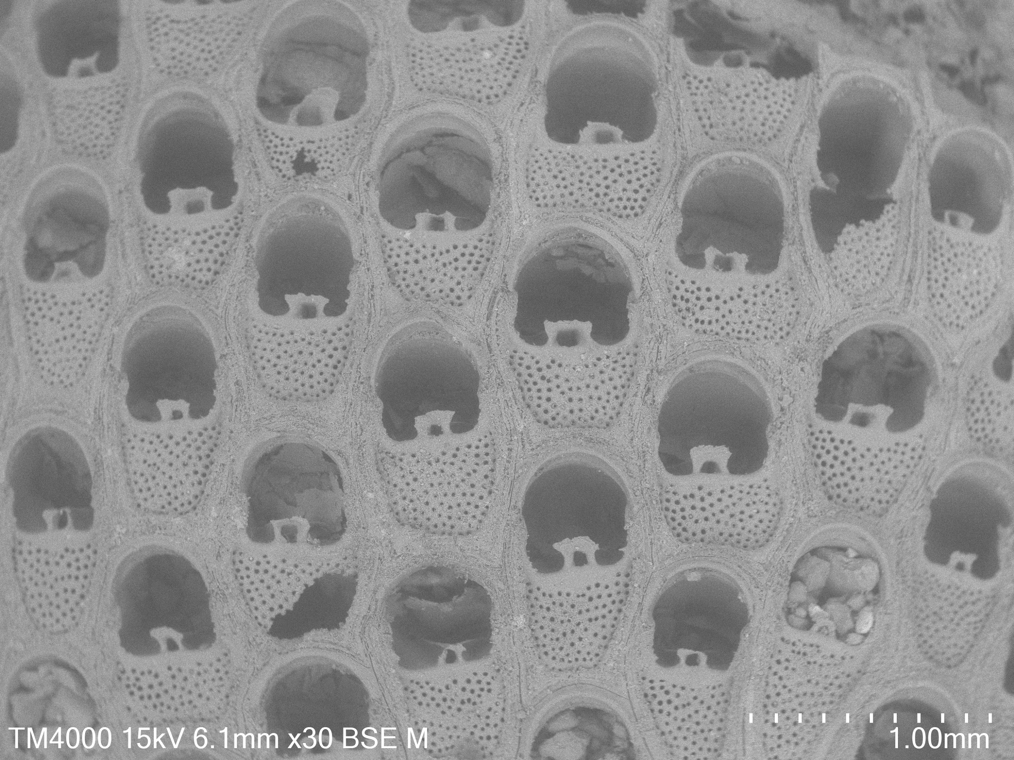
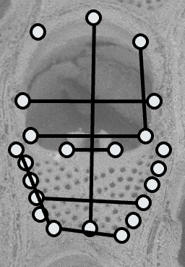
Add landmark numbers; add traits and abbr
Notes:
SI Fig Landmarks & Measurements

Slide 2
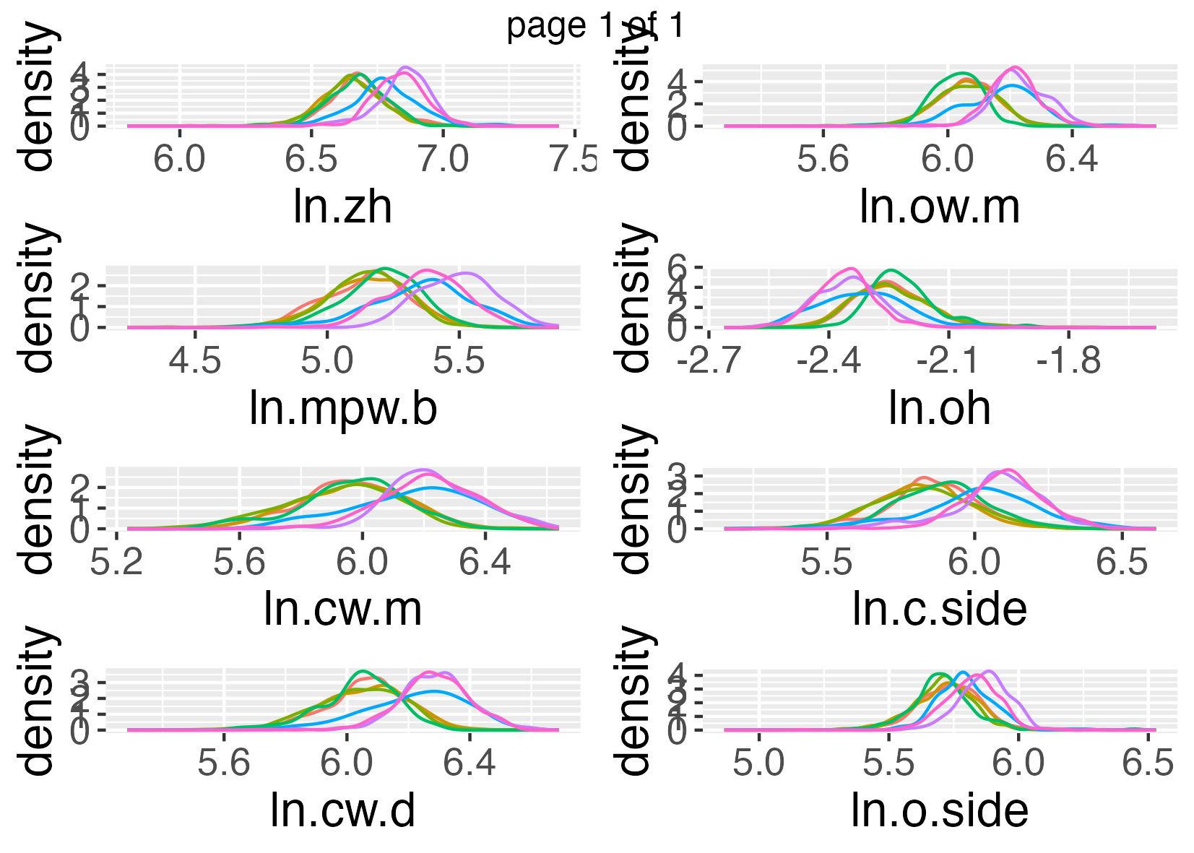
Add p-vlaues; make more clear
Notes:
SI Fig Traits

Slide 3
95%
SHCSBSB
Shakespeare Group
Tainui
0
97.5%
Upper
Kai-Iwi
0.5
96.8%
Kai-Iwi Group
Pleistocene
1.0
Okehu Group
1.5
Quaternary
93.6%
Waipuru
97.8%
Maxwell Group
2.0
96%
Pliocene
Tewkesbury
2.5
95.6%
Nukumaru Group
NKBS
NKLS
3.0
Notes:
Figure P & G Correlation

