Slide 1
Why Do Employees Leave?
Megan Ball
DDSAnalytics

Slide 2
The Data Set
Scope limited to those with less than 30 years of working experience
845 observations of 31 different variables
Variables included items such as age, education level, marital status, gender, income information, and job satisfaction levels
Variables that added no value were removed:
EmployeeCount
Over18
Standard Hours
EmployeeNumber

Slide 3
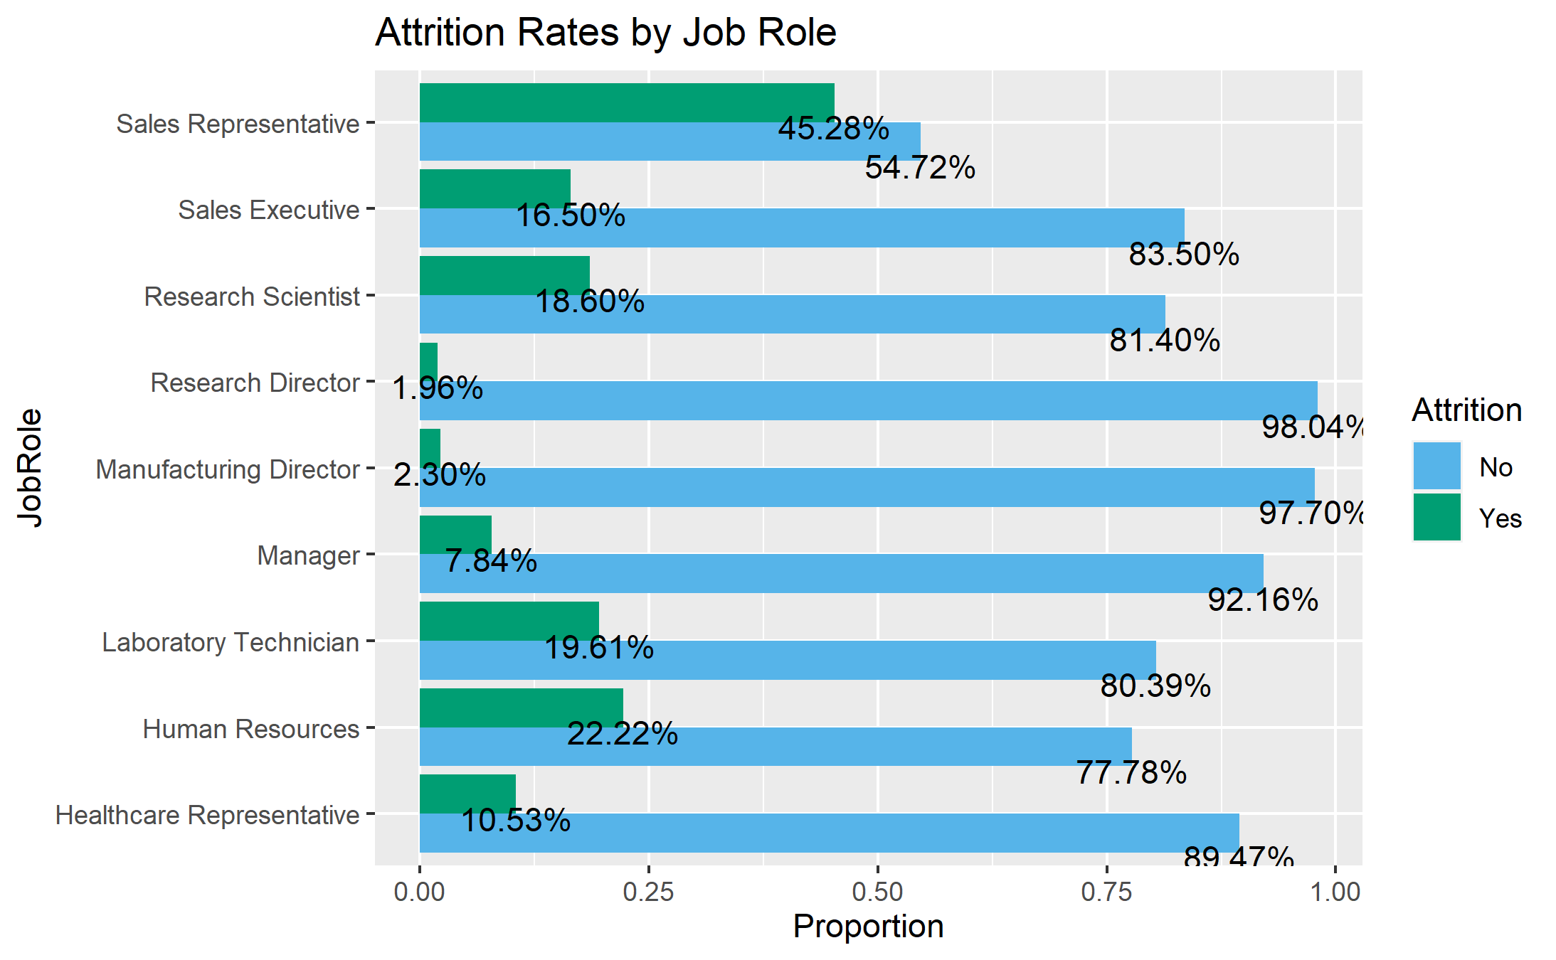
Exploring Job Roles
Across job roles, manufacturing directors and research directors have the lowest attrition rates at 1.96% and 2.3% respectively
On the contrary, sales representatives have the highest at almost half – 45.28%

Slide 4
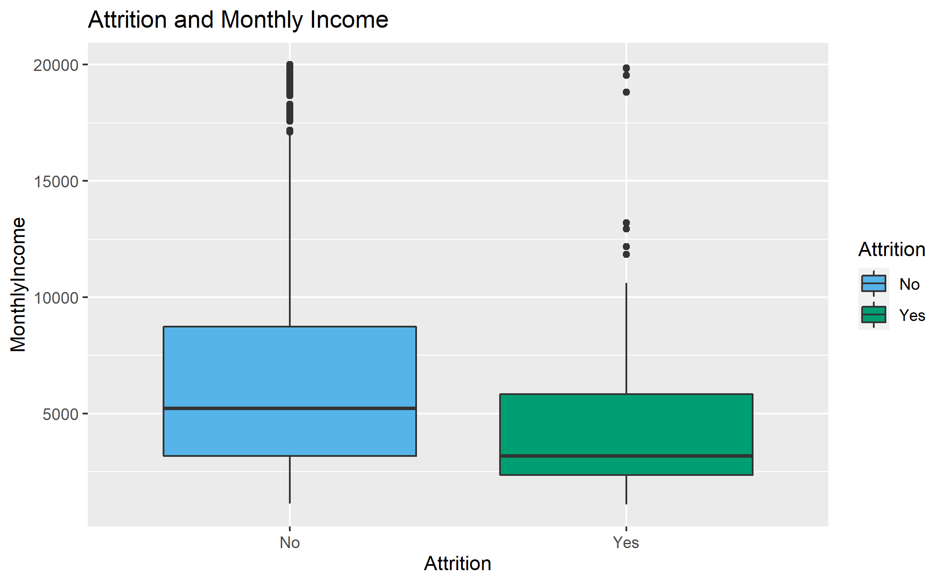
Salary & Attrition
Two managers and one research director
There does appear to be a relationship between monthly income level and attrition
It is estimated that those with a higher monthly income are less likely to leave (from a two-sided t-test with a p-value of < 0.001).
The estimated difference in salary between those that leave and those that stay is $1,220 and $2,654 (from a 95% confidence interval)

Slide 5
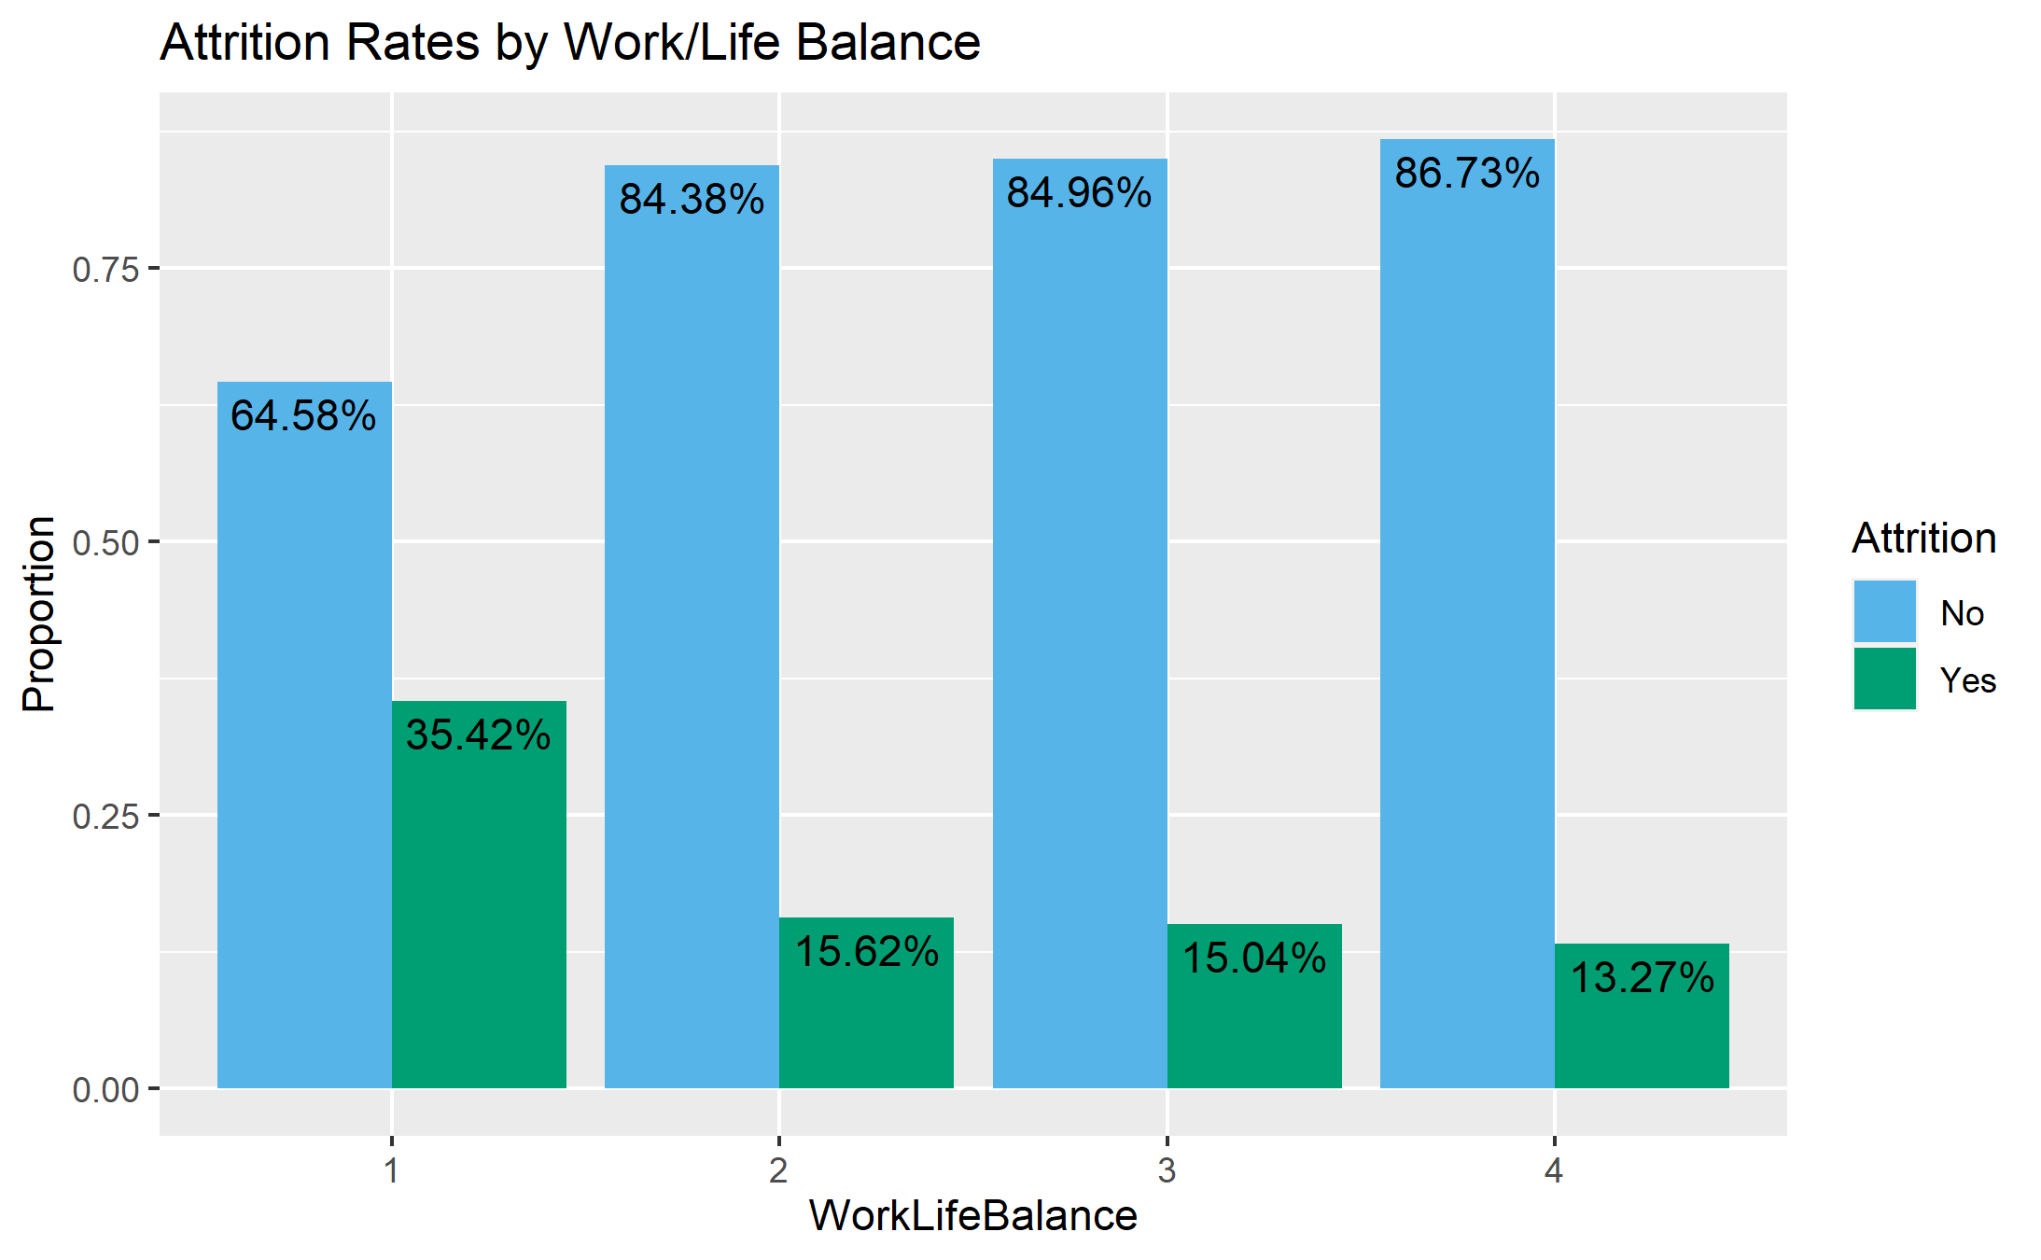
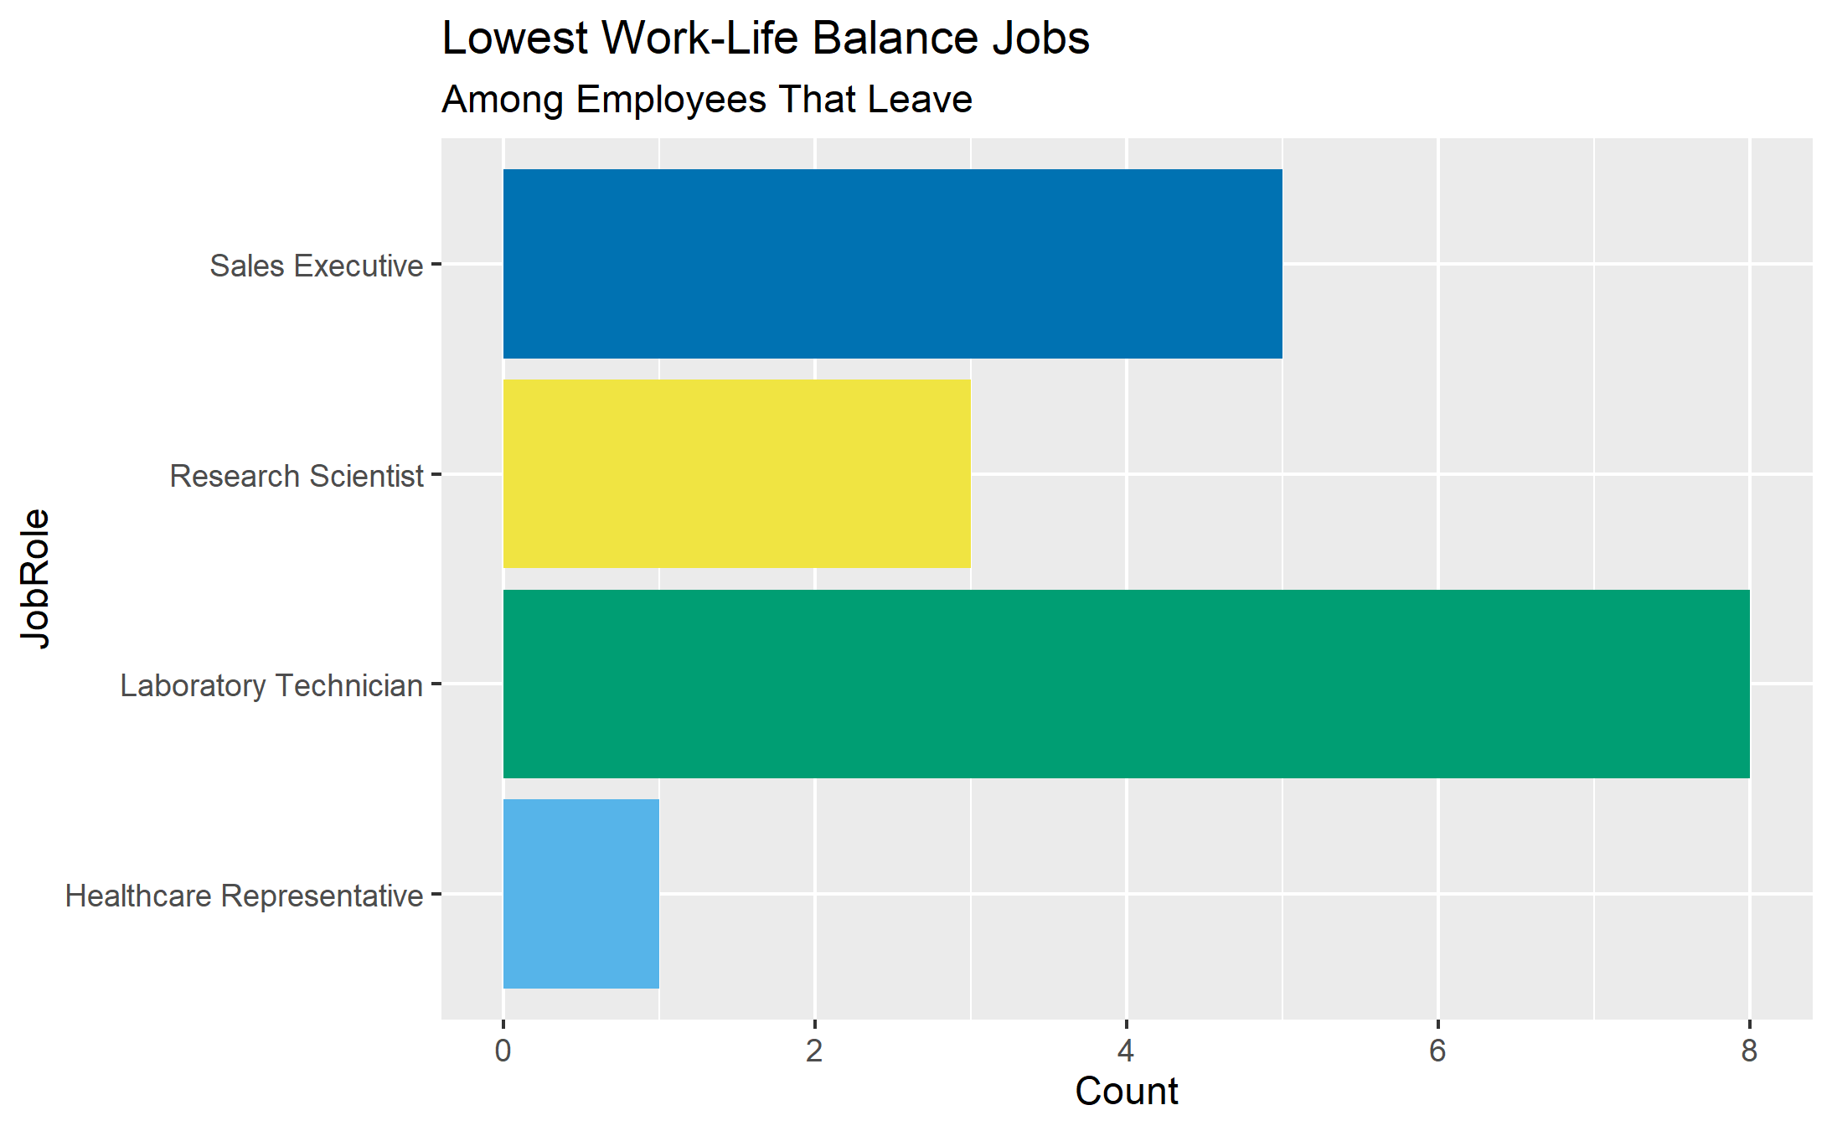

Work/Life Balance
Employees that gave a “1” for work-life balance rating had the highest attrition rates
This group accounted for 2.5% of all sales executives, 2% of research scientists, 5% of lab technicians, 1% of healthcare representatives

Slide 6
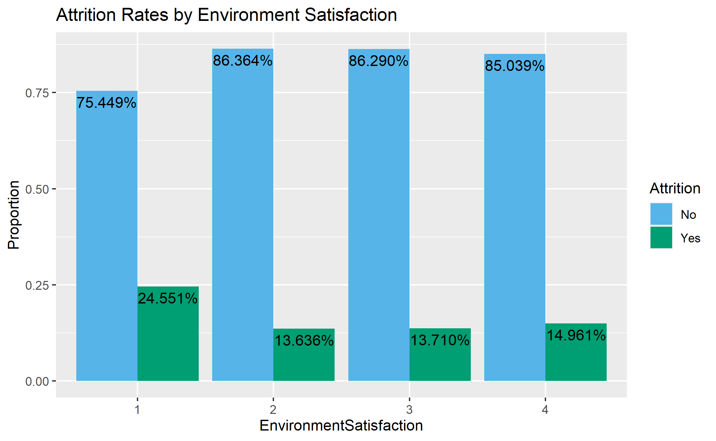
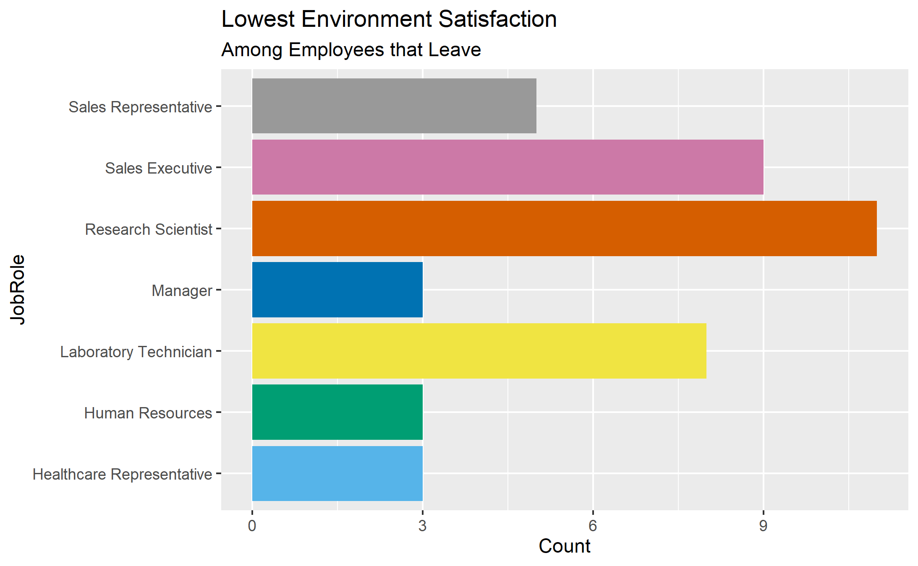
Environment Satisfaction
In environment satisfaction, those that also rated a “1” had the highest attrition rate (almost 25% of those with low environment satisfaction)

Slide 7
Predicting Attrition & Income
Attrition Model
Salary Model
The best performing attrition prediction model used all the variables within the data set
The model had
Overall 83% accuracy
Predicted a true attrition 80% of the time
Predicted a true non-attrition 83% of the time
The best performing salary prediction model also used all the variables within the data set
The model
Explained 93% of the variation in the monthly income
Had prediction error of approximately $1,100
 | Reference
Prediction | No | Yes
No | 177 | 8
Yes | 35 | 33

Slide 8

Summary
Top factors influencing attrition:
Job Role
Sales representatives have the highest attrition rate at 45%
Salary/Monthly Income
With the exception of a few outliers, those with a lower monthly income (average of $4,575) have higher attrition
Work/Life Balance
Of employees with a low work-life balance, 35% will leave the company
Environment Satisfaction
Of employees with a low environment satisfaction, 25% will leave the company
This Photo by Unknown Author is licensed under CC BY-SA-NC

