Slide 1
Logistic regression Diagnostics using SAS and R

Slide 2
proc logistic data=bank_train plots=all; class education default month poutcome Age_Grp ; model y(event='yes')= education default month poutcome Age_Grp duration campaign cons_price_idx euribor3m duration ; output out= bank_train_logreg predprobs=I p=probpreb resdev=resdev reschi=pearres; run; proc gplot data=bank_train_logreg; plot resdev*VAR1; plot pearres*VAR1; run; quit; proc logistic data=bank_train plots(MAXPOINTS=NONE) =all; class education default month poutcome Age_Grp ; model y(event='yes')= education default month poutcome Age_Grp duration campaign cons_price_idx euribor3m duration ; effectplot fit / obs(jitter(y=0.02)) clm; effectplot fit / obs(jitter(y=0.02)) clm link; run;

Slide 3
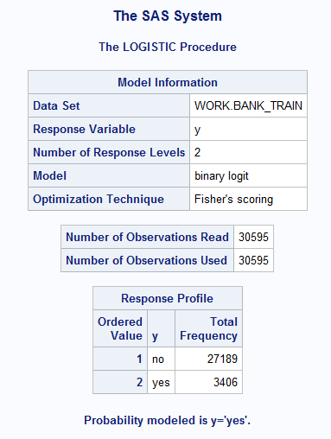
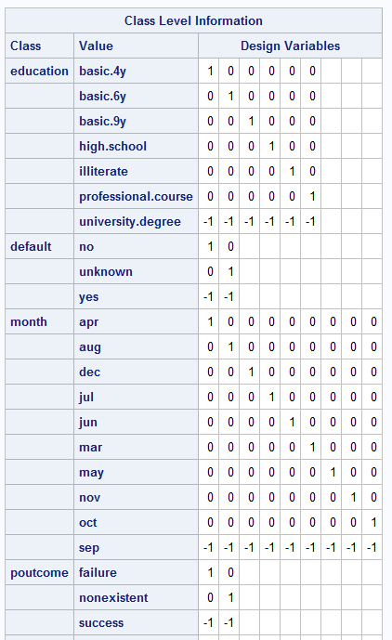
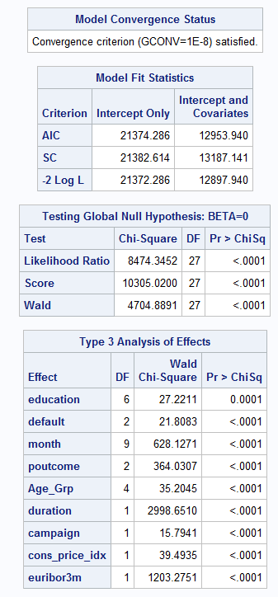
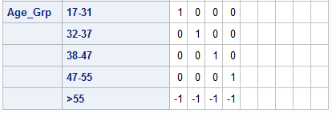

Slide 4
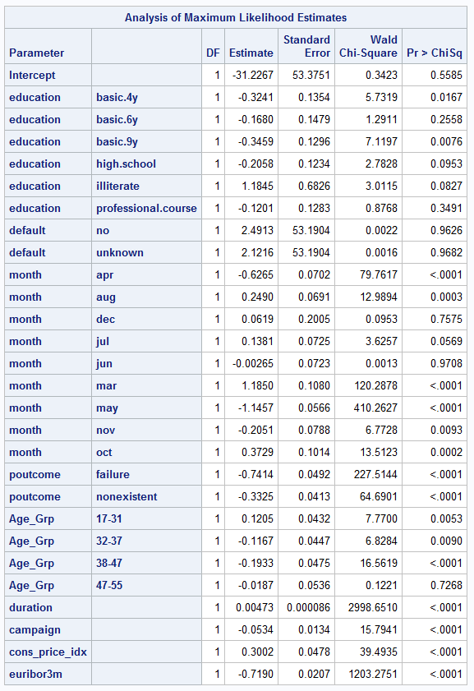
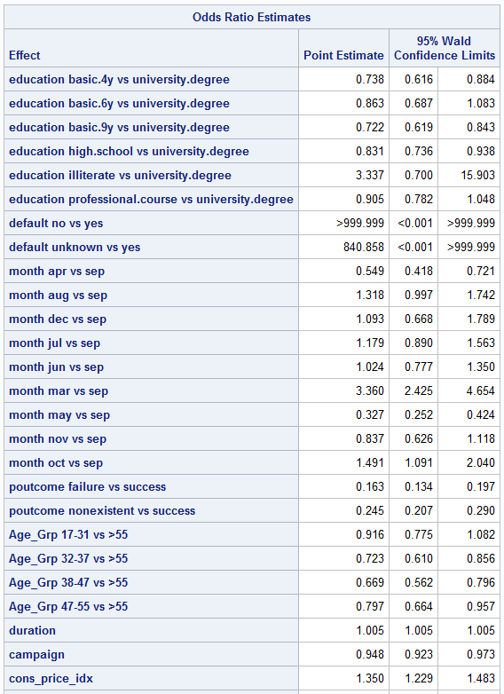

Slide 5
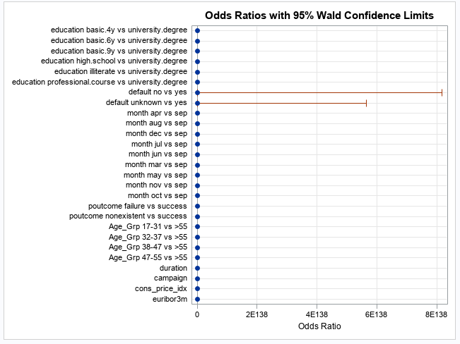
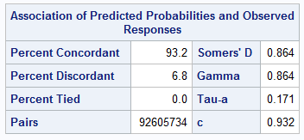
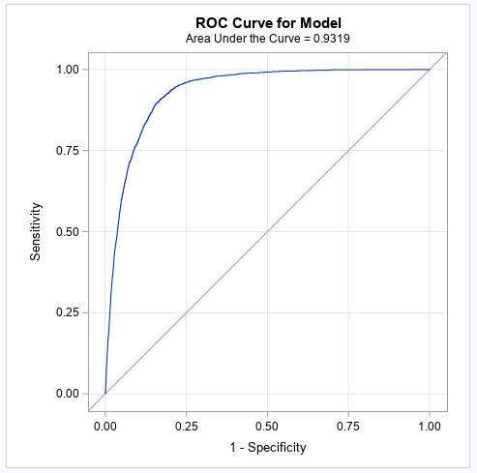

Slide 6
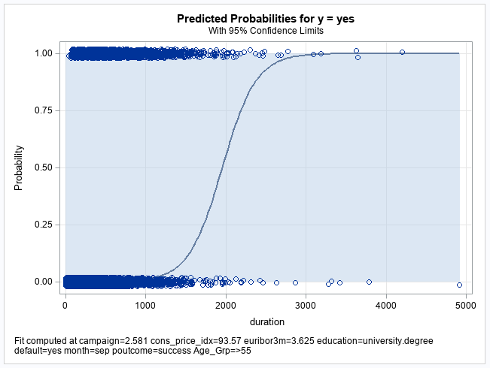
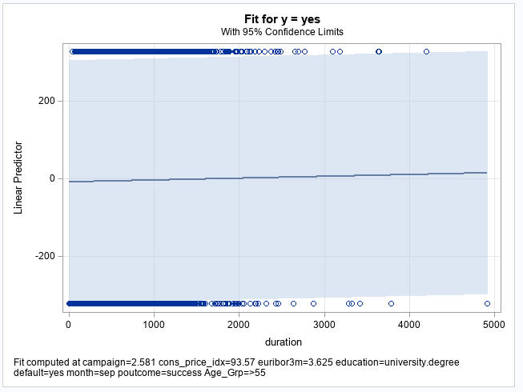

Slide 7
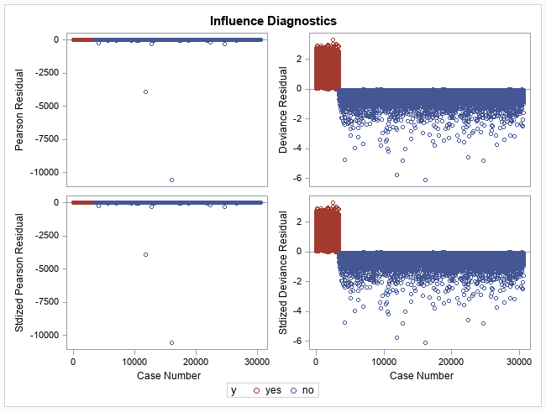
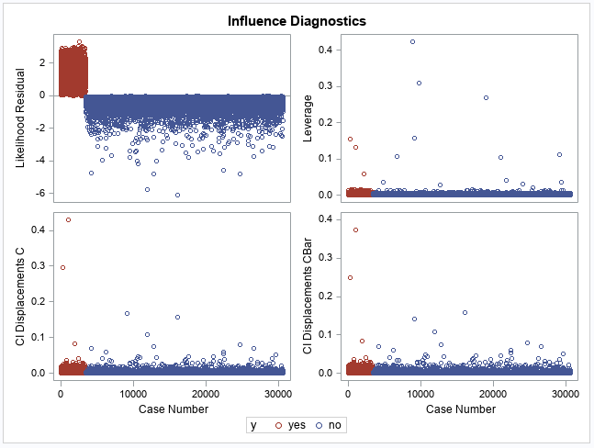

Slide 8
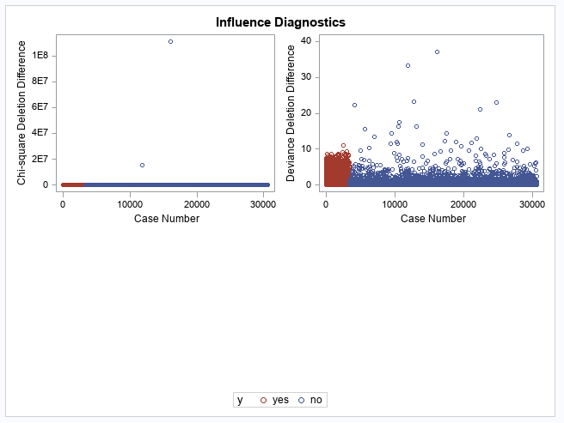
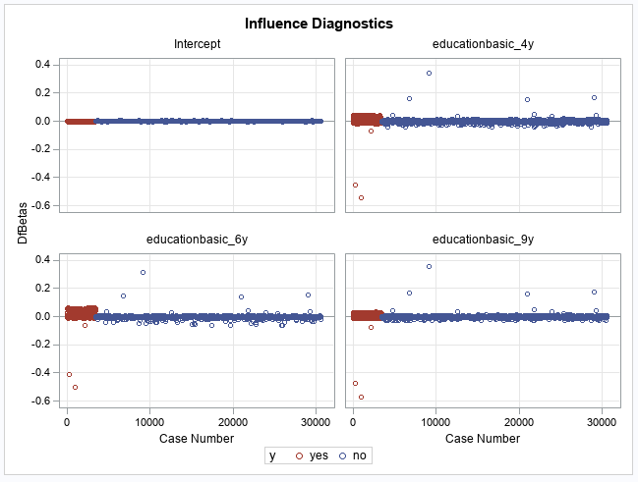

Slide 9
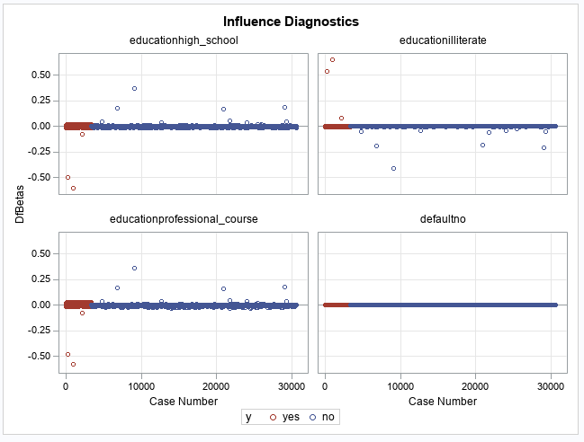
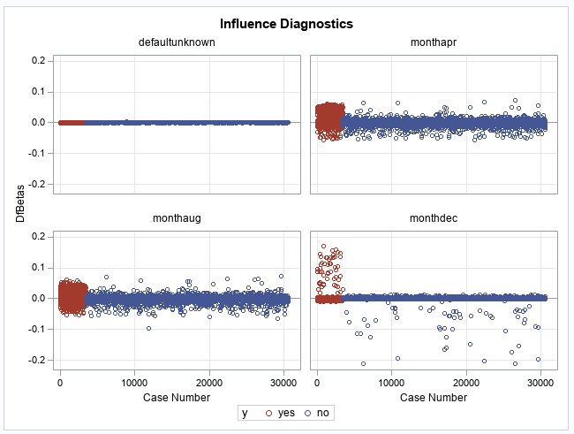

Slide 10
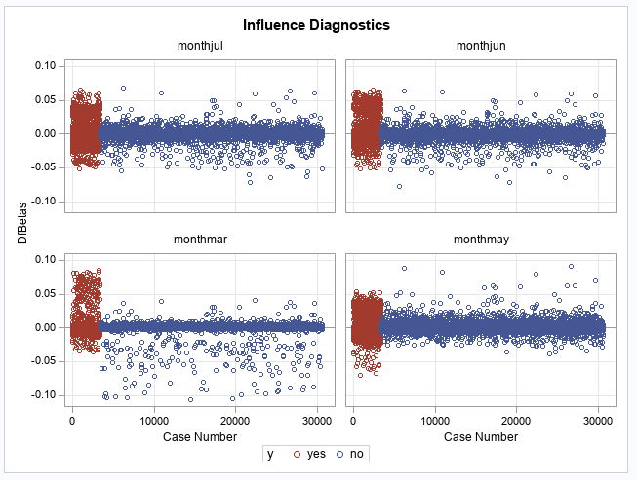
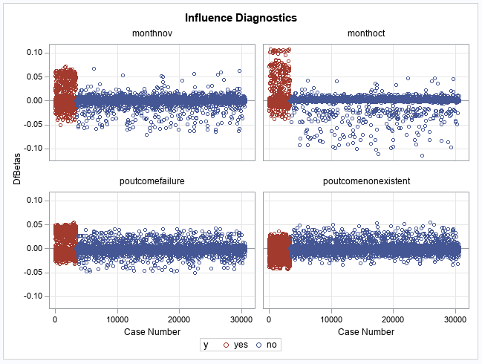

Slide 11
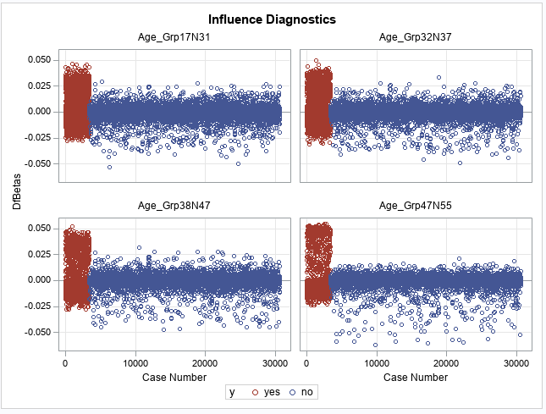
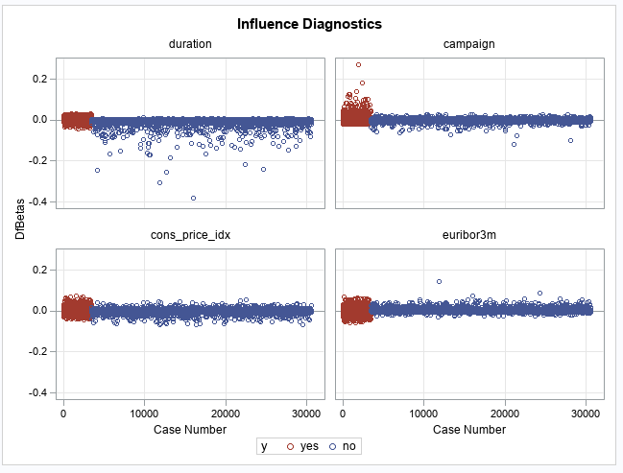

Slide 12
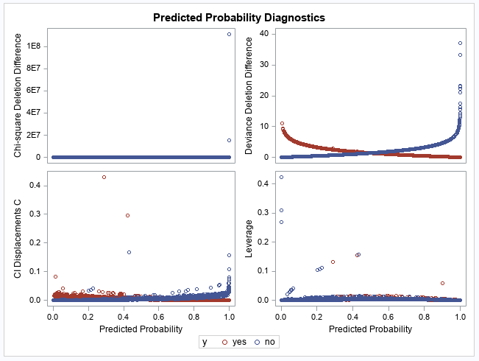
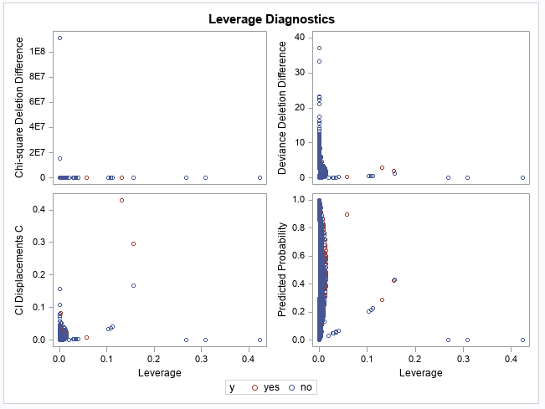

Slide 13
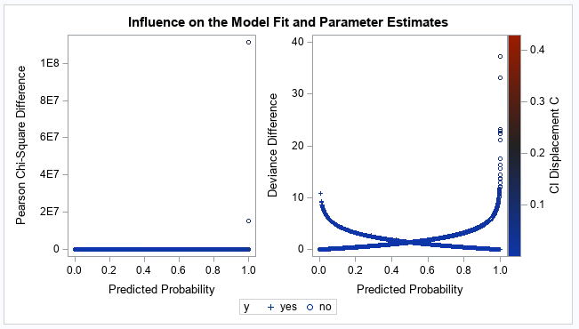
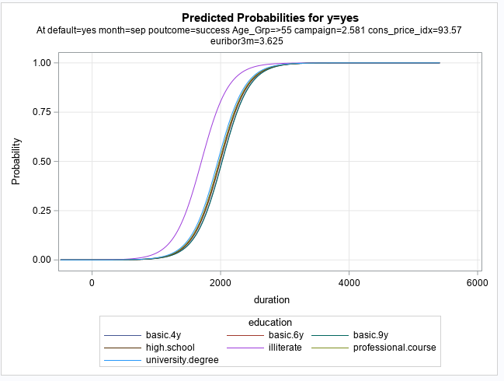

Slide 14
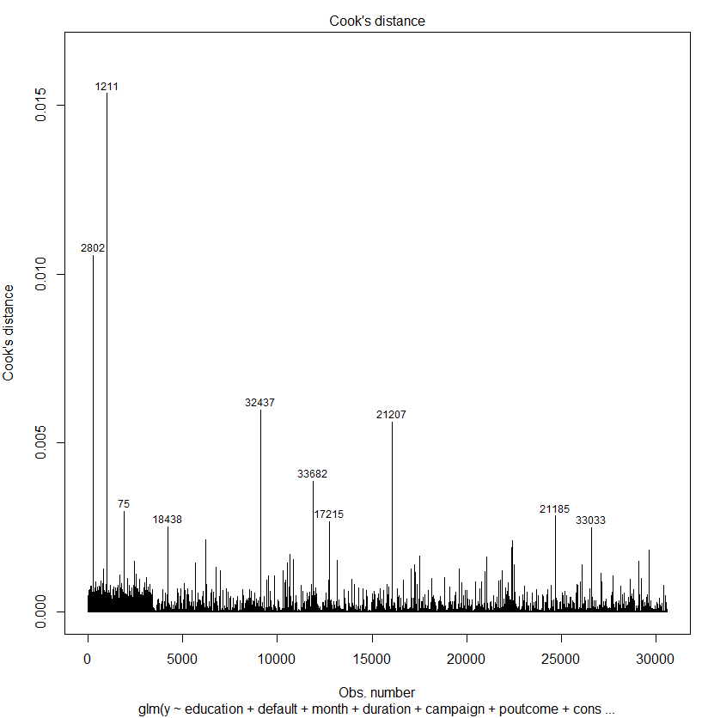
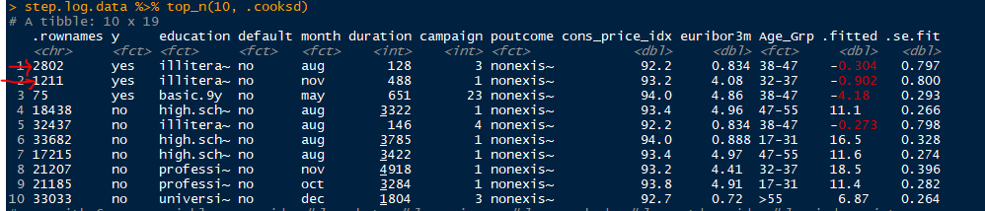
Diagnostics using R
full.log<-glm(y~education+default+month+duration+campaign+poutcome+cons_price_idx+euribor3m+Age_Grp,family="binomial",data=train)
step.log<-full.log %>% stepAIC(trace=FALSE)
summary(step.log)
library(broom)
plot(step.log, which = 4, id.n = 10) #Cooks D plot

Slide 15
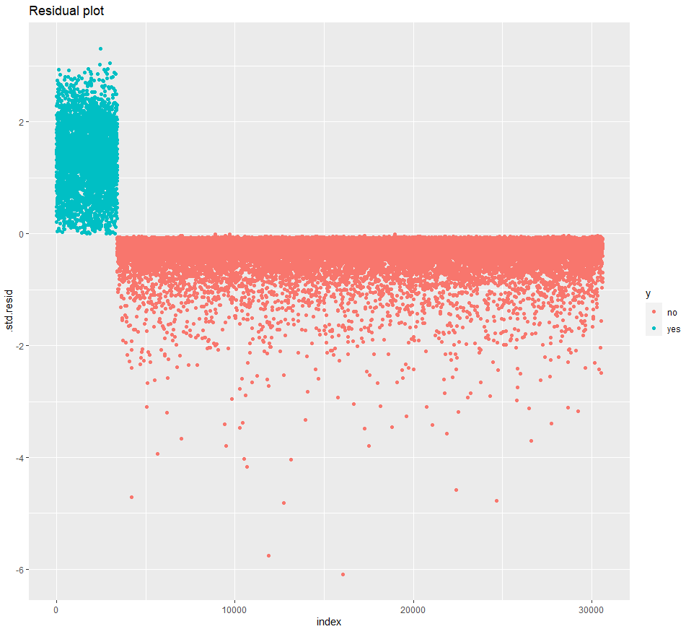
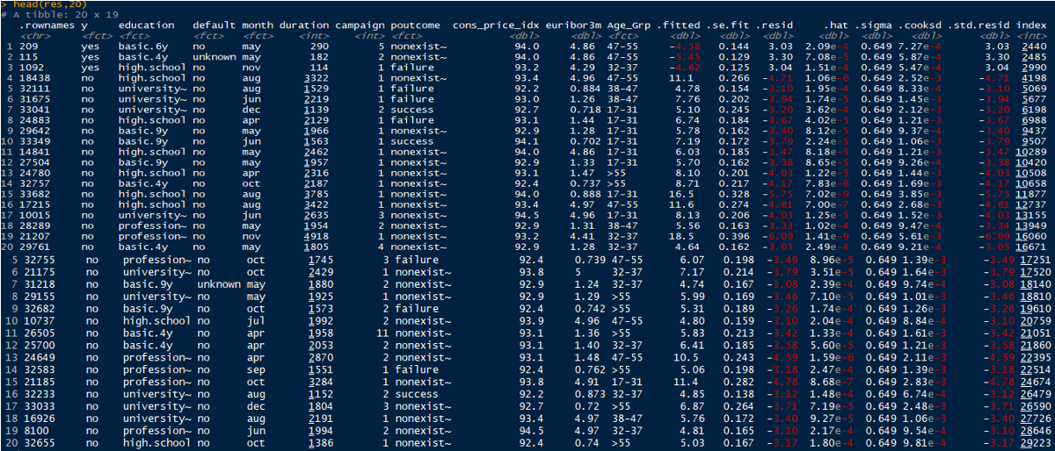
Diagnostics using R
step.log.data <- augment(step.log) %>%
mutate(index = 1:n())
ggplot(step.log.data, aes(index, .std.resid)) + geom_point(aes(color = y)) + ggtitle("Residual plot")

Slide 16
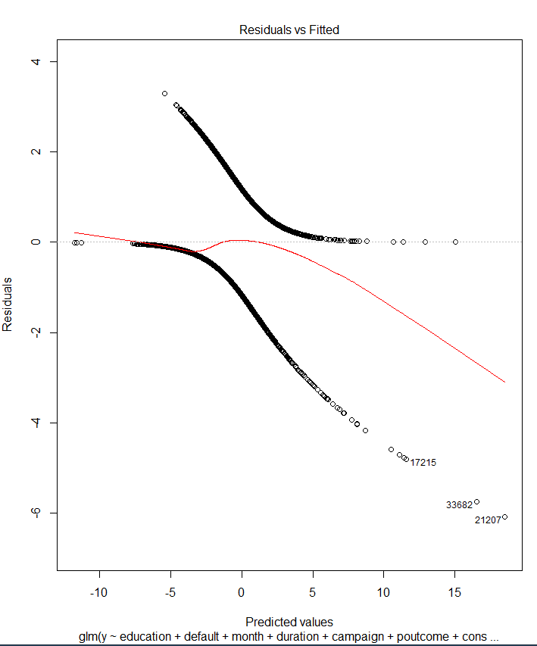
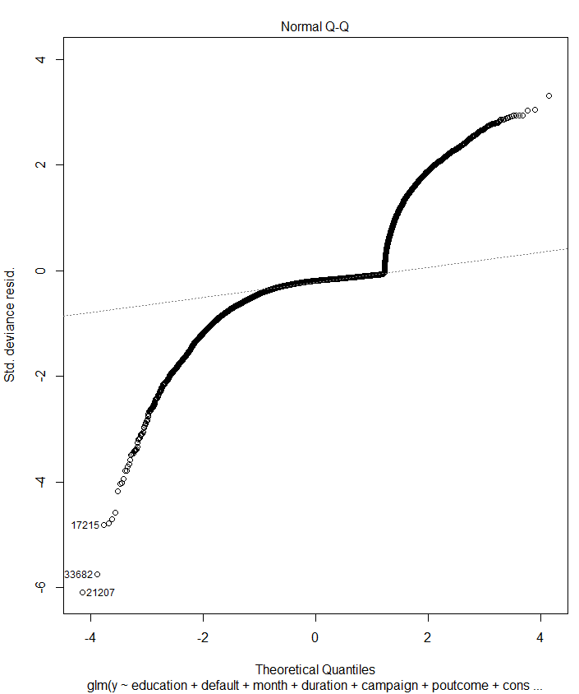
full.log<-glm(y~education+default+month+duration+campaign+poutcome+cons_price_idx+euribor3m+Age_Grp,family="binomial",data=train) step.log<-full.log %>% stepAIC(trace=FALSE) summary(step.log) plot(step.log)
Residuals/Deviance/Cooks D

Slide 17
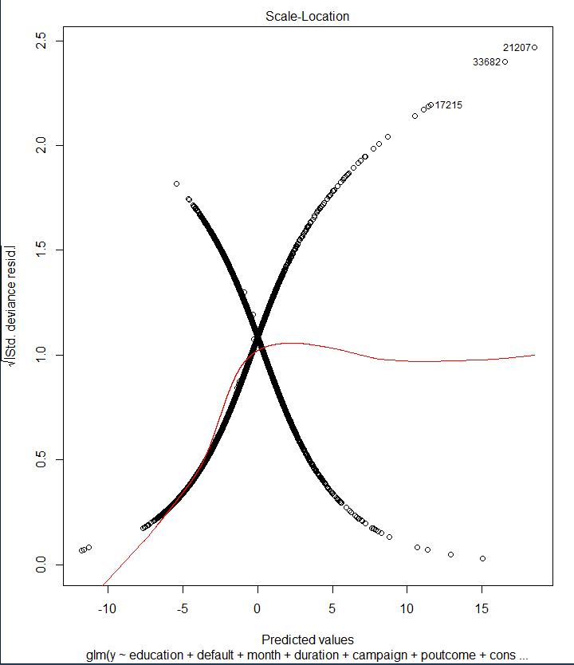
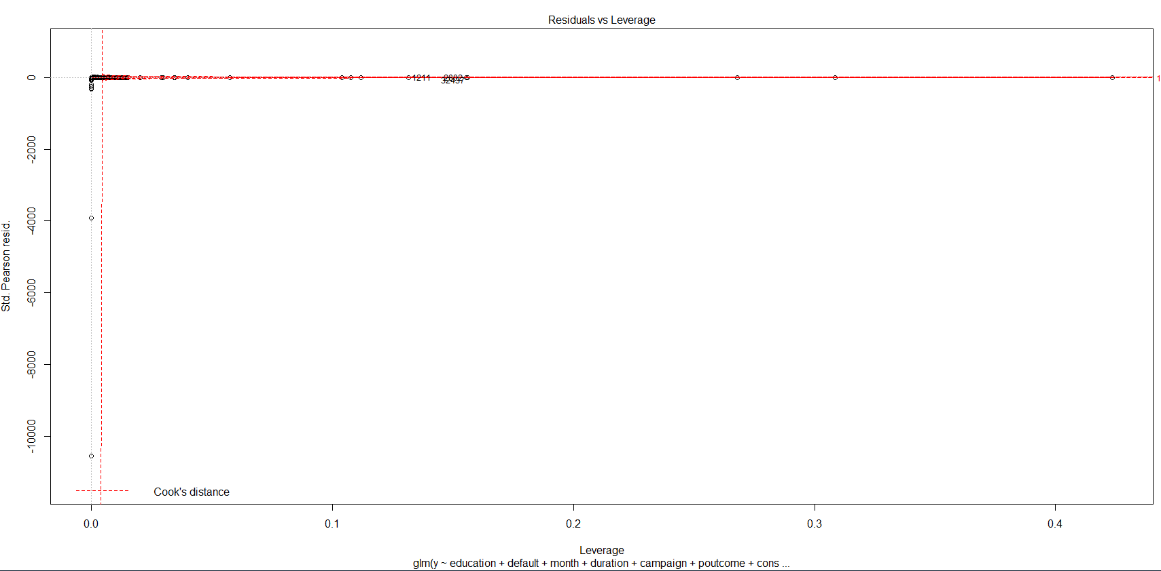
Full training data set

Slide 18
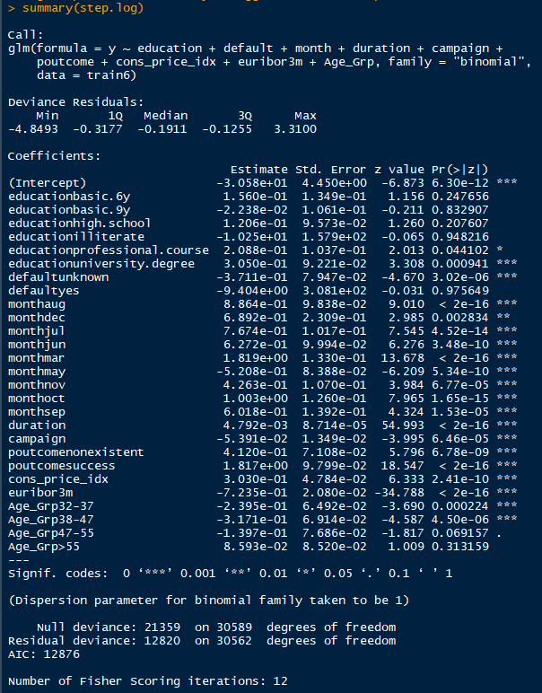
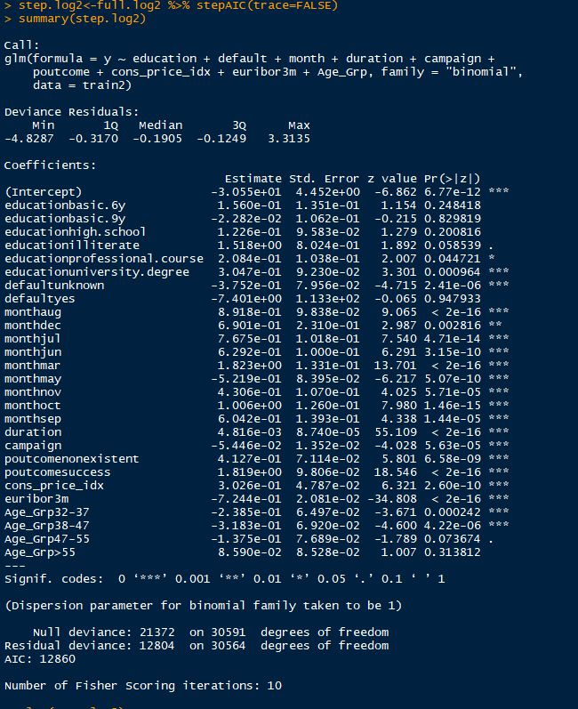
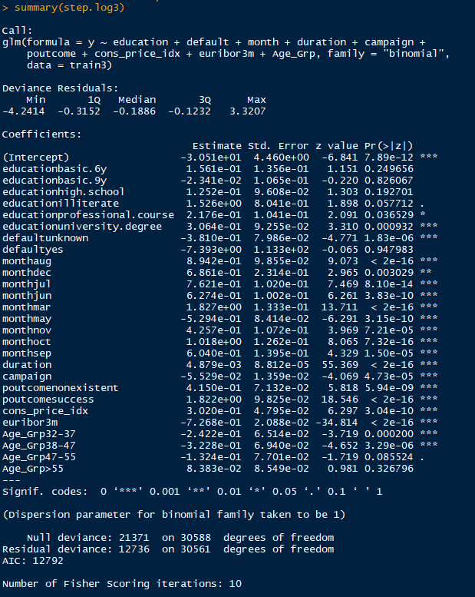
train
Model Summary – outlier analysis
train 2
train2 <- train %>% dplyr::filter(!rownames(train) %in% c("17215","33682","21207"))
train 3
train3 <- train %>% dplyr::filter(rownames(train) %in% c("17215","33682","21207","24649","18438","21185"))

Slide 19
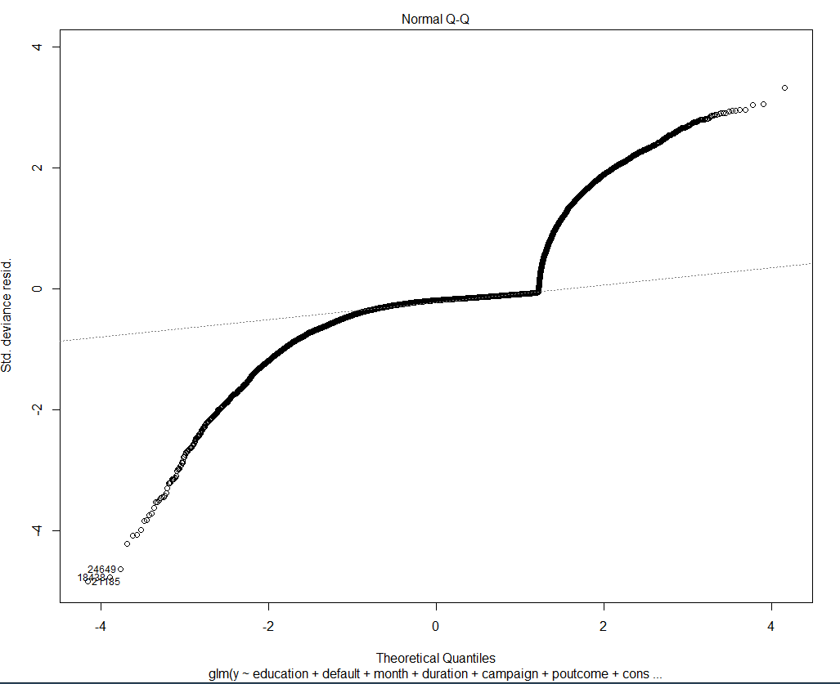
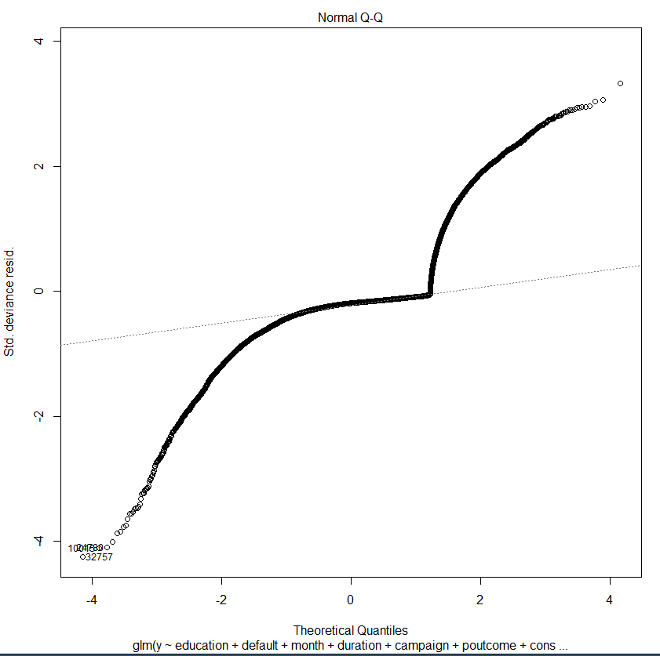
Std Deviance residual plot comparison
train
train 2
train2 <- train %>% dplyr::filter(!rownames(train) %in% c("17215","33682","21207"))
train 3
train3 <- train %>% dplyr::filter(rownames(train) %in% c("17215","33682","21207","24649","18438","21185"))

Slide 20
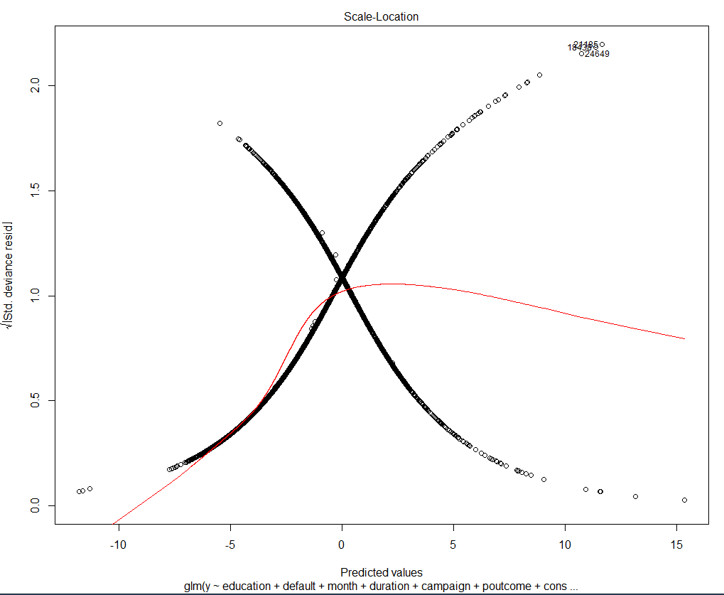
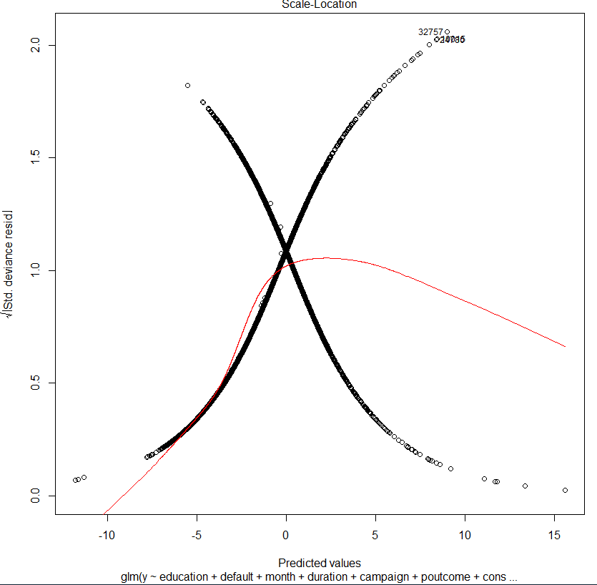
Sqrt Std Deviance residual plot comparison
train
train 2
train2 <- train %>% dplyr::filter(!rownames(train) %in% c("17215","33682","21207"))
train 3
train3 <- train %>% dplyr::filter(rownames(train) %in% c("17215","33682","21207","24649","18438","21185"))

Slide 21
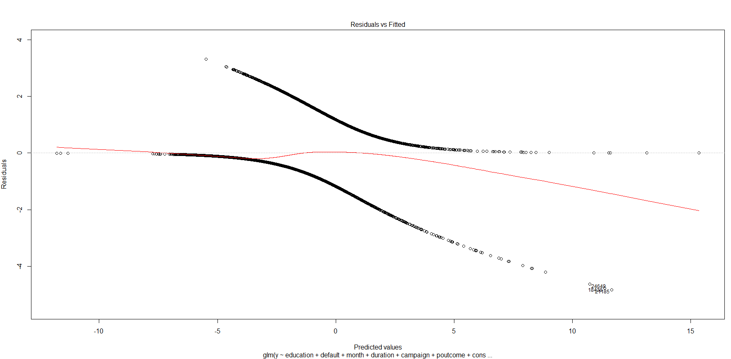
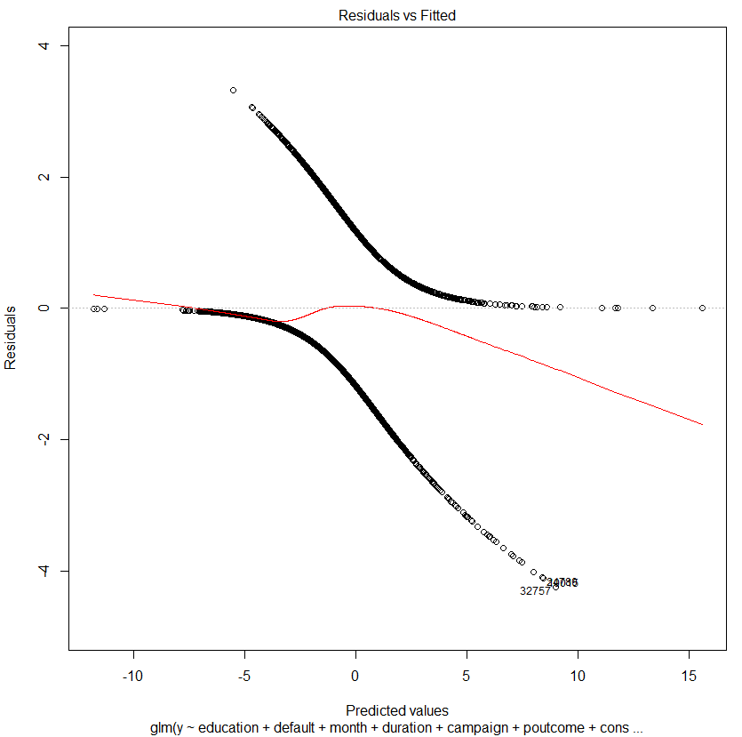
Residuals plot comparison
train
train 2
train2 <- train %>% dplyr::filter(!rownames(train) %in% c("17215","33682","21207"))
train 3
train3 <- train %>% dplyr::filter(rownames(train) %in% c("17215","33682","21207","24649","18438","21185"))

Slide 22
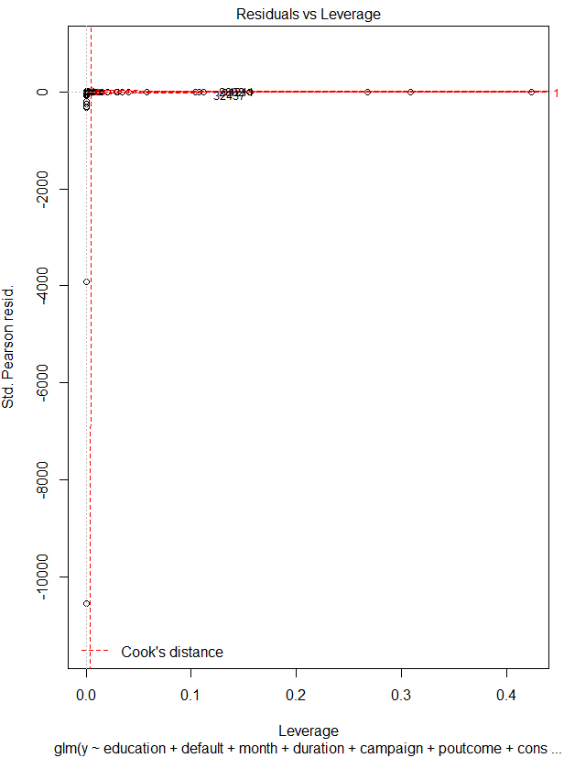
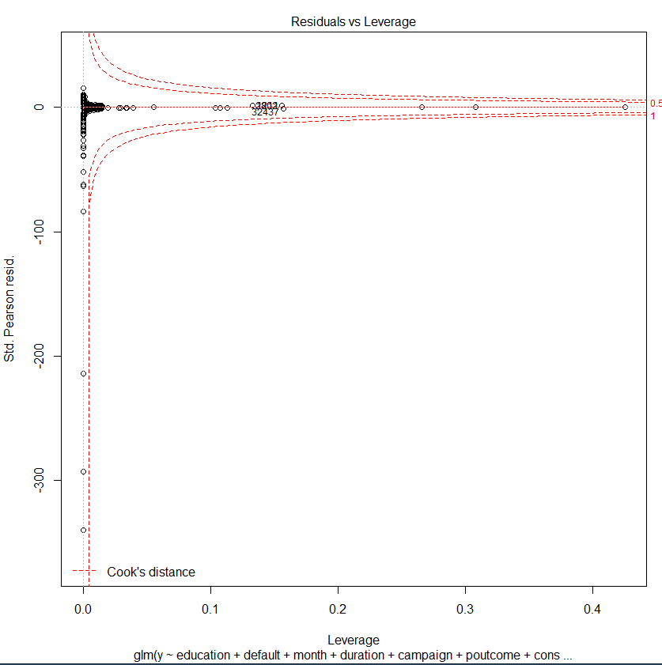
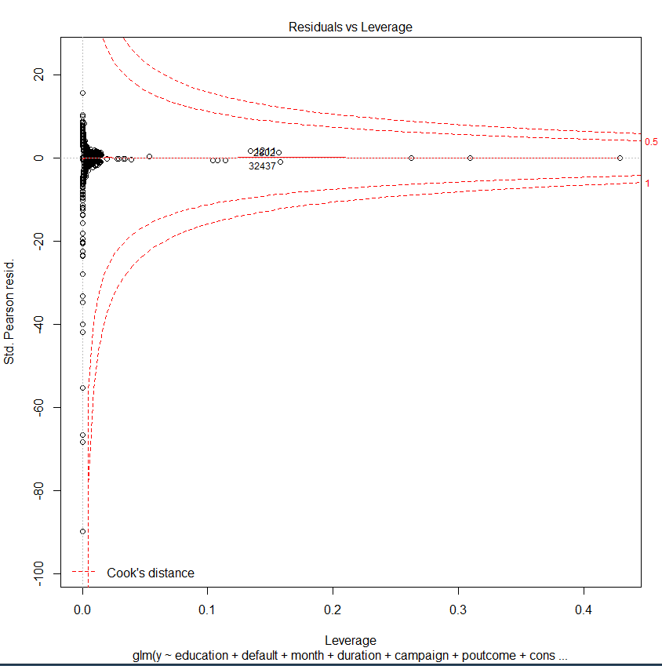
Residuals vs. Leverage plot comparison
train
train 2
train2 <- train %>% dplyr::filter(!rownames(train) %in% c("17215","33682","21207"))
train 3
train3 <- train %>% dplyr::filter(rownames(train) %in% c("17215","33682","21207","24649","18438","21185"))

Slide 23
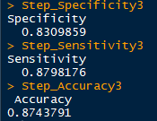
CM stats after removing outliers(train3)
Stats are very similar to those of step model with full data at cut off 0.15
Specificity - 0.8356808
Sensitivity - 0.8790821
Accuracy – 0.8742484

Slide 24
R Code
#Residual diagnostics
full.log<-glm(y~education+default+month+duration+campaign+poutcome+cons_price_idx+euribor3m+Age_Grp,family="binomial",data=train)
#full.log<-glm(y~.,family="binomial",data=train)
step.log<-full.log %>% stepAIC(trace=FALSE)
summary(step.log)
plot(step.log)
#examine outliers 1
nrow(train) #30595
train2 <- train %>% dplyr::filter(!rownames(train) %in% c("17215","33682","21207"))
nrow(train2)
#Residual diagnostics
full.log2<-glm(y~education+default+month+duration+campaign+poutcome+cons_price_idx+euribor3m+Age_Grp,family="binomial",data=train2)
#full.log<-glm(y~.,family="binomial",data=train)
step.log2<-full.log2 %>% stepAIC(trace=FALSE)
summary(step.log2)
plot(step.log2)
#examine outliers 2
nrow(train2) #30592
train3 <- train %>% dplyr::filter(!rownames(train) %in% c("17215","33682","21207","24649","18438","21185"))
nrow(train3)
#Residual diagnostics
full.log3<-glm(y~education+default+month+duration+campaign+poutcome+cons_price_idx+euribor3m+Age_Grp,family="binomial",data=train3)
#full.log<-glm(y~.,family="binomial",data=train)
step.log3<-full.log3 %>% stepAIC(trace=FALSE)
summary(step.log3)
plot(step.log3)
#Confusion matrix on train 3
#Predicting using step
cutoff=0.15
fit.pred.step3<-predict(step.log3,newdata=test,type="response")
class.step3<-factor(ifelse(fit.pred.step3>cutoff,"yes","no"),levels=c("no","yes"))
conf.step3<-table(class.step3,test$y)
print("Confusion matrix for Stepwise")
conf.step3
C_conf.step3 <- confusionMatrix(conf.step3)
Step_Specificity3 <- C_conf.step3$byClass[2]
Step_Sensitivity3 <- C_conf.step3$byClass[1]
Step_Accuracy3 <- C_conf.step3$overall[1]
#Outliers
train %>% dplyr::filter(rownames(train) %in% c("17215","33682","21207","24649","18438","21185")) %>% dplyr::select(y,education,default,month,duration,campaign,poutcome,cons_price_idx,euribor3m,Age_Grp)

