Slide 1
Logistic regression Diagnostics using SAS and R

Slide 2
proc logistic data=bank_train plots=all; class education default month poutcome Age_Grp ; model y(event='yes')= education default month poutcome Age_Grp duration campaign cons_price_idx euribor3m duration ; output out= bank_train_logreg predprobs=I p=probpreb resdev=resdev reschi=pearres; run; proc gplot data=bank_train_logreg; plot resdev*VAR1; plot pearres*VAR1; run; quit; proc logistic data=bank_train plots(MAXPOINTS=NONE) =all; class education default month poutcome Age_Grp ; model y(event='yes')= education default month poutcome Age_Grp duration campaign cons_price_idx euribor3m duration ; effectplot fit / obs(jitter(y=0.02)) clm; effectplot fit / obs(jitter(y=0.02)) clm link; run;

Slide 3
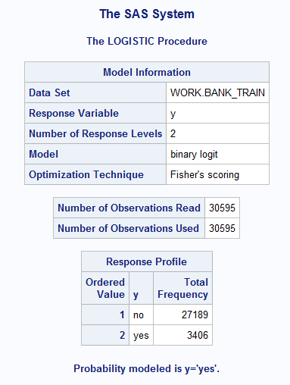
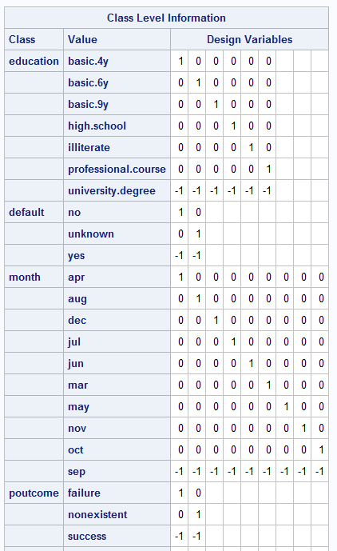
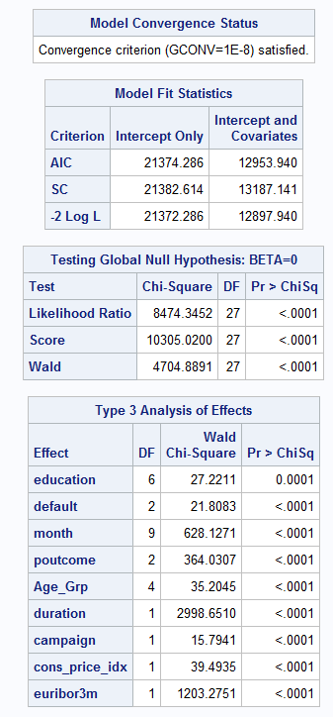
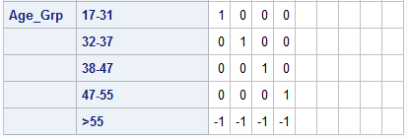

Slide 4
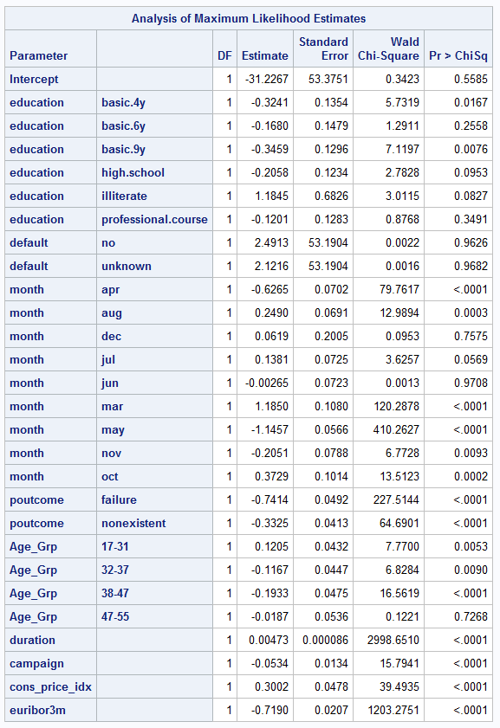
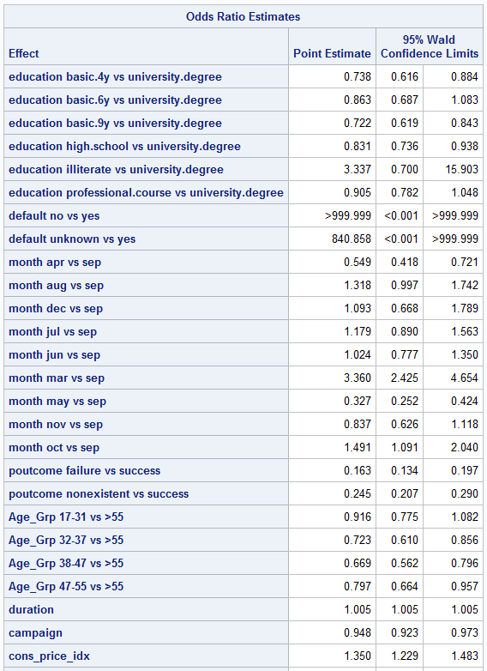

Slide 5
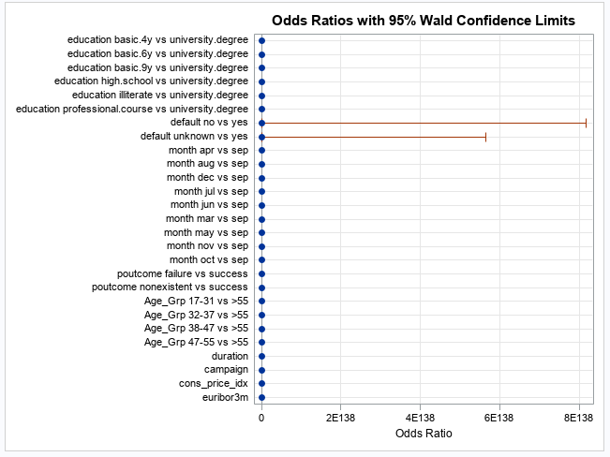
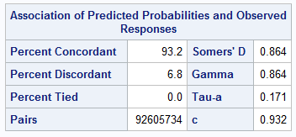
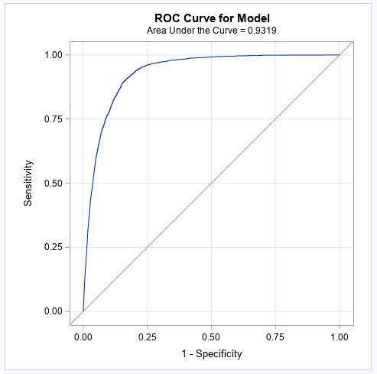

Slide 6
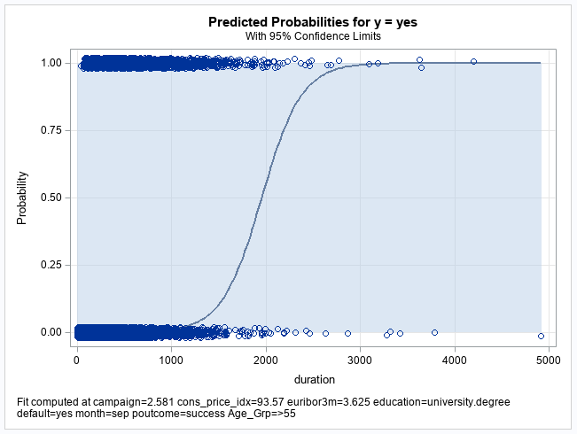
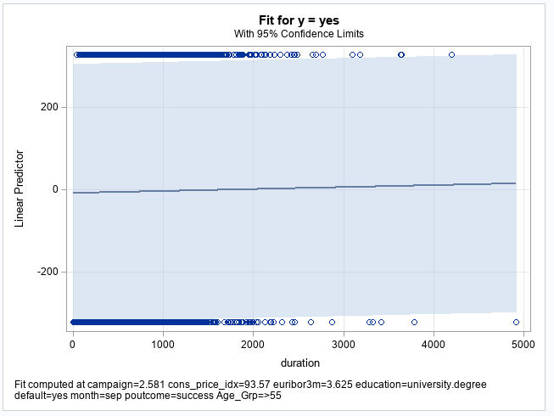

Slide 7
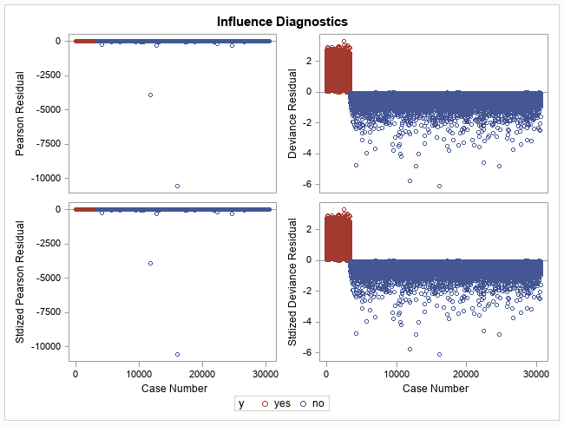
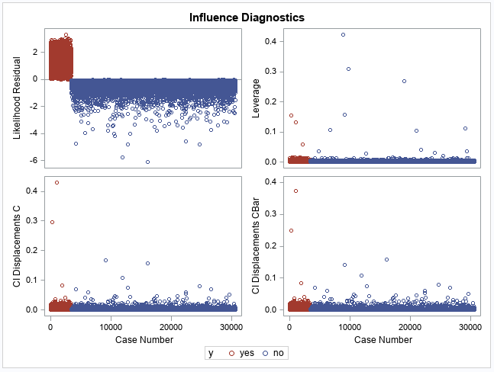

Slide 8
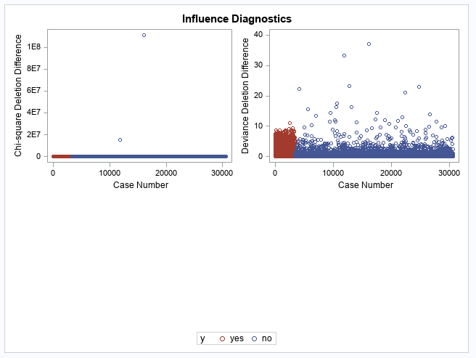
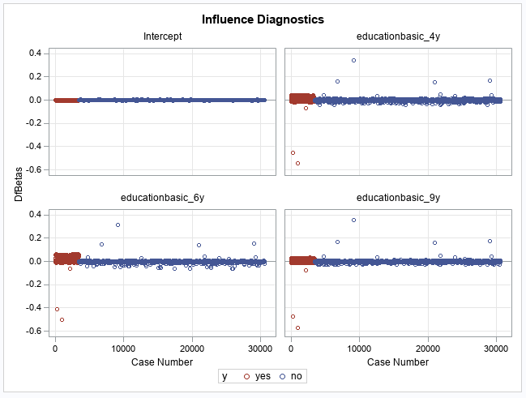

Slide 9
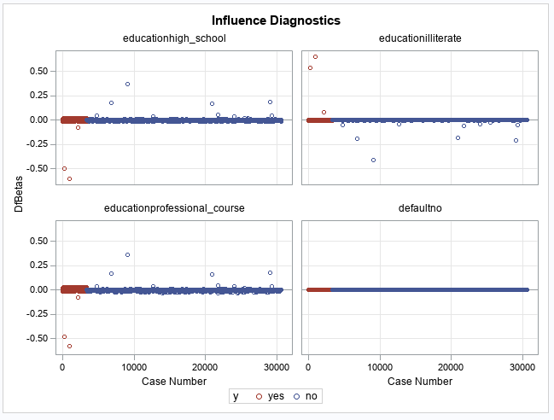
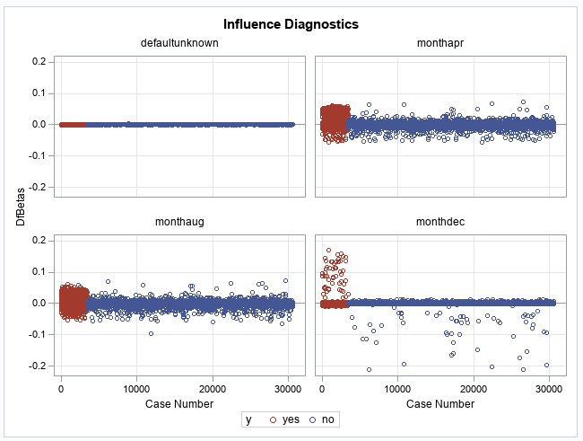

Slide 10
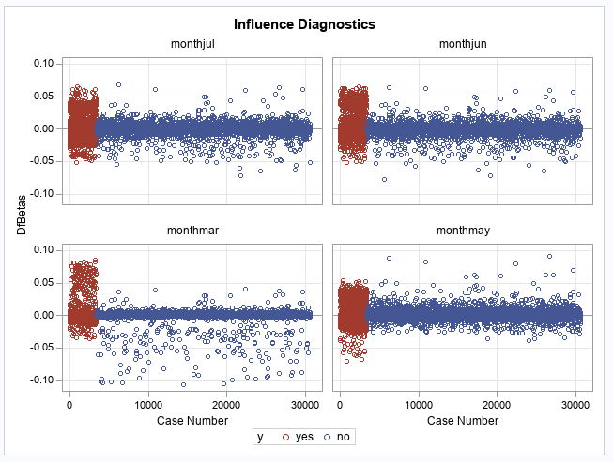
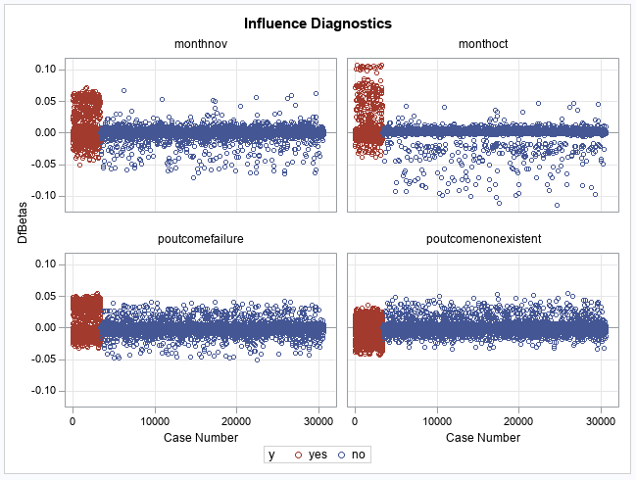

Slide 11
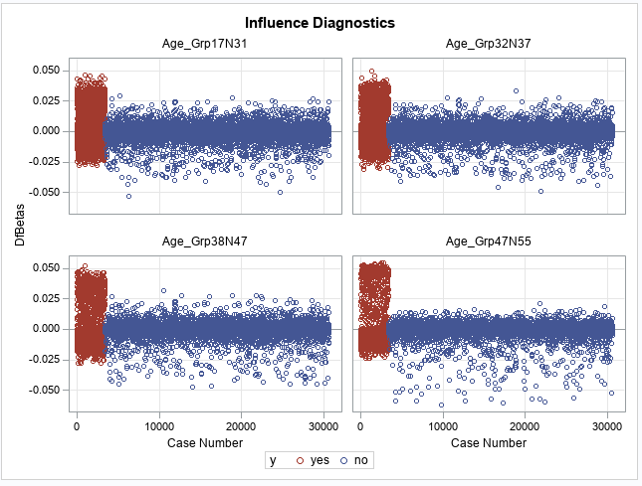
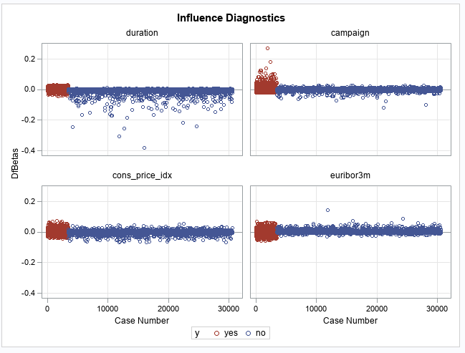

Slide 12
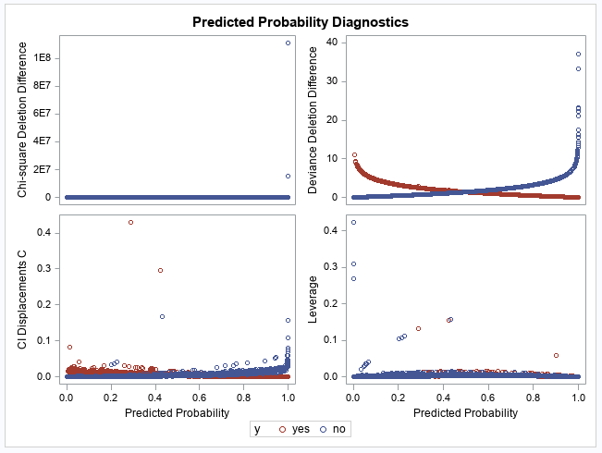
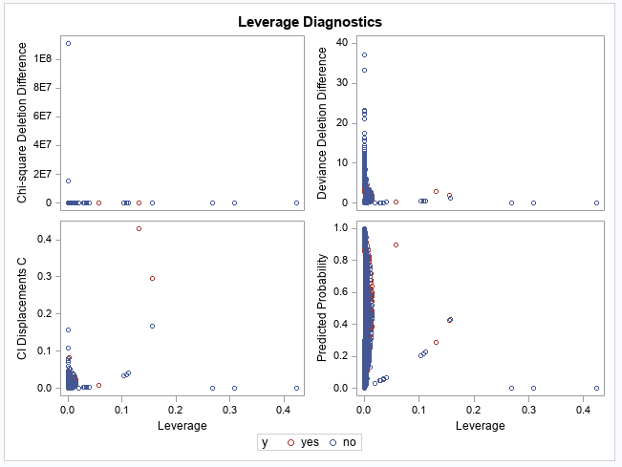

Slide 13
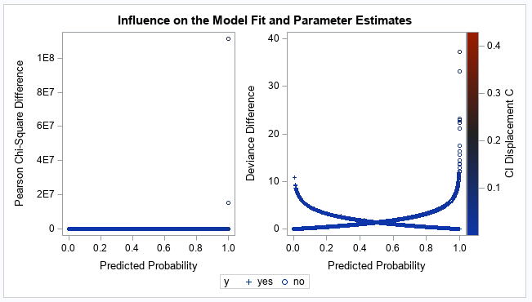
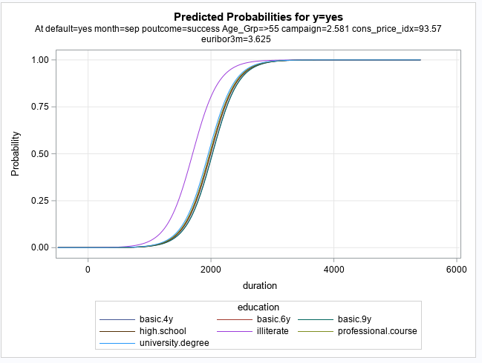

Slide 14
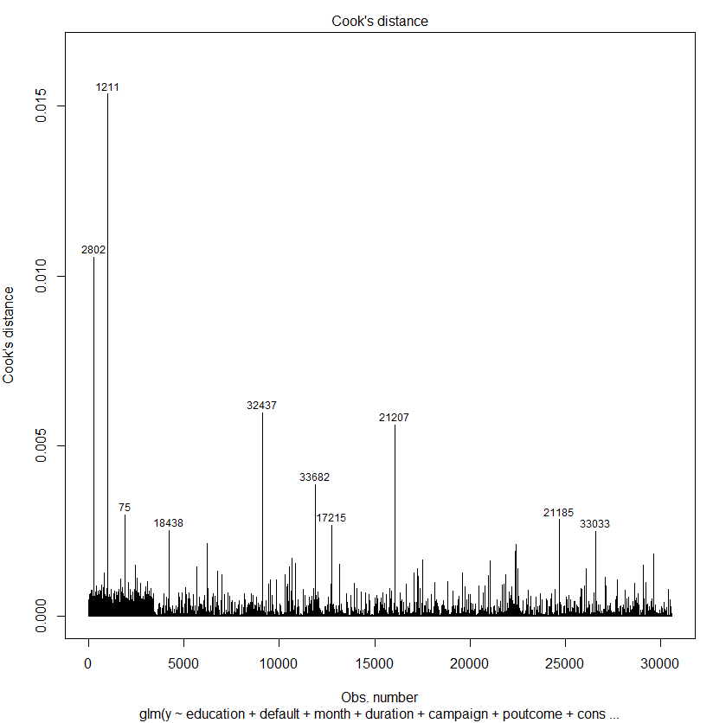
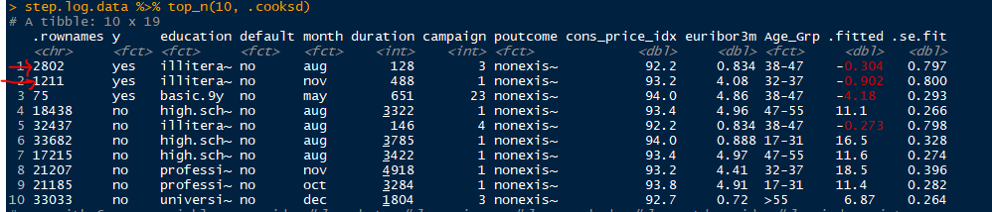
Diagnostics using R
full.log<-glm(y~education+default+month+duration+campaign+poutcome+cons_price_idx+euribor3m+Age_Grp,family="binomial",data=train)
step.log<-full.log %>% stepAIC(trace=FALSE)
summary(step.log)
library(broom)
plot(step.log, which = 4, id.n = 10) #Cooks D plot

Slide 15
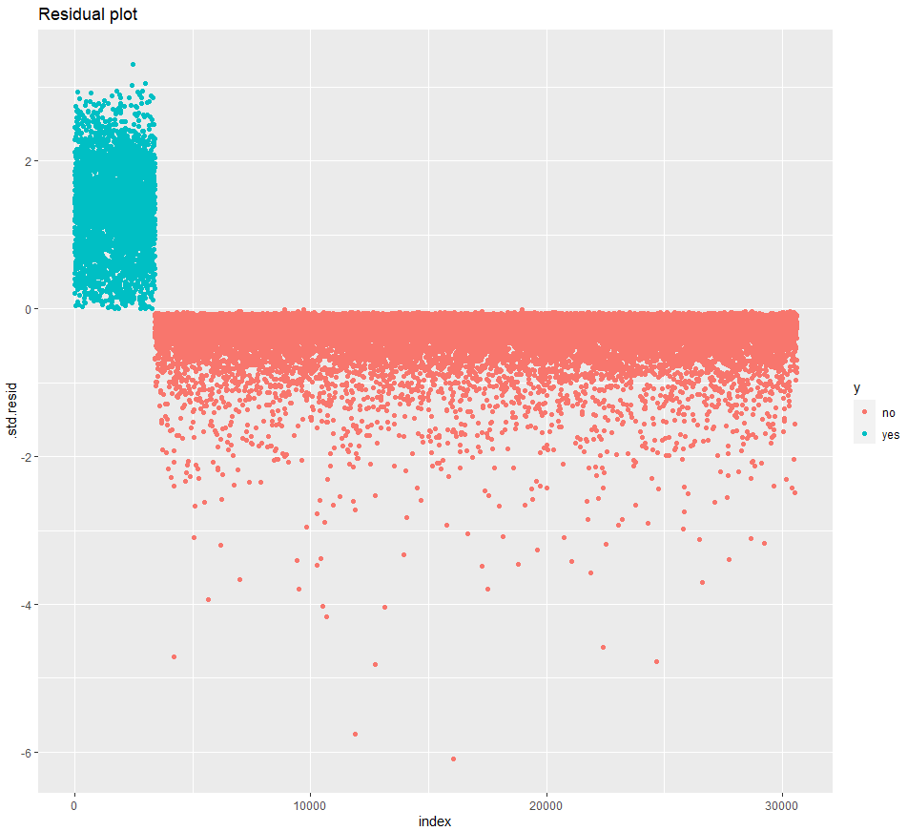
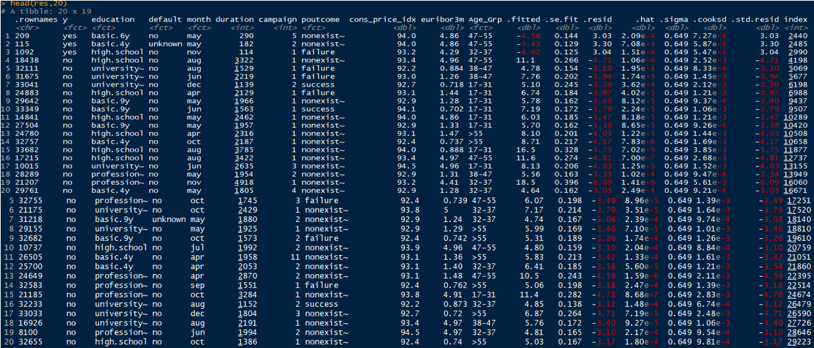
Diagnostics using R
step.log.data <- augment(step.log) %>%
mutate(index = 1:n())
ggplot(step.log.data, aes(index, .std.resid)) + geom_point(aes(color = y)) + ggtitle("Residual plot")

Slide 16
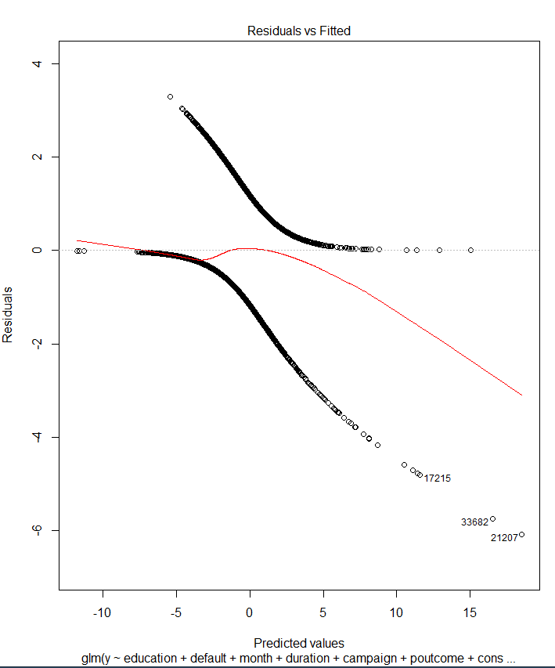
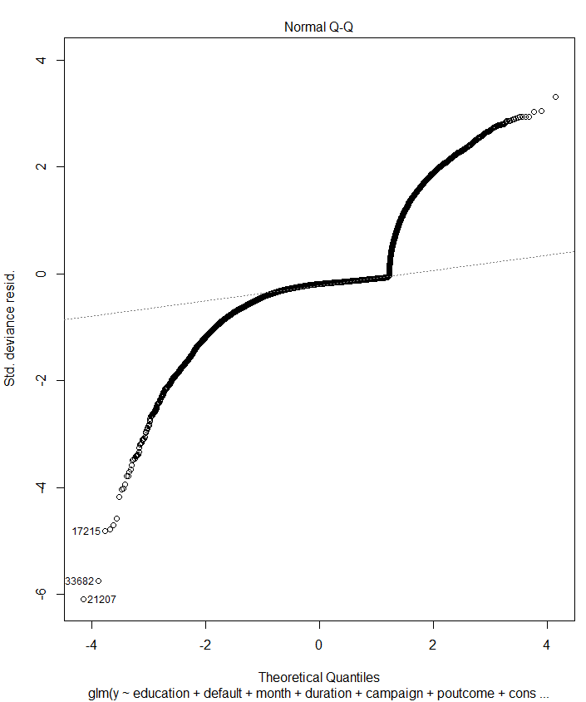
full.log<-glm(y~education+default+month+duration+campaign+poutcome+cons_price_idx+euribor3m+Age_Grp,family="binomial",data=train) step.log<-full.log %>% stepAIC(trace=FALSE) summary(step.log) plot(step.log)
Residuals/Deviance/Cooks D

Slide 17
