Slide 1

Diversifying the energy grid
Megan Ball
DS6390

Slide 2
Overview
How does the US compare in greenhouse gas emissions?
What is the current percent of energy being generated by renewable sources in the US?
But won’t increasing renewable sources lead to less reliability on the grid?
Areas of opportunity

Slide 3
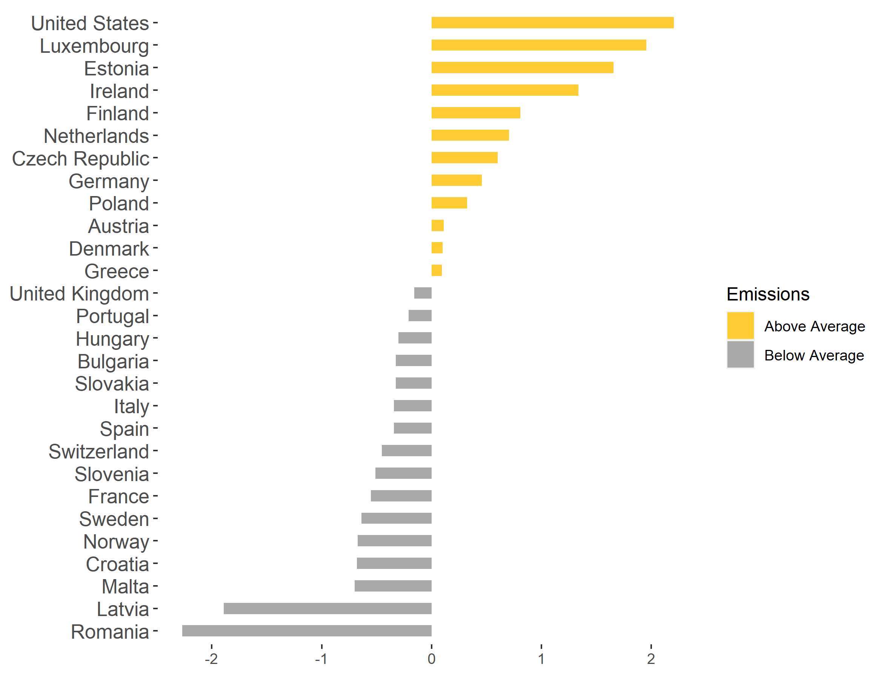
State of the Union’s Emissions
The US emitted 18 tons of CO₂ equivalents per capita in 2016
France emitted 5 tons of CO₂ equivalents per capita in 2016
The US leads in greenhouse gas emissions at a per capita level compared to most of Europe. In 2016, the United States total greenhouse gas emissions were 2 times the average of the European countries listed above.

Slide 4
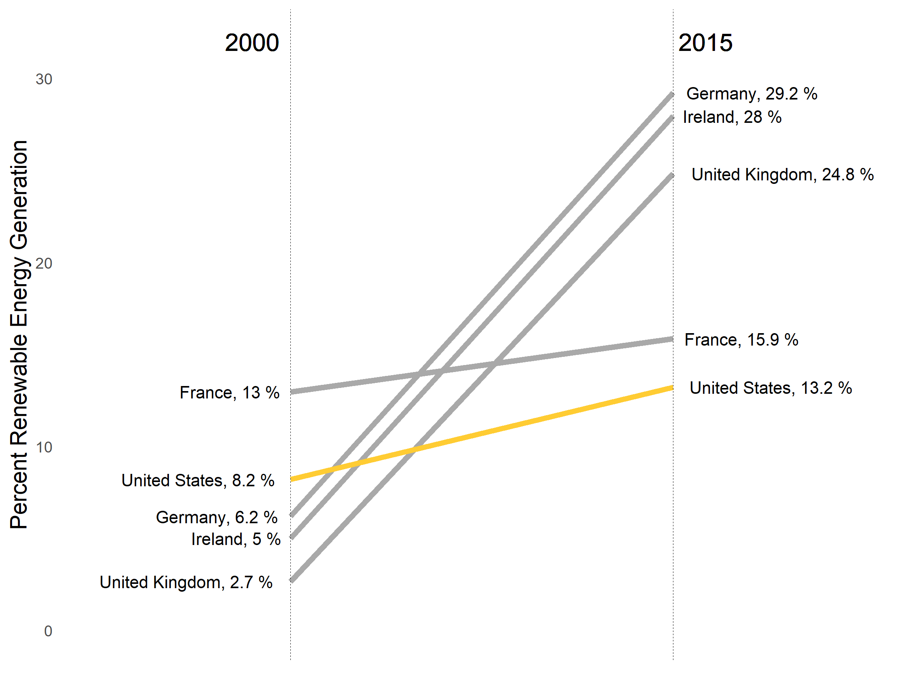
The US falls behind in renewable energy
Source
From the years 2000 to 2015, the US increased the amount of energy it generates from renewable sources from 8.2% to only 13.2%. In contrast, Germany increased their renewable portion from 6.2% to 29.2% - an increase of almost 300%!

Slide 5
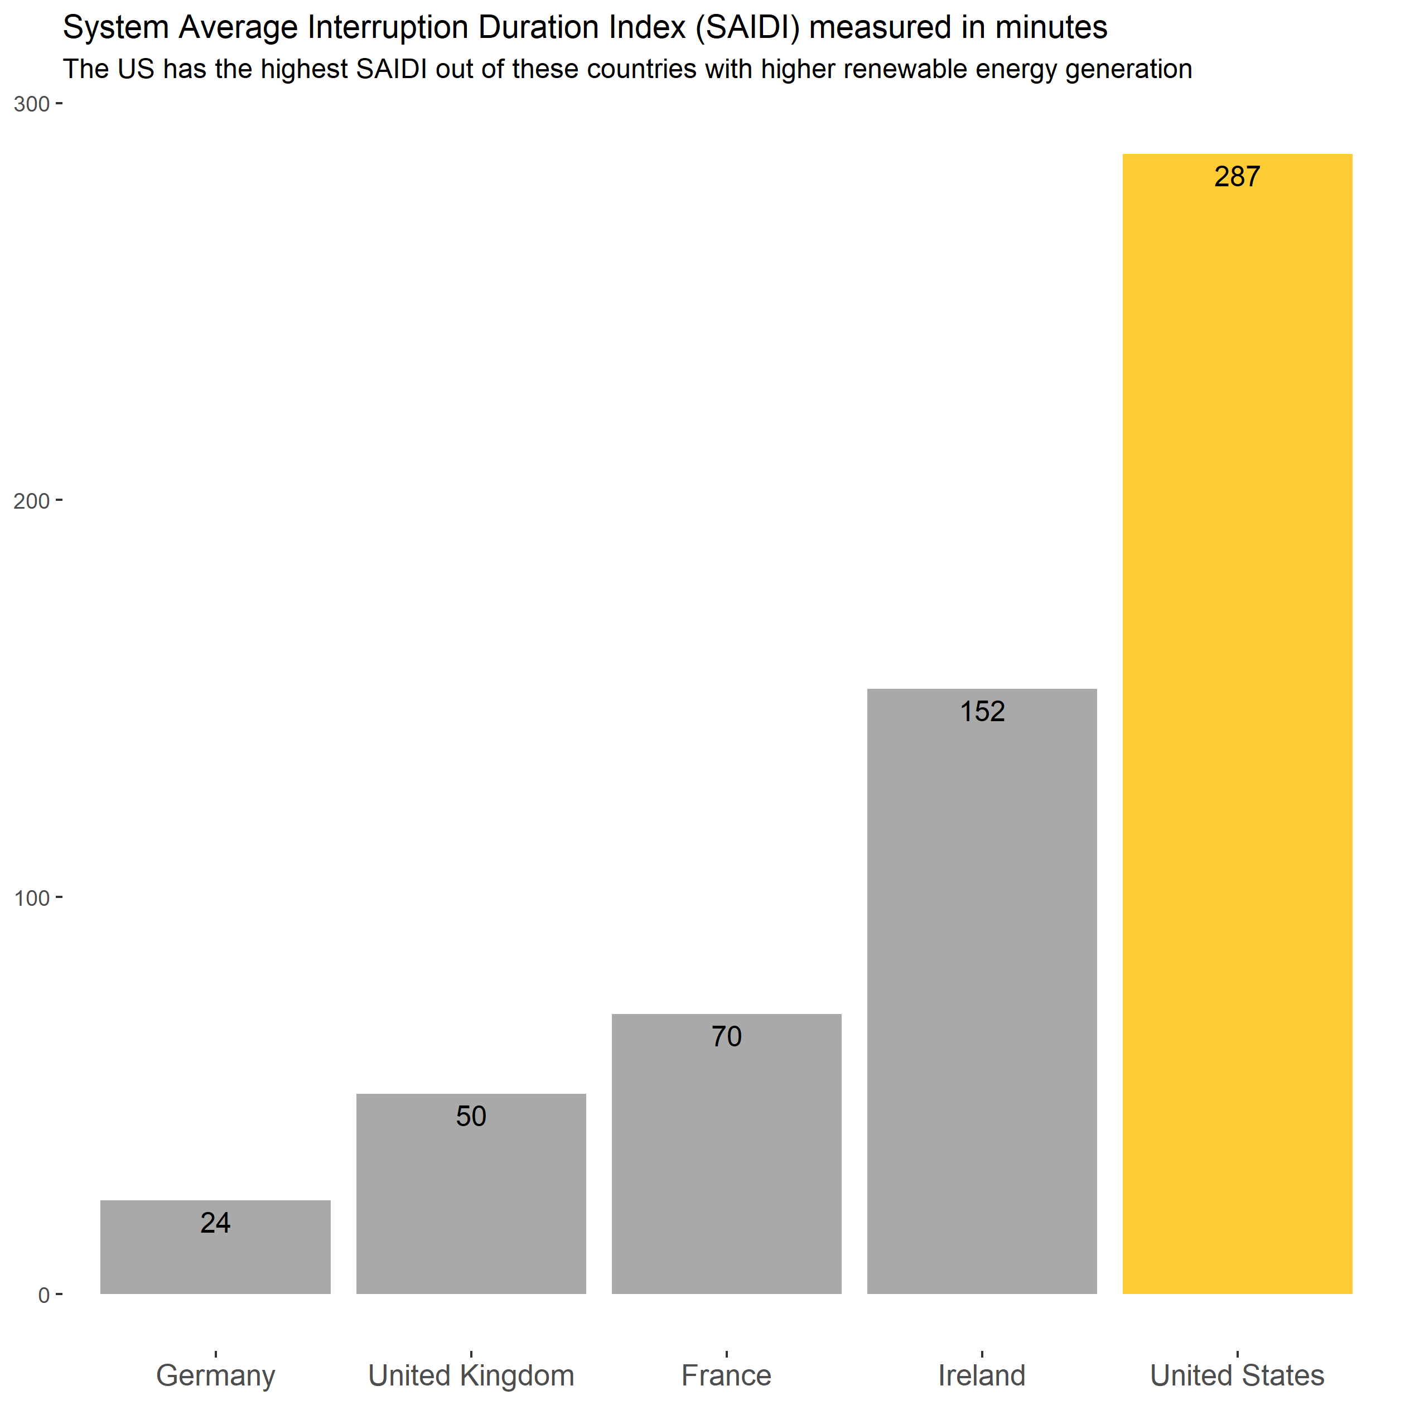
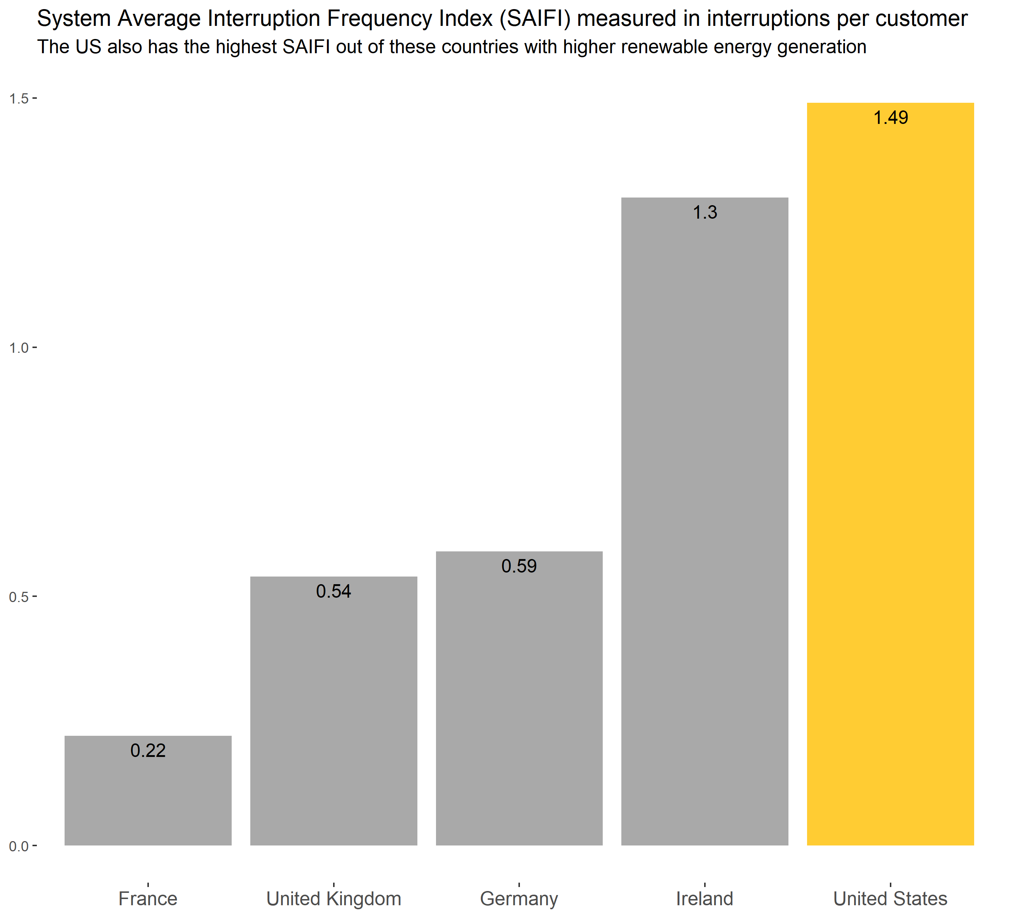
Yeah, but isn’t it less reliable?
Despite its higher percentage of conventional thermal energy sources, the US has the highest SAIDI and SAIFI

Slide 6
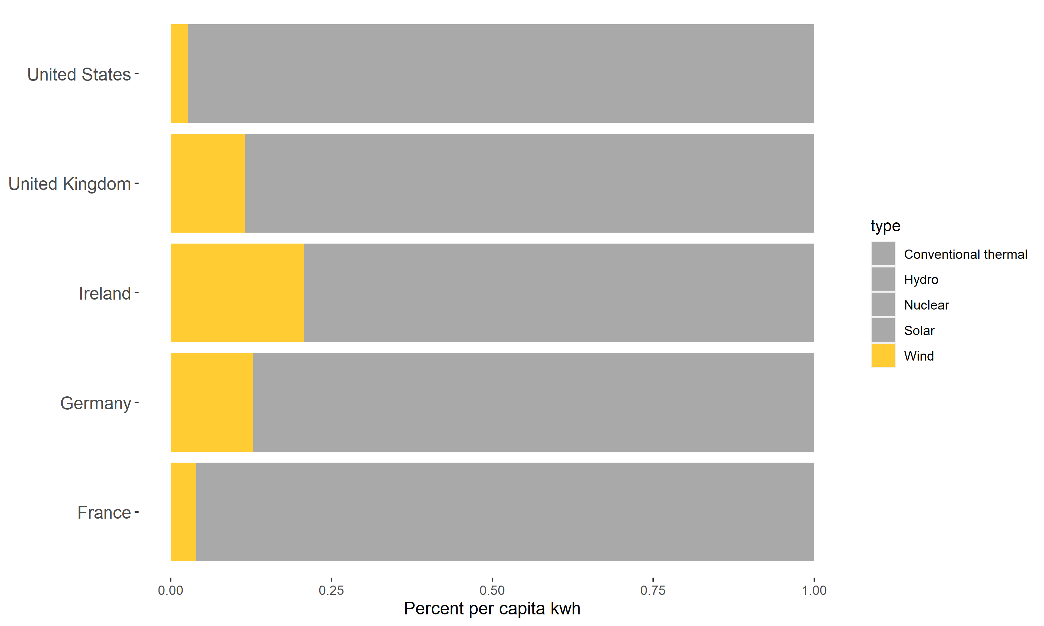
Opportunities for Investment
Wind is only about 2.6% of the renewable energy generated in the US.
There are several renewable sources that could use additional investment to decrease the overall reliance of the US on conventional thermal energy sources.

Slide 7
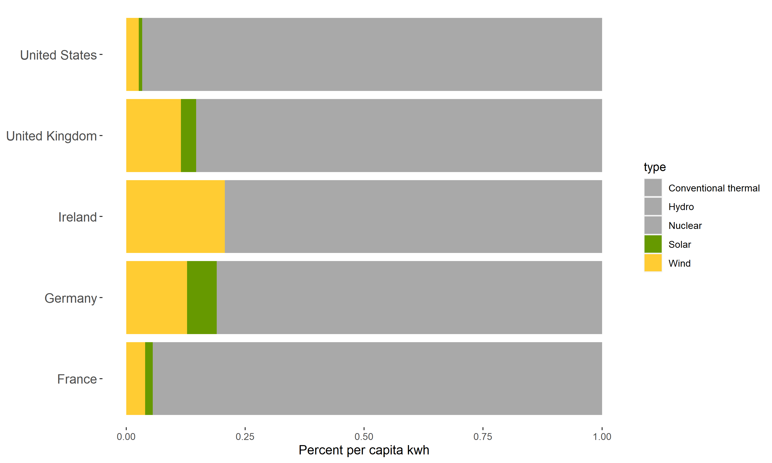
Opportunities for Investment
Solar is only about 0.7% of the renewable energy generated in the US.
There are several renewable sources that could use additional investment to decrease the overall reliance of the US on conventional thermal energy sources.

Slide 8
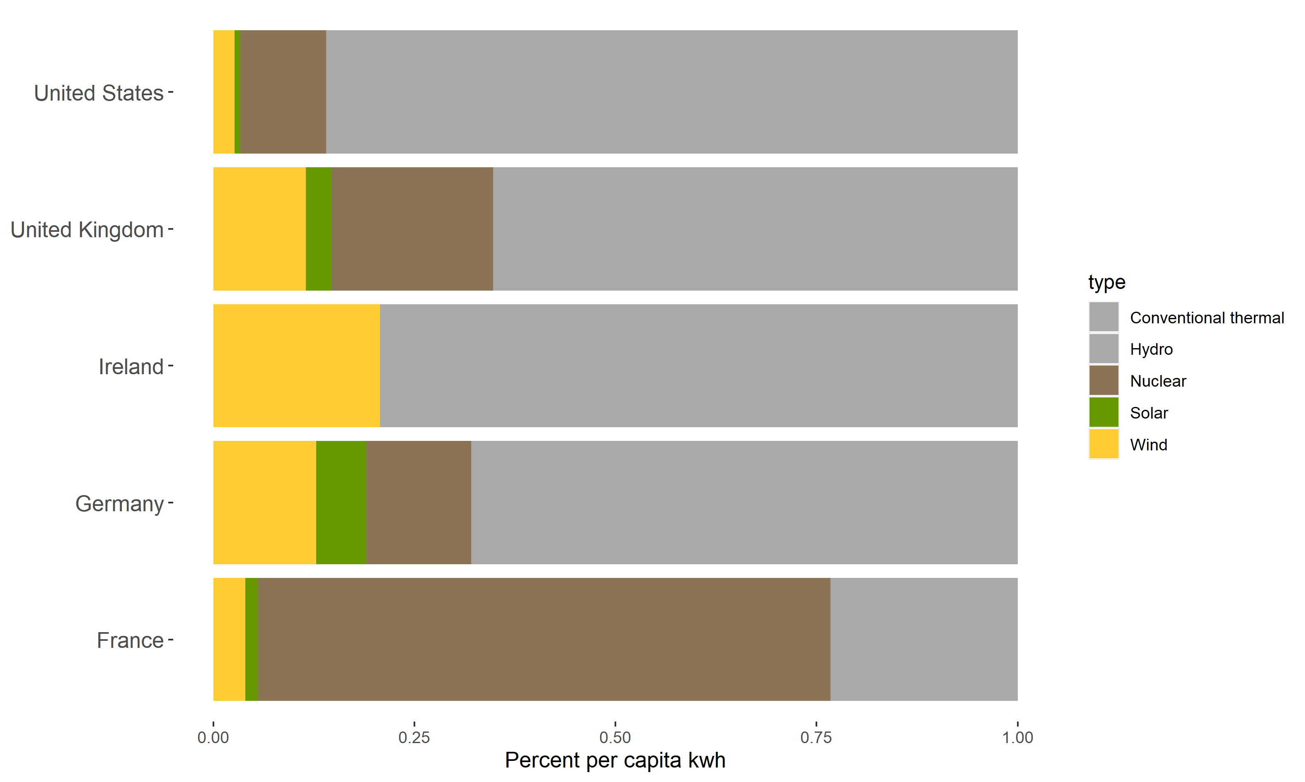
Opportunities for Investment
Nuclear is about 10.7% of the renewable energy generated in the US.
There are several renewable sources that could use additional investment to decrease the overall reliance of the US on conventional thermal energy sources.

Slide 9
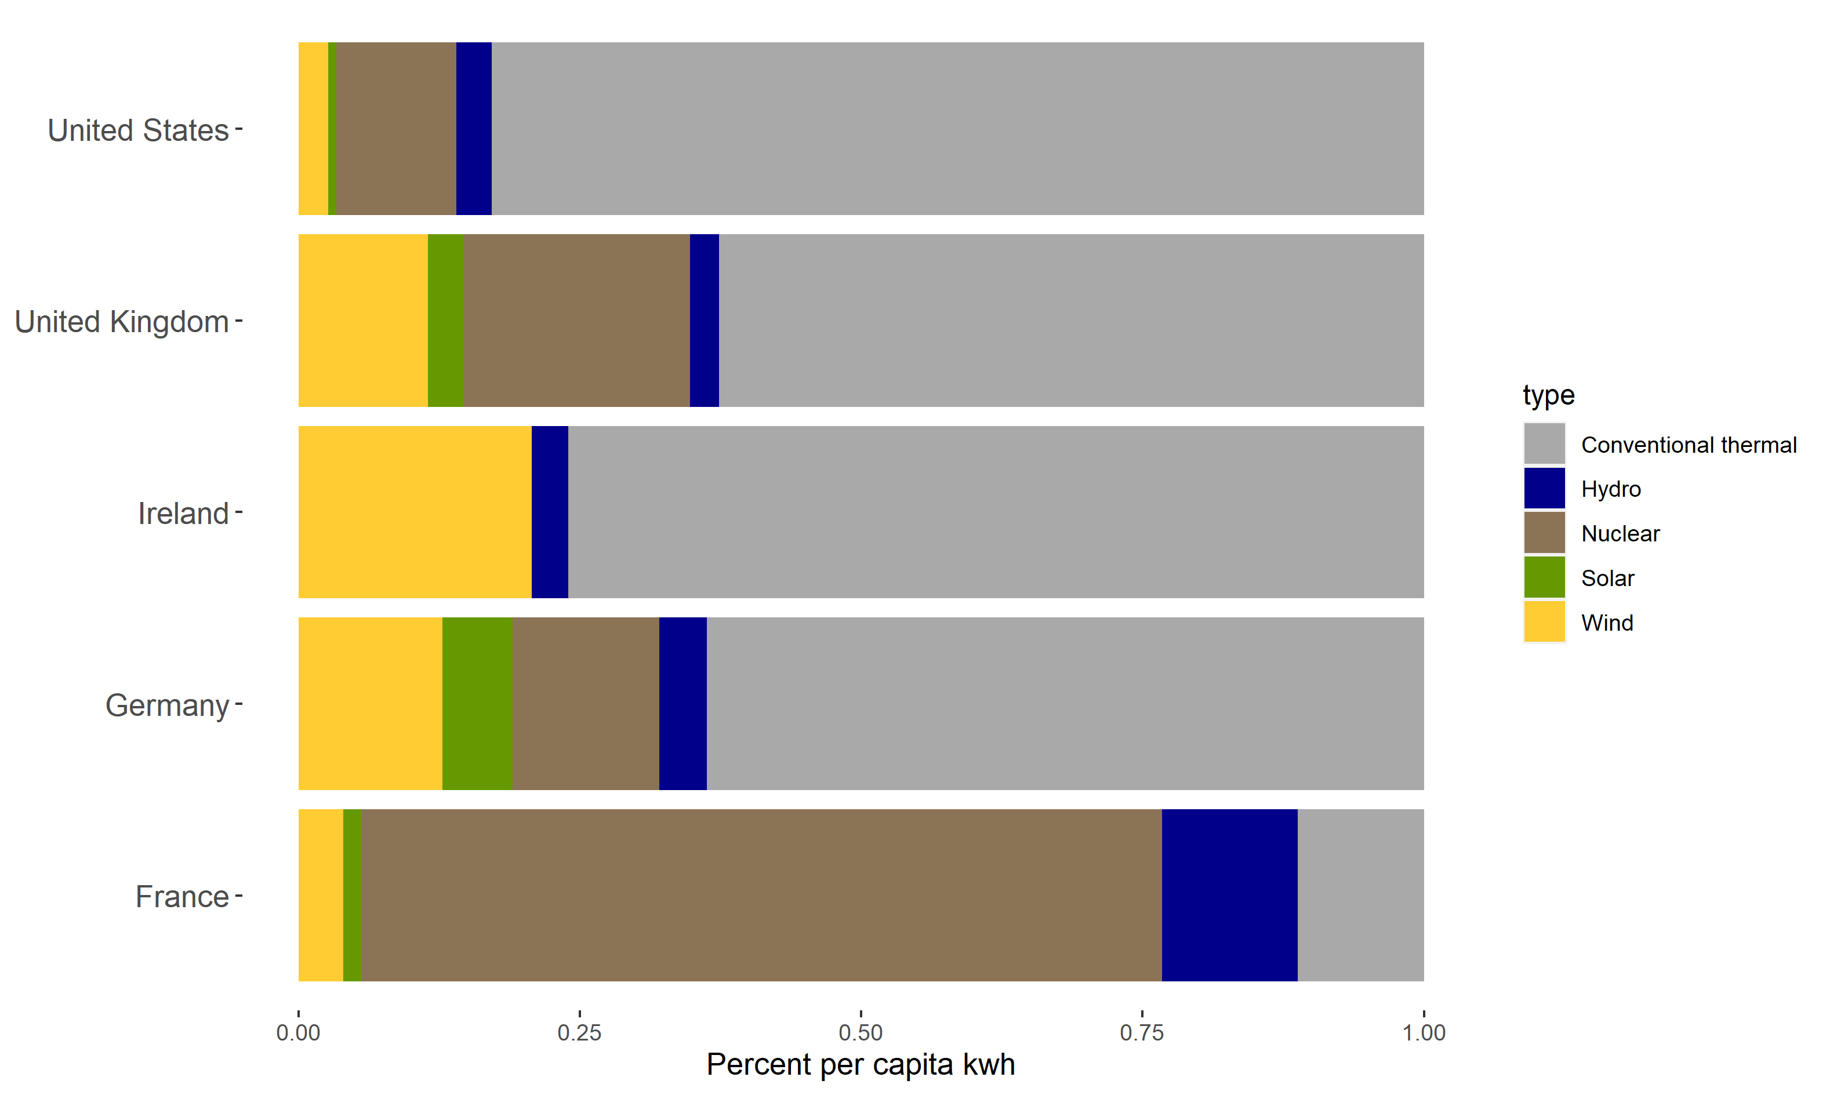
Opportunities for Investment
Hydro is only about 3.1% of the renewable energy generated in the US.
There are several renewable sources that could use additional investment to decrease the overall reliance of the US on conventional thermal energy sources.

Slide 10
Summary

Slide 11
Sources
[1] Council of European Energy Regulators. (2018). CEER Benchmarking Report 6.1 on the Continuity of Electricity and Gas Supply. Retrieved April 20, 2021 from: https://www.ceer.eu/documents/104400/-/-/963153e6-2f42-78eb-22a4-06f1552dd34c
US outage data: https://www.eia.gov/electricity/data/eia861/
US & EU energy generation (% renewable, % hydro, % thermal): https://data.worldbank.org/indicator/EG.ELC.RNWX.ZS?end=2015&start=2001
https://data.worldbank.org/indicator/EG.ELC.HYRO.ZS
US 2016 breakdown: https://www.eia.gov/totalenergy/data/annual/index.php
EU 2016 breakdown: https://ec.europa.eu/eurostat/statistics-explained/index.php/Electricity_generation_statistics_%E2%80%93_first_results
Greenhouse gas emissions: https://github.com/owid/co2-data
World population: World Development Indicators/World Bank

