Slide 1

Diversifying the energy grid
Megan Ball
DS6390

Slide 2
Overview
How does the US compare in greenhouse gas emissions?
What is the current percent of energy being generated by renewable sources in the US?
But won’t increasing renewable sources lead to less reliability on the grid?
Areas of opportunity

Slide 3
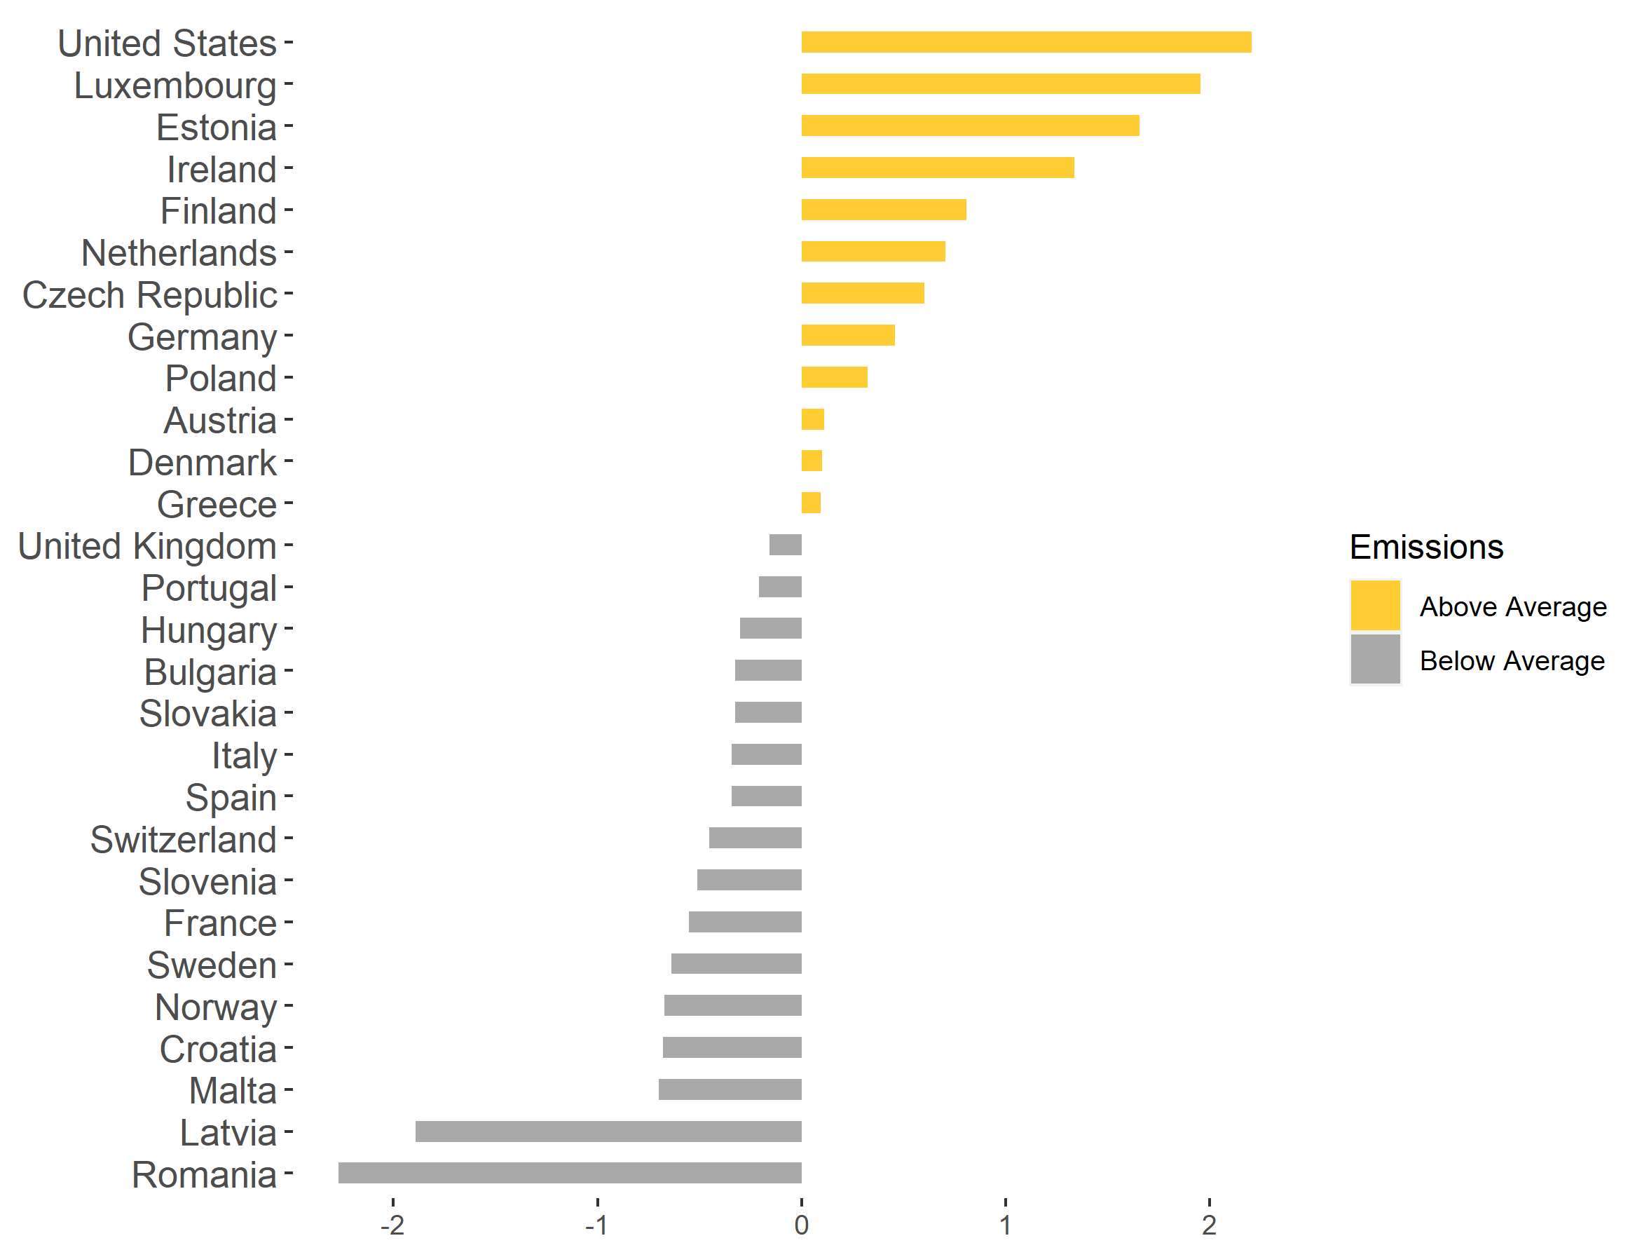
State of the Union’s Emissions
The US emitted 18 tons of CO₂ equivalents per capita in 2016
France emitted 5 tons of CO₂ equivalents per capita in 2016
Source: [8]
The US leads in greenhouse gas emissions at a per capita level compared to most of Europe. In 2016, the United States total greenhouse gas emissions were 2 times the average of the European countries listed above.

Slide 4
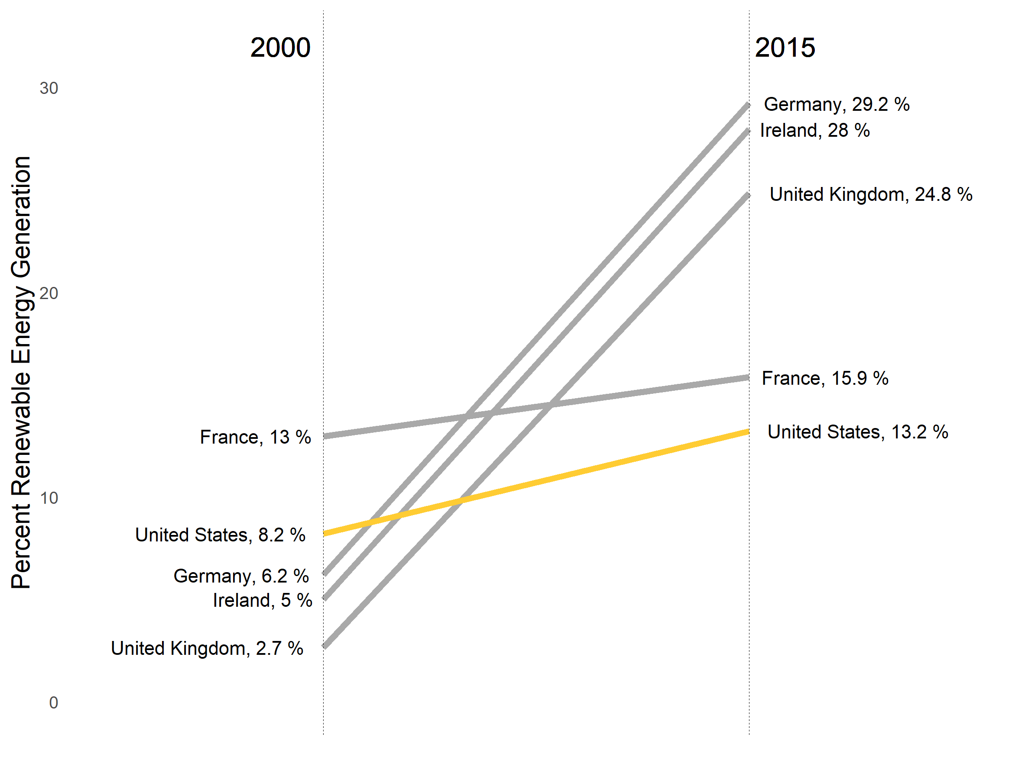
The US falls behind in renewable energy
Source [3] & [4]
From the years 2000 to 2015, the US increased the amount of energy it generates from renewable sources from 8.2% to only 13.2%. In contrast, Germany increased their renewable portion from 6.2% to 29.2% - an increase of almost 300%!

Slide 5
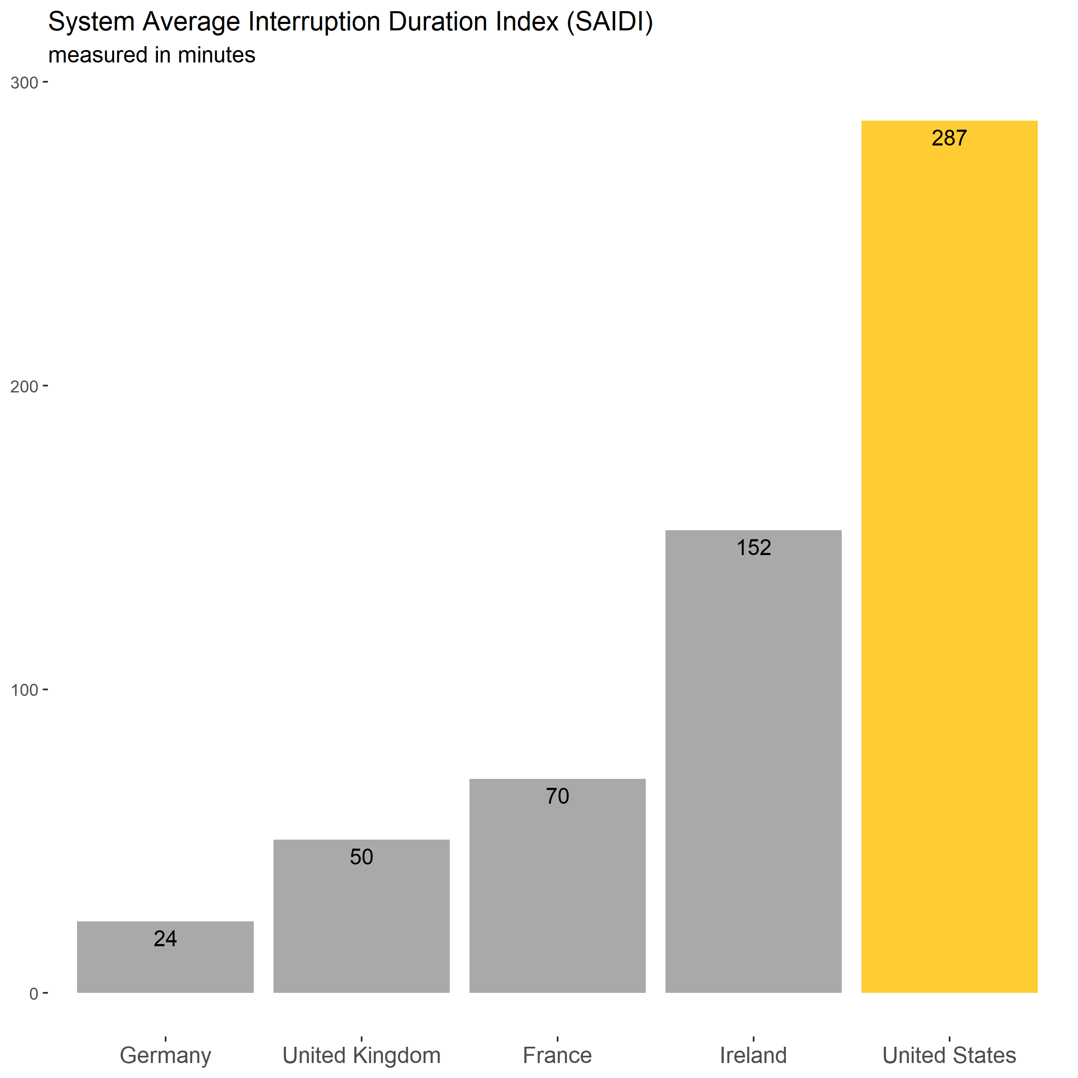
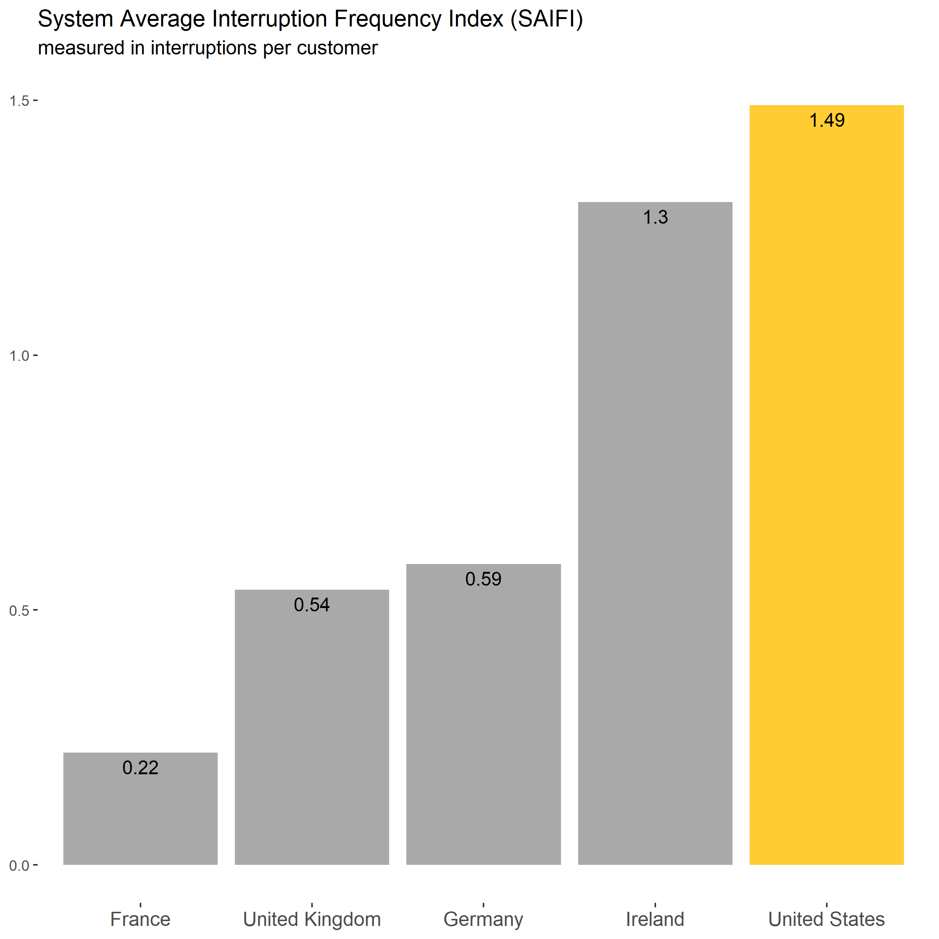
Yeah, but isn’t it less reliable?
Source [1] & [2]
Despite its higher percentage of conventional thermal energy sources, the US has the highest SAIDI and SAIFI

Slide 6
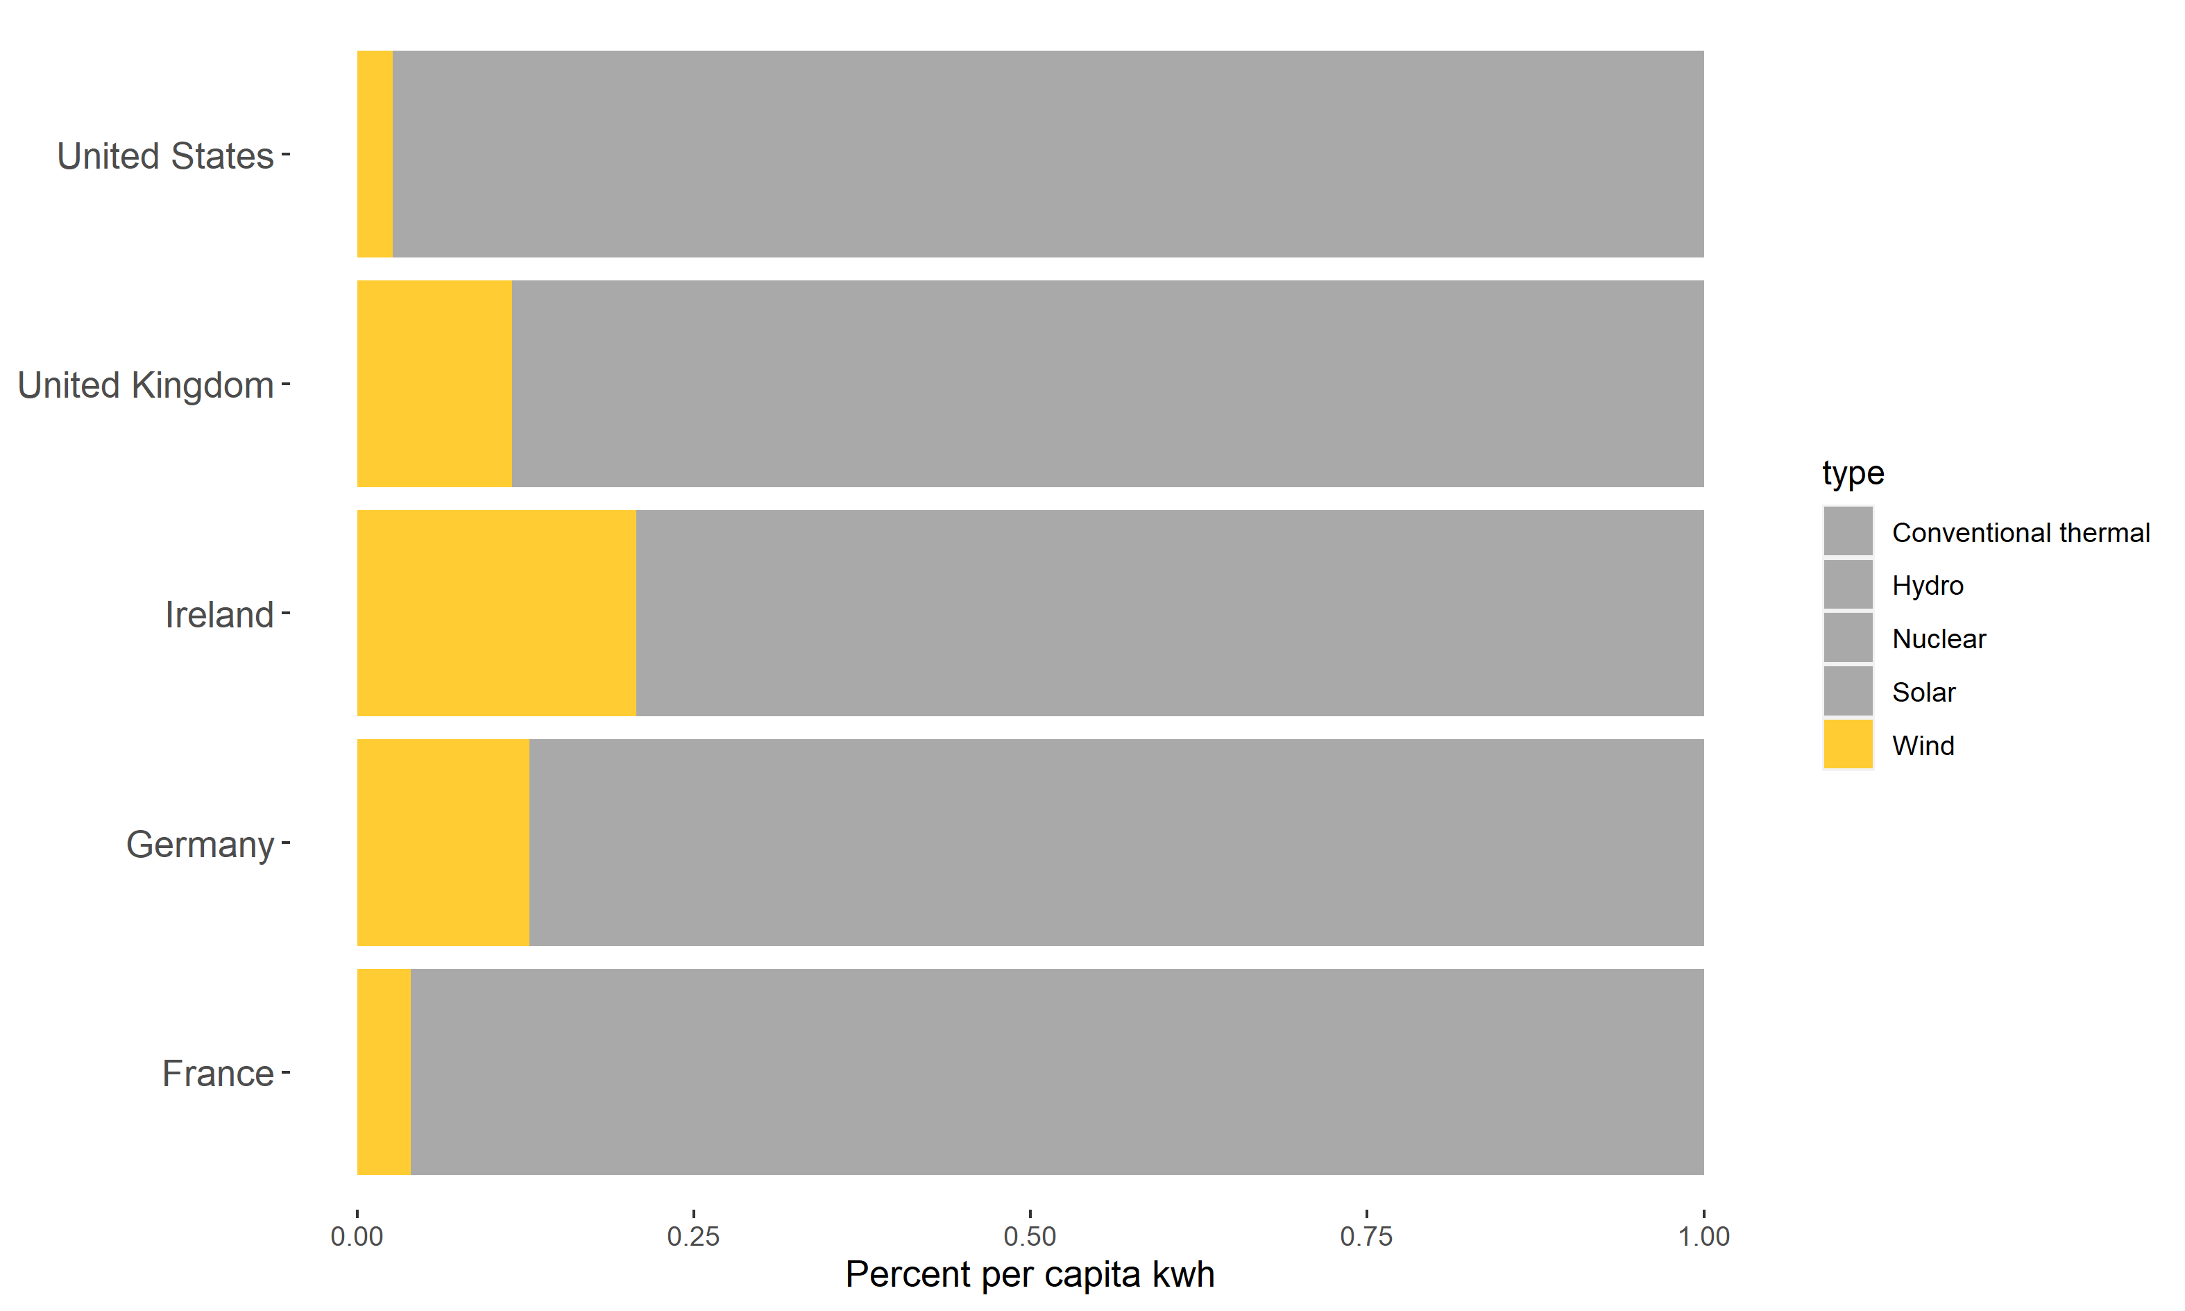
Opportunities for Investment
Wind is only about 2.6% of the renewable energy generated in the US.
Source [6] & [7]
There are several renewable sources that could use additional investment to decrease the overall reliance of the US on conventional thermal energy sources.

Slide 7
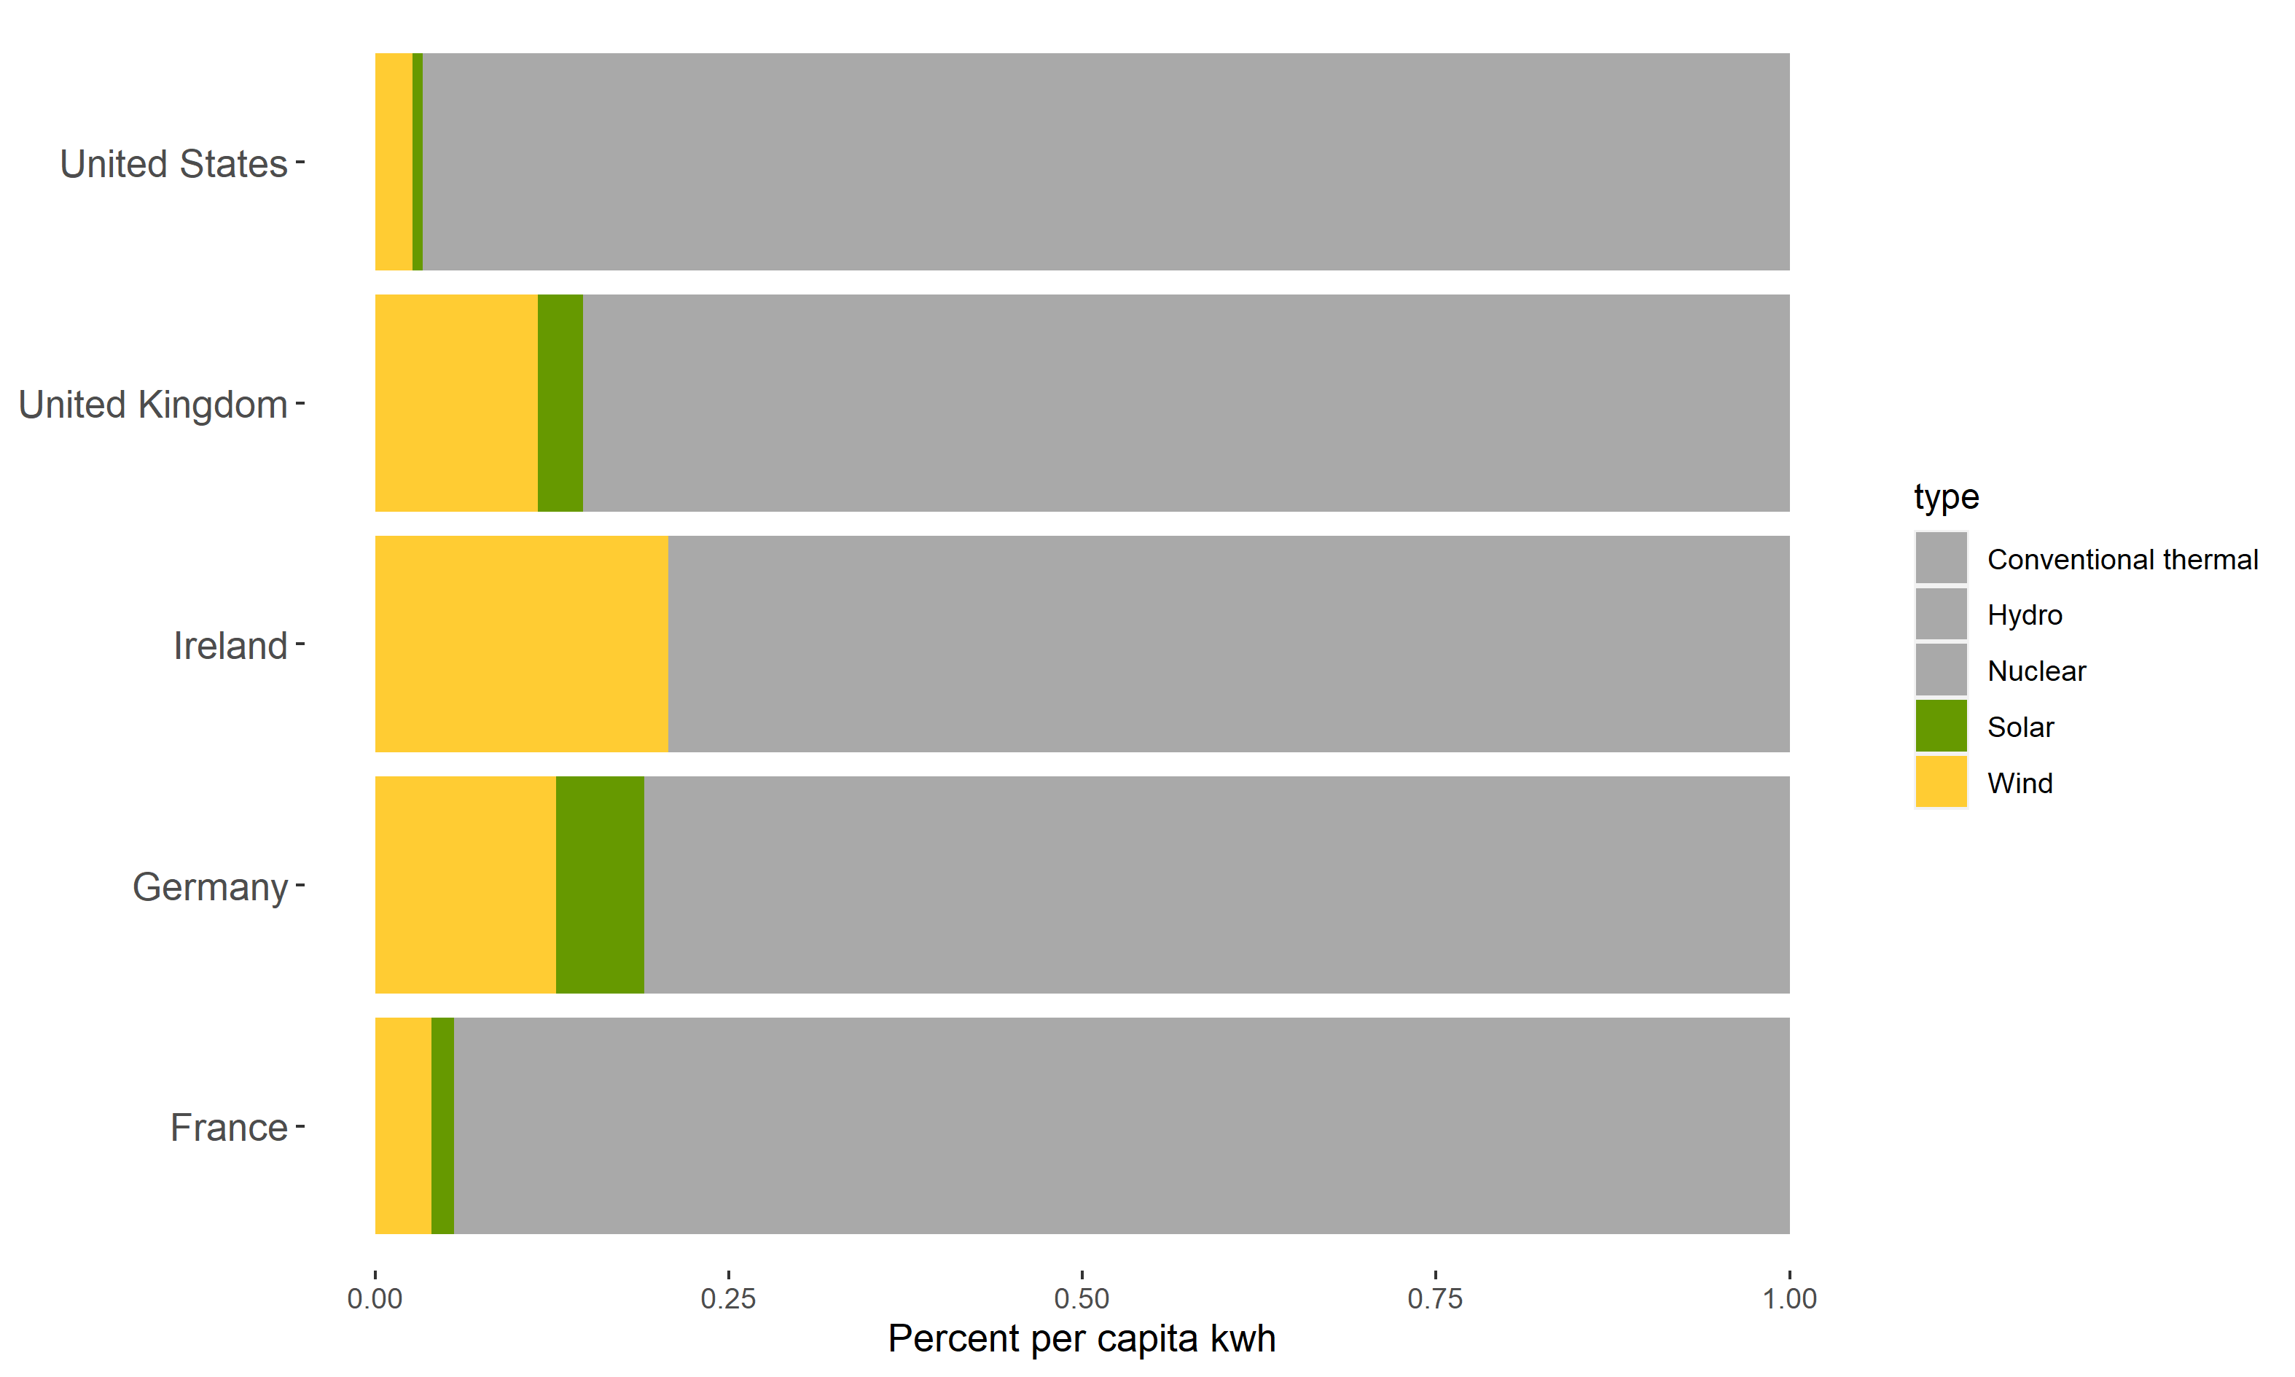
Opportunities for Investment
Solar is only about 0.7% of the renewable energy generated in the US.
Source [6] & [7]
There are several renewable sources that could use additional investment to decrease the overall reliance of the US on conventional thermal energy sources.

Slide 8
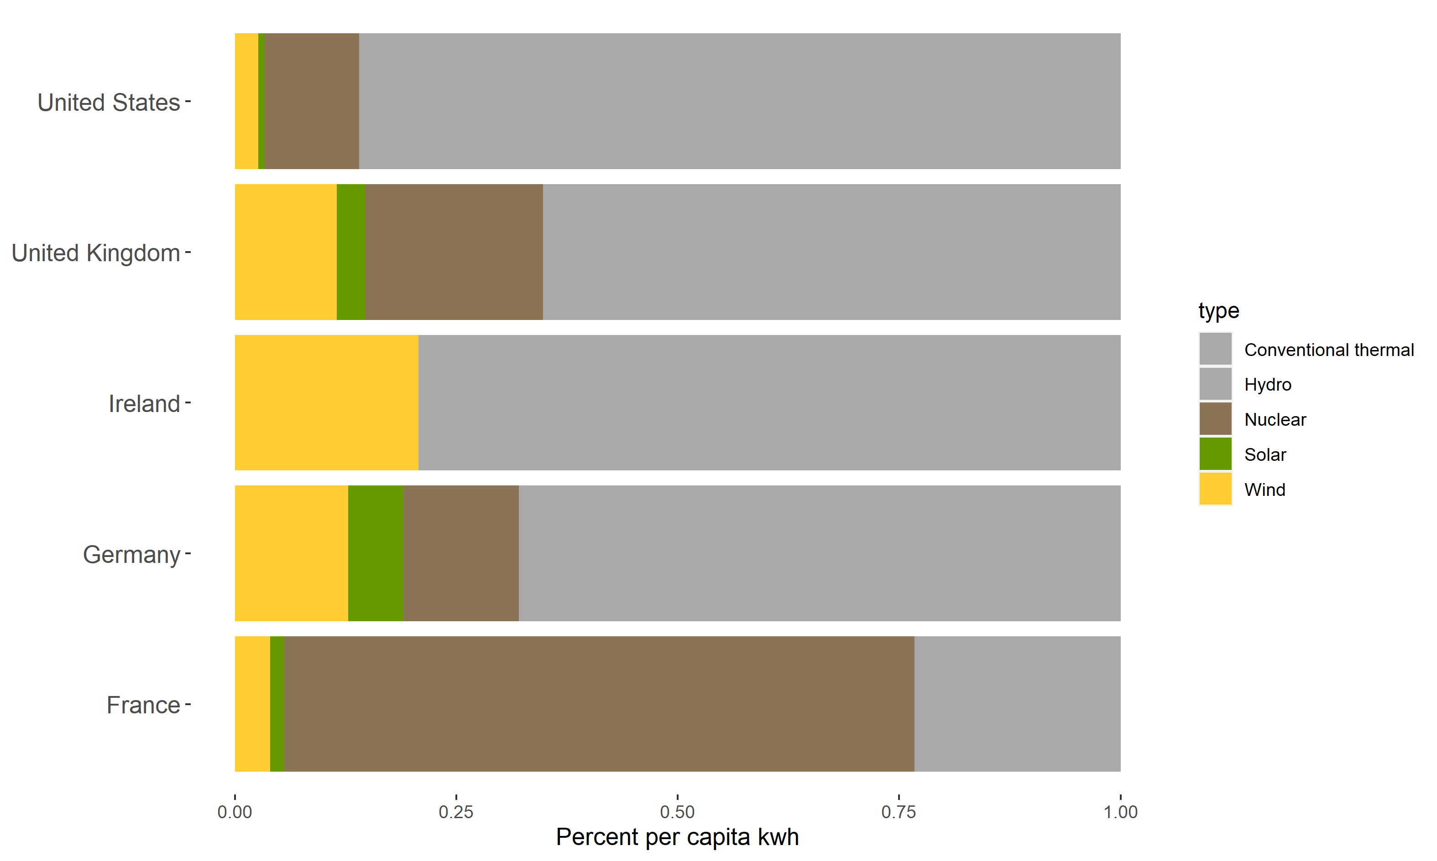
Opportunities for Investment
Nuclear is about 10.7% of the renewable energy generated in the US.
Source [6] & [7]
There are several renewable sources that could use additional investment to decrease the overall reliance of the US on conventional thermal energy sources.

Slide 9
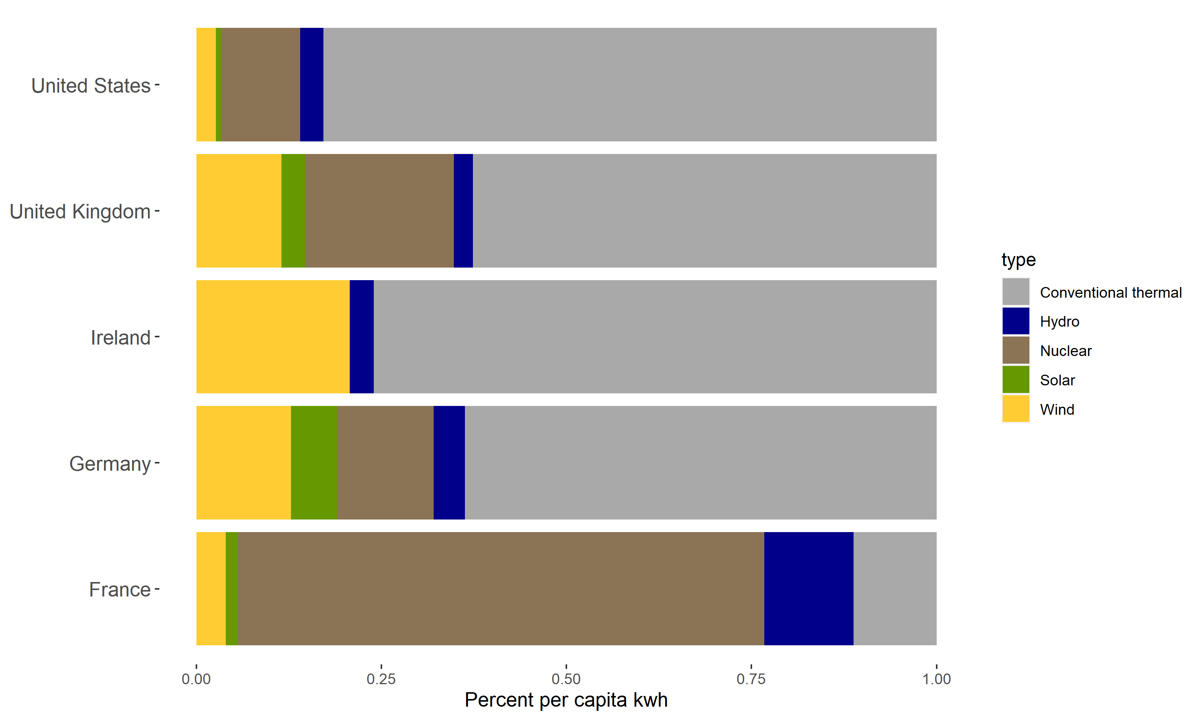
Opportunities for Investment
Hydro is only about 3.1% of the renewable energy generated in the US.
Source [6] & [7]
There are several renewable sources that could use additional investment to decrease the overall reliance of the US on conventional thermal energy sources.

Slide 10
Summary
The US has one of the highest per-capita CO2 equivalent greenhouse gas emissions, compared to most of Europe
The US also lags behind in renewable energy sources
Based on SAIDI and SAIFI data, there is no reason to believe increasing renewable sources will lead to decreased grid reliability
The US has opportunities to invest much more in solar and wind energy
We need more policies and incentives to increase the percent of energy generated by wind, hydropower, or solar within the United States.

Slide 11
Sources
[1] Council of European Energy Regulators. (2018). CEER Benchmarking Report 6.1 on the Continuity of Electricity and Gas Supply. Retrieved from
https://www.ceer.eu/documents/104400/-/-/963153e6-2f42-78eb-22a4-06f1552dd34c
[2] US Energy Information Administration. (2020). Annual Electric Power Industry Report, Form EIA-861
detailed data files. Retrieved from https://www.eia.gov/electricity/data/eia861/
[3] World Bank, World Development Indicators. (2015). Electricity production from renewable sources, excluding hydroelectric (% of total). [Data file]. Retrieved from https://data.worldbank.org/indicator/EG.ELC.RNWX.ZS?end=2015&start=2001
[4] World Bank, World Development Indicators. (2015). Electricity production from hydroelectric sources (% of total). [Data file]. Retrieved from https://data.worldbank.org/indicator/EG.ELC.HYRO.ZS
[5] World Bank, World Development Indicators. (2015). Electricity production from oil, gas, and coal sources (% of total). [Data file]. Retrieved from https://data.worldbank.org/indicator/EG.ELC.FOSL.ZS?end=2015&start=2001
[6] US Energy Information Administration. (2020). Primary energy production by source. [Data file]. Retrieved from https://www.eia.gov/totalenergy/data/annual/index.php
[7] Tidy Tuesday. (2020). 2020-08-04 [Data file]. Accessed from GitHub repository https://github.com/rfordatascience/tidytuesday/tree/master/data/2020/2020-08-04
[8] Mathieu, E., Ritchie, H. and Roser, M. (2021). co2-data. [Data file]. Accessed from GitHub repository https://github.com/owid/co2-data
World population: World Development Indicators/World Bank

