Slide 1

Diversifying the energy grid
Megan Ball
DS6390

Slide 2
Overview
What is the current percent of energy being generated by renewable sources in the US?
Why is it important to reduce conventional thermal energy sources?
A case study in European energy generation
The state of reliability of the grid

Slide 3
State of the Union’s Emissions

Slide 4
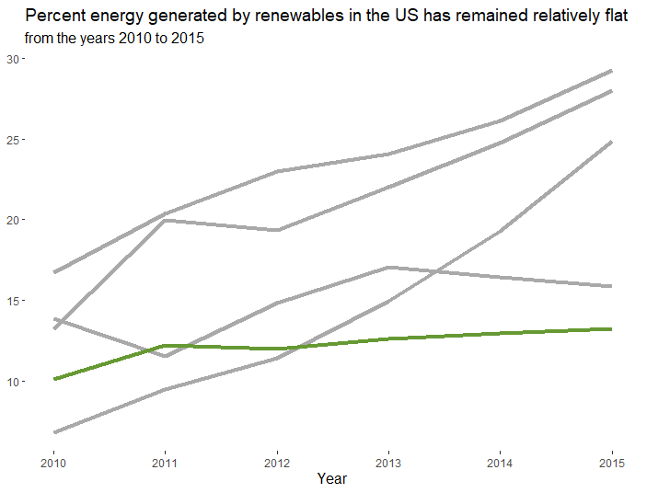
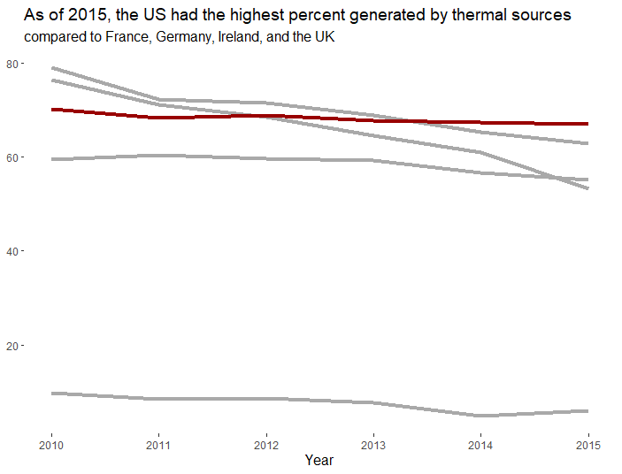
The US falls behind in renewable energy
Germany
Ireland
UK
France
US
Source:
Source:
There is significant opportunity for the US to increase renewable energy sources (hydroelectric, solar, wind, biomass, and geothermal) compared to the current conventional thermal sources.

Slide 5
Conventional thermal energy increases CO₂ emissions

Slide 6
EU energy mix vs. US

Slide 7
Yes but…reliability!

Slide 9
Sources
Europe outage data: https://www.ceer.eu/documents/104400/-/-/963153e6-2f42-78eb-22a4-06f1552dd34c
US outage data: https://www.eia.gov/electricity/data/eia861/
US & EU energy generation (% renewable, % hydro, % thermal): https://data.worldbank.org/indicator/EG.ELC.RNWX.ZS?end=2015&start=2001
https://data.worldbank.org/indicator/EG.ELC.HYRO.ZS
US 2016 breakdown: https://www.eia.gov/totalenergy/data/annual/index.php
EU 2016 breakdown: https://ec.europa.eu/eurostat/statistics-explained/index.php/Electricity_generation_statistics_%E2%80%93_first_results
Greenhouse gas emissions: https://github.com/owid/co2-data
World population: world development indicators/world bank

