Slide 1

Unsupervised learning
Megan Egbert
October 22, 2019

Slide 2
To supervise, Or not to supervise? That is the question
Supervised Learning (last month)
Training / Testing / Validation on labeled data sets & Predicting on unlabeled data sets
General goal: learning a mapping between input & output spaces
Unsupervised Learning
Operating on unlabeled data sets
General goal: discover properties of the data
Density Estimation
Clustering
Dimensionality Reduction, Representation & Feature extraction
Generation of new samples
Simeone, O. (2018). A very brief introduction to machine learning with applications to communication systems. IEEE Transactions on Cognitive Communications and Networking, 4(4), 648-664.

Slide 3
UNSupervised learning methodology
Less formally organized than supervised learning
Still follows 3 main steps
Select the model
Model defines the relationship between latent variables & observable variables
Directed / undirected generative models, discriminative models, autoencoders
Train the model – by learning from the data
Maximizing the log-likelihood of the data
Use the model – for prediction, sample generation, data reduction, etc.

Slide 4
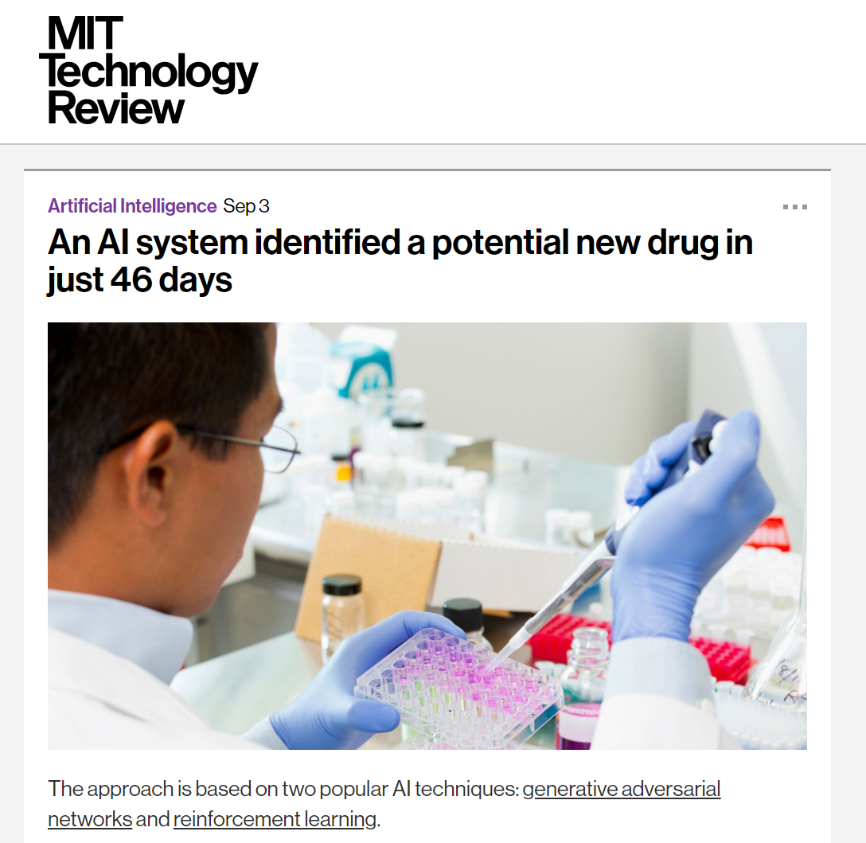
Generative models for drug discovery
Their AI model “created” a compound incredibly similar to the already FDA approved, Ponatinib… which was also in their training data…
BUT, they raised $30 million for a start up…

Slide 5
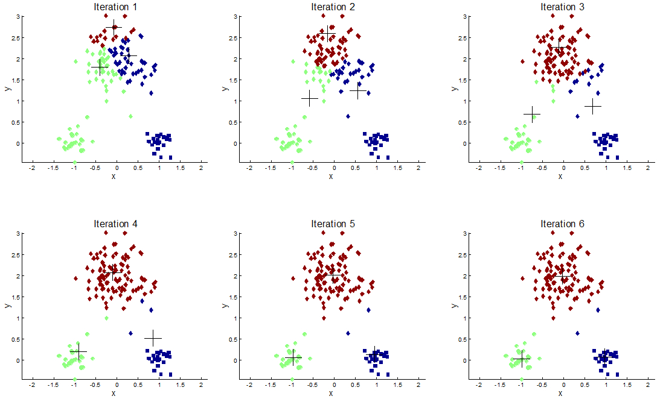
K – MEANS CluSTERING
Randomly select K cluster centers
Assign each point to a cluster, based on distant to cluster center
Recalculate the cluster center
Repeat 2-3 until cluster members do not change
Repeat clustering N times, and select most robust clustering result for output
http://jblomo.github.io/datamining290/slides/2013-03-07-Clustering.html

Slide 6
K-MEANS MINIBATCH CLUSTERING
Variant of K-MEANS that’s uses “mini-batches” to reduce the computation time
Mini-batches == subsets of the input data
Can produce results that are slightly worse than K-MEANS, but in practice this difference can be quite small

Slide 7
LINKS
SciKit Learn K-MEANS: https://scikit-learn.org/stable/modules/clustering.html#k-means
SciKit Learn K-MEAN-MINI-BATCH: https://scikit-learn.org/stable/modules/clustering.html#mini-batch-kmeans
GITHUB : https://github.com/megbert123/Machine-Learning-JC

Slide 8
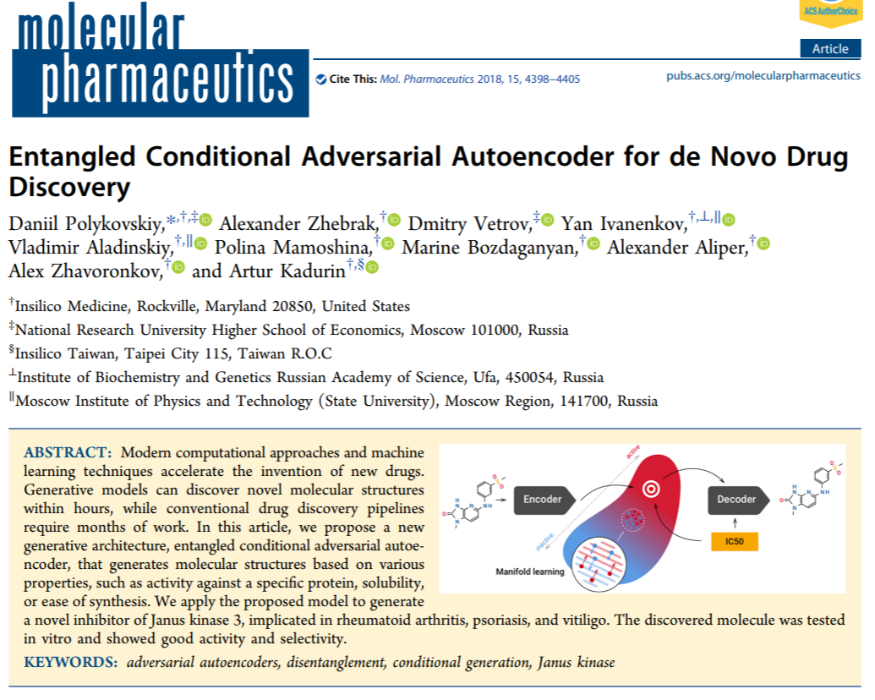
Autoencoders for drug discovery

