Slide 1
Brief introduction to machine learning: supervised learning
Biomolecular engineering research center
Israel desta
September 18, 2019

Slide 2
A li’l bit about the journal club
Supported by Biomolecular Research Center (www.bu.edu/bmerc/)
For students, by students (post-docs are also welcome though)
20-30 min presentation on main reference paper and Q&A
30-40 mins hands-on session
Free food!

Slide 3
Wrong Expectations from the journal club
Experts will teach me how to ‘do machine learning’
Going to learn by just listening to lectures and eating the food
It will be too hard to follow
ML will change my life and is the answer to all problems
With ML JC’s help, I can graduate next week

Slide 4
Right Expectations from the journal club
We are going to learn from each other
Practicing will help me learn better
I will get comfortable enough with ML to apply it on potentially important research problems that I face in my lab
I can present research challenges that might be solved via ML to bounce ideas

Slide 5
outline
What is Machine Learning?
Types of Machine Learning
When to use ML?
Supervised learning
Hands-on session

Slide 6
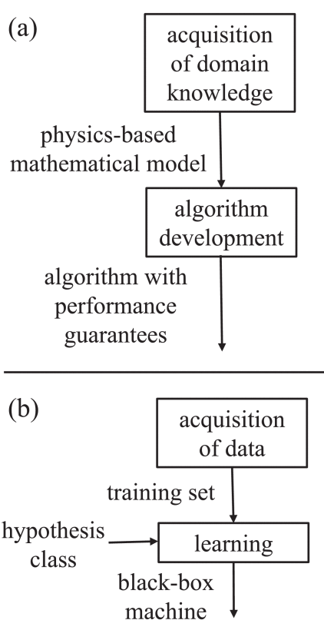
What is machine learning?
Tool that is able to understand the ‘behavior’ of a certain phenomenon through observation of ‘sufficient’ number of examples

Slide 7
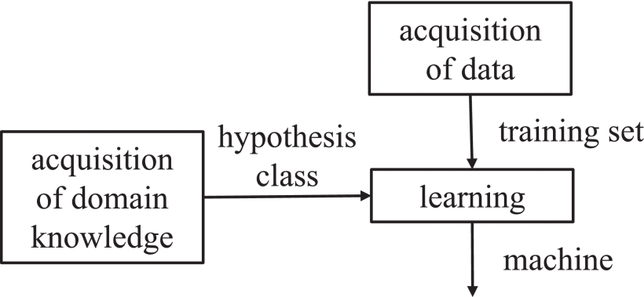
What is machine learning?
ML tools can also integrate domain knowledge
Example 1: translational invariance of visual features
Example 2: preference of low energy simulations for protein-protein interaction predictions

Slide 8
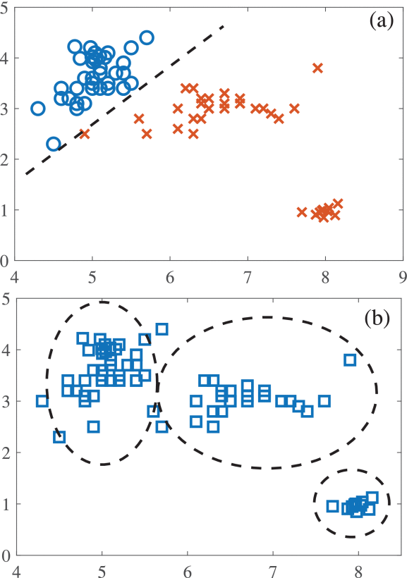
TYPES OF MACHINE LEARNING
Supervised learning: trained with pairs of input and true output (labeled inputs)
Relatively well-understood and is supported by well-developed algorithms
Eg. SVM, k-nearest neighbor, neural networks (deep learning), regression
Unsupervised learning: unlabeled inputs
Next week
Reinforcement learning: receives feedback after selection of output
Willing participant in the future? Maybe?

Slide 9
When to use machine learning?
Absence of model (due to insufficient domain knowledge) or lack of algorithms that capture the model
Large enough training data
Task doesn’t require logic/common sense/ explicit reasoning
Happy with black-box method
Phenomenon is stable/stationary for sufficient data collection
Loose requirement constraints/ good performance with numerical simulations

Slide 10
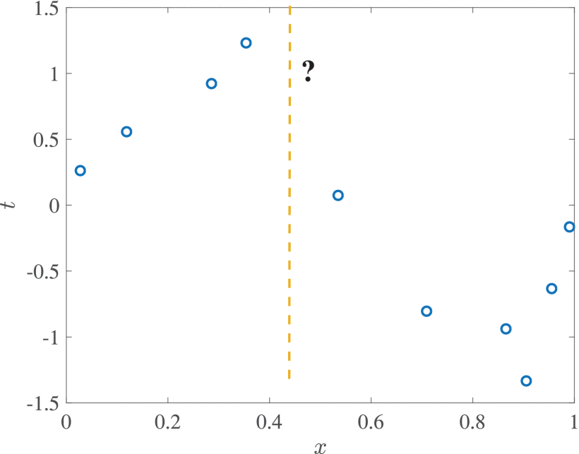
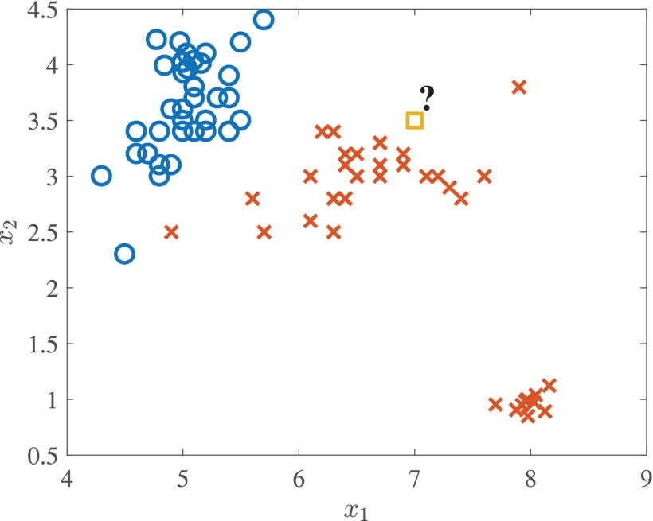
Supervised learning: intro
Tries to find a pattern based on given inputs and their respective true outputs
Two classes: Regression (continuous output), Classification (discreate output)
Notes:
This is why ML is not exactly memorizing. Learning is about generalization. Without making assumptions about the relationship between input and output, generalizing is impossible.

Slide 11
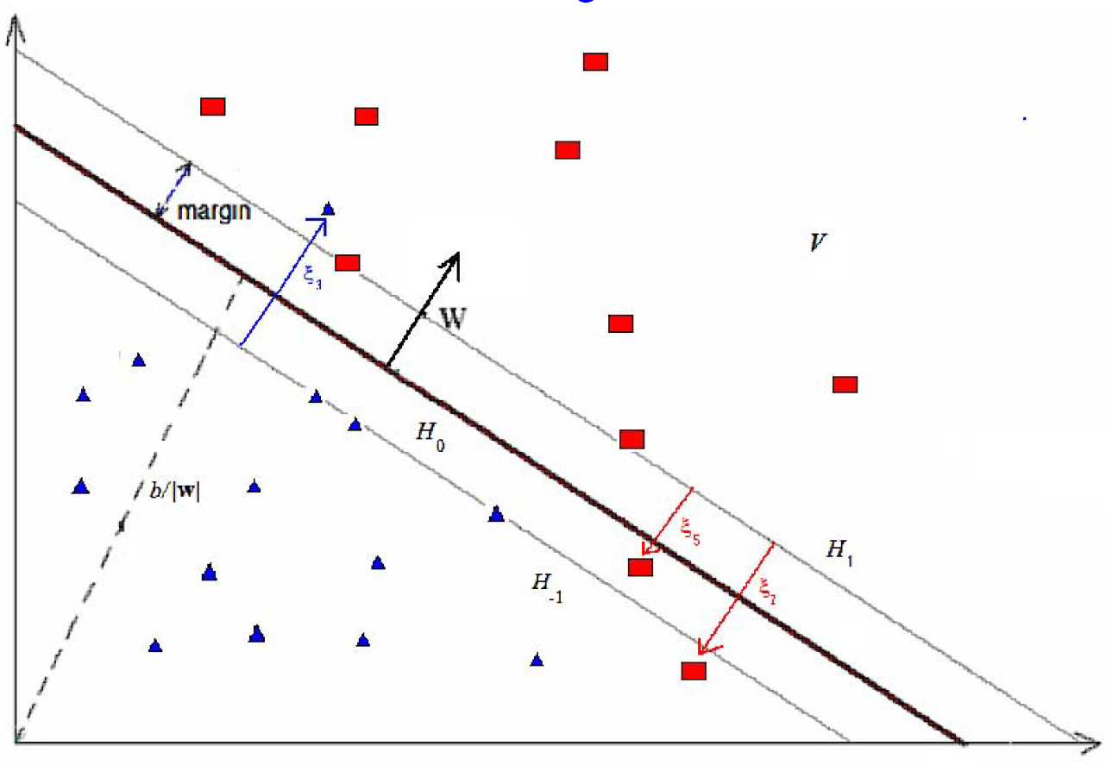

Generalization loss
$$E\left[\hat{t}\left(x\right)\right]= \int_{X×T}{l(}\hat{t}\left(x\right),t)ρ\left(x,t\right)dxdt$$
$$E\left[\hat{t}\left(x\right)\right]= \frac{1}{n}\sum_{i=1}^{n}{l(\hat{t}\left(x_{i}\right),t_{i})}$$
$$ξ_{n}=E_{\left(x,t\right)\sim p(x,t)}[l(t,\hat{t}(x))]$$
Mark Kon, BU GRS MA 770 lecture 10
Notes:
Gen loss is the difference between the expected and the empirical values of the target.

Slide 12

What do we optimize?
$$E\left[\hat{t}\left(x\right)\right]= \frac{1}{n}\sum_{i=1}^{n}{l(\hat{t}\left(x_{i}\right),t_{i})}$$
$$\hat{t}∗\left(x\right)=\underset{}{arg min}{\frac{1}{n}\sum_{i=1}^{n}{l\left(\hat{t}\left(x_{i}\right),t_{i}\right)}}+C{\left|w\right|}^{2}$$
Mark Kon, BU GRS MA 770 lecture 10
Notes:
lambda determines the trade-off between increasing the margin size and ensuring that the xi lie on the correct side of the margin
W is the normal vector to the hyperplane

Slide 13
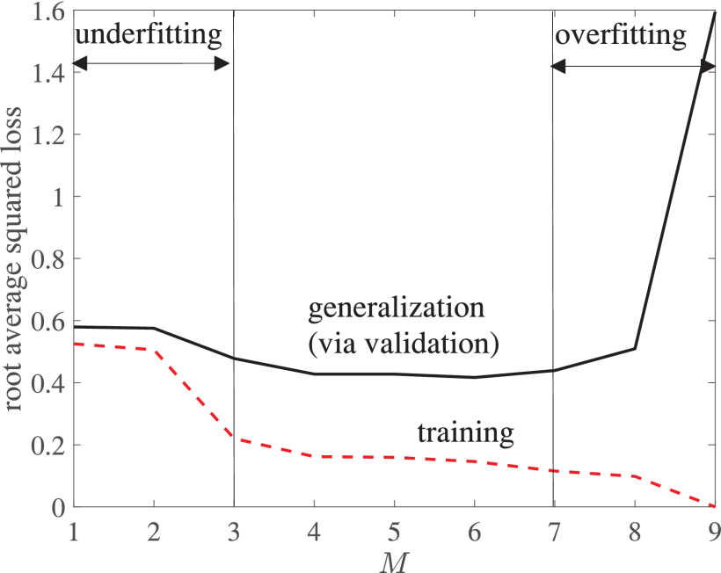

Learning
Goal is to maximize $\max_{}{\sum_{n=1}^{N}{\ln{p(t_{n}|x_{n},θ)}}}$
after each iteration
$$θ^{new}\overset{←}{} θ^{old}+γ∇_{θ}\ln{p(t_{n}|x_{n},θ)|_{θ=θ^{old}}}$$
Risk of under/overfitting depends on the penalty determined by the margin vector w
Notes:
At each iteration a mini-batch is taken for training and the parameter vector is updated in the direction of log-likelihood functions

Slide 14
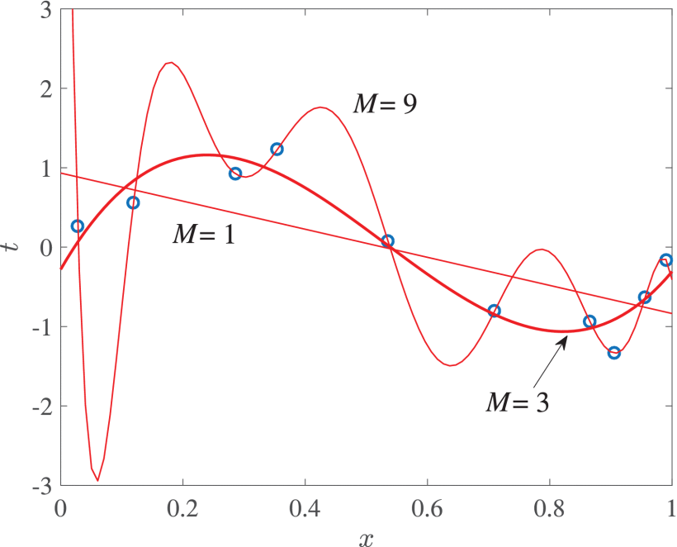

Model selection
Involves choosing number of layers in a multi-layered neural network, types of kernels (linear, polynomial, etc), and model order
$\sum_{m=0}^{M}{w_{m}x^{m}+ ℵ(0,1)}$
The vector $w= {[w_{0}, …,w_{M−1}]}^{T}$ is learned from data

Slide 15
Questions before hands-on session?

Slide 16
Hands-on session
Github.com/megbert123/Machine-Learning-JC

Slide 17
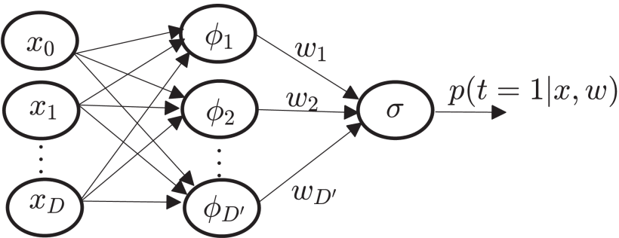

Mathematical background of supervised learning
𝓓 →$\left(x_{n},t_{n}\right) \sim p\left(x,t\right), n=1, …, N$
For test pair $(x,t)$ and prediction $\hat{t}(x)$ loss function → $l(t,\hat{t}(x))$
Generalization loss → $L_{p}\left(\hat{t}\right)= E_{\left(x,t\right)\sim p(x,t)}[l(t,\hat{t}(x))]$
Notes:
So, how exactly does ML generalize?
D – training set
Xn – inputs (covariates, domain points, explanatory variables)
tn – outputs (dependent variables, lables, responses)
Input, label pairings in D are independent identically distributed.

