Slide 1




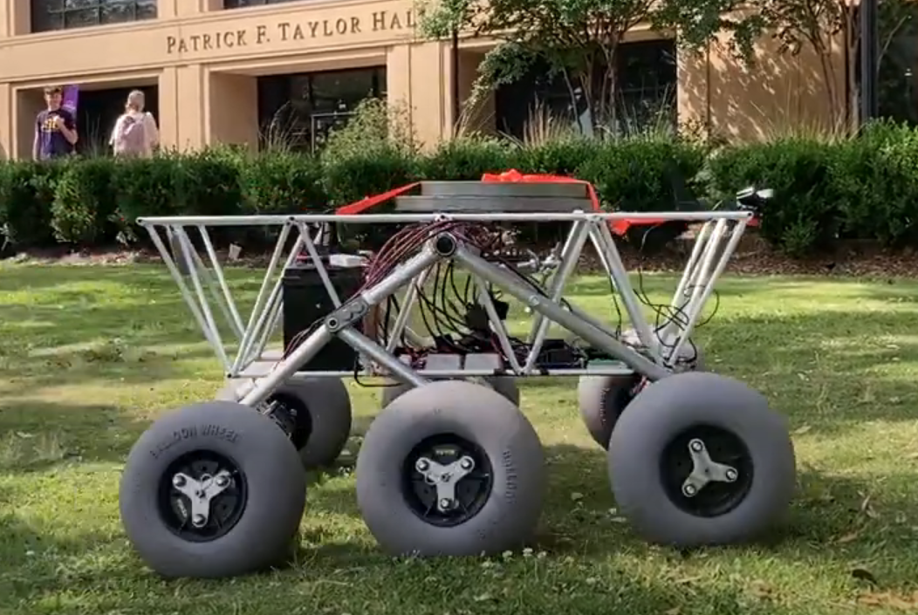
Solar-Powered Rover
Prepared by: William Mancuso
Presented by: William Mancuso
By Team 66:
William Mancuso (EE), Bowen Williamson (EE), Margaret Burkes (EE), Keldon Ngo (EE), Kenny Bui (EE)
Project Sponsor: Dr. Xiangyu Meng
Faculty Advisor: Dr. Shahab Mehraeen
2/13/2025
#1

Slide 2
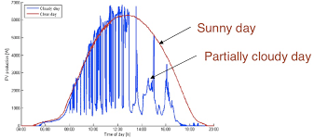
Functional Requirement #1: Convert Solar Energy to Power the Rover
Prepared by: Keldon Ngo
Presented by: Keldon Ngo
Test #1: Ideal Condition Power Production
Conducted by: Margaret Burkes & Keldon Ngo
Test the power production of the panel throughout a sunny day
Test #2 : Non-Ideal Condition Power Production
Conducted by: Keldon Ngo
Test the power production throughout a cloudy day
Test #3 : Indoor Power Production
Conducted by: Keldon Ngo
Test the power production indoors.
2/13/2025
#2

Slide 3
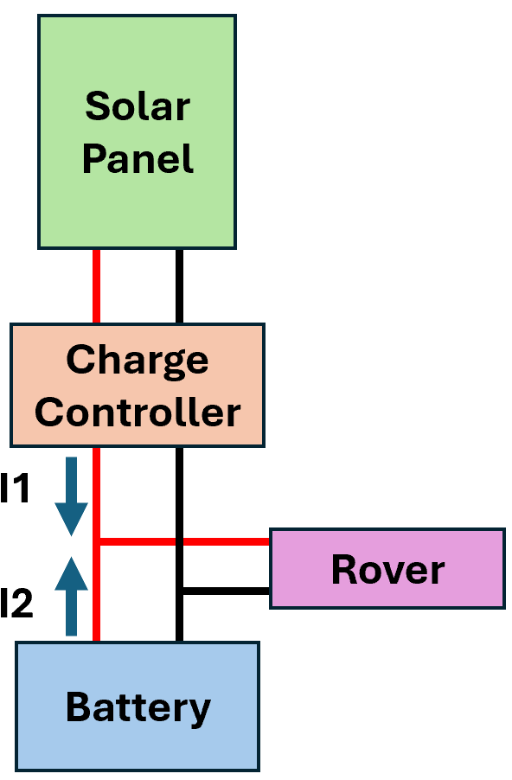
Functional Requirement #2: Autonomously Switch Power Between Power Sources
Prepared by: Bowen Williamson
Presented by: Bowen Williamson
Test #1: Battery charging from solar power
- Conducted by: Bowen Williamson
- Ensure battery charging while rover is stationary
Test #2: Monitor battery operation with solar power
- Conducted by: Bowen Williamson
- Time battery life during normal operation
- Compare current from charge controller vs. battery
2/13/2025
#3

Slide 4
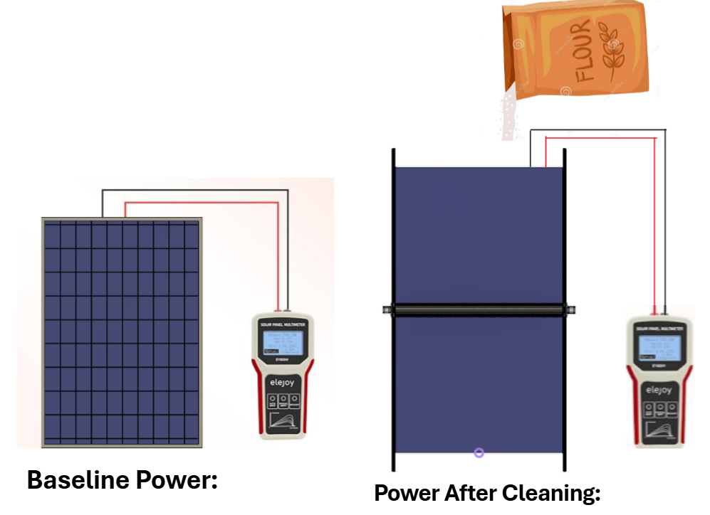
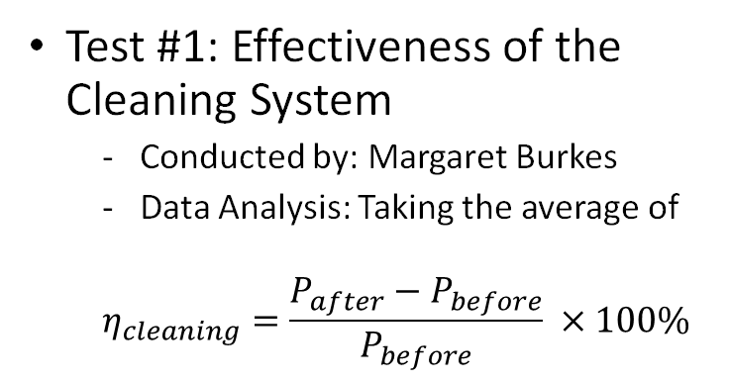
Functional Requirement #3: Clean the Solar Panel
Prepared by: Margaret Burkes
Presented by: Margaret Burkes
Test #1: Effectiveness of the Cleaning System
Conducted by: Margaret Burkes
Data Analysis: Taking the average of
$$η_{cleaning}=\frac{P_{after}−P_{before}}{P_{before}} ×100\%$$
2/13/2025
#4

Slide 5


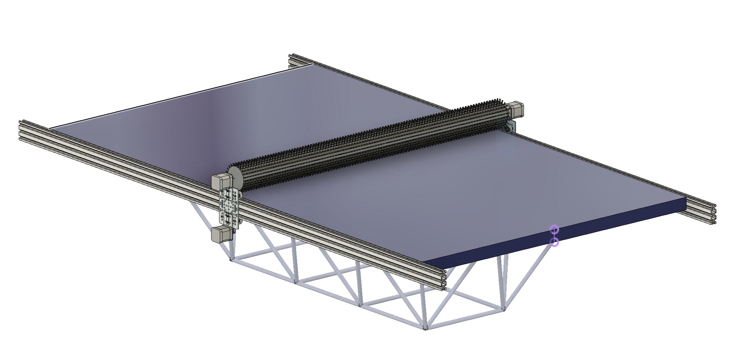

Functional Requirement #3: Clean the Solar Panel
Prepared by: Kenny Bui
Presented by: Kenny Bui
Test #2: Activation Of Brush Cleaning System
Conducted by Kenny Bui
Microcontroller acknowledges dust and debris, and different environmental aspects
A pyranometer output and solar panel output power will be compared for decision
Instrumentation: Recording device to visualize activation take place
Protocol: Flour will be used to represent dust/debris, and different environmental scenarios can be provided to simulate false-positive triggers
2/13/2025
#5

Slide 6
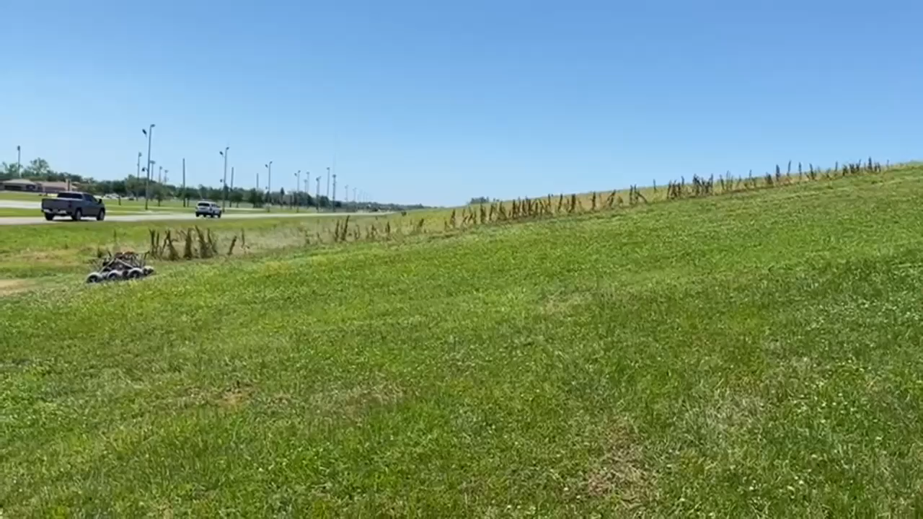

Qualitative Specification #1: Compatibility with Existing Design
Prepared by: Margaret Burkes
Presented by: Margaret Burkes
Terrain Test
Conducted by: Margaret Burkes
$Speed={Distance}/{Time}$
Previous Team’s Results with 36kg of additional weight:
Terrain: | Speed:
Sand | 0.5 m/s
Grass | 0.5 m/s
Concrete | 0.62 m/s
Levee | 0.33 m/s
2/13/2025
#6

Slide 7
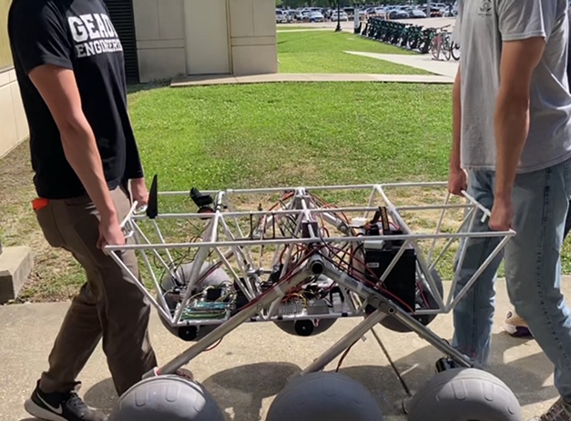
Qualitative Specification #3: Portability
Prepared by: William Mancuso
Presented by: William Mancuso
Assembly Test
-Conducted by: William Mancuso
-Measure assembly and disassembly time
-Test equipment: Drill or Screwdriver
-Measure and compare final dimensions
2/13/2025
#7

Slide 8

Environmental Impact Assessment
Prepared by: Bowen Williamson
Presented by: Bowen Williamson
• Decrease in power required from the grid
• Recyclable components
• Emission-free operation
Testing with biodegradable materials (flour)
Dry cleaning; no harmful chemicals
2/13/2025
#8

Slide 9
Safety Assessment
Prepared by: Kenny Bui
Presented by: Kenny Bui
Concern | Safety Preventative
Electrical Shock Hazard | All electrical connections on our rover are properly grounded to prevent shock hazard.
Arc Flash Hazard | All electrical connections are covered and have appropriate safety measures in place to avoid short circuiting. This will mitigate arc flashes.
Overcurrent | All major electrical components have incorporated fused connections that are sized properly and are expected to pop in the case of overcurrent.
Moving object hazard with motors on cleaning system | There is a cancel button designed in the brush cleaning system that is designed to cancel all operation of the cleaning system in case it is needed.
Unexpected cleaning system activation | There is also a buzzer designed to trigger before the cleaning system is activated to alert all nearby prior to the cleaning system activating.
Kill Switch | There are two switches attached to the battery that can be quickly disengaged to de-energize the entire rover in the case that it is needed
2/13/2025
#9

Slide 10
Appendix
Measurable Specification #1: Budget
Measurable Specification #2: Interior Space
Measurable Specification #3: Weight Limit
Qualitative Specification #2: Weatherproof Design
2/13/2025
#10

Slide 11
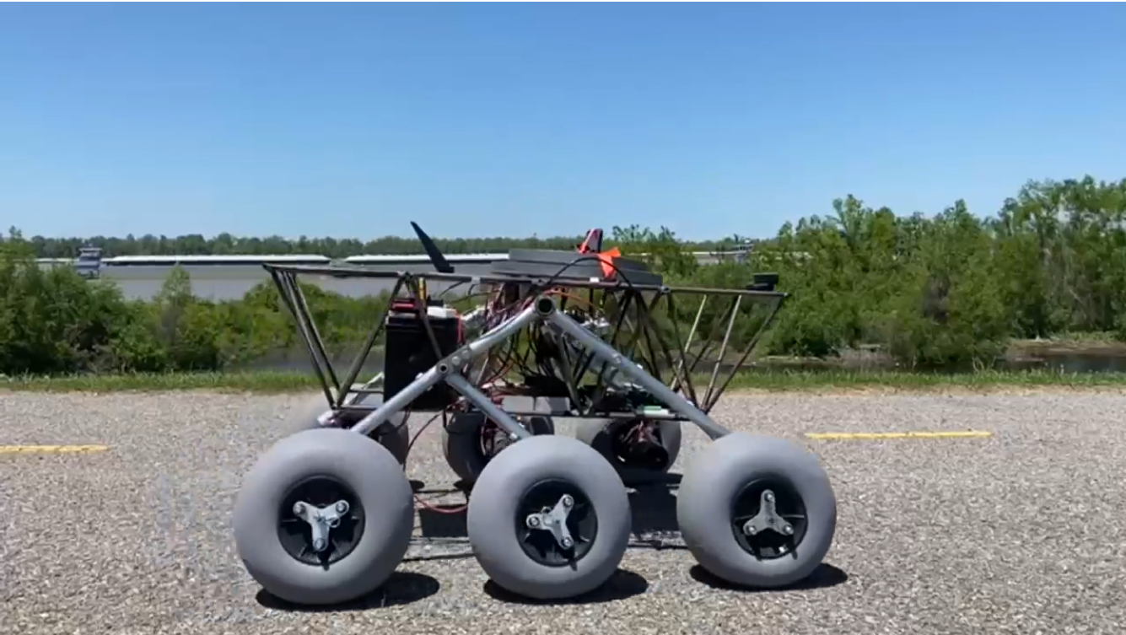
Measurable Specification #3: Weight Limit
Prepared by: William Mancuso
Presented by: William Mancuso
Max Speed Test
Conducted by: William Mancuso
Measure the speed of the fully assembled rover
Test equipment stop-watch, tape measure, camera
Compare speeds
2/13/2025
#11

Slide 12
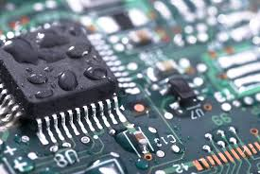
Qualitative Specification #2: Weatherproof Design
Prepared by: Keldon Ngo
Presented by: Keldon Ngo
Ducky Assumption
The assumption made by the team will be that the Ducky Products spray is reputable
The treated electronics will be water-proof
2/13/2025
#12

Slide 13
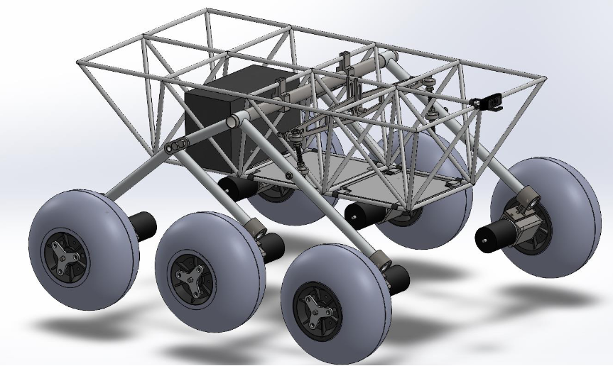
Measurable Specification #2: Interior Space
Prepared by: Kenny Bui
Presented by: Kenny Bui
Test: Chassis Measurement
Conducted by Kenny Bui
Measure overall interior space of the chassis
Measure and analyze volumes of components within the chassis
Calculate the occupied space within the chassis
Instrumentation: Tape Measure and Spec Sheets
Overall Interior Space – Occupied Interior Space = Remaining Interior Space
2/13/2025
#13

Slide 14
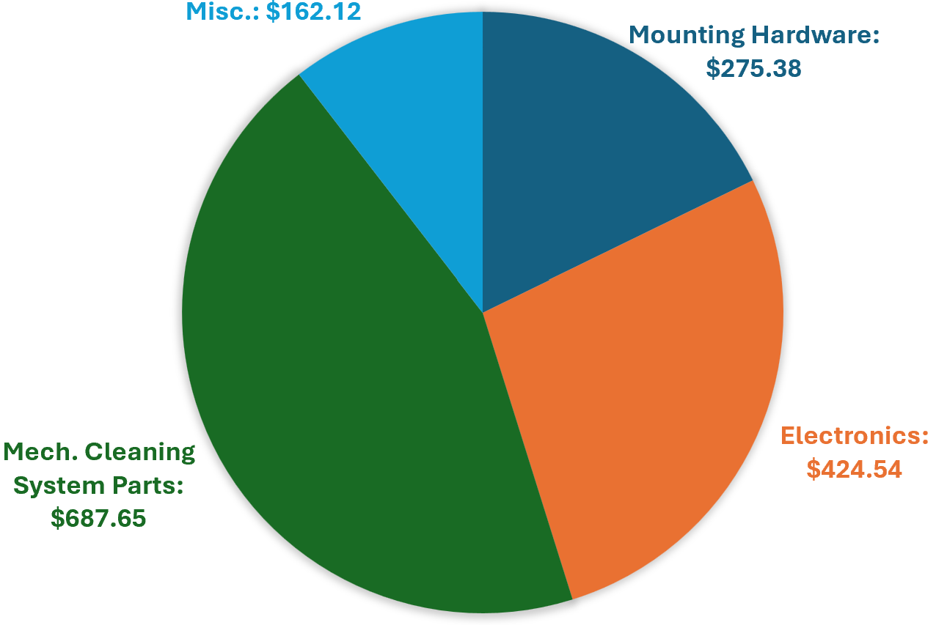
Measurable Specification #1: Budget
Prepared by: Bowen Williamson
Presented by: Bowen Williamson
Project Funding: $4,000
Total Spent: $1,549.69
Remaining: $2,450.31
1/21/2025
#14

