Slide 1




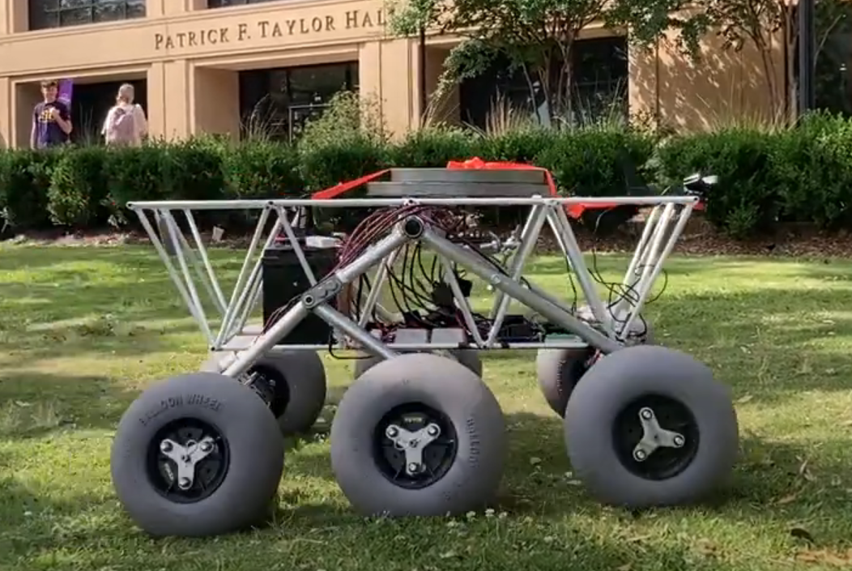
Prepared by: William Mancuso
Presented by: William Mancuso
Solar-Powered Rover
By Team 66:
William Mancuso (EE), Bowen Williamson (EE), Margaret Burkes (EE), Keldon Ngo (EE), Kenny Bui (EE)
Project Sponsor: Dr. Xiangyu Meng
Faculty Advisor: Dr. Shahab Mehraeen
3/12/2025
#1

Slide 2
Prepared by: William Mancuso
Presented by: William Mancuso
Problems:
Kenny, please describe the issue you are having with the activation
The pyranometer/camera mount was mis-sized after 3D printing.
Bowen, Will, and Keldon, please mention any other issues you have run into
3/12/2025
#1

Slide 3
Prepared by: William Mancuso
Presented by: William Mancuso
Problem #1: Pyranometer/Camera Mount
Issues:
The pyranometer slot is not wide enough
The pyranometer screw hole is too small
Gathering data:
Remeasuring the screw with a caliper
Checking the Fusion360 model for how the extrusion for the slot was made
Possible Causes:
I based my measurement on what the manufacturer had said online
I extruded the slot in the wrong direction
3/12/2025
#1

Slide 4
Prepared by: William Mancuso
Presented by: William Mancuso
Problem #2: Motor Controller Activation
Issues:
The motor controller takes time to turn on
Gathering data:
The electronics must be turned on before the entire rover receives power, based on the instructions
More specifically, the Arduino needs to power on before turning on the power to the motors.
Possible Causes:
The Arduino controlling it needs time to start up and get the code running.
The instructions need to be more clear, with warnings and explanations of why the steps are what they are, and specific details of what each step is requiring and doing.
3/12/2025
#1

Slide 5
Prepared by: William Mancuso
Presented by: William Mancuso
Root Cause Analysis
3/12/2025
#1

Slide 6
Criteria
This is an informal presentation where groups present the most critical RCA for their product.
Each team will submit a one slide pdf of either a Fault Tree Analysis or a FMEA.
The pdf is due by 1200 on TBA. The file will be submitted directly to TBA.
The file with the slide must be a pdf and named “ProjectX_RCS.pdf” filling in the appropriate group number. For example, for the submission of group 20 the name of the file should be “Project20_RCS.pdf”.

