Slide 1


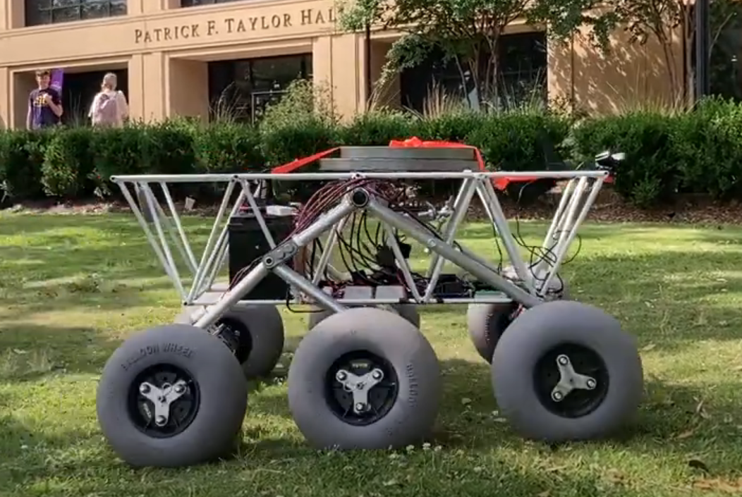
Solar-Powered Rover
By Team 66:
William Mancuso (EE), Bowen Williamson (EE), Margaret Burkes (EE), Keldon Ngo (EE), Kenny Bui (EE)
Project Sponsor: Dr. Xiangyu Meng
Faculty Advisor: Shahab Mehraeen
10/2/2024
#1

Slide 2
Objective Statement
The main objective of this project is enhancing the previously built rover, which is battery powered, by integrating solar power, autonomous power switching between solar and battery power, and an independent cleaning system for the solar panel.
10/2/2024
#2

Slide 3
Functional Requirements
# | Weight | Function | Explanation
F1 | 0.4 | Convert solar energy to power the rover. | Utilize solar panels to absorb sunlight as an additional power source to the battery power.
F2 | 0.35 | Autonomously switch power between power sources. | Autonomously switch between battery and solar power.
F3 | 0.25 | Clean the solar panels. | Intermittently clean off debris from solar panel to maximize energy absorption and efficiency.
10/2/2024
#3

Slide 4
Qualitative Constraints
# | Weight | Qualitative Constraint | Explanation
Q1 | 0.40 | Compatibility with Existing Design | Make sure that the new implementations to the previous rover are compliant with each other. The additions should merge with the existing design seamlessly.
Q2 | 0.35 | Weatherproof Design | The solar panel system should be built to withstand the elements of Louisiana such as wind, precipitation, and heat.
Q3 | 0.25 | Portability | Make sure that the system doesn’t hinder the transportation of the rover. Should be convenient to maneuver without disassembly.
10/2/2024
#4

Slide 5
Quantitative Constraints
# | Weight | Name | Symbol | Units | Value(s) | Explanation
M1 | 0.5 | Budget | B | $ | 4000 | A budget of $4000 was decided upon by the sponsor.
M2 | 0.4 | Interior Space | S | M^3 | 0.977 | This is the amount of available space inside the rover’s chassis to install new electronic components.
M3 | 0.1 | Weight Limit | W | Kg | <36.3 | The max additional weight load was measured at 36.3kg. The team would like to stay under this variable.
10/2/2024
#5

Slide 6
Function Objective Tree
Clean Solar Panels
Generate Solar Power
Autonomously Switch Power Sources
Recognize Power Generation Loss
Absorb Solar Energy
Detect Power Output Loss
Activate Brush Cleaning System
Convert Solar Rays to Electricity
Execute Pre-Programming For Action
Clear debris off solar panel surface
Supply Power to Rover System and Battery
Switch to Alternative Power Source
10/2/2024
#6

Slide 7
Concept Generation:
 | Self-Cleaning | Autonomous Power Switching | Solar Panel
Concepts | Continued on the next slides. | Voltage Regulator with Arduino, DC/DC Converter w/ Arduino, Solar Charge Controller | Monocrystalline, Polycrystalline, Thin-Film
10/2/2024
#7

Slide 8
Concept Evaluation & Selection: Self-Cleaning
 |  | Concepts
Criterion | Weights | Air Compressor | Electrostatic Method | Brush Method
Cost | 30 | 0 | -1 | 1
Cleans Effectively | 25 | -1 | 1 | 0
Mass | 20 | -1 | 0 | 1
Non-abrasive | 20 | 0 | 1 | -1
Maintenance | 5 | -1 | 1 | 0
Weighted Total | 100 | -0.5 | 0.2 | 0.3
10/2/2024
#8

Slide 9
Concept Evaluation & Selection: Solar Panel
 |  | Concepts
Criterion | Weights | Thin Film | Polycrystalline | Monocrystalline
Efficiency | 40 | -1 | 0 | 1
Cost | 25 | 1 | 0 | -1
Weight | 20 | 1 | -1 | -1
Life-span | 15 | -1 | 1 | 1
Weighted Total | 100 | -.1 | -.05 | 0.1
10/2/2024
#9

Slide 10
Concept Evaluation & Selection: Autonomous Power Switching
 |  | Concepts
Criterion | Weights | Voltage Regulator with Arduino | DC/DC Converter with Arduino | Solar Charge Controller
Functional Accuracy | 45 | -1 | 0 | 1
Simplicity | 25 | 0 | -1 | 1
Programmability | 20 | -1 | 0 | 1
Cost | 10 | 1 | 0 | -1
Weighted Total | 100 | -0.55 | -0.25 | 0.8
10/2/2024
#10

Slide 11
Concept Selection:
 | Solar Panel Cleaning System | Autonomously Switch Battery | Solar Panel
Concepts | Brush Method | Solar Charge Controller | Monocrystalline
10/2/2024
#11

Slide 12
Preliminary System Description
Sources
Source Management
Distribution
To Rover
PWM Solar Charge Controller
Bus Bars
36V Battery
Solar Panel
Solar Panel Cleaning System
10/2/2024
#12

Slide 13
Preliminary Budget
PWM Charge Controller | $250
Solar Panel | $2,000
Arduino | $50
Cleaning System | $400
Wiring | $100
Total Cost | $2,800
Project Budget | $4,000
10/2/2024
#13

Slide 14
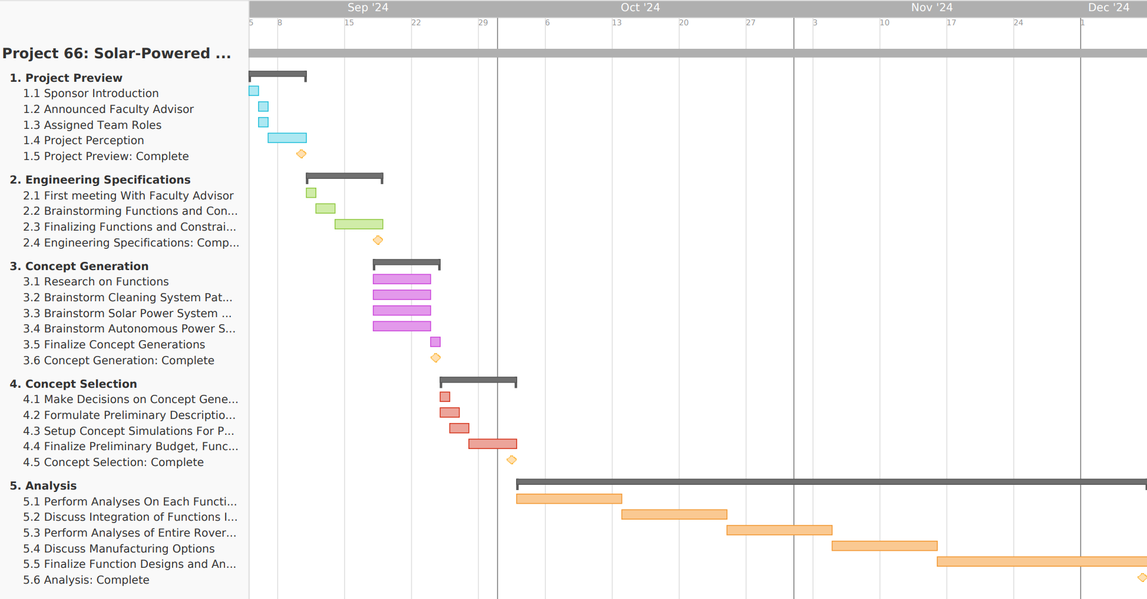
Preliminary Schedule/Timeline
10/2/2024
#14

Slide 15
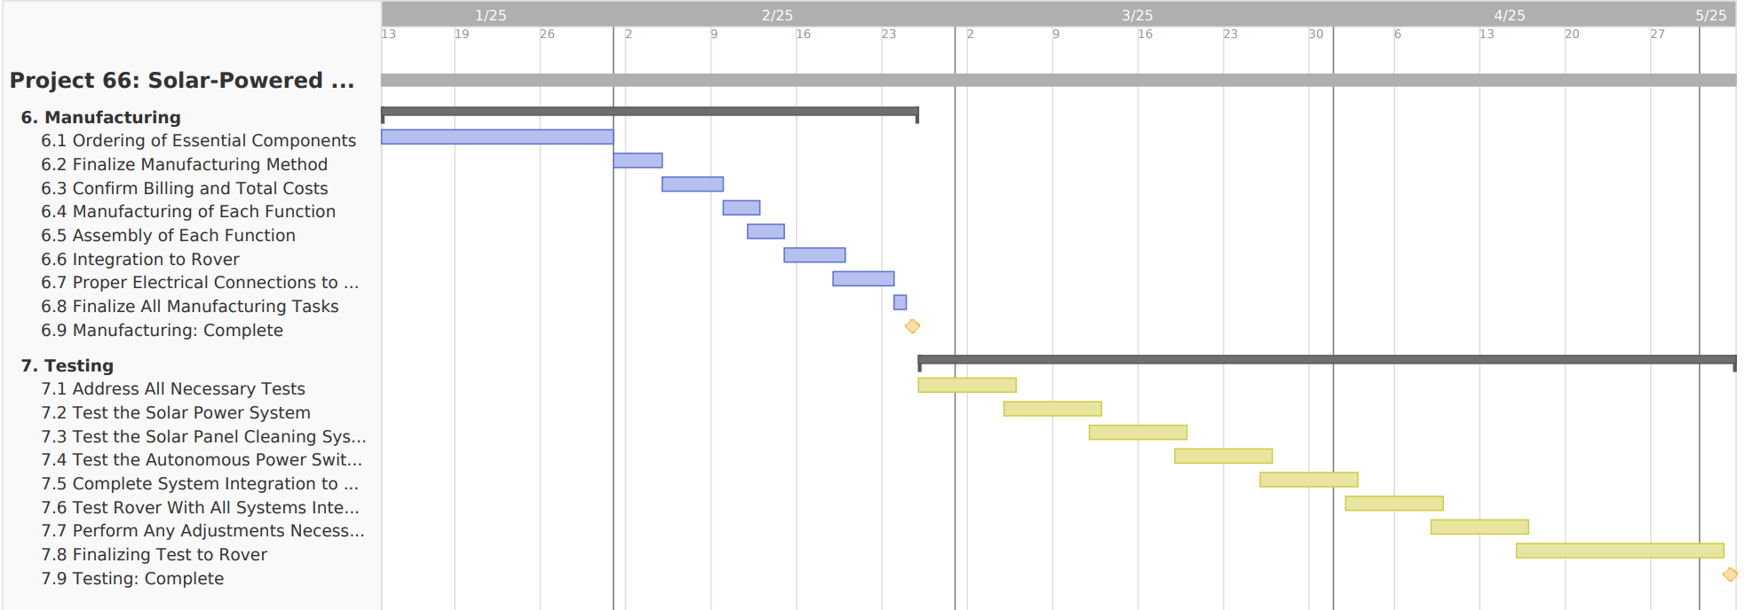
Preliminary Schedule/Timeline
10/2/2024
#15

Slide 16
Appendices
10/2/2024
#16

Slide 17
Pros and Cons of the Self-Cleaning Systems
 | Air Compressor | Electrostatic Method | Brush
Pros | Less likely to scratch | Requires humidity No scratch 90% effective | Easily obtainable parts Within budget Low power consumption
Cons | Weight distribution Large power consumption | Too expensive May not clean heavier debris | May scratch May trap debris
10/2/2024
#17

Slide 18
Pros and Cons of the Solar Panels:
 | Monocrystalline | Polycrystalline | Thin-Film
Pros | High Efficiency: 20-23% Space-Saving Longer Lifespan | Good Efficiency Cost-Effective Decent Space Utilization | Lightweight and Flexible Performance in High Temperatures Lower Cost
Cons | Expensive Production | Space Shorter Life-span Less efficient | Low Efficiency: 13-15% Consume lots of space Not Durable
10/2/2024
#18

Slide 19
Pros and Cons of the Autonomous Battery Switching:
 | Voltage Regulator w/ Arduino | DC/DC Converter w/ Arduino | Solar Charge Controller
Pros | Low cost | Low cost | Easily Programmable No design needed
Cons | Too simple to accomplish the task | Would have to be designed for our specific parameters. Would have to code our own program. | Most expensive
10/2/2024
#19
Notes:
In order to autonomously switch between solar power and battery power, the main thing we thought to use was a solar charge controller. Charge controllers are essentially controllable buck converters.

Slide 20


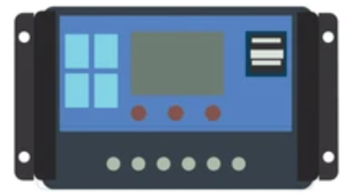
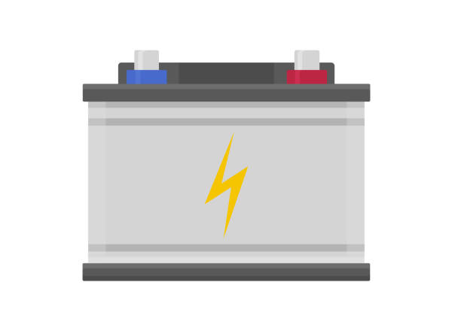
Evaluation and Selection : Autonomous Battery Switching
LOUIS
Solar Charge Controller
Solar Panel
Battery
10/2/2024
#20

Slide 21
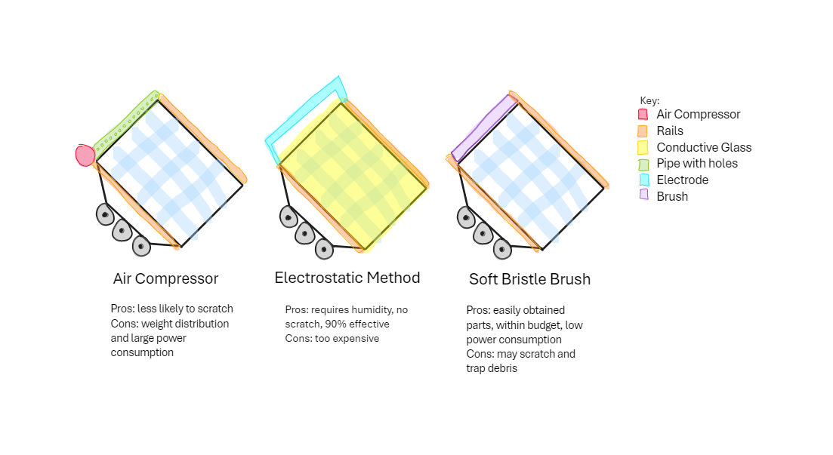
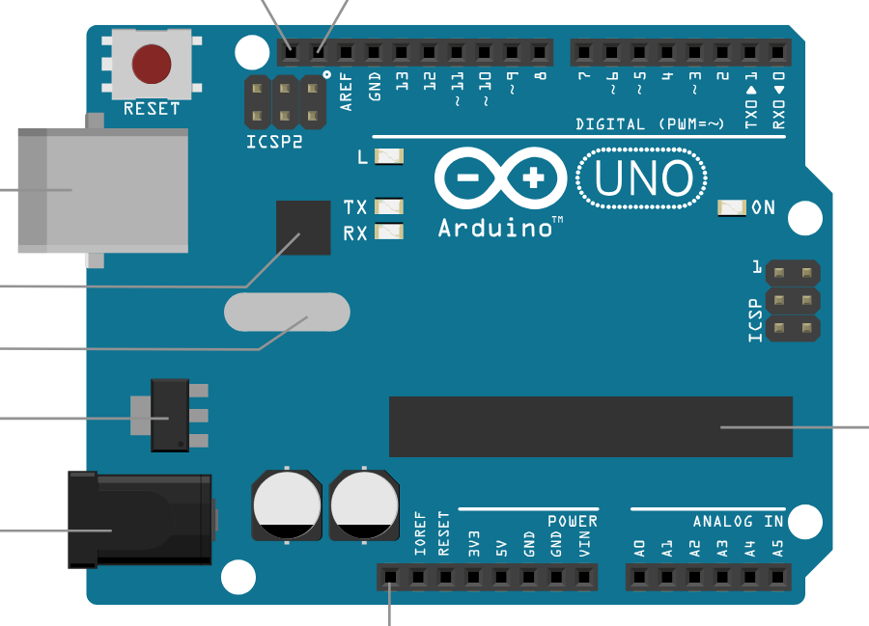

Overview of Self-Cleaning:
Key:
Brush
Rails
10/2/2024
#21

Slide 22
Drawings of Self-Cleaning Systems:
Air Compressor
Electrostatic Method
Brush Method
10/2/2024
#22

Slide 23
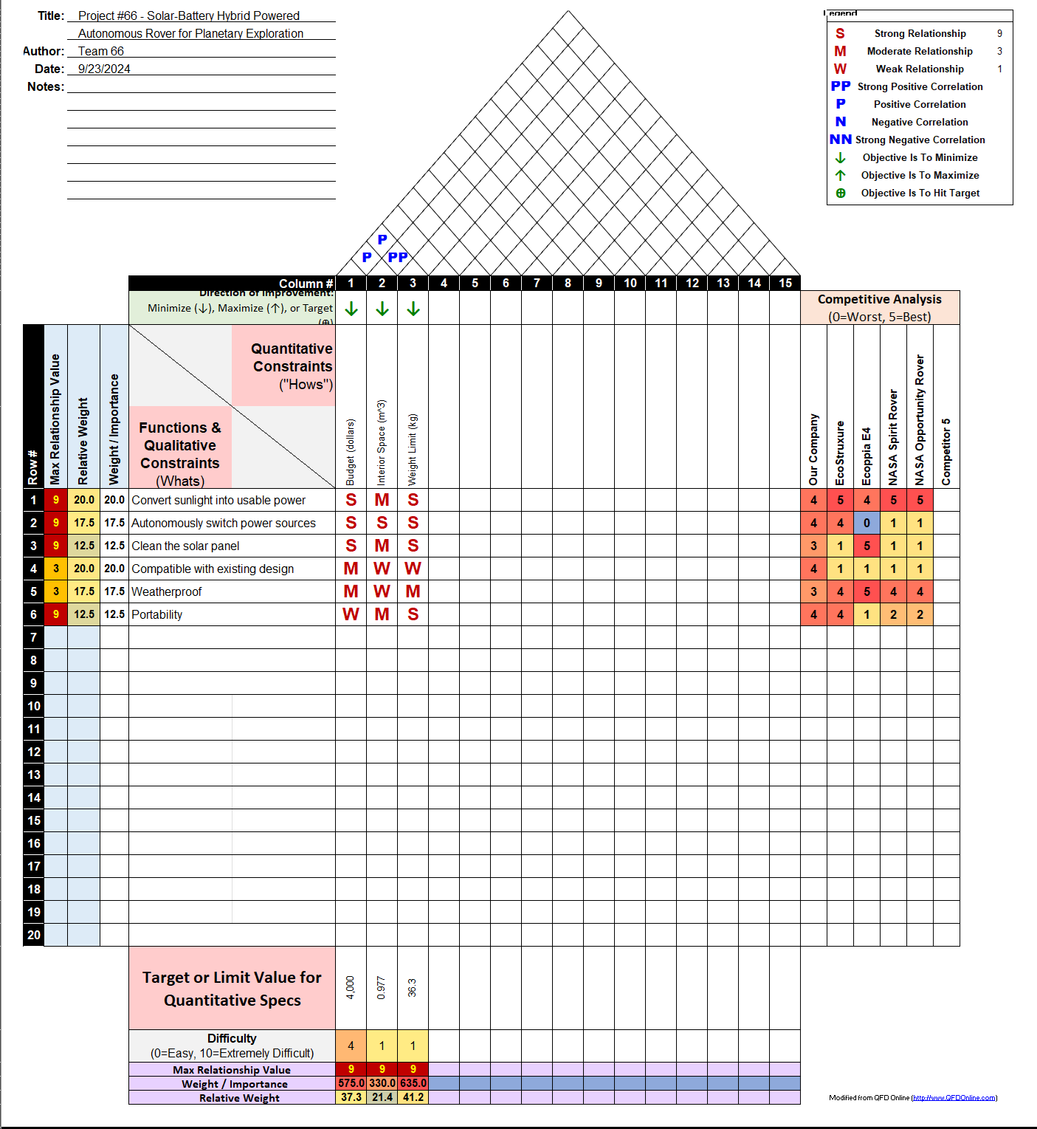
Appendices: HOQ
House of Quality:
10/2/2024
#23

Slide 24
References:
“Do Solar Panels Have Mounting Holes in Back.” Solar Industry Watch, 29 Aug. 2024, solarindustrywatch.org/do-solar-panels-have-mounting-holes-in-back/.
“Do Solar Panels Have Mounting Holes in the Back?” Sungoldsolar, 12 Sept. 2024, www.sungoldsolar.us/do-solar-panels-have-mounting-holes-in-the-back/.
Ecoppa. “ECOPPIA’s E4 Robotic Cleaning Solution.” ECOPPIA’S E4 ROBOTIC CLEANING SOLUTION, www.ecoppia.com/warehouse/temp/ecoppia/E4_Product_Overview.pdf. Accessed 23 Sept. 2024.
Levitan, Dave. “Tech from Mars: Self-Cleaning Solar Panels.” IEEE Spectrum, IEEE Spectrum, 13 July 2024.
Meng, Xiangyu. “Rover: LOUIS.” YouTube, YouTube, 18 May 2024, www.youtube.com/watch?v=Htv0q-P5DVE&t=1s.
“Maximizing Solar Efficiency: Nano Coatings for Solar Panels.” Nasiol, 1 July 2024.
Mazumder, M.K., et al. “Electrostatic Removal of Particles and Its Applications to Self-Cleaning Solar Panels and Solar Concentrators.” Developments in Surface Contamination and Cleaning, William Andrew Publishing, 29 Mar. 2011.
“Spirit Rover (MER-A) - NASA - NSSDCA - Spacecraft - Details.” Nasa, 2003, nssdc.gsfc.nasa.gov/nmc/spacecraft/display.action?id=2003-027A.
10/2/2024
#24

