Slide 1


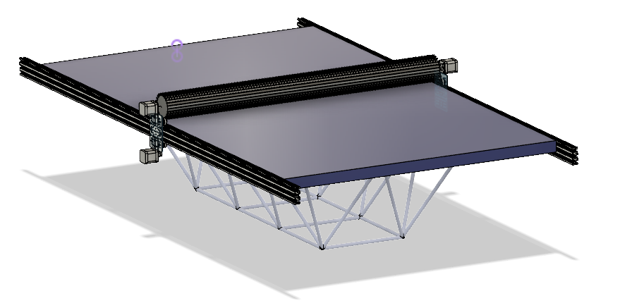
Solar-Powered Rover
Margaret Burkes (EE), Bowen Williamson (EE), Keldon Ngo (EE), William Mancuso (EE), Kenny Bui (EE)
Project Objective:
Concept Generation:
The main objective of this project is enhancing the previously built rover, which is battery powered, by integrating solar power, autonomous power switching between solar and battery power, and an independent cleaning system for the solar panel.
After researching what is being developed within the industry, our team discovered the following options and made our selections after using decision matrices:
Background:
 | Solar Panel Cleaning System | Autonomous Power Switching | Solar Panel
Concepts Generated | Air Compressor Method, Brush Method, Electrostatic Method | Voltage Regulator w/Arduino, DC/DC Converter w/Arduino, Solar Charge Controller | Monocrystalline, Polycrystalline, Thin Film
Selected Concept | Brush Method | Solar Charge Controller | Monocrystalline
The original inspiration behind the creation of LOUIS was to expose young engineers to the development and design of rovers, as it can easily be seen that space exploration will continue to be a prominent area of work for engineers in the future. We intend to build upon that idea by incorporating solar power into the design of LOUIS. As an educational proof of concept, we will also design a power switching system to autonomously switch between battery and solar power, depending on the environment. As many NASA rovers also use solar power, this addition will push the rover one step closer to the design of rovers currently being used in space exploration missions. This will make LOUIS an increasingly relevant tool for future students who are interested in working in this field.
Analysis:
Constraints:
Weight | Name | Symbol | Unit | Value(s)
0.5 | Budget | B | $ | 4000
0.4 | Interior Space | S | M^3 | 0.977
0.1 | Weight Limit | W | Kg | <36.3
Testing and Validation Plans:
Design
We will be conducting tests on the following systems to
Battery Runtime: The battery charge lasts longer with the addition of the solar panel than the previous design.
Indoor/Outdoor Environment Performance: The charge controller switches the primary power source, battery or solar panel, given the power output of the solar panel.
Brush Cleaning System Activation: The motors actuate along the length of the solar panel both ways and that the brush itself is spinning at the desired speed. The system should also activate only once, and safety measures should work properly.
Sponsor: Dr. Meng
Advisor: Dr. Mehraeen

