Slide 1



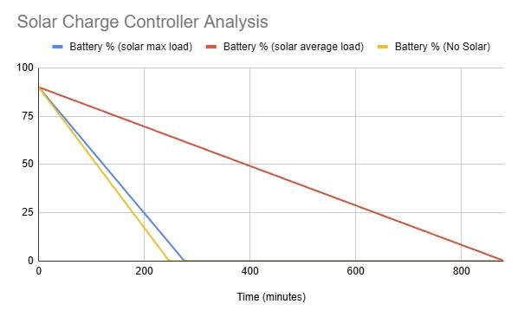
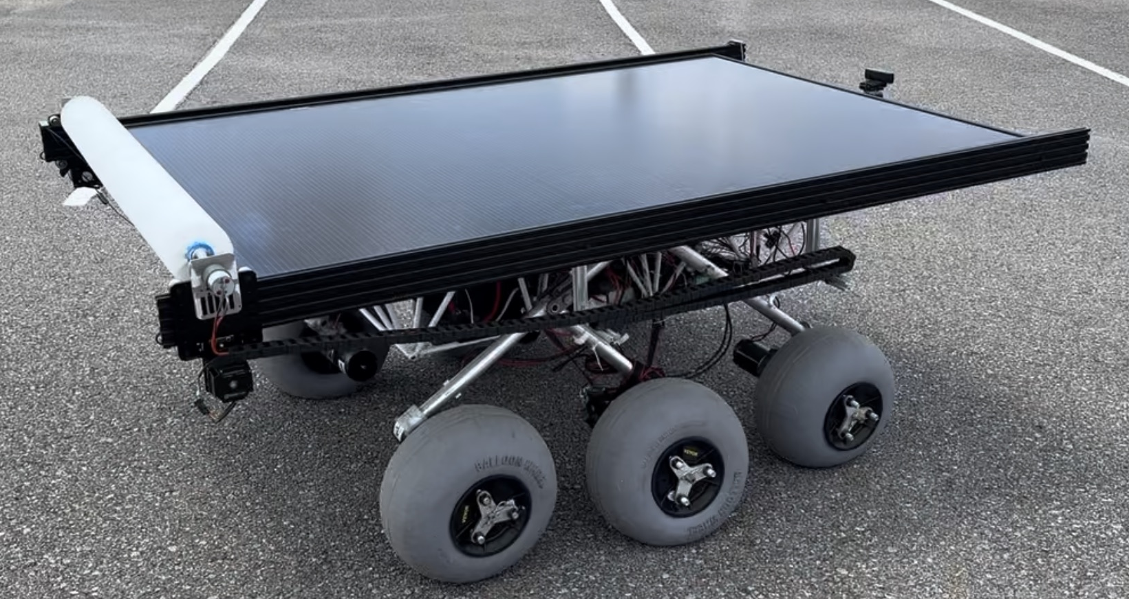
Solar-Powered Rover
Margaret Burkes (EE), Bowen Williamson (EE), Keldon Ngo (EE), William Mancuso (EE), Kenny Bui (EE)
Project Objective:
QR Code:
The main objective of this project is enhancing the previously built rover, which is battery powered, by integrating solar power, autonomous power switching between solar and battery power, and an independent cleaning system for the solar panel.
Scan me for more info on the project background, how LOUIS works, maintenance instructions, our parts list, and more!
Background:
The original inspiration behind the creation of LOUIS was to expose young engineers to the development and design of rovers, as it can easily be seen that space exploration will continue to be a prominent area of work for engineers in the future. We have built upon that idea by incorporating solar power into the design of LOUIS. As an educational proof of concept, we have also designed a power switching system to autonomously switch between battery and solar power, depending on the environment. As many NASA rovers also use solar power, this addition has pushed the rover one step closer to the design of rovers currently being used in space exploration missions. This will make LOUIS an increasingly relevant tool for future students who are interested in working in this field.
Analysis:
Constraints:
Weight | Name | Symbol | Unit | Expected Value(s) | Measured Value(s)
0.5 | Budget | B | $ | 4000 | 3525
0.4 | Interior Space | S | M^3 | 0.977 | 0.970
0.1 | Weight Limit | W | Kg | <36.3 | 36.2
Results:
Design
Cleaning System: After simulating a dirty panel, the brush has an improvement in the power generation from the dirty panel to the clean panel by 180%. Additionally, it restores 77.8% of its original power generation.
Battery Life:
 | Battery % Stationary | Battery % Full-Speed | Battery Life Expectancy
No solar power |  | -21.34% per hr | 4.69 hr
With solar power | +8% per hr | -6.95% per hr | 14.39 hr
206.8% Improvement
Sponsor: Dr. Meng
Advisor: Dr. Mehraeen

