Slide 1




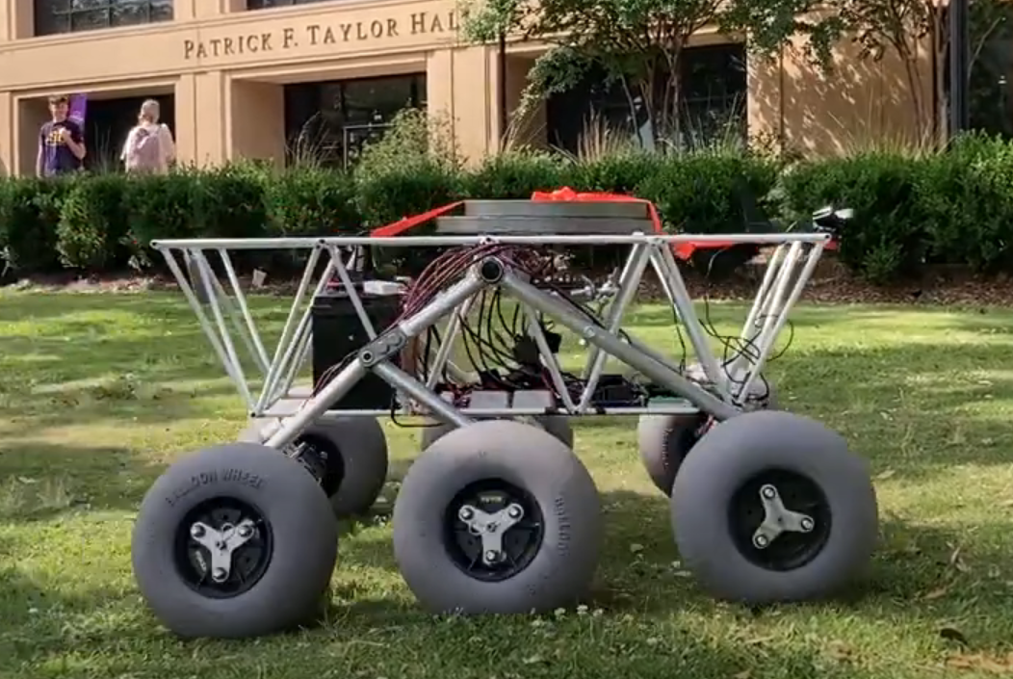
Solar-Powered Rover
By Team 66:
William Mancuso (EE), Bowen Williamson (EE), Margaret Burkes (EE), Keldon Ngo (EE), Kenny Bui (EE)
Project Sponsor: Dr. Xiangyu Meng
Faculty Advisor: Dr. Shahab Mehraeen
1/21/2025
#1

Slide 2
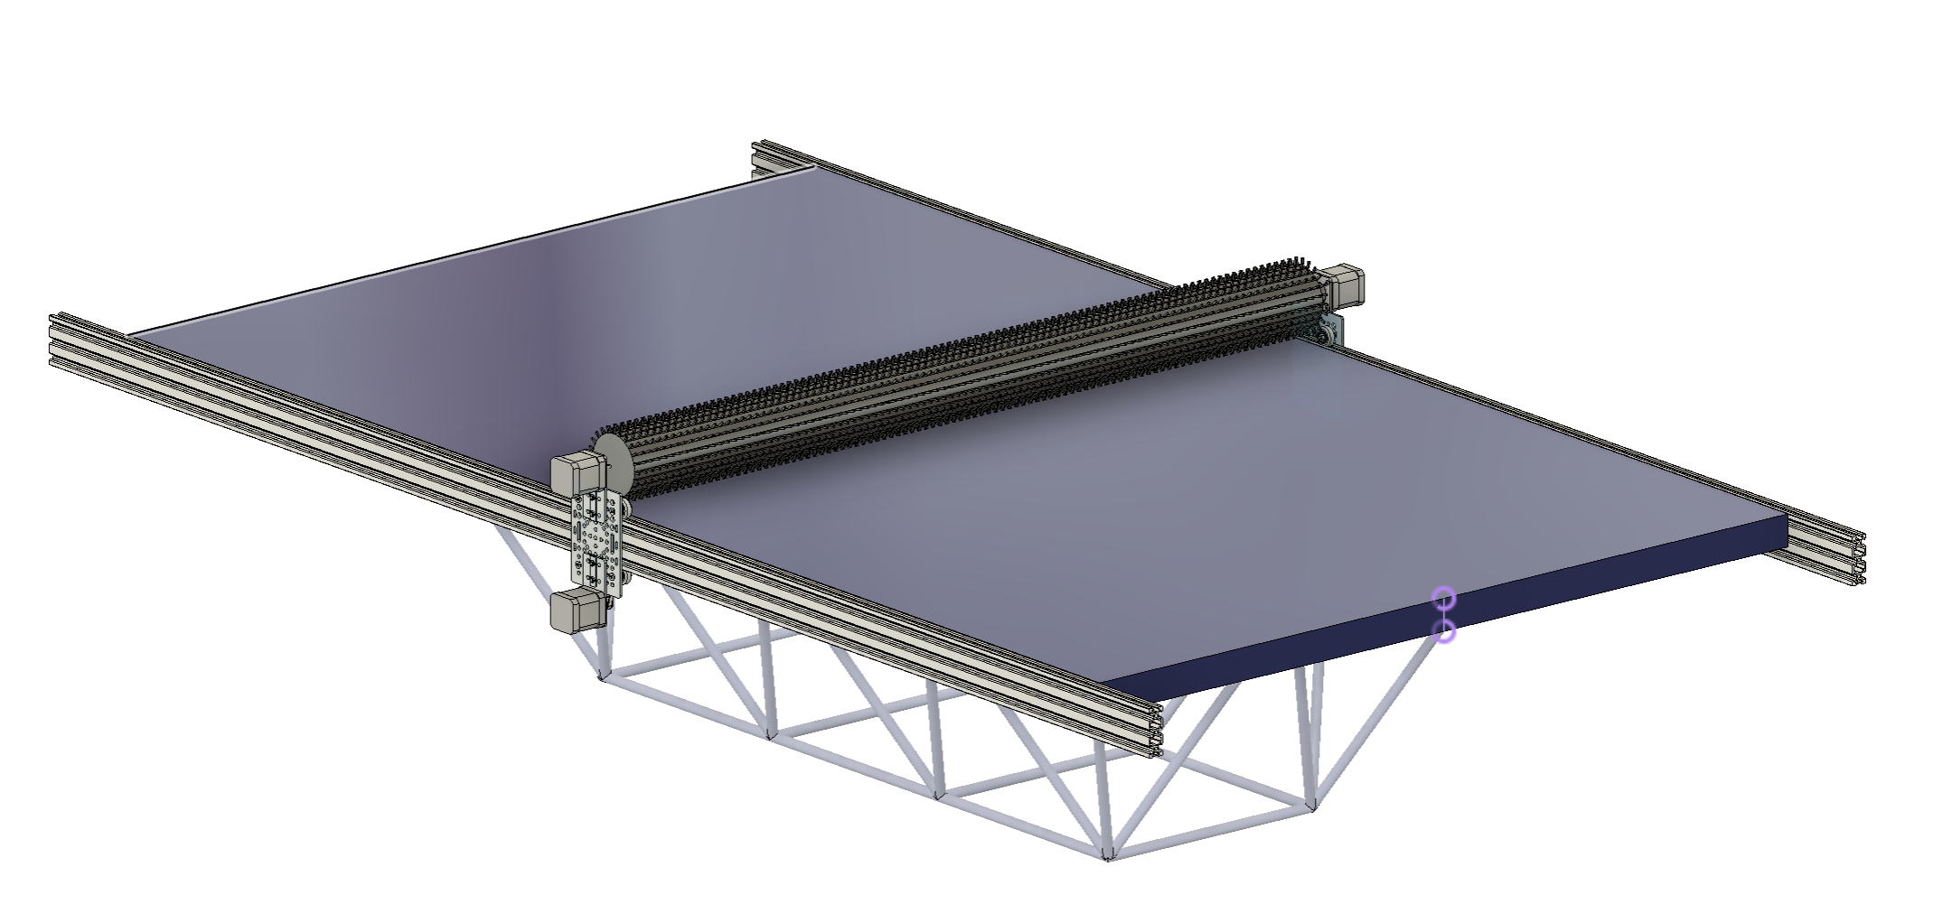

Final Design Status
Brush
Solar Panel
Linear Actuators
Rover
1/21/2025
#2

Slide 3
Potential Design Upgrades
Cleaning System Start Up
Pyranometer
Capacitive Sensor
Energy Monitoring
Brush Limit Switch
QR Code
How to Operate LOUIS
Maintenance Instructions
Schematics/Drawings
1/21/2025
#3

Slide 4
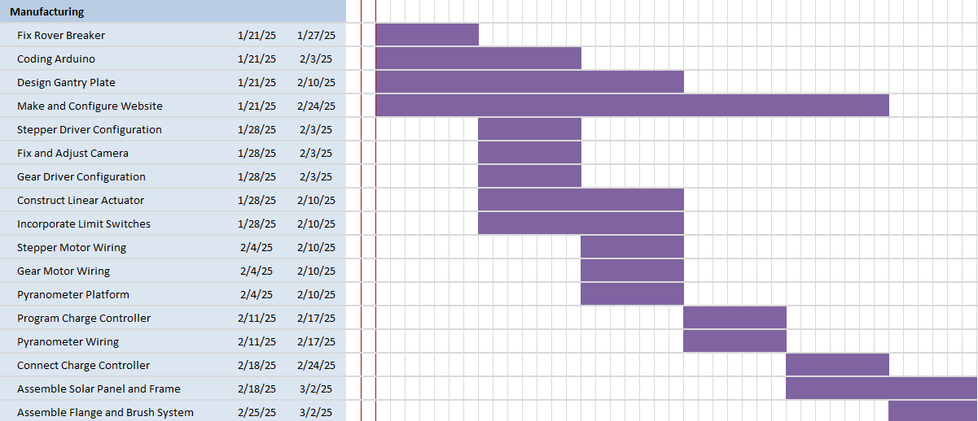
Project Timeline
1/21/2025
#4

Slide 5
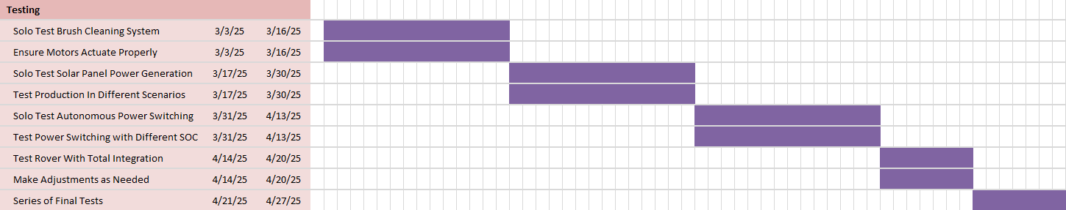
Project Timeline Cont.
1/21/2025
#5

Slide 6
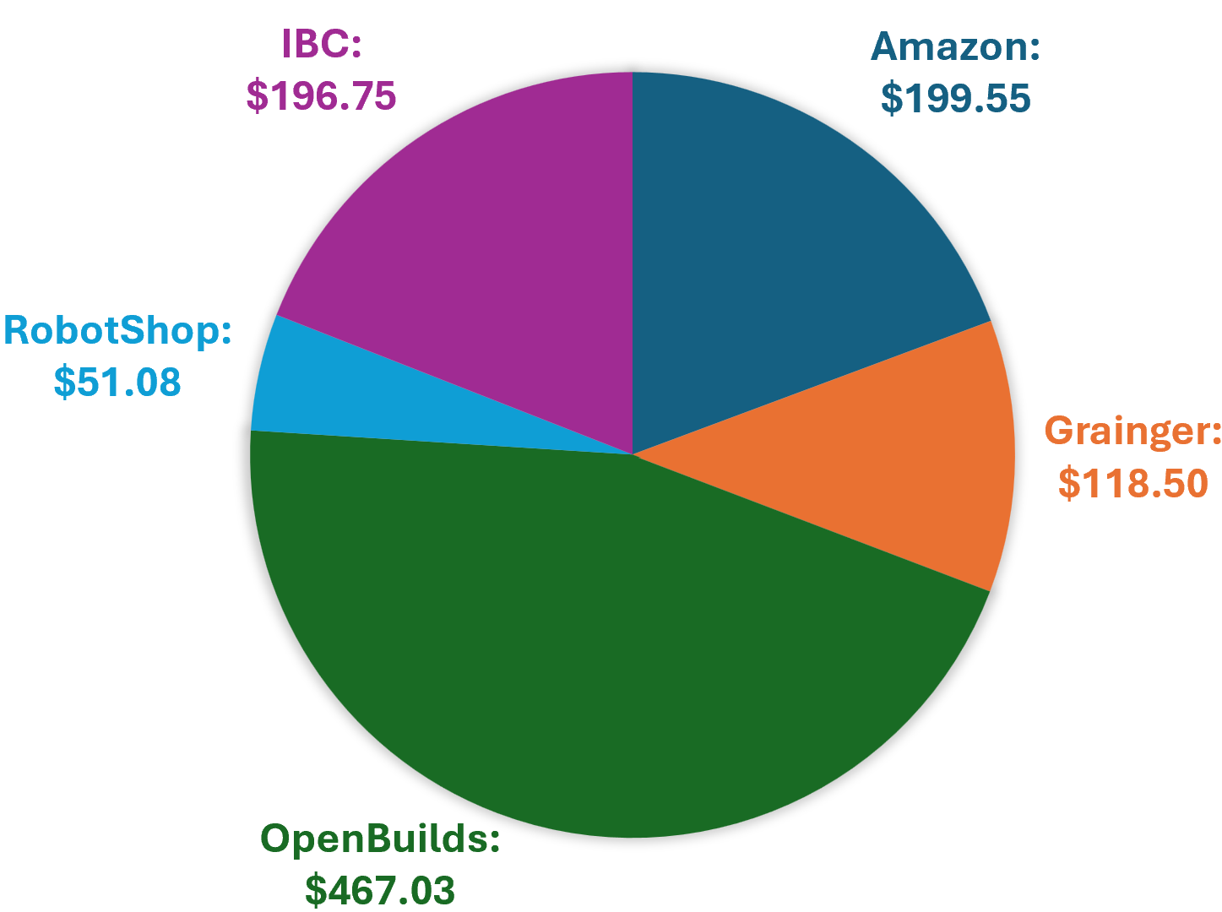
Current Budget/Procurement Status
Project Budget: $4,000
Total Spent: $1,032.91
Remaining: $2,967.09
1/21/2025
#6

Slide 7
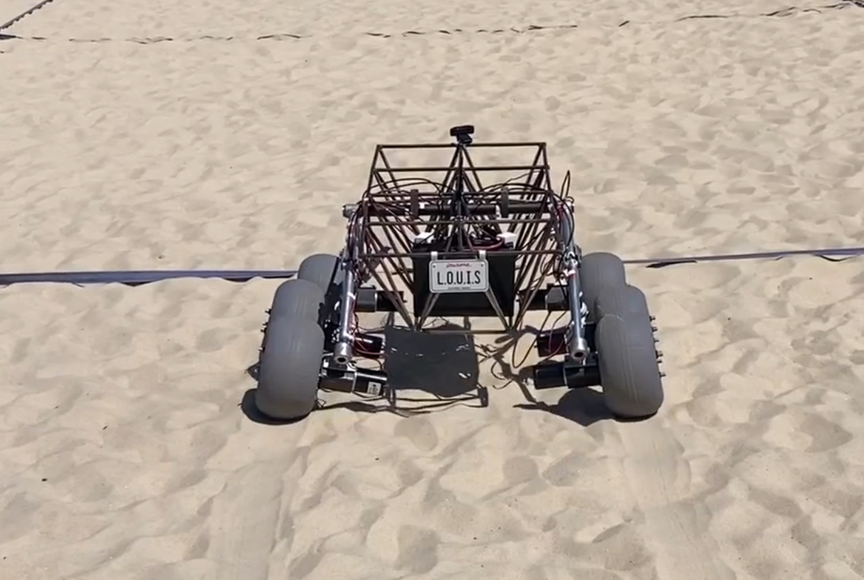
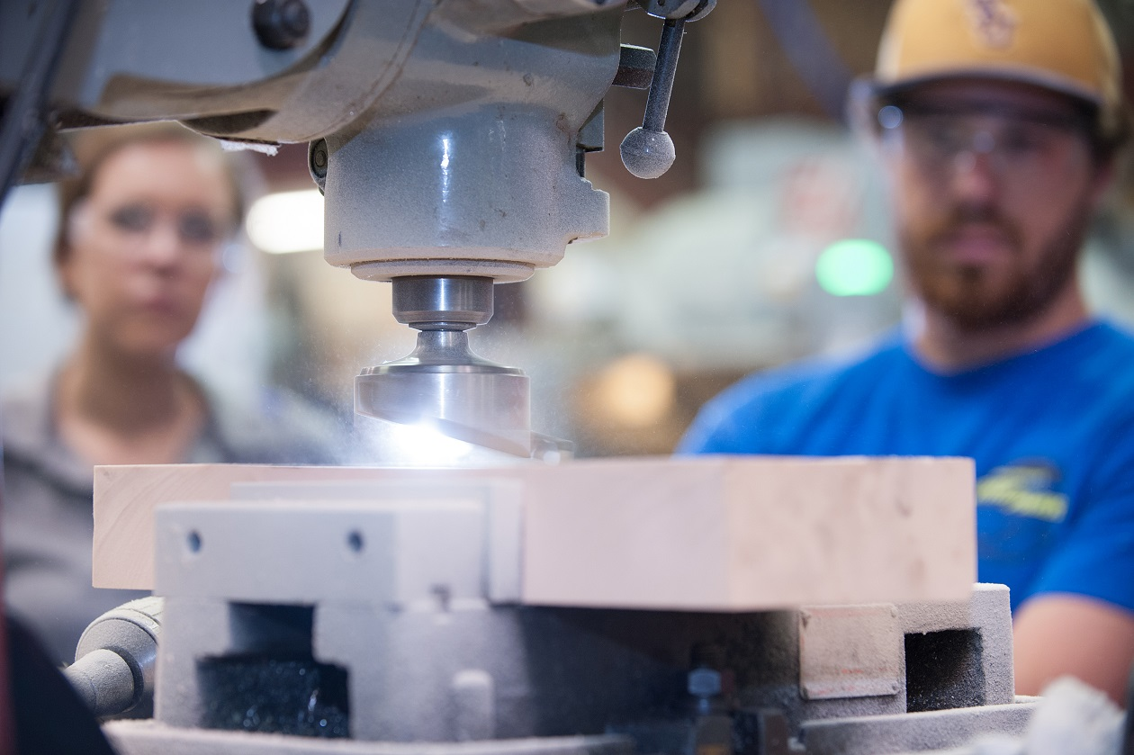
Project Execution Location
Testing Locations
PFT Parking lot- Easy Terrain with Minimal Shadows
Sand lot at UREC- Difficult Terrain with Minimal Shadowing
Manufacturing Locations
ERAD Capstone Lab- LOUIS is currently located
Machine Shop- Part Manufacturing
1/21/2025
#7

Slide 8
Individual Task Assignments
William
Fix the camera and breakers
Assemble the solar panel and frame
Margaret
Set up motor driver and the linear motor
Create a website with a QR code
Keldon
Set up motor driver and the rotational motor
Bowen
Kenny
Build the linear actuator
Program the Arduino
Assemble the flange and brush system
Design and manufacture the gantry plate
Program and connect the charge controller
Set up limit switch
Pyranometer
1/21/2025
#8

