Slide 1


Key-Value-Store
Lab 02
Lukas Bosshart|Markus Eggimann

Slide 2
Content
Architecture
Implementation Details
Performance
Next steps
Discussion

Slide 3
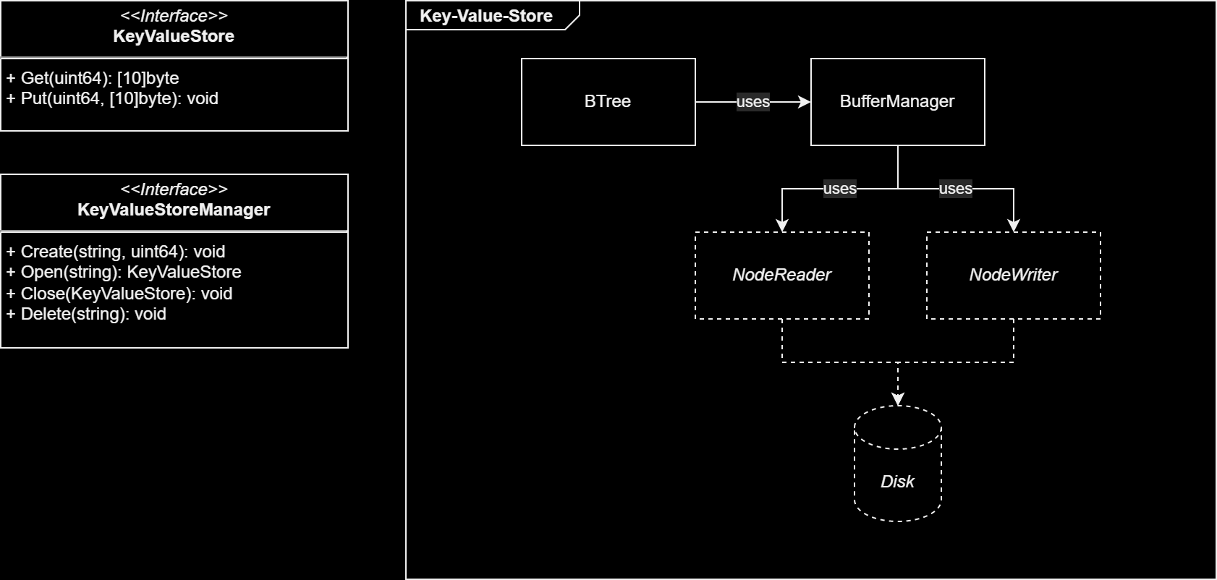
Architecture

Slide 4
Implementation Details

Slide 5
B+ Tree
Unique node ID
Nodes with children, next and parent “pointers”
Node resolution: ask tree/buffermanager for node with given ID

Slide 6
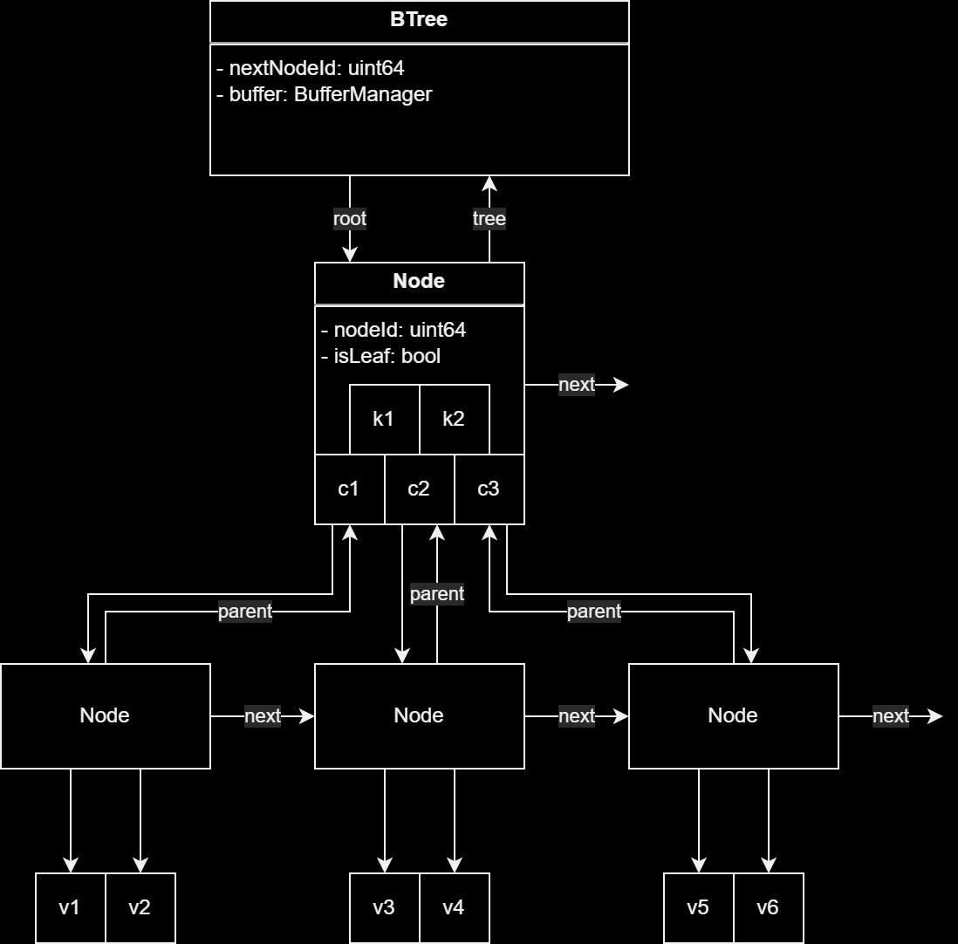
B+ Tree

Slide 7
Buffer Manager
Uses a fixed-size map
Replacement strategy: Least-recently-used
NodeWriter and NodeReader for disk access

Slide 8
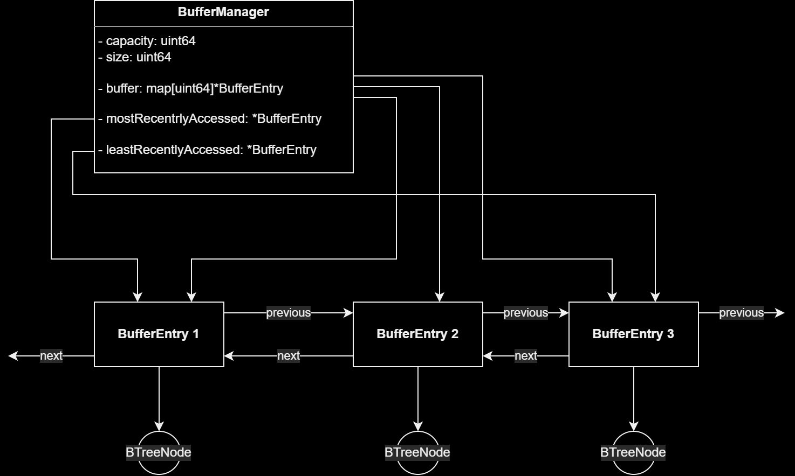
Buffer Manager

Slide 9
Performance
Btree: Read will perform better than write
Buffer Manager: Constant access time
Buffer Manager: Replacement of entry in constant time

Slide 10
Next steps
Definition of file layout
Implementation of node writer and reader
Calculation of tree degree
Optimization of btree implementation

Slide 11
Discussion

