Slide 1
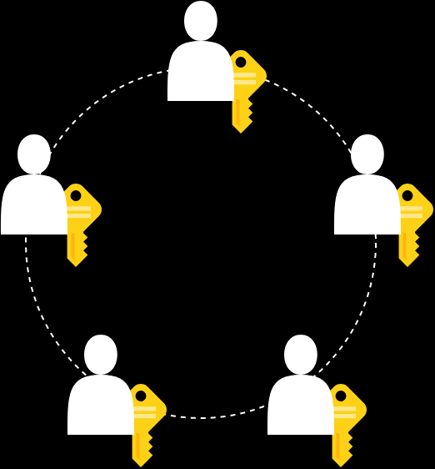
Ring Signatures
Implementation of Linkable Spontaneous Anonymous Group Signatures
Markus Eggimann

Slide 2
Content
Definitions
LSAG Ring Signature Scheme
Demonstration
Performance
Applications
Discussion

Slide 3
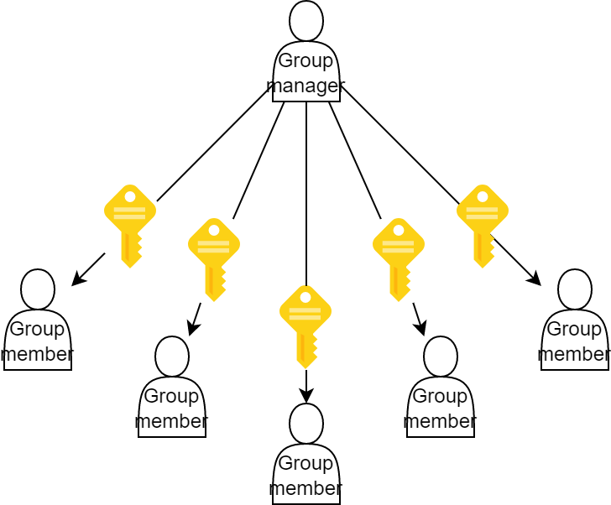
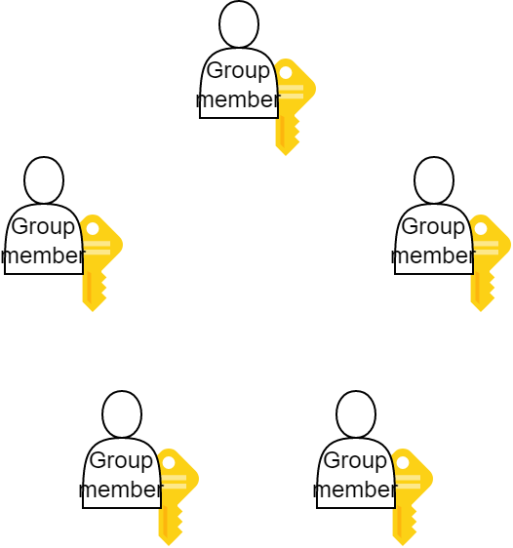
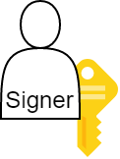
Definitions I – Signature Schemes
Single Signer Scheme
Group Signature Scheme
Ring Signature Scheme
Notes:
Group signatures: sign in the name of a company, manager adds employee to group

Slide 4
Definitions II – Properties
Anonymity
Signer remains anonymous
Spontaneity
No group setup or coordination necessary
Linkability
Two signatures of the same signer can be linked

Slide 5
Definitions III – Interface
Ring Signature Scheme Interface
public interface IRingSigner {
Signature Sign( byte[] message, BigInteger[] publicKeys, BigInteger signerPrivateKey, int signerPublicKeyIndex);
bool Verify( byte[] message, Signature signature, BigInteger[] publicKeys);
}

Slide 6
Selected Ring Signature Schemes
Spontaneous anonymous group signature scheme (SAG)
Linkable spontaneous group signature scheme (LSAG)
Rivest, Shamir, Tauman (2001)
Satisfies Anonymity, Spontaneity
Based on public/private key pairs
Motivation: safe whistleblowing
Liu, Wei, Wong (2004)
Satisfies Anonymity, Spontaineity, Linkability
bool SignedBySameSigner( Signature signature1, Signature signature2);
Based on public/private key pairs
Motivation: E-Voting

Slide 7
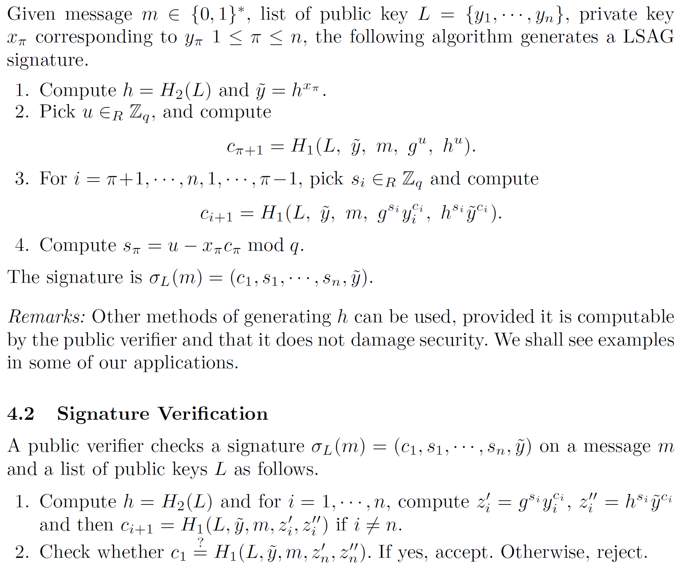
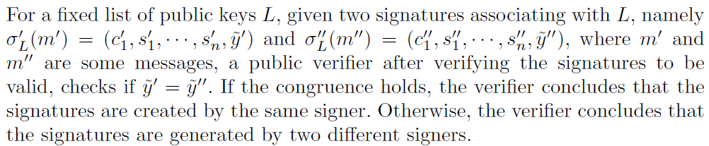
LSAG Algorithm I – Overview
Signing
Verification & Linking

Slide 8
LSAG Algorithm I – Overview
Signing
Verification
Signer private key
Public keys
Hash functions
Hash functions
“Nonces”
“Challenges”
Notes:
H1: hash to numbers
H2: hash to prime order subgroup

Slide 9
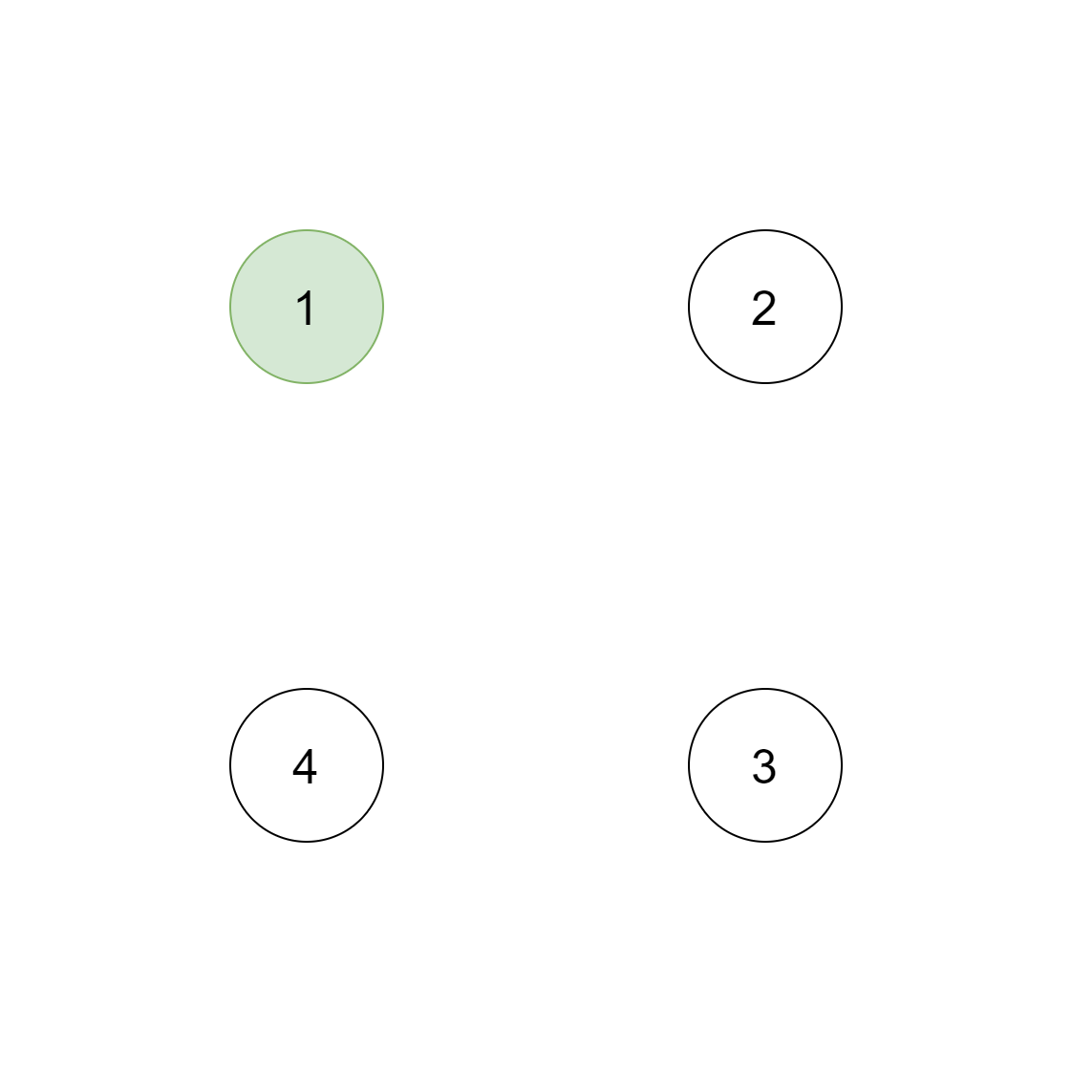
LSAG Algorithm II – Signing

Slide 10
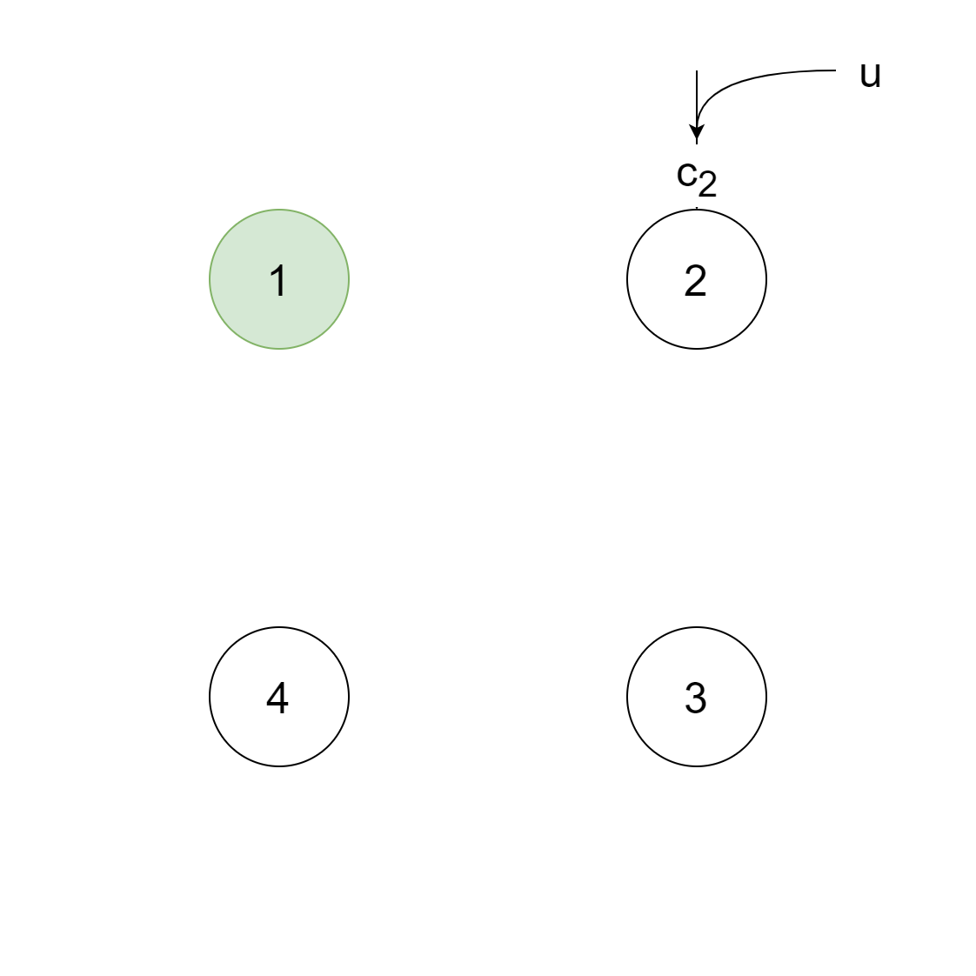
LSAG Algorithm II – Signing

Slide 11
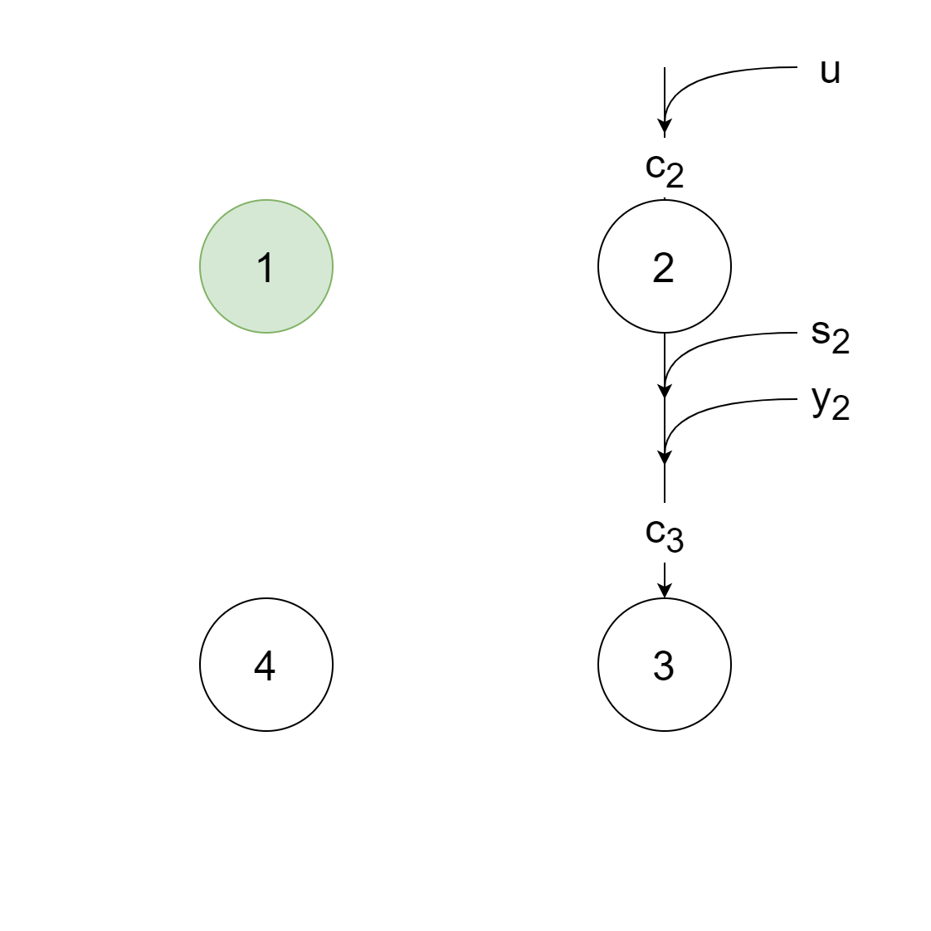
LSAG Algorithm II – Signing

Slide 12
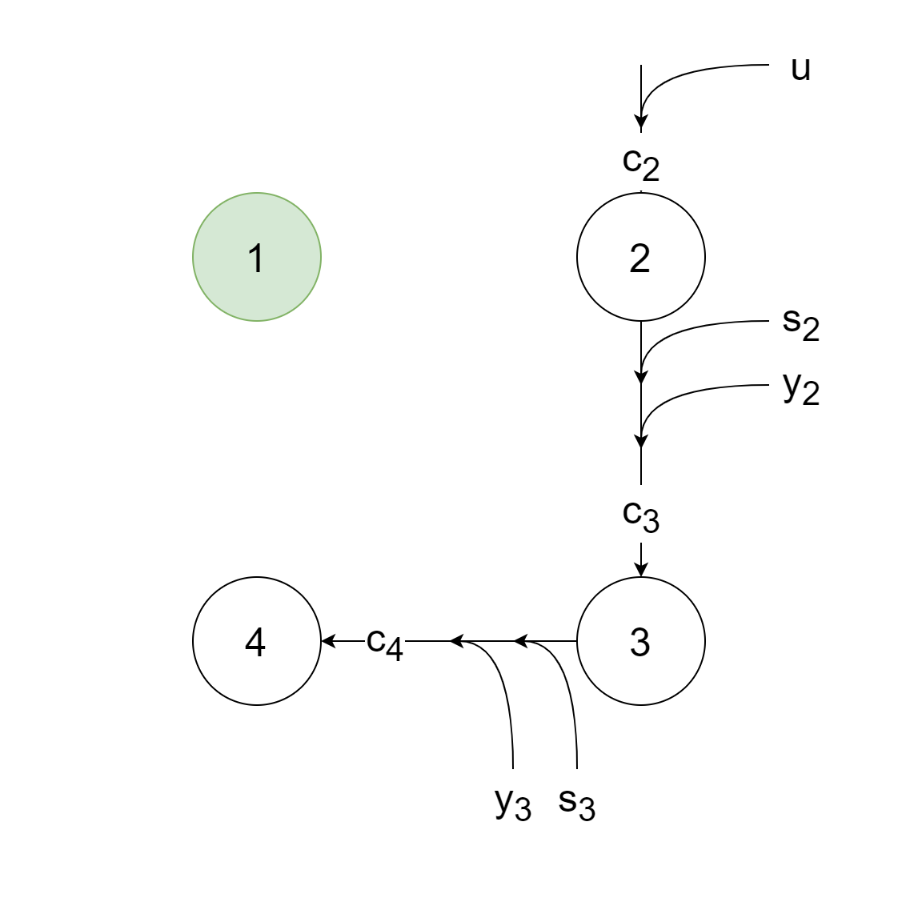
LSAG Algorithm II – Signing

Slide 13
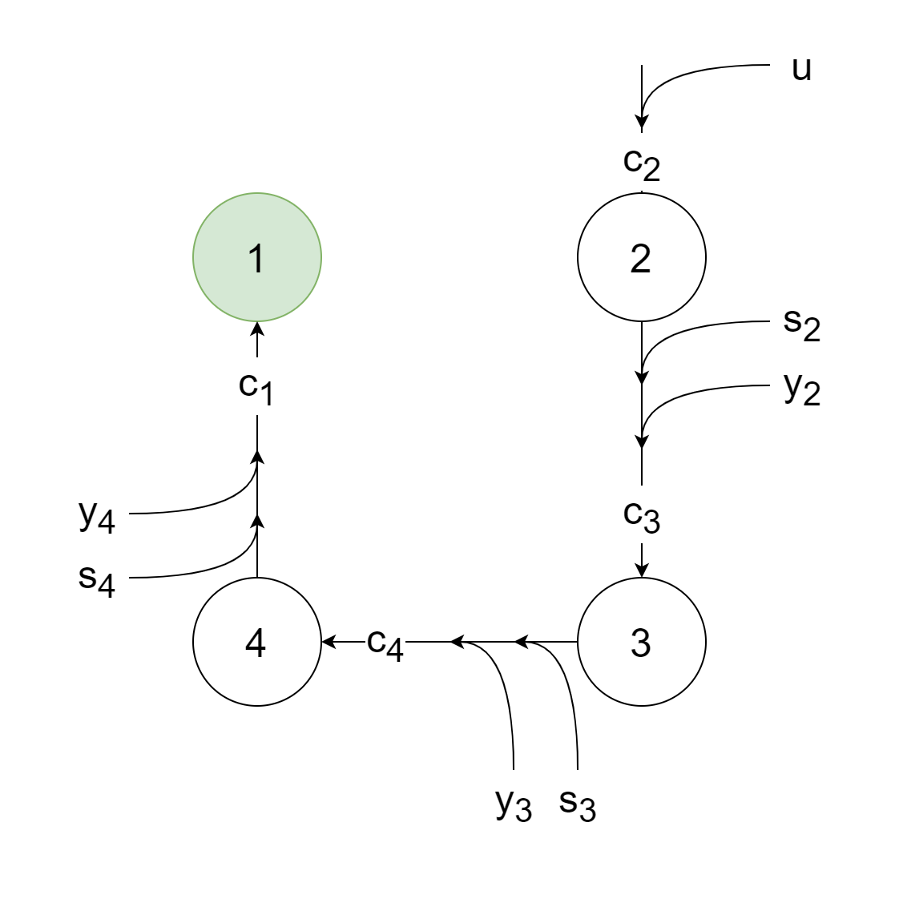
LSAG Algorithm II – Signing

Slide 14
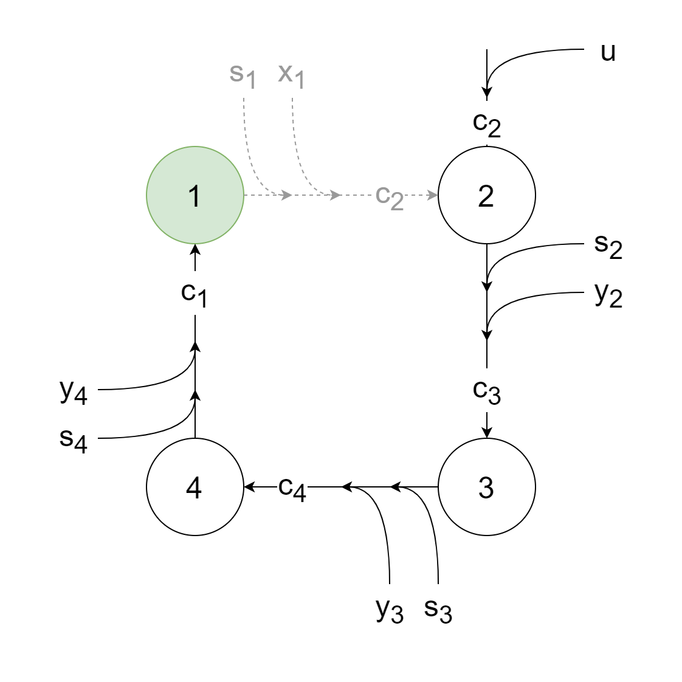
LSAG Algorithm II – Signing

Slide 15
LSAG Algorithm II – Signing
Notes:
Two properties fulfilled: anonymity, spontaneity

Slide 16
LSAG Algorithm II – Signing

Slide 17
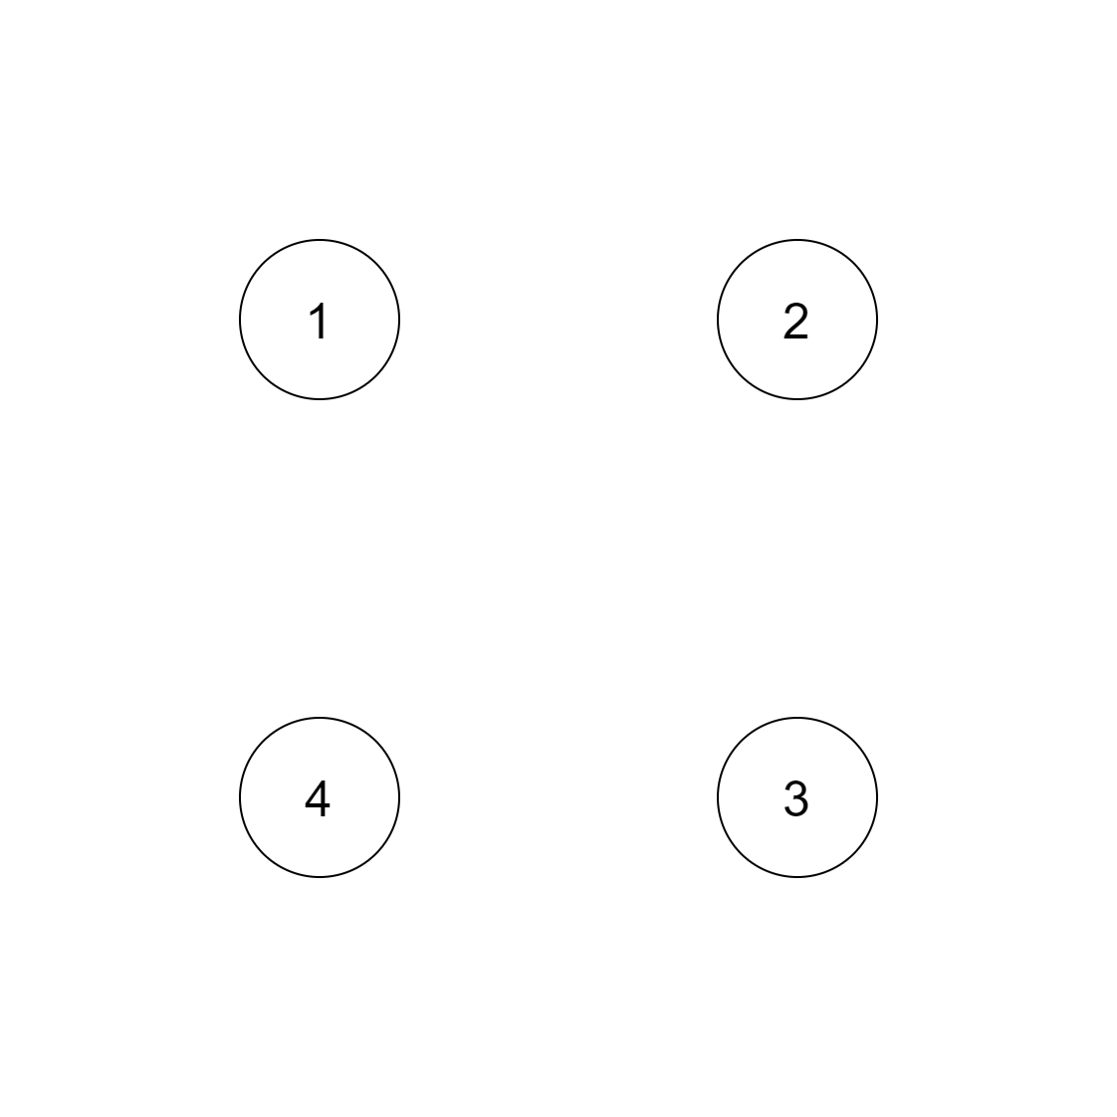
LSAG Algorithm III – Verification

Slide 18
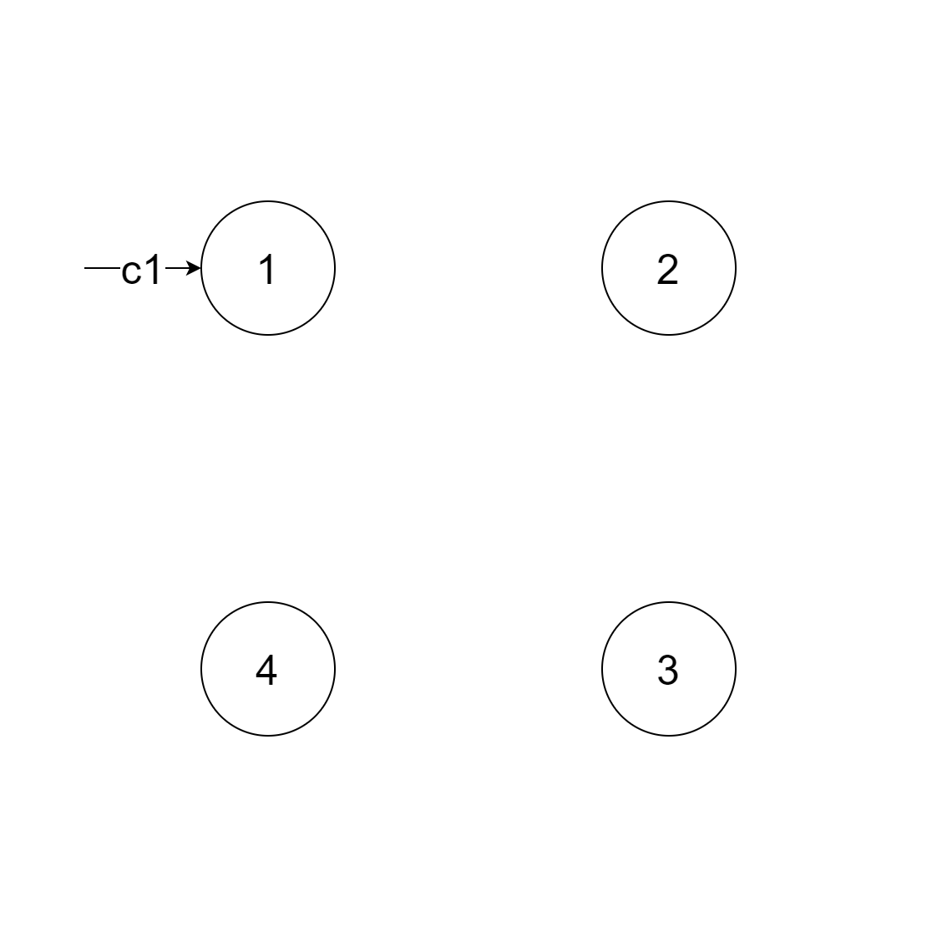
LSAG Algorithm III – Verification

Slide 19
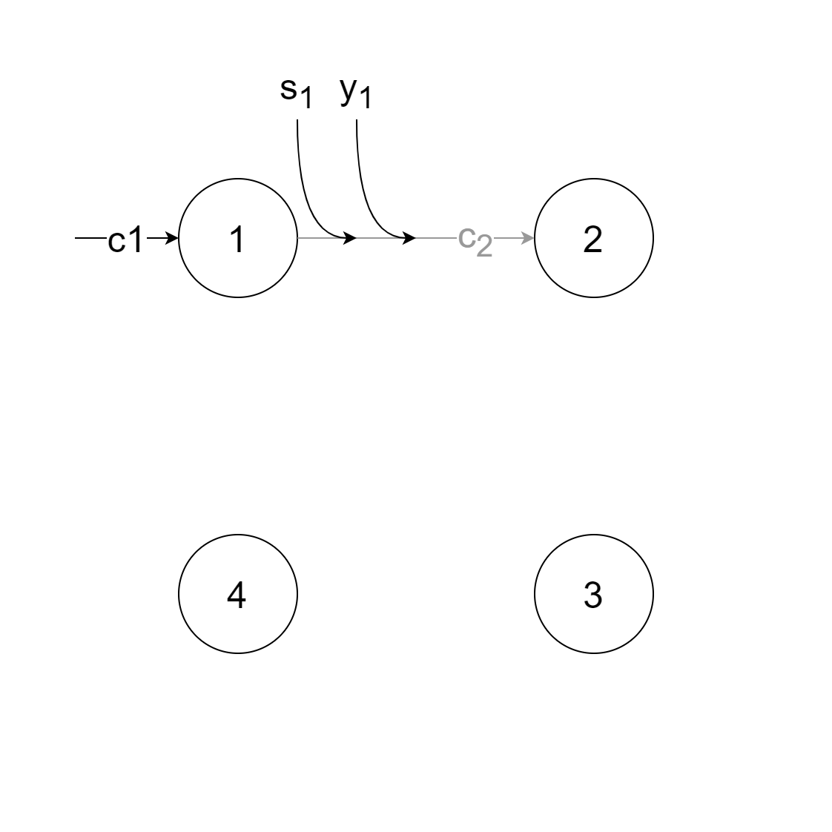
LSAG Algorithm III – Verification

Slide 20
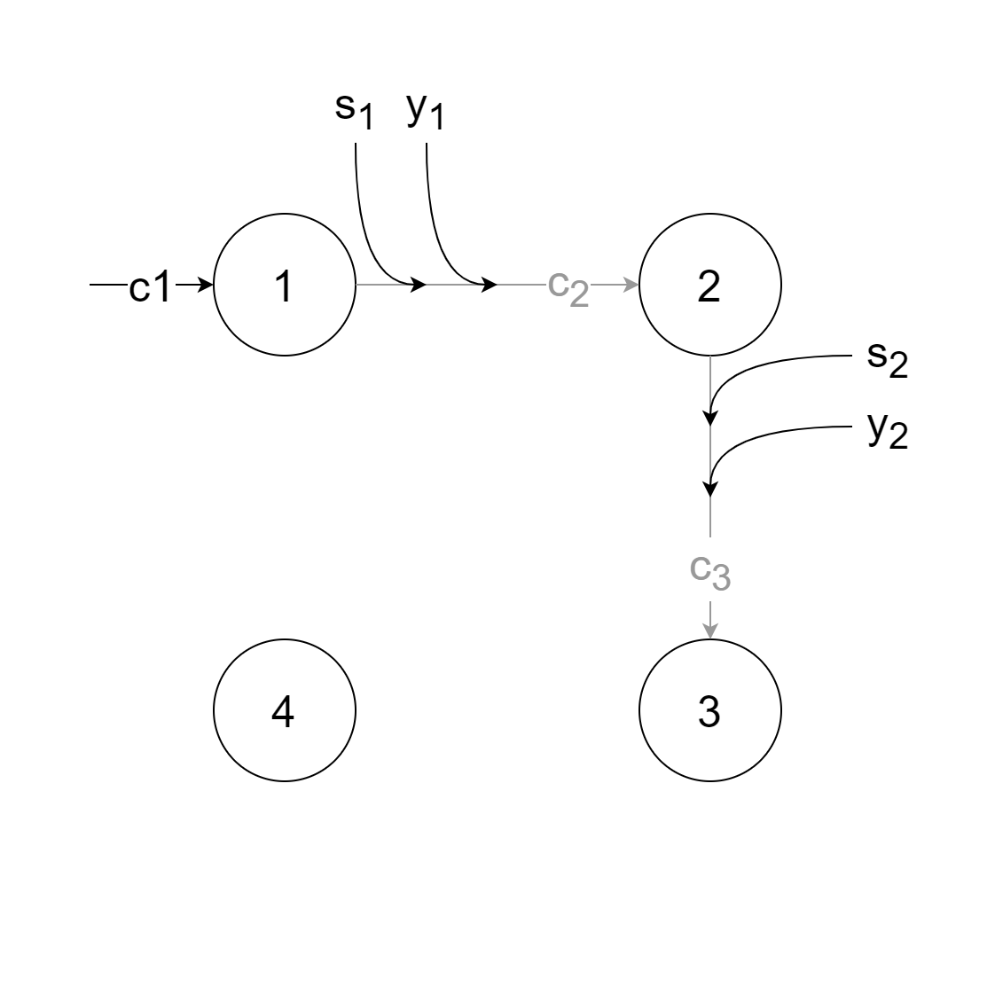
LSAG Algorithm III – Verification

Slide 21
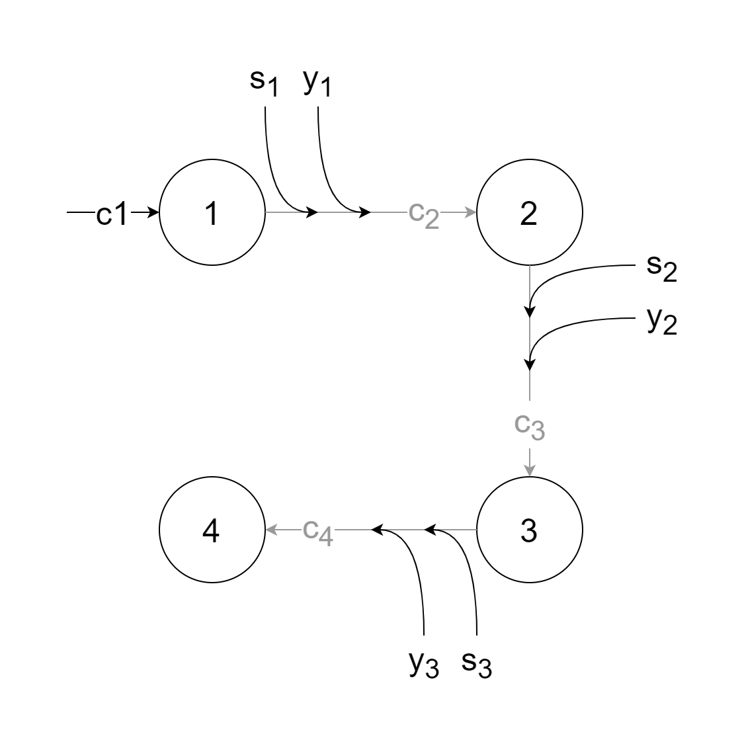
LSAG Algorithm III – Verification

Slide 22
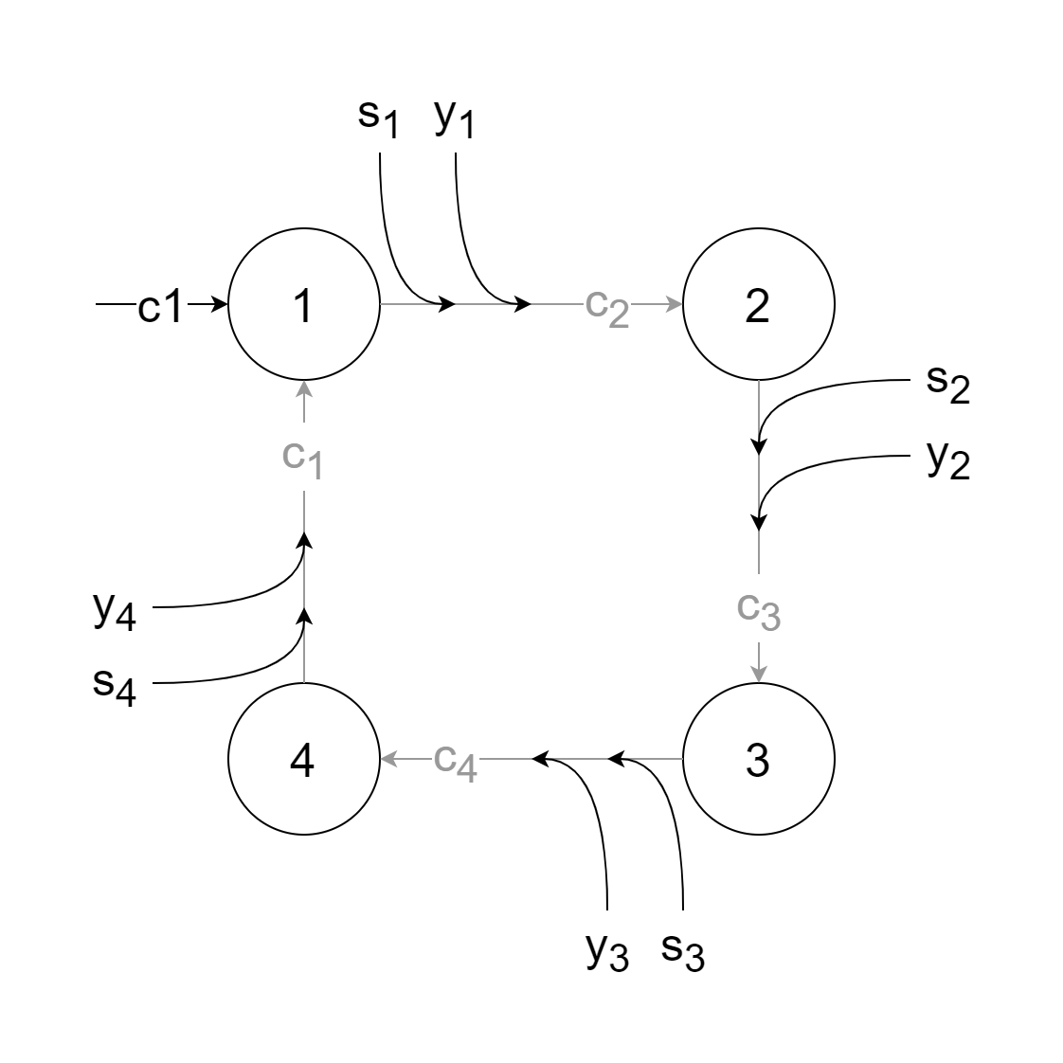
LSAG Algorithm III – Verification

Slide 23
LSAG Algorithm III – Verification

Slide 24

LSAG Algorithm IV – Linking
Two signatures $σ_{1}, σ_{2}$ are signed by same signer when ${\tilde{y}}_{1}={\tilde{y}}_{2}$

Slide 25
Demonstration
Implemented using C# and .NET Framework 6
Functional tests with Xunit Framework
Benchmarks using Benchmark.Net Framework

Slide 26
Demonstration

Slide 27
Performance I
Method | Ring Size [n] | Signature Size* [KB] | Mean [ms] | Error [ms] | StdDev [ms] | Allocated [KB]
SignMessage | 10 | 44 | 107.9 | 1.95 | 1.63 | 246
VerifySignature | 10 | 44 | 108.8 | 2.15 | 2.01 | 252
SignMessage | 100 | 404 | 1,093.0 | 18.60 | 17.40 | 4,723
VerifySignature | 100 | 404 | 1,119.7 | 4.76 | 4.22 | 4,723
SignMessage | 1000 | 4,004 | 11,477.0 | 220.37 | 235.79 | 272,279
VerifySignature | 1000 | 4,004 | 11,896.2 | 234.29 | 304.64 | 272,188
BenchmarkDotNet=v0.13.1, OS=Windows 10.0.22000
11th Gen Intel Core i7-11800H 2.30GHz, 1 CPU, 16 logical and 8 physical cores
* Theoretical number, actual size smaller as only necessary bytes are stored

Slide 28
Performance II
Signature length: |c₁| + |s₁| + … + |s_{n}| + |y’| + |y₁| + … + |y_{n}|
Signature length linear in ring size
Computational complexity linear in ring size
BUT: Implementation not optimized for performance
Notes:
Public key: 2048 bits
si: 2048 bits
c1: 2048 bits
y’: 2048 bits
For n = 10: 10* 2048 + 10 * 2048 + 2048 + 2048 = 44 Kbytes
For n = 100: 404 Kbytes

Slide 29
Applications I – Monero
Generalization of LSAG: MLSAG
Shen Noether, Monero Research Labs (2015)
Works with multiple key vectors instead of multiple keys
Prevents double spending

Slide 30
Applications I – Monero
Sender derives one-time receiver address
Sender sends money to that address
Receiver observes blockchain for transactions
If transaction is for him, uses private view key to unlock private spend key
Receiver uses spend key if he wants to send the money further

Slide 31
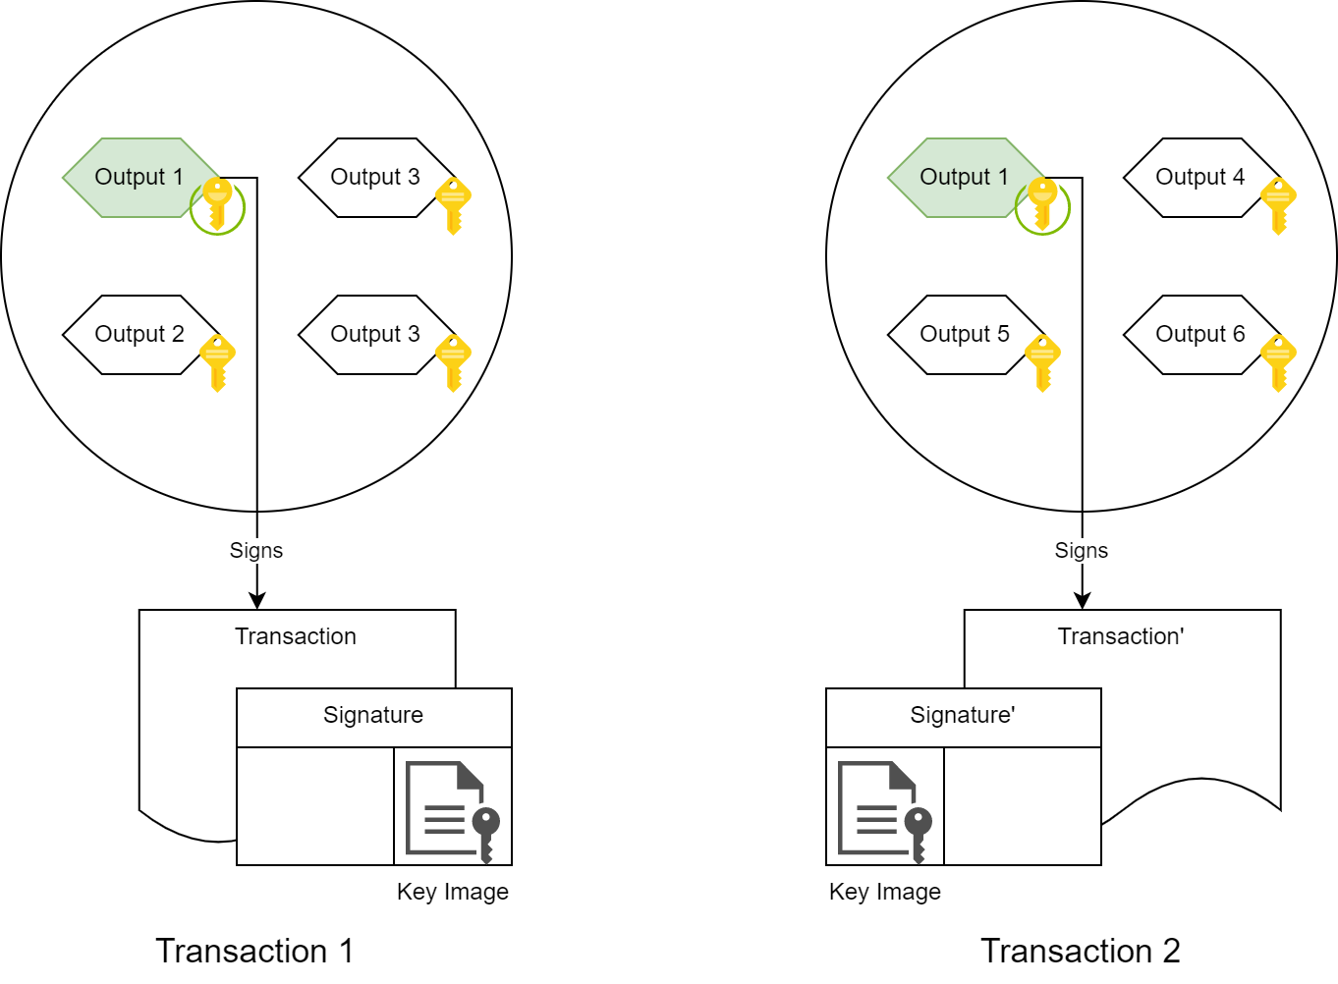
Applications I – Monero

Slide 32
Applications I – Monero
=

Slide 33
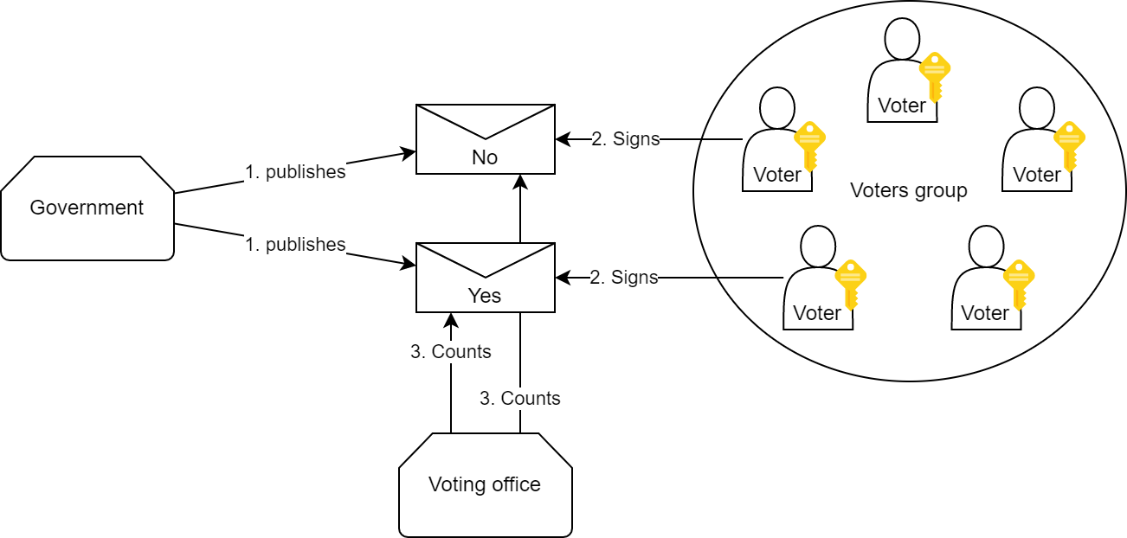
Applications II – E-Voting
No Registration Phase
Government issues m_{yes} and m_{no}
Voter signs one message
Multiple votes not possible

Slide 34
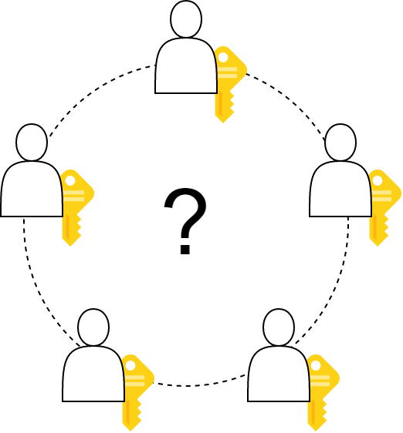
Discussion

Slide 35
References I
Linkable Spontaneous Anonymous Group Signature for Ad Hoc Groups Joseph K. Liu, Victor K. Wei, and Duncan S. Wong 2004
How to Leak a Secret Ronald L. Rivest, Adi Shamir, and Yael Tauman in Advances in Cryptology – ASIACRYPT 2001 Proceedings 2001
CryptoNote WhitePaper v2.0 https://web.archive.org/web/20201028121818/https://cryptonote.org/whitepaper.pdf Nicolas van Saberhagen 2013
Ring Confidential Transactions https://eprint.iacr.org/2015/1098.pdf Shen Noether 2015

Slide 36
References II
LSAG implementation https://github.com/meggima/seminar-crypto-2022 Markus Eggimann 2022
LSAG implementation https://github.com/sorrge/LSAG sorrge 2013

