Slide 1
Cubical complexes
Ana Gelez & Meggy-Lie-Anne Chamand

Slide 2
Outline
Cubical complexes
Tests and results
Conclusion
Computational methods

Slide 3
Cubical complexes

Slide 4
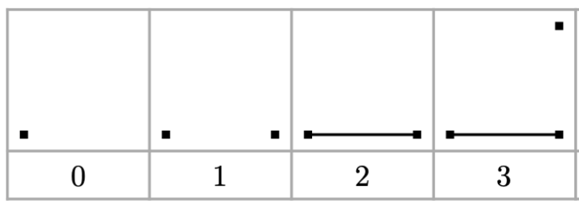
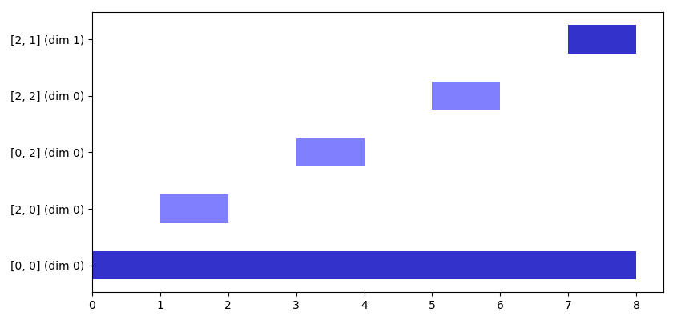
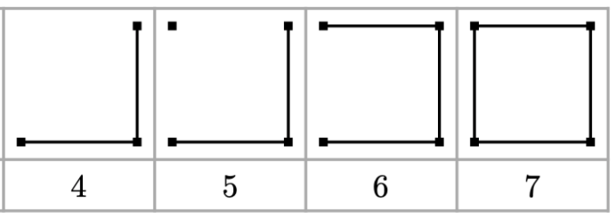
Tests and results

Slide 5
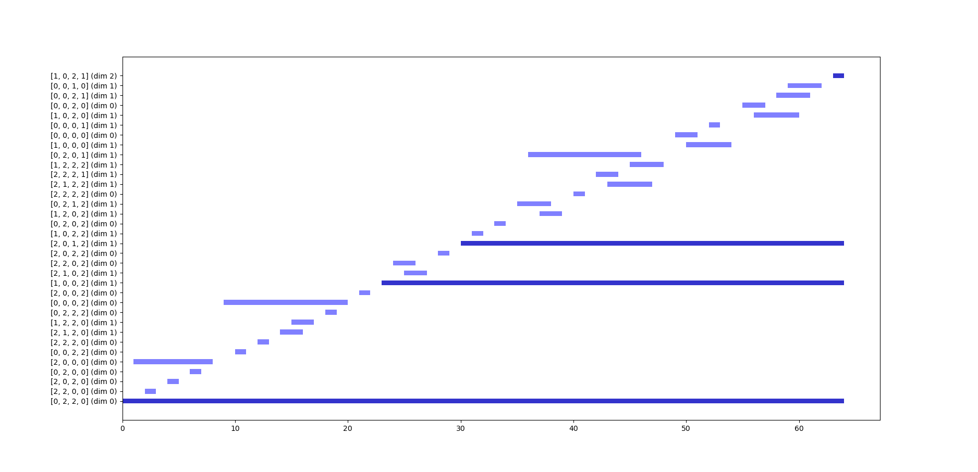
Bar code of projective plane

Slide 6
Bar code of torus

Slide 7
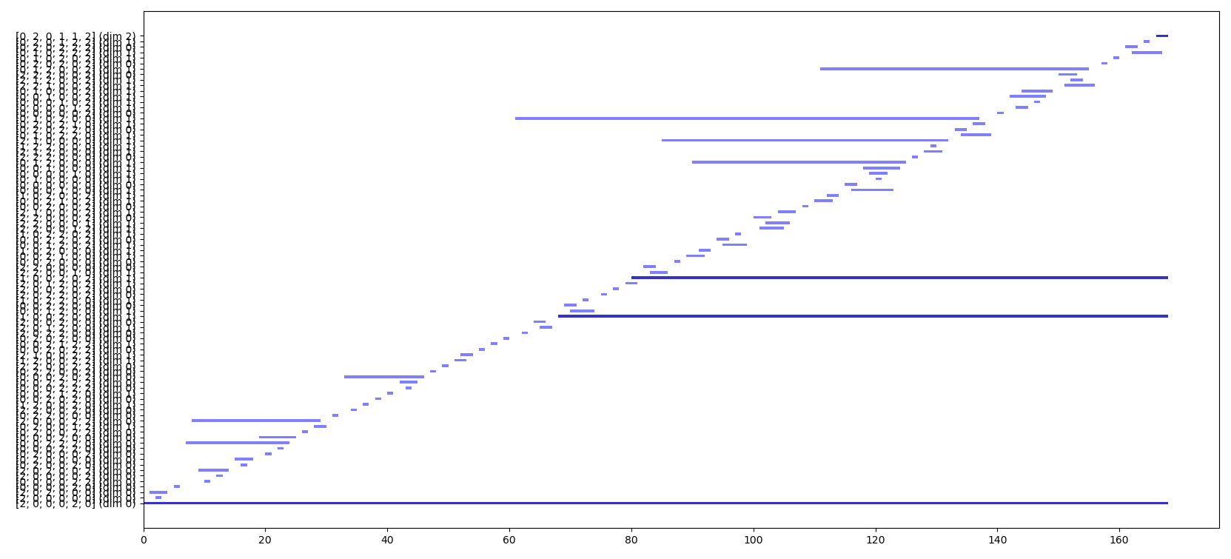
Bar code of Klein bottle

