Slide 1
Cubical complexes
Ana Gelez & Meggy-Lie-Anne Chamand

Slide 2
Outline
Cubical complexes
Tests and results
Conclusion
Computational methods

Slide 3
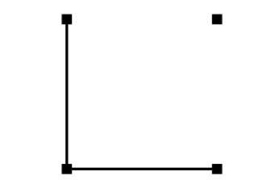
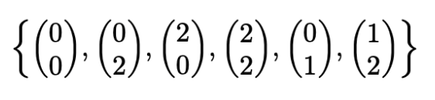
Cubical complexes
Complexes in which simplicies are replaced with cubes
Each cube can be represented as a vector.

Slide 4
Computational method
Generalization of filtration
Computation of the boundary matrix
Building of persistence pairs using the reduced matrix

Slide 5
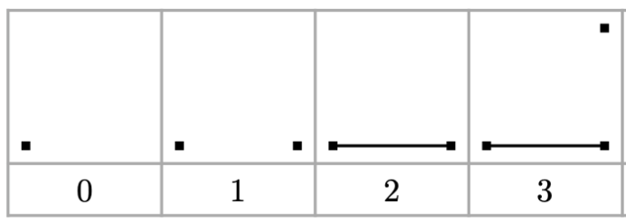
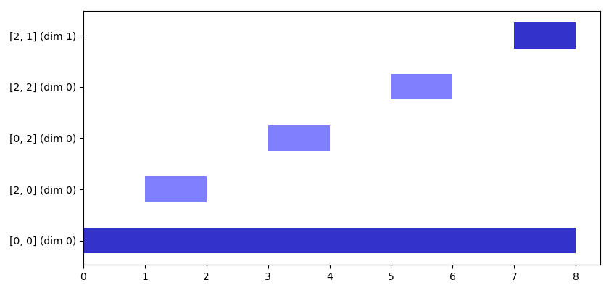
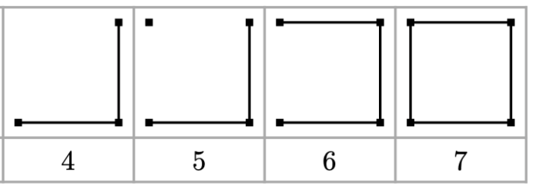
Tests and results

Slide 6
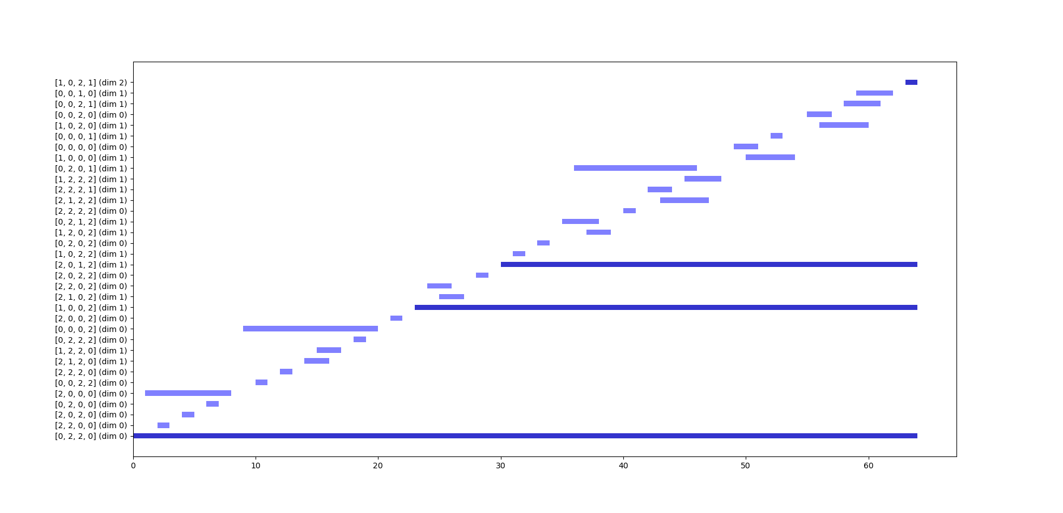
Bar code of projective plane

Slide 7
Bar code of torus

Slide 8
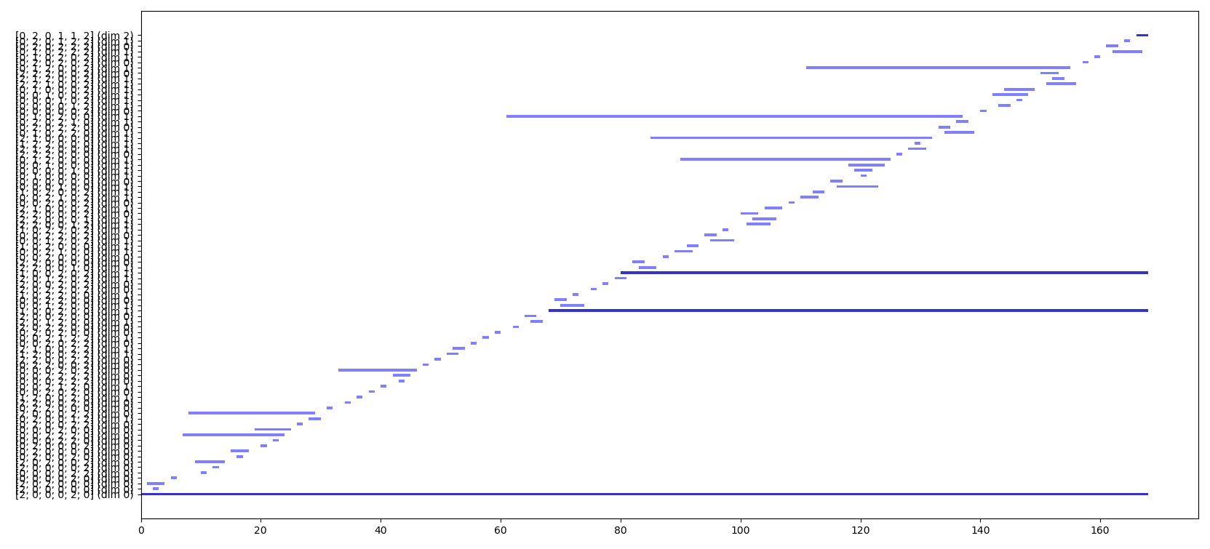
Bar code of Klein bottle

Slide 9
Conclusion

