Slide 1
Online Bookstore Management System
Mentor : Mr. Ashish Rajput.
Name : Megh Harshad Malvankar.
Enrollment No : EN12026093826

Slide 2
Project Overview
The project develops a structured and scalable Online Bookstore Management System using SQL to efficiently manage books, customers, orders, payments, and reviews.
It implements a normalized relational database design with proper primary keys, foreign keys, and constraints to ensure data integrity and reduce redundancy.
The system demonstrates complete database functionality including data insertion, retrieval, updating, deletion, analysis, and reporting using advanced SQL concepts.
It also incorporates automation features such as triggers, transactions, JSON handling, and views to improve reliability, consistency, and overall system performance.

Slide 3
Problem Statement
Online bookstores handle large volumes of interconnected data that can lead to redundancy and inconsistency.
Without a proper database design, managing orders, inventory, and payments becomes inefficient.
This project addresses these issues by implementing a normalized, secure, and automated SQL database system.

Slide 4
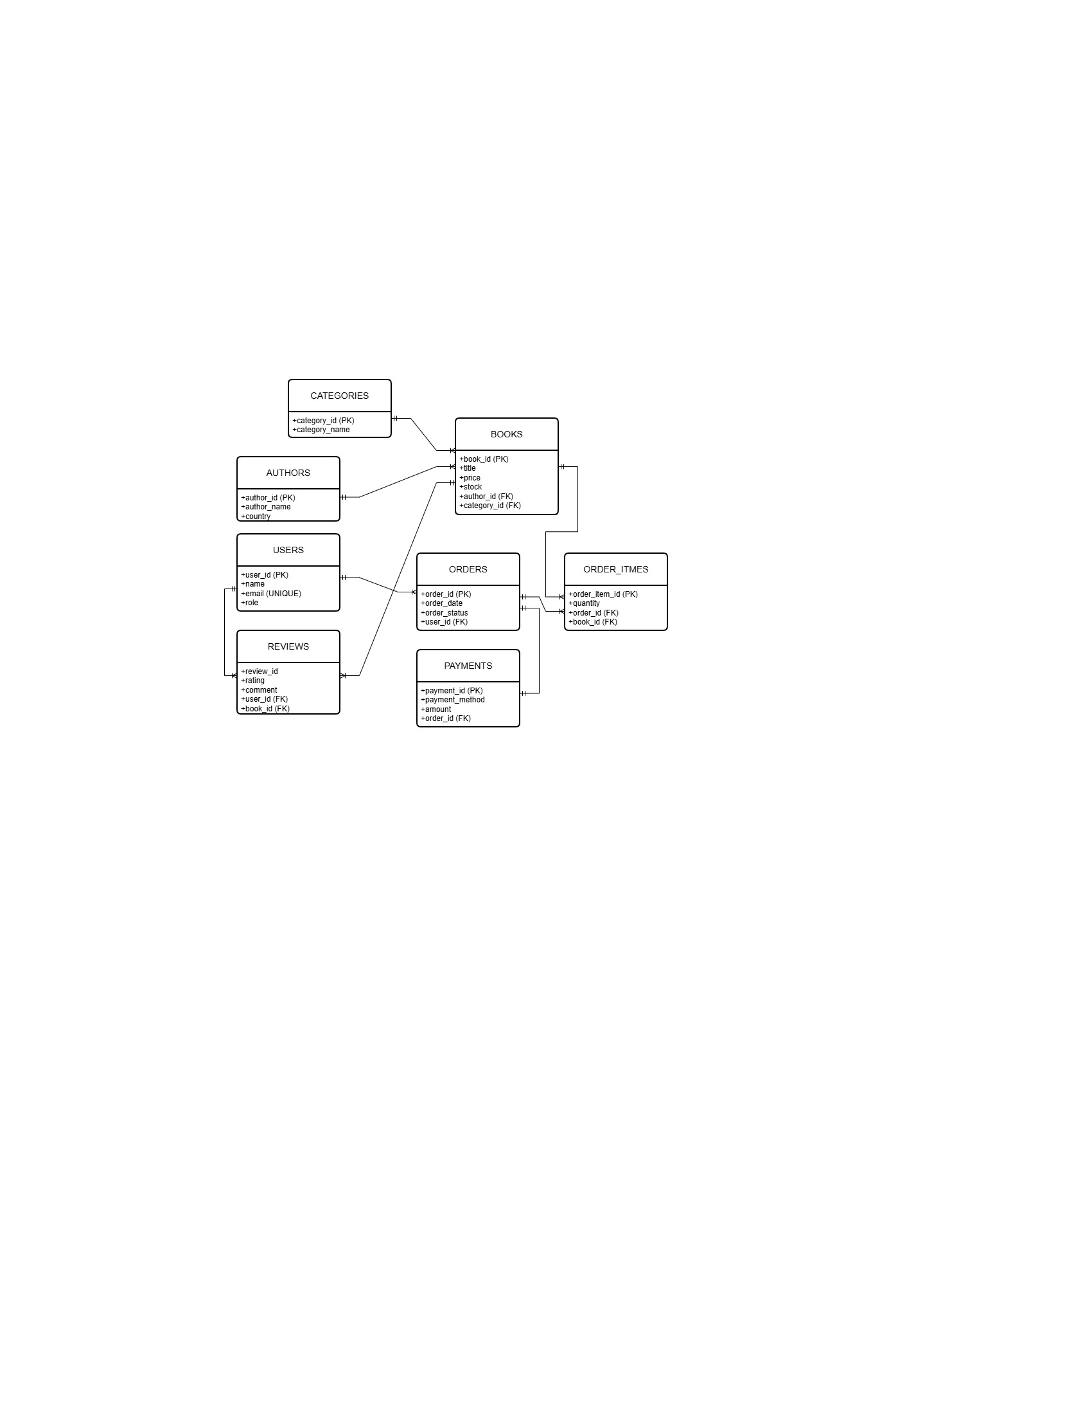
ER Diagram
The ER diagram represents the relationships between users, books, orders, payments, and reviews in the Online Bookstore system.
It defines primary and foreign key connections to maintain proper normalization and ensure data integrity.

Slide 5
Project Objectives
Objective 1 : Design and Define Bookstore Database Structure (DDL).
Objective 2 : Manage Bookstore Data Using DML Operations (DML).
Objective 3 : Retrieve and Combine Data Using SQL Joins (JOINS).
Objective 4 : Analyze Bookstore Data Using Subqueries and Aggregations (SUBQUERIES AND AGGREGATION).
Objective 5 : Automate Operations and Ensure Data Reliability (AUTOMATION AND RELIABILITY).

Slide 6
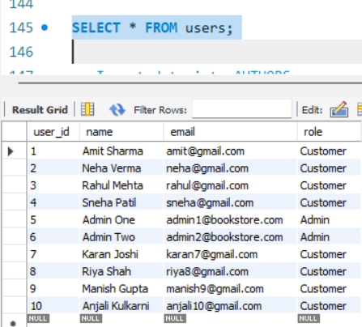
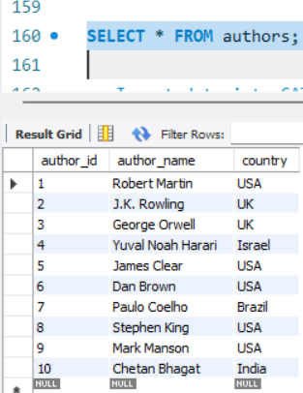
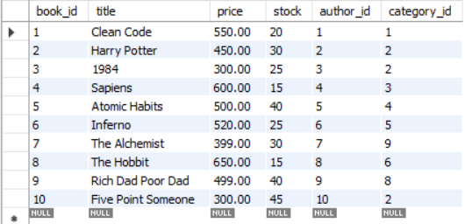
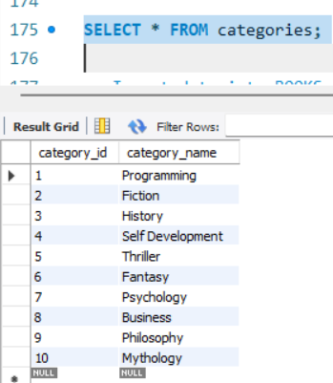
Objective 1: Design and Define Bookstore Database Structure (DDL).
Task 1 & 2: Creating Database and adding records into the Tables for Online Bookstore

Slide 7
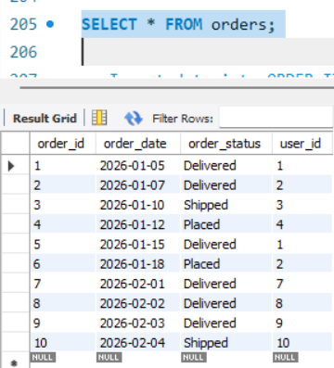
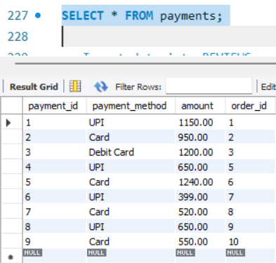
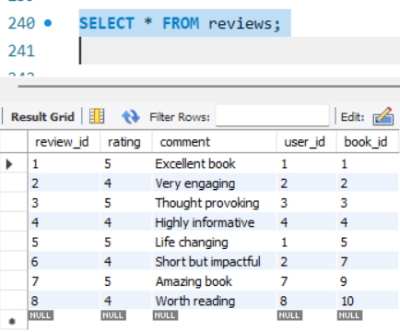
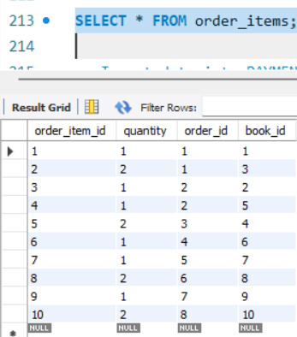
Objective 1: Design and Define Bookstore Database Structure (DDL).
This objective focuses on designing a structured and normalized bookstore database using DDL commands.
It defines tables, primary keys, foreign keys, and constraints to ensure accurate and consistent data management.

Slide 8
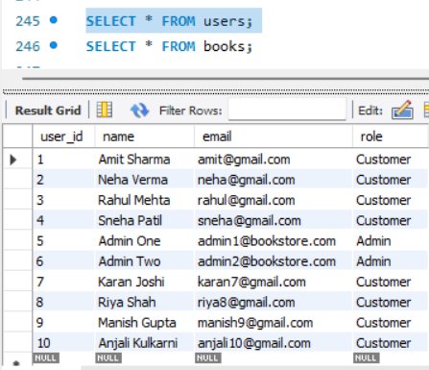
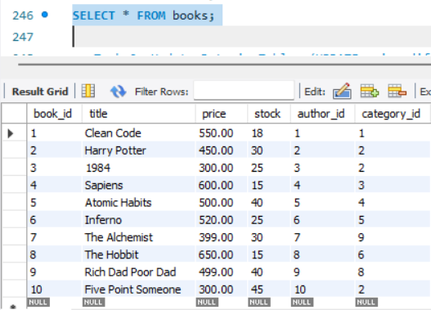
Objective 2 : Manage Bookstore Data Using DML Operations (DML).
Task 1: Retrieve Data from Tables (SELECT using multiple tables).

Slide 9
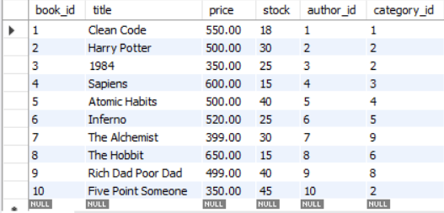
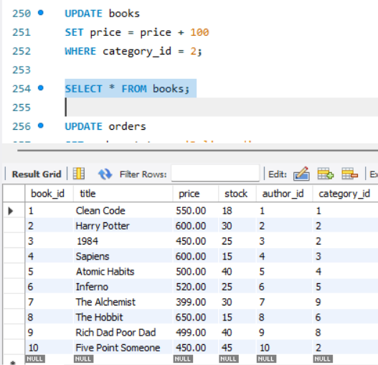
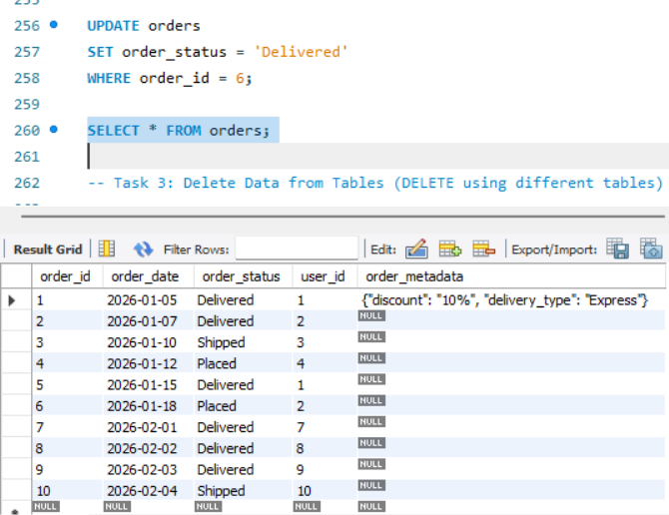
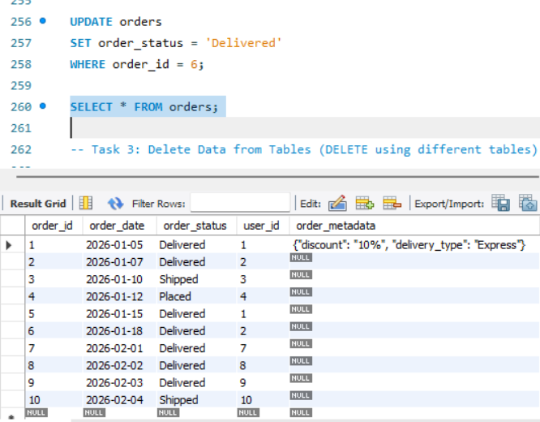
Objective 2 : Manage Bookstore Data Using DML Operations (DML).
Task 2: Update Data in Tables (UPDATE using different tables).

Slide 10
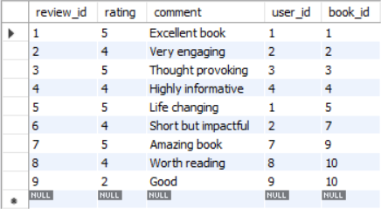
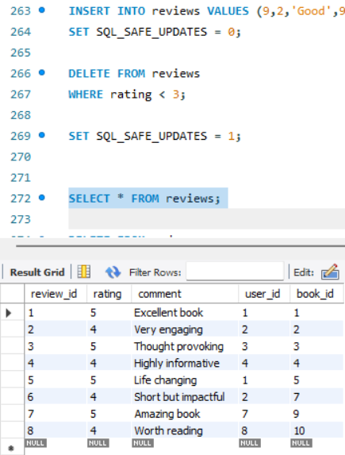
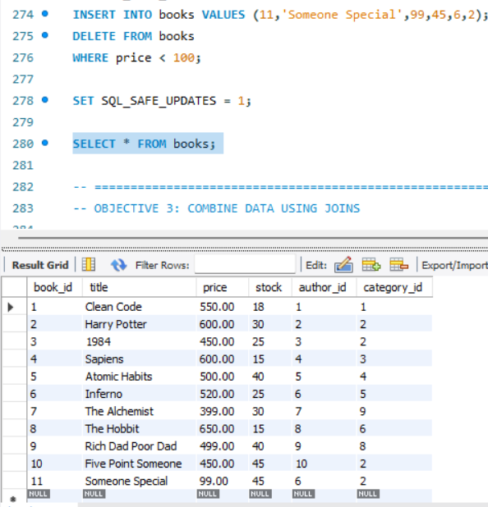
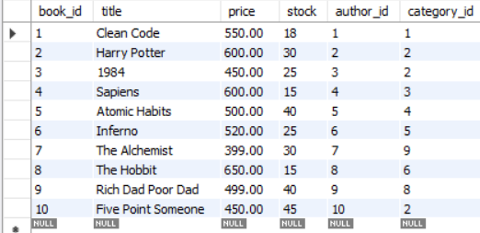
Objective 2 : Manage Bookstore Data Using DML Operations (DML).
Task 3: Delete Data from Tables (DELETE using different tables).
This objective demonstrates how DML commands are used to retrieve, update, and delete bookstore data across multiple tables.
It ensures proper data manipulation while maintaining consistency and integrity within the database.

Slide 11
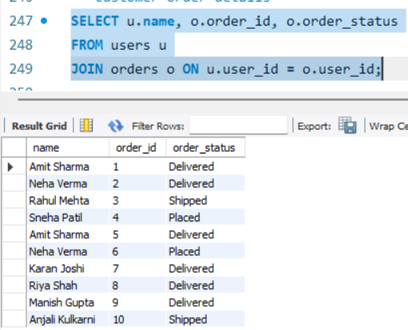
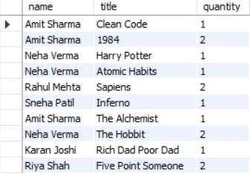
Objective 3 : Retrieve and Combine Data Using SQL Joins (JOINS).
Task 1: Retrieve Customer and Order Details Using INNER JOIN.
Task 2: Display Order and Book Information Using Multiple JOINs.

Slide 12
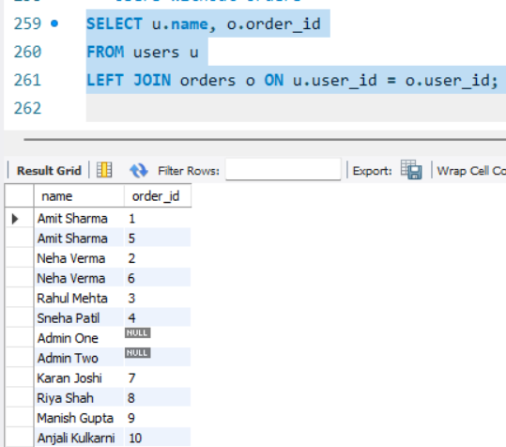
Objective 3 : Retrieve and Combine Data Using SQL Joins (JOINS).
Task 3: Identify Users Without Orders Using LEFT JOIN.
This objective demonstrates how SQL JOIN operations combine related tables to retrieve meaningful bookstore information.
It helps generate insights such as customer orders, purchased books, and users without orders.

Slide 13
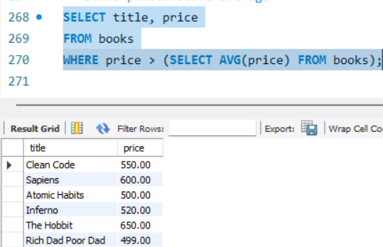
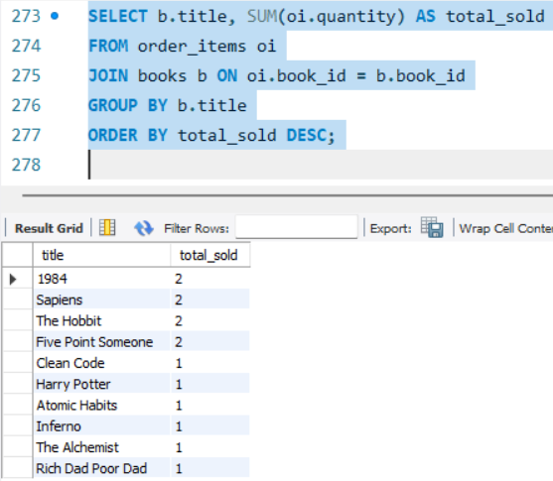
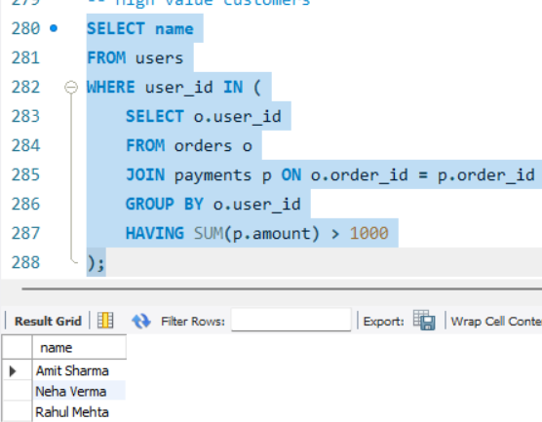
Objective 4 : Analyze Bookstore Data Using Subqueries and Aggregation.
Task 1: Analyze Book Prices Using Subqueries.
Task 2: Identify Best-Selling Books Using Aggregation Functions.
Task 3: Find High-Value Customers Using GROUP BY and HAVING.
This objective uses subqueries and aggregation functions to analyze bookstore data such as pricing and sales performance.
It helps identify best-selling books and high-value customers for better business insights.

Slide 14
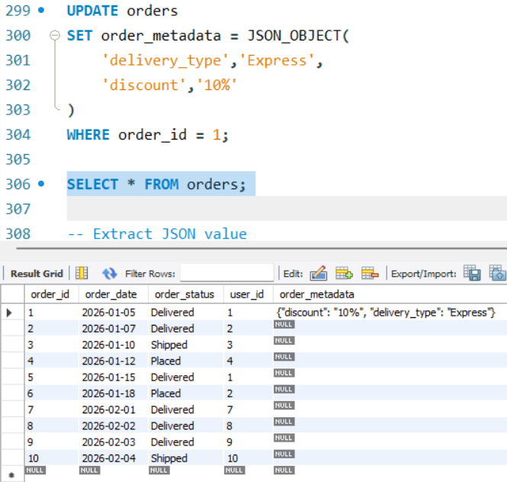
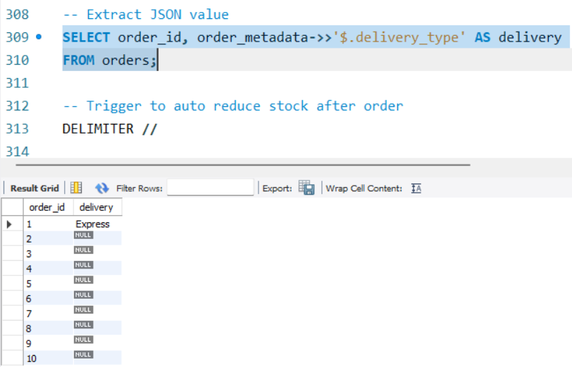
Objective 5 : Automate Operations and Ensure Data Reliability (AUTOMATION & RELIABILITY).
Task 1: Store and Retrieve Semi-Structured Data Using JSON.

Slide 15
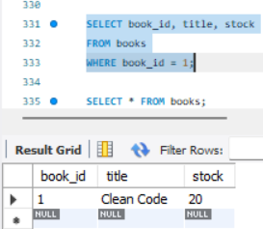
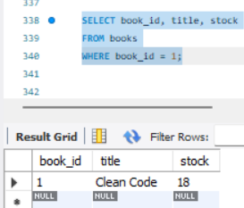
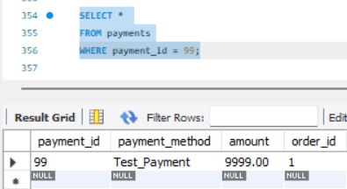
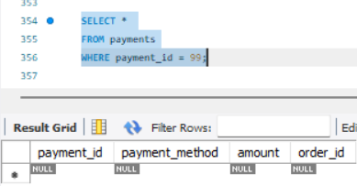
Objective 5 : Automate Operations and Ensure Data Reliability (AUTOMATION & RELIABILITY).
Task 2: Automate Inventory Management Using Database Triggers.
Task 3: Ensure Data Consistency Using Transactions and Rollback.
ROLLBACK

Slide 16
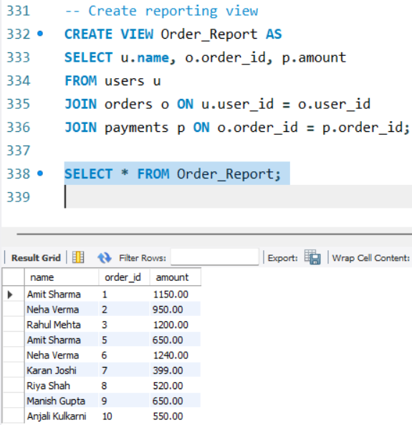
Objective 5 : Automate Operations and Ensure Data Reliability (AUTOMATION & RELIABILITY).
Task 4: Generate Summary Reports Using Database Views.
This objective focuses on automating database operations using JSON, triggers, transactions, and views to improve system efficiency.
It ensures data reliability, consistency, and secure handling of bookstore operations.

Slide 17
Challenges Faced
Designing a normalized database structure while maintaining correct relationships and constraints across multiple tables was initially complex.
Managing triggers and transactions without causing unintended data updates or inconsistencies required careful testing and debugging.
Writing optimized queries using joins, subqueries, and aggregations to retrieve accurate insights from large interconnected datasets was challenging.

Slide 18
Conclusion
The Online Bookstore Management System successfully demonstrates practical implementation of database design, data management, querying, and automation using SQL.
By integrating joins, subqueries, triggers, transactions, and JSON handling, the project ensures data integrity, efficiency, and reliability.
Overall, it reflects real-world database practices suitable for scalable and secure applications.

