Slide 1

Project Title -
[Student Name
College Name- ]
AICTE STU ID : (its available in your offer letter)

Slide 2

PROBLEM STATEMENT
(Agricultural activities are influenced by seasonal variations in environmental conditions, farming practices, resource availability and market conditions. As a result, agricultural performance may differ from one season to another. However, raw agricultural data does not clearly explain how agricultural performance changes across seasons or what patterns can be observed in different seasonal conditions. The problem is to analyze the given agricultural dataset and investigate seasonal differences in agricultural performance by identifying meaningful patterns, trends, relationships and variations within the available data.

Slide 3
Project Description
This project performs an end-to-end exploratory data analysis of a 4,000-record seasonal agriculture dataset covering 8 Indian states, 8 crops and 3 seasons (Kharif, Rabi, Zaid). Using Python (Pandas, NumPy, Matplotlib, Seaborn, SciPy), the data is cleaned, explored and visualized to compare yield, cost, revenue, profit, water-use efficiency and disease/pest risk across seasons. One-way ANOVA tests are used to check whether observed seasonal differences are statistically significant, and the findings are translated into practical, data-driven recommendations for seasonal agricultural planning.

Slide 4

WHO ARE THE END USERS?
Agricultural policymakers & state agriculture departments — for evidence-based seasonal planning
Farmers & farmer cooperatives — for choosing crops, irrigation methods and planting seasons
Agricultural researchers & academic institutions — for studying seasonal performance trends
Agri-fintech, insurance & lending providers — for assessing seasonal risk
Agri-tech startups — for building crop advisory & decision-support tools

Slide 5

Technology Used
  Python 3 — core programming language
Pandas & NumPy — data cleaning, wrangling and aggregation
Matplotlib & Seaborn — statistical data visualization
SciPy — hypothesis testing (one-way ANOVA)
Jupyter Notebook — interactive analysis and documentation
Git & GitHub — version control and project hosting

Slide 6
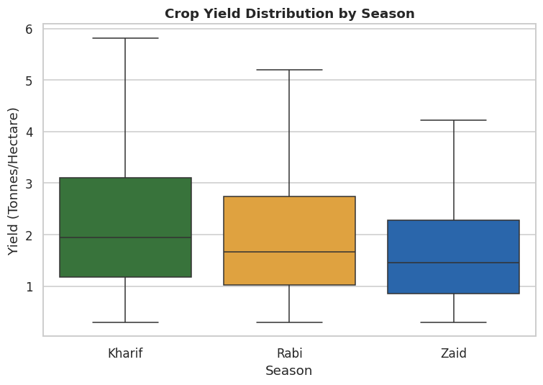
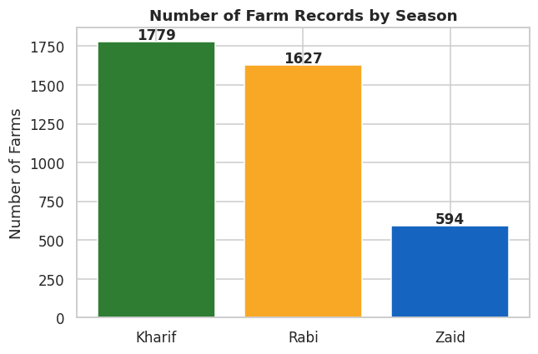
RESULTS
Kharif has the most farm records (1,779), followed by Rabi (1,627) and Zaid (594)
Yield is NOT significantly different across seasons (ANOVA p=0.21)

Slide 7
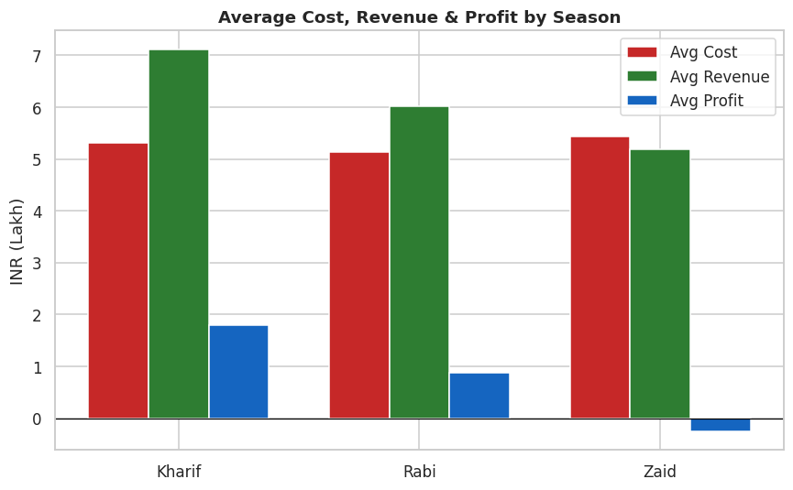
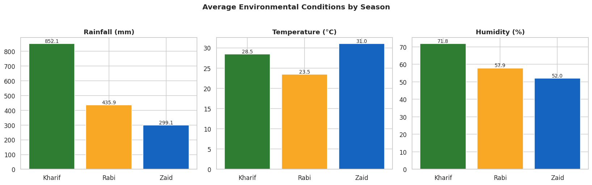
RESULTS
Kharif is the wettest & most humid season; Zaid is the hottest
Profit differs sharply by season (ANOVA p<0.001): Kharif highest, Zaid runs a net loss

Slide 8
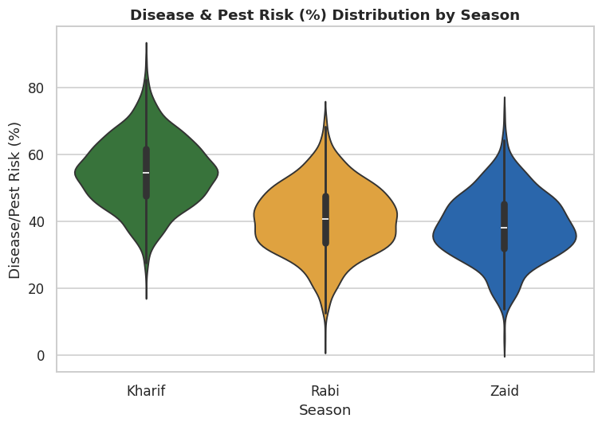
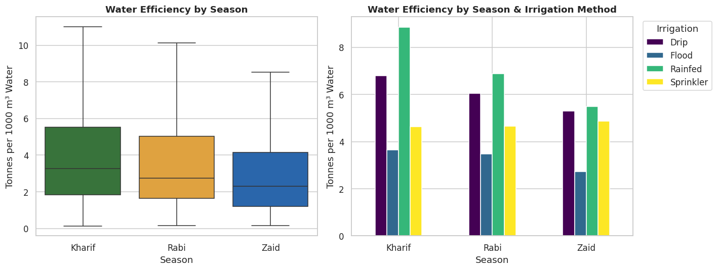
RESULTS
Rainfed plots show the highest water efficiency, ahead of Drip, Sprinkler & Flood
Disease/pest risk is significantly higher in Kharif (ANOVA p≈0), linked to rainfall & humidity

Slide 9
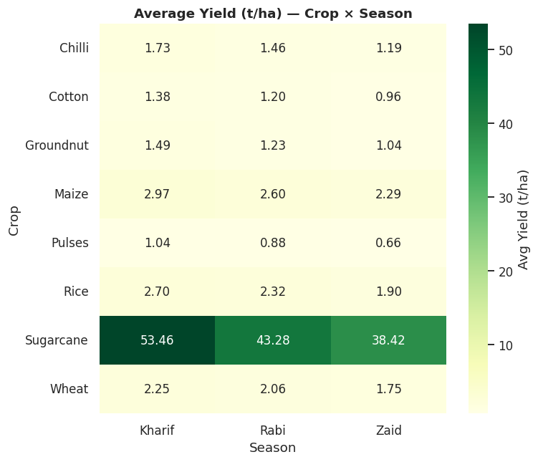
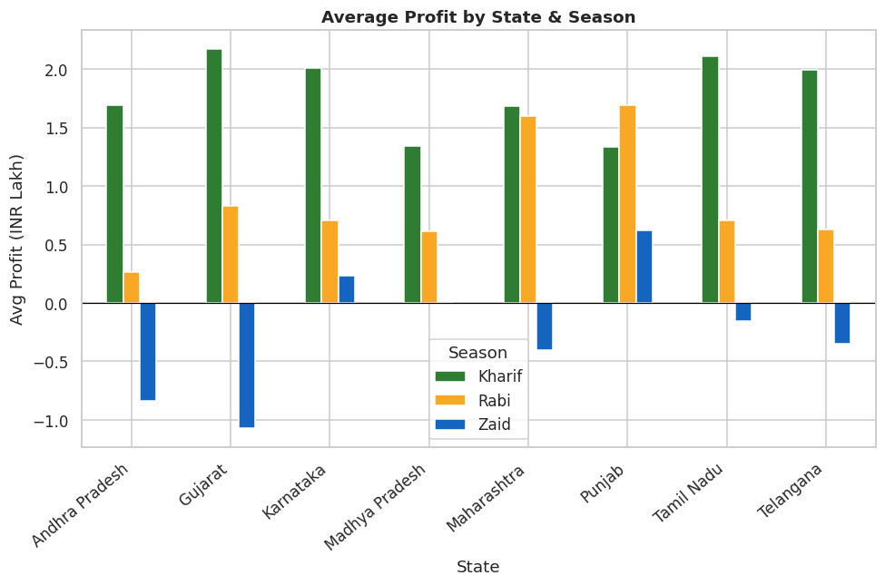
RESULTS
Every crop yields best in Kharif and weakest in Zaid; Sugarcane leads by far
Kharif is most profitable in 7 of 8 states — Punjab is the one exception (Rabi wins)

Slide 10
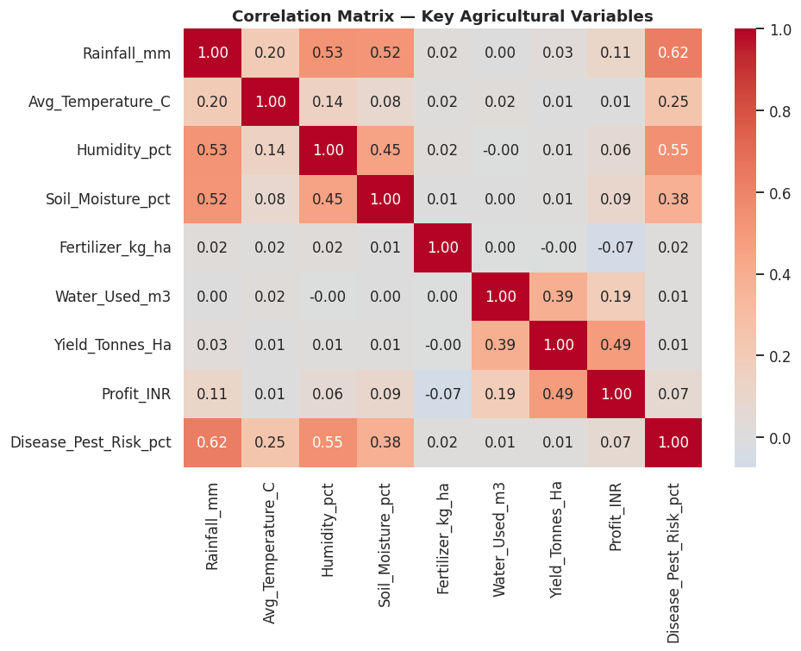
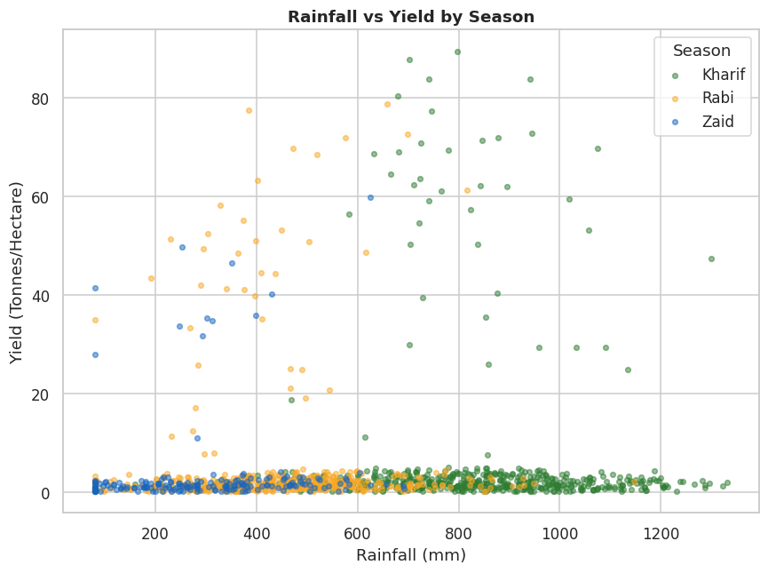
RESULTS
Rainfall alone shows only a weak relationship with yield
Most environmental variables correlate weakly with yield/profit individually

Slide 11
Future scope
Build a predictive model (regression/ML) for yield & profit forecasting
Add an interactive dashboard (Power BI / Streamlit) for real-time monitoring
Incorporate multi-year data to study year-over-year seasonal trends
Add geospatial (choropleth map) visualization for state-level insights

Slide 12
GitHub Link
https://github.com/<your-username>/seasonal-agriculture-performance-analysis (replace with your repo link after pushing)

Slide 13
VOIS Course completion certificate -
Course name- Data Visualization

Slide 14
Thank you
.
.

