Slide 1
PARKING ASSISTANCE SYSTEM

Slide 2
TEAM DETAILS:
Team Number: 01
Team Members | USN | Roll Number
Megha Somaradder | 01FE18BEC079 | 234
Pallavi A Karapurshetti | 01FE18BEC095 | 247
Pooja Savalagi | 01FE18BEC099 | 251
Prasannakumar Haveri | 01FE18BEC110 | 262

Slide 3
PROBLEM STATEMENT:
Build a system that assist the driver to orient the car in a correct position and thereby avoiding the risk of hitting the obstacles.

Slide 4
INTRODUCTION:
Parking Assistance Systems provides a confusion free and easy parking by helping the drivers of the cars to park their vehicles with minimum wastage of time with accurate information of the availability of the space to park.
Automatic car parking obtain information about available parking space, process it and then place the car at certain position. It is inevitable for the people to update with the growing technology and generally people are facing problems on parking vehicles in parking slot in a city.

Slide 5
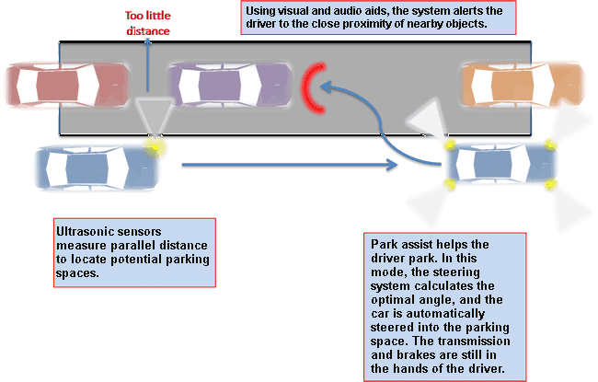
PARKING ASSISTANT SYSTEM:

Slide 6
OBJECTIVES:
Main objective of parking assistance system is to assist the driver in parking the car, thereby avoiding risk of accidents.
It also helps in finding sufficient area to park the vehicles.

Slide 7
BLOCK DIAGRAM:
Red led and buzzer on
<10
Input from the sensor
Arduino uno
Distance of obstacle from vehicle
<30
Yellow led
Green led
>50

Slide 8
IMPLEMENTATION DETAILS:
The Hardware details are as follows.
Components Used:
Arduino Uno
Ultrasonic sensor
Buzzer
LED
Resister(220ohm)
Resister(1k ohm)
wires
Simulation software: Tinkercad

Slide 9
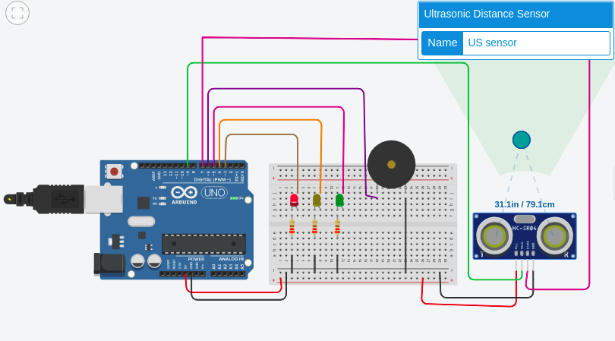
CIRCUIT DIAGRAM:
When distance between obstacle and vehicle is >50cm green light indicating vehicle is at safe distance.

Slide 10
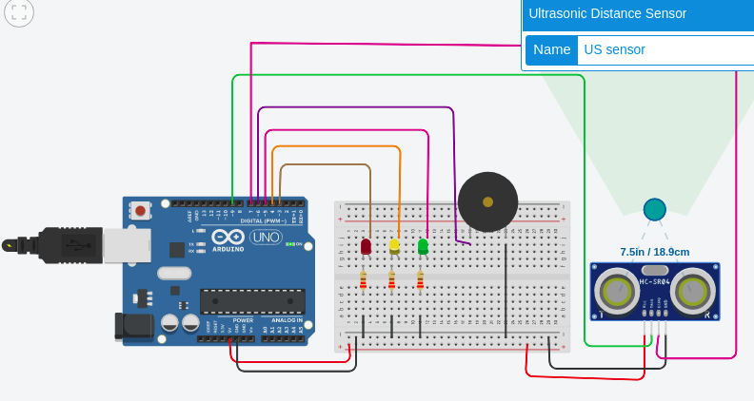
SIMULATION RESULTS:
When distance between obstacle and vehicle <30cm yellow light indicates not to move further.

Slide 11
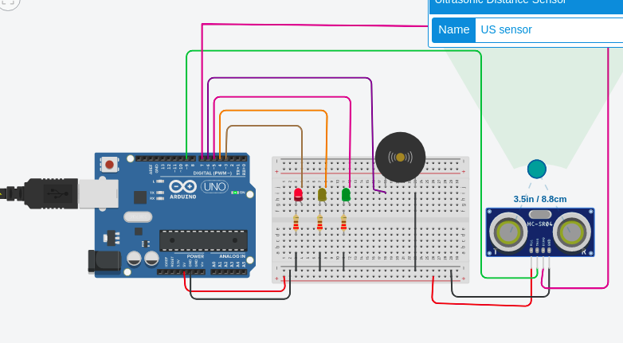
SIMULATION RESULTS:
When distance between vehicle and obstacle is <10cm red light turns on and buzzer beeps to assist the driver to stop the vehicle.

Slide 12
REFERENCES:
1.Simulation tool: https://www.tinkercad.com/
2. Theory: https://cecas.clemson.edu/cvel/auto/systems/parking.html
https://www.irjet.net/archives/V4/i3/IRJET-V4I3262.pdf
3. Circuit and Simulation: https://create.arduino.cc/projecthub/Tr3v3n_Jaganath/parking-sensor-assistant-fe5778

Slide 13
THANK YOU!

