Slide 1

Point Cloud Upsampling and Refinement
Team
Students: Avinash Reddy T 01FE18BCS057
Megha S 01FE18BEC079
Sanskruti B.K 01FE18BEC258
Rasheed Nadaf 01FE18BEC132
Guide: Ramesh Ashok Tabib
Department/ School:SoCSE and SoECE
2020-21
<number>

Slide 2

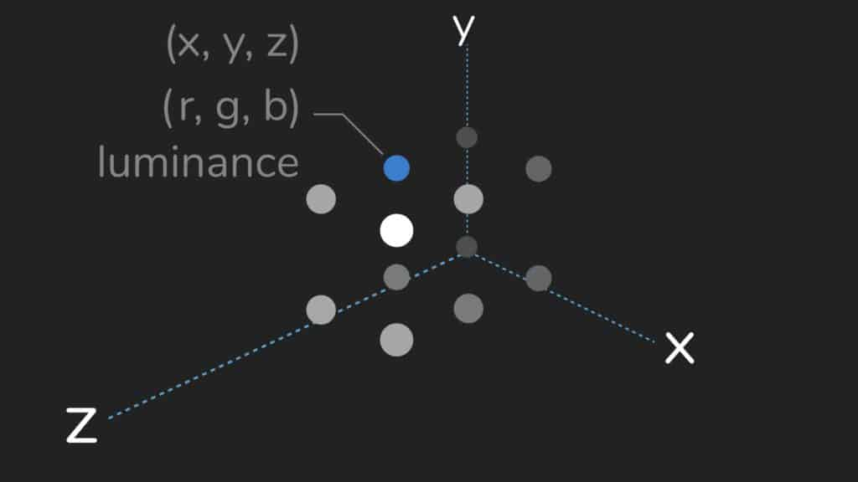
About Point Clouds:description and creation
Point clouds are the simplest representation of 3D models, They are the collection of individual points plotted in 3D
Each point contains several measurements, including its coordinates along the X, Y, and Z-axes, and sometimes additional data like color value(RGB format) and the luminance value
Point clouds are created in 2 ways
Laser scanners : they work by sending out pulses of light to the surface of an object and measuring how long it takes each pulse to reflect back and hit the scanner.
Photogrammetry: It uses photos of an object taken at different locations to triangulate points on the object and plot these points in 3D space.
Figure 1:Properties of Point Clouds in 3D space
<number>
Notes:
<number>

Slide 3
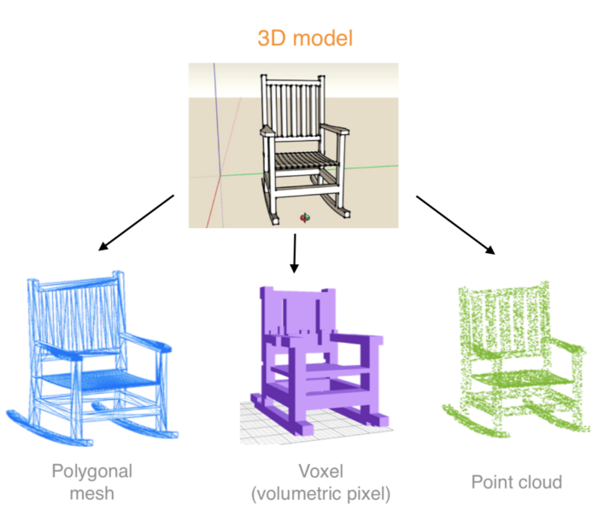
Motivation:why Point Clouds?
There are many other representations present for 3D data, ex meshes, voxels, grids, etc but these representations lead to unnecessarily voluminous data while rendering.
Ex :cubic voxel grid of size 100 will have 1,000,000 voxels.
The point clouds are generally created using lidar sensors, but the resultant point cloud is often sparse and noisy.
Thus up-sampling and refinement process are important for better representation and post processing of point clouds
Figure 2:Types of 3D data Representation
<number>
Notes:
<number>

Slide 4
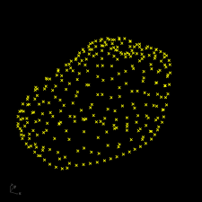
Constraints:Point Clouds boon or bane?
There are three main constraints:
Unordered: a network that consumes N 3D point sets needs to be invariant to N! permutations of the input set in data feeding order.
Interaction among points: the model needs to be able to capture local structures from nearby points, and the combinatorial interactions among local structures.
Invariance under transformations: rotating and translating points all together should not modify the global point cloud category nor the segmentation of the points.
Figure 3:Point Clouds do not a have definite structure as arrays or voxels they are highly unordered.
<number>
Notes:
<number>

Slide 5
Literature survey
Base paper: R. Q. Charles, H. Su, M. Kaichun and L. J. Guibas, "PointNet: Deep Learning on Point Sets for 3D Classification and Segmentation," 2017 IEEE Conference on Computer Vision and Pattern Recognition (CVPR), Honolulu, HI, USA, 2017, pp. 77-85, doi: 10.1109/CVPR.2017.16.
Paper 2: Y. Lian, T. Feng and J. Zhou, "A Dense Pointnet++ Architecture for 3D Point Cloud Semantic Segmentation," IGARSS 2019 - 2019 IEEE International Geoscience and Remote Sensing Symposium, Yokohama, Japan, 2019, pp. 5061-5064, doi: 10.1109/IGARSS.2019.8898177.
Paper 3: L. Yu, X. Li, C. Fu, D. Cohen-Or and P. Heng, "PU-Net: Point Cloud Upsampling Network," 2018 IEEE/CVF Conference on Computer Vision and Pattern Recognition, Salt Lake City, UT, USA, 2018, pp. 2790-2799, doi: 10.1109/CVPR.2018.00295.
5
Notes:
<number>

Slide 6
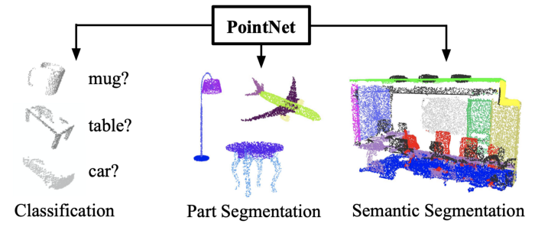
Literature survey:base paper
# | Title | Descriptions
1 | PointNet: Deep Learning on Point Sets for 3D Classification and Segmentation | Advantages: Application of object classification Part Segmentation Scene Semantic parsing. Limitation: Does not capture local structures induced by metric space.
<number>
Notes:
<number>

Slide 7
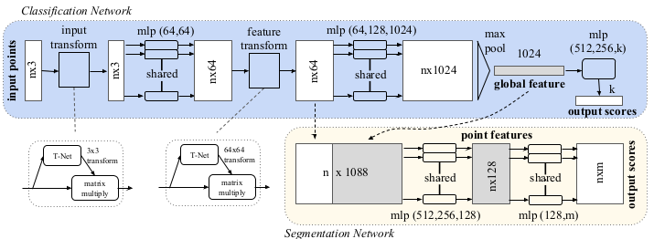
PointNet Architecture
Figure 4. PointNet Architecture. The classification network takes n points as input, applies input and feature transformations, and then aggregates point features by max pooling. The output is classification scores for k classes. The segmentation network is an extension to the classification net. It concatenates global and local features and outputs per point scores.
7
Notes:
<number>

Slide 8

Literature Survey:paper II
# | Title | Descriptions
2 | Point-Net++: Deep Hierarchical Feature Learning on Point Sets in a Metric Space | Advantages: Local features can be learnt efficiently and effectively. MSG and MRG helps us to achieve robust feature learning under non uniform sampling density. Inference: PointNet++ recursively functions on a nested partitioning of the input point set, and is effective in learning hierarchical features with respect to the distance metric. To handle the non uniform point sampling issue, we propose two novel set abstraction layers that intelligently aggregate multi-scale information according to local point densities.
<number>

Slide 9
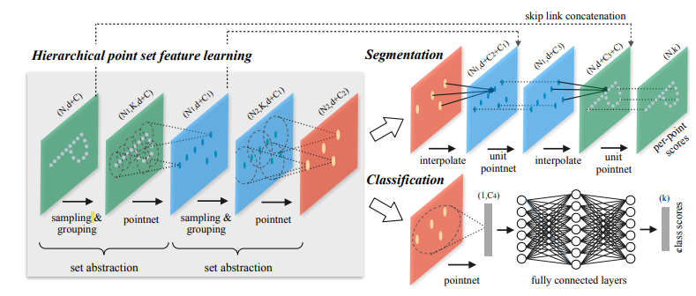
PointNet++ Architecture
Figure 5. PointNet++ Architecture:Set abstraction level consist of 3 layers sampling, grouping and pointnet layer. PointNet is used as local feature learner. Heirarchical feature learning is applied to obtain both local and global features. This architecture can be applied for both classification and segmentation task..
9
Notes:
<number>

Slide 10
Literature Survey:paper III
# | Title | Descriptions
3 | PU-Net: Point Cloud Up sampling Network | Advantages: PU-Net, learns geometry semantics of point-based patches from 3D models, and applies the learned knowledge to up sample a given point cloud. Proposed methodology: Network is applied at a patch-level, with a joint loss function that encourages the up sampled points to remain on the underlying surface with a uniform distribution. The key idea is to learn multilevel features per point, and then expand the point set via a multi-branch convolution unit implicitly in feature space. The expanded feature is then split to a multitude of features, which are then reconstructed to an up sampled point set.
<number>

Slide 11
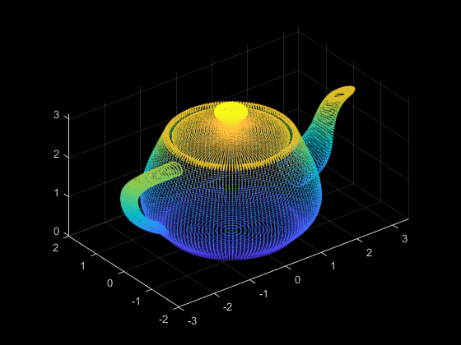
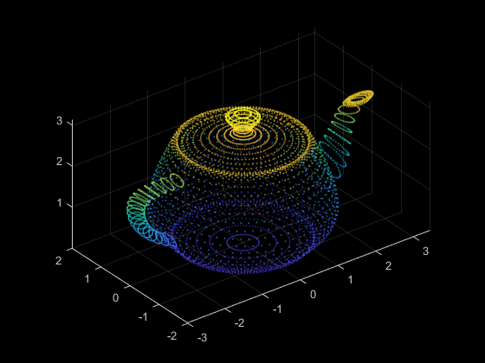
File formats:
.ply format(stanford triangle format)
PLY format describes object as a collection of vertices, faces and other elements along with properties such as color and normal direction.
.xyz file format
A point cloud data file in XYZ format must contain rows of data. For a rectangular coordinate system, each row must consist of X-, Y-, and Z-coordinates followed by the field value at that point.
Figure 6. Mesh
11
Figure 7. point cloud
Notes:
<number>

Slide 12
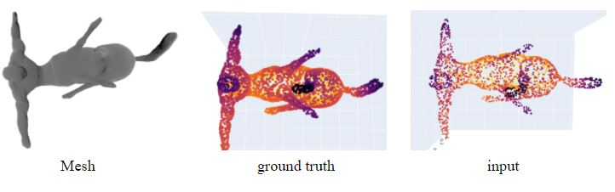
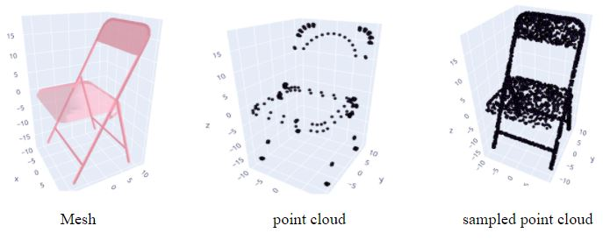
Dataset Description
We have worked with 2 datasets SHREC15 and Modelnet40:
SHREC15:It contains .obj formats of non-rigid objects and non-rigid human statues.
ModelNet40:This dataset contains .off format 3D object representations of 40 different class objects like bathtub,chair,closet,etc
We convert these .obj and .off formats into point clouds by uniformly sampling points all over the surface of the objects.
As there is no different train and test data set available we sub-sample the existing point cloud and use it as input
Figure 8: SHREC15 3D object representation
Figure 9: ModelNet40 3D object representation
12
Notes:
<number>

Slide 13
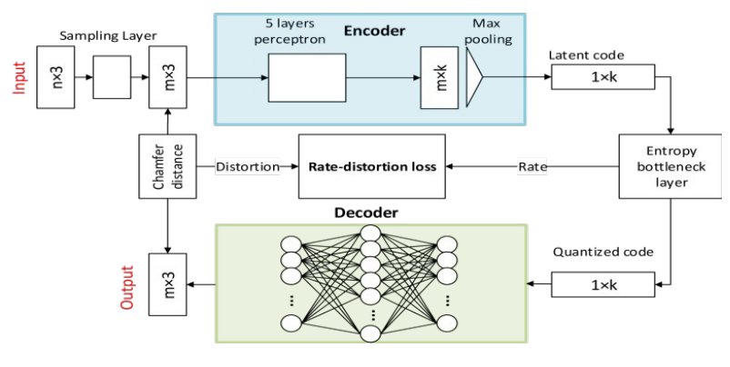
Implementation:I
Figure 10: Pointnet Autoencoder
<number>

Slide 14
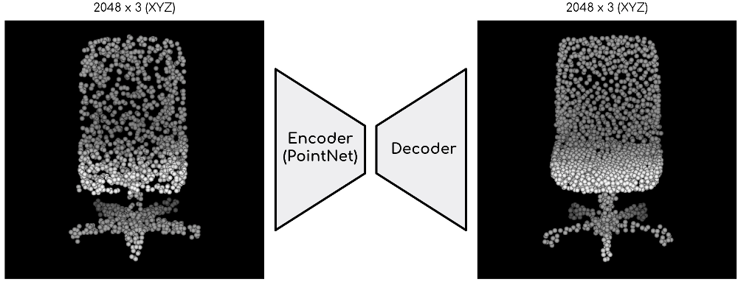
Implementation:I
Figure 11: Pointnet Autoencoder
<number>

Slide 15
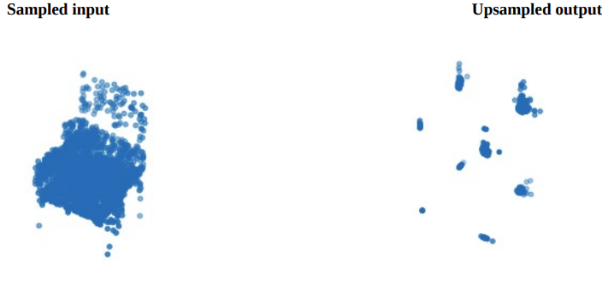
Result:
Figure 12:PointNet Autoencoder result
Number of training epochs: 100
Autoencoder failed to capture the geometry of the point cloud due to this reason the points are overlaped at the corners.
<number>

Slide 16
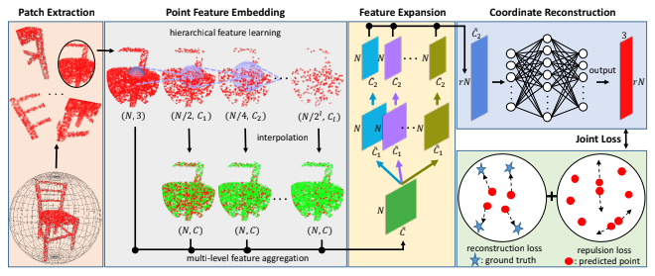
Implementation:II
Figure 13: PU-Net modules
Modules:
Patch Extraction:Extracting Patches of Point Clouds of varying sizes.
Point Feature Embedding:Progressively capture both the local and global geometry context from the patches.
Feature Expansion:Expanding the features in a feature space.
Co-ordinate Reconstruction: Reconstruction of the original Point Cloud from the feature vector.
16
Notes:
<number>

Slide 17
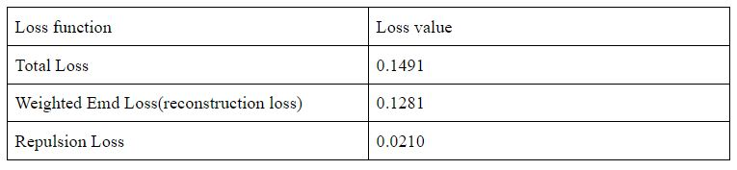
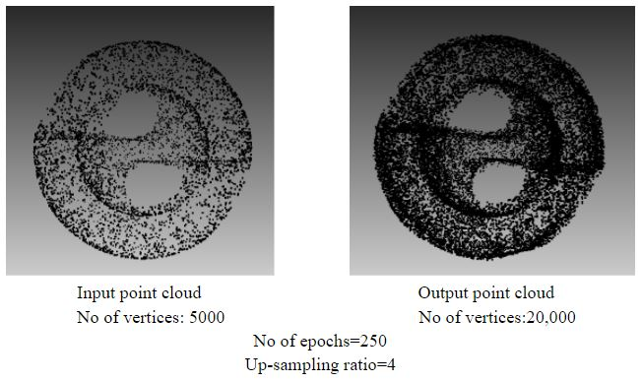
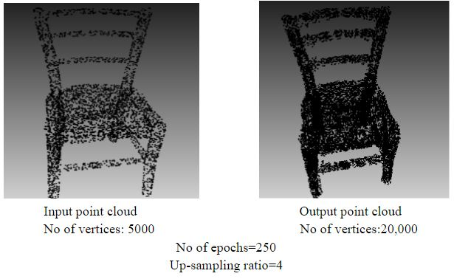
Results:
Table 1:Loss Values
Figure 14:Upsampling of a scult object
Figure 14:Upsampling of a chair object
<number>

Slide 18
Conclusion
Conclusions & Challenges:
Though point clouds are simplest representation of 3D data, they come with drawbacks the most important of it being the unorderedness of the Point Cloud data.Upsampling of the point cloud is challenging due to the irregularity and sparseness of the data. The model to which we input the point cloud must be invariant to certain geometric transformations and also it should be invariant to permutations of the input set. PointNet architecture helps us to achieve these constraints. The fully connected layer at the output helps us to obtain upsampled output, and chamfer distance helps us to propagate back if the geometry is not captured properly. The pointnet++ paper provides us with a mechanism to extract both the global and local features. This in turn is used by PU-Net paper to upsample the points. Using hierarchical feature learning has been fruitful in achieving upsampling.
Plan of Action :
we are looking to work and implement more robust models such as PU-GAN,PCN.
we are looking for various other kinds of Loss Functions to be used for upsampling.
we would like to work on the PointNet Autoencoder model and try to decrease the error of the model.
Contributions:
We were able to implement a deep learning model which takes in sparse and non-uniform Point Cloud and outputs an upsampled and uniform Point Cloud.
<number>

Slide 19
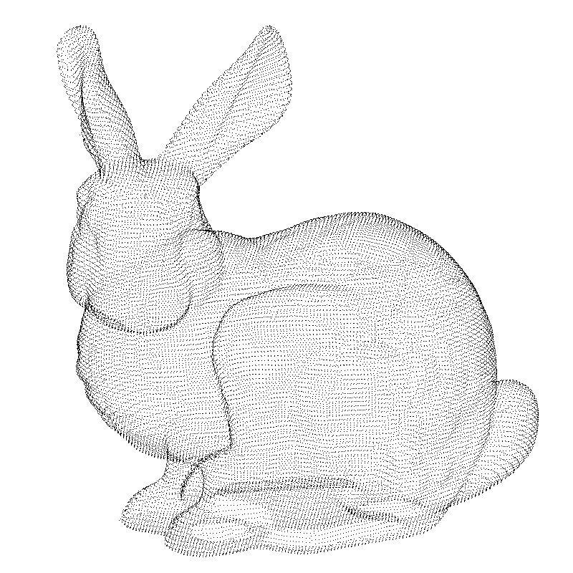
Thank You
<number>

