Slide 1

DR. BABASAHEB AMBEDKAR TECHNOLOGICALUNIVERSITY,
LONERE, MAHARASTRA
A
Seminar Presentation
On
Title:- “Obstacal Avoding Robot”
Presented By :- Rohini R. Narwade(2130331372511)
Meghraj Patil(2030331372020)
Department of Electronics And Telecommunication engineering Lonere,
2022-23

Slide 2
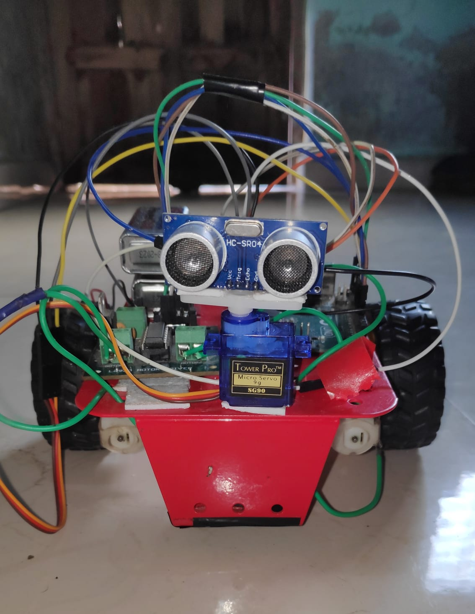
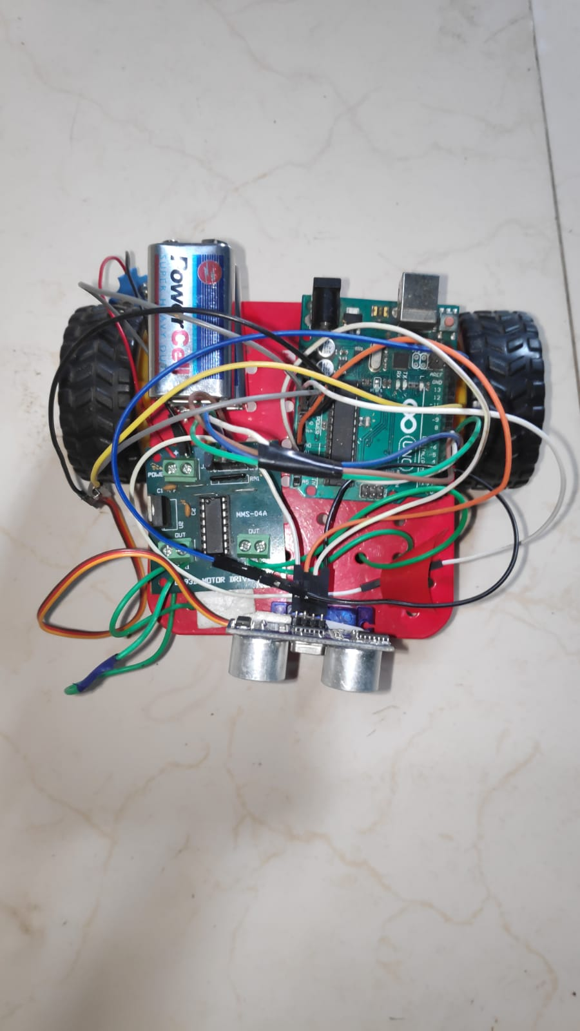
Obstacle avoiding robot

Slide 3
Contents:
Project overview.
Block diagram.
Components used
Microcontroller.
Power supply
Arduino.
Servo motor.
Ultrasonic sensor.
DC motor.
Software used.
Circuit diagram.
Working.
Applications.
Future scope.
Conclusion.

Slide 4
Project overview:
The project is developed with the motive that no external commands are given to the robot.
All the processing from detecting the object to making turns is done by an Arduino.
The distance value from the sensor is processed by the Arduino for making decisions.
The servo motor is commanded and the dc motor are also sent the signal for changing directions if an obstacle is detected.

Slide 5
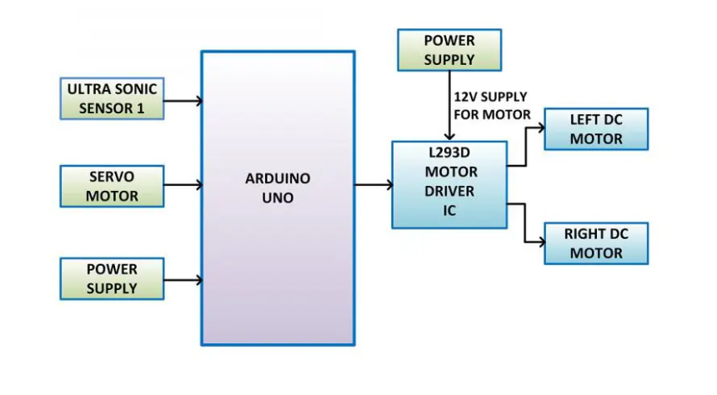
Block diagram:

Slide 6
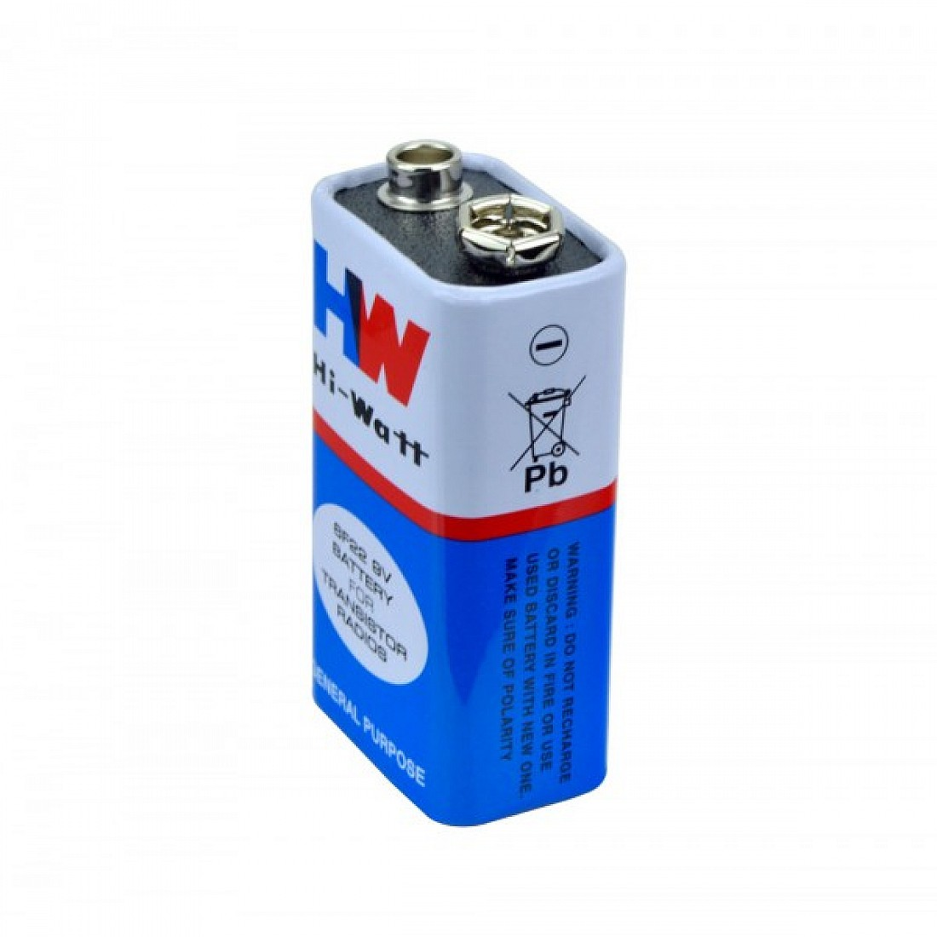
Components used - Power supply:
The Power supply used here is 9v battery
7805

Slide 7
Microcontroller used – AVR:
AVR is a family of microcontrollers developed by Atmel. These are modified Harvard architecture & 8 bit RISC single-chip microcontrollers.
AVR was one of the first microcontroller families to use on-chip flash memory for program storage, as opposed to one-time programmable ROM, EPROM, or EEPROM used by other microcontrollers at the time.
AVR microcontrollers used in the Arduino board designs.
The 8-bit Arduino used in this project is Atmega328p.

Slide 8
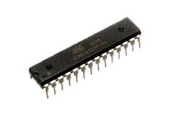
Atmega328p :
Arduino/Genuino Uno is a microcontroller board based on the ATmega328p
It has 14 digital input/output pins (of which 6 can be used as PWM outputs).
6 analog inputs are also available for input or output.
Atmega328p runs at a 16 MHz clock cycle.

Slide 9
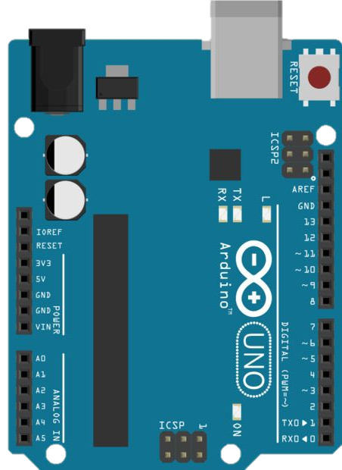
Arduino:
Arduino is a open source electronics community.
It focuses on using microcontrollers in advance electronics by building microcontroller boards.
These boards uses AVR series microcontrollers for processing and controlling.
You can blink an LED or control an servo motor or even send or receive your twitter messages.

Slide 10
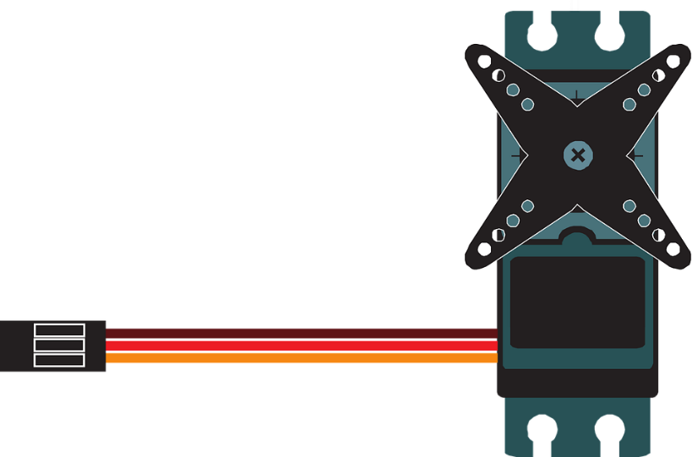
Servo Motor:
A servomotor is a rotary actuator or linear actuator that allows for precise control of angular or linear position, velocity and acceleration.
It consists of a suitable motor coupled to a microcontroller for position feedback.
Servo motors are small, have built-in control circuitry and have good power for their size.
Servos are used in radio-controlled airplanes, a robot, or operating rudders, etc.

Slide 12
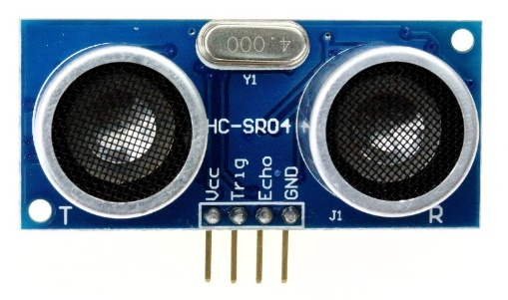
Ultrasonic Sensor:
As the name suggests, ultrasonic waves are used in this sensor. Also known as HC SR-04 ultrasonic sensor.
An Ultrasonic sensor is a device that can measure the distance to an object by using sound waves.
It measures distance by sending out a sound wave at a specific frequency and listening for that sound wave to bounce back.
By recording the elapsed time the distance is calculated.

Slide 13
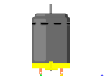
dc Motors:
A motor is an electrical machine which converts electrical energy into mechanical energy.
The principle of working of a DC motor is that "whenever a current carrying conductor is placed in a magnetic field, it experiences a mechanical force".
Electrical motors are everywhere around us. Almost all the electro-mechanical movements we see around us used them,
Additional sensors and electronics control the dc motors.

Slide 14
Software used:
Microcontrollers mostly use different software's from compiling code or to creating a ‘hex file’ till making its PCB( Printed Circuit Board ).
Unlike them the Arduino software is an all-in-one design.
The Arduino Integrated Development Environment - or Arduino Software (IDE) - contains a text editor for writing code, a graphic window (Serial Monitor), a text console, a toolbar with buttons for compiling the code .
Also, it connects to the Arduino hardware to upload programs and communicate with them.

Slide 15
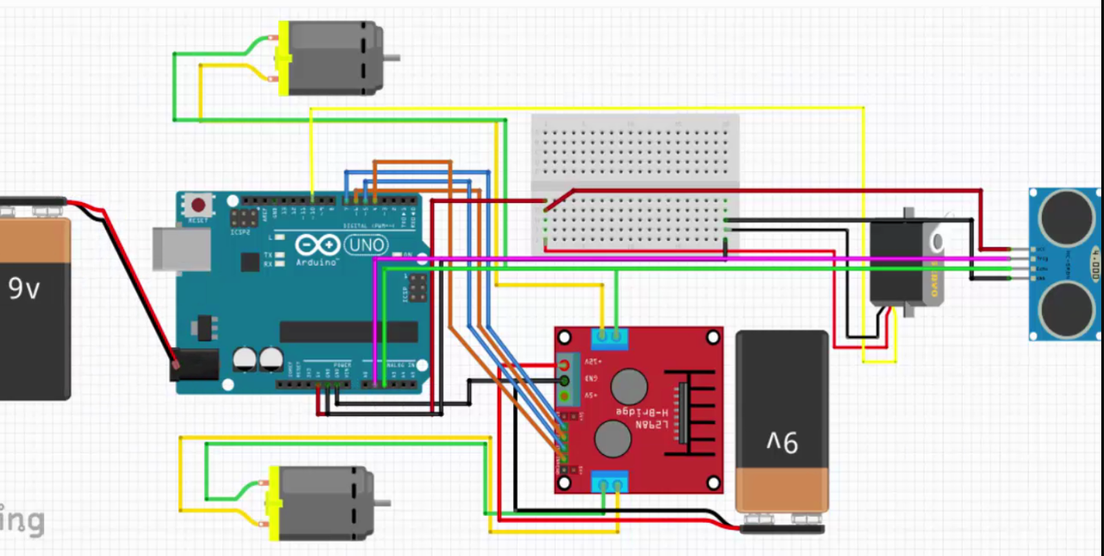
Circuit Diagram:

Slide 16
Working:
The Arduino used here is connected here with sensors and motors both servo and DC motors.
The sensor receives a signal whenever an obstacle is detected. This signal is then sent as a feedback to servo motors to change its angle to +90° or -90°. While the DC motors are stopped.
And then it’s checked that the path is clear. If it is then the DC motors are turned ON.
The obstacle detection check occurs repeatedly to avoid collision this is possible due to the sophisticated algorithm used in it.

Slide 17
Applications:
Obstacle avoiding robots can be used in almost all mobile robot navigation systems.
They can be used for household work like automatic vacuum cleaning.
They can also be used in dangerous environments, where human penetration could be fatal.

Slide 18
Future Scope:

Slide 19
Conclusion:
We hereby conclude that the Pixel is a versatile and a rugged robot which can work efficiently in avoiding obstacles in the path and reach its destination.
Also due to its highly efficient algorithm the robot detects the path for exist if it is surrounded by obstacles from all 3 sides.

Slide 20


