Slide 1
Information Communication Networks
BIG PICTURE
{ OVERVIEW }

Slide 2
Information Communication Networks
Traditional categories
1
2
Telecom Networks
Computer Networks
Meant primarily for only voice ( telephone ) communications
Meant primarily for
data communications
( Text, Image, Video ) using computers
Today’s internet

Slide 3
Technology principles
1
2
Telecom Networks
Computer Networks
certain core principles are common to both types of networks
Certain principles differ

Slide 4
Emerging trend
is
both technologies are converging
WHY & HOW ?

Slide 5
Emerging trend
is
both technologies are converging
WHY ?
Once upon a time
only telephones were used for voice communication
Only computers were used for data ( Text, Image, Video) communication
Only Radio was used for audio broadcasting
Only TVs were used for Video broadcasting

Slide 6
Today’s
Computers
Smart phones
connected to internet
are used
to get all these three services
Voice, Text & Video

Slide 7
Part#1
Telecom Networks
Basics

Slide 8
Telecom Networks
Traditional
Wired Phones
( also called as Landline phones )
Modern
Wireless Phones
( popularly known as Mobile phones )
2G, 3G, 4G, 5G

Slide 9
Telecom Network is a Switched Network

Slide 10
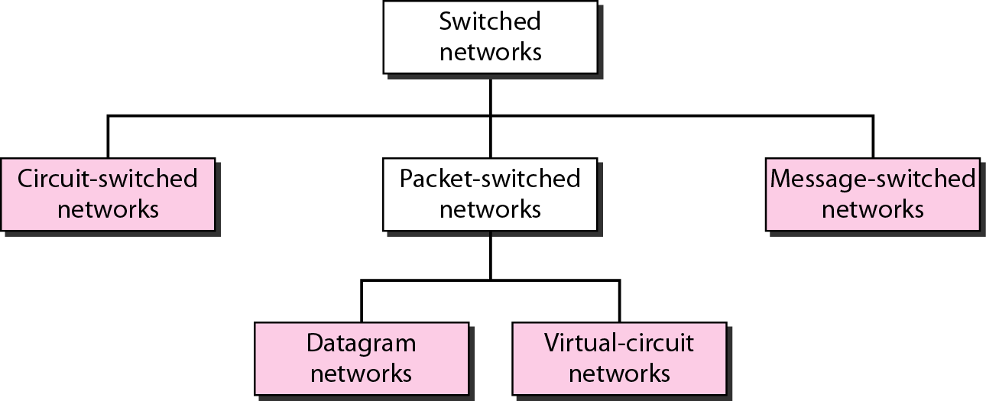

Slide 11




Circuit Switched Network
Telephone communication is connection oriented service
means
a logical connection is established before sending the data/information through a circuit / path / route /
Telecom Networks
Basics

Slide 12
Telecom Network
Circuit
or
Route
Or
Path
between two end active phones
In this case,
3 circuits
{ Simultaneous conversations }
are established

Slide 13
A Route/Path
between two end phones
is established
through
the series of
Switches and Multiplexers
connected using Transmission links
Each transmission link
is divided in to
multiple channels
Each channel carries
a conversation
between two end phones

Slide 14

3 Basic elements of Telecom Network
1.Switch
2.Multiplexer
3.Transmission Link

Slide 15
Terminologies related to Telecom Network
Route/Path/Circuit
Switche( Telephone Exchange/Voice Switch )
Multiplexer/Demultiplexer
Transmission links
Channels

Slide 16
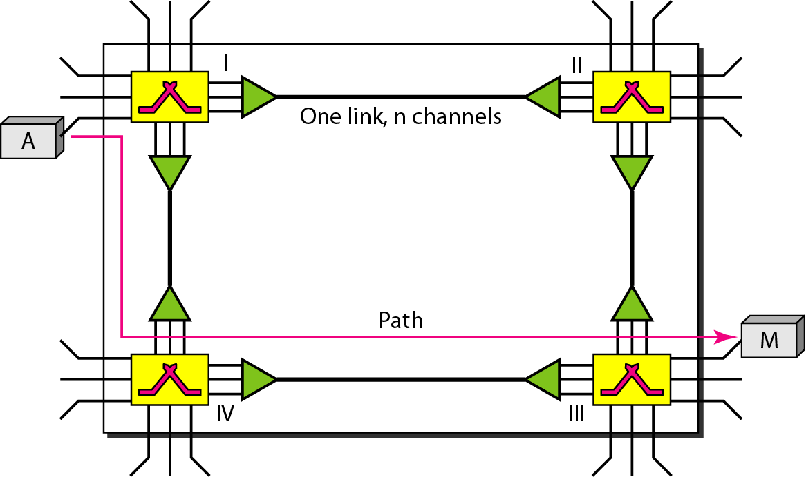
Typical Telecom Network
Switch
Multiplexer/Demultiplexer
Switch
End user Phone
Transmission Links
Route/Path
Route/Path
End user Phone

Slide 17
Switching
Important technology
to build
Communication Networks
be it is Telecom networks
or
be Internet (Computer Network )
What is the need for switching ?

Slide 18
Telecom Networks ( Voice networks )
are built
using
circuit switching technology

Slide 19
Cellphone Networks (2G ) are built
using
circuit switching technology
But
Cellphone networks 3G uses both Circuit switching/ Packet Switching

Slide 20
Cellphone Networks (4G and above ) are built
using
PACKET SWICTHNG TECHNOLOGY

Slide 21
Internet ( Data network )
is built
using
Packet Switching Technology

Slide 22
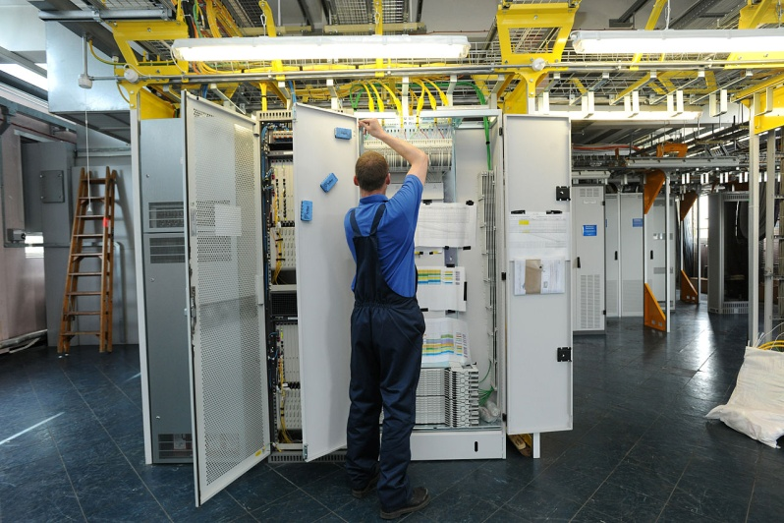
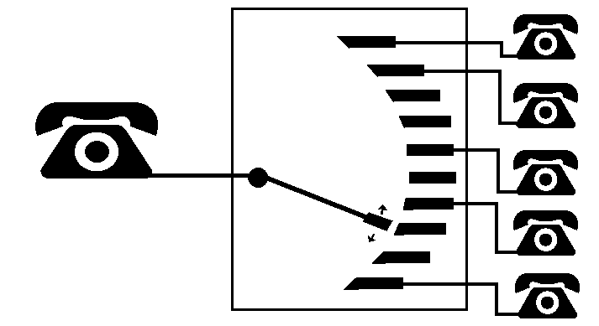
Typical telephone exchange in a network centre
What is a switch ?
A telephone at an input interface is connected using a switch to a telephone at output interface, on demand

Slide 23
As a result
Multiple telephones can be connected to a central switch
&
Connectivity can be established as and when required
Reduces number of physical links

Slide 24
Two Switches / Exchanges
are linked
using a Transmission Links
( Physical media like wire / cable or wireless and associated electronic equipment like amplifiers/ regenerators/ boosters)

Slide 25
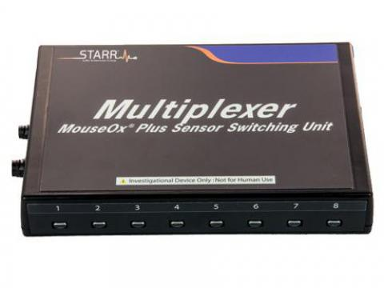
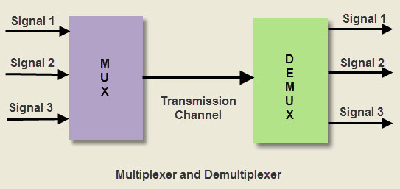
Mux/Demux pair is used
to share single transmission link
among
multiple users

Slide 26
Figure 8.3 A trivial circuit-switched network

Slide 27
8-1 CIRCUIT-SWITCHED NETWORKS
A circuit-switched network consists of a set of switches connected by physical links. A connection between two stations is a dedicated path made of one or more links. However, each connection uses only one dedicated channel on each link. Each link is normally divided into n channels by using FDM or TDM.

Slide 28

Note
A circuit-switched network is made of a set of switches connected by physical links, in which each link is divided into n channels.

Slide 29
Note
In circuit switching, the resources need to be reserved during the setup phase; the resources remain dedicated for the entire duration of data transfer until the teardown phase.

Slide 30
How
the bits generated from a Computer
transmitted on links ?
One of the key functions of Physical Layer

Slide 31
5-1 DIGITAL-TO-ANALOG CONVERSION
Digital-to-analog conversion is the process of changing one of the characteristics of an analog signal based on the information in digital data.

Slide 32
Digital to Analog Conversion
Digital data needs to be carried on an analog signal.
A carrier signal (frequency f_{c}) performs the function of transporting the digital data in an analog waveform.
The analog carrier signal is manipulated to uniquely identify the digital data being carried.

Slide 33
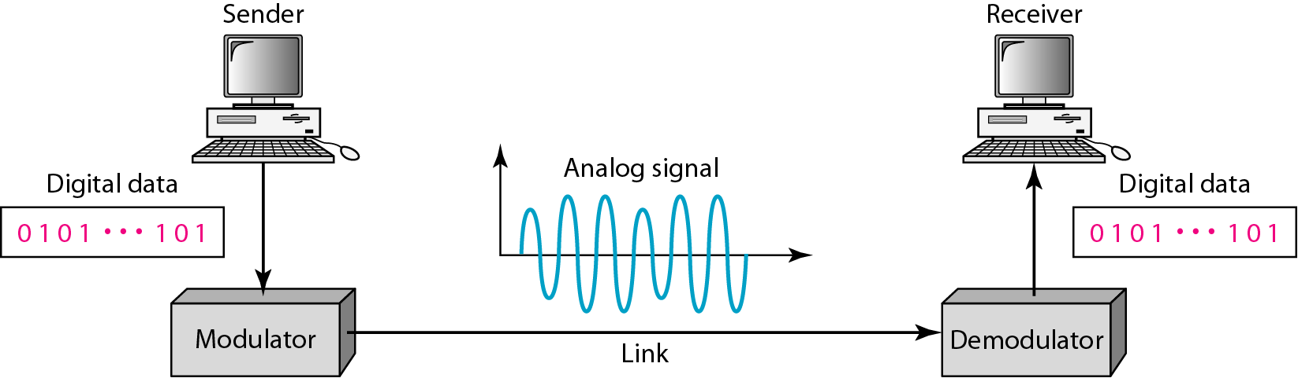
Figure 5.1 Digital-to-analog conversion

Slide 34
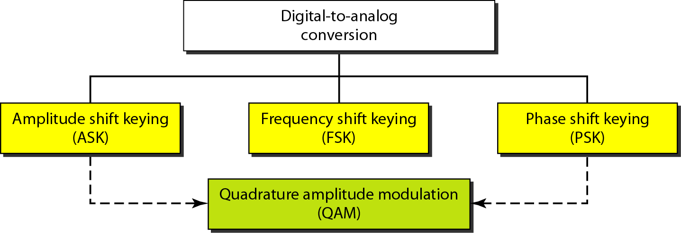
Figure 5.2 Types of digital-to-analog conversion

Slide 35
Note
Bit rate, N, is the number of bits per second (bps).
Baud rate is the number of signal elements per second (bauds).
In the analog transmission of digital data, the signal or baud rate is less than or equal to the bit rate.
S=Nx1/r bauds
Where r is the number of data bits per signal element.

Slide 36
Example 5.1
An analog signal carries 4 bits per signal element. If 1000 signal elements are sent per second, find the bit rate.
Solution
In this case, r = 4, S = 1000, and N is unknown. We can find the value of N from

Slide 37
Amplitude Shift Keying (ASK)
ASK is implemented by changing the amplitude of a carrier signal to reflect amplitude levels in the digital signal.
For example: a digital “1” could not affect the signal, whereas a digital “0” would, by making it zero.
The line encoding will determine the values of the analog waveform to reflect the digital data being carried.

Slide 38
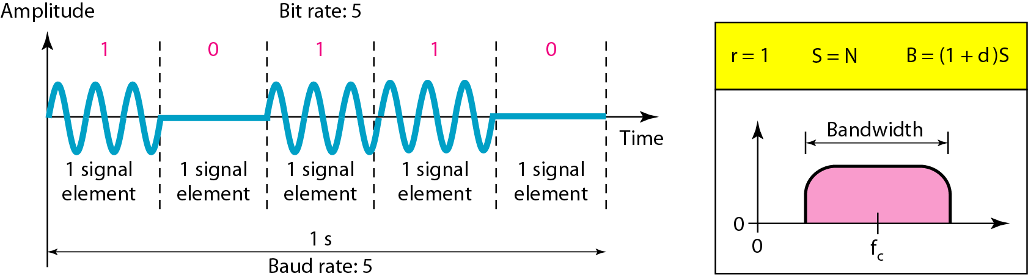
Figure 5.3 Binary amplitude shift keying

Slide 39
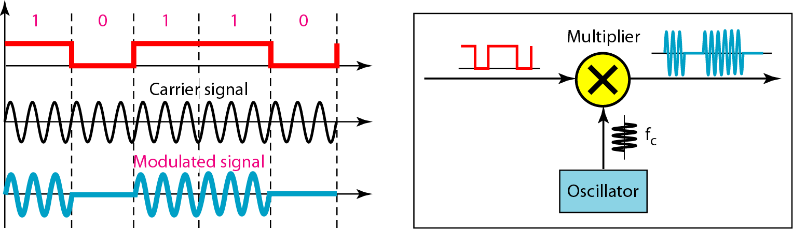
Figure 5.4 Implementation of binary ASK

Slide 40
Amplitude Shift keying
ASK Technique is used to transmit Digital data over optical fibre .
For LED transmitters a binary 1 is represented by a short pulse of light and binary 0 is represented by the absence of light

